Slide 1
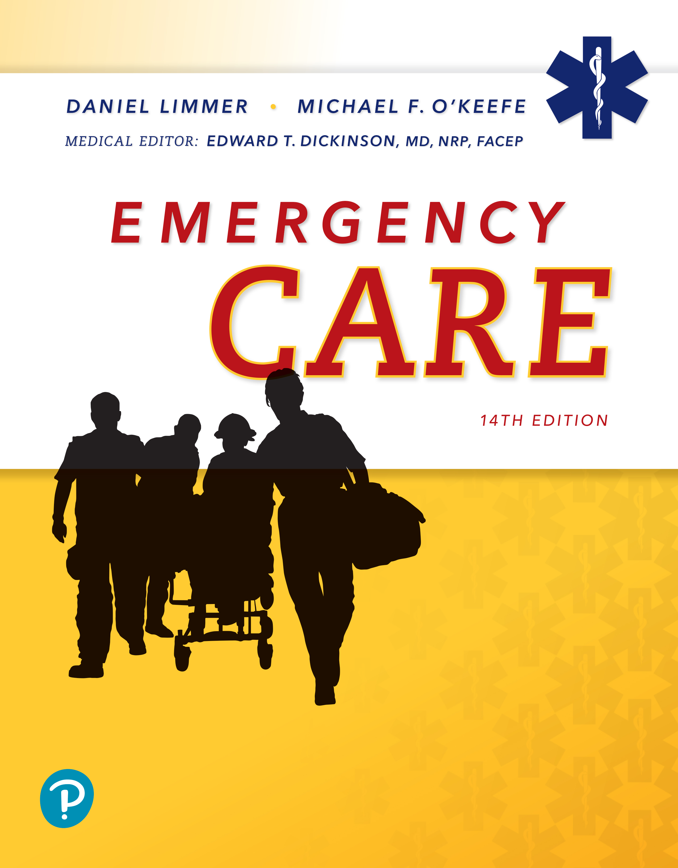
Emergency Care
Fourteenth Edition
Chapter 27
Behavioral and Psychiatric Emergencies and Suicide
Slides in this presentation contain hyperlinks. JAWS users should be able to get a list of links by using INSERT+F7
Copyright © 2021, 2016, 2012 Pearson Education, Inc. All Rights Reserved
Notes:
If this PowerPoint presentation contains mathematical equations, you may need to check that your computer has the following installed:
1) MathType Plugin
2) Math Player (free versions available)
3) NVDA Reader (free versions available)

Slide 2
Topics
Behavioral and Psychiatric Emergencies
Emergency Care for Behavioral and Psychiatric Emergencies
Notes:
Planning Your Time: Plan 105 minutes for this chapter.
Behavioral and Psychiatric Emergencies (45 minutes)
Emergency Care for Behavioral and Psychiatric Emergencies (60 minutes)
Note: The total teaching time recommended is only a guideline.
Core Concepts:
The nature and causes of behavioral and psychiatric emergencies
Emergency care for behavioral and psychiatric emergencies
Emergency care for potential or attempted suicide
Emergency care for aggressive or hostile patients
When and how to restrain a patient safely and effectively
Medical/legal considerations in behavioral and psychiatric emergencies

Slide 3
Behavioral and Psychiatric Emergencies
Back to Topics
Notes:
Teaching Time: 45 minutes
Teaching Tips: It is important in this lesson to define abnormal behavior and to differentiate behavioral emergencies. Take time to make these distinctions clear. Invite a mental health professional to class. Ask him to discuss the impact of psychiatric disease on our population. Do not minimize psychiatric problems. Psychiatric disorders are widespread and certainly will be encountered by new EMTs. Imprint a serious attitude toward dealing with these potentially life-threatening diseases. Dealing with stressful situations is an extremely important component of scene management. Take time to emphasize the necessary steps for dealing with a person who is experiencing a stress reaction. Acute psychosis is a dynamic and often dangerous situation for responders. Take time to teach safety in this lesson.

Slide 4
What Is a Behavioral Emergency? (1 of 2)
Behavior
  Manner in which a person acts or performs
Behavioral emergency
  Behavior within a given situation that is unacceptable or intolerable to patient, patient’s family, or community
Notes:
Covers Objective: 27.1
Point to Emphasize: A behavioral emergency exists when, within a given situation, a person exhibits abnormal behavior that is unacceptable or intolerable to others.
Discussion Topic: How is a behavioral emergency different from simply unusual behavior?

Slide 5
What Is a Behavioral Emergency? (2 of 2)
Recognize cultural behavior.
Behavioral conditions require full patient assessment.
Remain objective.
Notes:
Covers Objective: 27.1
Point to Emphasize: A behavioral emergency exists when, within a given situation, a person exhibits abnormal behavior that is unacceptable or intolerable to others.
Discussion Topic: Define behavioral emergency. How is it different from simply unusual behavior?

Slide 6
Behavior and Brain Chemistry (1 of 2)
Observable behavior largely controlled by neurotransmitters
  Inside the brain
  Neurotransmitters travel from neuron to neuron.
  Impulses move across nervous system by this mechanism.
Notes:
Covers Objective: 27.1
Point to Emphasize: The nervous system works through the use of neurotransmitters.
Discussion Topic: Describe the path by which an impulse is transmitted through the nervous system.

Slide 7
Behavior and Brain Chemistry (2 of 2)
Neurotransmitters—or the lack of neurotransmitters—have been implicated in depression and other behavioral and psychiatric disorders.
  Medications prescribed for these conditions are designed to affect the relevant neurotransmitters.
  Newer medications offer reuptake inhibition of more than one neurotransmitter.
Notes:
Covers Objective: 27.1
Point to Emphasize: Medications that target behavioral conditions help maintain proper levels and interactions of neurotransmitters.
Discussion Topic: List and describe the action of commonly prescribed drugs that affect behavior.

Slide 8
Psychiatric Conditions
Some behavioral emergencies are caused by psychiatric conditions (mental disorders).
Almost one in five adults in the United States have some sort of mental illness.
Mental health services declining or overcrowded
  More patients with mental illness are in the community with minimal treatment.
  This makes it more likely they will be seen as a patient by E M S systems.
Notes:
Covers Objective: 27.1
Discussion Topic: Discuss the significance for EMTs that almost one in five adults in the United States have some sort of mental illness.

Slide 9
Physical Causes of Altered Mental Status
Medical and traumatic conditions that can alter a patient’s behavior
  Low blood sugar
  Lack of oxygen
  Stroke or inadequate blood to brain
  Head trauma
  Seizures
  Mind-altering substances
  Environmental temperature extremes
Notes:
Covers Objective: 27.1
Point to Emphasize: EMTs always should assume first that altered mental status is due to a physical problem.
Knowledge Application: Have students work in small groups. Using a programmed patient, practice assessment of a patient who is experiencing an altered mental status. Be sure to include both psychiatric and medical scenarios.
Critical Thinking Discussion: Review the Think Like an EMT feature with students and encourage discussion.

Slide 10
Situational Stress Reactions (1 of 2)
Normal reactions to stressful situations produce emotions
  Fear
  Grief
  Anger
Notes:
Covers Objective: 27.1

Slide 11
Situational Stress Reactions (2 of 2)
Caring for patients with situational stress reactions
  Do not rush.
  Tell patient you are there to help.
  Remain calm.
  Keep emotions under control.
  Listen to patient.
  Be honest.
  Stay alert for changes in behavior.
Notes:
Covers Objective: 27.1
Point to Emphasize: EMS providers can greatly help persons who are experiencing a stress reaction by utilizing best practices of scene control and personal behavior.
Discussion Topic: Describe the steps that you can take as an EMT to help a patient who is experiencing a stress reaction.
Knowledge Application: Have students work in small groups. Have groups role-play assisting a person who is having a stress reaction. Critique and discuss.

Slide 12
Acute Psychosis (1 of 2)
Involves a severe break in patient’s abilities to process information and interact with their environments
Often associated with a psychiatric disorder such as schizophrenia
Notes:
Covers Objective: 27.1

Slide 13
Acute Psychosis (2 of 2)
Symptoms
  Hallucinations
  Delusions
  Catatonia
  Thought disorder
Ensure safety of patient and responders.
Notes:
Covers Objective: 27.1
Discussion Topic: Describe the common symptoms associated with acute psychosis.
Critical Thinking Discussion: Describe the safety threats associated with an acute psychosis patient.

Slide 14
Emergency Care for Behavioral and Psychiatric Emergencies
Back to Topics
Notes:
Teaching Time: 60 minutes
Teaching Tips: Behavioral and psychiatric disorders are far too numerous to review thoroughly in class. Consider assigning research homework. Teach a general approach to psychiatric emergencies. Invite a mental health professional to discuss interacting with a person in psychological crisis. Be sure to include discussions on empathy and compassion in this lesson. Emphasize safety in this lesson. All human behavior is inherently unpredictable. Emphasize that EMTs must be prepared for violent behavior at all times. Restraint is a medical/legal focus point. Use this lesson to reach back to prior discussions on medical/legal responsibilities of the EMT. Research available psychiatric facilities in your area. What transport options do local EMTs have?

Slide 15
Assessment and Care for Behavioral and Psychiatric Emergencies (1 of 3)
Range of presentations
  Withdrawn, not communicating
  Talkative, agitated
  Bizarre or threatening behavior
  Wish to harm selves or others
Notes:
Covers Objective: 27.2
Point to Emphasize: Behavioral and psychiatric emergencies vary greatly in terms of presentation. However, there are general guidelines for approaching such a patient.
Discussion Topic: Describe the potential signs of a behavioral or psychiatric emergency.

Slide 16
Assessment and Care for Behavioral and Psychiatric Emergencies (2 of 3)
Key techniques
  Identify yourself and your role.
  Speak slowly and clearly.
  Make eye contact.
  Listen to the patient.
  Do not be judgmental.
Notes:
Covers Objective: 27.2
Discussion Topic: Describe the general rules to follow when dealing with a behavioral or psychiatric patient.

Slide 17
Assessment and Care for Behavioral and Psychiatric Emergencies (3 of 3)
Key techniques
  Use positive body language.
  Acknowledge patient’s feelings.
  Do not enter patient’s personal space.
    Stay at least 3 feet from patient.
  Be alert for changes in emotional status.
  Use restraint to prevent harm if necessary.
Notes:
Covers Objective: 27.2
Discussion Topic: Describe the general rules to follow when dealing with a behavioral or psychiatric patient.

Slide 18
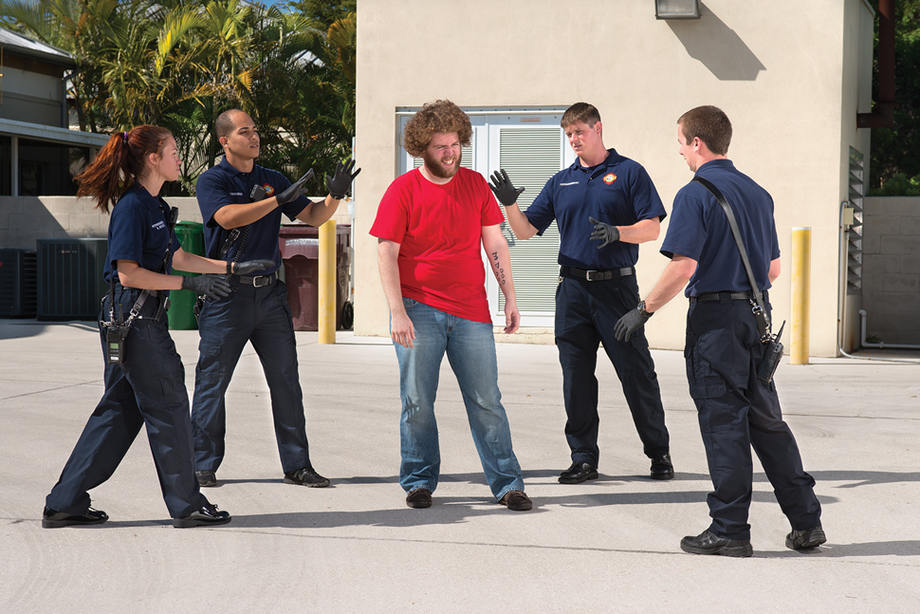
General Rules for Interactions
1. Plan your approach to the patient in advance and remain outside the range of the patient’s arms and legs until you are ready to act. Note: A fifth rescuer, if available, can control the patient’s head–taking special care, however, not to be bitten.
Notes:
Covers Objective: 27.2
Discussion Topic: Describe the general rules to follow when dealing with a behavioral or psychiatric patient.

Slide 19
Patient Assessment (1 of 2)
Perform careful scene size-up.
Identify yourself and your role.
Complete primary assessment.
Perform as much of detailed examination as possible.
Gather thorough history.
Notes:
Covers Objective: 27.2
Class Activity: Use a programmed patient to simulate a behavioral or psychiatric emergency. Have teams of students assess and treat.

Slide 20
Patient Assessment (2 of 2)
Common signs and symptoms
  Panic or anxiety
  Unusual appearance, disordered clothing, or poor hygiene
  Agitated or unusual activity
  Unusual speech patterns
  Bizarre behavior or thought patterns
  Suicidal or self-destructive behavior
  Violence or aggressive behavior
Notes:
Covers Objective: 27.2
Point to Emphasize: Panic or anxiety; unusual appearance; agitated or unusual activity; unusual speech patterns; bizarre behavior or thought patterns; and suicidal, self-destructive, or violent behavior are all common assessment findings in a psychiatric or behavioral emergency.

Slide 21
Patient Care
Be alert for personal or scene safety problems.
Treat any life-threatening problems.
Consider medical or traumatic causes.
Spend time talking to patient.
Encourage patient to discuss feelings.
Never play along with hallucinations.
Consider involving family or friends.
Notes:
Covers Objective: 27.2
Point to Emphasize: Treatment of a behavioral or psychiatric emergency first must address physical injuries or illnesses and then must address the psychiatric components.
Discussion Topic: Discuss specific treatment elements that will improve the care of a patient who is suffering a behavioral or psychiatric emergency.

Slide 22
Suicide (1 of 4)
Tenth-leading cause of death in United States
  Depression coupled with successful suicide has reached alarming levels in combat veteran and senior citizen populations.
  Many more people suffer both physical and emotional injuries in unsuccessful suicide attempts.
  Anyone may become suicidal if emotional distress is severe.
  People attempt suicide for many reasons.
Notes:
Covers Objective: 23.7
Point to Emphasize: You may observe suicides or attempted suicides by drug overdose, hanging, jumping from high places, ingesting poisons, inhaling gas, wrist-cutting, self-mutilation, stabbing, or shooting.

Slide 23
Suicide (2 of 4)
Potential or attempted suicide
  Explore the following possibilities
    Depression
    High stress levels (current or recent)
    Recent emotional trauma
    Age (15 to 25 and 40+ highest risk)
    Drug or alcohol abuse
Notes:
Covers Objective: 27.2
Discussion Topic: Describe the common factors associated with suicide.

Slide 24
Suicide (3 of 4)
Potential or attempted suicide
  Explore the following possibilities
    Threats of suicide
    Suicide plan
    Previous attempts or threats
    Sudden improvement from depression
Notes:
Covers Objective: 27.2
Discussion Topic: Describe the common factors associated with suicide.

Slide 25
Suicide (4 of 4)
Your first concern must be your own safety.
Emergency care
  Scene size-up
  Identify and treat life-threatening problems.
  Reassure patient.
  Perform secondary assessment.
    Detailed exam only if safe
  Reassess frequently.
  Notify receiving facility.
Notes:
Covers Objective: 27.2
Point to Emphasize: Personal safety must be the first concern in caring for a suicidal patient.
Discussion Topics: Describe the proper assessment of a suicidal patient. Describe the appropriate care for a suicidal patient.
Class Activity: Assign a research paper. Have students research and discuss common causes of psychiatric crisis. Include common assessment findings.

Slide 26
Think About It (1 of 2)
Patient is 23-year-old male. His girlfriend called 911 after a domestic dispute. He is uncooperative and refusing treatment. The girlfriend reports patient is depressed and suicidal. He owns a gun and has threatened to shoot himself.
Notes:
Covers Objective: 27.2

Slide 27
Think About It (2 of 2)
Can you treat the patient if he did not call?
Should you believe the girlfriend?
Does the patient need treatment or transport?
Can you treat and transport the patient against his will?
What should you do?
Notes:
Covers Objective: 27.2
Talking Points: Have students discuss the process for this call, with reference to the chapter content and knowledge of local protocol for technical details on transport and medical ramifications and legal consequences.

Slide 28
Aggressive or Hostile Patients (1 of 3)
Consider clues.
  Dispatch information
  Clues from the scene
  Information from neighbors, family, or bystanders
  Patient’s stance or position in room
Ensure escape route.
Do not threaten patient.
Stay alert for weapons of any type.
Notes:
Covers Objective: 27.2

Slide 29
Aggressive or Hostile Patients (2 of 3)
Patient assessment
  May not proceed beyond primary assessment until patient is calmed or restrained
  May spend most of time calming patient and ensuring everyone’s safety
  Hostility or aggression never an excuse for not assessing patient as thoroughly as possible
Notes:
Covers Objective: 27.2
Discussion Topic: Describe the common indicators of pending aggressive behavior.

Slide 30
Aggressive or Hostile Patients (3 of 3)
Emergency care
  Perform a scene size-up.
  Request additional help if necessary.
  Seek advice from medical control if necessary.
  Watch for sudden changes in behavior.
  Reassess frequently.
  Consider restraint.
Notes:
Covers Objective: 27.2
Discussion Topic: Describe the appropriate response to aggressive behavior.
Knowledge Application: Role-play violent patient scenarios. Practice techniques for safety assessments and de-escalation.

Slide 31
Reasonable Force and Restraint (1 of 6)
Reasonable force
  Force necessary to keep patient from injuring self or others
“Reasonable” determined by:
  Patient’s size and strength
  Type of behavior
  Mental status
  Available methods of restraint
Notes:
Covers Objective: 27.3

Slide 32
Reasonable Force and Restraint (2 of 6)
In most localities, restraint is within jurisdiction of law enforcement.
Never attempt restraint without proper legal authority and sufficient assistance.
Notes:
Covers Objective: 27.3
Discussion Topic: Describe the local guidelines for restraint of a patient.

Slide 33
Reasonable Force and Restraint (3 of 6)
Excited delirium
  Extremely agitated or psychotic behavior
  Triggers for this condition can include uncontrolled psychiatric illness and/or drug intoxication.
  These patients frequently develop significant and even life-threatening cardiovascular and metabolic stress.
Notes:
Covers Objective: 27.3

Slide 34
Reasonable Force and Restraint (4 of 6)
Positional asphyxia
  Inadequate breathing or respiratory arrest caused by a body position that restricts breathing
  Carefully monitor all restrained patients.
Notes:
Covers Objective: 27.3

Slide 35
Reasonable Force and Restraint (5 of 6)
Restraining a patient
  Have adequate help.
  Plan actions.
  Stay beyond patient’s reach until prepared.
  Act quickly.
  One E M T talks to and calms patient.
  Requires four persons, one at each limb.
  Restrain all limbs with approved leather restraints in supine position, always.
Notes:
Covers Objective: 27.3

Slide 36
Reasonable Force and Restraint (6 of 6)
  E M T is responsible for restrained patient’s airway.
  Ensure patient is adequately secured throughout transport.
  Apply a surgical mask to spitting patients if local protocols permit.
  Reassess frequently.
  Document thoroughly.
Notes:
Covers Objective: 27.3
Discussion Topic: Describe the proper procedures for restraining a patient.
Class Activity: Have students research the restraint protocols for your area. What rules/procedures must an EMT follow with regard to patient restraint?
Knowledge Application: Have students work in small groups to practice patient restraint scenarios. Review decision-making strategies as well as restraint technique.
Knowledge Application: Have students work in small groups to practice patient restraint scenarios. Review decision-making strategies as well as restraint technique.
Critical Thinking: We commonly associate patient restraint with psychiatric emergencies. Are there situations in which patient restraint might be appropriate for the trauma or medical patient? If so, give specific examples.

Slide 37
Transport to an Appropriate Facility
Not all hospitals are prepared to treat behavioral emergencies.
Choose correct facility based on capabilities and local protocol.
Notes:
Covers Objective: 27.3
Discussion Topic: Describe the local resources available for the care of a patient with a behavioral or psychiatric complaint.

Slide 38
Medical/Legal Considerations (1 of 2)
Consent
  Refusals and restraints cause significant medical/legal risk.
  Laws typically allow providers to treat and transport patients against their will if a danger to themselves or others.
  Know your state laws on treating patients without consent.
Notes:
Covers Objective: 27.3
Discussion Topic: Describe local laws and or guidelines associated with the transport of psychiatric patients.

Slide 39
Medical/Legal Considerations (2 of 2)
Sexual misconduct
  Behavioral patients sometimes accuse E M S providers of sexual misconduct.
  Have same-sex provider attend to patient.
  For the aggressive or violent patient, make sure law enforcement officers accompany you to the hospital.
    Protect you and the patient.
    In the event of a legal problem, they can serve as third-party witnesses.
Notes:
Covers Objective: 27.3

Slide 40
Chapter Review

Slide 41
Chapter Review (1 of 4)
As an E M T, you will respond to many behavioral emergencies. Be sure to ensure your own safety before entering a scene or caring for a violent or potentially violent patient.

Slide 42
Chapter Review (2 of 4)
A considerable portion of the population has a diagnosable psychiatric condition. However, not all patients are violent. It is important to remember that patients in crisis are patients–and people–who need your compassion as well as your care.

Slide 43
Chapter Review (3 of 4)
Always consider patients acting in an unusual or bizarre fashion to be experiencing an altered mental status; this will help you to avoid overlooking a medical or traumatic cause for the patient’s problem.

Slide 44
Chapter Review (4 of 4)
Because treatment of these patients usually requires long-term management, little medical intervention can be done in the acute psychiatric situation. However, the way you interact with the patient during the emergency and assess your patient throughout the call is crucial for the patient’s continued well-being.

Slide 45
Remember (1 of 3)
Safety is the first priority when approaching a patient with altered mental status.
Psychiatric and behavioral emergencies are prevalent in our society. E M Ts should treat them as they would any other potentially life-threatening disorder.

Slide 46
Remember (2 of 3)
Assessment of altered mental status should rule out physical causes first.
Psychiatric and behavioral emergencies can present differently, depending upon the disorder. There are best practices E M Ts employ in approaching, assessing, and treating such patients.

Slide 47
Remember (3 of 3)
Follow local protocols and use appropriate procedures to restrain patients when necessary.

Slide 48
Questions to Consider
What methods help calm the patient suffering a behavioral or psychiatric emergency?
What can you do when scene size-up reveals it is too dangerous to approach the patient?
What factors help assess the patient’s risk for suicide?
Notes:
Talking Points: As students discuss these questions, describe real-life incidents to show students the range of situations that they need to be prepared for.

Slide 49
Critical Thinking
You respond to an intoxicated minor who is physically aggressive, threatens suicide, and whose parents permit you to treat but not transport the patient. How would you manage this patient?
Notes:
Talking Points: Discussion should emphasize safety in this situation (and when to call for police presence), then calming the patient, and then actual assessment and treatment. Talking with the parents is important, as well as complete documentation of the run, signed and witnessed refusal form, and so on.

Slide 50

Copyright
This work is protected by United States copyright laws and is provided solely for the use of instructors in teaching their courses and assessing student learning. Dissemination or sale of any part of this work (including on the World Wide Web) will destroy the integrity of the work and is not permitted. The work and materials from it should never be made available to students except by instructors using the accompanying text in their classes. All recipients of this work are expected to abide by these restrictions and to honor the intended pedagogical purposes and the needs of other instructors who rely on these materials.

