Slide 1
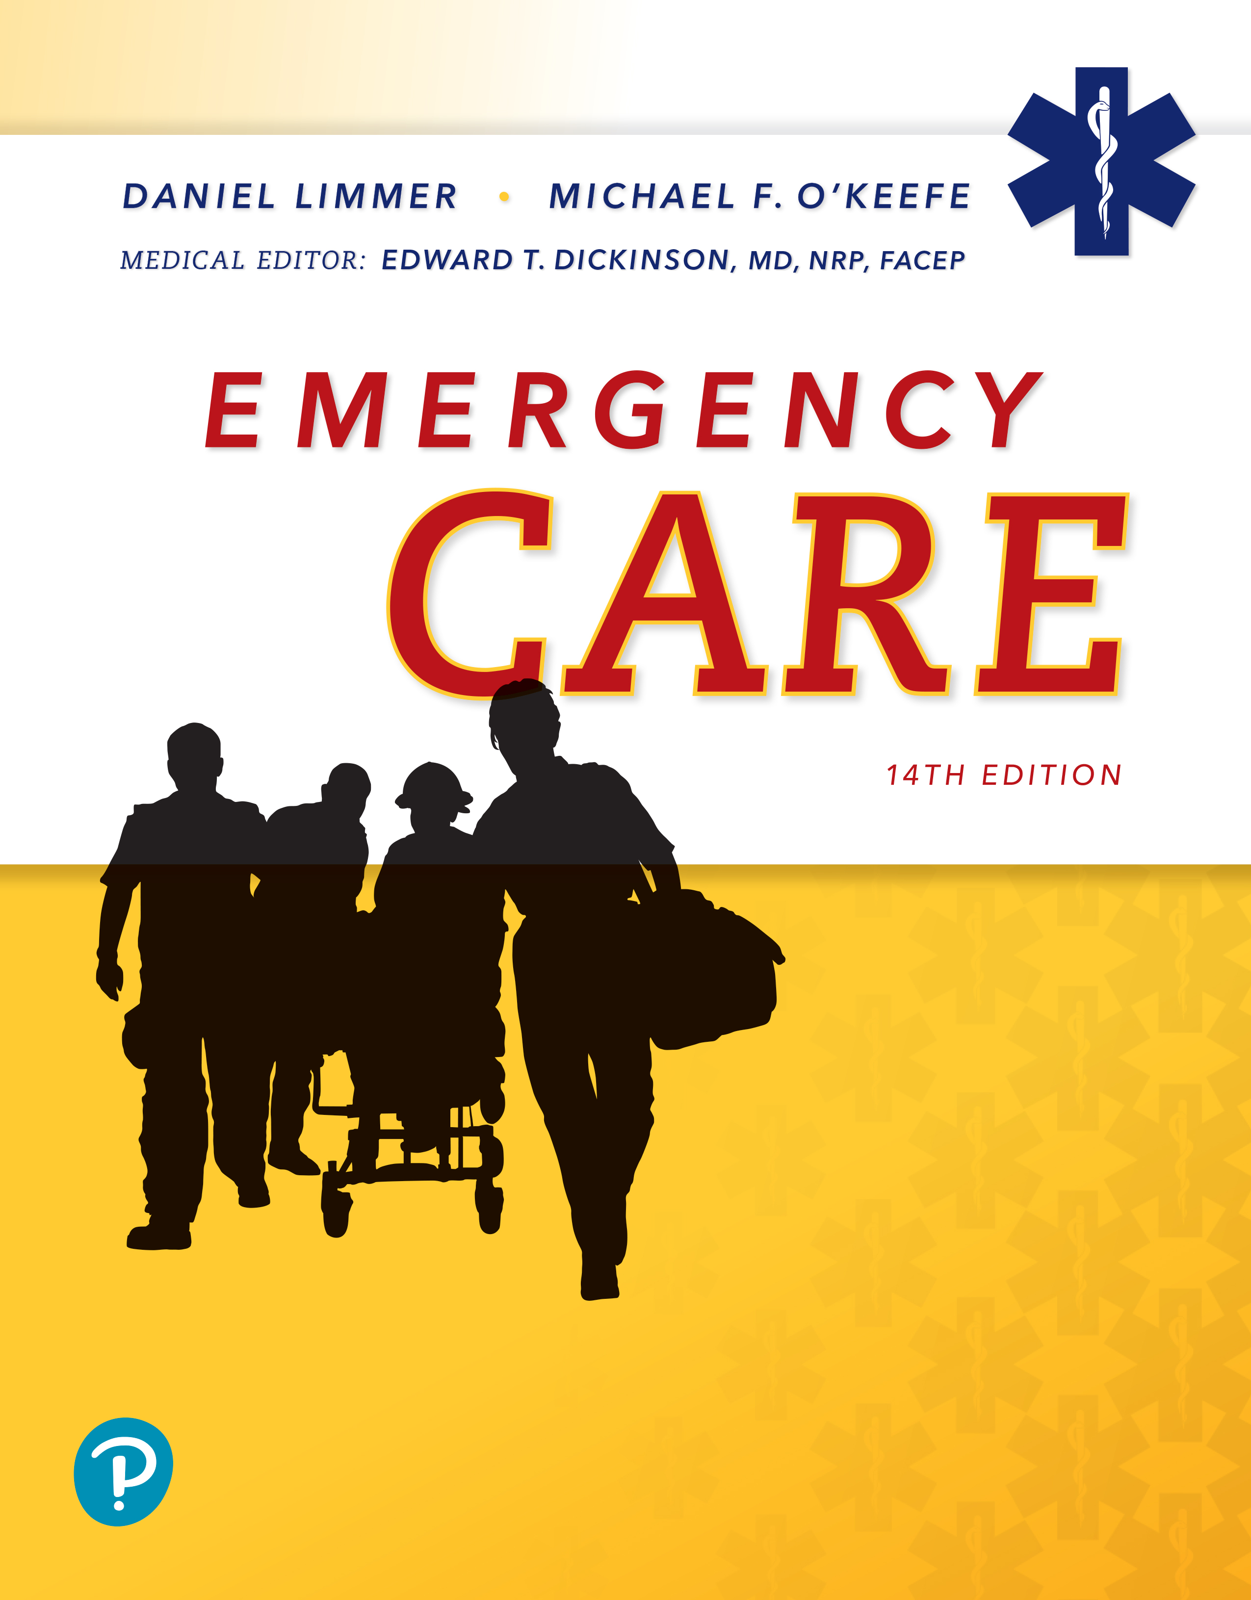
Emergency Care
Fourteenth Edition
Chapter 12
The Primary Assessment
Slides in this presentation contain hyperlinks. JAWS users should be able to get a list of links by using INSERT+F7
Copyright © 2021, 2016, 2012 Pearson Education, Inc. All Rights Reserved
Notes:
If this PowerPoint presentation contains mathematical equations, you may need to check that your computer has the following installed:
1) MathType Plugin
2) Math Player (free versions available)
3) NVDA Reader (free versions available)

Slide 2
Topic
The Primary Assessment
Notes:
Planning Your Time: Plan 50 minutes for this chapter.
The Primary Assessment (50 minutes)
Note: The total teaching time recommended is only a guideline.
Core concepts:
Deciding on the approach to the primary assessment
Manual stabilization of the head and neck when necessary
The general impression
Assessment of mental status using the AVPU scale
Identifying and treating problems with the airway, breathing and circulation
Making a priority decision

Slide 3
The Primary Assessment
Back to Topic
Notes:
Teaching Time: 50 minutes
Teaching Tips: This is a very important foundational lesson, but it also requires learning many steps. Break this lesson down into component parts and build one upon the other. Use standardized skill sheets. Allow students the guidance of working from a sheet as they practice. Begin working from skill sheets and add scenarios as students become more proficient. Beware of adding too many variables early on. Allow students to learn the steps in context first, and then add realistic twists later. The primary assessment is about decision making. Require students always to make patient priority decisions after completing their primary assessments.

Slide 4
Approach to the Primary Assessment (1 of 2)
Focus on life threats
Airway (A), breathing (B), circulation (C)
May vary depending on:
  Patient’s condition
  How many E M Ts are on the scene
  Other priorities you determine as you assess patient
Notes:
Covers Objective: 12.1
Point to Emphasize: Use warning signs in the general impression to help identify critical patients.

Slide 5
Approach to the Primary Assessment (2 of 2)
Order of A-B-C depends on initial impression of patient.
Sequence will vary.
  A-B-C if patient has signs of life
  C-A-B if patient appears lifeless, no pulse
  Immediate interventions may be needed.
Notes:
Covers Objective: 12.1
Discussion Topic: Describe how the primary assessment might vary depending of the needs of your patient.
Critical Thinking Discussion: Although the primary assessment can and should vary slightly depending on the needs of the patient, why is it important to develop consistency in the application of the primary assessment?

Slide 6
Decision Making in the Primary Assessment (1 of 2)
Any vomit in the airway that enters the lungs is very serious and often fatal.
Exsanguinating bleeding must be stopped immediately.
Breathing and circulation are obviously vital for life. Make sure your patient is breathing and breathing adequately to support life.
Notes:
Covers Objective: 12.1
Discussion Topic: Discuss the process by which you will make choices regarding the sequence of the primary assessment.

Slide 7
Decision Making in the Primary Assessment (2 of 2)
If immediate interventions such as bleeding control or C P R are not required, shift into an important but less urgent mode in which you will administer oxygen appropriate for the patient’s condition and evaluate for shock.
Notes:
Covers Objective: 12.1
Discussion Topic: Discuss the key findings and interventions that would force you to alter your primary assessment.
Critical Thinking Discussion: Describe how the primary assessment can be spilt up among multiple providers. What are the advantages and what are the potential pitfalls?

Slide 8
Performing the Primary Assessment
Forming a general impression
Assessing mental status
Assessing airway
Assessing breathing
Assessing circulation
Determining patient priority
Notes:
Covers Objective: 12.1
Talking Points: Life-threatening conditions discovered during the primary assessment require immediate interventions.
Discussion Topic: Describe the actions that must be taken if a problem is identified in the primary assessment.

Slide 9
Form a General Impression (1 of 2)
General impression
  Assesses environment and patient’s chief complaint and appearance
  Helps determine patient severity
  Helps set priorities for care and transport
Notes:
Covers Objective: 12.1

Slide 10

Form a General Impression (2 of 2)
Forming a general impression includes your immediate assessment of the environment and the patient’s chief complaint and appearance.
Notes:
Covers Objective: 12.1

Slide 11
Beginning Spinal Motion Restriction (1 of 2)
Treat the patient’s life-threatening conditions while not aggravating a potential spine injury.
Apply initial S M R to the head and neck on first contact with any patient you suspect may have an injury to the spine.
Continue S M R throughout the call unless a physical examination determines it is not necessary.
Notes:
Covers Objective: 12.1

Slide 12
Beginning Spinal Motion Restriction (2 of 2)
Manual stabilization of the head and neck holds the patient’s head still in a neutral, in-line position.
There may be more than one way to restrict motion of the spine during the primary and secondary assessments.
E M S systems have specific guidelines for when to use and when not to use manual stabilization and spinal motion restriction.
Notes:
Covers Objective: 12.1

Slide 13
The “Look Test” (1 of 3)
The “look test”
  Getting a feeling about patient’s condition from environmental observations as well as the first look at patient
Notes:
Covers Objective: 12.1
Talking Points: Specific positions indicating distress include tripod position and Levine's sign. The presence of any of these signs usually indicates a serious patient, but absence of these signs does not guarantee that the patient is stable.
Discussion Topic: Describe findings in the general impression that might indicate a critical patient.

Slide 14
The “Look Test” (2 of 3)
“Look test” identifies patients who may be critical.
  Patients who appear lifeless
    Resuscitate by beginning C P R compressions.
    Prepare A E D as soon as possible.
  Patients who have an obvious altered mental status
  Patients who appear unusually anxious and those who appear pale and sweaty
Notes:
Covers Objective: 12.1
Knowledge Application: Present pictures and/or video clips of patients to the class. Ask students to describe their general impression.

Slide 15
The “Look Test” (3 of 3)
Identify patients who may be critical.
  Obvious trauma to the head, chest, abdomen, or pelvis
  Specific positions indicate distress.
    Tripod position
      Difficulty breathing
    Levine’s sign
      Chest pain or discomfort
Notes:
Covers Objective: 12.1
Knowledge Application: Present pictures and/or video clips of patients to the class. Ask students to describe their general impression.

Slide 16
The Chief Complaint (1 of 2)
Patient’s description of why E M S was called
May be specific
  “Abdominal pain”
May be vague
  “Not feeling good”
Notes:
Covers Objective: 12.1
Point to Emphasize: The chief complaint is the reason that EMS was called, usually in the patient's own words.
Talking Points: Although the EMT cannot rely completely on the patient's environment to rule out trauma, when combined with the chief complaint, environmental clues become extremely useful.

Slide 17
The Chief Complaint (2 of 2)
Forming an impression of the patient
  Look
    Patient’s age, sex, and position
  Listen
    Moaning, snoring, or gurgling respirations
  Smell
    Hazardous fumes, urine, feces, vomitus, or decay
Notes:
Covers Objective: 12.1
Discussion Topic: Describe findings in the general impression that might indicate a critical patient.

Slide 18
Assess Mental Status
A V P U
  Alert
    Document orientation to person, place, and time.
  Verbal response
  Painful response
  Unresponsive
Notes:
Covers Objective: 12.2
Point to Emphasize: Determining mental status is an important element of the primary assessment.
Discussion Topic: What criteria are necessary for a patient to be deemed "alert and oriented"?
Knowledge Application: Have students work in small groups. Use a programmed patient to present various mental status levels. Discuss the use of the AVPU scale.
Critical Thinking Discussion: How might a patient with Alzheimer's disease affect your ability to assess mental status?

Slide 19
Assess the A B Cs (1 of 2)
Order of primary assessment will vary depending on patient’s condition.
  Airway
  Breathing
  Circulation
Identify and correct life threats.
Gather information that will help you later in your assessment.
Notes:
Covers Objective: 12.2
Point to Emphasize: Assessment of airway, breathing, and circulation will allow for rapid identification of life threats.

Slide 20
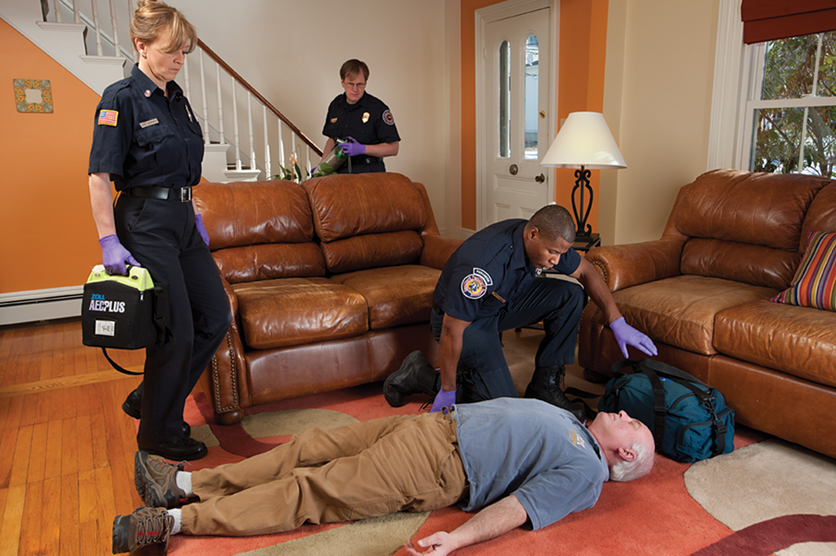
Assess the A B Cs (2 of 2)
Look for signs of life, including movement. Scan the chest for signs of breathing. If no signs of life such as breathing (or only gasping breathing) are found, check the pulse.
Notes:
Covers Objective: 12.2
Point to Emphasize: Assessment of airway, breathing, and circulation will allow for rapid identification of life threats.

Slide 21
Airway
If patient is alert and talking clearly or crying loudly then the airway is open.
If airway is not open or is endangered, take measures to open it and clear any blockages.
Notes:
Covers Objective: 12.2

Slide 22
Breathing
Situations calling for breathing assistance include if the patient:
  Is in respiratory arrest with a pulse
  Is not alert with inadequate breathing
  Has some level of alertness with inadequate breathing
  Has adequate breathing, but signs suggesting respiratory distress or hypoxia
Notes:
Covers Objective: 12.2
Talking Points: Inadequate breathing can be caused by insufficient minute volume because of decreased rate or depth or both.
Discussion Topic: In assessing breathing in the primary assessment, what four general situations call for immediate respiratory assistance?

Slide 23
Circulation (1 of 3)
Assessing skin
  Good circulation
    Warm, pink, dry skin
  Shock
    Pale, clammy (cool and moist) skin
Notes:
Covers Objective: 12.2
Talking Points: With dark-skinned patient, check color of lips or nail beds, which should be pink if circulation is good.

Slide 24
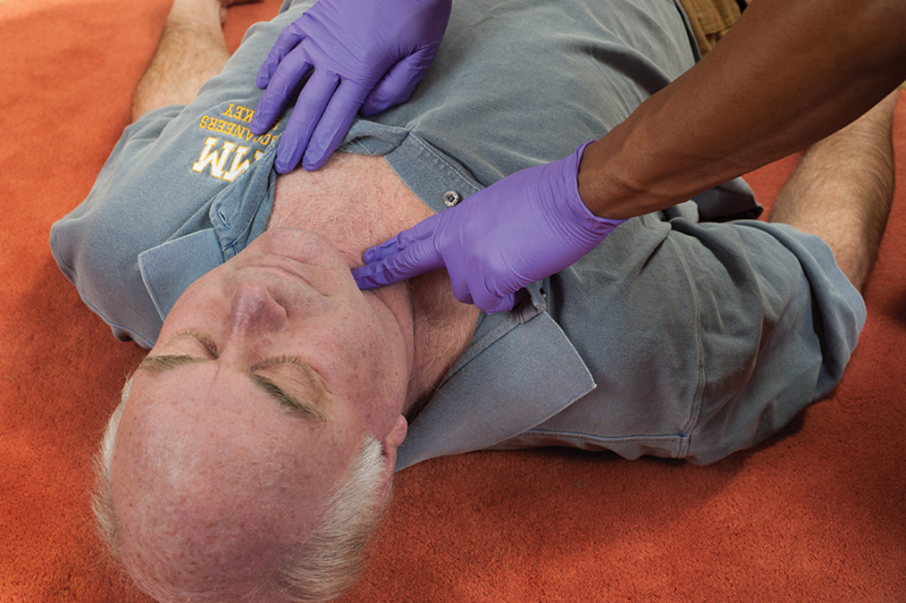
Circulation (2 of 3)
Check the pulse for no longer than 10 seconds.
Notes:
Covers Objective: 12.2

Slide 25
Circulation (3 of 3)
Three results of assessing pulse
  Within normal limits
  Unusually slow
  Unusually fast
Check for and control severe bleeding.
Notes:
Covers Objective: 12.2
Discussion Topic: Describe the three possible results of a pulse check performed in the primary assessment.

Slide 26
Determine Priority (1 of 4)
Treat any life-threatening A B C problem as soon as it is discovered.
To be stable, a patient needs to have vital signs that are in the normal range or just slightly abnormal.
A threat to the airway, breathing, or circulation, either actual or imminent, rules out stable.
Notes:
Covers Objective: 12.2
Point to Emphasize: Any life threats found while evaluating the ABC's must be treated immediately.
Knowledge Application: Have students use a standardized skill sheet to write out the steps that they would take and the questions that they would ask to accomplish the listed elements of the primary assessment.

Slide 27
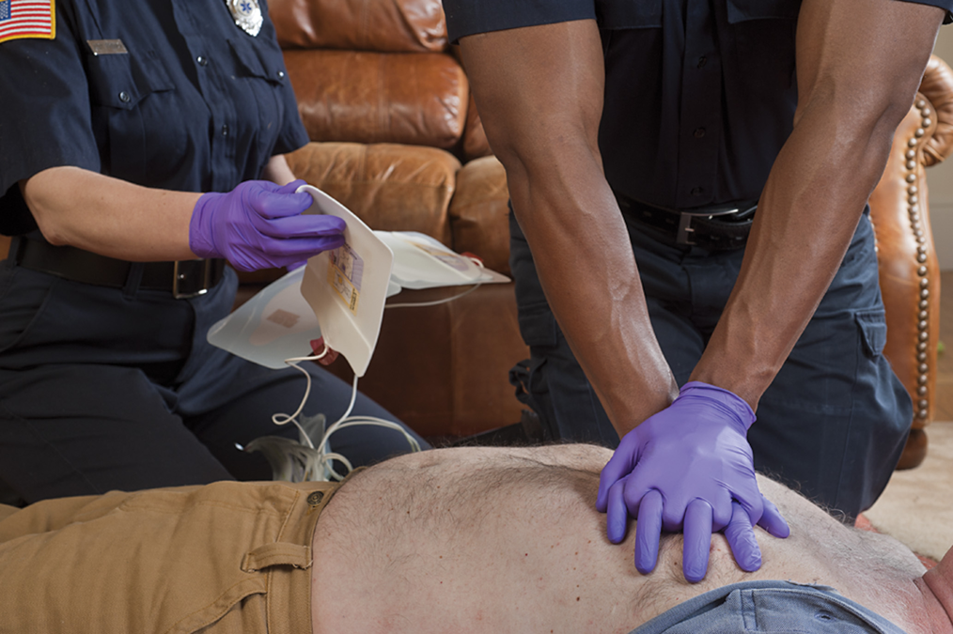
Determine Priority (2 of 4)
If no pulse, begin C P R compressions while the defibrillator is being readied.
Notes:
Covers Objective: 12.2
Point to Emphasize: Any life threats found while evaluating the ABC's must be treated immediately.
Knowledge Application: Have students use a standardized skill sheet to write out the steps that they would take and the questions that they would ask to accomplish the listed elements of the primary assessment.

Slide 28
Determine Priority (3 of 4)
There are many times when it is not crystal clear what a patient’s problem is, so there will be many possible diagnoses, some more serious than others.
A patient’s priority can change.
Notes:
Covers Objective: 12.2
Discussion Topic: Describe findings in the primary assessment that might lead you to categorize a patient as "unstable."

Slide 29
Determine Priority (4 of 4)
Initiate priority transport if a life-threatening problem cannot be controlled or threatens to recur, or if the patient has a depressed level of responsiveness.
  Continue assessment and care en route.
Notes:
Covers Objective: 12.2
Class Activity: Assign primary assessments as homework. Ask each student to complete five primary assessments, using a standardized skill sheet, for the next session.

Slide 30
Think About It (1 of 2)
Why must you continue to re-evaluate the primary assessment?
Notes:
Covers Objective: 12.2
Talking Points: Although the primary assessment occurs immediately, it is a part of your ongoing assessment. Re-evaluation of the primary assessment identifies life threats that may appear after the primary assessment and identifies problems that have deteriorated and now pose a life threat.

Slide 31
Think About It (2 of 2)
How might normal findings in a primary assessment differ for a child compared with an adult?
Notes:
Covers Objective: 12.2
Talking Points: Many physiologic differences alter findings of a pediatric primary assessment. Respiratory and heart rates are faster. Capillary refill is a useful tool, and the same quantities of bleeding might be life threatening in a child, but not in an adult.

Slide 32
Patient Characteristics and Primary Assessment
Patient assessment takes different forms, depending on certain characteristics of the patient.
  The patient may have a medical problem or trauma.
  The patient may or may not have an altered mental status.
  The patient may be an adult, a child, or an infant.
Notes:
Covers Objective: 12.3
Discussion Topic: Describe how your assessment might differ between a conscious patient and an unconscious patient.

Slide 33
Chapter Review

Slide 34
Chapter Review (1 of 6)
The primary assessment is a systematic approach to quickly finding and treating immediate threats to life.
The general impression, although subjective, can provide extremely useful information regarding the urgency of a patient’s condition.

Slide 35
Chapter Review (2 of 6)
The determination of mental status follows the A V P U approach.
Evaluating airway, breathing, and circulation quickly but thoroughly will reveal immediate threats to life that must be treated before further assessment.

Slide 36
Chapter Review (3 of 6)
Your approach to a patient will vary depending on how he presents. The American Heart Association recommends a C-A-B approach for patients who appear lifeless and apparently are not breathing or have only agonal respirations. This begins with a pulse check and chest compressions if there is no pulse.

Slide 37
Chapter Review (4 of 6)
If your patient shows signs of life (e.g., moving, moaning, talking) and is breathing, you will take a traditional A-B-C approach.

Slide 38
Chapter Review (5 of 6)
Remember that the mnemonic A-B-C is a guide to interventions that may be taken. You will choose your interventions based on the patient’s immediate needs. They may be done in any order that fits the patient’s needs.

Slide 39
Chapter Review (6 of 6)
The patient’s priority describes how urgent the patient’s need to be transported is and how to conduct the rest of your assessment.

Slide 40
Remember
Determine if a patient is responsive or unresponsive, whether the patient is an adult, child, or infant.
Rapidly identify the need for immediate airway intervention.
Determine if the patient’s condition is stable enough to allow further assessment and treatment at the scene.

Slide 41
Questions to Consider (1 of 2)
What factors will you take into account in forming a general impression of a patient?
How should you assess a patient’s mental status with regard to the A V P U levels of responsiveness?
Notes:
Talking Points: The general impression combines environmental findings and initial patient findings. Important elements include chief complaint, environmental clues such as mechanism of injury, and level of distress of the patient.
AVPU is an acronym that stands for 4 categories of mental status—alert, verbal, painful stimuli, and unresponsive.

Slide 42
Questions to Consider (2 of 2)
How should you assess airway, breathing, and circulation during the primary assessment?
What is meant by the term priority decision?
Notes:
Talking Points: Airway and breathing are first assessed by talking to the patient. If patient can speak, then at least at some level the airway and breathing are intact. If no airway is present, steps must be taken to provide one. Breathing is assessed by ensuring adequacy of breathing and recognizing respiratory arrest or respiratory failure. Circulation is assessed by evaluating pulses, skin, and gross bleeding.
Priority decision is the determination of the need for either immediate intervention or transport (or both). This decision is completed after assessing ABC's and is directly related to recognizing life threats.

Slide 43
Critical Thinking (1 of 2)
A middle-aged male is lying on the street after being hit by a car. He appears unresponsive as you approach. You notice that he is bleeding from a laceration on his forearm and making gurgling sounds from his airway.

Slide 44
Critical Thinking (2 of 2)
If you are alone, what factors do you consider in deciding what to do first? Why?
Notes:
Talking Points: Gurgling sounds in the airway require immediate suctioning unless the bleeding is life threatening. In general, the airway is the more important concern except in the case of exsanguinating hemorrhage.

Slide 45

Copyright
This work is protected by United States copyright laws and is provided solely for the use of instructors in teaching their courses and assessing student learning. Dissemination or sale of any part of this work (including on the World Wide Web) will destroy the integrity of the work and is not permitted. The work and materials from it should never be made available to students except by instructors using the accompanying text in their classes. All recipients of this work are expected to abide by these restrictions and to honor the intended pedagogical purposes and the needs of other instructors who rely on these materials.

