Slide 1
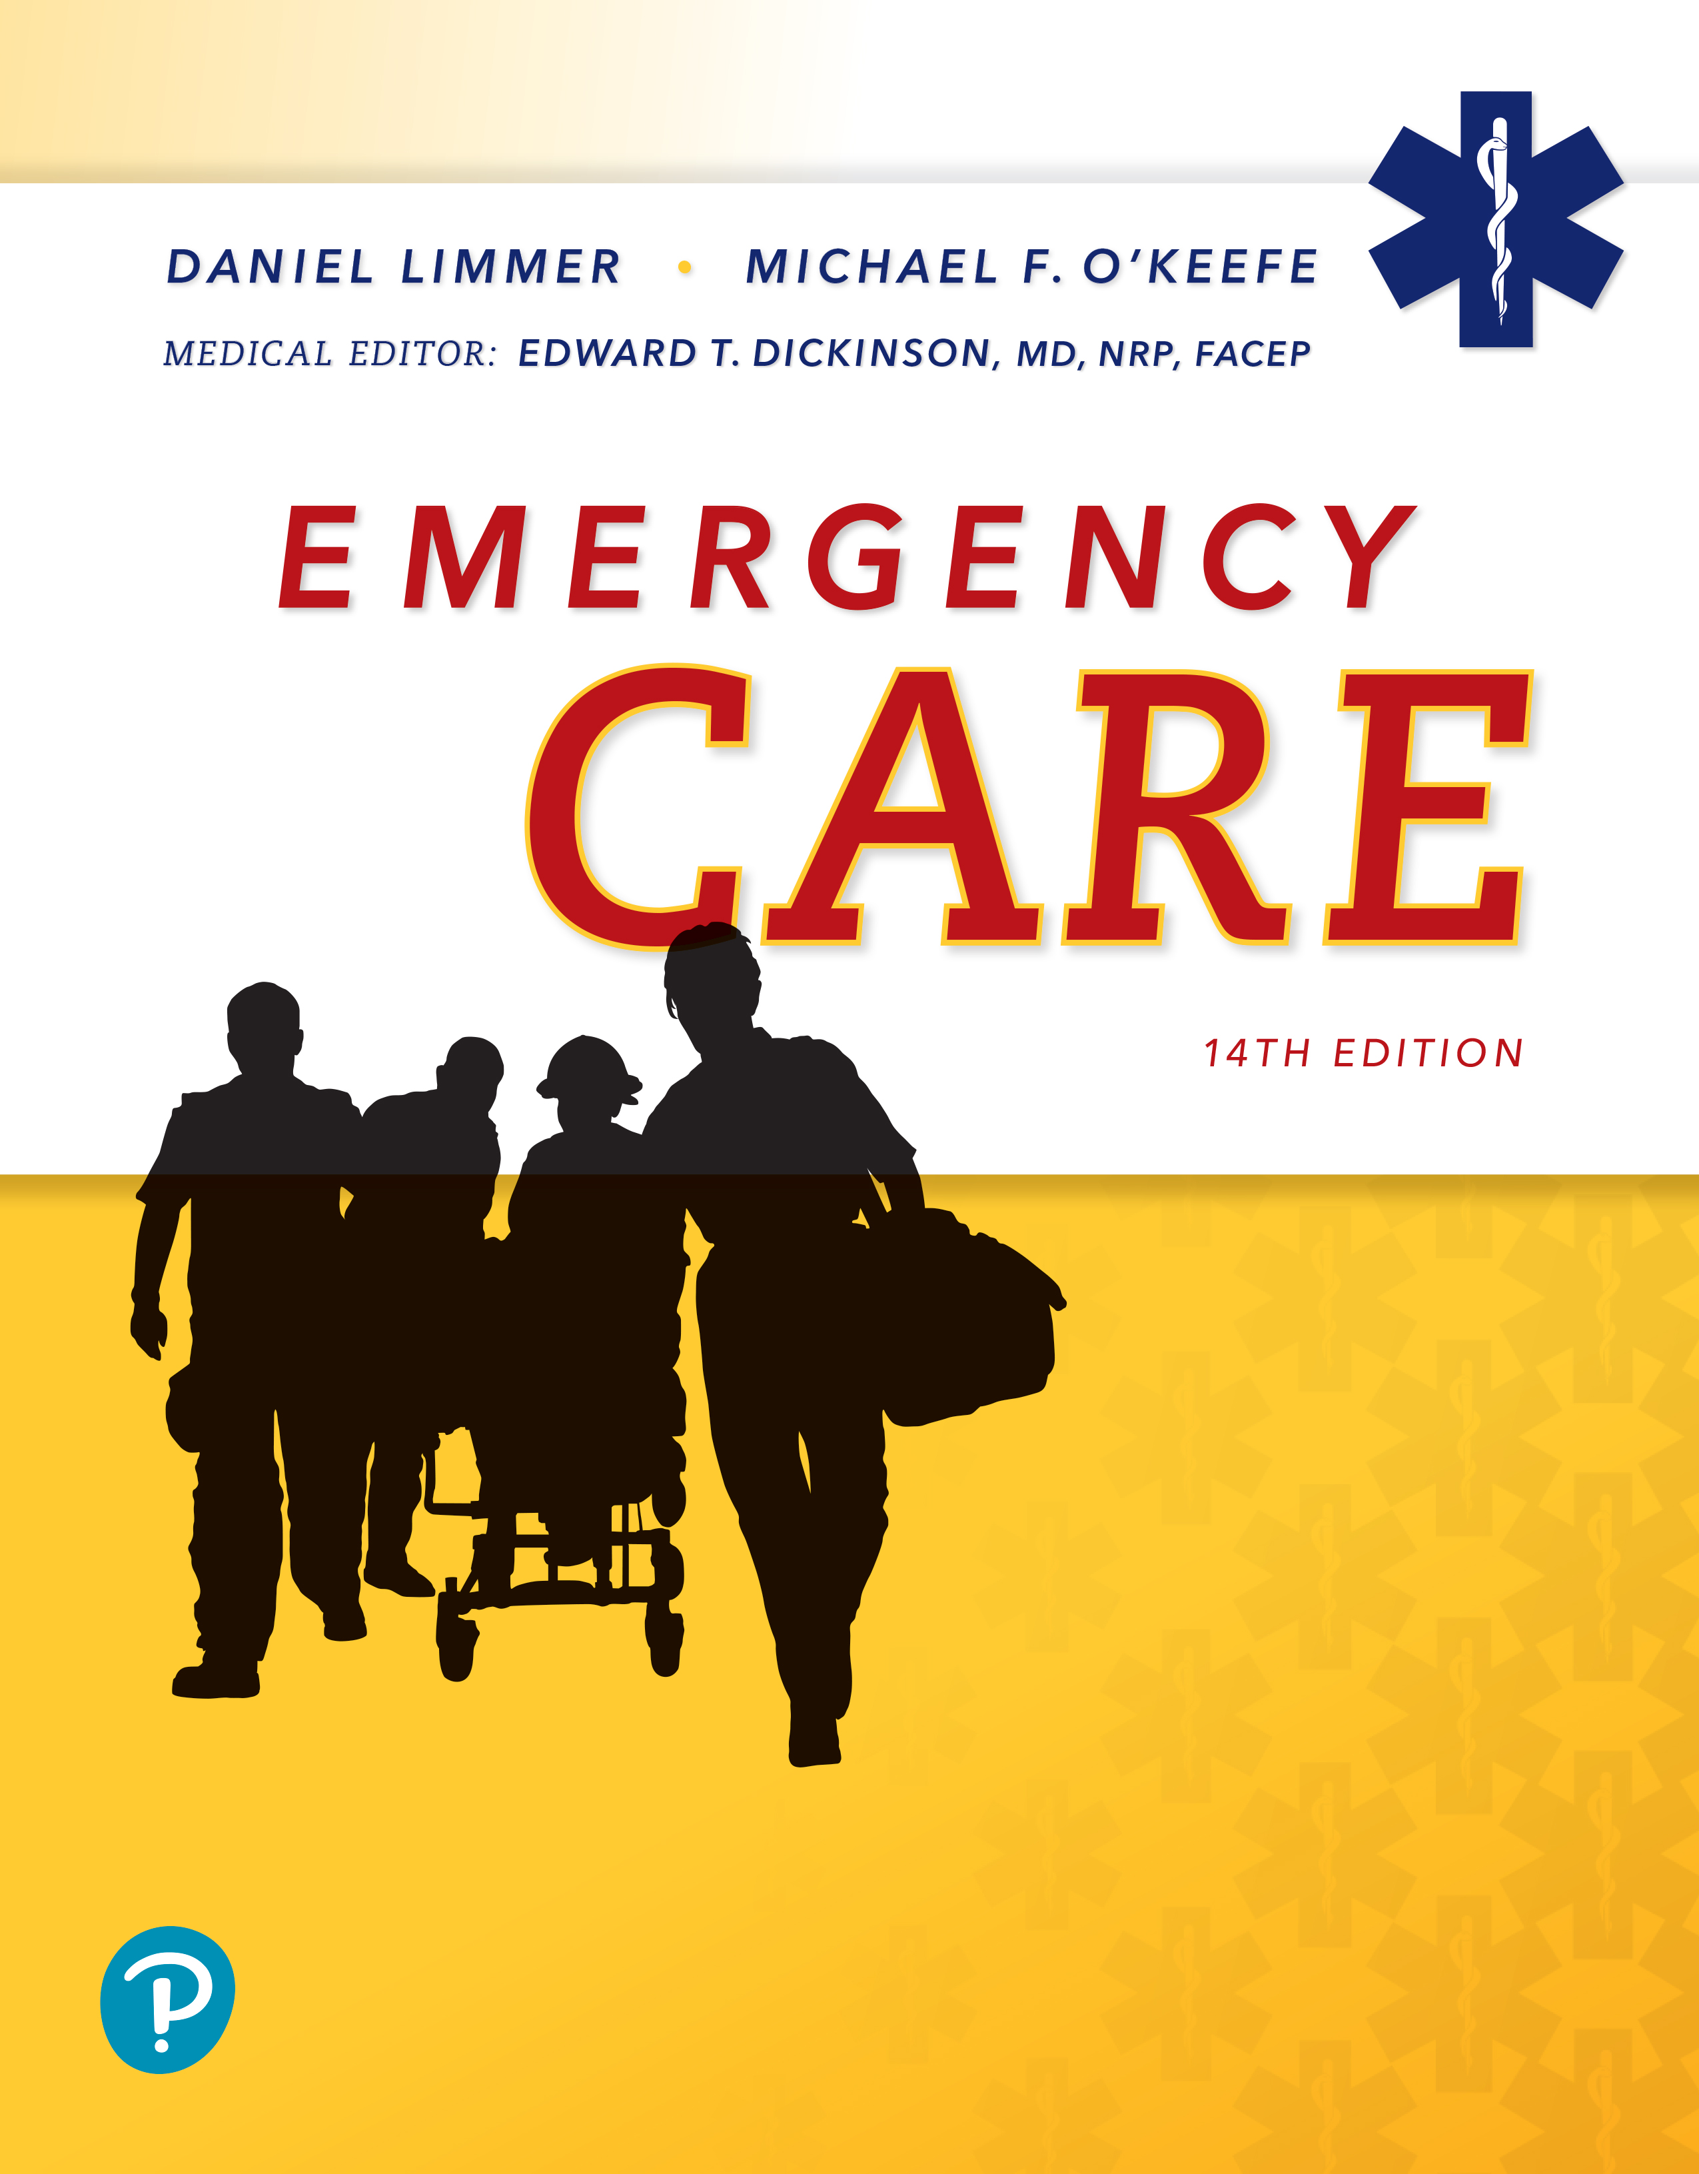
Emergency Care
Fourteenth Edition
Chapter 1
Introduction to Emergency Medical Services
Slides in this presentation contain hyperlinks. JAWS users should be able to get a list of links by using INSERT+F7
Copyright © 2021, 2016, 2012 Pearson Education, Inc. All Rights Reserved
Notes:
If this PowerPoint presentation contains mathematical equations, you may need to check that your computer has the following installed:
1) MathType Plugin
2) Math Player (free versions available)
3) NVDA Reader (free versions available)

Slide 2
Topics
The Emergency Medical Services System
Components of the E M S System
Roles and Responsibilities of the E M T
The E M S Role in Public Health
Research
Special Issues
Notes:
Planning Your Time: Plan 125 minutes for this chapter.
The Emergency Medical Services System (20 minutes)
Components of the EMS System (20 minutes)
Roles and Responsibilities of the EMT (60 minutes)
The EMS Role in Public Health (5 minutes)
Research (15 minutes)
Special Issues (5 minutes)
Note: The total teaching time recommended is only a guideline.
Core Concepts:
The chain of human resources that forms the EMS system
How the public activates the EMS system
Your roles and responsibilities as an EMT
The process of EMS quality improvement

Slide 3
The Emergency Medical Services System
Back to Topics
Notes:
Teaching Time: 20 minutes
Teaching Tip: Lessons on well-being will be lost if the instructor does not lead by example. Practice what you preach. Demonstrate healthy choices in the classroom. Consider healthy snacks and limit caffeine. Actively discuss other healthy choices, and make well-being the accepted norm.

Slide 4
How It Began (1 of 3)
1790s
  French began to transport wounded soldiers away from the scene of battle for care by physicians.
  Earliest documented Emergency Medical Service
Civil War
  Clara Barton began emergency service for wounded and later helped establish American Red Cross.
Notes:
Covers Objective 1.1
Discussion Topic: Describe the components of the EMS system.

Slide 5
How It Began (2 of 3)
  Volunteer ambulance corps
Korea/Vietnam
  Medical teams produced advances in field care.
  Battlefield advances led to civilian advances such as specialized emergency medical centers devoted to the treatment of trauma.
Notes:
Covers Objective 1.1
Discussion Topic: Describe the components of the EMS system.

Slide 6
How It Began (3 of 3)
Nonmilitary ambulance services began operating in early 1900s in U.S.
  Transport services only with little or no emergency care
  Did not develop in smaller communities until late 1940s
  Operated by local undertaker or fire service
  Need to organize systems for emergency prehospital care and train personnel recognized
Notes:
Covers Objective 1.1

Slide 7
E M S Today
1966
  Department of Transportation charged with developing E M S standards
1970
  Founding of the National Registry of E M Ts (N R E M T)
1973
  National Emergency Medical Service Systems Act passed by Congress
Notes:
Covers Objective 1.1

Slide 8
N H T S A Standards for E M S Systems (1 of 5)
Regulation and policy
  Each state establishes laws, a lead E M S agency, a funding mechanism, policies, procedures, and regulations.
Resource management
  Centralized coordination of emergency treatment and transport resources
Notes:
Covers Objective 1.1
Point to Emphasize: The National Highway Traffic Safety Administration (NHTSA) Technical Assistance Program established an assessment program with a set of standards for EMS systems.

Slide 9
N H T S A Standards for E M S Systems (2 of 5)
Human resources and training
  Assure E M S personnel are trained and certified to minimum standards.
Transportation
  Provide safe, reliable transportation.
Notes:
Covers Objective 1.1

Slide 10
N H T S A Standards for E M S Systems (3 of 5)
Facilities
  Transport to closest appropriate facility
Communications
  Universal system access number (911)
  Dispatch-to-ambulance, ambulance-to-ambulance, ambulance-to-hospital, and hospital-to-hospital communications
Notes:
Covers Objective 1.1

Slide 11
N H T S A Standards for E M S Systems (4 of 5)
Public information and education
  Educate public about their role in E M S, access to E M S, prevention of injury.
Medical direction
  Medical Director is accountable for E M S personnel within system.
Notes:
Covers Objective 1.1

Slide 12
N H T S A Standards for E M S Systems (5 of 5)
Trauma systems
  Develop trauma triage, transport, and treatment protocols.
Evaluation
  Establish program for evaluating and improving effectiveness (Q I, Q A, T Q M).
Notes:
Covers Objective 1.1

Slide 13
Components of the E M S System
Back to Topics
Notes:
Teaching Time: 20 minutes
Teaching Tip: Lessons on well-being will be lost if the instructor does not lead by example. Practice what you preach. Demonstrate healthy choices in the classroom. Consider healthy snacks and limit caffeine. Actively discuss other healthy choices, and make well-being the accepted norm.

Slide 14
Components of the E M S System (1 of 2)
Emergency medical dispatchers
  Activation of E M S in response to patient emergency
E M S responders
  Emergency medical responders and E M T s
Emergency department/hospital
  Doctors, nurses, allied health personnel
Notes:
Covers Objective 1.1
Point to Emphasize: It is important to consider the EMS system from the viewpoint of the patient.
Class Activity: Take a field trip. Visit the local EMS service, dispatch center, and/or hospital. Review how the patient is transitioned through each stage of transport.

Slide 15
Components of the E M S System (2 of 2)
Specialized care facilities
  Trauma centers
  Burn centers
  Pediatric centers
  Cardiac centers
  Stroke centers
Notes:
Covers Objective 1.1
Knowledge Application: Have groups of students build a mock EMS system. Discuss the key components and compare these components to existing systems.
Discussion Topic: Describe the components of the EMS system from access to delivery at the hospital. Consider the viewpoint of the patient.

Slide 16
Think About It 1
What medical services are available in your community?
How important is it that E M S personnel know the capabilities of community medical facilities?
What are the possible consequences of transporting a patient to a facility not equipped to handle the problem?
Notes:
Talking Points: Have students list medical services available; add others that are not obvious. Discuss with students their responsibility to know this essential information.

Slide 17
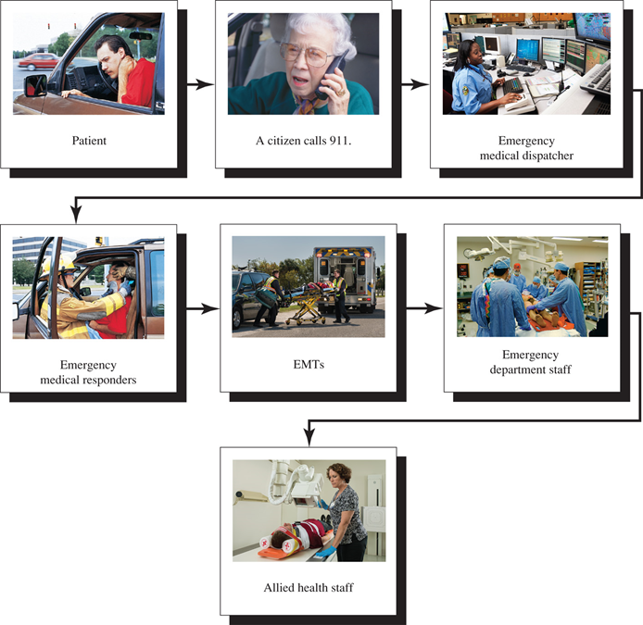
Accessing the E M S System (1 of 4)
The chain of human resources making up the E M S system.
Emergency Department staff photo: © Edward T. Dickinson, M D
For long description, see slide 61: Appendix 1
Notes:
Covers Objective 1.1
Class Activity: Have students work in groups to research examples of EMS systems that pertain to services in their area. Assign various topics including local, regional, state, and federal systems. Have groups present their findings to the class.

Slide 18
Accessing the E M S System (2 of 4)
911 telephone access
  Available in most communities
Enhanced 911
  Provides caller number and location for landline phones
Notes:
Covers Objectives 1.1
Point to Emphasize: Discuss how modern technology related to cell phones impacts the public's ability to access and utilize the EMS system.

Slide 19
Accessing the E M S System (3 of 4)
Emergency medical dispatchers
  Can provide instructions to callers on how to provide emergency care until E M S personnel arrive
  Research has consistently pointed to the importance of early access and prompt initiation of emergency care and C P R.
Notes:
Covers Objective 1.1

Slide 20
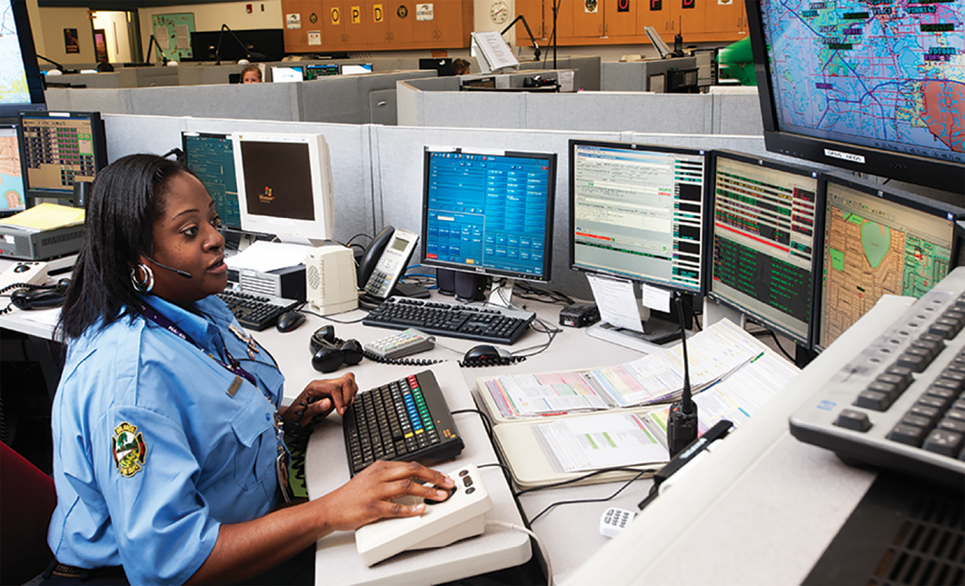
Accessing the E M S System (4 of 4)
Emergency medical dispatchers
Photo: © Edward T. Dickinson, M D
Notes:
Covers Objective 1.1

Slide 21
Critical Decision Making
Critical decision making is a very important concept in E M S.
  Gather information from scene, patient assessment, and other sources.
  Synthesize (interpret) information to make decisions regarding treatment and transport options.
When information is not enough
  Ask more questions.
  Perform additional examinations.
Notes:
Covers Objective 1.1

Slide 22
Examples of Critical Decisions
Should you take your patient to the closest hospital or to a more distant specialty hospital?
Will this medication help the patient’s current condition? Could it make the condition worse?
Notes:
Talking Points: Every situation is different, and transport decisions are often based on local protocols. This list should initiate discussion.

Slide 23
Levels of E M S Training
Four general levels of E M S training and certification that may vary from place to place
  Emergency Medical Responder
  Emergency Medical Technician
  Advanced Emergency Medical Technician
  Paramedic
Notes:
Covers Objective 1.2

Slide 24
Roles and Responsibilities of the E M T
Back to Topics
Notes:
Teaching Time: 60 minutes
Teaching Tip: Lessons on well-being will be lost if the instructor does not lead by example. Practice what you preach. Demonstrate healthy choices in the classroom. Consider healthy snacks and limit caffeine. Actively discuss other healthy choices, and make well-being the accepted norm.

Slide 25
Roles and Responsibilities of E M T s
Personal safety
Safety of crew, patient, and bystanders
Working with other public safety professionals
Patient assessment and care
Lifting and moving
Transport
Transfer of care
Patient advocacy
Notes:
Covers Objective 1.2
Discussion Topic: Discuss the roles and responsibilities of an EMT. What are the most important traits of a good EMT?

Slide 26
Think About It 2
How would it impact an older adult patient if they were transported to the hospital without glasses, hearing aid, or dentures?
On a routine call, would taking the time to gather these items have a negative effect on the patient's care?
How about ensuring the home is secure and locked before leaving?
Notes:
Covers Objective 1.2
Talking Points: Ask the students to think about these questions from the perspective of being a patient. Wouldn't they want the EMS responder to do these things for them? Emphasize how responding to a call is not always about dealing with the emergency, but also providing the emotional support that a patient needs.

Slide 27
Think About It 3
Could the concept of patient advocacy also extend to the community (fall prevention programs for the elderly, poisoning awareness, pool and water safety programs for children)?
Notes:
Covers Objective 1.2
Talking Points: Patient advocacy is an important role for EMS responders. Ask the students to think of any patient advocacy roles they see EMS responders taking part of in their community.

Slide 28
Physical Traits of a Good E M T
Ability to lift and carry equipment and patients up to 125 pounds
Good eyesight (distance and reading)
Awareness of any problems with color vision
Good communication skills (oral and written)
Notes:
Covers Objective 1.2
Talking Points: Ask the class to give examples of situations in which these traits would be vital in performing the duties of an EMT.

Slide 29
Personal Traits of a Good E M T (1 of 4)
Pleasant
Sincere
Cooperative
Resourceful
Notes:
Covers Objective 1.2

Slide 30
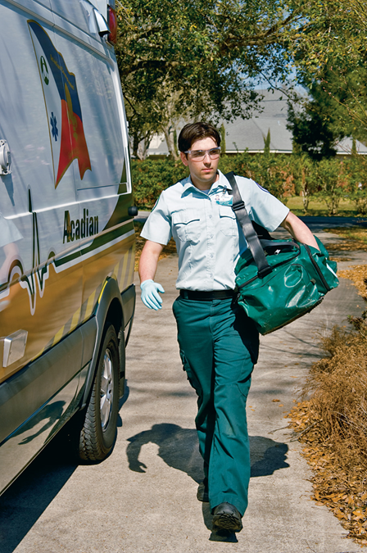
Personal Traits of a Good E M T (2 of 4)
A professional appearance inspires confidence.
Notes:
Covers Objective 1.2

Slide 31
Personal Traits of a Good E M T (3 of 4)
Self-starter
Emotionally stable
Able to lead
Neat and clean
Of good moral character and respectful of others
Notes:
Covers Objective 1.2
Knowledge Application: Have students play the role of EMTs. Assign negative traits and have students demonstrate the serious impact of poor behavior. Discuss.

Slide 32
Personal Traits of a Good E M T (4 of 4)
In control of personal habits
Controlled in conversation and able to communicate properly
Able to listen to others
Nonjudgmental and fair
Notes:
Covers Objective 1.2

Slide 33
Education (1 of 2)
Maintain up-to-date knowledge and skills
  Refresher courses
  Continuing education courses
  Conferences, seminars, and lectures
Notes:
Covers Objective 1.2
Talking Points: Emphasize to students that being an EMT involves career-long learning in order to stay abreast of current standards of care. Provide examples of how research has led to changes in standard of care in the past (for example, hyperventilation of cardiac arrest patients).

Slide 34
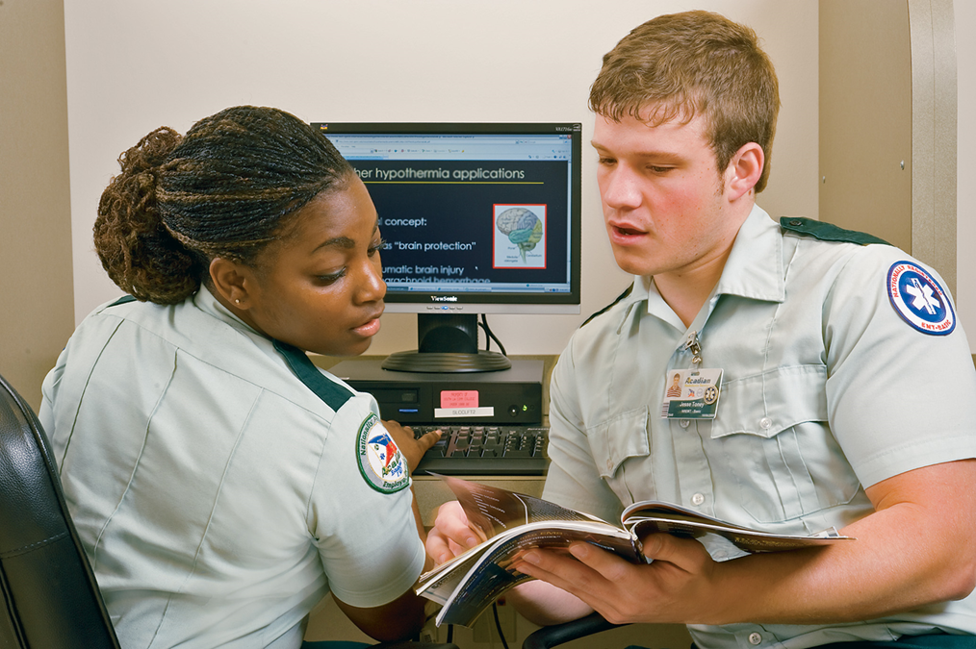
Education (2 of 2)
Many E M S/rescue operations adopt new procedures and equipment on the basis of research providing evidence that they are effective.
Notes:
Covers Objective 1.2
Talking Points: Emphasize to students that being an EMT involves career-long learning in order to stay abreast of current standards of care. Provide examples of how research has led to changes in standard of care in the past (for example, hyperventilation of cardiac arrest patients).

Slide 35
Think About It 4
How will you refresh your knowledge and stay current once you are out of the classroom?
What qualities would you like to see in an E M T who is caring for you? How can you come closer to being this kind of E M T?
Notes:
Covers Objective 1.2
Talking Points: Being an EMT involves career-long learning. Just because your class ends does not mean you should stop learning. The students may list qualities such as emphatic, caring, respectful, of good moral standing, able to lead, and nonjudgmental.

Slide 36
Where Will You Become a Provider? (1 of 2)
Ambulance services
Fire departments
Rural/wilderness teams
Urban/industrial settings
Volunteering
Notes:
Covers Objective 1.2
Talking Points: Many fire and EMS agencies are volunteers, especially in rural communities. In addition, many fire department personnel are cross-trained as firefighters and EMTs.

Slide 37
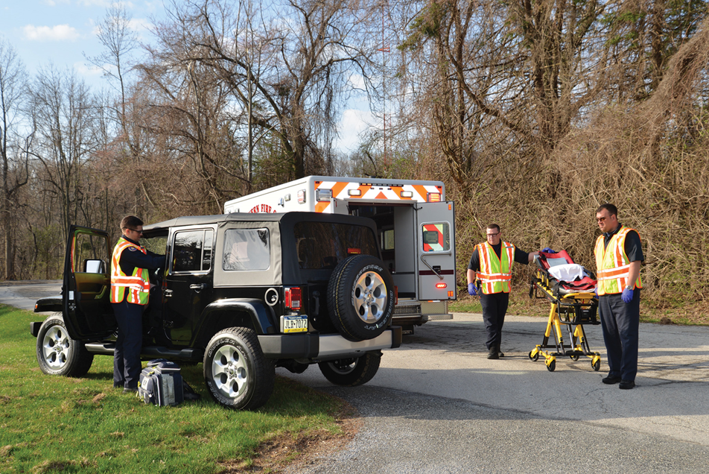
Where Will You Become a Provider? (2 of 2)
Career opportunities for E M Ts include work in rural/wilderness settings.
Photo © Edward T. Dickinson, M D
Notes:
Covers Objective 1.2
Talking Points: Many fire and EMS agencies are volunteers, especially in rural communities. In addition, many fire department personnel are cross-trained as firefighters and EMTs.

Slide 38
National Registry of Emergency Medical Technicians
Registration for E M Rs, E M Ts, A E M Ts, and paramedics who successfully complete N R E M T examinations
May help in reciprocity (transferring to another state or region)
Beneficial when applying for employment
Notes:
Covers Objective 1.2
Talking Points: NREMT exams are often used as state certification exams. If your state or region does not use the registry exam, ask your instructor how you can sit for the examination. Upon passing the exam and obtaining registry, you will be entitled to wear the NREMT patch.

Slide 39
Quality Improvement (1 of 2)
Continuous self-review with the purpose of identifying aspects of the system that require improvement
Develop plans to correct deficiencies and improve performance.
Notes:
Covers Objective 1.2
Point to Emphasize: Quality assurance, research, and education ensure constant improvement for both individual providers and the EMS system in general.

Slide 40
Quality Improvement (2 of 2)
Everyone in organization has a role.
  Preparing carefully written documentation
  Becoming involved in the quality process
  Obtaining feedback from patients and hospital staff
  Maintaining your equipment
  Continuing your education
Notes:
Covers Objective 1.2

Slide 41
Medical Direction
All patient care performed under direction of Medical Director
  Ultimate responsibility for patient care
  Oversees training
  Develops treatment protocols
  Issues off-line medical direction (standing orders)
  Provides on-line medical direction
Notes:
Covers Objective 1.2

Slide 42
The E M S Role in Public Health
Back to Topics
Notes:
Teaching Time: 5 minutes
Teaching Tip: Lessons on well-being will be lost if the instructor does not lead by example. Practice what you preach. Demonstrate healthy choices in the classroom. Consider healthy snacks and limit caffeine. Actively discuss other healthy choices, and make well-being the accepted norm.

Slide 43
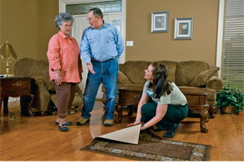
EMS Role in Public Health
Injury prevention for geriatric patients
Injury prevention for youth
Public vaccination programs
Disease surveillance
Notes:
Covers Objective 1.3

Slide 44
Research
Back to Topics
Notes:
Teaching Time: 15 minutes
Teaching Tip: Lessons on well-being will be lost if the instructor does not lead by example. Practice what you preach. Demonstrate healthy choices in the classroom. Consider healthy snacks and limit caffeine. Actively discuss other healthy choices, and make well-being the accepted norm.

Slide 45
Research
Two ways research affects E M S
  Focus on improving patient outcomes
  Through evidence-based techniques
Evidence-based process
  Forming a hypothesis
  Reviewing literature
  Evaluating the evidence
  Adopting the practice if evidence supports it
Notes:
Covers Objective 1.4
Talking Points: EMTs should stay abreast of ongoing EMS-related research and participate in the research process when possible to ensure quality of care for the patient.
Critical Thinking: Once you have completed class, how will you continue to improve as an EMT? Use specific examples.
Discussion Topic: Explain how medical directors, medical research, and quality improvement impact the EMS system.

Slide 46
The Basics of E M S Research (1 of 2)
Dynamic nature of treatment makes research difficult.
  Not all research is created equal.
  Embrace best practices of conducting and evaluating research
Rely on the scientific method.
  General observations turned into hypothesis
  Predictions tested to prove or disprove hypothesis
Notes:
Covers Objective 1.4
Knowledge Application: Have students work in groups. Assign meaningful EMS research articles. Have the groups discuss how these articles impacted national and local EMS systems.

Slide 47
The Basics of E M S Research (2 of 2)
Types of medical research
  Peer-reviewed research in medical journals
  Articles in E M S magazines
    Not original research
    Not peer reviewed
Notes:
Covers Objective 1.4

Slide 48
Special Issues
Back to Topics
Notes:
Teaching Time: 5 minutes
Teaching Tip: Lessons on well-being will be lost if the instructor does not lead by example. Practice what you preach. Demonstrate healthy choices in the classroom. Consider healthy snacks and limit caffeine. Actively discuss other healthy choices, and make well-being the accepted norm.

Slide 49
Special Issues (1 of 2)
Throughout the course we will discuss:
  Local issues
  Administrative matters
    Course description
    Class meeting times
    Requirements for certification as an E M T
Notes:
Talking Points: At this time you should explain the above topics with your students if you have not already done so.

Slide 50
Special Issues (2 of 2)
The Americans with Disabilities Act (A D A) has set strict guidelines preserving the rights of Americans with disabilities.
Notes:
Talking Points: At this time you should explain the above topics with your students if you have not already done so.

Slide 51
Chapter Review

Slide 52
Chapter Review (1 of 3)
The E M S system has been developed to provide prehospital as well as hospital emergency care.
The E M S system includes 911 or another emergency access system, dispatchers, E M Ts, hospital emergency department, physicians, nurses, physician's assistants, and other health professionals.

Slide 53
Chapter Review (2 of 3)
The E M T’s responsibilities include safety; patient assessment and care; lifting, moving, and transporting patients; transfer of care; and patient advocacy.

Slide 54
Chapter Review (3 of 3)
An E M T must have certain personal and physical traits to ensure the ability to do the job.
Education (including refresher training and continuing education), quality improvement procedures, and medical direction are all essential to maintaining high standards of E M S care.

Slide 55
Remember (1 of 2)
E M S dates back to Napoleonic times.
Modern E M S standards come from 1960s–1970s and National Emergency Medical Service Systems Act (N E M S S A).
There is a chain of human resources involved in E M S.
  Critical decisions are made by each member of the chain.

Slide 56
Remember (2 of 2)
There are certain personal and physical traits that help you to be a successful E M S provider.
An E M S provider should actively pursue opportunities to improve personal knowledge and abilities as well as the unit's overall quality.

Slide 57
Questions to Consider
What innovation was introduced in the Korean and Vietnam wars that is now common in many E M S systems?
What are the four levels of E M S providers?
Requesting orders from a physician by radio is an example of what kind of medical control?
Notes:
Talking Points: Helicopter transport
EMR, EMT, AEMT, paramedic
On-line medical control

Slide 58
Critical Thinking
Your patient is hesitant to go to the hospital because she is worried about her dog. What can you do to assist in this situation? What part of your role as an E M T is this an example of?
Notes:
Talking Points: Help to contact a neighbor or relative that can come by and check on the dog; Patient advocate.

Slide 59

Copyright
This work is protected by United States copyright laws and is provided solely for the use of instructors in teaching their courses and assessing student learning. Dissemination or sale of any part of this work (including on the World Wide Web) will destroy the integrity of the work and is not permitted. The work and materials from it should never be made available to students except by instructors using the accompanying text in their classes. All recipients of this work are expected to abide by these restrictions and to honor the intended pedagogical purposes and the needs of other instructors who rely on these materials.

Slide 60
Appendix 1
A flowchart displays the following images in order:
A patient sitting in a motor vehicle, presumably following an accident.
A concerned citizen calls 911.
An emergency medical dispatcher takes the call and dispatches the emergency personnel.
Emergency medical responders stabilize the patient at the scene.
E M T’s transport the patient to an ambulance.
Emergency department staff treat the patient in an emergency room.
Allied health staff examine the patient in a treatment room.
Return to presentation

