Slide 1
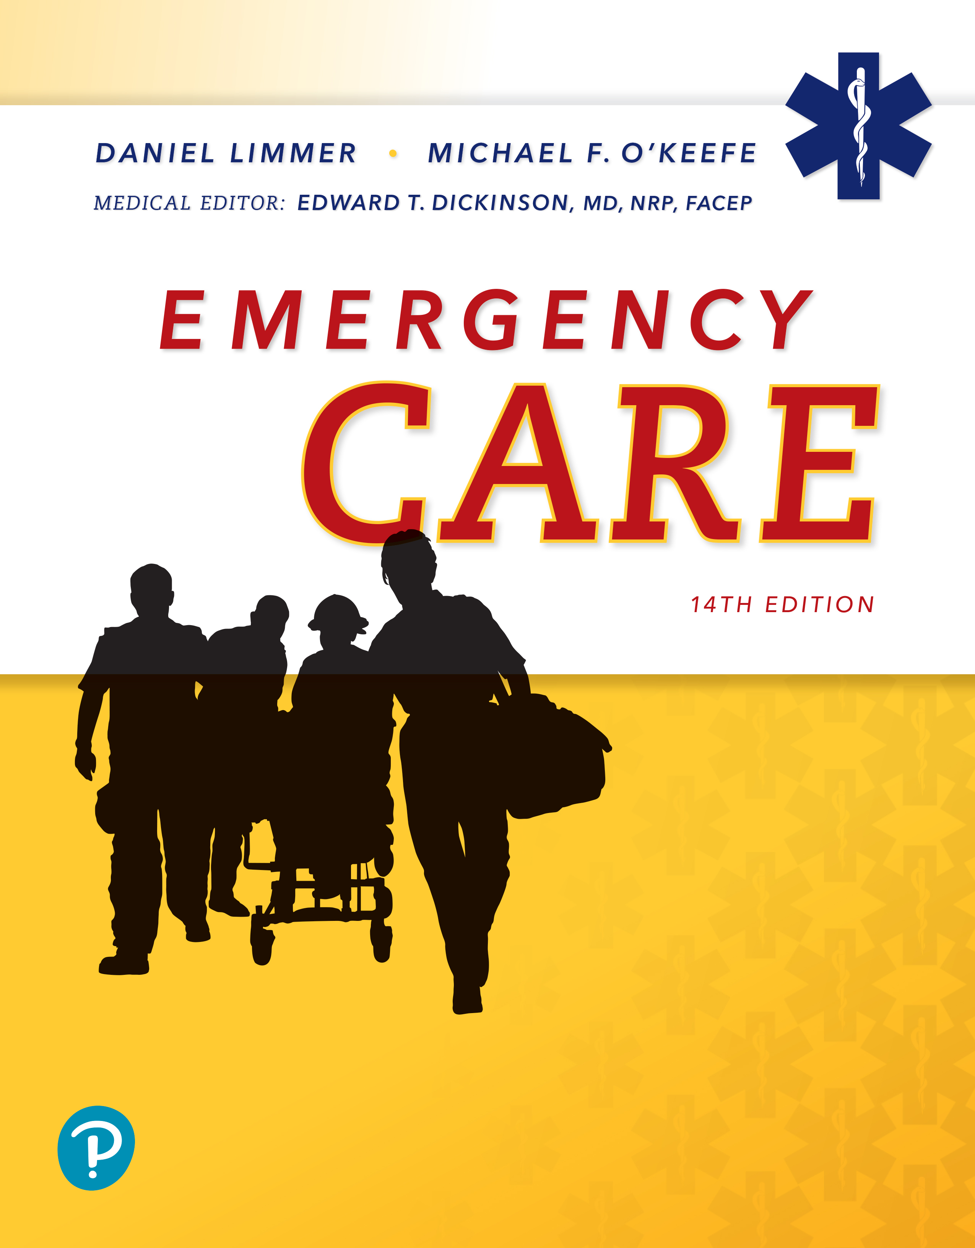
Emergency Care
Fourteenth Edition
Chapter 9
Airway Management
Slides in this presentation contain hyperlinks. JAWS users should be able to get a list of links by using INSERT+F7
Copyright © 2021, 2016, 2012 Pearson Education, Inc. All Rights Reserved
Notes:
If this PowerPoint presentation contains mathematical equations, you may need to check that your computer has the following installed:
1) MathType Plugin
2) Math Player (free versions available)
3) NVDA Reader (free versions available)

Slide 2
Topics
Airway Physiology
Airway Pathophysiology
Opening the Airway
Obstructed Airways
Airway Adjuncts
Suctioning
Keeping an Airway Open: Definitive Care
Special Considerations
Notes:
Planning Your Time: Plan 220 to 230 minutes for this chapter.
Introduction (5 minutes)
Airway Physiology (20 minutes)
Airway Pathophysiology (50 minutes)
Opening the Airway (30 minutes)
Obstructed Airways (20 minutes)
Airway Adjuncts (45 minutes)
Suctioning (40 minutes)
Keeping an Airway Open: Definitive Care (5 minutes)
Special Considerations (5 minutes)
Note: The total teaching time recommended is only a guideline.
Teaching Tips
This lesson lends itself well to multimedia presentations and real-life examples. Anatomical models and web graphics will enhance your presentation on physiology and pathophysiology

Slide 3
Airway Physiology
Back to Topics
Notes:
Teaching Time: 20 minutes

Slide 4
Airway Physiology (1 of 5)
The airway is divided into upper and lower portions
Upper airway
  Begins at the mouth and nose
  The pharynx lies posterior and inferior to the mouth and nose
    Nasopharynx is the upper portion
    Oropharynx is the middle portion
    Laryngopharynx is the lower portion
  The larynx is the boundary between the upper and lower airways
Notes:
Covers Objective: 9.1
Point to Emphasize: The airway begins at the mouth and nose and terminates at the alveoli.
Knowledge Application: Assign a homework assignment that has students label a blank diagram of the upper and lower airway.

Slide 5
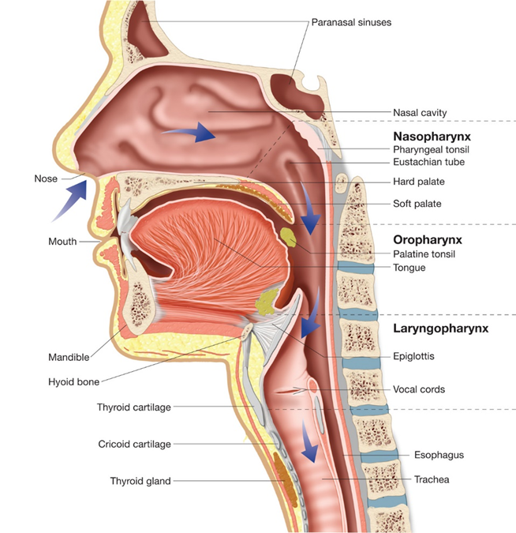
Airway Physiology (2 of 5)
For long description, see slide 85: Appendix 1
The upper airway.
Notes:
Covers Objective: 9.1
Knowledge Application: Instructors have traditionally “traced the flow of a drop of blood through the heart.” Consider tracing the flow of a molecule of oxygen through the respiratory system. Discuss the various factors that influence the ability of oxygen to reach the alveoli.

Slide 6
Airway Physiology (3 of 5)
Lower airway
  The trachea lies below the larynx
  Mainstem bronchi branch from the trachea and progressively become smaller
  Alveoli lie at the end of the bronchi
    Pulmonary capillaries surround the alveoli
    Oxygen and carbon dioxide are exchanged at the capillaries
Notes:
Covers objective: 9.1
Point to Emphasize: The larynx is the boundary between the upper airway and lower airway, but the glottic opening is the true point at which air moves from one into the other.
Discussion Topic: Describe how the airway is protected. Specifically discuss the role of cartilage and the epiglottis.

Slide 7
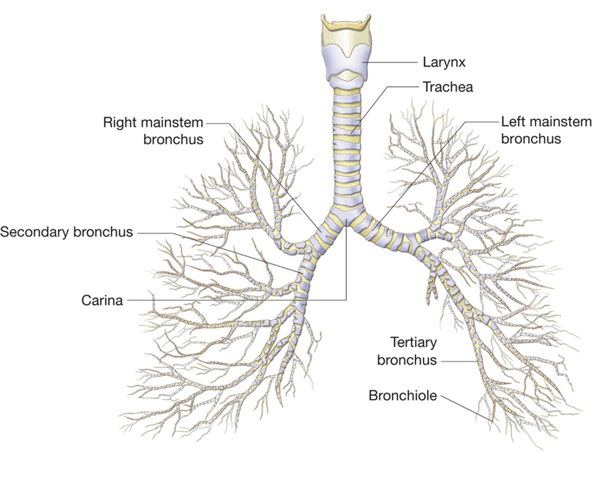
Airway Physiology (4 of 5)
For long description, see slide 86: Appendix 2
The lower airway. (A) The bronchial tree.
Notes:
Covers Objective: 9.1
Knowledge Application: Using an anatomical model, have students or groups of students point out specific airway structures.

Slide 8
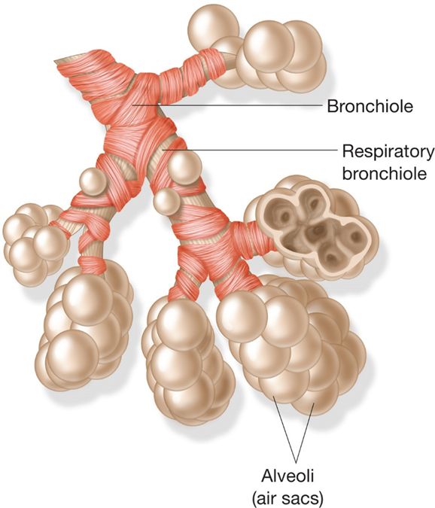
Airway Physiology (5 of 5)
The lower airway. (B) The alveolar sacs (clusters of individual alveoli).
Notes:
Covers Objective: 9.1

Slide 9
Airway Physiology—Pediatric Airway Physiology
Airway structures of infants and children are shorter, narrower, and less rigid than in adults
  Mouth and nose are smaller and easily obstructed
  Tongue is proportionately larger
  Newborns and infants are nose breathers
  The trachea is softer, more flexible, and narrower and easily obstructed by swelling and foreign objects
  The chest wall is softer
  Breathing is more dependent on the diaphragm
Notes:
Covers Objective: 9.1
Critical Thinking Discussion: How would changes in the airway, such as narrowing or obstruction, effect the movement of air?

Slide 10
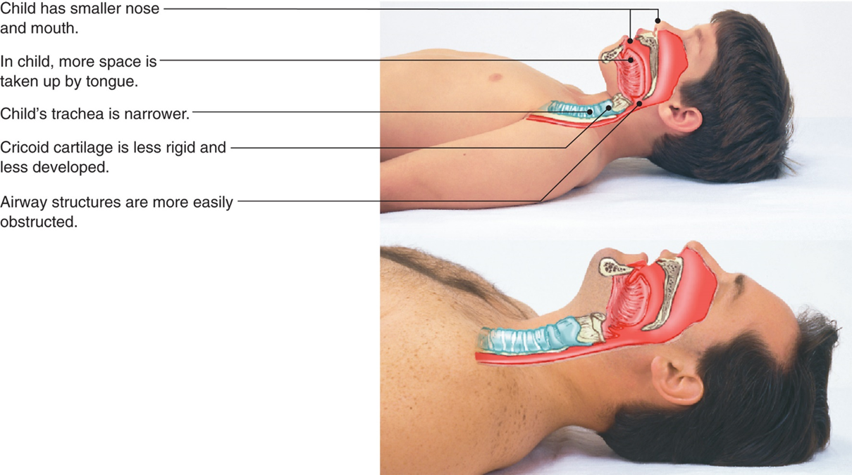
Pediatric Anatomical Considerations
For long description, see slide 87: Appendix 3
Comparison of child and adult respiratory passages.
Notes:
Covers Objective: 9.1

Slide 11
Airway Pathophysiology
Back to Topics
Notes:
Teaching Time: 50 minutes
Teaching Tip: Relate pathologies to real world examples to help improve understanding.

Slide 12
Airway Pathophysiology (1 of 2)
A variety of obstructions interfere with air flow
  Foreign bodies, including food and small toys
  Liquids, including blood and vomit
  Loss of muscle tone, as with altered mental status
Obstructions can be acute or chronic
The airway must be initially evaluated and monitored for patency over time
Notes:
Covers Objective: 9.2
Point to Emphasize: Airway obstructions can be caused by foreign bodies, loss of muscle tone, or swelling in the airway.
Discussion Topic: Describe the mechanisms by which the airway can be obstructed. Discuss specific examples. Compare and contrast upper airway obstructions and lower airway obstructions.

Slide 13
Airway Pathophysiology (2 of 2)
Severe allergic reaction (anaphylaxis) causes rapid airway tissue swelling
Burns, blunt force trauma, and certain infections cause swelling of the issues in and around the glottic opening
Smooth muscle constriction of the lower airway changes the airway diameter and creates resistance.
Notes:
Covers Objective: 9.2
Class Activities: Have students work in groups. Assign common airway pathologies and have students research and report back to the class on what areas of the airway these pathologies effect and the mechanism by which they disrupt air flow.
Critical Thinking Discussion: What types of infectious diseases might present a threat to the airway? Give specific examples.

Slide 14
Airway Pathophysiology—Sounds of a Partially Obstructed Airway
Four sounds can be indicative of limited air movement
  Stridor—High-pitched whistling sound; indicative of a severely narrowed air passage
  Hoarseness—Raspy change in voice; indicative of swelling around the vocal cords
  Snoring—Similar to a snore during sleep; indicative of diminished muscle tone
  Gurgling—Bubbling sound; indicative of vomit, blood, or secretions in the airway
Notes:
Covers Objective: 9.2
Teaching Tips: Play recordings of stridor, hoarseness, snoring, and gurgling for students and discuss their differences in class.

Slide 15
Patient Assessment—Is the Airway Open? (1 of 2)
Two questions must be answered when assessing the airway
  Is airway open?
  Will airway stay open?
The ability to speak is an immediate indicator that the patient is capable of moving air
Stridor may be present on inhalation, exhalation, or both and is an ominous sign
Notes:
Covers Objective: 9.2
Teaching Tip: Airway assessment is a key point. Spend time on this topic to assure comprehension before moving on to airway skills. Although this concept is critical, it is largely intuitive and should be taught as such.
Point to Emphasize: Assessment of the airway must consider both immediate and long-term patency.
Talking Points: Airway assessment is a high priority for, without the ability to move air, the patient will die. In most cases, airway is the first area checked during the primary assessment.

Slide 16
Patient Assessment—Is the Airway Open? (2 of 2)
Breathing sounds from the nose an mouth should be free of sounds associated with obstruction
  Gurgling
  Gasping
  Crowing
  Wheezing
  Snoring
Some patients use body position to keep the airway open
Assess the airway in the primary assessment and stop and fix problems immediately
Notes:
Covers Objective: 9.2
Discussion Topics: Describe how you would assure a patent airway in your primary assessment. List the common indicators of a non-patent airway.
Critical Thinking Discussion: Describe a medical and trauma situation that would cause failure of an airway.

Slide 17
Patient Assessment—Will the Airway Stay Open?
Airway assessment is not just a moment in time, but a constant consideration
  This is especially true in critical care patients
  You may need to consider how to keep an airway open immediately after establishing it
When the airway is partially obstructed, you must consider how long until it will be completely obstructed
The ability to maintain an airway can change over time
  Mental status affects the ability to maintain an airway
  There is no guarantee an airway will remain open
Notes:
Covers Objective: 9.2
Teaching Tips: Recognizing ongoing threats to an airway is an important compliment to recognizing a non-patent airway. These two steps go hand in hand in the context of the primary assessment. Teach assessment in the context of decision making—for example, “As an EMT, you will use these findings to identify an inadequate airway.” Practice decision making. Make decision making part of every use of airway management and artificial ventilation.
Discussion Topics: Describe the ongoing assessment of a patient’s airway. List potential long-term airway threats.
Critical Thinking Discussion: How might changes in mental status affect the patency of an airway over time?

Slide 18
Patient Assessment—Signs of an Inadequate Airway (1 of 2)
No signs of breathing or air movement
Evidence of foreign bodies in the airway
No air felt or heard at the nose or mouth
Inability to speak or difficulty speaking
Unusual hoarse or raspy quality to the voice
Absent, minimal, or uneven chest movement
Notes:
Covers Objective: 9.2
Discussion Topic: Describe the signs of an inadequate airway.

Slide 19
Patient Assessment—Signs of an Inadequate Airway (2 of 2)
Breathing movement limited to the abdomen
Diminished or absent breath sounds
Abnormal noises such as wheezing, crowing, stridor, snoring, gurgling, or gasping during breathing
In children, retractions above the clavicles and between and below the ribs
In children and infants, nasal flaring
Notes:
Covers Objectives: 9.2
Class Activity: Use a programmed patients and conduct scenarios that ask students to make airway evaluations.

Slide 20
Opening the Airway
Back to Topics
Notes:
Teaching Time: 30 minutes
Teaching Tips: Attempt to keep this lesson grounded in reality. Use programmed patients and not just manikins to teach key techniques. Link psychomotor skills to assessment. Demonstrate that the use of skills is guided by assessment and critical decision making. Assure proper supervision in practical skill stations. Imprint correct techniques early.

Slide 21
Opening the Airway (1 of 2)
Airway problems must be dealt with immediately
Open and maintain the airway in any patient who cannot do so for himself
In a patient with diminished mental status, airway procedures are best done with the patient supine
If you suspect spinal trauma, protect the head and neck
  Airway has priority over spine protection
  Provide manual stabilization if time does not allow for spinal precautions
Notes:
Covers Objective: 9.3
Discussion Topic: Describe how evaluating airway patency might be different for a conscious person from what it would be for an unconscious person.

Slide 22
Opening the Airway (2 of 2)
In unconscious patients, watch for indications of head, neck, and spinal injury:
  The mechanism of injury causes such injuries
  The injury is at or above the level of the shoulders
  Family or bystanders indicate such injuries occurred
Some patients have open but threatened airways
  Conscious patients should be helped into a comfortable position
  Unconscious patients should be placed in a head-elevated, sniffing position
Notes:
Covers Objective: 9.3
Point to Emphasize: EMTs must evaluate the potential for spinal injury in order to choose the most appropriate method for opening an airway.
Teaching Tips: Assure the laboratory session has adequate supervision and appropriate equipment and manikins. Allocate the appropriate amount of time, to conduct an efficient psychomotor session. Closely monitor and frequently correct students. Use standardized skill sheets to assess competency when practicing the various methods of opening an airway.

Slide 23
Opening the Airway—Head-Elevated, Sniffing Position (1 of 2)
The slight elevation and anterior positioning of the head aligns airway structures for improved patency
The head is moved in an anterior fashion similar to the posture used to sniff flowers
  In supine patients, this may be achieved with 1.5 to 2.0 inches of padding behind the head
  Anatomy and head size can create unique positioning needs
  In pediatric patients, padding may be needed behind the shoulders
Notes:
Covers Objective: 9.3
Class Activity: Have students choose a partner and practice airway maneuvers on one another.

Slide 24
Opening the Airway—Head-Elevated, Sniffing Position (2 of 2)
Optimal position is achieved when the patient’s ear is at the same level as the suprasternal notch
The position may be contraindicated when there is risk of spinal injury
Notes:
Covers Objective: 9.3

Slide 25
Opening the Airway—Providing an Airway: Manual Maneuvers (1 of 4)
Patients without an intact airway require manual airway opening and ongoing interventions to support patency
Airway problems are often caused by diminished control of muscles in the airway
Basic procedures keep the tongue in position and prevent the epiglottis from covering the glottic opening.
The head-tilt chin lift maneuver and the jaw-thrust maneuver are commonly used.
Notes:
Covers Objective: 9.3
Class Activity: (Skill Demonstration) Referring to a standardized skill competency sheet, and using an airway manikin, demonstrate the proper procedure for opening an airway using both the head-tilt, chin lift and the jaw-thrust maneuvers.

Slide 26
Opening the Airway—Providing an Airway: Manual Maneuvers (2 of 4)
The head-tilt, chin-lift maneuver aligns the airway structures to provide for free passage of air
  Place one hand on the forehead and the fingertips of other hand at the center of the lower jaw
  Tilt the head by applying pressure to the forehead
  Lift the chin and support the lower jaw
  Move the jaw forward
  Do not allow mouth to close
Notes:
Covers Objective: 9.3
Talking Points: Do not apply pressure to the soft tissue of the lower jaw. Do not allow the mouth to close, but do not put your fingers in the mouth.
Discussion Topic: Describe the technique for opening an airway using a head-tilt, chin-lift technique.

Slide 27
Head-Tilt, Chin-Lift Maneuver
Head-tilt, chin-lift maneuver, side view. Right image shows E M T’s fingertips under the bony area at the center of the patient’s lower jaw.
Notes:
Covers Objective: 9.3
Point to Emphasize: The head-tilt, chin-lift maneuver is used to open the airway of a patient who does not have a spinal injury.

Slide 28
Opening the Airway—Providing an Airway: Manual Maneuvers (3 of 4)
The jaw-thrust maneuver is used to open the airway of an unconscious patient with spinal injury
  Keep the head, neck, and spine aligned, moving patient as a unit into the supine position
  Kneel at the top of the head
  Place one hand on each side of the lower jaw, at angles of jaw below ears
Notes:
Covers Objective: 9.3
Discussion Topics: Describe the procedure used to open an airway using the head-tilt, chin-lift maneuver. Describe how the two common maneuvers actually open an airway

Slide 29
Opening the Airway—Providing an Airway: Manual Maneuvers (4 of 4)
  Push angles of the lower jaw forward with index fingers
  Retract the lower lip with your thumb to keep the mouth open
  Do not tilt or the head
Notes:
Covers Objective: 9.3
Critical Thinking Discussion: Describe why a jaw-thrust maneuver might be preferred over a head-tilt, chin-lift maneuver.

Slide 30
Jaw-Thrust Maneuver
Jaw-thrust maneuver, side view. Inset shows E M T’s finger position at angle of the jaw just below the ears.
Notes:
Covers Objective: 9.3
Point to Emphasize: The jaw-thrust maneuver is used to open the airway of a patient who has a potential spinal cord injury.

Slide 31
Obstructed Airways
Back to Topics
Notes:
Teaching Time: 20 minutes
Teaching Tip: Remind students that a conscious, severely choking patient may be able to walk, grab, and indicate fear, but there will be no signs of air movement.

Slide 32
Obstructed Airways (1 of 4)
If an opened airway remains obstructed, consider the possibility of a foreign-body obstruction
If attempts to ventilate and reopen the airway fail, immediately begin foreign-body airway procedures
Choking is classified as severe or nonsevere
  In severe choking, the trachea is fully blocked and no air is moving
  In nonsevere choking, the trachea is partially blocked and some air is exchanged
Notes:
Covers Objective: 9.3

Slide 33
Obstructed Airways (2 of 4)
Conscious, severely choking adults are treated with abdominal thrusts
  Stand or kneel behind the patient
  Place a fist over the navel and grasp the fist with the other hand
  Press the fist into the abdomen with a quick, forceful upward thrust
  Repeat the thrust until the obstruction clears or the patient becomes unconscious
Notes:
Covers Objective: 9.3

Slide 34
Obstructed Airways (3 of 4)
Conscious, severely choking infants are treated with back slaps and chest thrusts
  Lay the infant along the forearm in a prone position with the head lower than the body
  Support the head with your hand
  Deliver five forceful back slaps with the other hand
  Cradle the infant with the forearms and turn him over with head lower than the body
  Deliver five rapid chest thrust at one per second
  Alternate slaps and thrust until the obstruction clears or the patient becomes unconscious
Notes:
Covers Objective: 9.3
Discussion Topics: Why is the procedure for severe choking in an adult different than that for severe choking in an infant? Be sure to consider the differences in physiology between these two patient groups.

Slide 35
Obstructed Airways (4 of 4)
If you cannot wrap both arms around the adult patient to deliver thrusts, position the hands over the sternum
If the choking patient is unconscious or becomes unconscious during airway maneuvers, begin C P R
Notes:
Covers Objective: 9.3

Slide 36
Airway Adjuncts
Back to Topics
Notes:
Teaching Time: 45 minutes
Teaching Tips: This lesson is more than just practical skills. Teach the value of airway adjunct use. Assure proper supervision in practical skill stations. Imprint correct techniques early. Utilize the whole-part-whole technique of demonstrating practical skills. First, demonstrate the skill in its entirety. Next, break down the skill, discussing each step. Finally, demonstrate the skill in its entirety again.

Slide 37
Airway Adjuncts
Manual maneuvers open the airway, but an obstruction may resume when a maneuver is released
Airway adjuncts aid in maintaining an open airway
There are two common types of airway adjuncts
  Oropharyngeal airway (O P A)
  Nasopharyngeal airway (N P A)
The main function of these devices is to keep the tongue from blocking the airway when muscle tone is diminished
Notes:
Covers Objective: 9.4
Point to Emphasize: Airway adjuncts may be used to assist initially in the opening of an airway and then used continually to help keep an airway open.
Discussion Topic: Discuss when it might be appropriate to use an airway adjunct. Describe how an airway adjunct will assist with maintaining a patent airway.

Slide 38
Airway Adjuncts—Rules for Using Airway Adjuncts (1 of 2)
Use an O P A only on patients not exhibiting gag reflex
  Gag reflex may reappear as a patient regains consciousness
  If an O P A is not tolerated, an N P A may be
Open patient’s airway manually before using an adjunct device
When inserting the airway, take care not to push patient’s tongue into pharynx
Have suction ready prior to inserting any airway
Notes:
Covers Objective: 9.4
Point to Emphasize: In adults, rotate the oral airway while inserting the airway adjunct so as to move the tongue out of the path of the adjunct.

Slide 39
Airway Adjuncts—Rules for Using Airway Adjuncts (2 of 2)
Do not continue inserting airway if patient begins to gag
Maintain head position after adjunct insertion and monitor the airway
Continue to be ready to provide suction if fluid obstructs the airway
If patient regains consciousness or develops a gag reflex, remove the airway immediately
Use infection control practices while maintaining airway
Notes:
Covers Objective: 9.4
Discussion Topic: What type of infection control practices should be used when maintaining a patient’s airway? Remember to consider the likelihood of a patient’s body fluids coming in contact with your face and eyes.

Slide 40
Airway Adjuncts—Oropharyngeal Airway (1 of 9)
An O P A is a curved plastic device inserted in the mouth to keep the airway open
  It has a flange that rests against the patient’s lips
  It moves the tongue forward as it curves back to the pharynx
O P A s come in standard sizes
  Range in size from infant to adult
  A complete set should always be carried
  An airway is not effective unless it is the correct size
Notes:
Covers Objective: 9.4
Knowledge Application: Present a variety of airway scenarios. Ask students if they would utilize an adjunct and, if so, what type they would use. Discuss their choices.

Slide 41
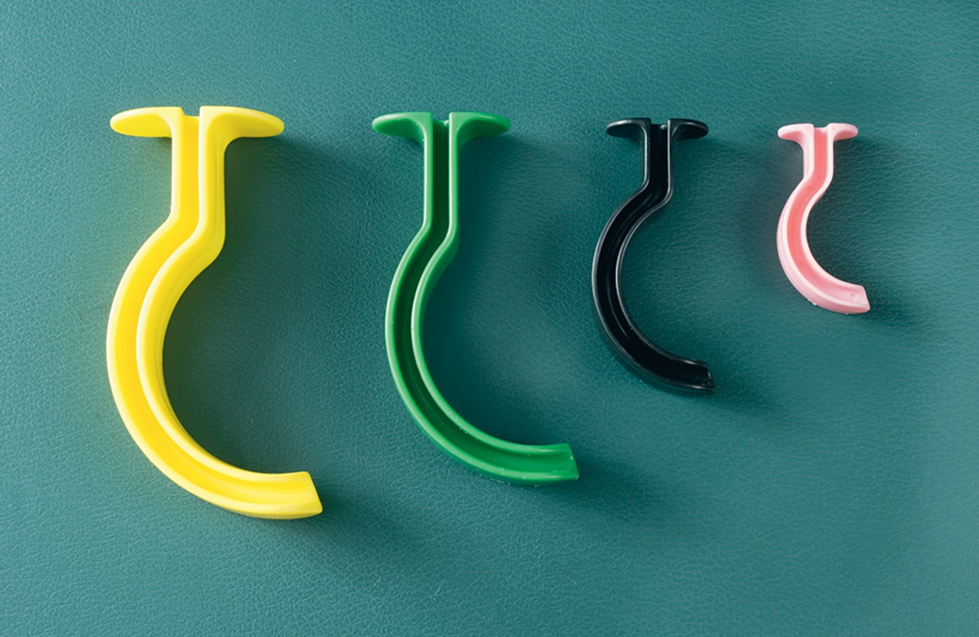
Airway Adjuncts—Oropharyngeal Airway (2 of 9)
Oropharyngeal airways.
Notes:
Covers Objective: 9.4

Slide 42
Airway Adjuncts—Oropharyngeal Airway (3 of 9)
To determine size, measure the device from the corner of the mouth to the tip of the earlobe on the same side
Alternatively, measure from the center of the mouth to the angle of the lower jaw bone
  Do not use a device unless you have measured and verified size
  If the airway used is too big, air will be directed into the stomach instead of the lungs
Notes:
Covers Objective: 9.4
Discussion Topic: Describe the procedure used to measure and insert an oropharyngeal airway.

Slide 43
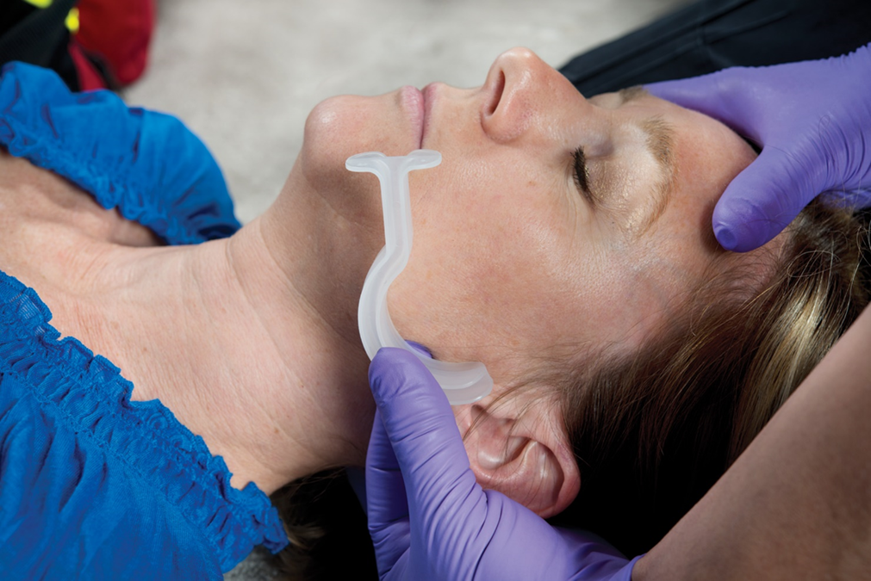
Airway Adjuncts—Oropharyngeal Airway (4 of 9)
Measure from the corner of the patient’s mouth to the tip of the earlobe.
Notes:
Covers Objective: 9.4
Point to Emphasize: Sizing of airway adjuncts is important. The principles are important, but so is the value of sizing adjuncts.
Discussion Topic: Describe the technique for sizing an oropharyngeal airway.

Slide 44
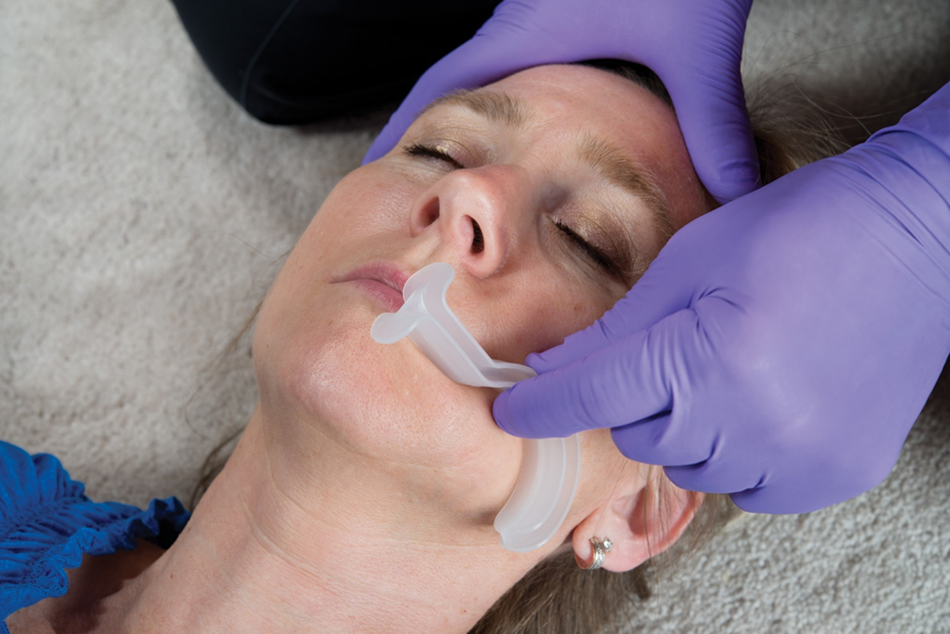
Airway Adjuncts—Oropharyngeal Airway (5 of 9)
Alternatively, measure from the center of the mouth to the angle of the lower jaw bone.
Notes:
Covers Objective: 9.4
Knowledge Application: Ask students why sizing an airway adjunct is important. Discuss their answers.

Slide 45
Airway Adjuncts—Oropharyngeal Airway (6 of 9)
Steps for inserting an O P A:
  Place patient on his back, and use appropriate manual method to open the airway
  Open the mouth with a crossed-finger technique
  Position the airway device with the tip pointing toward roof of mouth
  Insert the device along the roof of the mouth
Notes:
Covers Objective: 9.4
Teaching Tips: Assure the laboratory session has adequate supervision and appropriate equipment and manikins. Allocate the appropriate amount of time, to conduct an efficient psychomotor session. Closely monitor and frequently correct students. Use standardized skill sheets to assess competency when practicing the various methods of measuring and inserting airway adjuncts.

Slide 46
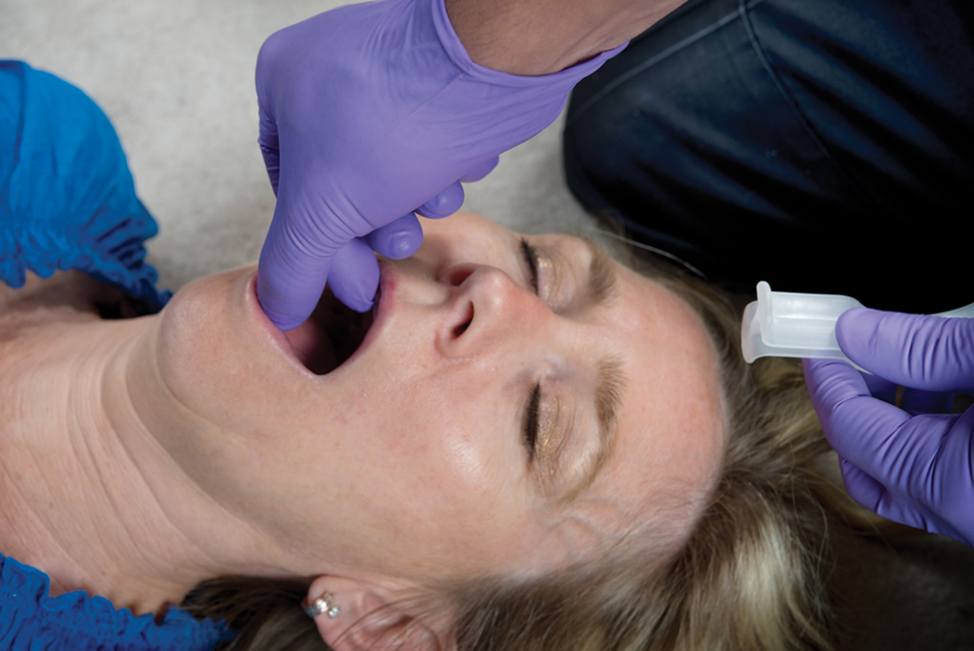
Airway Adjuncts—Oropharyngeal Airway (7 of 9)
Use a crossed-fingers technique to open the patient’s mouth.
Notes:
Covers Objective: 9.4

Slide 47
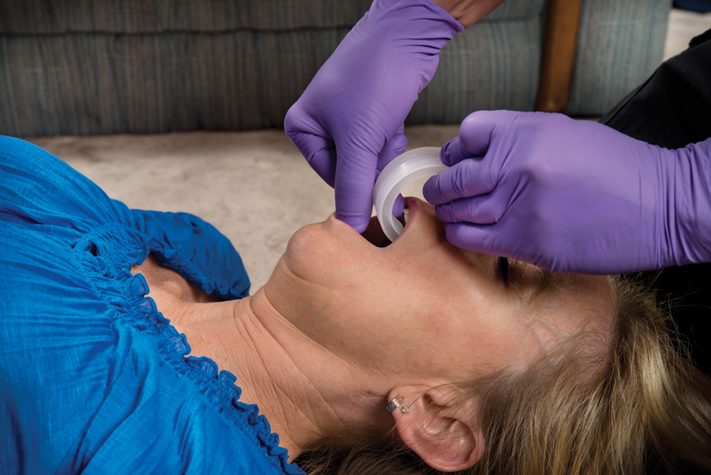
Airway Adjuncts—Oropharyngeal Airway (8 of 9)
Insert the airway with the tip pointing to the roof of the patient’s mouth.
Notes:
Covers Objective: 9.4

Slide 48
Airway Adjuncts—Oropharyngeal Airway (9 of 9)
Steps for inserting an O P A:
  Gently rotate airway 180 degrees so the tip is pointing down into patient’s pharynx
  Position the patient
  Check that the flange of the airway is against the patient’s lips
  Monitor the patient closely
Notes:
Covers Objective: 9.4

Slide 49
Airway Adjuncts—Nasopharyngeal Airway (1 of 6)
A N P A is used when there is an intact gag reflex, teeth are clenched, or there are oral injuries
May be contraindicated with basilar skull fracture, epistaxis, or nasal trauma
Soft, flexible airways should be used in the field rather than rigid, clear plastic airways
Notes:
Covers Objective: 9.4
Critical Thinking Discussion: In what type of situation would a nasopharyngeal airway be more appropriate than an oropharyngeal airway?

Slide 50
Airway Adjuncts—Nasopharyngeal Airway (2 of 6)
Steps for inserting a N P A:
  Measure for correct size from nostril to the tip of the earlobe or the angle of the jaw
  Lubricate the outside of the tube with water-based lubricant before insertion
  Push the tip of the nose upward and insert the airway
    Keep the head in a neutral position
    Point the bevel toward the base of the nostril or toward the septum
Notes:
Covers Objective: 9.4

Slide 51
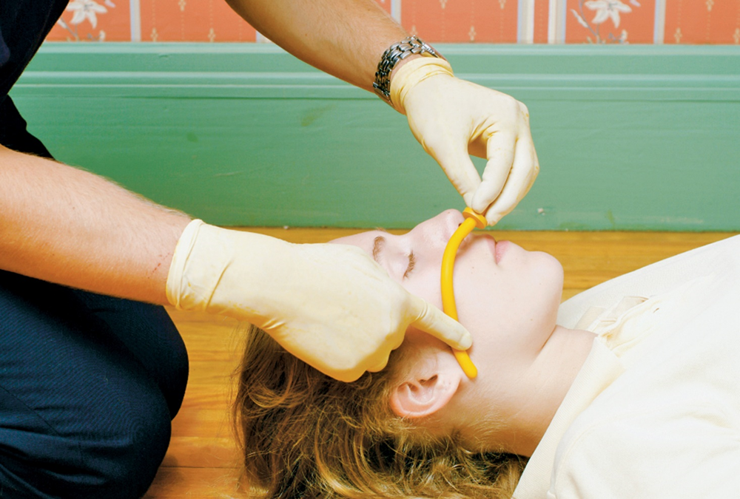
Airway Adjuncts—Nasopharyngeal Airway (3 of 6)
Measure the nasopharyngeal airway from the patient’s nostril to the tip of the earlobe or to the angle of the jaw.
Notes:
Covers Objective: 9.4
Critical Thinking Discussion: What are the limitations of airway adjuncts? Describe a scenario in which the adjuncts might not protect the airway enough.

Slide 52
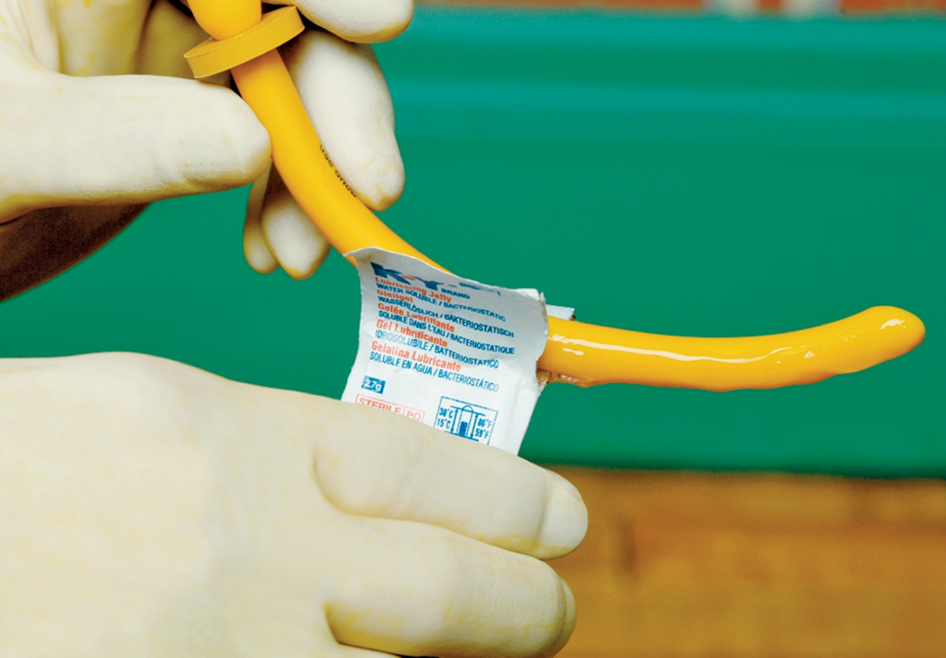
Airway Adjuncts—Nasopharyngeal Airway (4 of 6)
Apply a water-based lubricant before insertion.
Notes:
Covers Objective: 9.4

Slide 53
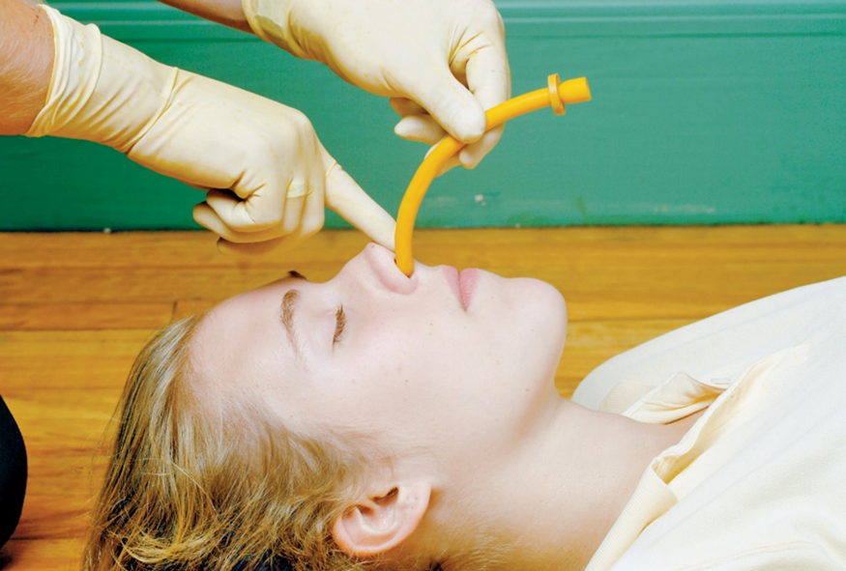
Airway Adjuncts—Nasopharyngeal Airway (5 of 6)
Gently push the tip of the nose upward, and insert the airway with the beveled side toward the base of the nostril or toward the septum (wall that separates the nostrils). Insert the airway, advancing it until the flange rests against the nostril.
Notes:
Covers Objective: 9.4
Discussion Topic: Describe the procedure for inserting a nasopharyngeal airway.
Class Activity: Using an airway manikin, demonstrate the proper sizing and insertion technique for both an oropharyngeal and a nasopharyngeal airway.

Slide 54
Airway Adjuncts—Nasopharyngeal Airway (6 of 6)
Steps for inserting a N P A:
  Insert into the nostril
    Advance along the floor of the nasopharynx
    The flange should rest firmly against the nostril
Notes:
Covers Objective: 9.4

Slide 55
Airway Adjuncts—Supraglottic Airway (1 of 3)
Supraglottic airways isolate the glottic opening by occupying space in the larynx and hypopharynx
Airways are indicated when other, basic measures have failed
May also be used if the airway must be maintained over a long period
Specific insertion steps vary by airway manufacturer
Notes:
Covers Objective: 9.4
Teaching Tips: Explain to students that many systems now allow EMTs to insert supraglottic airways, but these devices are not universally allowed in all EMT scopes of practices. Local protocols should be consulted to determine availability. Point out that there are many types of supraglottic airways and students should always be trained to the manufacturer’s specific standards before attempting to use one. Remind students that an advanced airway—like the supraglottic airway—is not the answer to all airway problems. It is essential for the EMT to use their assessment skills to identify situations where these airways

Slide 56
Airway Adjuncts—Supraglottic Airway (2 of 3)
General steps for inserting a supraglottic airway:
  Prepare the patient
    Attempt simple procedures first
    If these fail, position the patient’s head
    Preoxygenate the patient
  Prepare the team
    Discuss roles and responsibilities
    Assign suction, assessment, and equipment duties
Notes:
Covers Objective: 9.4

Slide 57
Airway Adjuncts—Supraglottic Airway (3 of 3)
General steps for inserting a supraglottic airway:
  Prepare the device
    Size the device per manufacturer’s instructions
    Attach and check any required inflation devices
    Prepare suction
Notes:
Covers Objective: 9.4

Slide 58
Suctioning
Back to Topics
Notes:
Teaching Time: 40 minutes
Teaching Tip: Link the decision to suction to assessment findings. Attempt to create reality-based decisions. Assure proper supervision in practical skill stations. Imprint correct techniques early.

Slide 59
Suctioning—Using Gravity to Clear an Airway
Foreign materials that remain in the airway may be forced into the trachea and lungs, causing complications
Gravity can be used to clear fluids from the mouth by turning the patient to one side and allowing fluids to drain
  This is fast compared to technical alternatives
  It can be done while devices are being prepared
  It cannot be done with spinal injuries or when there is a single responder
When using gravity, always turn the patient away from your body
Notes:
Covers Objective: 9.4
Teaching Tips: Explain to students that the lateral recumbent position and gravity may also enhance the capability of suction devices. Point out that in the case of high-volume liquid obstruction, it may be reasonable to turn the patient to one side while utilizing a suction device.

Slide 60
Suctioning—Suctioning Devices (1 of 7)
Suctioning uses a vacuum device to remove foreign materials from the airway
A patient with fluid or secretions present or a gurgling sound should be suctioned immediately
Each suction unit includes:
  Suction source
  Collection container
  Tubing
  Suction tips or catheters
Notes:
Covers Objective: 9.4
Teaching Tips: Assure the laboratory session has adequate supervision and appropriate equipment and manikins. Allocate the appropriate amount of time, to conduct an efficient psychomotor session. Closely monitor and frequently correct students. Use standardized skill sheets to assess competency when practicing the various methods of suctioning.

Slide 61
Suctioning—Suctioning Devices (2 of 7)
Vehicle mounted or on-board suction units:
  Create a suctioning vacuum using the engine’s manifold or an electrical power source
  Must furnish an air intake of at least 30 liters per minute at the end of the collection tube
  Must generate a vacuum of no less than 300 m m H g when collecting tube is clamped
Notes:
Covers Objective: 9.4
Point to Emphasize: Both portable and mounted suction devices exist. Various types of tips and catheters enable suctioning under different circumstances.
Knowledge Application: Tour an ambulance or a hospital. Identify the various types of suction devices.

Slide 62
Suctioning—Suctioning Devices (3 of 7)
Portable suction units:
  May be oxygen or air-powered, electrically powered, or manual
  Must provide an amount of suction identical to that of an on-board unit
Notes:
Covers Objective: 9.4
Discussion Topic: Compare and contrast the capabilities and limitations of portable suction devices compared to wall-mounted units.

Slide 63
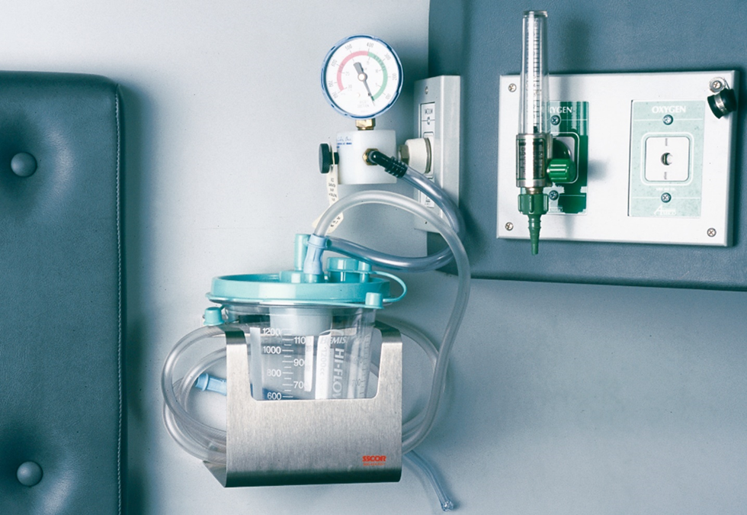
Suctioning—Suctioning Devices (4 of 7)
A mounted suction unit installed in the ambulance’s patient compartment.
Notes:
Covers Objective: 9.4

Slide 64
Suctioning—Suctioning Devices (5 of 7)
Operation of a suction unit requires:
  Tubing
  Suction tips
  Suction catheters
  Collection container
  Container of clean or sterile water
Notes:
Covers Objective: 9.4

Slide 65
Suctioning—Suctioning Devices (6 of 7)
The most popular suction tip is the rigid pharyngeal tip, also called a Yankauer or tonsil tip
  It allows mouth and pharyngeal suction with excellent device control
  It has a larger bore than more flexible catheters
  It is most successful with unresponsive patients
Suction catheters are flexible plastic tubes
  Come in sizes identified by a number “French”
  Designed for use in situations when a rigid tip cannot
Notes:
Covers Objective: 9.4
Critical Thinking Discussion: In what type of situation would a suction catheter be more appropriate than a rigid tip suction device?
Discussion Topics: Describe the requirements of the suction procedure. Compare and contrast the two different types of suction catheters. Describe the procedure used to suction an airway.
Class Activities: (Skill Demonstration) Referring to a standardized skill competency sheet, and using an airway manikin, demonstrate the proper procedure for suctioning an airway.

Slide 66
Suctioning—Suctioning Devices (7 of 7)
The collection container should be non-breakable and easily removable
The water container is used to clear partially blocked tubing
Notes:
Covers Objective: 9.4

Slide 67
Suctioning—Pediatric Suctioning
Infants are very sensitive to vagal stimulation from catheter contact with the hypopharynx
  They respond with a slowing of the heart rate
  Minimize the necessary suctioning time and take care to avoid hypopharyngeal contact
  Bulb syringe suctioning is common in infants and small children
  It is very effective in clearing small airways
Used in child birth and when infants experience respiratory distress
Notes:
Covers Objective: 9.4
Teaching Tip: Remind students that, for the most part, suctioning in pediatrics is not very different than suctioning for adults. Point out that both rigid and flexible suction catheters come in pediatric sizes.

Slide 68
Suctioning—Suctioning Techniques (1 of 2)
Always use appropriate infection control practices while suctioning
When possible, limit suctioning to no longer than 10 seconds at a time
Place tip or catheter where you want to begin suctioning and suction on the way out
Suction is best delivered with the patient on his side
Suction devices may activate the gag reflex or stimulate vomiting
Notes:
Covers Objective: 9.4
Teaching Tips: Assure the laboratory session has adequate supervision and appropriate equipment and manikins. Allocate the appropriate amount of time, to conduct an efficient psychomotor session. Closely monitor and frequently correct students. Use standardized skill sheets to assess competency when practicing the various methods of suctioning.
Discussion Topics: Describe the requirements of the suction procedure. Describe the procedure used to suction an airway.
Class Activity: (Skill Demonstration) Referring to a standardized skill competency sheet, and using an airway manikin, demonstrate the proper procedure for suctioning an airway.

Slide 69
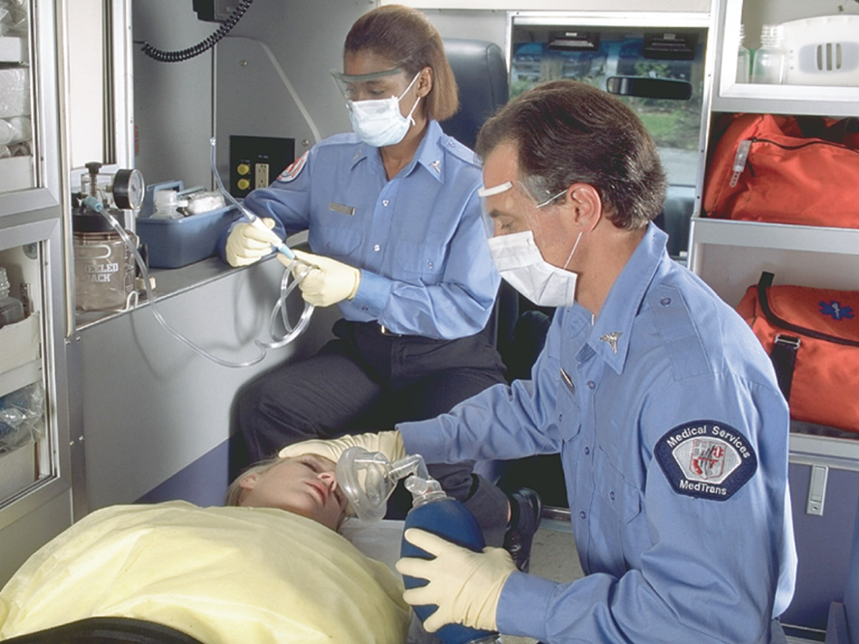
Suctioning—Suctioning Techniques (2 of 2)
For long description, see slide 88: Appendix 4
Position yourself at the patient’s head and turn the patient’s head or entire body to the side.
Notes:
Covers Objective: 9.4

Slide 70
Keeping an Airway Open: Definitive Care
Back to Topics
Notes:
Teaching Time: 5 minutes
Teaching Tip: This section teaches humility. Encourage providers to recognize when they need help. Use a scenario-based approach. Keep this decision making process steeped in reality.

Slide 71
Keeping an Airway Open: Definitive Care
Keeping the airway open may exceed capabilities of a basic E M T
Rapidly evaluate and treat airway problems
Quickly recognize when more definitive care is needed
  May be Advanced Life Support intercept
  May be closest hospital
Notes:
Covers Objective: 9.4
Teaching Tip: Discuss the EMT’s role within the larger system. This is a good time to open the discussion on tiered response.
Point to Emphasize: An EMT must understand his limitations, constantly evaluate for the need of further intervention, and know the availability of advanced resources.
Discussion Topics: Describe airway-related circumstances in which advanced intervention is necessary. Discuss the indications for requesting advanced life support in the context of an airway problem.

Slide 72
Special Considerations
Back to Topics
Notes:
Teaching Time: 5 minutes
Teaching Tip: Multimedia graphics of facial injuries may enhance comprehension of special ventilatory circumstances.

Slide 73
Special Considerations (1 of 2)
Facial injuries
  Bleeding may require frequent suctioning
  An airway adjunct or endotracheal tube may be needed
Obstructions
  Suction units are not adequate for removing solid objects
  Use abdominal thrusts, chest thrusts, or finger sweeps
Notes:
Covers Objective: 9.4
Point to Emphasize: Facial injuries may impair breathing and alter the procedure for opening the airway.
Discussion Topic: Discuss how a facial injury or airway obstruction might interfere with your ability to provide artificial ventilation.
Knowledge Application: Provide examples of facial injuries (and/or show graphics) and discuss methods to properly assess and manage the airway. Specifically highlight how such injuries might alter normal procedures. Divide the class into small groups. Assign each group a special consideration such as a facial injury, a pediatric patient, dentures, and so on. Have each group discuss the potential challenges, improvise a solution, and present its findings to the class.

Slide 74
Special Considerations (2 of 2)
Dental appliances
  Dentures should be left in place during airway procedures
  Partial dentures may become dislodged during an emergency
  Be prepared to remove a device if it endangers the airway
Notes:
Covers Objective: 9.4
Point to Emphasize: Dental appliances should be left in place, but they potentially can threaten airway management. If they interfere with the airway, they should be removed.
Critical Thinking Discussion: In this section we highlighted some specific circumstances that might make artificial ventilations and supplemental oxygen delivery more difficult. There are many other difficult situations. What others can you think of? Discuss.

Slide 75
Chapter Review

Slide 76
Chapter Review (1 of 2)
The airway is the passageway by which air enters the body during respiration, or breathing.
A patient cannot survive without an open airway.
Airway adjuncts—the oropharyngeal and nasopharyngeal airways—can help keep the airway open.

Slide 77
Chapter Review (2 of 2)
It may be necessary to suction the airway or to use manual techniques to remove fluids and solids from the airway before, during, or after artificial ventilation.

Slide 78
Remember
Always use proper personal protective equipment when managing an airway.
Airway assessment must be an ongoing process. Airway status can change over time.
Airway management should start simply and become more complicated only if necessary.

Slide 79
Questions to Consider (1 of 2)
Name the main structures of the airway.
Explain why care for the airway is the first priority of emergency care.
Describe the signs of an inadequate airway.
Notes:
Talking Points: The airway begins at the nose and mouth, continues through the oropharynx, nasopharynx, and hypopharynx, and then enters the lower airway via the glottic opening and travels through the lungs through the right and left bronchi and bronchiole tubes. The airway terminates at the alveoli.
The airway is the first priority of care because without oxygen, death is assured.
Signs of an inadequate airway include inability to speak, stridor, no air movement, and gurgling.

Slide 80
Questions to Consider (2 of 2)
Explain when the head-tilt, chin-lift maneuver should be used and when the jaw-thrust maneuver should be used to open the airway—and why.
Explain how airway adjuncts and suctioning help in airway management.
Notes:
Talking Points: The head-tilt, chin-lift causes the neck and c-spine to move. The jaw-thrust minimizes neck movement.
Adjuncts help create a channel for air into the lungs. They help direct air to the proper place. Suctioning clears liquids out of the path of air and prevents aspiration of those liquids into the lungs.

Slide 81
Critical Thinking (1 of 3)
On arrival at the emergency scene, you find an adult female patient with gurgling sounds in the throat and inadequate breathing slowing to almost nothing. How do you proceed to protect the airway?
Notes:
Talking Points: Gurgling indicates suctioning. Other necessary treatments include position, insertion of an airway adjunct, and positive pressure ventilation.

Slide 82
Critical Thinking (2 of 3)
When evaluating a small child you hear stridor. What does this sound tell you? What are your immediate concerns regarding this sound?
Notes:
Talking Points: Stridor indicates a partially obstructed airway. Immediate concerns include the fact that this airway is threatened and could become completely obstructed.

Slide 83
Critical Thinking (3 of 3)
When assessing an unconscious patient, you note snoring respirations. Should you be concerned with this and, if so, what steps can you take to correct this situation?
Notes:
Talking Points: Snoring indicates at least airway impedance, and at worst poor muscle control of the airway. Typically, better positioning and/or insertion of an airway adjunct will resolve this problem.

Slide 84

Copyright
This work is protected by United States copyright laws and is provided solely for the use of instructors in teaching their courses and assessing student learning. Dissemination or sale of any part of this work (including on the World Wide Web) will destroy the integrity of the work and is not permitted. The work and materials from it should never be made available to students except by instructors using the accompanying text in their classes. All recipients of this work are expected to abide by these restrictions and to honor the intended pedagogical purposes and the needs of other instructors who rely on these materials.

Slide 85
Appendix 1
The diagram depicts a cross section of a human head and neck with labeled components of the upper airway. Paranasal sinuses are located around eye level on the left and right side of the head. The nasal cavity is in line with the nose. The nasopharynx is below the nasal cavity and includes the pharyngeal tonsil, Eustachian tube, hard palate, and soft palate. Below the nasopharynx is the oropharynx which includes the palatine tonsil and tongue. The mandible, or lower jawbone, is in line with the oropharynx on the front side of the face and the hyoid bone is in line with the base of the mandible. Below the oropharynx is the laryngopharynx which includes the epiglottis and vocal chords. On the front side of the larynx are the thyroid cartilage, cricoid cartilage, and thyroid gland. Below the larynx are the Esophagus and trachea.
Return to presentation

Slide 86
Appendix 2
The lower airway begins with the larynx and the trachea in the throat. The trachea leads into the lungs and branches into the right main stem bronchus and the left main stem bronchus. The carina, which is part of the trachea, runs between the two main stem bronchi. Secondary bronchus and tertiary bronchus are attached to the main stem bronchi with bronchiole located at the outermost tip of the tertiary bronchi.
Return to presentation

Slide 87
Appendix 3
The following points describe the features of a child’s nose, tongue, trachea, cricoid cartilage, and airway structures.
A child has smaller nose and mouth.
In child, more space is taken up by tongue.
Child’s trachea is narrower.
Cricoid cartilage is less rigid and less developed.
Airway structures are more easily developed.
Return to presentation

Slide 88
Appendix 4
An E M T turns a patient’s head to the side while holding an oxygen mask toward her face as another E M T sits behind the patient holding a catheter attached to a mounted suction unit.
Return to presentation

