Slide 1
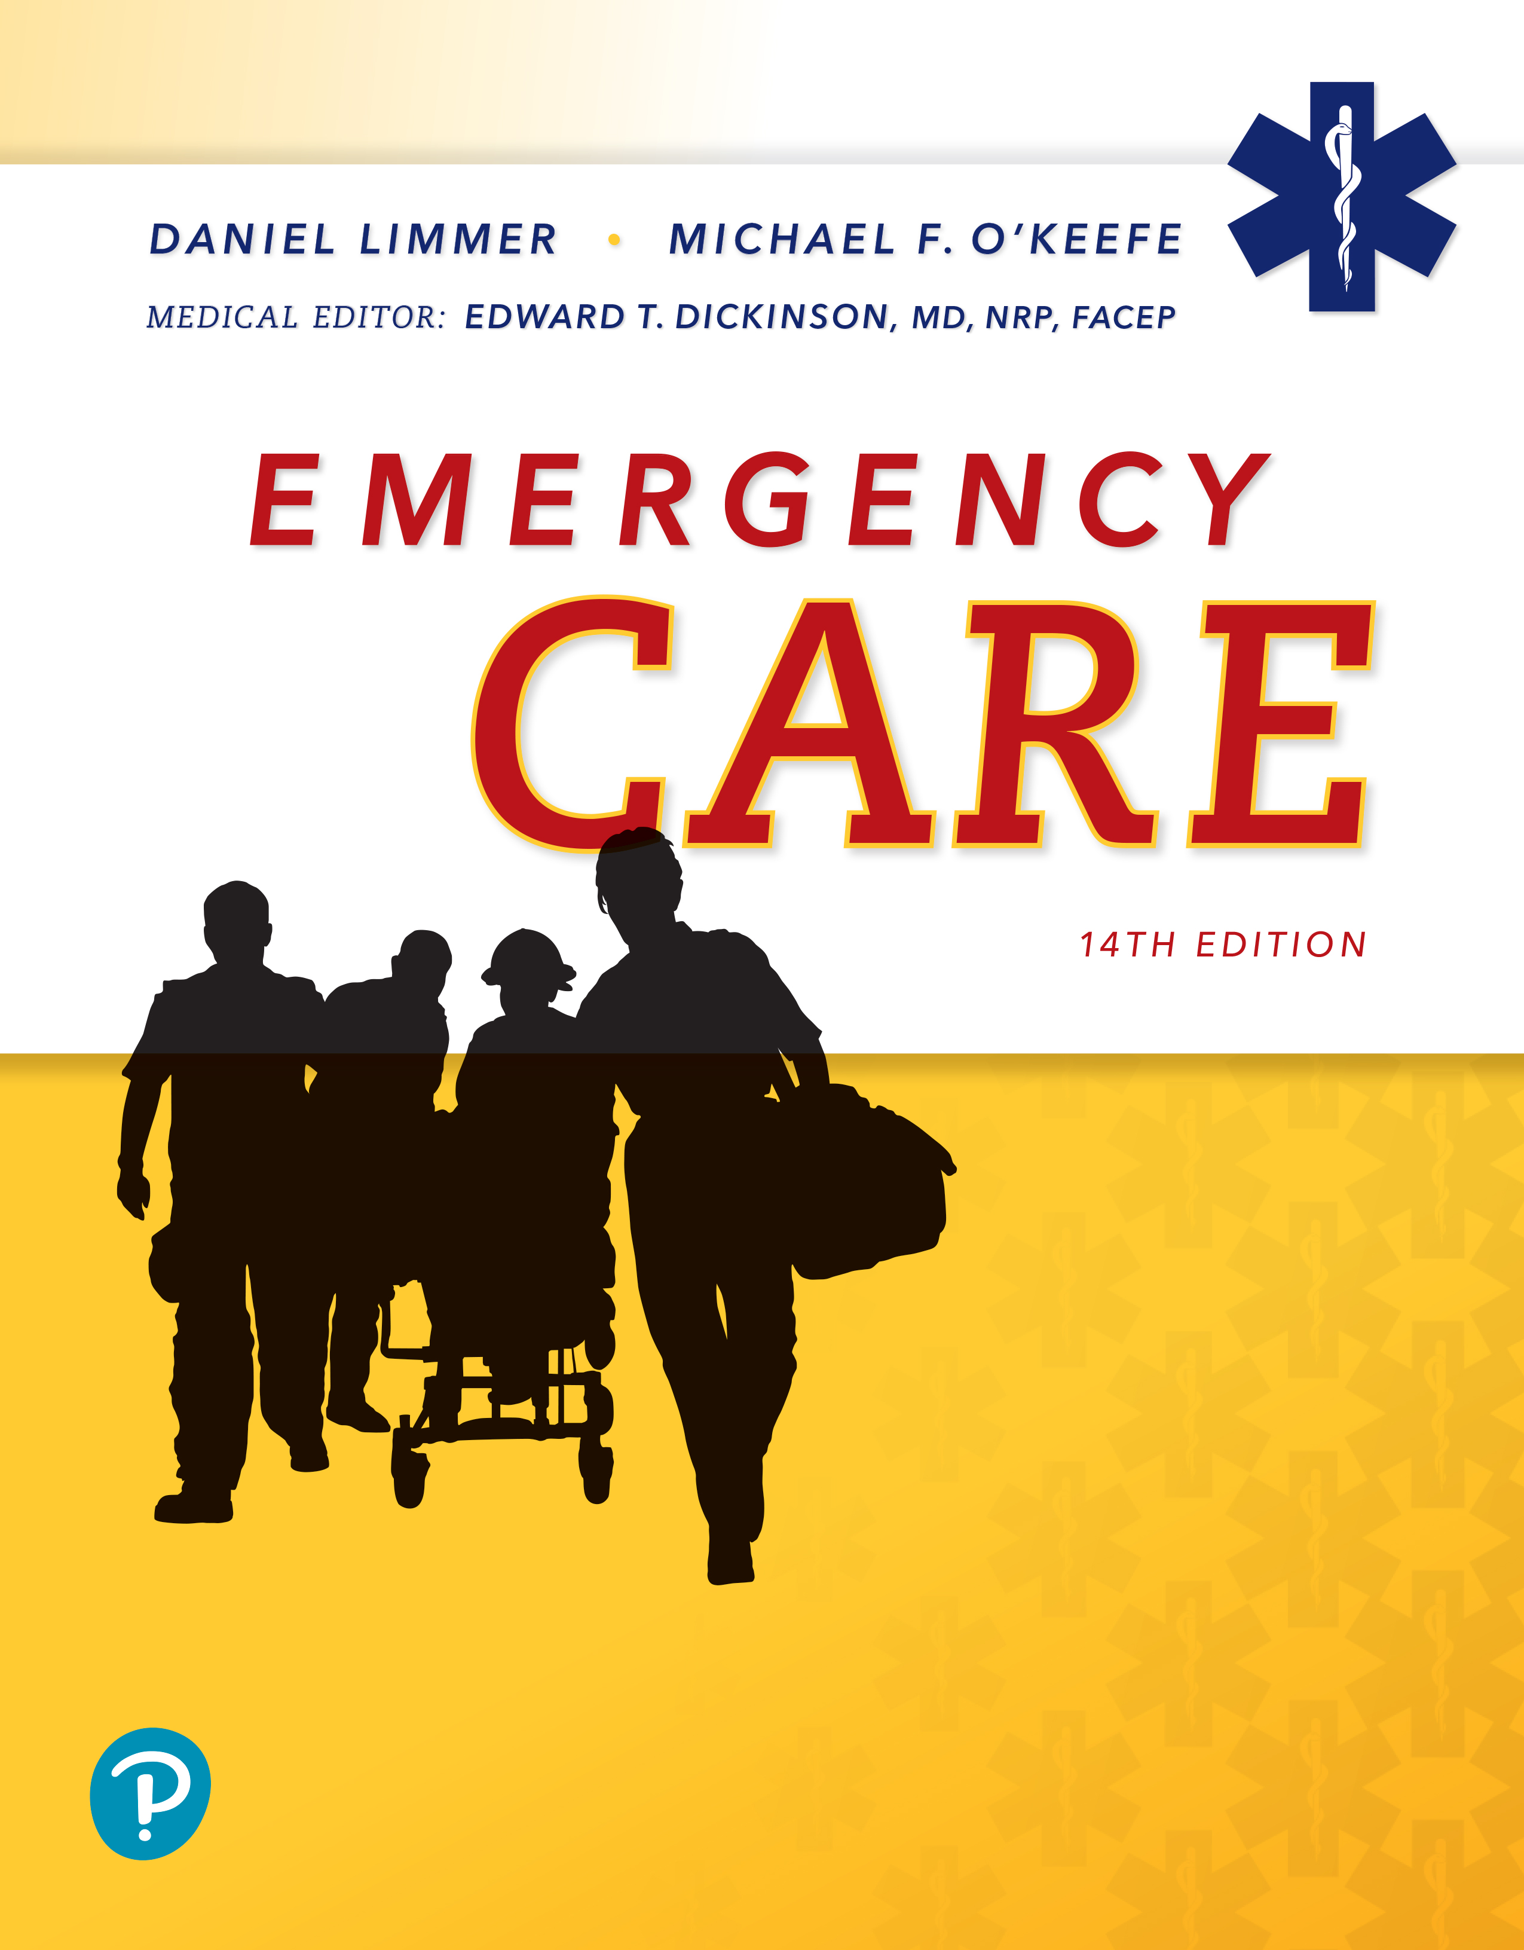
Emergency Care
Fourteenth Edition
Chapter 29
Bleeding and Shock
Slides in this presentation contain hyperlinks. JAWS users should be able to get a list of links by using INSERT+F7
Copyright © 2021, 2016, 2012 Pearson Education, Inc. All Rights Reserved
Notes:
If this PowerPoint presentation contains mathematical equations, you may need to check that your computer has the following installed:
1) MathType Plugin
2) Math Player (free versions available)
3) NVDA Reader (free versions available)

Slide 2
Topics
The Circulatory System
Shock
Bleeding
Notes:
Planning Your Time: Plan 90 minutes for this chapter.
The Circulatory System (20 minutes)
Shock (30 minutes)
Bleeding (40 minutes)
Note: The total teaching time recommended is only a guideline.
Core Concepts:
Signs, symptoms, and care of a patient with shock
How to recognize arterial, venous, and capillary bleeding
How to evaluate the severity of external bleeding
How to control external bleeding
Signs, symptoms, and care of a patient with internal bleeding

Slide 3
The Circulatory System
Back to Topics
Notes:
Teaching Time: 20 minutes
Teaching Tips: Relate this lesson to the material learned in the “Principles of Pathophysiology” chapter. Consider the basic requirements of cells when reviewing the function of the circulatory system. Spend time clarifying the need for perfusion. Other lessons depend on a fundamental understanding of this concept.

Slide 4
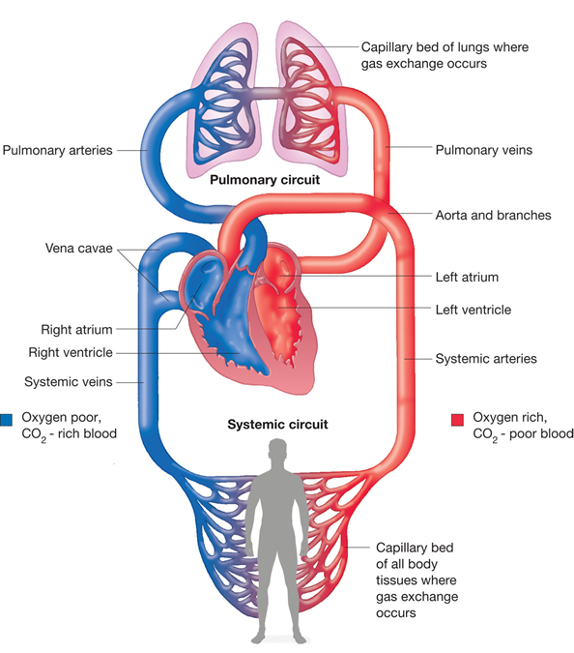
Circulatory System
For long description, see slide 85: Appendix 1
The circulatory system.
Notes:
Covers Objective: 29.1
Discussion Topics: Describe the role of the circulatory system. What functions does it provide to the body? Describe the components of the circulatory system. What role does each component play within the system?
Knowledge Applications: Have students label the components of the circulatory system on a blank illustration. Ask students to describe the basic function of each component.

Slide 5
Main Components (1 of 7)
Heart
Blood vessels
Blood
Notes:
Covers Objective: 29.1

Slide 6
Main Components (2 of 7)
Heart
  Job is to pump blood
    Supplies oxygen and nutrients to body’s cells
    Must pump at an adequate rate and rhythm
Notes:
Covers Objective: 29.1

Slide 7
Main Components (3 of 7)
Arteries
  Carry oxygenated blood away from the heart
  Have thick, muscular walls that enable dilation and constriction
Notes:
Covers Objective: 29.1

Slide 8
Main Components (4 of 7)
Capillaries
  Microscopic blood vessels
  Vital exchange site
    Oxygen, nutrients passed through capillary walls in exchange for carbon dioxide from cells
Notes:
Covers Objective: 29.1

Slide 9
Main Components (5 of 7)
Veins
  Carry oxygen-depleted blood rich in carbon dioxide back to the heart
  Contain one-way valves to prevent back flow of blood
Notes:
Covers Objective: 29.1

Slide 10
Main Components (6 of 7)
Functions of blood
  Transportation of gases
  Nutrition
  Excretion
  Protection
  Regulation
Notes:
Covers Objective: 29.1

Slide 11
Main Components (7 of 7)
Perfusion
  Adequate circulation of blood throughout body
Hypoperfusion
  Inadequate perfusion of body’s tissues and organs
Notes:
Covers Objective: 29.1
Talking Points: Perfusion is the adequate filling of the body's capillaries, supplying cells and tissues with oxygen and nutrients. Hypoperfusion results when some cells and organs do not receive adequate oxygen, which causes a dangerous build up of waste in the cells.
Discussion Topic: What are the implications of inadequate perfusion?
Class Activity: Role-play the circulatory system. Assign specific roles and have students act out the normal function of a circulatory system.
Critical Thinking Discussion: What role does the pulmonary system play with regard to the normal function of the circulatory system? Describe how the two are linked.

Slide 12
Shock
Back to Topics
Notes:
Teaching Time: 30 minutes
Teaching Tips: Review anatomy and physiology of the cardiovascular system. Shock becomes much clearer with it is framed against normal perfusion. Teach compensation. If a student understands how the body compensates, he can relate signs and symptoms. This also works the other way: If a student sees signs and symptoms, he can predict the level of compensation.

Slide 13
Shock
Inadequate tissue perfusion
If hypoperfusion persists, cells and organs will die.
Notes:
Covers Objective: 29.2
Point to Emphasize: Shock is defined as inadequate tissue perfusion.

Slide 14
Pathophysiology of Shock
Four causes
  Volume problems
  Pump problems
  Blood vessel tone problems
  Obstruction of blood flow
Notes:
Covers Objective: 29.2
Discussion Topic: Discuss the main causes of shock. How are they different? How are they similar?

Slide 15
Volume Problems
Hypovolemia
  Blood is lost (absolute hypovolemia)
  Plasma is removed from circulatory system (relative hypovolemia)
  Not enough blood volume in the blood vessels, so pressure falls
  Both absolute and relative hypovolemia are called hypovolemic shock
  Hemorrhagic shock is loss of blood
Notes:
Covers Objective: 29.2

Slide 16
Pump Problems
Caused by failure of the heart to pump blood
Usually related to a mechanical problem of the heart
Blood cannot be moved because of a drop in blood pressure
Categorized as cardiogenic shock
Notes:
Covers Objective: 29.2

Slide 17
Blood Vessel Tone Problems
All blood vessels dilate at the same time
  Blood cannot fill entire circulatory system
  Referred to as distributive shock
Types of distributive shock
  Anaphylactic shock
  Neurogenic shock
  Septic shock
Notes:
Covers Objective: 29.2
Knowledge Application: Assign small groups examples of anaphylactic and obstructive shock. Have groups research the pathophysiology, signs and symptoms, and appropriate treatments. Discuss.

Slide 18
Obstruction of Blood Flow
Blood flow is blocked
  Called obstructive shock
Caused by conditions such as:
  Pulmonary embolism
  Cardiac tamponade
  Tension pneumothorax
Notes:
Covers Objective: 29.2

Slide 19
Fight or Flight
Baroreceptors stimulate release of epinephrine and norepinephrine
  Blood vessels constrict
  Skin becomes cool and pale
  Skin becomes sweaty
  Kidneys produce less urine
  Nausea and vomiting
  Increased heart rate and contractility
Notes:
Covers Objective: 29.2
Discussion Topic: What effect does shock have on the body?

Slide 20
Compensation
Body senses the decrease in perfusion and attempts to compensate for it.
Compensation aims to restore blood flow.
  Regulation of volume
  Vasoconstriction
  Cardiopulmonary response
Compensatory actions collectively called compensated shock.
Notes:
Covers Objective: 29.2
Discussion Topic: Explain how the body compensates for hypoperfusion. What steps does it take, and how will these steps be noticeable in your patient?
Class Activity: Discuss cell hypoperfusion. Ask the class what steps the body might take to compensate for this problem. How will the body save itself?

Slide 21
Pediatric Note
Infants and children
  Efficient compensating mechanisms maintain blood pressure until half of volume is depleted
Never wait for a drop in blood pressure to identify shock in pediatric patients.
Pediatric patients rely on heart rate to compensate for shock.
  Fast heart rates are a key indicator of shock.
Notes:
Covers Objective: 29.2

Slide 22
Decompensation
Compensated shock requires more fuel.
When muscles run out of fuel for compensation, compensated shock becomes decompensated shock.
Indicators of decompensation
  Drop in blood pressure
  Mental status changes
  Slow heart rate
  Slow respiratory rate
Notes:
Covers Objective: 29.2
Critical Thinking Discussion: What can be done to assist compensation and prevent decompensation in a shock patient?
Knowledge Application: Ask small groups to discuss the long-term effects of compensation. Why does it eventually lead to decompensation? Are their lasting effects?

Slide 23
Irreversible Shock and Death
Prolonged vasoconstriction will lead to organ-system damage and death over time.
As organs begin to fail, irreversible shock begins.
Often results in apnea and cardiac arrest.
Notes:
Covers Objective: 29.2
Class Activity: Describe some signs and symptoms of a shock patient. Have students tell you what stage of shock the patient is experiencing.

Slide 24
Patient Assessment (1 of 11)
Identify underlying problem
Recognize compensation
Scene survey for mechanism of injury/illness
Primary assessment
Notes:
Covers Objective: 29.2

Slide 25
Patient Assessment (2 of 11)
Airway
  Correct airway problems immediately
Breathing
  Never allow patient to become or remain hypoxic
  Treat hypoxia with supplemental oxygen
Notes:
Covers Objective: 29.2

Slide 26
Patient Assessment (3 of 11)
Circulation
  Skin color
  Distal pulses
  Capillary refill time
  Heart rate
Treat problems found in primary assessment immediately
Identify shock by trends in vital signs
Notes:
Covers Objective: 29.2

Slide 27
Patient Assessment (4 of 11)
Physical examination
  Identify conditions that are associated with shock
History taking in secondary assessment
  Mechanism of injury
  History of present illness
  Chief complaint
Notes:
Covers Objective: 29.2

Slide 28
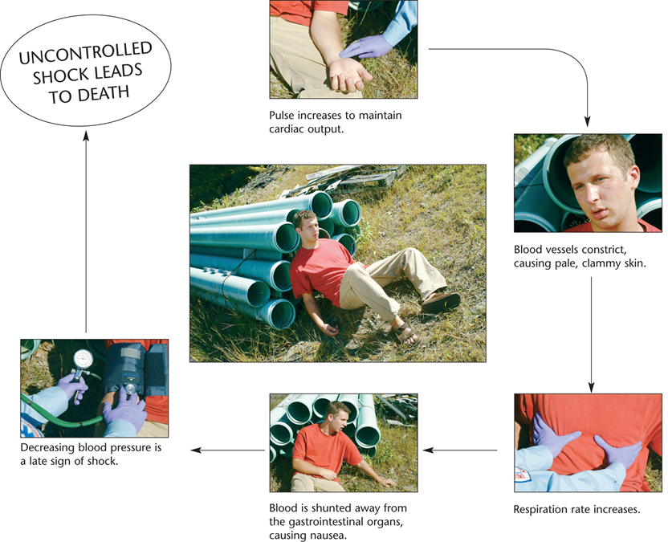
Signs of Shock
For long description, see slide 86: Appendix 2
Signs of shock will be detectable during the patient assessment.
Notes:
Covers Objective: 29.2
Knowledge Application: Assign small groups a component of the cardiovascular system. Ask them to discuss how that component is affected by shock and subsequent compensation. What changes occur?

Slide 29
Treating Shock (1 of 3)
Treatment depends on underlying cause.
Best way to resolve hypoperfusion is to stop whatever is causing it.
  May mean surgery
Use primary assessment to identify urgent interventions.
Use patient assessment to identify treatment needs.
Notes:
Covers Objective: 29.3
Critical Thinking Discussion: Review the Think Like an EMT feature with students and encourage discussion.

Slide 30
Treating Shock (2 of 3)
Deadly triad of trauma
  Acidosis
  Hypothermia
  Coagulopathy
Notes:
Covers Objective: 29.3

Slide 31
Treating Shock (3 of 3)
Treatment of deadly triad
  Initiate transport to an appropriate destination
  Prevent hypoxia
  Prevent heat loss
  Consider shock positioning
  Consider advanced life support (A L S)
Notes:
Covers Objective: 29.3

Slide 32
Patient Care (1 of 4)
Initiate rapid transport to an appropriate destination
Manage specific underlying causes of shock
Manage the airway and breathing to prevent hypoxia.
Take steps to prevent heat loss.
Place patient in supine position.
Request A L S.
Notes:
Covers Objective: 29.3
Knowledge Application: Use programmed patients to create shock scenarios. Have teams practice assessment and treatment.

Slide 33
Bleeding
Back to Topics
Notes:
Teaching Time: 40 minutes
Teaching Tips: Use multimedia graphics to illustrate the different types of bleeding. Have personal protective equipment (PPE) on hand. Demand appropriate protective equipment, even when practicing. Have bleeding control equipment on hand for practice. Unless it is massive in nature, bleeding likely will be a lower priority than airway and breathing. However, bleeding is often distracting. Emphasize an appropriate progression through the primary assessment. Instill a fear of internal bleeding. Make sure students know that it is impossible to estimate and is potentially deadly.

Slide 34
Types of Bleeding
Hemorrhage is severe bleeding.
  Major cause of shock (hypoperfusion) in trauma
External
Internal
Notes:
Covers Objective: 29.4

Slide 35
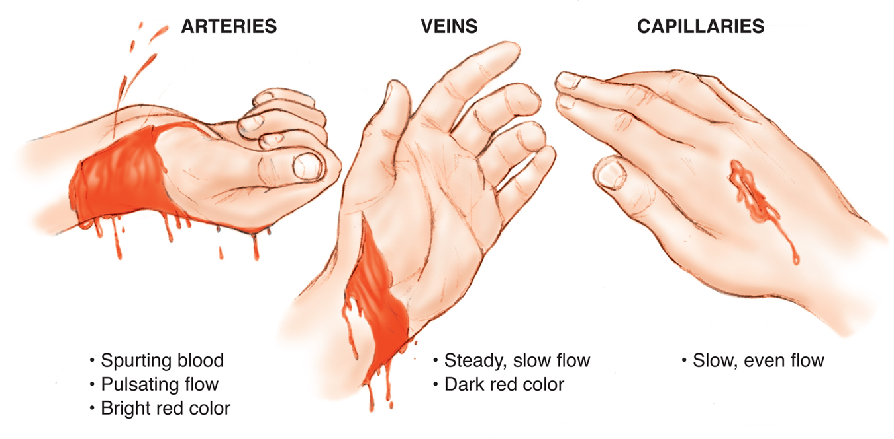
External Bleeding (1 of 2)
For long description, see slide 87: Appendix 3
Three types of external bleeding.
Notes:
Covers Objective: 29.4
Point to Emphasize: External bleeding, or hemorrhage, is bleeding that occurs outside the body. It is typically visible on the surface of the skin.

Slide 36
External Bleeding (2 of 2)
Occurs outside of body after force penetrates skin and lacerates or destroys underlying blood vessels
Typically visible on surface of the skin
How much a person bleeds determined by:
  Size and severity of wound
  Size and pressure of ruptured vessel
  Individual’s ability to clot
Notes:
Covers Objective: 29.4
Point to Emphasize: The severity of external hemorrhage is directly related to the amount of pressure within the ruptured vessel.
Talking Points: Arterial circulation is a high-pressure system inside thick, muscular walls making it most difficult to control. Venous circulation is a low-pressure system that is often lower than atmospheric pressure, which may suck in debris or air bubbles through an open wound.

Slide 37
Massive Hemorrhage (1 of 3)
Arterial bleeding
  Bright red color
  Spurting with heartbeat
  Oxygen rich
Notes:
Covers Objective: 29.4
Discussion Topic: Compare and contrast massive and non-massive bleeding. Include assessment findings.

Slide 38
Massive Hemorrhage (2 of 3)
Venous bleeding
  Darker in color than arterial bleeding
  Less pressure than arterial bleeding
  Volume of blood carried by some veins can create immediately life-threatening hemorrhage
Notes:
Covers Objective: 29.4

Slide 39
Massive Hemorrhage (3 of 3)
Junctional hemorrhage
  Occurs where appendages of the body connect to the trunk
  Large arteries and veins are not well protected
  Injury is likely to cause massive bleeding
Notes:
Covers Objective: 29.4

Slide 40
Other External Hemorrhage (1 of 2)
Capillary bleeding
  Caused by superficial wounds to surface of skin
  Slow and oozing
  Stops spontaneously
All bleeding needs to be stopped
Identifying type of bleeding is almost irrelevant
Notes:
Covers Objective: 29.4

Slide 41
Other External Hemorrhage (2 of 2)
Bleeding can be accelerated by underlying conditions.
  Prescription medications designed to limit body’s natural ability to form blood clots
Hypothermia affects body’s ability to clot.
External hemorrhage can usually be controlled by compressing the tissue around the wound.
Notes:
Covers Objective: 29.4
Discussion Topic: Describe the additional situations in which bleeding can be accelerated.
Critical Thinking Discussion: How might blood-thinning medications change your strategy for bleeding control?

Slide 42
Precautions with External Hemorrhage
Use Standard Precautions
  Gloves
  Mask
  Eyewear
  Gown
Always wash hands after each call.
Notes:
Covers Objective: 29.4

Slide 43
Think About It 1
How severe is the bleeding? Is it a massive hemorrhage? If so, how does that affect the priorities of treatment?
Notes:
Covers Objective: 29.4
Talking Points: Massive hemorrhage is rapidly life threatening, so it must be the first priority.

Slide 44
Patient Assessment (5 of 11)
Identify and control massive hemorrhage within first seconds of primary assessment.
Ensure open airway.
Ensure adequate breathing.
Notes:
Covers Objective: 29.4
Talking Points: Bleeding control comes after airway and breathing assessment in the patient assessment. Standard Precautions are still the first and most important step in every assessment.
Discussion Topic: Describe the primary assessment sequence in a patient with massive bleeding. Contrast the approach to patient assessment in a patient with non-massive bleeding.

Slide 45
Patient Assessment (6 of 11)
Control nonmassive bleeding only after assessing and treating prior elements.
  Be aware of signs or symptoms of shock.
  Do not wait for symptoms of shock to appear before beginning treatment.
Notes:
Covers Objective: 29.4

Slide 46
Patient Care (2 of 4)
Methods of controlling external bleeding
  Direct pressure
  Hemostatic agents
  Wound packing
  Tourniquet use on extremities
  Specialized compression devices for junctional bleeding
Notes:
Covers Objective: 29.4

Slide 47
Controlling External Bleeding
Control of bleeding is essential to preventing shock.
Uncontrolled bleeding can lead to patient death.
Standard Precautions are mandatory.
Observe Standard Precautions and infection control practices when cleaning up after the call.
Notes:
Covers Objective: 29.4

Slide 48
Strategies for External Bleeding Control (1 of 9)
Direct pressure
  Apply firm pressure to wound with the palm of your hand or fingers
  Hold pressure until bleeding is controlled.
  Resist the temptation to apply layers of “absorbent” dressings.
Notes:
Covers Objective: 29.4

Slide 49
Strategies for External Bleeding Control (2 of 9)
Direct pressure
  Once bleeding is controlled, bandage a dressing firmly in place to form a pressure dressing.
  Do not remove a dressing once it has been placed on the wound.
Notes:
Covers Objective: 29.4

Slide 50
Strategies for External Bleeding Control (3 of 9)
Wound packing
  Junctional areas present natural cavities that promote profuse bleeding.
  Direct pressure should be augmented by wound packing.
  Fill void spaces with hemostatic gauze.
Notes:
Covers Objective: 29.4

Slide 51
Strategies for External Bleeding Control (4 of 9)
Wound packing
  Pressure dressing
    Place several gauze pads on wound.
    Hold dressings in place with self-adhering roller bandage wrapped tightly over dressings and above and below wound site.
    Create enough pressure to control bleeding.
Notes:
Covers Objective: 29.4

Slide 52
Strategies for External Bleeding Control (5 of 9)
Hemostatic agents
  Designed to enhance direct pressure’s ability to control bleeding
  Agents come in the form of impregnated gauze or dressings
  Best suited for wound packing
Notes:
Covers Objective: 29.4

Slide 53
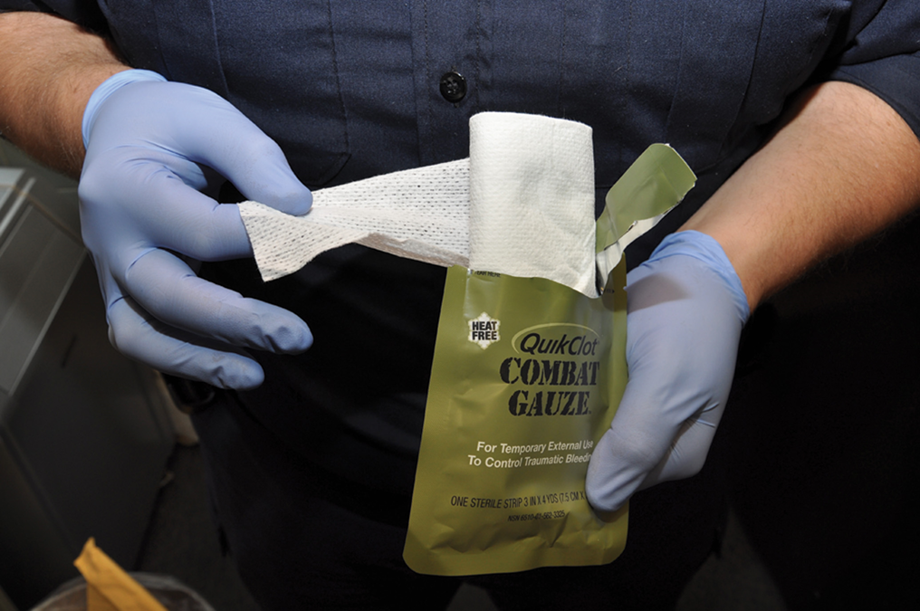
Strategies for External Bleeding Control (6 of 9)
Combat gauze. © Edward T. Dickinson, M D
Notes:
Covers Objective: 29.4
Discussion Topic: Describe the steps used to control external hemorrhage.

Slide 54
Strategies for External Bleeding Control (7 of 9)
Tourniquet
  Closes off all blood flow to and from an extremity.
  Use if bleeding is uncontrollable by direct pressure.
  Use only on extremity injuries.
  Always apply between the wound and the heart.
Notes:
Covers Objective: 29.4
Talking Points: Battlefield testing has shown that tourniquets are useful in bleeding not otherwise controllable and that the average transport time of less than one hour does not pose a severe risk to the long-term outcome. Removing a tourniquet can dislodge clots that have formed, resulting in further blood loss.

Slide 55
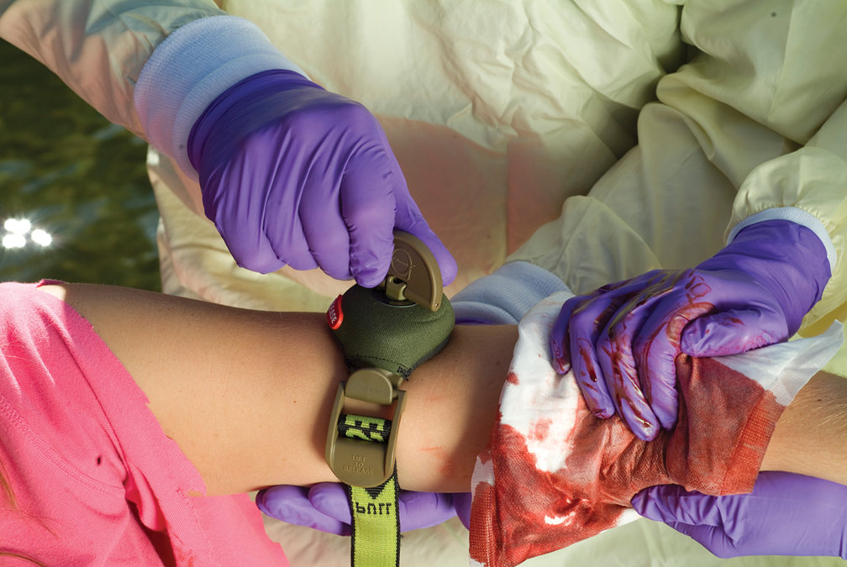
Tourniquet
The Mechanical Advantage Tourniquet (M A T).
Notes:
Covers Objective: 29.4
Talking Points: Battlefield testing has shown that tourniquets are useful in bleeding not otherwise controllable and that the average transport time of less than one hour does not pose a severe risk to the long-term outcome. Removing a tourniquet can dislodge clots that have formed, resulting in further blood loss.

Slide 56
Strategies for External Bleeding Control (8 of 9)
Tourniquet
  Follow manufacturer’s instructions.
  Once applied, do not remove or loosen.
  Attach notation to patient alerting other providers tourniquet has been applied.
Notes:
Covers Objective: 29.4

Slide 57
Strategies for External Bleeding Control (9 of 9)
Junctional tourniquets
  Designed specifically to control hemorrhage in junctional areas of axilla and groin
Notes:
Covers Objective: 29.4
Knowledge Application: Have students work in small groups. Assign each group a method of bleeding control. Have the group research and present the correct procedure for using its particular method. Include benefits and costs.

Slide 58
Think About It 2
Is the current method of bleeding control working? Do you need to move on to a more aggressive step? How would you evaluate this?
Notes:
Covers Objective: 29.4
Talking Points: EMTs must evaluate the efficacy of the current treatment before escalating.

Slide 59
Other Methods of Bleeding Control (1 of 2)
Elevation
  Elevate injured extremity above level of the heart while applying direct pressure.
  Do not elevate if musculoskeletal injury, impaled objects in extremity, or spine injury is suspected.
Notes:
Covers Objective: 29.4

Slide 60
Other Methods of Bleeding Control (2 of 2)
Splinting
  Stabilizing sharp ends of broken bones
  Inflatable (air) splints
Cold application
  Minimizes swelling, constricts blood vessels, and reduces pain
  Use in conjunction with other manual techniques.
Notes:
Covers Objective: 29.4
Knowledge Application: Use programmed patients to practice bleeding control. Use all the methods discussed.

Slide 61
Special Situations Involving Bleeding (1 of 2)
Head injury
  From increased intracranial pressure, not direct trauma to ears or nose
  Stopping bleeding only increases intracranial pressure.
  Allow drainage to flow freely, using gauze pad to collect it.
Notes:
Covers Objective: 29.4

Slide 62
Special Situations Involving Bleeding (2 of 2)
Nosebleed (epistaxis)
  Have patient sit and lean forward.
  Apply direct pressure to fleshy portion of nostrils.
  Keep patient calm and quiet.
  Do not let patient lean back.
  If patient becomes unconscious, place patient in recovery position and be prepared to suction.
Notes:
Covers Objective: 29.4
Talking Points: If the patient leans back, the patient can swallow blood causing stomach irritation and eventually nausea and vomiting.
Discussion Topic: Describe the procedure for treating a nosebleed.

Slide 63
Patient Care (3 of 4)
Begin hemorrhage control with direct pressure.
Consider hemostatic agents to augment direct pressure.
Consider the need for wound packing.
Consider the use of a junctional tourniquet.
If direct pressure fails or is inappropriate, apply a tourniquet.
Initiate rapid transport.
Consider the need for A L S.
Notes:
Covers Objective: 29.4
Class Activity: (Skill Demonstration) Using a standardized skill sheet, appropriate bleeding control equipment, and a programmed patient, demonstrate the steps for controlling external bleeding.
Critical Thinking Discussion: Describe the order in which you might assess and treat a patient with both massive bleeding and an airway problem.

Slide 64
Internal Bleeding
Damage to internal organs and large blood vessels can result in loss of a large quantity of blood in short time.
Blood loss commonly cannot be seen.
Severe blood loss can even result from injuries to extremities.
Notes:
Covers Objective: 29.5
Point to Emphasize: Internal bleeding is bleeding that occurs inside the body. This type of bleeding is difficult to assess and can be massive.
Talking Points: Sharp bone ends from a fractured extremity can tear surrounding vessels and tissue, resulting in severe bleeding.
Discussion Topic: Describe the signs that indicate internal bleeding.

Slide 65
Patient Assessment (7 of 11)
Mechanisms of blunt trauma that may cause internal bleeding
  Falls
  Motor-vehicle or motorcycle crashes
  Auto-pedestrian collisions
  Blast injuries
Notes:
Covers Objective: 29.5
Class Activity: Describe signs and symptoms of a trauma patient. Ask the class if there are signs of internal hemorrhage. Discuss decision making.

Slide 66
Patient Assessment (8 of 11)
Common injuries from penetrating trauma
  Gunshot wounds
  Stab wounds
  Impaled objects
Notes:
Covers Objective: 29.5
Talking Points: Penetrating trauma is also a leading cause of internal bleeding. The amount of internal injury and bleeding is often difficult to judge.

Slide 67
Patient Assessment (9 of 11)
Signs of internal bleeding
  Injuries to surface of body
  Bruising, swelling, or tenderness over vital organs
  Painful, swollen, or deformed extremities
  Bleeding from mouth, rectum, or vagina
Notes:
Covers Objective: 29.5
Discussion Topic: Describe the assessment of a patient with suspected internal bleeding.

Slide 68
Patient Assessment (10 of 11)
Signs of internal bleeding
  Tender, rigid, or distended abdomen
  Vomiting coffee-grounds like substance or bright red vomitus
  Dark, tarry stools or bright red blood in stool
  Signs and symptoms of shock
Notes:
Covers Objective: 29.5

Slide 69
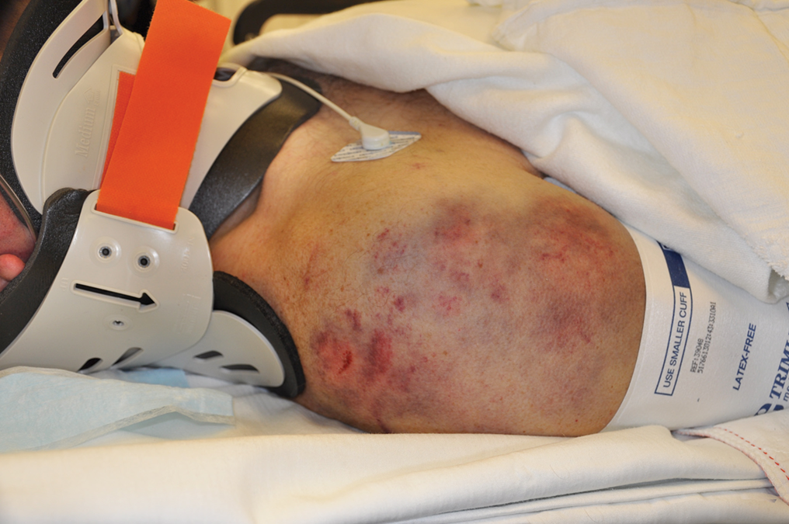
Patient Assessment (11 of 11)
Bruising is one sign of internal bleeding. © Edward T. Dickinson, M D
Notes:
Covers Objective: 29.5

Slide 70
Patient Care (4 of 4)
Maintain A B Cs.
Consider the need for high-concentration oxygen.
Control any external bleeding.
Apply a splint if needed.
Take steps to preserve body temperature.
Provide prompt transport to appropriate medical facility.
Notes:
Covers Objective: 29.5
Point to Emphasize: Care for internal bleeding must include rapid transport to an appropriate facility.
Discussion Topic: Describe the appropriate care of a patient with suspected internal bleeding.

Slide 71
Chapter Review

Slide 72
Chapter Review (1 of 4)
Early signs of shock are often restlessness, anxiety, pale skin, and rapid pulse and respirations.
If shock remains uncontrolled, the patient’s blood pressure falls, a late sign of shock.

Slide 73
Chapter Review (2 of 4)
Signs and symptoms of shock may not be evident early in the call, so treatment based on the mechanism of injury may be lifesaving.
Treat shock by maintaining the airway, preventing hypoxia, controlling bleeding, and keeping the patient warm.

Slide 74
Chapter Review (3 of 4)
Almost all external bleeding can be controlled by direct pressure and elevation. When these don’t work, apply a tourniquet if bleeding is on an extremity or a hemostatic dressing if the bleeding is from the head or torso.
Emergency care for internal bleeding is based on prevention and treatment of shock.

Slide 75
Chapter Review (4 of 4)
One of most important treatments is early recognition of shock and immediate transport to a hospital.

Slide 76
Remember (1 of 4)
The circulatory system is designed to ensure adequate perfusion of body tissues.
The classification of hemorrhage is directly related to the type of vessel ruptured and the pressure within that vessel.

Slide 77
Remember (2 of 4)
Shock develops if the heart fails, blood volume is lost, or blood vessels dilate, resulting in inadequate perfusion.
Signs of shock reflect the body’s attempts at compensating for inadequate perfusion.

Slide 78
Remember (3 of 4)
The most significant treatment for the shock patient is early recognition and prompt transport to a hospital where the patient will receive definitive care.

Slide 79
Remember (4 of 4)
Treatment of external hemorrhage includes progression through the following steps: direct pressure, wound packing, use of hemostatic agents, and tourniquet application.
Internal bleeding is impossible to evaluate. The most appropriate treatment must be rapid transport to an appropriate facility.

Slide 80
Questions to Consider (1 of 2)
What can I use for a tourniquet that will control bleeding but not damage tissue?
When treating a patient with shock, what should I do at the scene and what should I do en route to the hospital?
Notes:
Talking Points: When students are discussing these questions, make sure to insert real-life details that will help them understand that the situations they find themselves in as EMTs will not necessarily follow the clear-cut order they find in their textbooks.

Slide 81
Questions to Consider (2 of 2)
Is a patient with pale, cool skin, tachycardia, and rapid, shallow respirations in shock or just under stress? How will continuing assessment help in making that decision?

Slide 82
Critical Thinking (1 of 2)
A patient has been involved in a motor-vehicle collision. There is considerable damage to the vehicle. The steering column and wheel are badly deformed. The patient complains of a “sore chest.” You note no external bleeding.

Slide 83
Critical Thinking (2 of 2)
The patient’s vital signs are pulse 116, respirations 20, blood pressure 106/70. How would you proceed to assess and care for this patient?
Notes:
Talking Points: Have one student suggest a course of assessment and care. When that student has finished, ask other students to critique the process.

Slide 84

Copyright
This work is protected by United States copyright laws and is provided solely for the use of instructors in teaching their courses and assessing student learning. Dissemination or sale of any part of this work (including on the World Wide Web) will destroy the integrity of the work and is not permitted. The work and materials from it should never be made available to students except by instructors using the accompanying text in their classes. All recipients of this work are expected to abide by these restrictions and to honor the intended pedagogical purposes and the needs of other instructors who rely on these materials.

Slide 85
Appendix 1
Diagram shows how deoxygenated blood travels from a person’s veins to the right side of the heart through the pulmonary artery to the lungs, where gas exchange occurs. Then, oxygenated blood travels from the lungs through the pulmonary vein to left side of the heart, where it is pumped back to the body.
Return to presentation

Slide 86
Appendix 2
First image depicts an E M T checking the pulse on a patient, who experienced a shock. A text reads, pulse increases to maintain cardiac output. The next image depicts the patient’s lethargic, pale face. A text reads, blood vessels constrict, causing pale, clammy skin. The third image depicts an E M T’s hands palpating the patient’s anterior chest. Hands are placed under the front ribcage with thumbs in midline. A text reads, respiration rate increases. The fourth image depicts the patient sitting and leaning slightly to the side. A text reads, blood is shunted away from gastrointestinal organs, causing nausea. The fifth image depicts an E M T checking a manual blood pressure on the patient. A text reads, decreasing blood pressure is a late sign of shock. The final image leads to this statement in uppercase letters, Uncontrolled shock leads to death.
Return to presentation

Slide 87
Appendix 3
One hand illustrates an arterial bleed with a large amount of drainage. The image text reads, Spurting blood, pulsating flow, bright red color. The middle image shows a hand with a venous bleed with a moderate amount of drainage. The text reads, Steady slow flow, dark red color. The third hand shows a capillary bleed with a scant amount of drainage. The text reads, Slow, even flow.
Return to presentation

