Slide 1
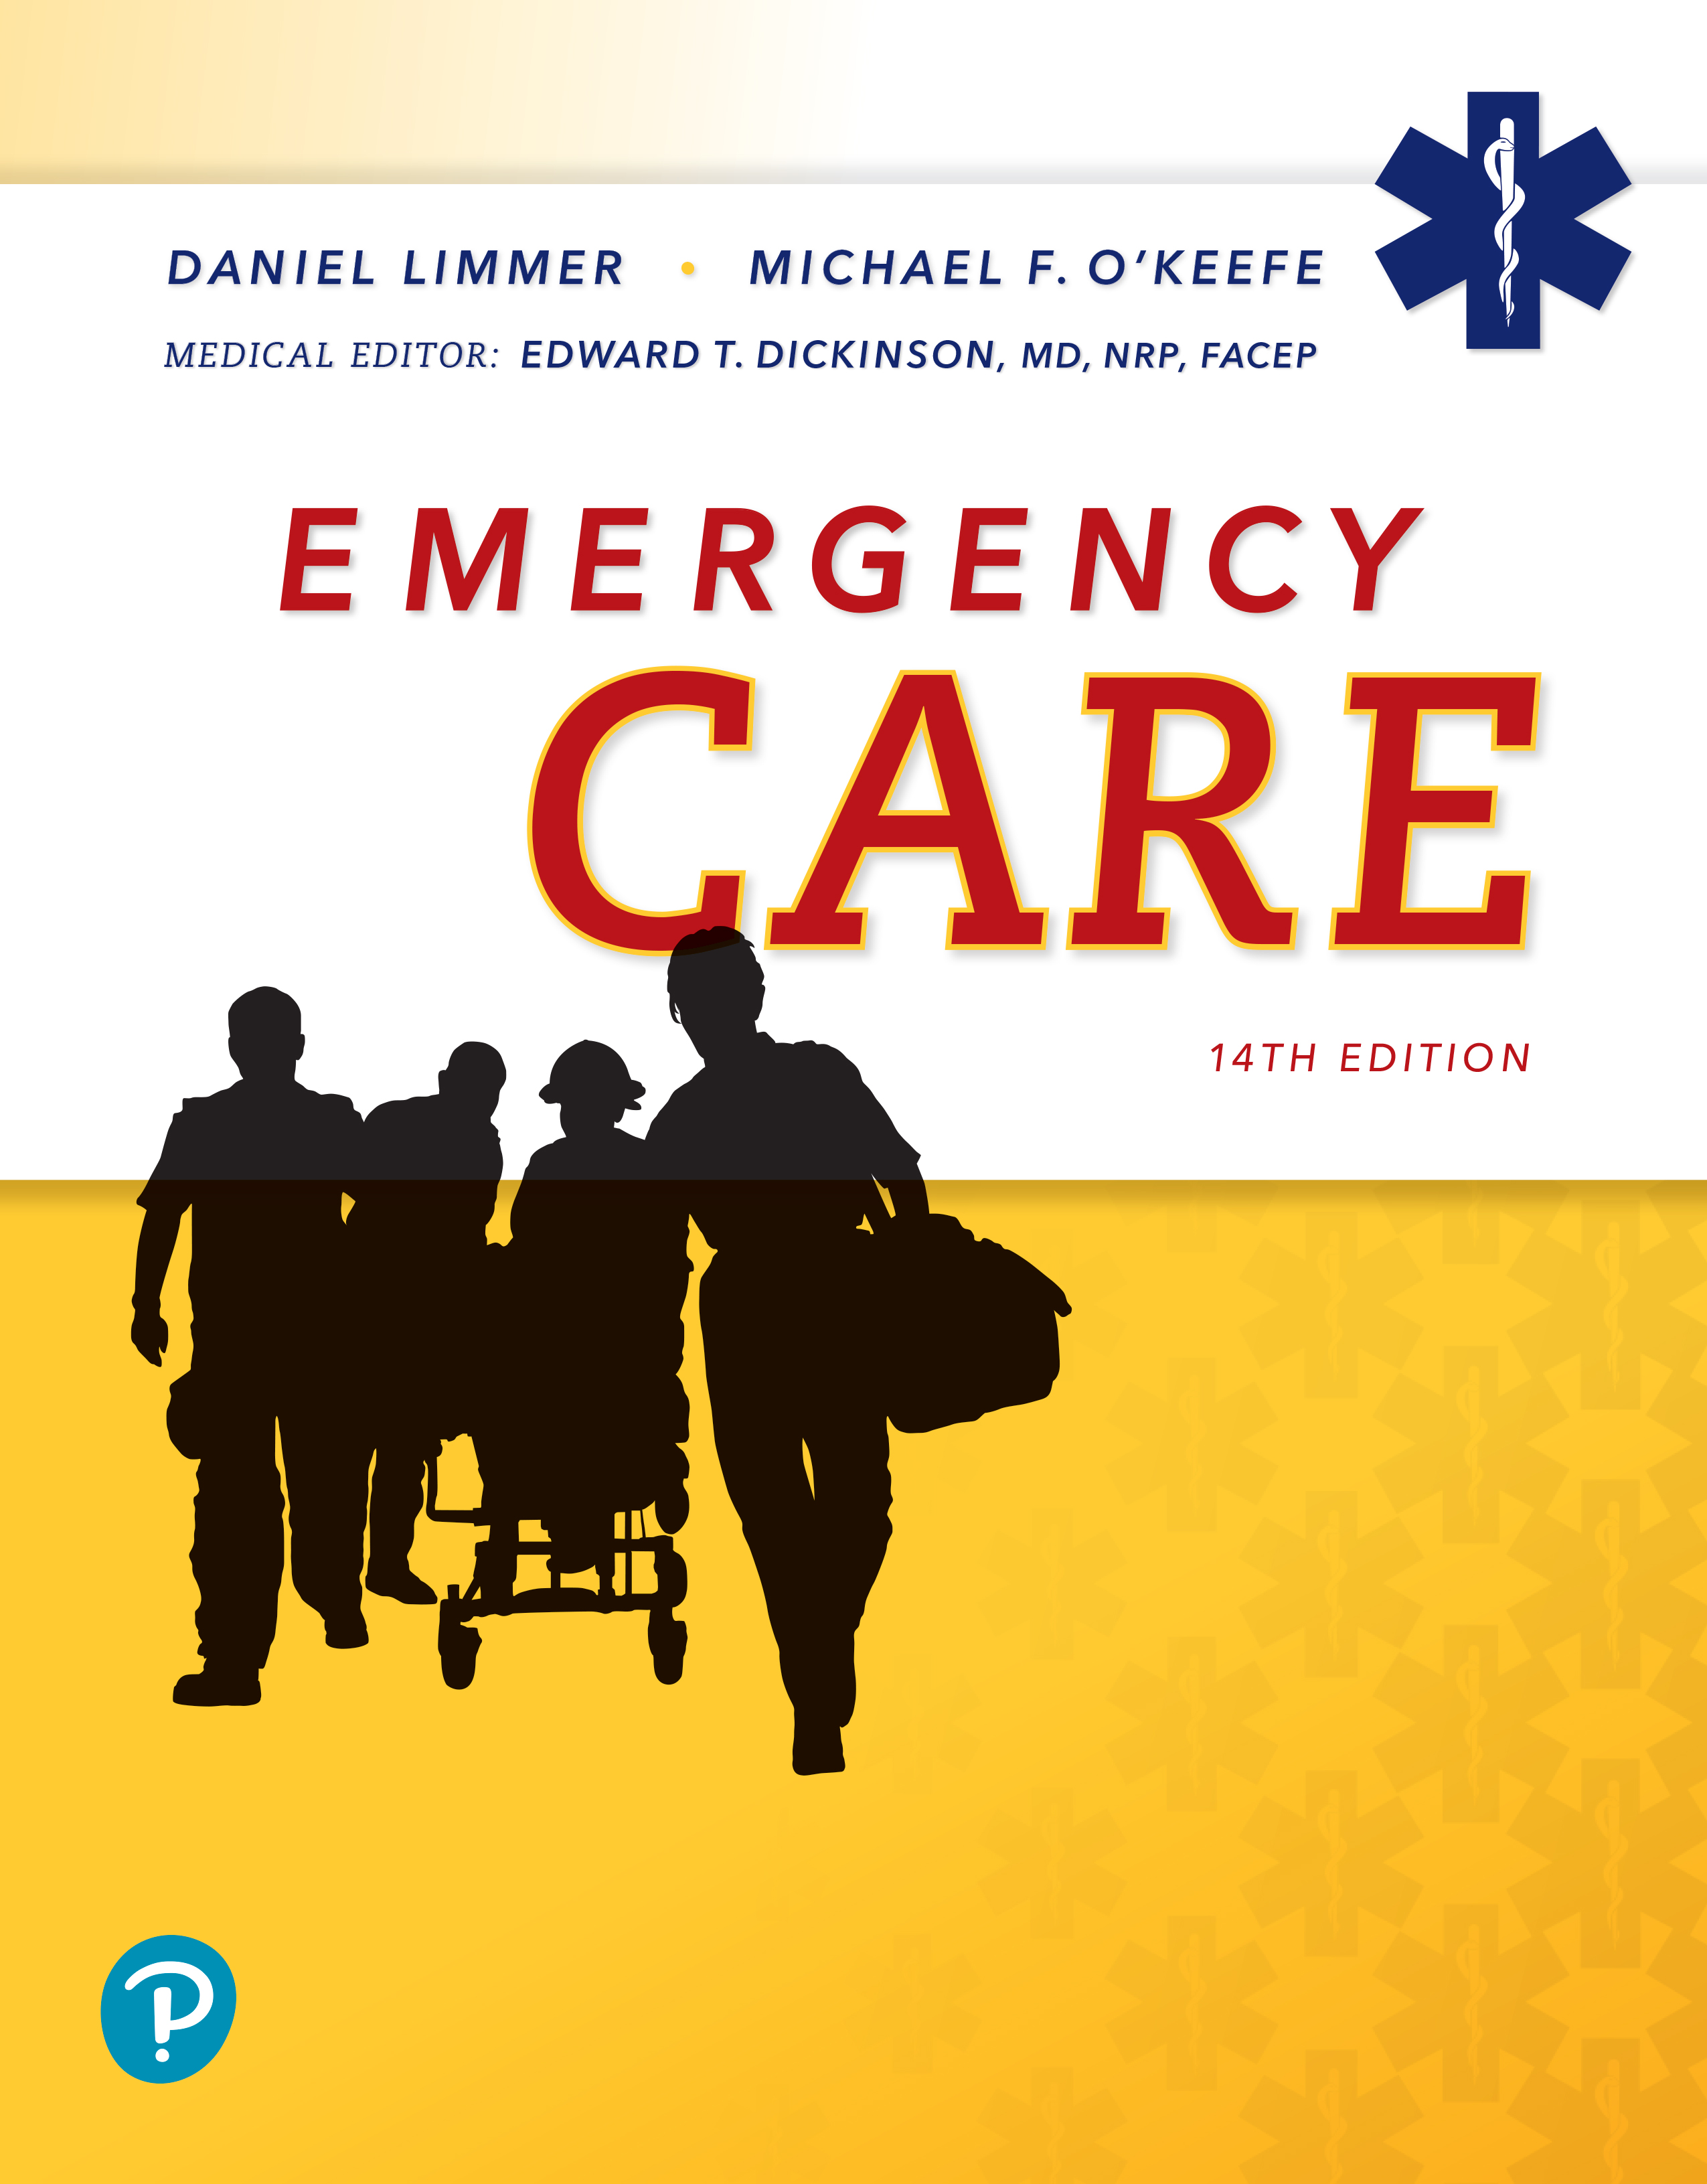
Emergency Care
Fourteenth Edition
Chapter 38
E M S Operations
Slides in this presentation contain hyperlinks. JAWS users should be able to get a list of links by using INSERT+F7
Copyright © 2021, 2016, 2012 Pearson Education, Inc. All Rights Reserved
Notes:
If this PowerPoint presentation contains mathematical equations, you may need to check that your computer has the following installed:
1) MathType Plugin
2) Math Player (free versions available)
3) NVDA Reader (free versions available)

Slide 2
Topics (1 of 2)
Preparing for the Ambulance Call
Receiving and Responding to a Call
Transferring the Patient to the Ambulance
Transporting the Patient to the Hospital
Notes:
Planning Your Time: Plan 140 minutes for this chapter.
Preparing for the Ambulance Call (20 minutes)
Receiving and Responding to a Call (35 minutes)
Transferring the Patient to the Ambulance (15 minutes)
Transporting the Patient to the Hospital (15 minutes)
Transferring the Patient to the Emergency Department Staff (10 minutes)
Terminating the Call (25 minutes)
Air Rescue (20 minutes)
Note: The total teaching time recommended is only a guideline.
Core Concepts
Phases of an ambulance call
Preparation for a call
Operating an ambulance
Transferring and transporting the patient
Transferring the patient to the emergency department staff
Terminating the call, replacing and exchanging equipment, cleaning and disinfecting the unit and equipment
When and how to use air rescue

Slide 3
Topics (2 of 2)
Transferring the Patient to the Emergency Department Staff
Terminating the Call
Air Rescue

Slide 4
Preparing for the Ambulance Call
Back to Topics
Notes:
Teaching Time: 20 minutes
Teaching Tips: Operational responsibilities differ from service to service. Appreciate that students may have varying levels of pre-class experience and post-class responsibilities. Create a culture of responsibility in the classroom. Teach students to respect equipment and to prepare it for the next use. If students use standard equipment for scenario work, make it the responsibility of the students to check the equipment before class. Design a restocking protocol. Create standardized sheets for students to report deficits or restocking issues.

Slide 5
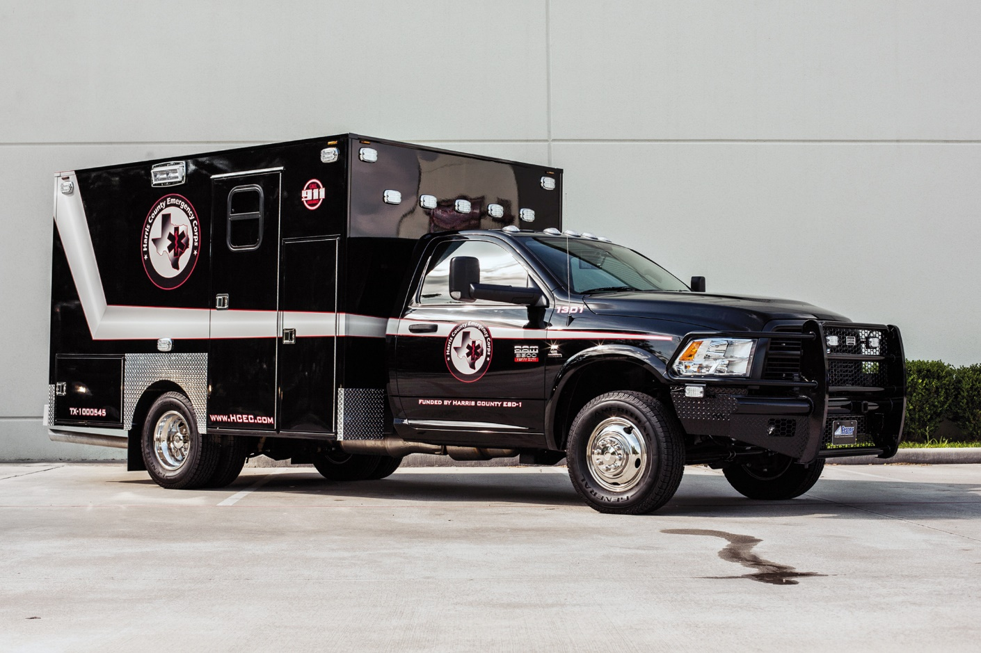
Preparing for the Call (1 of 5)
Four types of ambulances: Type
Notes:
Covers Objective: 38.1

Slide 6
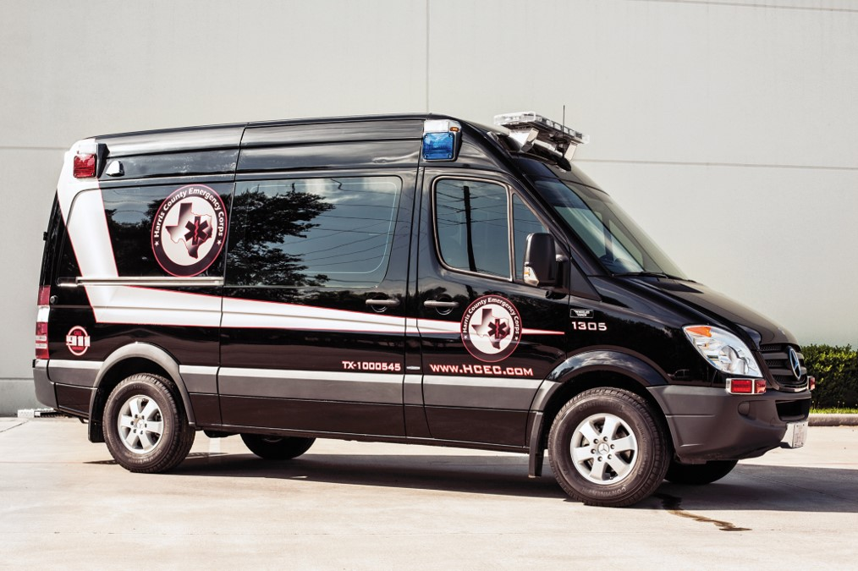
Preparing for the Call (2 of 5)
Four types of ambulances: Type
Notes:
Covers Objective: 38.1
Discussion Topic: Describe the differences between a Type I, Type II, and Type III ambulance.

Slide 7
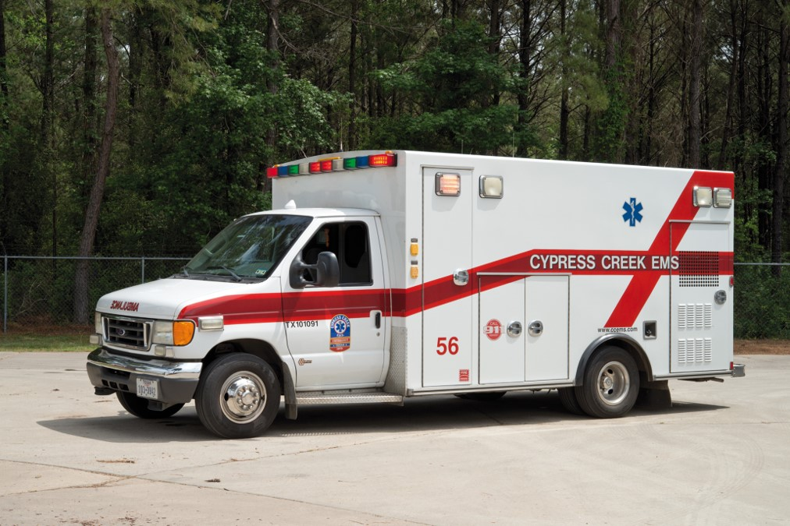
Preparing for the Call (3 of 5)
Four types of ambulances: Type
Notes:
Covers Objective: 38.1

Slide 8
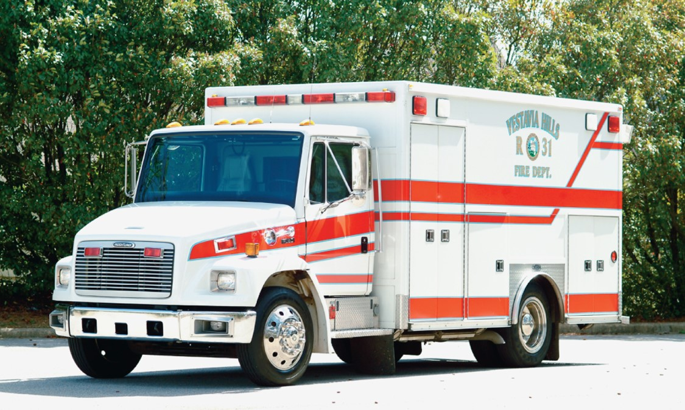
Preparing for the Call (4 of 5)
Four types of ambulances: medium duty.
Notes:
Covers Objective: 38.1

Slide 9
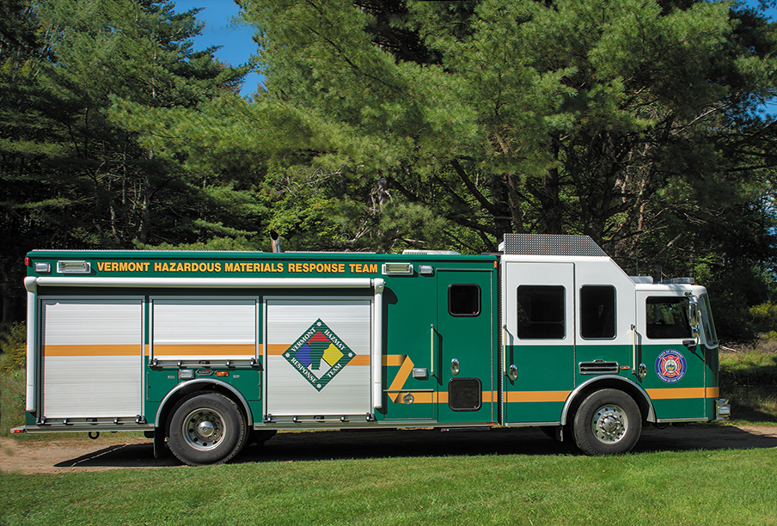
Preparing for the Call (5 of 5)
A specialty response vehicle.
Notes:
Covers Objective: 38.1

Slide 10
Ambulance Supplies and Equipment
An ambulance without proper equipment may have its agency cited and fined a considerable amount of money by a state E M S regulatory agency.
Learn where each item is, what it is for, and when it should be used.
Notes:
Covers Objective: 38.1
Discussion Topic: Describe local resources regarding required ambulance equipment.
Knowledge Application: Have students design a standardized reporting system for broken, missing, or expended equipment. Utilize this system throughout the course. Build a regular expectation of preparedness.

Slide 11
Ensuring Ambulance Readiness for Service
Be sure that you, your vehicle, and your equipment are ready to respond when an emergency occurs.
Inspect vehicle and equipment at the start of every shift.
Do shift report with off-going crew.
Two components
  Vehicle component (completed by driver)
  Equipment component (completed by crew leader)
Notes:
Covers Objective: 38.1
Discussion Topic: Discuss the value of checking a response vehicle prior to a call. Why is it so important?
Critical Thinking Discussion: You are treating an asthma patient with supplemental oxygen. As you are applying the nonrebreather mask, you notice that the tank is just about empty. Whose responsibility is it that this tank was not changed?

Slide 12
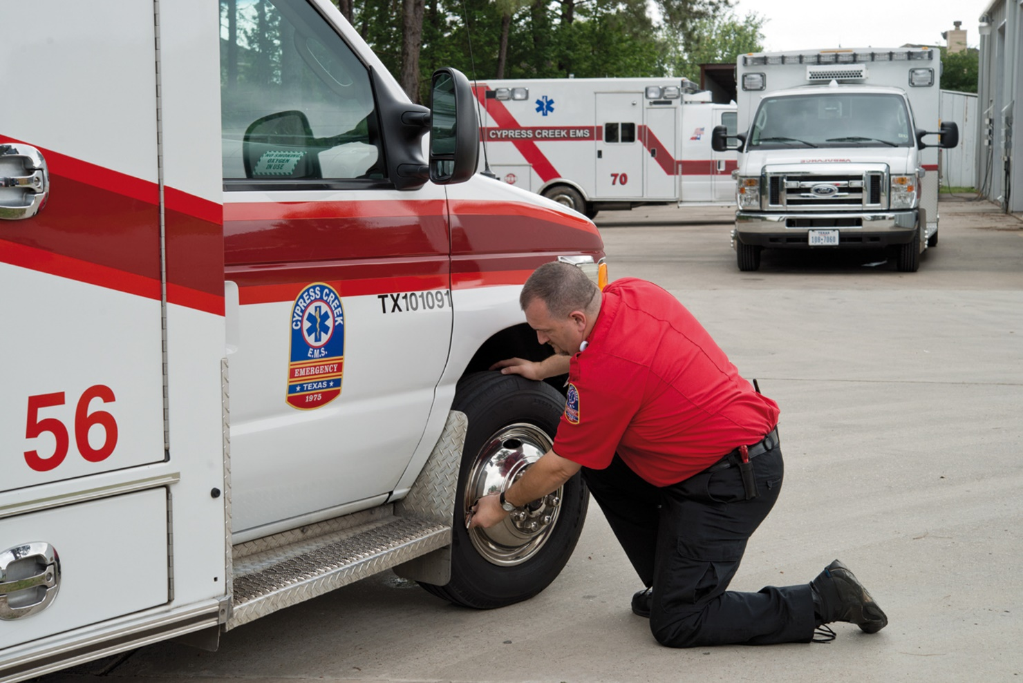
Ensuring Readiness for Service (1 of 2)
1. Check the ambulance body, wheels, tires, and windshield wipers.
Notes:
Covers Objective: 38.1

Slide 13
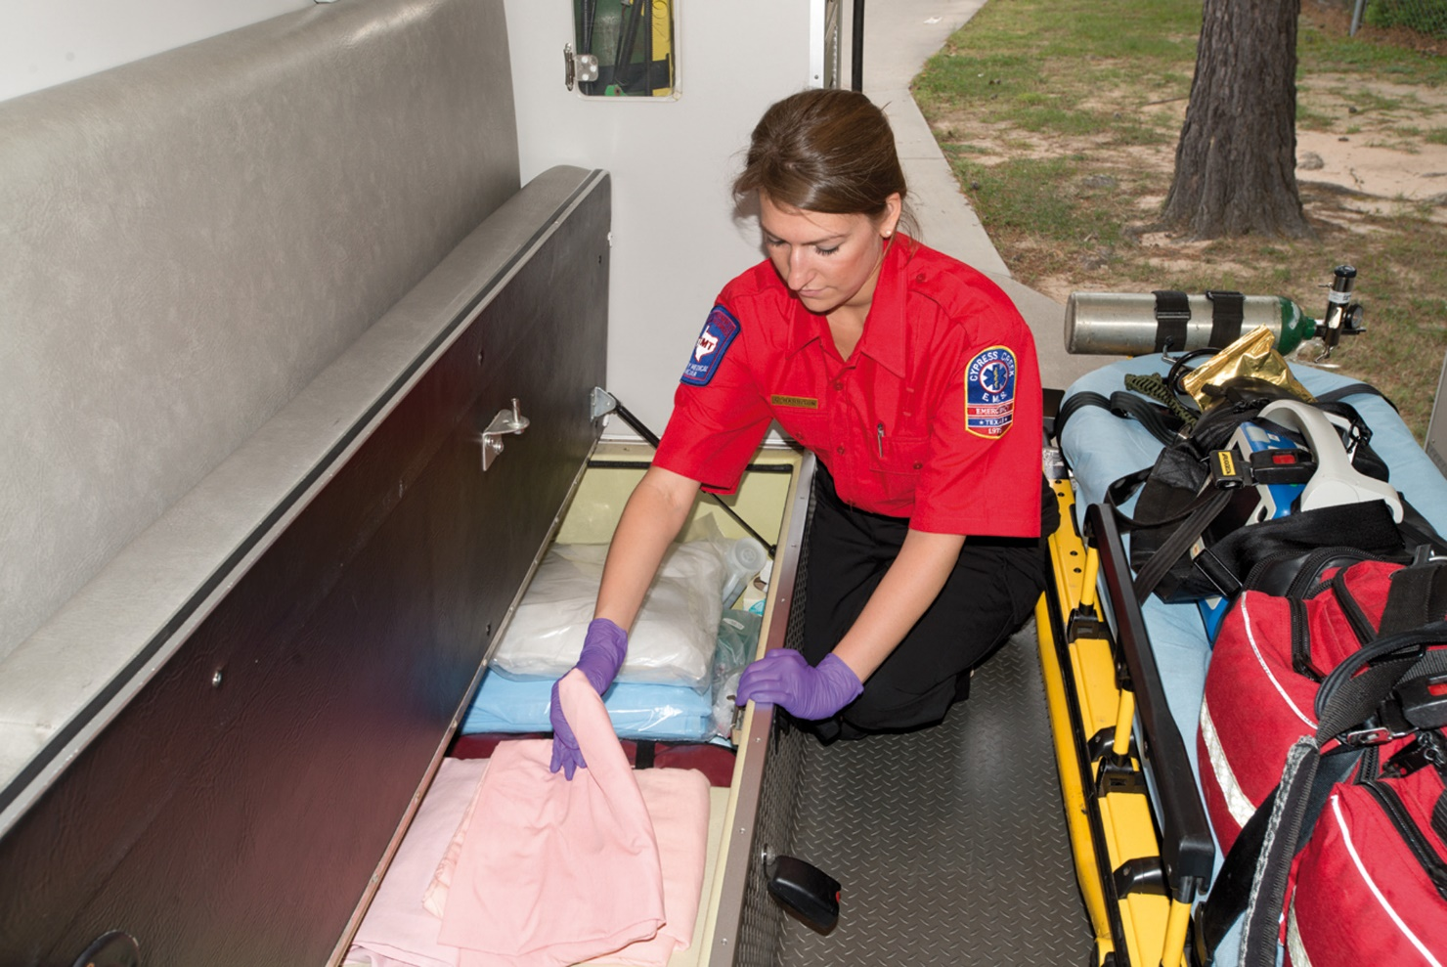
Ensuring Readiness for Service (2 of 2)
4. Check the interior surfaces and upholstery.
Notes:
Covers Objective: 38.1

Slide 14
Ambulance Inspection, Engine Off (1 of 4)
Inspect the body of the vehicle. Report any damage that may be evident. Indicate past damage that has not been repaired.
Inspect the wheels and tires. Check for damage or worn wheel rims and tire sidewalls. Check the tread depth. Use a pressure gauge.
Inspect the windows and mirrors. Look for broken glass and loose or missing parts. See that mirrors are clean and properly adjusted for maximum visibility.
Check the operation of every door and all latches and locks.
Notes:
Covers Objective: 38.1
Points to Emphasize: An "engine off" inspection reviews the non-engine-related components of the ambulance. An "engine on" inspection reviews the mechanical elements of the ambulance. It is essential to inspect the patient compartment and ensure proper equipment and supplies prior to responding to a call.
Discussion Topics: Describe the components of a typical "engine off" and “engine on” ambulance check.

Slide 15
Ambulance Inspection, Engine Off (2 of 4)
Check the level of all fluids.
Check the battery. Inspect the battery cable connections for tightness and signs of corrosion.
Inspect the interior surfaces and upholstery for damage and cleanliness. Wipe down the steering wheel with disinfectant.
Check the windows for operation and cleanliness.
Test the horn, siren, and emergency lights
Notes:
Covers Objective: 38.1
Class Activity: Use a standardized equipment list to check an ambulance. If an ambulance is not available, check the class equipment used for scenario work.

Slide 16
Ambulance Inspection, Engine Off (3 of 4)
Adjust the driver’s seat and ensure the seat belts are operational.
Check the fuel level. Refuel according to agency policies.
Notes:
Covers Objective: 38.1

Slide 17
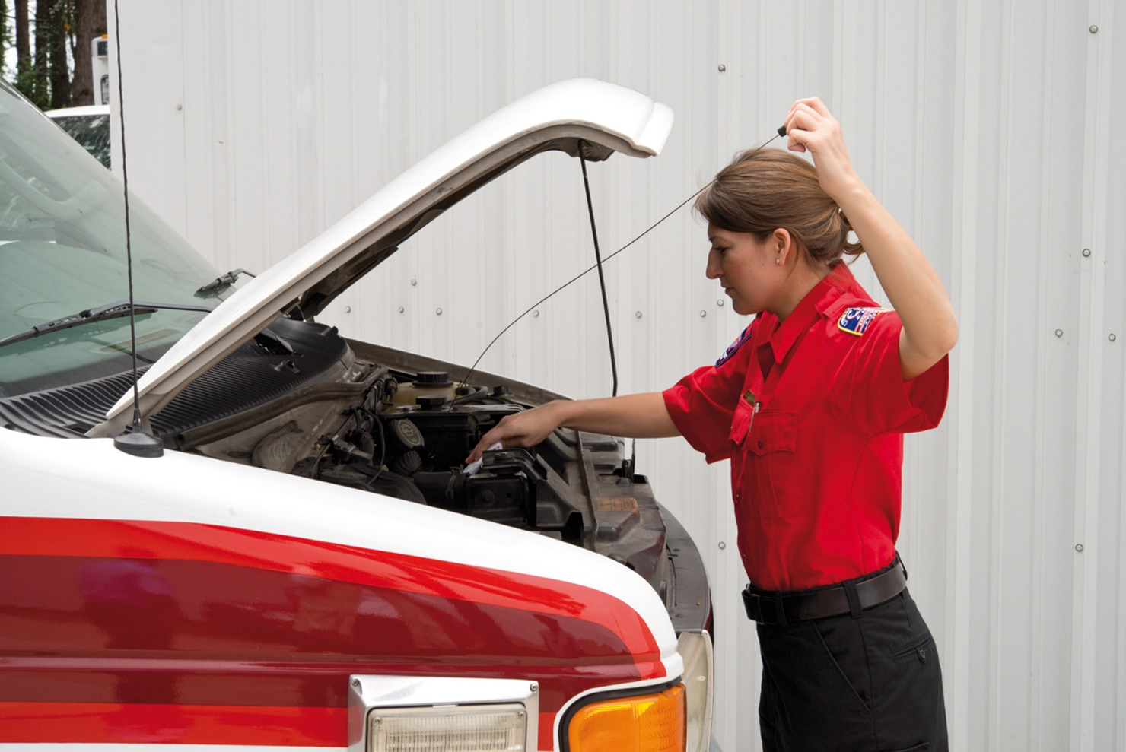
Ambulance Inspection, Engine Off (4 of 4)
3. Check under the hood.
Notes:
Covers Objective: 38.1

Slide 18
Ambulance Inspection, Engine On (1 of 4)
Check the dash-mounted indicators to see if any light remains on to indicate a possible problem with oil pressure, engine temperature, or the vehicle’s electrical system.
Check dash-mounted gauges for proper operation.
Depress the brake pedal. Note pedal travel. Check air pressure.
Test the parking brake. Move the transmission level to a drive position. Replace the level to the park position as soon as you are sure that the parking brake is holding.
Notes:
Covers Objective: 38.1

Slide 19
Ambulance Inspection, Engine On (2 of 4)
Turn the steering wheel from side to side.
Check the operation of the windshield wipers and washers. The glass should be wiped clean each time the blades move.
Turn on the vehicle’s warning lights. Have your partner walk around the ambulance and check each flashing and revolving light for operation. Turn off the warning lights.
Notes:
Covers Objective: 38.1

Slide 20
Ambulance Inspection, Engine On (3 of 4)
Turn on the other vehicle lights. Have your partner walk around the ambulance again, this time checking the headlights (high and low), turn signals, four-way flashers, brake lights, reverse lights, side and rear scene illumination lights, and box marker lights.
Check the operation of the heating and air conditioning equipment in both the driver’s compartment and the patient compartment. Check the on-board suction.
Operate the communications equipment. Test portable and mobile radios and any cellular telephone communications.
Notes:
Covers Objective: 38.1

Slide 21
Ambulance Inspection, Engine On (4 of 4)
If your unit is equipped with a back-up camera, make sure that the camera is not damaged and is clean.
Return the ambulance to quarters. While you are backing up, have your partner note whether the backup alarm is operating.
Notes:
Covers Objective: 38.1

Slide 22
Inspection of Patient Compartment Supplies and Equipment (1 of 2)
Using your checklist, conduct a detailed inspection and inventory of the equipment and supplies.
Check treatment supplies, interior equipment, and exterior equipment. Check the pressure of oxygen cylinders. Test oxygen and ventilation equipment for proper operation. Examine rescue tools for rust and dirt. Operate battery-powered devices to ensure that the batteries have a proper charge.
Notes:
Covers Objective: 38.1
Discussion Topics: Describe the components of a standard inspection of ambulance patient compartments, supplies, and equipment.

Slide 23
Inspection of Patient Compartment Supplies and Equipment (2 of 2)
Some equipment, such as the A E D, may require additional testing. See that an item-by-item inspection of everything carried on the ambulance is done, with findings recorded on the inspection report.
Complete the inspection report. Correct any deficiencies. Replace missing items. Make your supervisor aware of any deficiencies that cannot be immediately corrected.
Finally, clean the unit for infection control and appearance. Use only approved cleaning and disinfecting materials.
Notes:
Covers Objective: 38.1

Slide 24
Think About It
As I walk around the vehicle (engine-on and engine-off check), what information do I get from what I hear, see, and smell?
Notes:
Covers Objective: 38.1
Talking Points: EMTs must be aware of unusual sounds and smells coming from the vehicle in the engine-on check, lights that don't work, gauges that seem broken, and so on.

Slide 25
Receiving and Responding to a Call
Back to Topics
Notes:
Teaching Time: 35 minutes
Teaching Tips: Use real-life examples of potential response hazards in your area. Consider road construction, traffic bottlenecks, and so on. Compile media articles on ambulance crashes. Discuss factors that contributed to each crash. Consider using video graphics of an ambulance response. Illustrate hazards and the actions of the driver. Emergency vehicle driving simulators are a wonderful training resource. Check into local availability.

Slide 26
Role of the Emergency Medical Dispatcher (1 of 2)
Ask questions of caller and assign priority to call
Provide prearrival medical instructions to callers and information to crews
Dispatch and coordinate E M S resources
Coordinate with other public safety agencies
Notes:
Covers Objective: 38.2
Points to Emphasize: Interrogation of the caller, prioritization of the call, prearrival instructions, coordination of EMS resources, and coordination with other public safety agencies are all important responsibilities of the Emergency Medical Dispatcher. An EMD uses specific questions to obtain information about the patient prior to the arrival of EMS crews.
Discussion Topics: Discuss the key roles and responsibilities of an Emergency Medical Dispatcher. Describe how EMDs might improve patient care.

Slide 27
Role of the Emergency Medical Dispatcher (2 of 2)
Questions E M D should ask:
  What is the exact location of the patient?
  What is your call-back number
  What’s the problem?
  How old is the patient?
  What’s the patient’s sex?
  Is the patient conscious?
  Is the patient breathing?
Notes:
Covers Objective: 38.2
Class Activity: Tour a dispatch center. Listen to prearrival questions and instructions.
Knowledge Activity: Work with an EMD to simulate a 911 call. Describe a situation and listen to the prearrival questions and instructions.

Slide 28
Operating the Ambulance (1 of 14)
Being a safe ambulance operator
  Be physically and mentally fit.
  Be able to perform under stress.
  Have a positive attitude about your ability as a driver but not be an unreasonable risk taker.
  Be tolerant of other drivers.
  Never drive while under the influence of any substance.
Notes:
Covers Objective: 38.3

Slide 29
Operating the Ambulance (2 of 14)
Being a safe ambulance operator
  Never drive while taking prescription medications that can impair your ability to operate a motor vehicle.
  Never drive with a suspended license.
  Always wear your glasses or contact lenses if required for driving.
  Evaluate your ability to drive based on personal stress, illness, and fatigue.
Notes:
Covers Objective: 38.3

Slide 30
Operating the Ambulance (3 of 14)
Understanding the law
  An ambulance operator must have a valid driver’s license and may be required to complete a training program.
  Privileges granted under the law to the operators of ambulances apply when the vehicle is responding to an emergency.
    Not applicable if not on call
Notes:
Covers Objective: 38.3
Points to Emphasize: Each state regulates operation of emergency vehicles. EMTs must be familiar with rules and regulations prior to driving an ambulance. EMTs should use warning devices and sirens only in true emergencies.
Knowledge Application: Have students research local ambulance operation policies. Consider state, regional, and service levels. Compare and contrast.

Slide 31
Operating the Ambulance (4 of 14)
Understanding the law
  Even though certain privileges are granted during an emergency, the exemptions granted do not provide immunity to the driver.
  Privileges granted during emergency situations apply only if the operator uses warning devices in the manner prescribed by law.
Notes:
Covers Objective: 38.3
Class Activity: Have a discussion about what type of situation would necessitate an emergency response. Discuss local rules and regulations.

Slide 32
Operating the Ambulance (5 of 14)
Understanding the law
  Most statutes allow:
    Parking wherever necessary as long as life and property are not endangered
    Proceeding past stop signs/signals
    Exceeding the posted speed limit as long as life and property are not endangered
Notes:
Covers Objective: 38.3

Slide 33
Operating the Ambulance (6 of 14)
Understanding the law
  Most statutes allow:
    Passing other vehicles in no-passing zones after properly signaling and taking precautions
    Disregarding regulations that govern direction of travel and turning with proper use of caution and signals
Notes:
Covers Objective: 38.3

Slide 34
Operating the Ambulance (7 of 14)
Using the warning devices
  The siren
    Never use it indiscriminately.
  The horn
  Visual warning devices
    Day or night
    Vehicle should be easily seen from 360 degrees in emergency response mode.
Notes:
Covers Objective: 38.3
Discussion Topic: Describe the proper use of warning devices during emergency response.

Slide 35
Operating the Ambulance (8 of 14)
Speed and safety
  Excessive speed increases the probability of a collision.
  Speed increases stopping distance, reducing the chance of avoiding a hazardous situation.
Notes:
Covers Objective: 38.3
Class Activity: Visit an emergency vehicle driving simulator. Experience the rigors of driving in an emergency response.
Critical Thinking Discussion: You are responding to a call at a speed that you feel is safe. Dispatch radios to tell you that first responders have asked you to “expedite” your response. Your partner yells at you to “step on it.” What do you do?

Slide 36
Operating the Ambulance (9 of 14)
Escorted or multiple-vehicle responses
  Inexperienced ambulance operator often follows the escort vehicle too closely and is unable to stop when the lead vehicle brakes hard.
  Recommendation of no escorts unless absolutely necessary
  Greater care must be used.
Notes:
Covers Objective: 38.3

Slide 37
Operating the Ambulance (10 of 14)
Factors that affect response
  Day of the week
  Time of day
  Weather
  Road maintenance and construction
  Railroads
  Bridges and tunnels
  Schools and school buses
Notes:
Covers Objective: 38.3
Knowledge Application: Play with trucks. Use toy trucks to simulate ambulance traffic operations. Use a tabletop to walk through a variety of driving hazards.

Slide 38
Operating the Ambulance (11 of 14)
Navigating to the scene
  Global positioning satellite (G P S) navigation often installed
    No substitute for an intimate knowledge of the response area.
    May become a distraction
  Obtain detailed maps of your service area.
Notes:
Covers Objective: 38.3

Slide 39
Operating the Ambulance (12 of 14)
Response safety summary
  Minimize lights-and-siren “hot” responses. Driving with lights and siren involves high risk.
  Wear your seat belts.
  Know where you are going before you respond. Use the G P S and check the maps. Be familiar with your response area.
Notes:
Covers Objective: 38.4
Discussion Topic: Describe key procedures for safe vehicle operation on and around a highway.

Slide 40
Operating the Ambulance (13 of 14)
Safety at highway incidents
  Keep unnecessary units and people off the highway
  Avoid crossovers unless a turn can be completed without obstructing traffic
  Protect the scene if yours is the first unit on scene
Notes:
Covers Objective: 38.4
Knowledge Application: Have students work in small groups. Ask each group to discuss the components of a safe scene response. Have groups present their findings.
Critical Thinking Discussion: Review the Think Like an EMT feature with students and encourage discussion.

Slide 41
Operating the Ambulance (14 of 14)
Safety at highway incidents
  Wear Your P P E
  Place cones/flares and reduce emergency lighting
  Unit placement is important!
  Backing up
    Avoid backing up, if possible, especially during emergencies.
Notes:
Covers Objective: 38.4

Slide 42
Transferring the Patient to the Ambulance
Back to Topics
Notes:
Teaching Time: 15 minutes
Teaching Tips: Have patient-carrying devices on hand for demonstration purposes. Give students a different perspective. Ask students to play the role of the patient in packaging scenarios.

Slide 43
Transferring the Patient to the Ambulance (1 of 5)
Select proper patient-carrying device
Package patient for transfer
Move patient to ambulance
Load patient into ambulance
Notes:
Covers Objective: 38.5
Class Activity: (Skill Demonstration) Using different examples of patient transfer devices, demonstrate proper patient packaging.

Slide 44
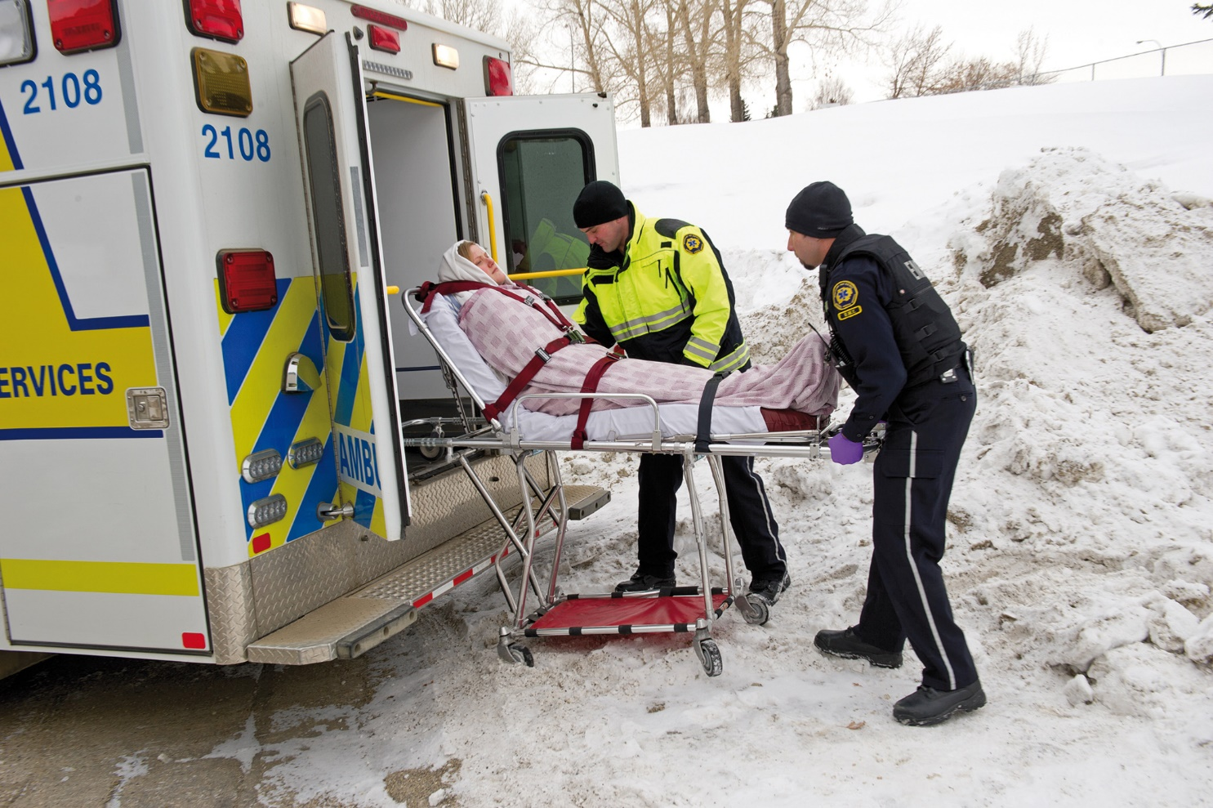
Four Steps of Transferring
This patient is packaged for cold, wet conditions.
Notes:
Covers Objective: 38.5

Slide 45
Transferring the Patient to the Ambulance (2 of 5)
Packaging the patient
  Readying patient to be moved and combining patient and patient-carrying device as unit ready for transfer
  Sick or injured patient must be packaged so that condition is not aggravated.
Notes:
Covers Objective: 38.5
Critical Thinking Discussion: What is meant by "a balance between expedience and function"? Is it appropriate to disregard safety because a patient is critically ill or injured?

Slide 46
Transferring the Patient to the Ambulance (3 of 5)
  Before placing patient on carrying device
    Complete necessary care for wounds, other injuries.
    Stabilize impaled objects.
    Check dressings and splints.
  Cover patient and secure to patient-carrying device.
Notes:
Covers Objective: 38.5
Discussion Topic: Discuss the elements involved and how packaging might be different when dealing with a critical patient.
Knowledge Application: Package fellow students. Using student volunteers, practice securing and packaging students for transfer to the ambulance.

Slide 47
Transferring the Patient to the Ambulance (4 of 5)
Protecting the patient
  Must be secured to patient-carrying device
  Minimum of three straps to secure
    Chest level
    Waist level
    Lower extremities
  Use shoulder harness if available.
Notes:
Covers Objective: 38.5
Discussion Topics: Describe ways to secure a patient to a transfer device. Use specific examples. Describe the necessary safety steps involved with caring for a patient in the back of a moving ambulance.
Knowledge Application: Using an ambulance, demonstrate proper safety procedures for providing patient care while the ambulance is moving.

Slide 48
Transferring the Patient to the Ambulance (5 of 5)
Protecting the E M T
  E M T at greater risk in patient compartment
  Remain seated.
  Wear seat belt and harness if possible.
  Avoid unnecessary movement during response and transport.
  Make sure all equipment is secured.
Notes:
Covers Objective: 38.5

Slide 49
Transporting the Patient to the Hospital
Back to Topics
Notes:
Teaching Time: 15 minutes
Teaching Tips: Have stretchers and an ambulance on hand. Review securing these devices properly. Load simulated patients into an ambulance. Discuss movement and positioning. Relate to previous discussions about safety. Discuss the need for patient care in the context of passenger safety. Teach that care en route is an active process, even for a patient with a minor injury. Interaction with patients is an important affective lesson and often forgotten in this phase of an EMS call.

Slide 50
Preparing the Patient for Transport (1 of 2)
Continue assessment.
Secure stretcher in place in ambulance.
Position and secure patient.
Adjust security straps.
Prepare for respiratory and cardiac complications.
Notes:
Covers Objective: 38.5
Points to Emphasize: Assessment and care must continue as the patient is transferred to the hospital. The EMT should position patient and self to maximize these capabilities. The patient must be safely secured prior to the ambulance leaving the scene. The EMT should check that the patient is properly secured to the stretcher and that the stretcher is properly secured in place before the ambulance moves. Patients should be transferred on the stretcher. EMTs should avoid transferring patients in other seats unless there are unusual circumstances.
Discussion Topics: Describe the steps involved in properly securing a patient to a stretcher. Consider local protocols. Describe the procedure for securing a stretcher to the ambulance. Explain why the stretcher is the most appropriate place to secure a patient for transfer.
Knowledge Application: Have students work in small groups. Have each group demonstrate securing a member of the group to a stretcher.

Slide 51
Preparing the Patient for Transport (2 of 2)
Loosen constricting clothing.
Load relative or friend who must accompany patient.
Load personal effects.
Talk to your patient.
Avoid letting patients sit on bench or airway seat.
Notes:
Covers Objective: 38.5
Class Activities: Tour an ambulance. Review how to secure stretchers properly. (Skill Demonstration) Using an ambulance stretcher and a manikin, demonstrate the proper procedure for securing a patient for transport.
Knowledge Application: Practice securing a stretcher in an ambulance. Review how an EMT might check to assure that it has been secured.
Critical Thinking Discussion: Under what types of circumstances might it be reasonable to transport a patient in a position off the stretcher?

Slide 52
Caring for the Patient en Route
Notify the hospital.
Continue to provide emergency care as required.
Use safe practices during transport.
Compile additional patient information.
Continue assessment and monitor vital signs.
Notify the receiving facility.
Notes:
Covers Objective: 38.5
Point to Emphasize: The EMT who rides in the patient compartment will continue assessment and care on the way in to the hospital.
Discussion Topic: Discuss the continuing responsibilities of the EMT during transfer of the patient to the hospital.
Knowledge Application: Use programmed patients or manikins to simulate care in the back of an ambulance. Have students practice safe assessment and care procedures.

Slide 53
Pediatric Note
The entire scene may create a terrifying experience for a child.
  A toy such as a teddy bear can do much to calm a frightened child.
  The presence of a female E M T or police officer may be helpful.
Small children do not, as a rule, carry identification.
Notes:
Covers Objective: 38.5

Slide 54
Transferring the Patient to the Emergency Department Staff
Back to Topics
Notes:
Teaching Time: 10 minutes
Teaching Tips: Include verbal reports and written documentation after practice scenarios. Imprint this lesson throughout the class. Teach that transfer is an important component of patient care. Keep it in the context of any other necessary intervention.

Slide 55
Transferring the Patient to the Emergency Department Staff
In a routine admission situation or when an illness or injury is not life-threatening, check first to see what is to be done with patient.
Assist emergency department staff as required and provide a verbal report.
As soon as you are free from patient-care activities, prepare the prehospital care report.
Transfer the patient’s personal effects.
Obtain your release from the hospital.
Notes:
Covers Objective: 38.6
Points to Emphasize: Transfer of care is a crucial step, during which the primary concern must be the continuation of patient care activities. Failure to transfer care properly can be considered abandonment.
Discussion Topic: Describe the steps that must take place to transfer patient care. What are the necessary components? Describe how the concept of abandonment might apply to an improper transfer of patient care.
Knowledge Application: Have students give simulated verbal reports. Have the class critique the reports.
Critical Thinking Discussion: You have been waiting for 20 minutes to give a patient report to a member of the ED. Dispatch notifies you that there is a high-priority call holding and asks you to clear. What should you do?

Slide 56
Terminating the Call
Back to Topics
Notes:
Teaching Time: 25 minutes
Teaching Tips: Make post-call readiness a common theme in class. Always prepare equipment for the next use. Even though the threat of biohazard is comparatively low, practice proper decontamination procedures on equipment in the classroom. Invite a local EMT to discuss service-level call termination procedures. Describe the necessary tasks and priorities associated with returning to service/returning to quarters.

Slide 57
At the Hospital
Quickly clean the patient compartment while taking appropriate Standard Precautions.
Prepare respiratory equipment for service.
Replace expendable items.
Exchange equipment according to your local policy.
Make up the ambulance cot.
Notes:
Covers Objective: 38.6
Points to Emphasize: Cleaning the ambulance, replacing used supplies and equipment, and readying the ambulance stretcher are important elements that the EMT must complete while terminating a call.
Discussion Topic: Describe the necessary steps involved in properly terminating a call. Describe the priorities involved in readying an ambulance for the next call.

Slide 58
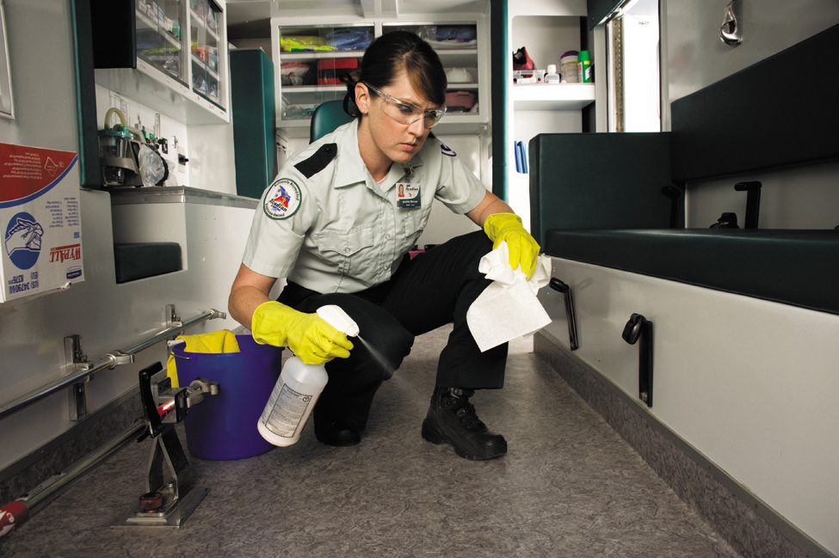
Terminating the Call: At the Hospital
1. Clean the ambulance interior.
Notes:
Covers Objective: 38.6

Slide 59
En Route to Quarters
Radio the E M D.
Air out the ambulance if necessary.
Refuel the ambulance.
Notes:
Covers Objective: 38.6
Points to Emphasize: Safe ambulance operation must continue even after the call has been concluded. Refueling, cleaning, and decontaminating the ambulance are priorities in readying the unit for the next call.
Discussion Topic: Describe the necessary tasks and priorities associated with returning to service/returning to quarters.
Critical Thinking Discussion: Motor-vehicle crashes are the leading cause of emergency medical service worker line of duty death. What steps can be taken while returning to quarters to change this fact?

Slide 60
In Quarters (1 of 2)
Place contaminated linens in a biohazard container and noncontaminated linens in a regular hamper.
As necessary, clean any equipment that touched the patient.
Clean and disinfect used nondisposable respiratory-assist and inhalation therapy equipment.
Clean and sanitize the patient compartment.
Prepare yourself for service.
Notes:
Covers Objective: 38.6
Discussion Topics: Describe the steps taken in quarters to ready equipment for the next call.
Knowledge Application: Using appropriate supplies, properly decontaminate EMS equipment.
Critical Thinking: Improper resupply and missing equipment issues occur frequently. What might be examples of impediments to properly readying an ambulance for the next call?

Slide 61
In Quarters (2 of 2)
Replace expendable items.
Replace or refill oxygen cylinders.
Replace patient-care equipment.
Carry out postoperation vehicle maintenance procedures as required.
Clean the vehicle.
Complete your paperwork.
Notes:
Covers Objective: 38.6

Slide 62
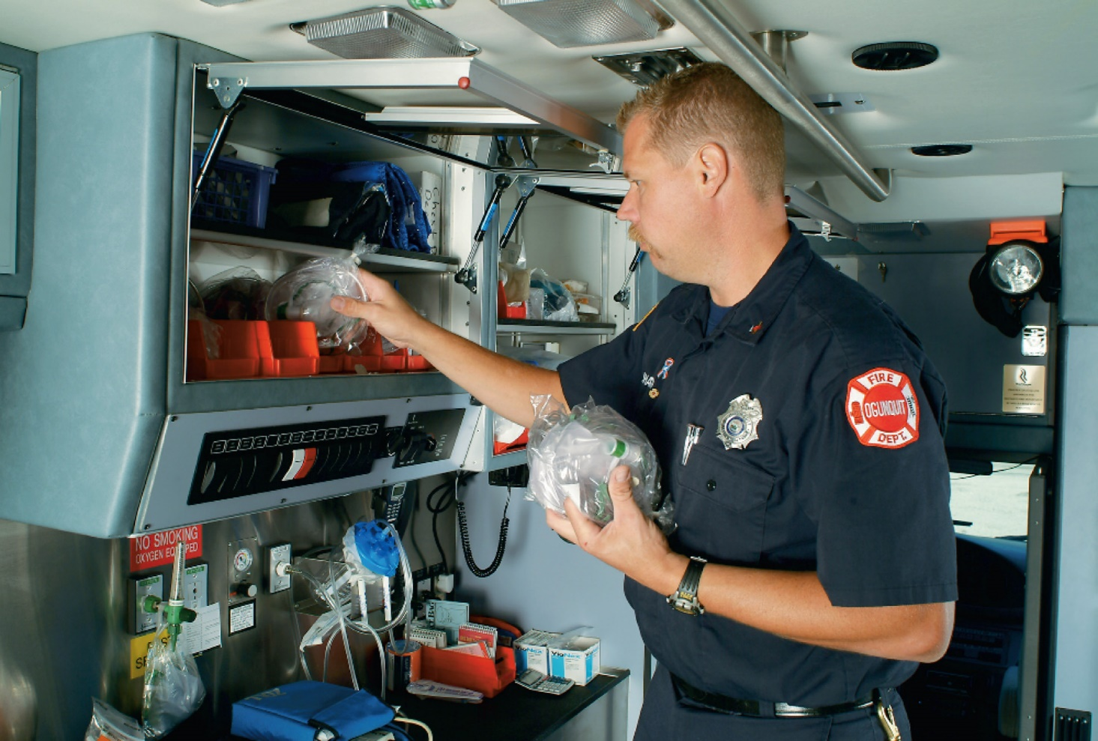
Terminating the Call: In Quarters
6. Replace expendable items as required.
Notes:
Covers Objective: 38.6
Knowledge Application: Review an EMS standard operating guideline for return to service. Discuss important elements.

Slide 63
Air Rescue
Back to Topics
Notes:
Teaching Time: 20 minutes
Teaching Tips: Contact your local aeromedical transport service. Ask for assistance in teaching this lesson. Discuss local protocols for activation of aeromedical transport. Discuss the risks of aeromedical transport. Review crashes and describe a cost-benefit analysis in choosing air transport. Tour the local aeromedical service. Review aircraft safety procedures.

Slide 64
When to Call for Air Rescue (1 of 4)
Operational reasons
  To speed transport to distant trauma center
  When extrication of high-priority patient is prolonged and air rescue can speed transport
  When patient must be rescued from remote location
Notes:
Covers Objective: 38.7
Points to Emphasize: Indications for utilizing air rescue may include both operational and medical reasons. Speed of transport and specialized capabilities often make air rescue requests appropriate. EMTs should know the local air rescue resources that are available to them and the procedures for activating those resources.
Discussion Topics: Describe the benefits and risks of air rescue and aeromedical transport. Discuss the decision-making process for choosing the air mode of transport. Discuss common indications for air rescue transport. Review local protocols and regulations regarding air rescue activation.
Knowledge Application: Describe various scenarios. Have students discuss the most appropriate mode of transport. Include an air rescue cost benefit discussion.
Critical Thinking Discussion: What are the risks and costs of air rescue? Discuss examples of situations in which air rescue might not be appropriate even though some indications are present.

Slide 65
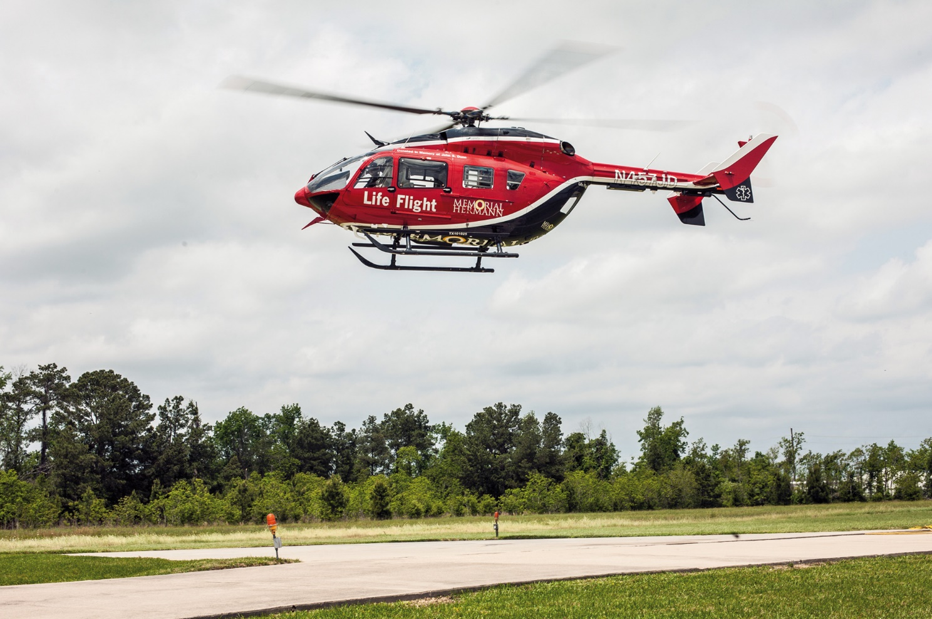
When to Call for Air Rescue (2 of 4)
Patients are sometimes transported by air rescue helicopter.
Notes:
Covers Objective: 38.7

Slide 66
When to Call for Air Rescue (3 of 4)
Clinical reasons
  Patient in shock
  Glasgow Coma Scale total less than 10
  Head injury with altered mental status
  Chest trauma and respiratory distress
  Penetrating injuries to body cavity
Notes:
Covers Objective: 38.7

Slide 67
When to Call for Air Rescue (4 of 4)
  Amputation proximal to hand or foot
  Extensive burns
  Serious mechanism of injury
  Patient is post–cardiac arrest with a pulse
Notes:
Covers Objective: 38.7

Slide 68
How to Call for Air Rescue
Name and callback number
Agency name
Nature of situation
Exact location
  Crossroads, major landmarks
Exact location and description of landing zone
If possible, G P S coordinates
Notes:
Covers Objective: 38.7
Discussion Topic: Describe the necessary steps for activating local air rescue.

Slide 69
How to Set up a Landing Zone
Describe the landing zone to the air rescue service.
  Terrain
  Major landmarks
  Estimated distance to nearest town
  Other pertinent information
    Such as wires, ditches, or wind
Notes:
Covers Objective: 38.7
Point to Emphasize: An appropriate landing zone (LZ) for a helicopter should be a flat area, free of utility lines, and at least 100 feet square. The slope of an LZ should not be greater than 8 degrees. The LZ should be marked with one flare in an upwind position.
Discussion Topic: Describe an appropriate landing zone for a helicopter. Describe how you would identify the LZ.
Knowledge Application: Review the area around your classroom. Choose and mark a helicopter landing zone. Simulate relaying information about the LZ to an incoming helicopter.

Slide 70
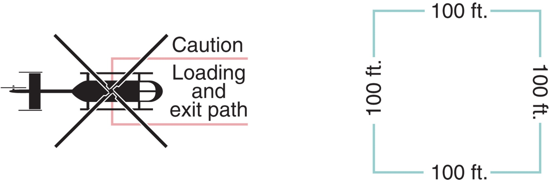
Landing Zone (1 of 2)
Helicopter landing zone.
Notes:
Covers Objective: 38.7
Point to Emphasize: An appropriate landing zone (LZ) for a helicopter should be a flat area, free of utility lines, and at least 100 feet square. The slope of an LZ should not be greater than 8 degrees. The LZ should be marked with one flare in an upwind position.
Discussion Topic: Describe an appropriate landing zone for a helicopter. Describe how you would identify the LZ.
Knowledge Application: Review the area around your classroom. Choose and mark a helicopter landing zone. Simulate relaying information about the LZ to an incoming helicopter.

Slide 71
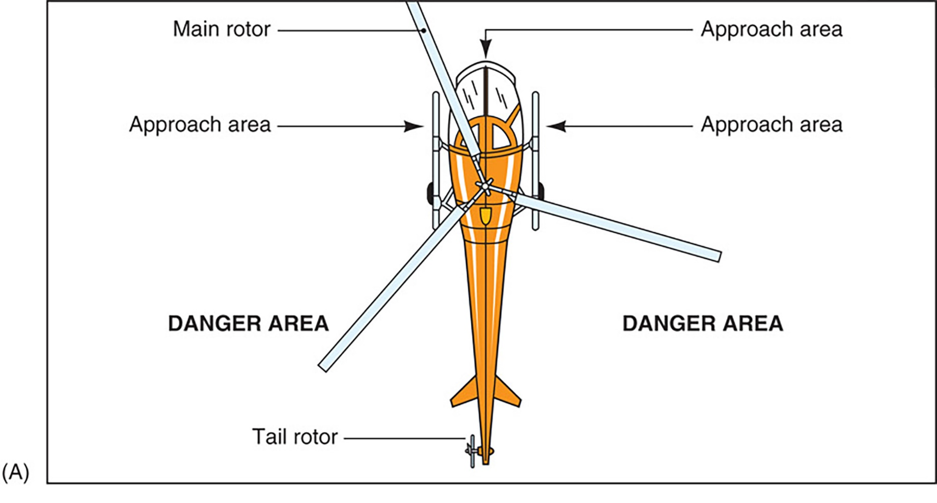
Landing Zone (2 of 2)
For long description, see slide 83: Appendix 1
(A) The area around the tail rotor is extremely dangerous. A spinning rotor cannot be seen.
Notes:
Covers Objective: 38.7
Point to Emphasize: An appropriate landing zone (LZ) for a helicopter should be a flat area, free of utility lines, and at least 100 feet square. The slope of an LZ should not be greater than 8 degrees. The LZ should be marked with one flare in an upwind position.
Discussion Topic: Describe an appropriate landing zone for a helicopter. Describe how you would identify the LZ.
Knowledge Application: Review the area around your classroom. Choose and mark a helicopter landing zone. Simulate relaying information about the LZ to an incoming helicopter.

Slide 72
How to Approach a Helicopter
Do not approach unless escorted by flight personnel.
Allow the crew to direct loading of the patient.
Stay clear of tail rotor at all times.
Keep all traffic and vehicles at least 100 feet from the helicopter.
Do not smoke near the aircraft.
Be aware of danger areas.
Notes:
Covers Objective: 38.7
Discussion Topic: Describe an appropriate approach to a helicopter.
Class Activity: Tour a local air rescue service. Review the aircraft and discuss safety procedures.

Slide 73
Chapter Review

Slide 74
Chapter Review (1 of 3)
Inspect the vehicle to ensure it is complete and critical items can be easily located.
A “hot” response means using lights and siren. Hot responses involve high risk. A “cold” response means no lights or sirens. Cold responses decrease risk.
The laws in most states allow the driver of an emergency vehicle running “hot” to break some of the vehicle and traffic laws. However, it must be done with due regard for the safety of others.

Slide 75
Chapter Review (2 of 3)
Pay attention! Do not text, make phone calls, drink beverages, or be in any way distracted while driving.
Secure all gear. It can become a projectile in a crash!
Don’t let your patient become a projectile. Use the stretcher shoulder straps.

Slide 76
Chapter Review (3 of 3)
Wear your seat belt in front and in back (whenever possible).
Know the medical and operational reasons for helicopter transport. Know how to set up a safe helicopter landing zone.

Slide 77
Remember (1 of 3)
Ambulances must be properly stocked and prepared. Pre-call inspections assure readiness and appropriate equipment.
Emergency Medical Dispatchers enhance patient care by providing prearrival instructions and by obtaining information for responders.
Each state has statutes regulating operation of emergency vehicles. E M Ts must be familiar with local rules and regulations.
E M Ts should use good judgment and due regard for safety of others when operating an ambulance.

Slide 78
Remember (2 of 3)
The four steps involved in transferring the patient to the ambulance are selecting proper patient-carrying device, packaging patient for transfer, moving patient to ambulance, and loading patient into ambulance.
Patients should be safely secured prior to the ambulance’s moving. Assessment and care must continue during transport.
The primary concern of transfer of care is continuation of patient care. Failure to do so properly can be considered abandonment.

Slide 79
Remember (3 of 3)
Cleaning the ambulance, replacing used supplies and equipment, and readying the ambulance stretcher are important elements the E M T must complete while terminating a call. However, E M Ts should be prepared for unusual circumstances.
Indications for utilizing air rescue may include both operational and medical reasons. E M Ts should be familiar with local protocols for accessing and utilizing air rescue transport.

Slide 80
Questions to Consider
Does the patient have a true emergency adversely affected by time?
How can I park to best protect the scene and personnel?
Does my personal protective equipment “match” what is being worn by others?
Notes:
Talking Points: True emergencies are generally those that involve threats to life or limb of the patient. When parking at the scene, take into account crime scene management, other apparatus arriving/required, and your vehicle's role in the rescue. Matching PPE with other responders ensures that you are as safe as everyone else at the scene.

Slide 81
Critical Thinking
What equipment should you include in a kit that you carry to the scene?
How should the equipment be positioned so that you can reach urgently needed items quickly?
What special items, if any, should be in the kit to meet local needs?
Notes:
Talking Points: A kit for carrying into a scene should contain items essential to an initial assessment and to treat primary life threatening injuries. When positioning equipment, items necessary for life threatening events should be within reach while the provider is securely seated.

Slide 82

Copyright
This work is protected by United States copyright laws and is provided solely for the use of instructors in teaching their courses and assessing student learning. Dissemination or sale of any part of this work (including on the World Wide Web) will destroy the integrity of the work and is not permitted. The work and materials from it should never be made available to students except by instructors using the accompanying text in their classes. All recipients of this work are expected to abide by these restrictions and to honor the intended pedagogical purposes and the needs of other instructors who rely on these materials.

Slide 83
Appendix 1
The main rotor is the propeller on top. The front of the helicopter and the sides near the cockpit are approach areas. The tail rotor is on the back of the helicopter. The sides near the tail are danger areas.
Return to presentation

