Slide 1

Emergency Care
Fourteenth Edition
Chapter 28
Hematologic and Renal Emergencies
Slides in this presentation contain hyperlinks. JAWS users should be able to get a list of links by using INSERT+F7
Copyright © 2021, 2016, 2012 Pearson Education, Inc. All Rights Reserved
Notes:
If this PowerPoint presentation contains mathematical equations, you may need to check that your computer has the following installed:
1) MathType Plugin
2) Math Player (free versions available)
3) NVDA Reader (free versions available)

Slide 2
Topics
The Hematologic System
The Renal System
Notes:
Planning Your Time: Plan 80 minutes for this chapter.
The Hematologic System (40 minutes)
The Renal System (40 minutes)
Note: The total teaching time recommended is only a guideline.
Core Concepts
Disorders of the hematologic system
Disorders of the renal system

Slide 3
The Hematologic System
Back to Topics
Notes:
Teaching Time: 40 minutes
Teaching Tips: Use multimedia graphics to illustrate anemia. Microscopic images will enhance comprehension. Use real-life examples to enhance an otherwise technical discussion. Relate blood disorders to actual symptoms. Clotting and coagulopathies touch on many previous lessons and some lessons to come. Use discussions on acute coronary syndrome and bleeding to add real life elements to this topic. Use conditions such as anemia to underscore the previous discussion on the components of the blood. Use conditions such as sickle cell anemia to underscore the previous discussion on the components of the blood.

Slide 4
The Hematologic System (1 of 2)
Blood
  Represents its own organ system
  Has specific functions
    Control of bleeding by clotting
    Delivery of oxygen to cells
    Removal of carbon dioxide from cells
    Removal and delivery of other waste products to organs that filtrate and remove them
Notes:
Covers Objective: 28.1
Point to Emphasize: Control of bleeding, delivery of oxygen to the cells, and removal of carbon dioxide and other waste products are all functions of the blood.
Discussion Topic: Discuss the role of the blood. What specific functions does it serve?

Slide 5
The Hematologic System (2 of 2)
  Made up of solid components
    Red blood cells
    White blood cells
    Platelets
    Suspended in plasma
  Medications can affect some components of blood.
Notes:
Covers Objectives: 28.1
Knowledge Application: List the components of blood. Ask students to discuss the role that each component plays with regard to body function. Discuss the dysfunction associated with deficits of any component.

Slide 6
Blood Clotting
Aggregation of platelets is body’s most rapid and initial response to stop bleeding.
Clotting factors are a group of proteins produced in liver and released into the bloodstream.
Once activated, clotting factors form clots through clotting cascades.
Notes:
Covers Objective: 28.1
Discussion Topic: Describe the elements of blood clotting and their function.

Slide 7
Coagulopathies
Abnormal clotting of blood
Can occur when body forms clots too readily or patient clots too slowly
Certain diseases make patients prone to poor clotting:
  Advanced liver disease
  Hemophilia
  von Willebrand disease
Notes:
Covers Objective: 28.2

Slide 8
Identifying Patients with Coagulopathies
Certain medical conditions in which the normal ability to form clots can worsen patient’s disease
Patients with prescribed “blood thinners”
  More prone to have life-threatening bleeding when injured than patients not on these medications
Notes:
Covers Objective: 28.3
Discussion Topic: Describe the common causes or origins of coagulopathies.
Class Activity: Divide the class into groups. Assign each group a specific cause of coagulopathy and have them research and present on their topic.

Slide 9
Care for Patients with Coagulopathies (1 of 2)
Emergency treatment
  Take appropriate Standard Precautions.
  Perform a primary assessment and care for any immediate life threats.
  Obtain a history from the patient and identify which specific blood thinning medication he is taking, or which bleeding disorder he suffers from.
  Notify the hospital as early as possible.
Notes:
Covers Objective: 28.3

Slide 10
Care for Patients with Coagulopathies (2 of 2)
Emergency treatment
  Monitor the patient for the development of the signs and symptoms of shock or decreasing mental status.
  Administer supplemental oxygen if the patient appears to be in shock or has a decreased mental status.
  Transport to an appropriate receiving hospital.
Notes:
Covers Objective: 28.3
Discussion Topic: Describe the assessment and care of a patient with a coagulopathy.

Slide 11
Anemia
Lack of normal amount of red blood cells in circulation
Acute anemia
  Sudden blood loss
Chronic anemia
  Recurrent heavy menstrual periods
  Slow gastrointestinal bleeding
  Diseases affecting bone marrow or structure of hemoglobin
Notes:
Covers Objective: 28.3
Point to Emphasize: A lack of a normal number of red blood cells in the circulation is called anemia. This condition can be either chronic or acute.
Discussion Topic: Differentiate acute from chronic anemia.
Critical Thinking: How might anemia complicate other injuries and illnesses? Consider the following problems: blood loss and acute asthma attack.

Slide 12
Sickle Cell Anemia (1 of 4)
Genetic disease affecting R B Cs
Most commonly occurs in patients of African descent
Defective shape resembles a sickle.
Cells have a short life span, leading to chronic anemia.
Notes:
Covers Objective: 28.3
Point to Emphasize: Sickle cell anemia is an inherited disease in which patients have a genetic defect that results in an abnormal structure of the red blood cells.
Discussion Topic: Describe the specific pathophysiology of sickle cell anemia.

Slide 13
Sickle Cell Anemia (2 of 4)
Complications
  Destruction of spleen
  Sickle pain crisis
  Acute chest syndrome
  Priapism
  Stroke
  Jaundice
Notes:
Covers Objective: 28.3
Discussion Topic: Discuss the complications associated with this pathophysiology.
Class Activity: Have students research sickle cell anemia. Discuss prevalence, morbidity and mortality rates, pathophysiology, and complications.

Slide 14
Sickle Cell Anemia (3 of 4)
It is estimated that 1 in 13 African Americans has the sickle cell trait.
Sickle cell trait doesn’t always lead to complications.
  Possible to lead a normal life with sickle cell trait
Notes:
Covers Objective: 28.3

Slide 15
Sickle Cell Anemia (4 of 4)
Administer supplemental oxygen.
Monitor for inadequate respiration.
Monitor for signs of hypoperfusion.
Transport to stroke center if stroke is suspected.
Notes:
Covers Objective: 28.4

Slide 16
The Renal System
Back to Topics
Notes:
Teaching Time: 40 minutes
Teaching Tips: Use this lesson to help underscore previous discussions on abdominal pain. Obtain examples of urinary catheters for demonstration. Use anatomical models and multimedia graphics to demonstrate the renal system. Emphasize that renal problems can be a primary problem or can complicate other illnesses or injuries. Discuss kidney transplant in the context of renal disease. Build on previous lessons by using this topic as an end point.

Slide 17
The Renal System
Components
  Two kidneys
  Two ureters
  One urethra
Kidneys essential for life
  Filter blood.
  Remove certain waste products, excessive salts, and excessive fluid.
  Maintain fluid balance.
Notes:
Covers Objective: 28.5
Point to Emphasize: The renal system is made up of two kidneys, two ureters, and a single urethra. It is responsible for the filtration of the blood and the removal of certain waste products, excessive salts, and excessive fluid from the body.
Discussion Topic: Describe the components and function of the renal system.
Knowledge Application: Have students label the components of the renal system on a blank illustration.

Slide 18
Diseases of the Renal System
Affect many different portions
Range from minor to life threatening
Notes:
Covers Objective: 28.6

Slide 19
Urinary Tract Infections
Most common disease that afflicts renal and urinary system
Caused by bacteria
Usually limited to the bladder
Cause pain and frequent urination.
If left untreated, can result in pyelonephritis
  U T I ascends up ureter into kidney.
Notes:
Covers Objective: 28.6
Discussion Topic: Describe the symptoms associated with a urinary tract infection.

Slide 20
Kidney Stones
Usually made of calcium and formed within the kidney
When in the kidney, they usually cause no symptoms.
When they become dislodged, can cause severe unilateral flank pain.
Patients may report nausea and vomiting.
Notes:
Covers Objective: 28.6
Discussion Topic: Describe the symptoms associated with kidney stones.

Slide 21
Patients with Urinary Catheters
Need for urinary catheter
  Obstruction of bladder outflow
  Neurologic disorder
These patients use urinary catheters to drain urine.
  Commonly inserted in urethra
  May be placed through skin
Complications of U T I and local trauma at site of catheter insertion
Notes:
Covers Objective: 28.6
Discussion Topic: Describe the common complications associated with urinary catheters.

Slide 22
Renal Failure (1 of 3)
Occurs when kidneys lose ability to adequately filter and remove toxins
Acute failure typically results from shock or toxic ingestion.
Chronic failure may be inherited or secondary to damage from uncontrolled diabetes or hypertension.
Notes:
Covers Objective: 28.6
Point to Emphasize: Renal failure can occur acutely or chronically. It is characterized by the kidneys' losing their ability to filter the blood adequately and to remove toxins and excess fluid from the body.

Slide 23
Renal Failure (2 of 3)
End-stage renal disease (E S R D)
  Irreversible renal failure
  Requires dialysis
    Hemodialysis
    Peritoneal dialysis
90% receive hemodialysis in specialized centers.
Notes:
Covers Objective: 28.6
Point to Emphasize: Patients with end-stage renal disease usually require an external medical system to remove toxins and excess fluid from their body.

Slide 24
Renal Failure (3 of 3)
Vast majority of more than 450,000 Americans on dialysis who are treated in dialysis centers undergo 3treatments a week, each lasting 3 to 4 hours.
Only 8 percent treat themselves at home.
E S R D patients often rely on E M S for transport to and from dialysis.
Notes:
Covers Objective: 28.6
Talking Points: At some point in your career, you will transport an ESRD patient and deal with the complications of kidney failure.
Discussion Topic: Discuss the ramifications of failure of the renal system.

Slide 25
Hemodialysis (1 of 5)
Patient connected to a dialysis machine that pumps blood through specialized filters
Two large catheters create a circuit by which blood is removed from the body, filtered, and returned to the body over several hours.
Notes:
Covers Objective: 28.6
Talking Points: A two-port catheter is inserted into a major vein in the torso. An A-V fistula is surgically created and connects arterial and venous blood flow.

Slide 26
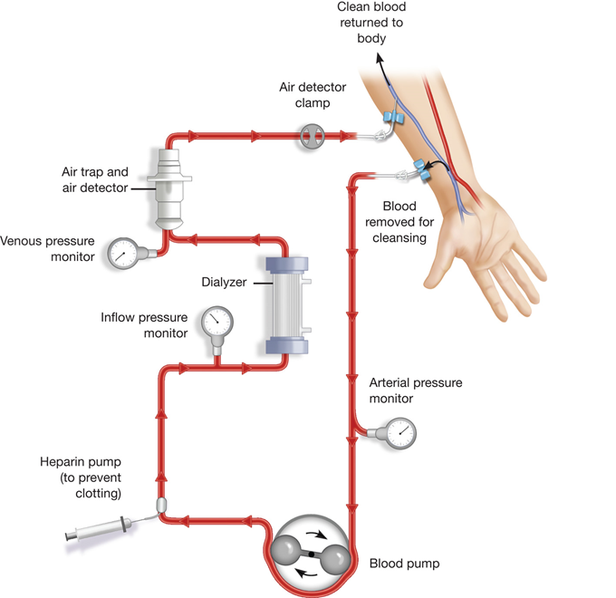
Hemodialysis (2 of 5)
For long description, see slide 51: Appendix 1
How hemodialysis works. Adapted from Treatment Methods for Kidney Failure, National Institute of Diabetes and Digestive and Kidney Diseases; U.S. Centers for Disease Control and Prevention.
Notes:
Covers Objective: 28.6
Talking Points: A two-port catheter is inserted into a major vein in the torso. An A-V fistula is surgically created and connects arterial and venous blood flow.

Slide 27
Hemodialysis (3 of 5)
Two types of access to blood circulation
  Two-port catheter
  A-V fistula
    Characteristic thrill when palpated
Notes:
Covers Objective: 28.6
Critical Thinking: What are the side effects of hemodialysis? How might these side effects impact EMS?

Slide 28
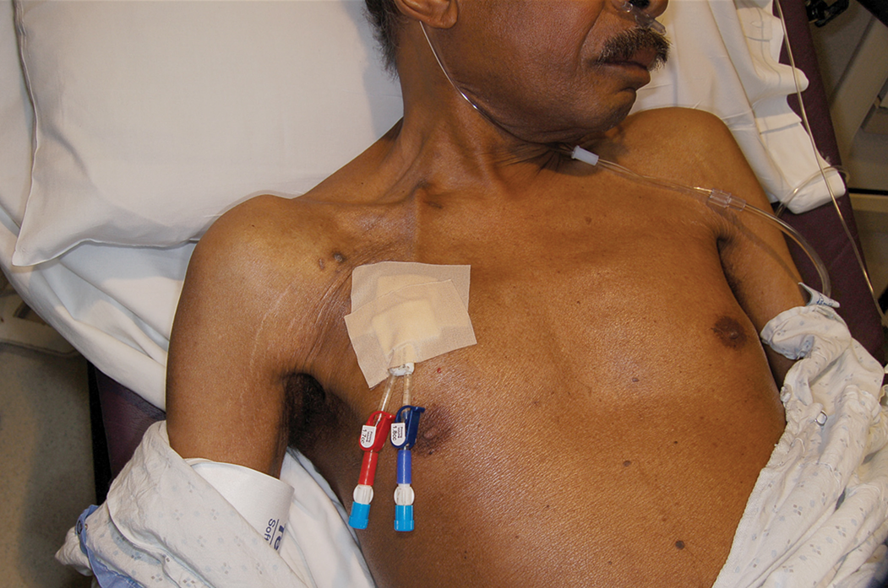
Hemodialysis (4 of 5)
A two-port catheter for hemodialysis inserted into a major vein of the torso. © Edward T. Dickinson, M D
Notes:
Covers Objective: 28.6
Critical Thinking: What are the side effects of hemodialysis? How might these side effects impact EMS?

Slide 29
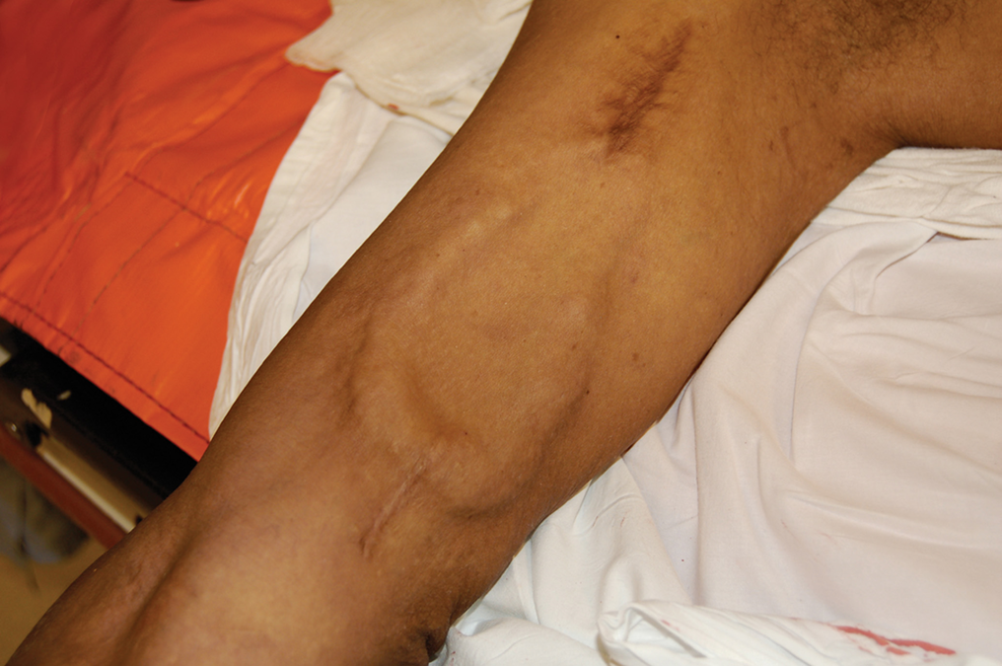
Hemodialysis (5 of 5)
A fistula surgically connects an artery and a vein in an extremity.
© Edward T. Dickinson, M D
Notes:
Covers Objective: 28.6
Critical Thinking: What are the side effects of hemodialysis? How might these side effects impact EMS?

Slide 30
Peritoneal Dialysis (1 of 3)
Uses peritoneal cavity’s large surface area
Special fluid infused into abdominal cavity and left for several hours to absorb waste and excess fluid
Fluid is removed and discarded.
Notes:
Covers Objective: 28.6
Knowledge Application: Have students work in small groups. Ask each group to describe a specific type of dialysis. Include a discussion about how filtration is achieved.

Slide 31
Peritoneal Dialysis (2 of 3)
Continuous ambulatory peritoneal dialysis (C A P D)
  Gravity exchange process repeated several times a day
Continuous cycler-assisted peritoneal dialysis (C C P D)
  Machine used to fill and empty abdominal cavity while person sleeps
Notes:
Covers Objective: 28.6
Knowledge Application: Have students work in small groups. Ask each group to describe a specific type of dialysis. Include a discussion about how filtration is achieved.

Slide 32
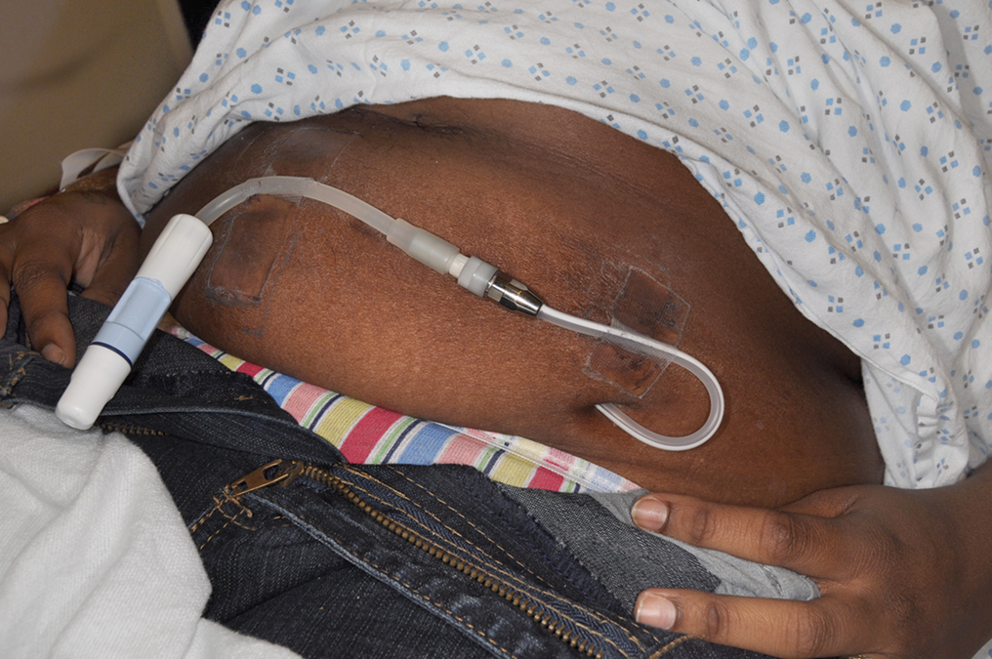
Peritoneal Dialysis (3 of 3)
Peritoneal dialysis catheter.
© Edward T. Dickinson, M D
Notes:
Covers Objective: 28.6
Knowledge Application: Have students work in small groups. Ask each group to describe a specific type of dialysis. Include a discussion about how filtration is achieved.

Slide 33
Medical Emergencies in E S R D
Medical emergencies encountered in patients with E S R D can be broadly divided into two groups.
  Those that arise from the loss of normal kidney function
  Those that are complications of patients’ dialysis treatments
Vast majority of dialysis patients have other underlying diseases such as diabetes and high blood pressure.
Notes:
Covers Objective: 28.7

Slide 34
Complications of E S R D
Usually relate to patient missing dialysis
Present with signs and symptoms similar to congestive heart failure
  Shortness of breath
  Edema
  Electrolyte disturbances
Notes:
Covers Objective: 28.7
Discussion Topic: Describe the most common complications associated with end-stage renal disease.

Slide 35
Care for E S R D Patient Who Has Missed Dialysis
For the E S R D patient who has missed dialysis
  Assess A B Cs.
  Obtain vital signs.
  Place patient in position of comfort.
  Administer oxygen.
  Consider use of C P A P.
  Monitor vital signs closely and have A E D ready.
  Transport to facility capable of dialysis.
Notes:
Covers Objective: 28.7
Talking Points: Be certain not to take a blood pressure on the same arm containing a fistula, as you will damage it. Patients are usually very aware of this, but if your patient is obtunded, you will have to assess this for yourself.

Slide 36
Complications of Dialysis
Bleeding from A-V fistula site
Clotting and loss of function of the A-V fistula
Bacterial infection of blood due to contamination at A-V fistula or dialysis catheter site
  Peritonitis
Notes:
Covers Objective: 28.7
Point to Emphasize: Advanced life support will be an important resource for complications associated with dialysis patients.
Discussion Topic: Discuss common complications associated with dialysis.
Class Activities: Tour a dialysis center. Discuss dialysis equipment. Interview a dialysis patient. Discuss how dialysis is accomplished and whether the patient regularly experiences any complications.
Knowledge Application: Brainstorm common complications of dialysis. Discuss potential treatment options.

Slide 37
Care for E S R D Patient with Complications of Dialysis (1 of 2)
E S R D patient with complications of dialysis
  Assess A B Cs.
  Control bleeding.
    Use direct pressure, elevation, and hemostatic dressings as needed.
    If bleeding cannot be controlled by other means, a tourniquet should be applied.
  Administer oxygen.
Notes:
Covers Objective: 28.7
Knowledge Application: Invite a paramedic to class to discuss the role of advanced life support in the treatment of a dialysis complication.

Slide 38
Care for E S R D Patient with Complications of Dialysis (2 of 2)
  Treat for shock.
    Keep patient supine and warm.
  If peritonitis is suspected, transport dialysis fluid for confirmation.
Notes:
Covers Objective: 28.7

Slide 39
Kidney Transplant Patients
Kidneys are the most commonly transplanted organs.
  Approximately 21,000 transplants per year
Patients spend their lives on special class of drugs.
  Help prevent organ rejection
  Increased susceptibility to infections
Notes:
Covers Objective: 28.7

Slide 40
Chapter Review

Slide 41
Chapter Review (1 of 6)
Blood delivers oxygen to the cells, removes carbon dioxide from the cells, and controls bleeding by clotting.
Blood consists of red blood cells, white blood cells, platelets, and plasma.
Anemia is deficiency of red blood cells in circulation.

Slide 42
Chapter Review (2 of 6)
Sickle cell anemia is an inherited disease in which a defect in the hemoglobin results in a sickle shape to red blood cells. This misshaping inhibits movement of red blood cells through capillaries, causing “sludging” and blockages in smaller blood vessels, and causes chronic anemia.

Slide 43
Chapter Review (3 of 6)
The renal system is comprised of the kidneys, the ureters, the bladder, and the urethra.
The kidneys perform a vital filtering of the blood to remove waste products. They also help maintain a water balance within the body.

Slide 44
Chapter Review (4 of 6)
Problems with the renal system include infection, kidney stones, and renal failure.
Renal failure is a condition in which the kidneys are unable to normally filter waste and provide a balance of fluids and electrolytes in the body.

Slide 45
Chapter Review (5 of 6)
Dialysis removes excess fluid and electrolytes from the body by filtration. Dialysis may be performed in either of two ways: hemodialysis or peritoneal dialysis. Hemodialysis at dialysis centers is generally performed three times per week. Peritoneal dialysis is done at home and is usually done several times daily.

Slide 46
Chapter Review (6 of 6)
Major complications in patients with end-stage renal disease can occur after the patient has missed dialysis appointments, from infections, or as a result of bleeding from hemodialysis access sites.

Slide 47
Remember
Blood has specific cellular components.
Abnormal blood cells can significantly affect patients.
The renal system is critical to maintaining homeostasis.
Renal failure can be chronic or acute.
End-stage renal disease is managed through dialysis.

Slide 48
Questions to Consider
Does my patient have a history of sickle cell disease or E S R D?
Does my patient have an A-V fistula?
Will I need to make an early request for A L S because of complications from a missed dialysis appointment?
Notes:
Talking Points: Discuss how an EMT would handle patients with ESRD. What special precautions are needed?

Slide 49
Critical Thinking
You have a patient who is transported routinely for dialysis three times per week. She was sick and canceled the trip yesterday. Now she calls saying she can’t breathe and feels like she is going to die. Is it possible that she has a legitimate complaint after missing dialysis by only one day?
Notes:
Talking Points: Dialysis is a critical function for patients in ESRD. Missing even one appointment can be a life-threatening emergency. The kidneys are essential to eliminate toxins and regulate water in our bodies. Without dialysis to replace the lost function, this patient's body has no way to rid itself of dangerous toxins.

Slide 50

Copyright
This work is protected by United States copyright laws and is provided solely for the use of instructors in teaching their courses and assessing student learning. Dissemination or sale of any part of this work (including on the World Wide Web) will destroy the integrity of the work and is not permitted. The work and materials from it should never be made available to students except by instructors using the accompanying text in their classes. All recipients of this work are expected to abide by these restrictions and to honor the intended pedagogical purposes and the needs of other instructors who rely on these materials.

Slide 51
Appendix 1
An arm with a fistula and a diagram of blood flow through the dialysis process. The diagram begins with unfiltered blood being removed via catheter from the fistula. Blood flow is controlled via blood pump, which helps blood to move forward. An arterial pressure monitoring gauge is attached before the blood pump. After the blood pump, a syringe is attached to the tubing, and the label states, Heparin pump, to prevent clotting. Then, blood flows into a dialyzer where toxins and excess water are removed. Before the dialyzer is an inflow pressure monitoring gauge, and after the dialyzer is a venous pressure monitoring gauge. Lastly, filtered blood passes through an air detector chamber into a catheter that is inserted into the patient’s arm fistula.
Return to presentation

