Slide 1

Emergency Care
Fourteenth Edition
Chapter 36
Obstetric and Gynecologic Emergencies
Slides in this presentation contain hyperlinks. JAWS users should be able to get a list of links by using INSERT+F7
Copyright © 2021, 2016, 2012 Pearson Education, Inc. All Rights Reserved
Notes:
If this PowerPoint presentation contains mathematical equations, you may need to check that your computer has the following installed:
1) MathType Plugin
2) Math Player (free versions available)
3) NVDA Reader (free versions available)

Slide 2
Topics (1 of 2)
Anatomy and Physiology
Physiologic Changes in Pregnancy
Labor and Delivery
Normal Childbirth
Notes:
Planning Your Time: Plan 180 minutes for this chapter.
Anatomy and Physiology (20 minutes)
Physiologic Changes in Pregnancy (20 minutes)
Labor and Delivery (30 minutes)
Normal Childbirth (20 minutes)
The Neonate (15 minutes)
Care After Delivery (20 minutes)
Childbirth Complications (40 minutes)
Gynecologic Emergencies (15 minutes)
Note: The total teaching time recommended is only a guideline.
Core Concepts
Anatomy and physiology of the female reproductive system
Physiologic changes in pregnancy
Care of the mother and baby during labor and childbirth
Care of the neonate
Postdelivery care of the mother
Complications of delivery
Emergencies in pregnancy
Gynecologic emergencies

Slide 3
Topics (2 of 2)
The Neonate
Care After Delivery
Childbirth Complications
Gynecologic Emergencies

Slide 4
Anatomy and Physiology
Back to Topics
Notes:
Teaching Time: 20 minutes
Teaching Tips: Use anatomic models and multimedia graphics to illustrate anatomy and physiology. Anticipate the changes in pregnancy. Discuss briefly how these organs might change with fetal development. Discuss menses in the context of the reproductive cycle.

Slide 5
External Genitalia
Labia
Perineum
Mons pubis
Notes:
Covers Objective: 36.1
Discussion Topic: Describe the three major external anatomic features of the female reproductive system.

Slide 6
Internal Genitalia (1 of 3)
The vagina
  Birth canal
  Smooth muscle
The ovaries and fallopian tubes
  Ovaries responsible for producing ova
  Fallopian tubes (oviducts) are where fertilization usually occurs.
    Ectopic pregnancy occurs if fertilized ovum implants in fallopian tubes.
Notes:
Covers Objective: 36.1
Discussion Topic: Describe the location and function of the following female reproductive organs: ovaries, fallopian tubes, uterus, vagina.
Knowledge Application: Have students work in groups. Assign each group a specific organ or structure associated with female reproduction. Have groups present to the class and discuss function.

Slide 7
Internal Genitalia (2 of 3)
The uterus
  Muscular, hollow organ located along midline in women’s lower abdominal quadrants
  Intended site for fertilized ovum to implant and develop into a fetus
Notes:
Covers Objective: 36.1
Knowledge Application: Create a matching exercise. Have students match organs and structures to their functions.

Slide 8
Internal Genitalia (3 of 3)
The uterus
  Can stretch and grow as fetus gets larger
  Cervix
    Muscular ring separating uterus and vagina
Notes:
Covers Objective: 36.1

Slide 9
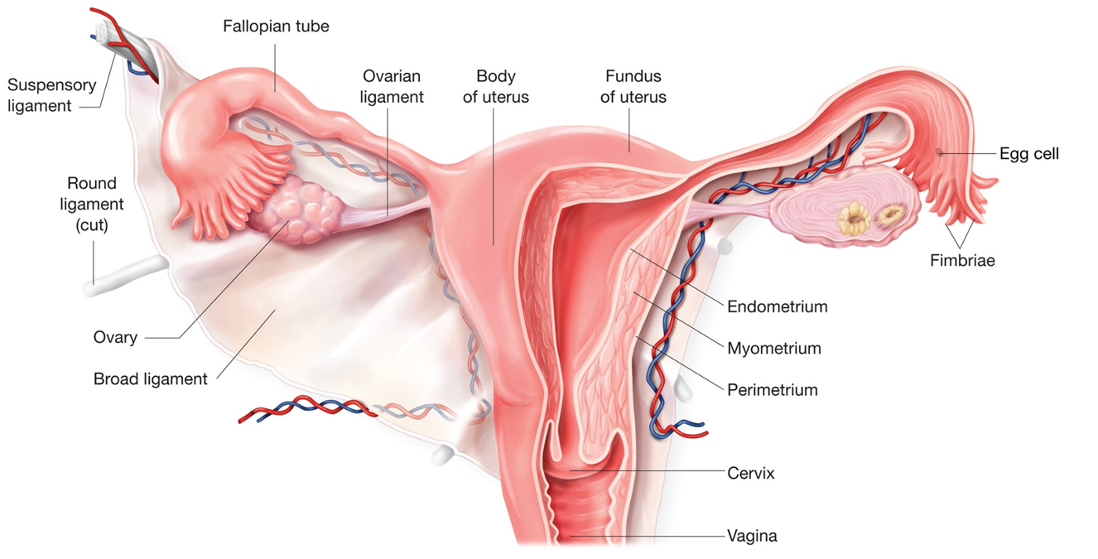
Female Genitalia
For long description, see slide 119: Appendix 1
Internal female genitalia.
Notes:
Covers Objective: 36.1
Point to Emphasize: The ovaries, fallopian tubes, uterus, and vagina are the female reproductive organs. Each organ has specific functions with regard to the production and development of a fetus.
Class Activity: Have students label the major structures of the female reproductive system on a blank diagram.

Slide 10
The Female Reproductive Cycle
Menstruation
  Stimulated by estrogen and progesterone
  Ovaries release ovum (ovulation).
  Uterus walls thicken.
  Fallopian tubes move egg toward uterus (peristalsis).
  Without fertilization, uterine walls expelled
    Bleeding three to five days
Notes:
Covers Objective: 36.1
Points to Emphasize: The monthly reproductive cycle produces predictable changes to the reproductive organs in anticipation of fetal implantation and development. If fertilization does not occur, the reproductive cycle ends with menses.
Discussion Topic: Describe the reproductive changes that occur during the female reproductive cycle.

Slide 11
Fertilization
Sperm reaches ovum.
Ovum becomes embryo.
Embryo implants in uterus.
Fetal stage begins at week 8.
Notes:
Covers Objective: 36.1
Critical Thinking Discussion: Given the anatomic differences in their reproductive systems, what risks might women have that men do not? For what injuries/illnesses do these anatomic differences pose a risk?

Slide 12
Physiologic Changes in Pregnancy
Back to Topics
Notes:
Teaching Time: 20 minutes
Teaching Tips: Consider using an anatomic model to better illustrate the fetus, placenta, and uterus. Compare and contrast normal abdominal anatomy to the anatomy of a full-term pregnancy. Discuss the changes that occur. Invite a pregnant female to class. Describe external changes and illustrate changes in vital signs.

Slide 13
Changes in the Reproductive System (1 of 3)
Nine months of pregnancy
  Three 3-month trimesters
Placenta
  Organ of maternal and fetal tissues
  Exchange area between mother and fetus
    Oxygen
    Nutrients
    Waste products
Notes:
Covers Objective: 36.1
Class Activity: Have students work in groups. Have each group research pregnancy related changes to a particular part of a woman’s body and present to the larger group.

Slide 14
Changes in the Reproductive System (2 of 3)
Umbilical cord
  Circulates blood
  Expelled with delivery of baby, placenta
Amniotic sac
  Fluid that allows fetus to float, cushions fetus, and maintains constant fetal body temperature
Notes:
Covers Objective: 36.1
Critical Thinking Discussion: How might the changes of pregnancy make a woman more vulnerable to trauma?

Slide 15
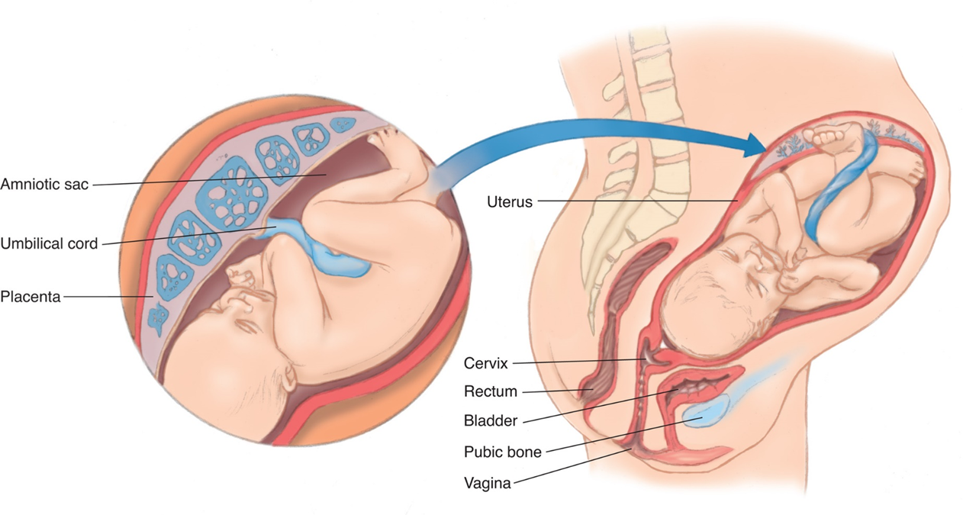
Changes in the Reproductive System (3 of 3)
Structures of pregnancy.
Notes:
Covers Objective: 36.1
Points to Emphasize: A growing fetus creates massive changes to the reproductive system. Most important, the uterus gets larger. Pregnancy increases oxygen demand, increases maternal blood volume, puts pressure on the GI system, and causes ligaments to stretch.
Discussion Topics: Describe how the fetus obtains oxygen and nutrients while inside the uterus. What role does the placenta play?

Slide 16
Other Physiologic Changes in Pregnancy (1 of 3)
Cardiovascular system
  Increased blood volume, cardiac output, and heart rate
Respiratory system
  Increased oxygen demand and consumption
Gastrointestinal system
  Slowed digestion
  Nausea and vomiting
Notes:
Covers Objective: 36.1
Discussion Topic: Describe the major changes that occur during pregnancy. Specifically comment on the following: reproductive system, cardiovascular system, musculoskeletal system, and respiratory system.

Slide 17
Other Physiologic Changes in Pregnancy (2 of 3)
Hormones
  Ligaments are more elastic, thus more vulnerable to injury
Additional weight affects posture, possibly leading to back pain and balance issues
Preexisting medical conditions
Notes:
Covers Objective: 36.1

Slide 18
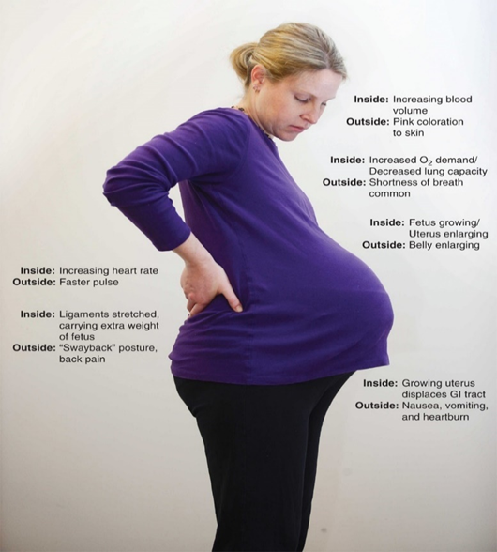
Other Physiologic Changes in Pregnancy (3 of 3)
For long description, see slide 120: Appendix 2
Physiologic changes in pregnancy.
Notes:
Covers Objective: 36.1

Slide 19
Supine Hypotensive Syndrome
Placenta, infant, and amniotic fluid total 20 to 24 l b s.
When supine, mass compresses inferior vena cava.
Cardiac output decreases.
Dizziness and drop in blood pressure
Notes:
Covers Objective: 36.1
Point to Emphasize: Supine hypotensive syndrome causes late-term pregnant females' blood pressure to drop when they lie flat. EMTs can prevent this by positioning them in a lateral recumbent position.
Knowledge Application: Have students work in small groups. Have each group position one of its members so as to avoid supine hypotension syndrome. Consider a seated patient, a supine patient, and a patient on a backboard.

Slide 20
Think About It 1
How does the development of the fetus affect other body systems?
Notes:
Covers Objective: 36.1
Talking Points: The development of the fetus has immediate physical effects on neighboring body systems as well as making other systems in the body work harder to sustain the growing fetus.

Slide 21
Labor and Delivery
Back to Topics
Notes:
Teaching Time: 30 minutes
Teaching Tips: Use multimedia graphics to illustrate the progression of labor. Explain why the changes occur. Discuss how structures must change to allow for delivery of the fetus. Discuss the stages of labor, using real-life examples. Discuss how these stages might be recognizable from assessment findings. The questions used in this assessment are additions to the traditional patient assessment. Remind students not to forget the primary and secondary assessments.

Slide 22
The Stages of Labor
First stage
  Starts with regular contractions and ends when cervix fully dilated
Second stage
  Baby enters birth canal and is born.
Third stage
  Begins after baby is born and ends when afterbirth is delivered
Notes:
Covers Objective: 36.1
Talking Points: Far from involving just the reproductive system, childbirth involves the woman's whole body. Not only is all her strength called for, but her body undergoes massive change in a very short time.

Slide 23
First Stage (1 of 2)
Braxton-Hicks contractions
  Irregular, not sustained, and not indicative of impending delivery
Lightening
  Fetus’s movement from high in the abdomen down toward birth canal
Contractions of the uterus produce normal labor pains.
Notes:
Covers Objective: 36.1

Slide 24
First Stage (2 of 2)
Characteristics of labor pains
  Contraction time, or duration
  Contraction interval, or frequency
  When they last 30 seconds to 1 minute and are 2–3 minutes apart, delivery of the baby may be imminent.
Breaking of amniotic sac
  Fluid with meconium staining indicates that there may be fetal distress.
Notes:
Covers Objective: 36.1

Slide 25
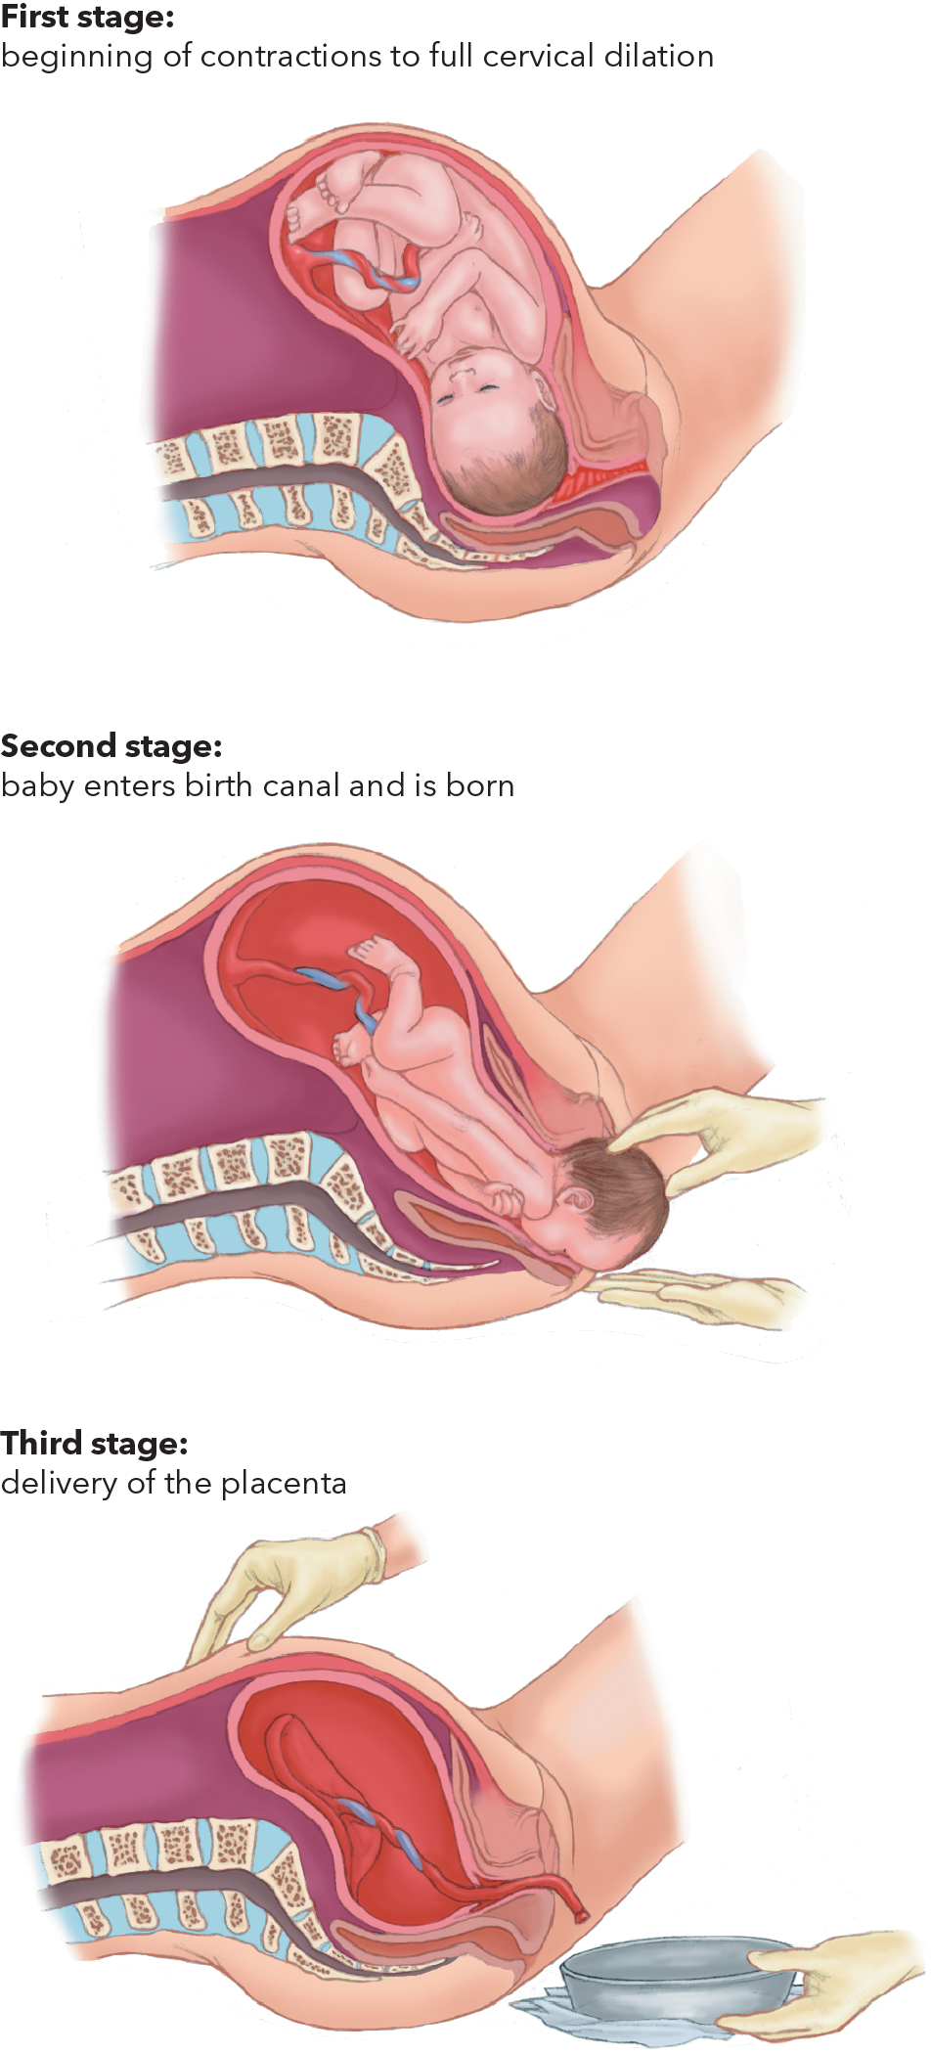
Labor Stages
Three stages of labor.
Notes:
Covers Objective: 36.1

Slide 26
Second Stage
Full dilation of cervix
Contractions increasingly frequent
Labor pain severe
Mother feels urge to push or move bowels.
E M T will have to decide whether to transport the patient, or keep her where she is and prepare to assist with delivery.
Notes:
Covers Objective: 36.1
Discussion Topic: Discuss the pathway that the fetus takes to reach the outside world.

Slide 27
Third Stage
After baby’s birth, contractions resume until placenta is delivered.
Usually lasts 10 to 20 minutes
Notes:
Covers Objective: 36.1

Slide 28
Think About It 2
Why is childbirth such an exhausting ordeal for the mother?
Notes:
Covers Objective: 36.1

Slide 29
Patient Assessment (1 of 4)
Traditional patient assessment
  Airway, breathing, and circulation of primary assessment
  Past medical history of secondary assessment
Expected due date
First pregnancy?
Has patient seen doctor about pregnancy?
Notes:
Covers Objective: 36.2
Point to Emphasize: Assessment of the woman in labor is designed to predict imminent delivery and to recognize likely resuscitation of the neonate. Assessment can also help indicate the level of resources necessary to deliver the baby.
Discussion Topic: Describe the assessment steps necessary to identify imminent delivery. What are the most important findings?

Slide 30
Patient Assessment (2 of 4)
When did labor pains start?
Has water broken or has she had bloody show?
Patient feeling the urge to push or to move her bowels?
Examine for crowning.
Take vital signs.
Notes:
Covers Objective: 36.2
Point to Emphasize: The urge to push and crowning indicate imminent delivery. Transport typically should be deferred to ready for a delivery on scene.
Class Activity: Have students write out a script of questions that they would add to their traditional assessment that might help them identify imminent delivery or neonatal resuscitation.
Knowledge Application: Describe the signs and symptoms of a woman in labor. Ask the class if transport is indicated or if a home delivery is likely. Discuss the decision-making process.
Critical Thinking Discussion: What equipment is necessary in normal childbirth? How might you proceed if standard equipment were not available?

Slide 31
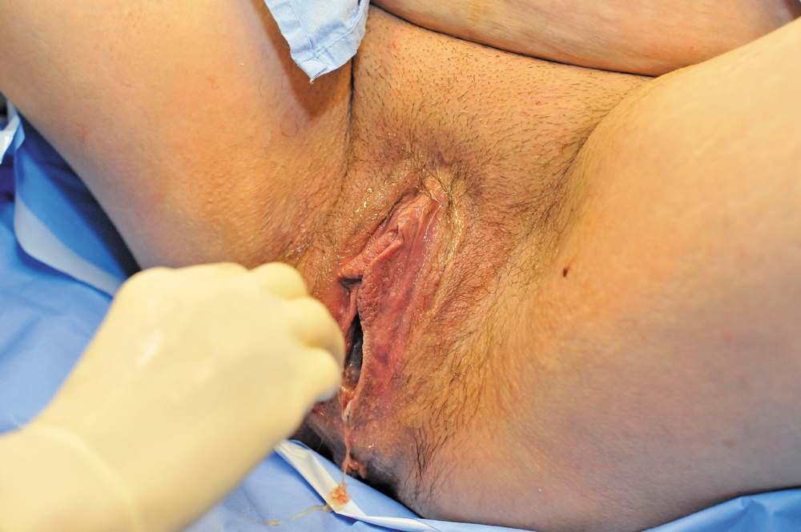
Crowning
Crowning of the infant’s head.
Notes:
Covers Objective: 36.2

Slide 32
Patient Assessment (3 of 4)
Findings that might indicate the need for neonatal resuscitation
  No prior prenatal care
  Premature delivery
  Labor induced by trauma
  Multiple births
Notes:
Covers Objective: 36.2
Point to Emphasize: A lack of prenatal care, premature labor, multiple gestation, and underlying conditions indicate a likelihood of neonatal resuscitation.
Discussion Topic: What questions might you ask to help predict neonatal resuscitation? What answers would indicate resuscitation?
Knowledge Application: Have students work in small groups. Assign a finding that indicates a likelihood of resuscitation. Ask that group to research and present to the class on why that finding might indicate resuscitation.

Slide 33
Patient Assessment (4 of 4)
Findings that might indicate the need for neonatal resuscitation
  History of pregnancy problems (especially placenta previa and breech presentation)
  Labor induced by drug use (especially narcotics)
  Meconium staining when water breaks
Notes:
Covers Objective: 36.2
Discussion Topic: Describe what additional resources might be necessary in the event of a home delivery or neonatal resuscitation.
Knowledge Application: Use programmed patients to simulate assessment scenarios. Have teams of students practice assessment decision making.

Slide 34
Think About It 3
How can you get necessary information from a patient who may be having uncontrolled pain from contractions?
Notes:
Covers Objective: 36.2
Talking Points: Interviewing a woman who is in the midst of delivery is not an easy task. It will be helpful to get information from family. If the mother cannot tell you how far apart contractions are, you may have to time a set yourself.

Slide 35
Normal Childbirth
Back to Topics
Notes:
Teaching Time: 20 minutes
Teaching Tips: This section lends itself well to video clips of birth. Use video to demonstrate the progression of labor. Discuss and demonstrate the personal protective equipment necessary during a delivery. Use an anatomic model to demonstrate checking the position of the umbilical cord. Describe the technique used if the umbilical cord is wrapped around the baby’s neck. Demonstrate a bulb syringe. Use a manikin to demonstrate the steps of suctioning a newborn.

Slide 36
Role of the E M T
E M Ts do not deliver babies; mothers do.
Primary role is to determine whether the delivery will occur on scene and if so, to assist mother as she delivers her child.
Notes:
Covers Objective: 36.2

Slide 37
Preparing the Mother for Delivery (1 of 2)
Control scene.
Wear proper P P E.
Place mother on bed, floor, or ambulance stretcher.
Remove clothing obstructing vagina.
Position assistant and O B kit.
If possible, make environment as warm as possible.
Notes:
Covers Objective: 36.2
Point to Emphasize: Childbirth requires a high level of personal protective equipment.
Discussion Topic: Describe the personal protective equipment necessary for a delivery.
Knowledge Application: Using a programmed patient or a manikin, prepare for a delivery. Don appropriate personal protective equipment; prepare equipment and organize the delivery field. Discuss.

Slide 38
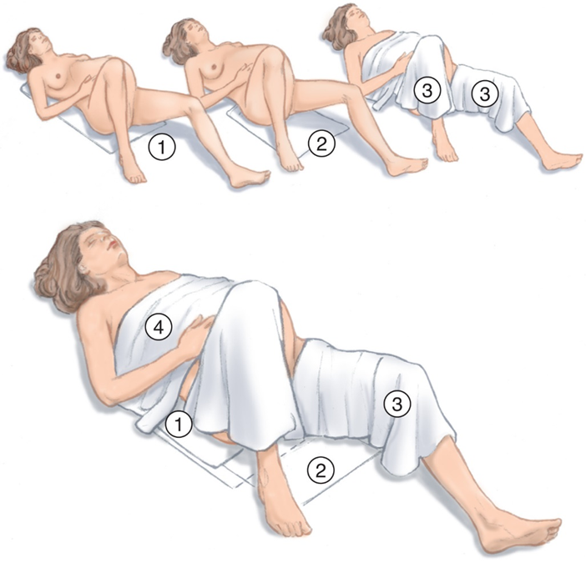
Preparing the Mother for Delivery (2 of 2)
Preparing the mother for delivery. Numbers signify the order for placing items and draping the mother.
Notes:
Covers Objective: 36.2
Point to Emphasize: Emotional support for the mother is important during childbirth.
Knowledge Application: Have groups of students use programmed patients to role-play a delivery. Concentrate on scene management and teamwork.

Slide 39
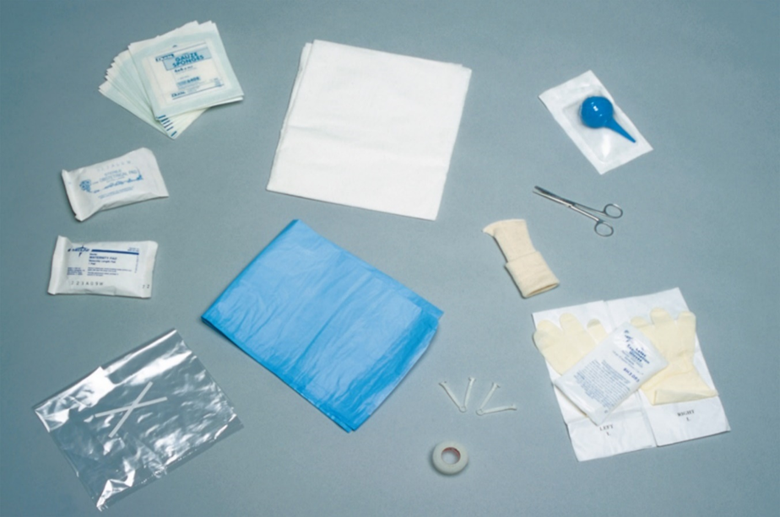
Preparing the O B Kit (1 of 2)
Contents of an O B (obstetrics) kit.
Notes:
Covers Objective: 36.2
Class Activity: Assemble an obstetrics kit. Have students compile the components and discuss the use of each component.

Slide 40
Preparing the O B Kit (2 of 2)
Off-duty delivery supplies
  Clean sheets and towels
  Heavy, flat twine or new shoelaces
  Towel or plastic bag (for placenta)
  Clean, unused rubber gloves and eyewear
  Head covering for the baby
Notes:
Covers Objective: 36.2

Slide 41
Think About It 4
Are there legal/moral/ethical concerns for an off-duty delivery?
Notes:
Covers Objective: 36.2
Talking Points: Students should be conversant with local laws and regulations governing any work that EMTs do while not on duty. Are they covered by Good Samaritan statutes? Are they required to assist?

Slide 42
Assisting the Delivery (1 of 8)
Position for constant view of the vaginal opening.
Be prepared for the patient to experience discomfort.
Provide emotional support.
Communicate with patient through contractions.
Notes:
Covers Objective: 36.2

Slide 43
Assisting the Delivery (2 of 8)
Assisting with a normal delivery
  Keep someone at mother’s head.
  Position gloved hands at vaginal opening when baby’s head starts to appear.
    Place hand on baby’s head as it bulges out to prevent sudden uncontrolled expulsion.
  Place one hand below baby’s head as it delivers.
Notes:
Covers Objective: 36.2

Slide 44
Assisting the Delivery (3 of 8)
Assisting with a normal delivery
  If amniotic sac has not broken at time of delivery, use your finger to puncture the membrane.
  Once the head delivers, check to see if the umbilical cord is wrapped around the baby’s neck.
  Help deliver the shoulders.
Notes:
Covers Objective: 36.2

Slide 45
Assisting the Delivery (4 of 8)
Assisting with a normal delivery
  Support the baby during the entire process.
  Assess the airway.
    Use syringe to suction mouth and nose if necessary.
  Note exact time of birth.
Notes:
Covers Objective: 36.2
Knowledge Application: Using a manikin, demonstrate the steps involved in suctioning a newborn. Have students repeat.

Slide 46
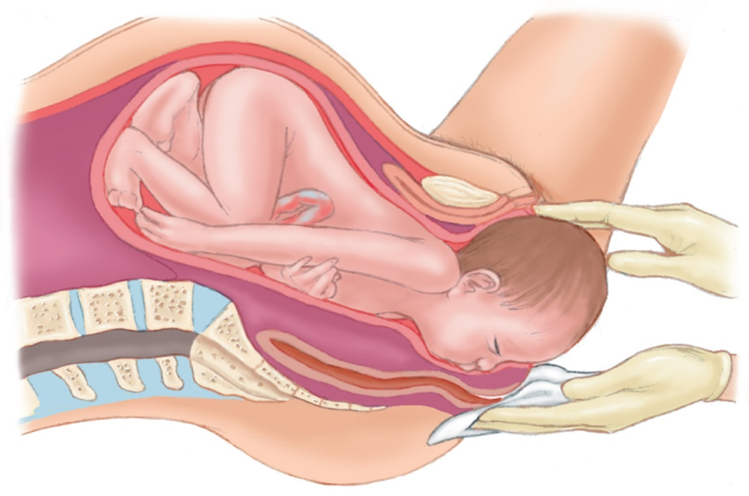
Assisting the Delivery (5 of 8)
First Take Standard Precautions.
1. Support the infant’s head. (Assist the mother by supporting the baby throughout the birth process.)
Notes:
Covers Objective: 36.2

Slide 47
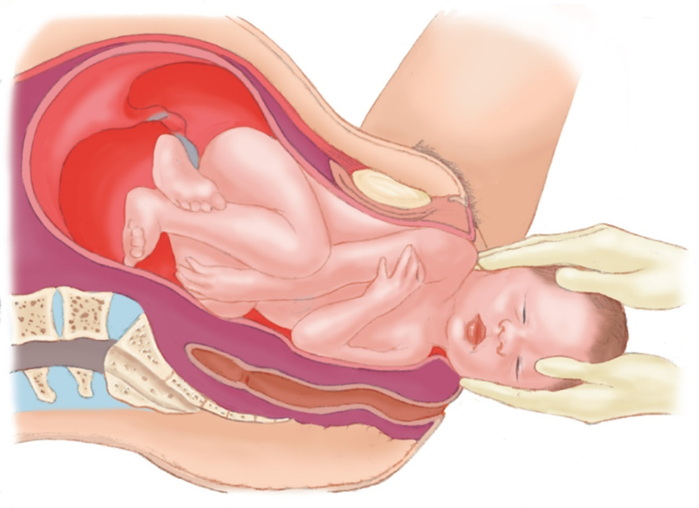
Assisting the Delivery (6 of 8)
2. Aid in the birth of the upper shoulder.
Notes:
Covers Objective: 36.2
Discussion Topic: Discuss the steps that you must take as the baby's head appears. Describe preventing an explosive delivery, assessing the umbilical cord, and suctioning.

Slide 48
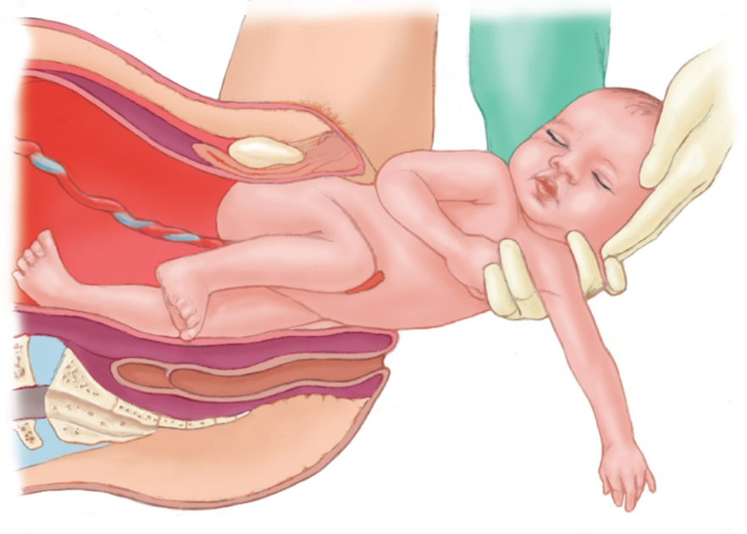
Assisting the Delivery (7 of 8)
3. Support the trunk.
Notes:
Covers Objective: 36.2

Slide 49
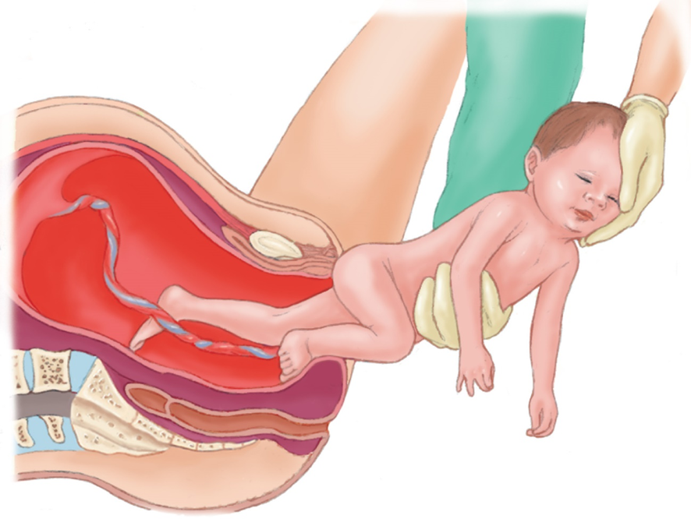
Assisting the Delivery (8 of 8)
4. Support the pelvis and lower extremities.
Notes:
Covers Objective: 36.2
Critical Thinking Discussion: How might cultural considerations affect the steps you take to assist with delivery? Are there cultures in which standard practice might not be acceptable?

Slide 50
Ongoing Assessment and Care of the Mother
Do not forget to continue to assess and care for the mother following birth.
Use the primary assessment to identify life threats.
Most frequent risk for the mother is bleeding.
Provide emotional care.
Notes:
Covers Objective: 36.2

Slide 51
The Neonate
Back to Topics
Notes:
Teaching Time: 15 minutes
Teaching Tips: Invite a labor and delivery nurse or physician to share their insights on the world of neonates. Use multimedia graphics to simulate the assessment of a neonate. Use a manikin to demonstrate the immediate steps in caring for a newborn. Describe drying and stimulating. Neonatal resuscitation is an infrequently used skill that requires immediate action. Emphasize the need to learn and memorize the basic, immediate steps. Practice!

Slide 52
Assessing the Neonate
Assess neonate immediately at birth.
Protocol usually calls for noting ease of breathing, heart rate, crying, movement, and skin color.
A P G A R score
  Does not guide resuscitation efforts
  Based on Appearance, Pulse, Grimace, Activity, and Respiratory effort.
Notes:
Covers Objective: 36.2
Discussion Topic: List the key elements of the initial neonatal assessment.
Knowledge Application: Given a simulated patient, complete a neonatal assessment including computation of an APGAR score.

Slide 53
Caring for the Neonate (1 of 4)
Keeping the baby warm
  Heat retention is high priority.
  Dry baby.
  Discard wet blankets.
  Wrap baby in a dry blanket.
    Infant swaddler or “space blanket”
  Cover head.
  Encourage breastfeeding.
Notes:
Covers Objective: 36.2
Discussion Topic: List and describe the immediate treatment priorities for a neonate.

Slide 54
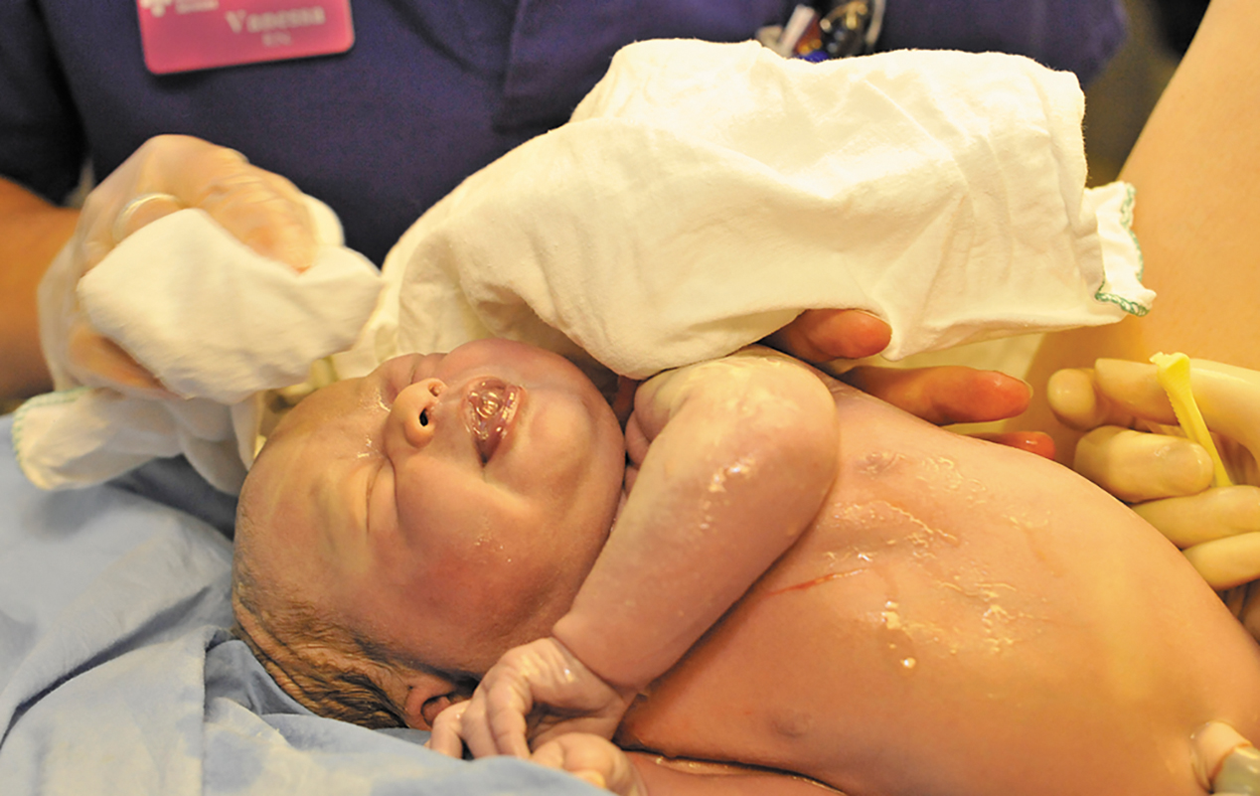
Keeping the Baby Warm
Dry and wrap the baby in a warm blanket or swaddler.
Notes:
Covers Objective: 36.2

Slide 55
Caring for the Neonate (2 of 4)
Cutting the umbilical cord
  Circumstances necessitating cutting
    If cord wrapped around baby’s neck and cannot be slipped over head
    If attachment impedes resuscitation effort
    If attachment interferes with urgent need for transport of mother or baby
    If protocol requires it
Notes:
Covers Objective: 36.2

Slide 56
Caring for the Neonate (3 of 4)
Cutting the umbilical cord
  Steps
    Keep infant warm
    Use sterile clamps.
    Apply one clamp about 10 inches from the baby.
    Place a second clamp about 7 inches from the baby.
Notes:
Covers Objective: 36.2
Discussion Topic: Describe the process for cutting an umbilical cord.

Slide 57
Caring for the Neonate (4 of 4)
Cutting the umbilical cord
  Steps
    Cut the cord between clamps using surgical scissors.
    Be careful when moving the baby so no trauma is brought to the clamped cord.
  Place the baby on the mother’s abdomen and allow her to begin breastfeeding.
Notes:
Covers Objective: 36.2

Slide 58
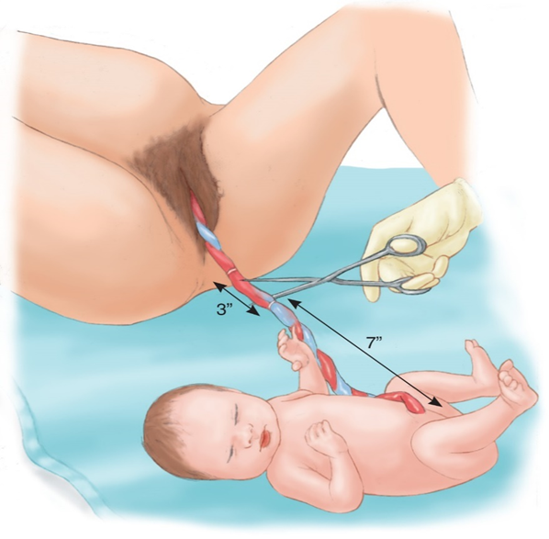
Cutting the Umbilical Cord
Cutting the umbilical cord.
Notes:
Covers Objective: 36.2

Slide 59
Think About It 5
Why is it so important to stimulate the baby?
Notes:
Covers Objective: 36.2

Slide 60
Neonatal Resuscitation (1 of 5)
Dry, warm, and stimulate the neonate for 30 seconds.
Establish that the baby is breathing.
  Evaluate respirations, heart rate, and muscle tone.
  If shallow, slow, gasping, or absent, provide positive pressure ventilation at a rate of 40 to 60 per minute.
Notes:
Covers Objective: 36.2
Knowledge Application: Have students work in small groups, using a manikin to practice the immediate care of a newborn. Provide different scenarios that require increased levels of intervention.
Class Activity: Dry, warm, and stimulate. Pass a manikin among students. Have each student dry, warm, and stimulate the newborn. Emphasize key steps to prevent hypothermia.

Slide 61
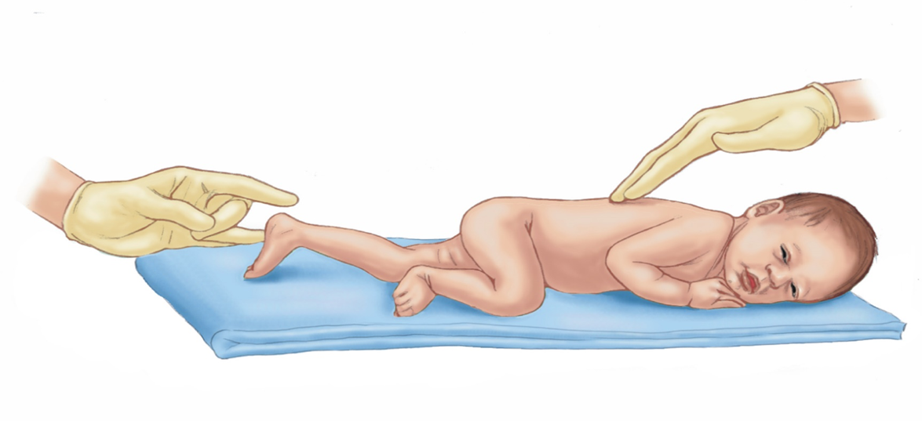
Neonatal Resuscitation (2 of 5)
It may be necessary to stimulate the newborn to breathe.
Notes:
Covers Objective: 36.2

Slide 62
Neonatal Resuscitation (3 of 5)
Assess infant’s heart rate.
  If less than 100 beats per minute, continue positive pressure ventilations.
  If less than 60 beats per minute, begin chest compressions at 120 events per minute (90 compressions and 30 ventilations).
If adequate respirations and a pulse greater than 100 beats per minute, move to routine care.
Notes:
Covers Objective: 36.2
Knowledge Application: Have small groups of students discuss how ventilations and compressions differ in a newborn when compared to adult CPR.
Class Activity: (Skill Demonstration) Using a manikin, demonstrate the proper procedure for performing positive pressure ventilations on a neonate.
(Skill Demonstration) Using a manikin, demonstrate the proper procedure for performing CPR on a neonate.

Slide 63
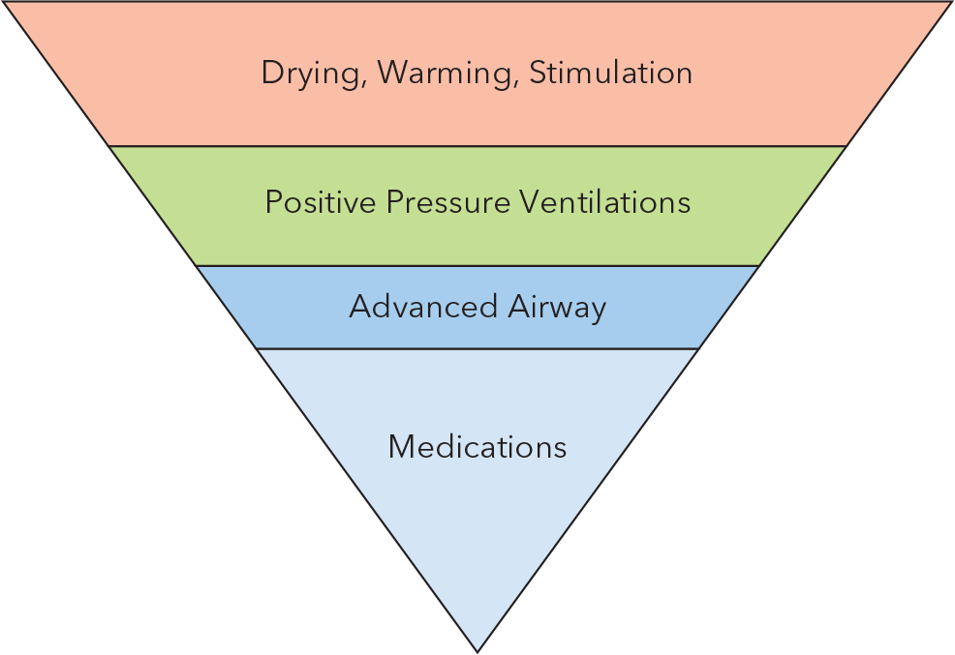
Neonatal Resuscitation (4 of 5)
For long description, see slide 121: Appendix 3
Inverted pyramid of neonatal resuscitation.
Notes:
Covers Objective: 36.2
Critical Thinking Discussion: You are called to respond to a mother who has delivered an extremely premature baby. You arrive and find that the baby was delivered at 15 weeks. It is extremely small and is not breathing. Do you begin resuscitation? What is the age of viability for a newborn?

Slide 64
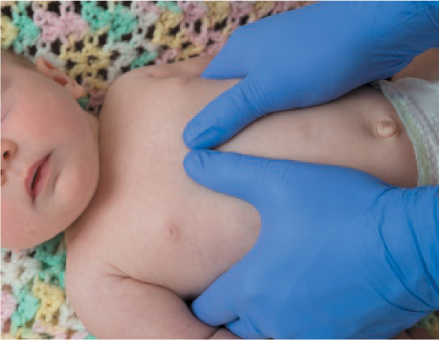
Neonatal Resuscitation (5 of 5)
Deliver chest compressions mid-sternum with two thumbs, at a depth of one-third to one-half depth of the chest. For a very small infant, the thumbs may be overlapped.
Notes:
Covers Objective: 36.2
Knowledge Application: Have students use a manikin to practice the assessment and treatment steps of neonatal resuscitation.

Slide 65
Think About It 6
What are the first steps in neonatal resuscitation?
What is central cyanosis?
When is artificial ventilation required, and what is the rate of artificial ventilations?
Notes:
Covers Objective: 36.2

Slide 66
Care After Delivery
Back to Topics
Notes:
Teaching Time: 20 minutes
Teaching Tips: Emphasize that the mother may be the more serious patient. Post-partum hemorrhage can kill. Use previous discussions about shock to describe the treatment of a hemorrhaging mother. Advise students that uterine massage can be quite painful to the mother. Nonetheless, it is necessary in the event of excessive hemorrhage.

Slide 67
Caring for the Mother
Mother at risk for serious bleeding, infection, emboli
Deliver placenta.
Control vaginal bleeding.
Comfort.
Notes:
Covers Objective: 36.3

Slide 68
Delivering the Placenta (1 of 2)
Afterbirth
  Placenta with umbilical cord, amniotic sac membranes, and tissues lining uterus
Placental delivery starts with labor pains.
May take 30 minutes or longer
Begin transport in 20 minutes.
Notes:
Covers Objective: 36.3
Discussion Topic: Describe the delivery of the placenta. How would you know that this stage of labor has begun?

Slide 69
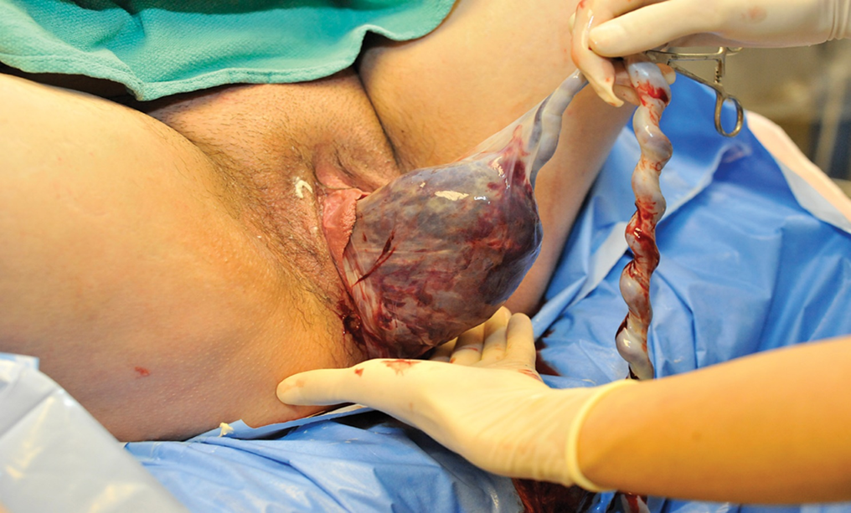
Delivering the Placenta (2 of 2)
Guide the placenta out as it begins to appear at the vaginal opening.
Notes:
Covers Objective: 36.3
Critical Thinking Discussion: You deliver the placenta, but what has delivered looks like only a piece of the placenta. The mother is still bleeding heavily. What are the potential problems if part of the placenta remains inside the uterus?

Slide 70
Controlling Vaginal Bleeding after Birth
Place a sanitary napkin over the mother’s vaginal opening. Do not place anything in the vagina.
Have the mother lower her legs and keep, but not squeeze, them together.
Massaging the uterus will help it contract, which controls the bleeding.
Encourage the mother to begin nursing the baby.
Notes:
Covers Objective: 36.3
Discussion Topic: Describe how you might differentiate the normal bleeding that is associated with delivery from excessive bleeding.
Knowledge Application: Use a programmed patient to create post-delivery scenarios. Practice assessment. Have students focus on identifying excessive bleeding and shock.

Slide 71
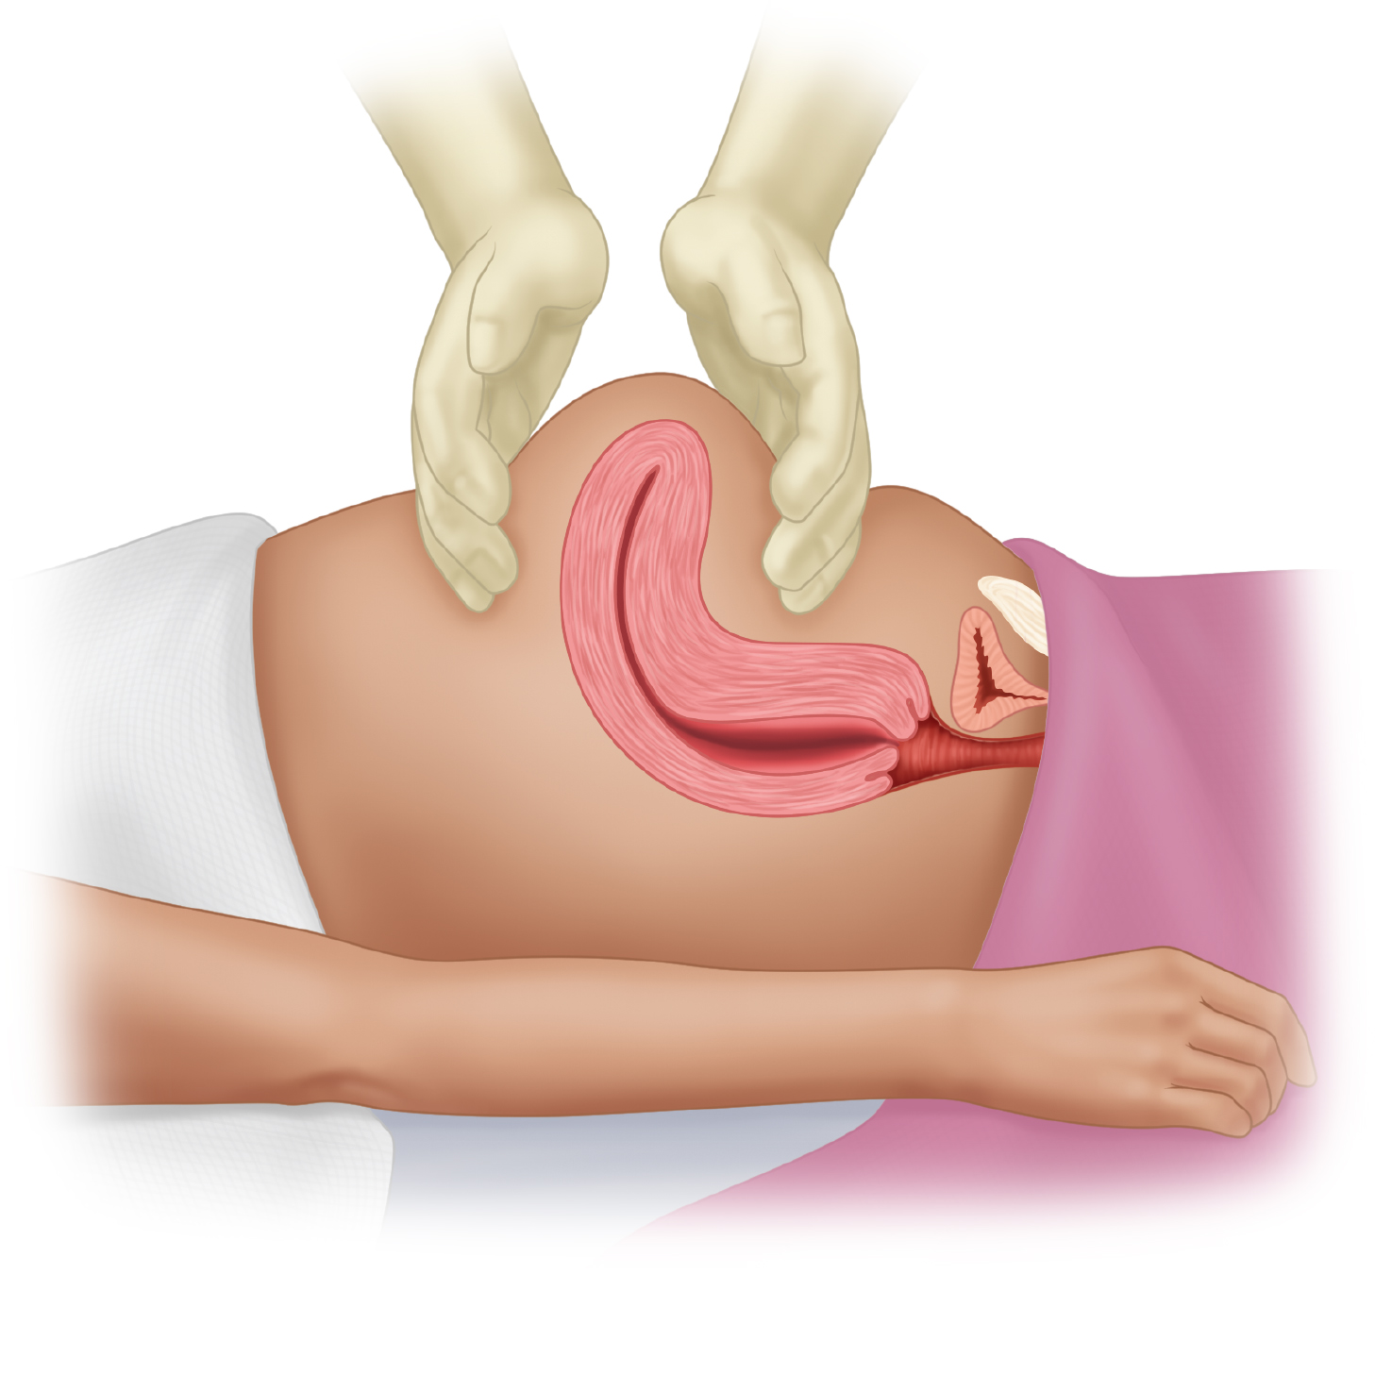
Controlling Vaginal Bleeding
After delivery of the placenta, massage the uterus to help control vaginal bleeding.
Notes:
Covers Objective: 36.3
Discussion Topic: Discuss the steps used to treat excessive bleeding after delivery.
Knowledge Application: Have students work in small groups to describe the steps used to control excessive hemorrhage after delivery.

Slide 72
Providing Comfort to the Mother
Take vital signs frequently.
Acts of kindness will be appreciated and remembered.
  Wipe face and hands with damp washcloth.
  Replace blood-soaked sheets and blankets.
Notes:
Covers Objective: 36.3
Class Activity: Discuss emotional care. If there are mothers in the class, ask them to discuss how they would like to have been treated following childbirth.

Slide 73
Think About It 7
What are your responsibilities in caring for the mother?
What is considered to be the usual blood loss?
Give examples of acts of kindness toward the mother.
Notes:
Covers Objective: 36.3

Slide 74
Childbirth Complications
Back to Topics
Notes:
Teaching Time: 40 minutes
Teaching Tips: This section lends itself well to a multimedia presentation. Use graphics to illustrate umbilical prolapse, placenta previa/abruption placentae, and breech presentations. Emphasize that the steps necessary to treat a prolapsed cord or a difficult breech delivery need to be undertaken immediately. Relate this to your previous discussions about neonatal CPR. How many ventilations of a newborn are lost with just a minute’s delay? Consider inviting a midwife, OB physician, or OB nurse to discuss treating complications of delivery. Reach out to your local domestic violence or sexual assault support center. Their experts frequently have extensive resources on trauma (assault) during pregnancy and are typically eager to offer their expertise.

Slide 75
Complications of Delivery
Common complications
  Cord around the neck
  Unbroken amniotic sac
  Infants who need encouragement to breathe
Notes:
Covers Objective: 36.4

Slide 76
Breech Presentation (1 of 2)
Most common abnormal delivery
Buttocks- or both-legs-first delivery
Risk of birth trauma to baby is high.
Meconium staining often occurs.
Notes:
Covers Objective: 36.4
Discussion Topic: Describe the steps necessary to provide an airway to a complicated breech delivery. Why is immediate action so important?

Slide 77
Patient Care—Breech Presentation
Initiate rapid transport.
Never attempt to deliver baby by pulling on legs.
Provide high-concentration oxygen to mother.
Place mother in head-down position with pelvis elevated.
If body delivers, support it to prevent explosive delivery.
Care for baby, cord, mother, and placenta as for cephalic delivery.
Notes:
Covers Objective: 36.4

Slide 78
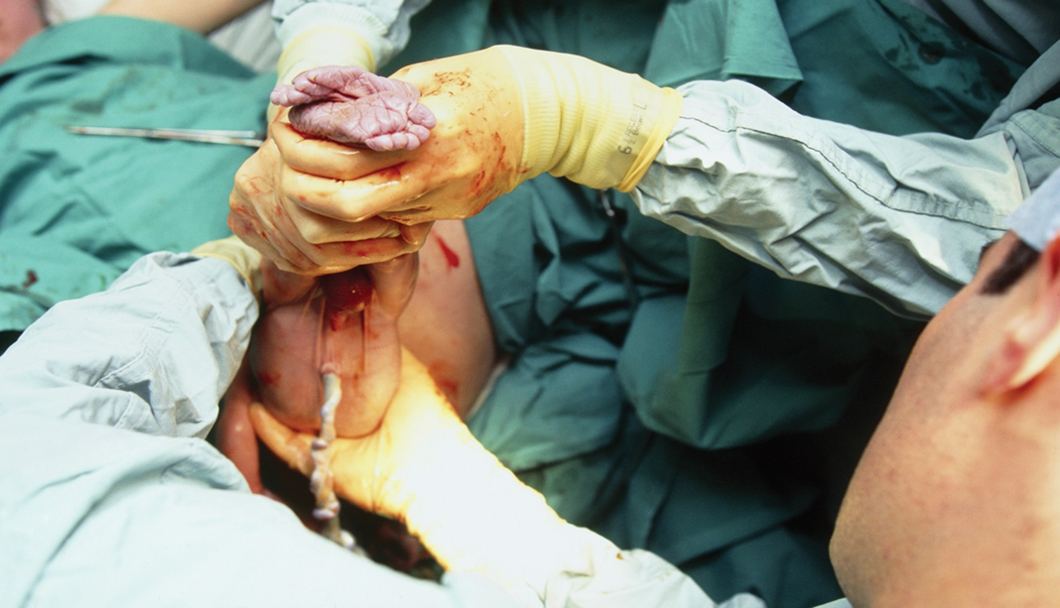
Breech Presentation (2 of 2)
Breech delivery. © Eddie Lawrence/ScienceSource
Notes:
Covers Objective: 36.4

Slide 79
Limb Presentation (1 of 2)
A limb of infant protrudes from the vagina.
Commonly a foot when baby in breech position.
Prolapsed cord often present as well.
Rapid transport essential
  Cannot be delivered in a prehospital setting
Notes:
Covers Objective: 36.4

Slide 80
Patient Care—Limb Presentation
Transport immediately.
Place mother in head-down position with pelvis elevated.
Do not pull on limb or replace limb into vagina.
Do not place gloved hand into vagina unless there is a prolapsed cord.
Administer high-concentration oxygen to mother.
Notify receiving facility of limb presentation.
Notes:
Covers Objective: 36.4

Slide 81
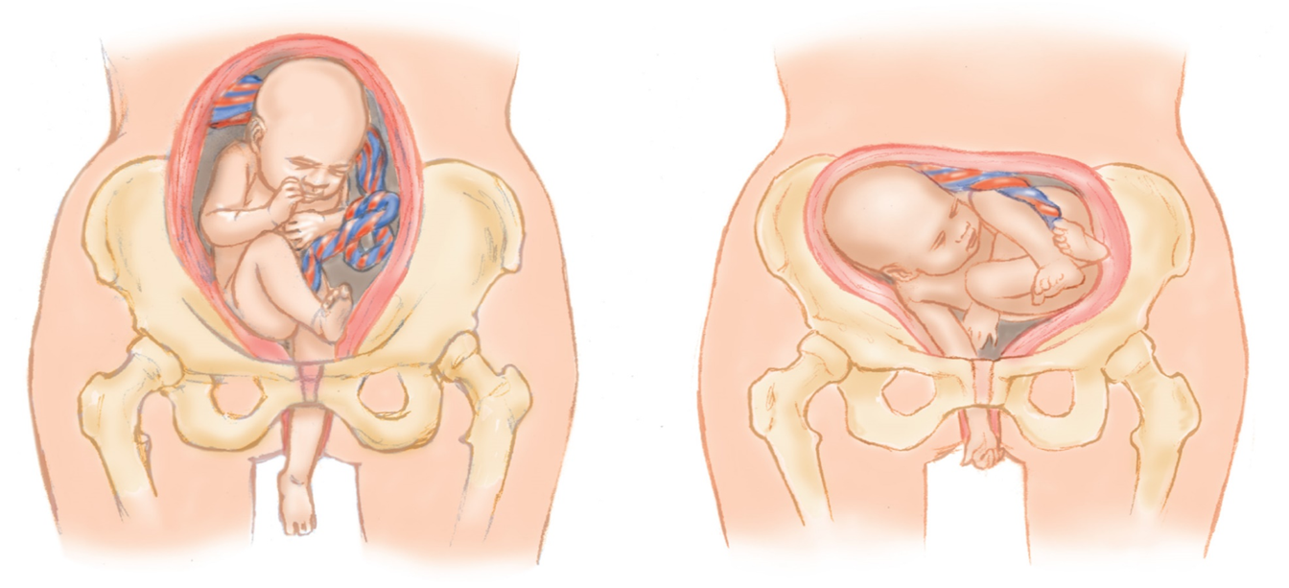
Limb Presentation (2 of 2)
Limb presentation.
Notes:
Covers Objective: 36.4

Slide 82
Prolapsed Umbilical Cord (1 of 2)
When umbilical cord presents first and becomes squeezed between vaginal wall and baby’s head
Oxygen supply to the baby may be totally interrupted.
Life-threatening condition
Notes:
Covers Objective: 36.4
Discussion Topic: Describe a prolapsed umbilical cord. Why is this dangerous to the fetus? Describe the immediate actions necessary to treat this complication.

Slide 83
Patient Care—Prolapsed Umbilical Cord
Position mother with head down and pelvis raised.
Provide mother with high-concentration oxygen.
Check cord for pulses and wrap exposed cord.
Insert fingers into vagina to push up on baby’s head or buttocks to keep pressure off the cord.
Keep mother, child, and E M T as a unit.
Transport immediately.
Notify receiving facility of prolapsed cord.
Notes:
Covers Objective: 36.4
Class Activity: Describe a complication. Have students discuss the immediate necessary actions. Discuss treatment in general.

Slide 84
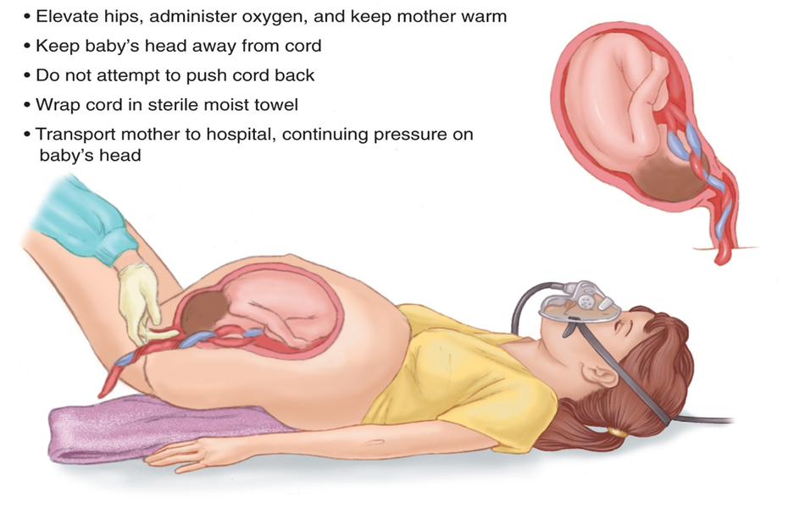
Prolapsed Umbilical Cord (2 of 2)
For long description, see slide 122: Appendix 4
Prolapsed umbilical cord.
Notes:
Covers Objective: 36.4

Slide 85
Patient Care—Multiple Birth
Have appropriate resources.
Clamp or tie cord of first baby.
Assist with delivery of second baby.
Placenta and cord care are same as single delivery.
Keep babies and mother warm.
Notes:
Covers Objective: 36.4
Discussion Topic: Describe the assessment findings that might indicate multiple births.

Slide 86
Patient Care—Premature Birth
Keep baby warm.
Keep airway clear.
Provide ventilations and/or chest compressions.
Watch umbilical cord for bleeding.
Avoid contamination.
Call ahead to emergency department.
Notes:
Covers Objective: 36.4
Discussion Topic: Discuss the hazards of prematurity. What risks are present with premature infants that are not present with term babies?
Knowledge Application: Assign small groups different weeks of fetal development. Have groups research and present. Focus on fetal development at that week and the potential challenges posed if the baby were to be delivered at that stage of development. Discuss.

Slide 87
Patient Care—Meconium
Stains amniotic fluid greenish or brownish yellow color
Do not stimulate infant before suctioning.
Maintain open airway.
Provide ventilations and/or chest compressions.
Transport as soon as possible.
Notes:
Covers Objective: 36.4
Knowledge Application: Have students work in small groups. Assign each group a specific complication of delivery. Have the group research and report on pathophysiology and immediate treatment priorities.

Slide 88
Think About It 8
Why is it important to have your partner or another person (birthing coach or other adult acceptable to the mother) observing as you help the mother through childbirth?
Notes:
Covers Objective: 36.4

Slide 89
Emergencies in Pregnancy
Excessive prebirth bleeding
Ectopic pregnancy
Seizures in pregnancy
Miscarriage and abortion
Trauma in pregnancy
Stillbirths
Cardiac arrest of pregnant woman
Notes:
Covers Objective: 36.5

Slide 90
Excessive Prebirth Bleeding (1 of 2)
Placenta previa
  Placenta blocks birth canal
  If placenta is damaged or torn, severe bleeding may occur
Abruptio placentae
  Placenta prematurely separates from uterine wall
  Usually caused by trauma
  Complete abruption causes massive hemorrhage and is usually fatal for the fetus
Notes:
Covers Objective: 36.5
Discussion Topic: Describe the pathophysiology of placenta previa and abruptio placentae. Describe how these disorders might injure the mother and baby.

Slide 91
Excessive Prebirth Bleeding (2 of 2)
Main sign is profuse bleeding.
Abdominal pain may or may not be felt.
Assess for signs of shock.
Provide high-concentration oxygen and transport.
Place sanitary napkin over vagina.
Save all tissue that is passed.
Notes:
Covers Objective: 36.5

Slide 92
Ectopic Pregnancy
Be alert for:
  Acute abdominal pain, often on one side
  Vaginal bleeding
  Rapid and weak pulse
  Low blood pressure
  Absent menstrual period
Notes:
Covers Objective: 36.5
Discussion Topic: Describe the cardinal presentation of ectopic pregnancy. Describe the assessment and care of a patient experiencing an ectopic pregnancy.

Slide 93
Seizures in Pregnancy
Existing preeclampsia
Elevated blood pressure
Excessive weight gain
Excessive swelling to face, ankles hands, and feet
Altered mental status, headache, or other unusual neurologic findings
Notes:
Covers Objective: 36.5
Discussion Topic: Describe the assessment and care of a patient seizing during pregnancy.

Slide 94
Miscarriage and Abortion (1 of 2)
Spontaneous or induced
Cramping, abdominal pains
Bleeding ranging from moderate to severe
Noticeable discharge of tissue and blood from vagina
Notes:
Covers Objective: 36.5

Slide 95
Miscarriage and Abortion (2 of 2)
Obtain vital signs.
If shock is present, keep patient warm and prevent hypoxia.
Place sanitary napkin over vaginal opening.
Transport as soon as possible.
Save all blood-soaked pads and expelled tissues.
Provide emotional support.
Notes:
Covers Objective: 36.5
Knowledge Application: Have students work in small groups. Have them rehearse death and dying situations associated with spontaneous abortion.

Slide 96
Trauma in Pregnancy
Pregnant patient’s pulse 10 to 15 beats per minute faster than nonpregnant women.
Blood loss may be 30 to 35 percent before signs/symptoms appear.
Ask patient if she received blows to abdomen.
Notes:
Covers Objective: 36.5
Discussion Topic: Describe the assessment and care of a patient with trauma during pregnancy.
Critical Thinking Discussion: Discuss the causes of trauma during pregnancy. What portion of the trauma can be accounted for by domestic violence?

Slide 97
Stillbirths
Do not resuscitate if it is obvious the baby died some time before birth.
Provide full resuscitation measures if baby is born in pulmonary or cardiac arrest.
Prepare to provide life support.
Provide emotional support for family.
Notes:
Covers Objective: 36.5

Slide 98
Cardiac Arrest of Pregnant Woman
Chance to save unborn child
Begin C P R on mother immediately.
  Displace uterus if more than 20 weeks
  Position hands 1 to 2 inches higher on sternum to make up for shifting of the heart by large uterus.
Continue C P R until emergency cesarean section can be performed or you are relieved in emergency department.
Notes:
Covers Objective: 36.5

Slide 99
Gynecologic Emergencies
Back to Topics
Notes:
Teaching Time: 15 minutes
Teaching Tips: Teach that vaginal bleeding is another form of internal bleeding and can have the same level of risk. Teach the link between external genitalia trauma and sexual assault. Sexual assault is a difficult situation for EMTs. Recruit expert help for your presentation. Many domestic violence/sexual assault advocacy groups have professional educators who are willing to lend a hand. Invite a law enforcement officer or sexual assault nurse to class to discuss evidence collection and crime scene preservation.

Slide 100
Vaginal Bleeding
Treat as potentially life-threatening.
Check for associated abdominal pain.
Monitor for hypovolemic shock.
Notes:
Covers Objective: 36.6
Discussion Topic: Describe the assessment findings that would indicate life-threatening vaginal bleeding.

Slide 101
Trauma to the External Genitalia
When sizing up the scene, observe for mechanisms of injury.
During primary assessment, look for signs of severe blood loss and shock.
Consider additional internal injuries.
Notes:
Covers Objective: 36.6
Discussion Topic: Describe the treatment steps for external genitalia trauma.

Slide 102
Sexual Assault
Treat immediate life threats.
Do not disturb potential criminal evidence.
Examine genitals only if severe bleeding is present.
Discourage bathing, voiding, or cleansing wounds.
Fulfill mandated reporting requirements.
Notes:
Covers Objective: 36.6
Discussion Topic: Describe the priorities in caring for a sexual assault victim.
Class Activity: Discuss the nonmedical priorities of caring for a sexual assault victim. Consider using a professional advocate/educator to lead this discussion.
Knowledge Application: Using a programmed patient, simulate trauma and sexual assault situations. Have groups of students practice assessment and treatment strategies.
Critical Thinking Discussion: You are called for a sexual assault victim who is refusing evaluation and care. What steps should you take to deal with this situation? Might it be appropriate not to transport this patient?

Slide 103
Think About It 9
When arriving at a crime scene, what are the key things to keep in mind as you respond?
Notes:
Covers Objective: 36.6

Slide 104
Chapter Review

Slide 105
Chapter Review (1 of 5)
Although birth is a natural process that usually takes place without complications, the involvement of E M S usually indicates something unusual has happened.
The E M T’s role at a birth is generally to provide reassurance and to assist the mother in the delivery of her baby.

Slide 106
Chapter Review (2 of 5)
During the normal delivery, the E M T will evaluate the mother to determine if there should be immediate transport or if birth is imminent and will take place at the scene.
If birth is to take place at the scene, the E M T must prepare for the worst. Have equipment ready and appropriate resources on hand. Always be prepared for neonatal resuscitation.

Slide 107
Chapter Review (3 of 5)
Complications of delivery are a true emergency. An E M T must be prepared to initiate rapid transport in the case of breech presentation, prolapsed umbilical cord, limb presentation, premature birth, or meconium staining of the amniotic fluid.

Slide 108
Chapter Review (4 of 5)
There may also be predelivery emergencies or emergencies associated with pregnancy (such as excessive bleeding, ectopic pregnancy, seizures, abortion, or trauma to the pregnant mother) that the E M T must be prepared to treat.

Slide 109
Chapter Review (5 of 5)
Stillbirth, death of the mother, and sexual assault are difficult emergencies the E M T is occasionally called upon to manage. Emotional care for these issues may be as important as medical care.

Slide 110
Remember (1 of 5)
Female reproductive organs present new anatomy and specific potential emergencies. E M Ts should recognize the different anatomy and be prepared to address reproductive emergencies.
A growing fetus creates massive change to the mother’s body. All systems undergo major alterations.

Slide 111
Remember (2 of 5)
Assessment of the woman in labor is designed to predict imminent delivery and to recognize likely resuscitation.
The urge to push and crowning indicate imminent delivery. Transport typically should be deferred for a home delivery.

Slide 112
Remember (3 of 5)
Lack of prenatal care, premature labor, multiple gestation, and underlying conditions indicate a likelihood of neonatal resuscitation.
Childbirth requires a high level of personal protective equipment.

Slide 113
Remember (4 of 5)
The most important aspect of care for a neonate is keeping the baby warm. Resuscitation may be indicated by assessing breathing and heart rate.
After delivery, there are two patients to care for: the infant and the mother.

Slide 114
Remember (5 of 5)
E M Ts should be familiar with the pathophysiology and emergency treatment of the various complications of childbirth.
Care of the sexual assault patient must include medical, legal, and psychological considerations.

Slide 115
Questions to Consider
What is the difference between abruptio placenta and placenta previa?
How do you care for a prolapsed cord?
What do you do if the bag of water is still intact during delivery?
Notes:
Talking Points: Abruptio placenta is when the placenta prematurely separates from the uterine wall. It is often the result of trauma or other medical issues. Placenta previa is when the placenta forms in an abnormal location and blocks the birth canal. Both conditions can cause massive bleeding.
For a prolapsed cord, insert fingers into the mother’s vagina to relieve pressure on the cord from the baby’s head or buttocks. This needs to continue until relieved at the emergency department.
If the bag of water is still intact during delivery, puncture it with a finger after the baby’s head is delivered.

Slide 116
Critical Thinking (1 of 2)
You are called to a pregnant woman in labor. During your evaluation you find that it is the woman’s first pregnancy, the baby’s head is not crowning, and contractions are 10 minutes apart.

Slide 117
Critical Thinking (2 of 2)
You ask the mother if she feels the need to move her bowels, and she says no. Do you prepare for delivery at the scene? Or do you transport the mother to the hospital?
Notes:
Talking Points: The mother is in the first stage of labor, and delivery does not seem imminent. The mother should be transported to the hospital.

Slide 118

Copyright
This work is protected by United States copyright laws and is provided solely for the use of instructors in teaching their courses and assessing student learning. Dissemination or sale of any part of this work (including on the World Wide Web) will destroy the integrity of the work and is not permitted. The work and materials from it should never be made available to students except by instructors using the accompanying text in their classes. All recipients of this work are expected to abide by these restrictions and to honor the intended pedagogical purposes and the needs of other instructors who rely on these materials.

Slide 119
Appendix 1
Diagram shows the location of the broad ligament, ovary, round ligament, suspensory ligament, fallopian tube, ovarian ligament, body of uterus, fundus of uterus, egg cell, fimbriae, endometrium, myometrium, perimetrium, cervix, and vagina.
Return to presentation

Slide 120
Appendix 2
The changes are listed in pairs, one on the inside and the corresponding one noticeable on the outside.
Inside | Outside
increasing heart rate | faster pulse
Ligaments stretched, carrying extra weight of fetus | Swayback posture, back pain
Increasing blood volume | Pink coloration to skin
Increased oxygen demand and decreased lung capacity | Shortness of breath is common
Fetus growing and uterus enlarging | Belly enlarging
Growing uterus displaces G I tract | Nausea, vomiting, and heartburn
Return to presentation

Slide 121
Appendix 3
The steps listed in the neonatal resuscitation pyramid, from bottom to apex, are as follows.
Drying, warming, stimulation.
Positive pressure ventilations
Advanced airway
Medications
Return to presentation

Slide 122
Appendix 4
The steps are as follows.
Elevate hips, administer oxygen, and keep mother warm.
Keep baby’s head away from cord.
Do not attempt to push cord back.
Wrap cord in sterile moist towel.
Transport mother to hospital, continuing pressure on baby’s head.
Return to presentation

