Slide 1
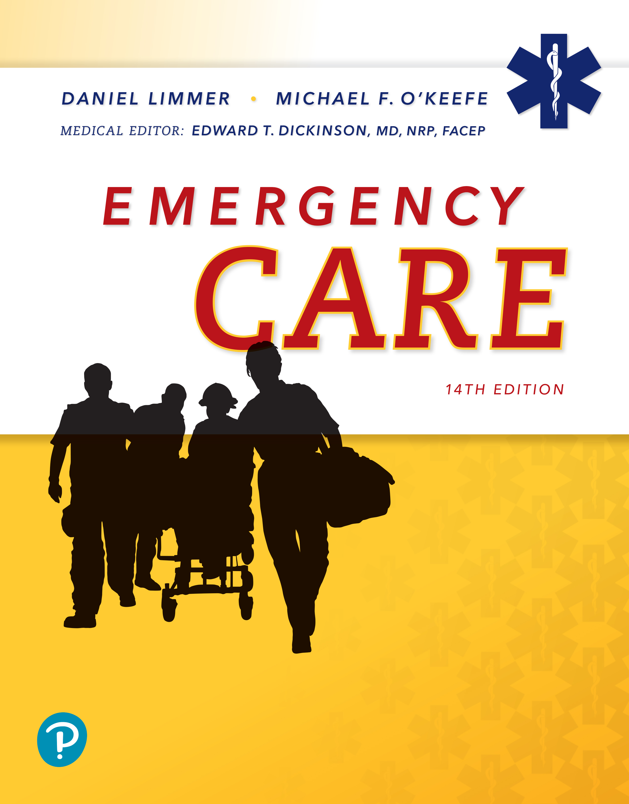
Emergency Care
Fourteenth Edition
Chapter 14
Principles of Assessment
Slides in this presentation contain hyperlinks. JAWS users should be able to get a list of links by using INSERT+F7
Copyright © 2021, 2016, 2012 Pearson Education, Inc. All Rights Reserved
Notes:
If this PowerPoint presentation contains mathematical equations, you may need to check that your computer has the following installed:
1) MathType Plugin
2) Math Player (free versions available)
3) NVDA Reader (free versions available)

Slide 2
Topics
Principles of Assessment
The Physical Examination
Body System Examinations
Critical Thinking and Decision Making
Notes:
Planning Your Time: Plan 145 minutes for this chapter.
Principles of Assessment (15 minutes)
The Physical Examination (10 minutes)
Body System Examinations (70 minutes)
Critical Thinking and Decision Making (50 minutes)
Note: The total teaching time recommended is only a guideline.
Core concepts:
The patient history can help the EMT determine the history of the present illness and the patient’s past medical history.
Key physical examination techniques include observation, auscultation, and palpation.
Each body system has specific history questions and physical examination techniques that are useful for assessment and treatment of the patient.
Diagnosis of a patient’s condition requires knowledge of the patient’s history, physical exam, vital signs, and critical thinking.

Slide 3
Principles of Assessment
Back to Topics
Notes:
Teaching Time: 15 minutes
Teaching Tips: Build on previous lessons. Link secondary assessment to scene size-up and primary assessment. Use real-life examples to underscore the importance of an assessment that continues beyond the primary assessment.

Slide 4
The Patient History
Patient history has two different components:
  History of the present illness (H P I)
  Past medical history (P M H)
Notes:
Covers Objective: 14.1

Slide 5
History-Taking Techniques (1 of 5)
History is obtained by talking to the patient.
If the patient is unable to respond, gather history from:
  Family members
  Bystanders
  Medications present
  Other things you observe at the scene
Notes:
Covers Objective: 14.1

Slide 6
History-Taking Techniques (2 of 5)
Develop a rapport with the patient.
Ask open-ended questions.
Only use closed-ended questions if you need an immediate answer.
History taking helps you obtain a picture of what is going on with the patient.
Notes:
Covers Objective: 14.1
Class Activity: Create an activity in which the students must obtain a piece of information from a classmate using only open-ended questions.
Critical Thinking Discussion: Describe a situation where a closed-ended question would be more appropriate than an open-ended question.

Slide 7
History-Taking Techniques (3 of 5)
Use the mnemonic O P Q R S T to learn about the chief complaint and history of the present illness/injury.
  Onset
  Provocation
  Quality
  Region; radiation
  Severity
  Time
Notes:
Covers Objective: 14.1
Discussion Topic: List the components of the mnemonic OPQRST.

Slide 8
History-Taking Techniques (4 of 5)
Use the mnemonic SAMPLE to learn about the patient’s past medical history.
  Signs and symptoms
  Allergies
  Medications
  Pertinent past history
  Last oral intake
  Events leading to the injury or illness
Notes:
Covers Objective: 14.1
Discussion Topic: List the components of the mnemonic SAMPLE.
Knowledge Application: Assign a fill in the blank homework assignment asking each student to complete the SAMPLE and OPQRST mnemonics.

Slide 9
History-Taking Techniques (5 of 5)
When assessing children:
  Preschoolers can be interviewed with simple language.
  School-age children will be able to describe what they feel and what happened.
  Include parents, teachers, and/or care providers in your interview.
Notes:
Covers Objective: 14.1

Slide 10
The Physical Examination
Back to Topics
Notes:
Teaching Time: 10 minutes

Slide 11
Physical Examination Techniques (1 of 2)
Performed before, during, or after patient history
Three primary techniques
  Observe – Look at the patient for an overall sense of patient condition
  Auscultate – Listen for sounds of an abnormal condition
  Palpate – Feel an area for deformities or other abnormal findings
Notes:
Covers Objective: 14.2
Discussion Topic: List and describe the three techniques used in physical examination.

Slide 12
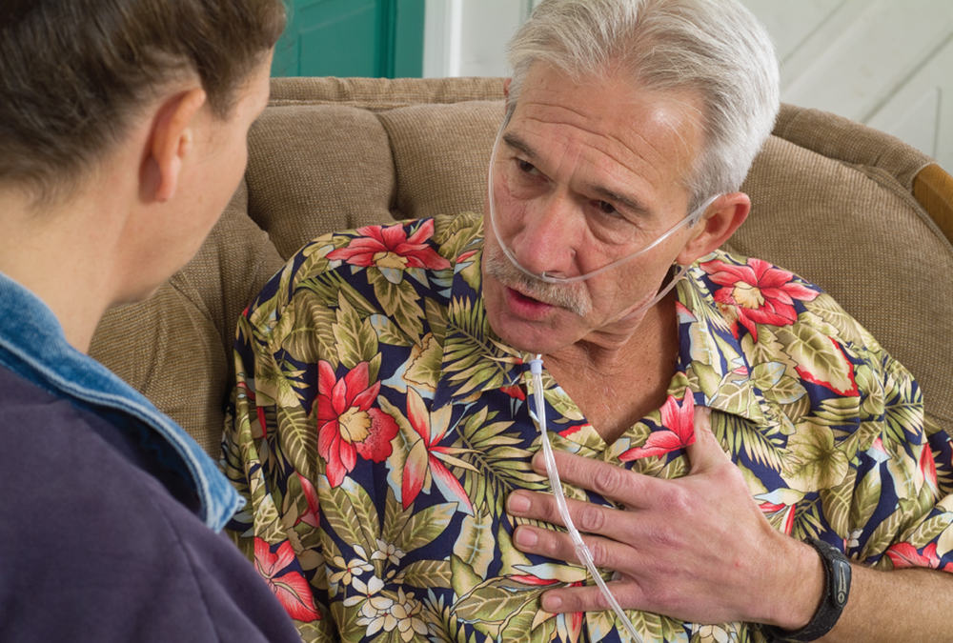
Physical Examination Techniques (2 of 2)
Observe the patient for an overall sense of the patient’s condition.
Notes:
Covers Objective: 14.2

Slide 13
Pediatric Physical Exam
Approach frightened children slowly.
Start from the least invasive parts to the most invasive.
Start with the toes or trunk and work your way toward the head.
Explain all equipment to the child before use.
Never lie to a child about something that hurts.
Provide for the patient’s privacy.
Notes:
Covers Objective: 14.2
Class Activity: Divide students into small groups. Assign students different age groups of children and have them practice physical exam techniques that are appropriate for that age group.

Slide 14
Body System Examinations
Back to Topics
Notes:
Teaching Time: 70 minutes
Teaching Tips: This lesson works best when you can provide real world examples. Provide descriptions of actual findings and discuss how they apply to the larger assessment.

Slide 15
Respiratory System
The most important determination when assessing the respiratory system is whether the patient is breathing adequately.
Notes:
Covers Objective: 14.2

Slide 16
Respiratory Assessment—History
Obtain history of existing respiratory conditions and medications taken for each.
Determine if medications have been taken as prescribed.
Determine if signs and symptoms of this episode match previous episodes.
Notes:
Covers Objective: 14.2
Discussion Topic: Describe the assessment and examination of the respiratory system.

Slide 17
Respiratory Assessment—Physical Examination
Mental status
Level of respiratory distress
Chest wall motion
Auscultate lung sounds
Use pulse oximetry
Observe edema
Fever
Notes:
Covers Objective: 14.2
Discussion Topic: Discuss why mental status and level of respiratory distress are the most important elements of respiratory system assessment.
Knowledge Application: Using a stethoscope, demonstrate the assessment of lung sounds.

Slide 18
Cardiovascular System
Heart
Blood vessels
Cardiac patient and patient in shock or with a vascular problem
Notes:
Covers Objective: 14.2

Slide 19
Cardiovascular System—History
Existing cardiac conditions and medications
Signs and symptoms of episode
Description of chest pain using O P Q R S T
Determine specific characteristics of discomfort
Notes:
Covers Objective: 14.2
Discussion Topic: Describe the assessment and examination of the cardiovascular system. Describe how the OPQRST mnemonic would be used to assess a cardiac complaint.

Slide 20
Cardiovascular System—Physical Examination
Look for signs condition may be severe.
Obtain pulse.
Obtain blood pressure.
Note pulse pressure.
Look for jugular vein distention (J V D).
Palpate the chest.
Observe posture and breathing.
Notes:
Covers Objective: 14.2

Slide 21
Nervous System
Mental status
Signs of dysfunction in the body
Notes:
Covers Objective: 14.2
Discussion Topic: Describe the importance of mental status evaluation in a neurologic assessment.

Slide 22
Neurologic Assessment—History
Determine patient’s mental status.
Determine patient’s normal state of mental functioning.
Obtain history of neurologic conditions.
Note patient’s speech.
Notes:
Covers Objective: 14.2

Slide 23
Neurologic Assessment—Physical Examination
Perform a stroke scale.
Check peripheral sensation and movement.
Gently palpate the spine.
Check extremity strength.
Check patient’s pupils for equality and reactivity.
Examine the patient’s gait.
Notes:
Covers Objective: 14.2
Discussion Topic: Describe the physical examination of the nervous system.
Class Activity: Using a skill sheet, perform a nervous system assessment on a fellow student.

Slide 24
Endocrine System
The most common endocrine emergency is the diabetic patient.
Notes:
Covers Objective: 14.2

Slide 25
Endocrine Assessment—History
Diabetes mellitus or thyroid disease history
Current medications and whether being taken properly
Whether patient has eaten or exerted energy at an unusual level
Whether patient is sick
Whether patient has taken blood glucose or uses insulin pump
Notes:
Covers Objective: 14.2
Discussion Topic: Describe the diabetes-related questions involved in the assessment of the endocrine system.

Slide 26
Endocrine Assessment—Physical Examination
Evaluate patient’s mental status.
Observe the patient’s skin.
Obtain a blood glucose level.
Look for an insulin pump.
Look for medical jewelry.
Notes:
Covers Objective: 14.2
Discussion Topic: Describe the physical examination of the endocrine system.

Slide 27
Gastrointestinal System
Looking for:
  What has gone in
  What has come out
  What it looks like when it comes out
Notes:
Covers Objective: 14.2
Discussion Topic: Describe the importance of considering intake and output when assessing the GI system.

Slide 28
Gastrointestinal Assessment—History
Pain or discomfort
Oral intake
History of gastrointestinal issues
Vomiting
Bowel movements
Notes:
Covers Objective: 14.2
Discussion Topic: Describe the assessment and examination of the GI system.
Critical Thinking Discussion: How might a lack of output relate to a GI emergency?

Slide 29
Gastrointestinal Assessment—Physical Examination
Observe patient’s position.
Assess the abdomen.
Inspect other parts of the gastrointestinal system.
Inspect vomitus or feces if available.
Notes:
Covers Objective: 14.2
Class Activity: Palpate the abdomen of the student next to you.

Slide 30
Immune System
Allergic reaction most relevant for E M S
  Anaphylaxis
Notes:
Covers Objective: 14.2

Slide 31
Immune System—Patient History
History of allergies
  Exposure to known allergens
  What are typical reactions like?
History of asthma
Symptoms of tightness in chest or throat
G I distress, itchiness, or rash
Medications for allergic reaction
Notes:
Covers Objective: 14.2
Discussion Topic: Describe the assessment and examination of the immune system.

Slide 32
Immune System—Physical Examination
Inspect point of contact with allergen.
Inspect patient’s skin for rash or hives.
Inspect the face, lips, and mouth for swelling.
Listen to the patient speak.
Listen to lungs to ensure adequate breathing.
Notes:
Covers Objective: 14.2
Discussion Topic: Describe the common physical examination findings associated with allergy and anaphylaxis.

Slide 33
Musculoskeletal System
Medical diseases in this system are rare.
Most musculoskeletal examinations will be performed as part of a complete trauma examination.
Notes:
Covers Objective: 14.2

Slide 34
Musculoskeletal Assessment—History
Prior injuries
Whether patient takes blood-thinning medication
Underlying diseases or conditions that make fractures more common
History to determine if a medical problem caused the traumatic injury
Notes:
Covers Objective: 14.2
Discussion Topic: Describe the assessment and examination of the musculoskeletal system.

Slide 35
Musculoskeletal Assessment—Physical Examination
Inspect for signs of injury, such as deformity.
Palpate areas with suspected injury.
Compare sides for symmetry.
Be alert for crepitation.
Assess patient head-to-toe if there are multiple injuries or if the patient is unresponsive.
Notes:
Covers Objective: 14.2
Discussion Topic: Describe why physical examination generally yields more information in a musculoskeletal system assessment.
Critical Thinking Discussion: How might a medical problem cause a traumatic injury?

Slide 36
Critical Thinking and Decision Making
Back to Topics
Notes:
Teaching Time: 50 minutes
Teaching Tips: Make judgment and critical thinking an ongoing part of your course. When practicing scenarios (in any lesson), add elements of critical thinking and decision making. Critical thinking is not limited to EMS. Consider asking your medical director or another clinician to speak on this topic. Use real-world examples to demonstrate the issues involved in making a diagnosis in the world of emergency medicine.

Slide 37
E M T Diagnosis and Critical Thinking
Diagnosis is label for condition.
  Based on history, physical examination, vital signs
  Involves both physical and intellectual activity
Notes:
Covers Objective: 14.3
Points to Emphasize: A diagnosis is the conclusion that the EMT reaches, after assessing a patient, about the nature of the patient's condition. Critical thinking is an analytical process that can help to solve problems in an organized and efficient manner. EMTs must use critical thinking to arrive at a diagnosis.
Talking Points: Diagnosis for the EMT is called "presumptive diagnosis," "field diagnosis," or "working diagnosis." It can be difficult to differentiate between all the information received; therefore the EMT must simultaneously use critical thinking to determine what information is pertinent.
Class Activity: Hand out a patient scenario that includes signs and symptoms and assessment findings. Have students develop a diagnosis and defend their conclusions.
Knowledge Application: Have a class discussion on critical thinking. Brainstorm important elements of critical thinking and discuss how they relate to making a diagnosis.
Critical Thinking: Some say EMTs cannot diagnose. Discuss why their arguments might be true or not true.

Slide 38
How a Clinician Reaches a Diagnosis
Clinicians have different levels of training, experience, time, technology and other resources.
Techniques vary among types of clinicians.
Notes:
Covers Objective: 14.3
Talking Points: The first steps are to gather information, consider possibilities, and reach a conclusion. How these steps are implemented varies significantly among traditional clinicians, emergency medicine clinicians, and EMS clinicians.

Slide 39
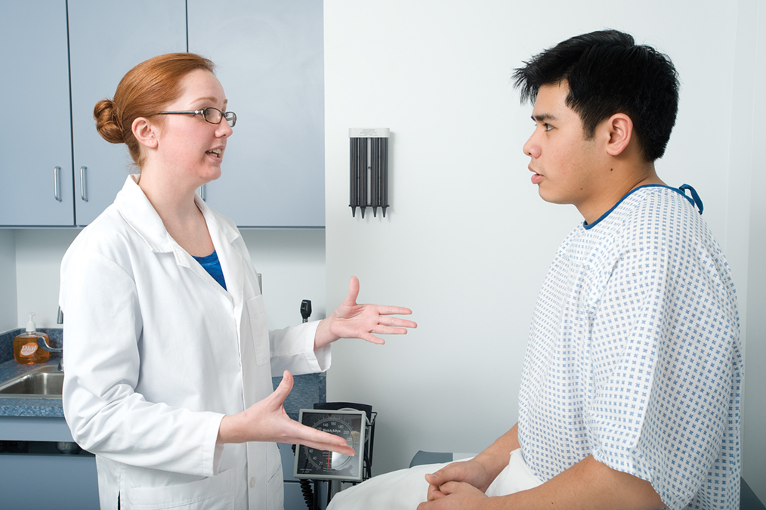
The Traditional Approach to Diagnosis in Medicine (1 of 2)
The traditional approach to reaching a diagnosis includes interviewing the patient in the controlled environment of a clinic or office.
Notes:
Covers Objective: 14.3
Discussion Topic: Describe the process by which a clinician makes a decision.
Knowledge Application: Have students interview experienced providers about how they reach a diagnosis. Discuss students’ findings.

Slide 40
The Traditional Approach to Diagnosis in Medicine (2 of 2)
Assess patient
List of conditions or diagnoses
  “Differential diagnosis” or “the differential”
Further evaluation
  Exclude unlikely conditions
Final diagnosis
Notes:
Covers Objective: 14.3
Point to Emphasize: The availability of resources is what often guides the approach to making a diagnosis.
Discussion Topic: Describe the process by which a clinician makes a decision.
Knowledge Application: Have students interview experienced providers about how they reach a diagnosis. Discuss students’ findings.

Slide 41
The Emergency Medicine Approach to Diagnosis (1 of 2)
Quickly rule out or treat immediate life threats.
Gather information from patient, family, friends.
Perform physical exam.
Focus on ruling out worst-case scenario.
  Red flags suggest serious problem.
May be responsible for multiple patients
Notes:
Covers Objective: 14.3
Point to Emphasize: Emergency physicians and EMS providers must account for immediate life threats in their diagnostic procedures.
Discussion Topic: Discuss how experienced providers approach making a diagnosis. What specific traits do they use in their technique?
Class Activity: Discuss problem solving with your medical director. What insights might this person have?

Slide 42
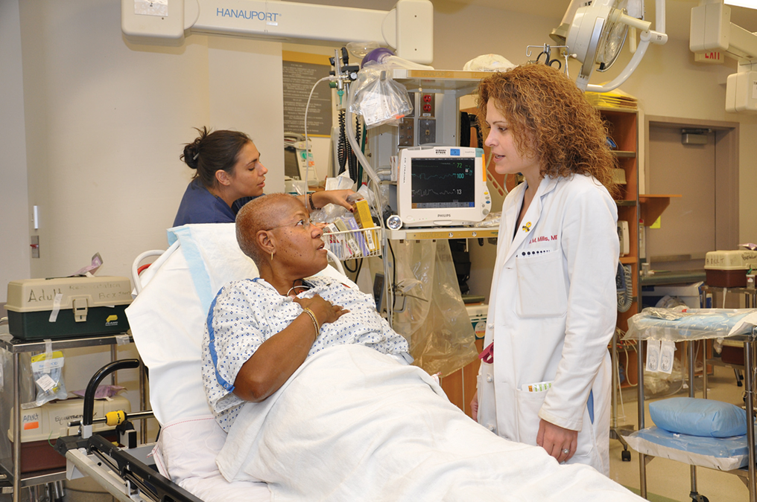
The Emergency Medicine Approach to Diagnosis (2 of 2)
The emergency physician assesses patients in the busy, hectic atmosphere of an emergency department. © Edward T. Dickinson, M D
Notes:
Covers Objective: 14.3
Point to Emphasize: The availability of resources is what often guides the approach to making a diagnosis.
Discussion Topic: Contrast the traditional diagnostic method with the techniques of emergency providers. How do they differ, and why?

Slide 43
The E M S Approach to Diagnosis (1 of 2)
Must be very efficient
  Be available for another call as soon as possible.
Work in uncontrolled environment
Limited tools and skill set
Narrow educational focus
Notes:
Covers Objective: 14.3
Discussion Topic: Describe how the EMS approach to diagnosis is similar to the emergency medical approach. How is it different?
Knowledge Applications: Have students work in small groups to examine particular diagnostic methods (traditional, emergency physician, and EMT). Have groups present and discuss their findings.

Slide 44
The E M S Approach to Diagnosis (2 of 2)
Follows same steps as emergency physician
  Most are abbreviated or limited.
Considers most serious conditions associated with patient
  Rules them in or out
Creates a diagnosis
Notes:
Covers Objective: 14.3
Class Activity: Challenge students with exceptionally difficult scenarios. The point is not necessarily to reach the correct diagnosis, but rather to develop a working strategy. Discuss.

Slide 45
Think About It 1
You can reach a diagnosis, but your work is not done. Why?
Notes:
Covers Objective: 14.3
Talking Points: You must continually look for information that will rule in/rule out your conclusions. Patients may have more than one thing wrong with them, so you cannot stop looking.

Slide 46
Approach to Diagnosis in Medicine—Shortcuts and Biases (1 of 2)
Experienced physicians learn heuristics (shortcuts).
  Pattern recognition
  Features narrow possibilities
Reach difficult diagnoses more quickly
Realize limitations of shortcuts
  Understands common biases of heuristics
Notes:
Covers Objective: 14.3
Point to Emphasize: Experienced clinicians develop key traits in the diagnostic approach.
Discussion Topics: Describe the pitfalls of diagnostic shortcuts. How might they actually limit an EMTs ability to make an accurate diagnosis?
Knowledge Application: Work in small groups. Assign each group a particular diagnostic trait of an experienced provider. Ask them to discuss that trait and present their findings to the class. Findings must include advantages, disadvantages, and applicability to EMS.

Slide 47
Approach to Diagnosis in Medicine—Shortcuts and Biases (2 of 2)
Common heuristics
  Representativeness
  Availability
  Overconfidence
  Confirmation bias
  Illusory correlation
  Anchoring and adjustment
  Search satisfying
Notes:
Covers Objective: 14.3
Point to Emphasize: Experienced clinicians develop key traits in the diagnostic approach.
Discussion Topics: Describe the pitfalls of diagnostic shortcuts. How might they actually limit an EMTs ability to make an accurate diagnosis?
Knowledge Application: Work in small groups. Assign each group a particular diagnostic trait of an experienced provider. Ask them to discuss that trait and present their findings to the class. Findings must include advantages, disadvantages, and applicability to EMS.
Critical Thinking Discussion: What are the bad diagnostic habits of the experienced provider? How might you avoid these habits as you develop in your career?

Slide 48
How an E M T Can Learn to Think Like an Experienced Physician (1 of 2)
Learn to love ambiguity.
Understand the limitations of technology and people.
Realize that no one strategy works for everything.
Form a strong foundation of knowledge.
Notes:
Covers Objective: 14.4
Points to Emphasize: There are critical thinking traits that EMTs can learn from experienced providers. Adopting these attitudes can improve their capability to solve problems and work through difficult issues. Ambiguity and uncertainty will always be present in medicine. This is true in the back of an ambulance as well.
Talking Points: Understand the limits of your knowledge and realize you won't always have the answer you seek. When you get a vital sign or a value that doesn't seem right, don't assume it's wrong. Investigate it.

Slide 49
How an E M T Can Learn to Think Like an Experienced Physician (2 of 2)
Organize the data in your head.
Change the way you think.
Learn from others.
Reflect on what you have learned.
Notes:
Covers Objective: 14.4
Points to Emphasize: Many of the attitudes and understandings of experienced clinicians focus upon flexibility. This is an extremely important trait for a new EMT to develop.
Discussion Topics: How do both a strong foundation of learning and continued education improve an EMT's ability to diagnose?
Class Activity: Discuss problem solving with an experienced EMS provider. What lessons has this person learned from experience?
Knowledge Application: Have students work in small groups. Assign each group an attitude or understanding of an experienced clinician. Have the groups present ways in which those traits improve diagnostic technique.
Critical Thinking: This section presents "learning from others" as a positive trait used to improve diagnostic technique. What actual steps might you use on the job to realize this strategy?

Slide 50
Think About It 2
What are some of the important things to remember as you learn how to make a diagnosis and improve your critical thinking skills in E M S?
Notes:
Covers Objective: 14.4
Talking Points: Reaching a diagnosis is a process that can be learned. Critical thinking comes from study, practice, and reflection. It is a skill that takes time. Know the boundaries of your knowledge. Do not let a diagnosis attempt delay your patient care.

Slide 51
Chapter Review

Slide 52
Chapter Review (1 of 5)
E M Ts make diagnoses in the field, although they may not be as extensive or detailed as physicians’ diagnoses.
The traditional approach to reaching a diagnosis is to assess the patient, draw up a list of differential diagnoses, assess further to rule in or rule out different conditions, and narrow the list until you reach a conclusion.

Slide 53
Chapter Review (2 of 5)
Highly experienced physicians don’t always use the traditional approach. They use heuristics (shortcuts) in combination with their experience and training, which speeds up the process of reaching a diagnosis.

Slide 54
Chapter Review (3 of 5)
Potential pitfalls of heuristics include representativeness, anchoring and adjustment, overconfidence, confirmation bias, illusory correlation, and search satisfying.

Slide 55
Chapter Review (4 of 5)
Learn to think more critically by accepting the ambiguity of E M S working conditions, understanding limitations of people and technology, forming a strong foundation of knowledge, and organizing the data in your mind.

Slide 56
Chapter Review (5 of 5)
When considering the cause of a patient’s condition, don’t let your search for a cause delay your treatment of the patient.

Slide 57
Remember
Use open-ended questions when taking a patient history.
Learn how to use three important examination techniques: Observe, auscultate, and palpate.
Each body system has specific examination techniques to learn.
Use critical thinking when making a field diagnosis.

Slide 58
Question to Consider
Why is it important to obtain both the history of the present illness/injury and the past medical history when assessing a patient?
Notes:
Talking Points: The two types of history have different purposes but the same goal, which is to provide the best treatment for the patient’s current condition. The history of the present illness/injury tells you what the patient is experiencing right now, and the past medical history tells you about a patient’s previous conditions. Sometimes, a previous or ongoing/chronic condition can affect the patient’s present condition, so understanding the patient’s past medical history can give you insight into what is happening right now in the patient’s body.

Slide 59
Critical Thinking (1 of 2)
You have been called to the scene of a patient with an altered mental status. No one appears to know what is wrong with the patient or what happened to cause the change in mental status.

Slide 60
Critical Thinking (2 of 2)
After performing your scene size-up and primary assessment, which body systems would you feel the need to examine further?
Notes:
Talking Points: Changes in many body systems can cause an altered mental status. For example, changes in the respiratory or cardiovascular systems can cause an altered mental status due to poor oxygen delivery to the brain, so the respiratory and cardiovascular systems should be assessed. Because mental status is an indication of brain function, the nervous system would need to be assessed. Endocrine conditions, such as diabetes, can also cause altered mental status, so the endocrine system should be assessed. Conditions such as dehydration can cause changes in mental status, so the gastrointestinal system should be assessed. Allergic reactions and asthma can affect the airway, and both of these processes involve the immune system, so it should also be assessed. Changes in mental status can cause falls and other trauma, so the musculoskeletal system should be assessed. If the only sign of a change in the patient’s condition is altered mental status and you have no other information, you will need to perform an assessment of the entire body to help you narrow down the cause of the altered mental status.

Slide 61

Copyright
This work is protected by United States copyright laws and is provided solely for the use of instructors in teaching their courses and assessing student learning. Dissemination or sale of any part of this work (including on the World Wide Web) will destroy the integrity of the work and is not permitted. The work and materials from it should never be made available to students except by instructors using the accompanying text in their classes. All recipients of this work are expected to abide by these restrictions and to honor the intended pedagogical purposes and the needs of other instructors who rely on these materials.

