Slide 1
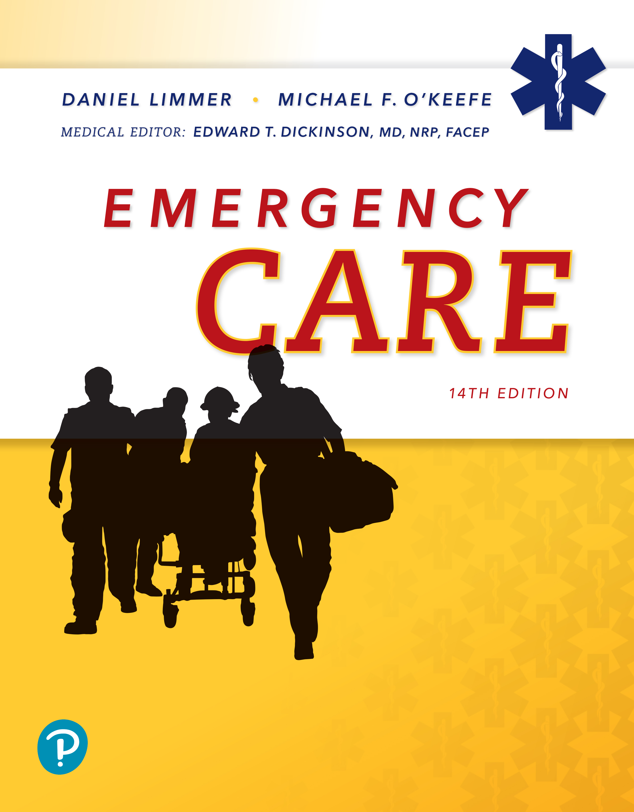
Emergency Care
Fourteenth Edition
Chapter 17
Communication and Documentation
Slides in this presentation contain hyperlinks. JAWS users should be able to get a list of links by using INSERT+F7
Copyright © 2021, 2016, 2012 Pearson Education, Inc. All Rights Reserved
Notes:
If this PowerPoint presentation contains mathematical equations, you may need to check that your computer has the following installed:
1) MathType Plugin
2) Math Player (free versions available)
3) NVDA Reader (free versions available)

Slide 2
Topics
Communication Systems and Radio Communication
The Verbal Report
Interpersonal Communication
Prehospital Care Report
Special Documentation Issues
Notes:
Planning Your Time: Plan 105 to 115 minutes for this chapter.
Communications Systems and Radio Communication (20 minutes)
The Verbal Report (15 minutes)
Interpersonal Communication (20 minutes)
Prehospital Care Report (25 minutes)
Special Documentation Issues (25 minutes)
Note: The total teaching time recommended is only a guideline.
Core Concepts:
Radio procedures used at various stages of the EMS call
Delivery and format of a radio report to the hospital
Delivery and format of a verbal hand-off report to the hospital
Communication skills used when interacting with other members of the health care team
Communication skills used when interacting with the patient
Components and procedures for the written prehospital care report
Legal aspects and benefits of documentation
Documentation concerns in patient refusal

Slide 3
Communication Systems and Radio Communication
Back to Topics
Notes:
Teaching Time: 20 minutes
Teaching Tips: Take a field trip. Visit a local EMS communications center. Review components of EMS communications there. Invite an EMS dispatcher to class. Share the insights of an experienced professional communicator. Have actual radio systems on hand to demonstrate.
Knowledge Application: Scan local EMS frequencies and listen to actual communications. Discuss positive and negative examples.

Slide 4
Communication Systems (1 of 2)
E M S radio systems consist of:
  Base stations
  Mobile radios
  Portable radios
  Repeaters
  Cell phones
  Telemetry
Notes:
Covers Objective: 17.1
Discussion Topic: Describe the components of an EMS radio or communication system.
Class Activity: Tour a local EMS station. Review the radio and other communication equipment.

Slide 5
Communication Systems (2 of 2)
New technology developing almost constantly
  Computers and tablets
Backup radios in many systems
Radio systems require preventive maintenance and repair.
Notes:
Covers Objective: 17.1
Point to Emphasize: Traditional EMS radio systems take a variety of forms. Most systems have common components that are readily identifiable.

Slide 6
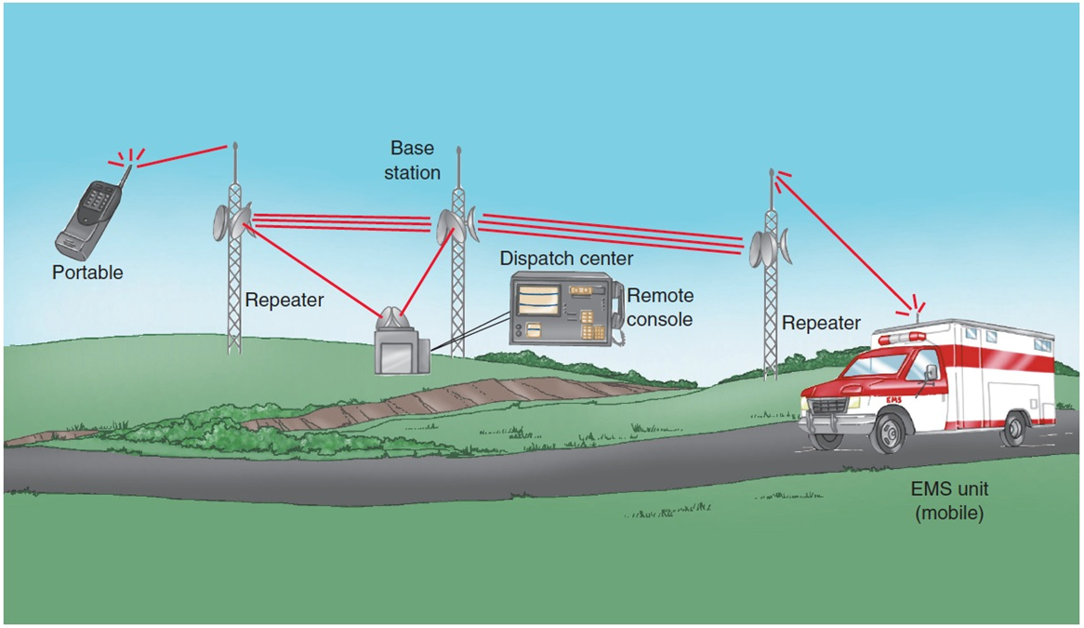
Repeaters
Example of an E M S communication system using repeaters.
Notes:
Covers Objective: 17.1

Slide 7
Radio Communication
Regulated by the Federal Communications Commission (F C C)
  Assigns and licenses designated radio frequencies
  Prevents interference with emergency radio traffic
  Prohibits profanities and offensive language
Notes:
Covers Objective: 17.1
Point to Emphasize: The Federal Communications Commission (FCC) regulates radio usage in EMS.
Discussion Topic: Describe the federal and local regulation of EMS radio communication.

Slide 8
Box 17-1 Principles of Radio Communication (1 of 2)
Follow These Principles When Using the E M S Radio System:
Make sure that your radio is on and the volume is adjusted properly.
Reduce background noise by closing the vehicle window when possible.
Listen to the frequency and ensure that it is clear before beginning a transmission.
Press the “press to talk” (P T T) button on the radio, then wait one second before speaking. This prevents cutting off the first few words of your transmission.
Speak with your lips about two to three inches from the microphone.
When calling another unit or base station, use their unit number or name, followed by yours. “Dispatcher, this is Ambulance 2.”
If the unit you are calling tells you to “Stand by,” wait until they tell you they are ready to take your transmission.
Speak slowly and clearly.
Keep the transmissions brief. If it takes longer than 30 seconds, stop at that point and pause for a few seconds so emergency traffic can use the frequency if necessary.
Use plain English. Avoid codes.
Notes:
Covers Objective: 17.1

Slide 9
Box 17-1 Principles of Radio Communication (2 of 2)
Do not use phrases such as “be advised.” These are implied and serve no purpose.
Courtesy is assumed, so there is no need to say “Please,” “Thank you,” and “You’re welcome.”
When transmitting a number that might be unclear (15 may sound like 16 or 50), give the number and then repeat the individual digits. Say “Fifteen, one-five.”
Anything said over the radio can be heard by the public on a scanner. Do not use the patient’s name over the radio. For the same reason, do not use profanities or statements that tend to slander any person. Use objective, impartial statements.
Use “we” instead of “l.” As an E M T, you will rarely be acting alone.
“Affirmative” and “Negative” are preferred over “Yes” and “No” because the latter are difficult to hear.
Give assessment information about your patient, but avoid offering a field diagnosis of the patient’s problem. For example, say, “Patient complains of abdominal pain” rather than “Patient probably has appendicitis.”
Avoid slang or abbreviations that are not authorized.
Use E M S frequencies for only authorized E M S communication.
Notes:
Covers Objective: 17.1

Slide 10
Radio Transmissions Throughout the Call (1 of 3)
Initial call often comes via telephone but may be radioed from another agency.
Without prompt and efficient dispatch and receipt of information, ambulances can be sent to the wrong location.
Notes:
Covers Objective: 17.1
Point to Emphasize: Most radio communication in EMS takes place between field personnel and dispatch. Common processes make communication more efficient.

Slide 11
Radio Transmissions Throughout the Call (2 of 3)
Dispatch records all times according to 24-hour clock.
  Time of Original call
  Time ambulance was dispatched
  Time ambulance reached staging area
  Time ambulance arrived at scene
Dispatcher gives times after most transmissions.
Notes:
Covers Objective: 17.1
Discussion Topic: Describe the process of transmitting information throughout an EMS call.

Slide 12
Radio Transmissions Throughout the Call (3 of 3)
Many transmissions are between the mobile radio within the ambulance and the dispatcher at a base station.
In some E M S systems, simple standard communications are transmitted by pushing a button on a mobile data terminal (M D T) mounted in the ambulance.
Carry portable radio whenever you leave unit.
Notes:
Covers Objective: 17.1
Knowledge Application: Make radio communication an ongoing lesson. Require radio communication and patient reports for any mock scenario.

Slide 13
Radio Medical Reports (1 of 2)
Report must be given to destination hospital so it can prepare for arrival.
  Reports may be by radio, verbally (in person), in writing, or in all three ways
  Radio report is specifically structured to present only most important information.
  “Paint a picture” of the patient in words.
Notes:
Covers Objective: 17.1
Point to Emphasize: The medical radio report is structured to present pertinent facts about the patient without telling more detail than necessary.
Class Activity: Invite a local communications supervisor or dispatch to discuss the local communications system.

Slide 14
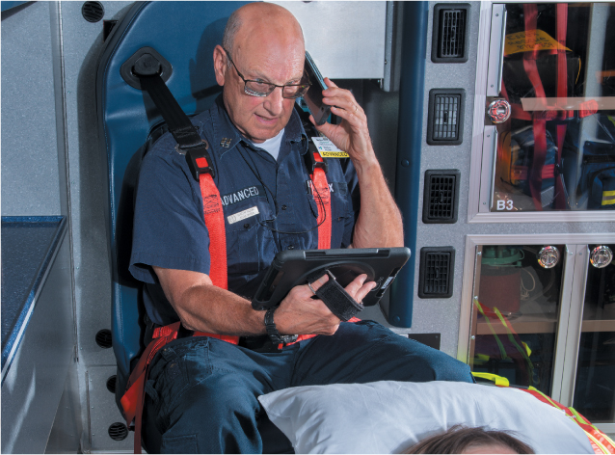
Radio Medical Reports (2 of 2)
Communication from the ambulance can be by radio or cell phone.
Notes:
Covers Objective: 17.1

Slide 15
Medical Radio Reports (1 of 3)
Unit identification and level of provider
Estimated time of arrival (E T A)
Patient’s age and sex
Chief complaint
Brief, pertinent history of present illness/injury
Major past illnesses
Notes:
Covers Objective: 17.1

Slide 16
Medical Radio Reports (2 of 3)
Mental status
Baseline vital signs
Pertinent findings of physical exam
Emergency care given
Response to emergency medical care
Contact medical direction if required or if you have a question
Notes:
Covers Objective: 17.1
Discussion Topic: Describe the essential components of communication between provider and EMS dispatcher.
Knowledge Application: Use actual radios (or toy radios) and require students to give real-time medical radio reports. Critique and discuss.
Critical Thinking Discussion: What potential confidentiality concerns arise out of communicating patient information over the radio?

Slide 17
Medical Radio Reports (3 of 3)
Communicating with medical direction
  Give information clearly and accurately.
  After receiving order or denial for medication or procedure, repeat back word for word.
  If order unclear, ask physician to repeat.
  If order seems inappropriate, question physician.
Notes:
Covers Objective: 17.1

Slide 18
The Verbal Report
Back to Topics
Notes:
Teaching Time: 15 minutes
Teaching Tips: Practice makes perfect. Use mock scenarios and practice verbal reports. Make verbal reports (and radio reports) an ongoing lesson in class. Require reports to be given after any scenario. Offer constructive criticism. Do not allow poor reports. Correct and require improved performance.

Slide 19
The Verbal Report (1 of 2)
Given upon arrival at destination
Introduce patient by name.
Give complete and detailed report.
Notes:
Covers Objective: 17.2
Points to Emphasize: The first information given to hospital personnel usually will be the verbal report. A verbal report will summarize and enhance the prior radio report.
Discussion Topic: When would an EMT utilize a verbal report?
Class Activity: Assign students the task of practicing five verbal reports at home. Have them make up scenarios and practice with a friend. Have them document self-critiques.
Knowledge Application: Have students work in small groups. Provide each group with a scenario and have them prepare and deliver a verbal report. Critique and discuss.

Slide 20
The Verbal Report (2 of 2)
Elements of verbal report
  Chief complaint
  History that was not given previously
  Assessment treatment given en route
  Additional vital signs taken en route
Notes:
Covers Objective: 17.2
Point to Emphasize: A proper verbal report will include the chief complaint, any history that was not given previously, additional treatment given, and additional vital signs taken en route.
Discussion Topic: Discuss the key components of an effective verbal report.
Knowledge Application: Assign "written verbal reports." Provide an in-class scenario and have students write up the components of their verbal report.
Critical Thinking Discussion: This chapter discusses limiting verbal reports and being concise. What are the potential hazards of being too brief?

Slide 21
Interpersonal Communication
Back to Topics
Notes:
Teaching Time: 20 minutes
Teaching Tips: Role play. Use scripted situations to simulate communication challenges. Discuss. Use nonverbal communication. Ask students to demonstrate nonverbal communication; discuss the results. Discuss improving communication in the context of the secondary assessment. Build on the lessons of previous chapters. Review how more information might improve the assessment. Discuss language choices. Relate this section to medical terminology. Discuss how plain language can aid therapeutic communication.

Slide 22
Team Communication
E M Ts must communicate with others involved in patient’s care.
  First responders
  Advanced E M Ts, paramedics
  Home healthcare aides, family
Speak candidly and respectfully to:
  Gather information about the patient.
  Complete any necessary and appropriate transfer of care.
Notes:
Covers Objective: 17.2
Point to Emphasize: Communication is an invaluable component of teamwork.
Discussion Topic: Discuss the role of communication in teamwork.

Slide 23
Therapeutic Communication (1 of 5)
Communication techniques learned by experience
  May be more difficult with those in crisis
Everyone can improve communication skills by learning effective communication techniques.
Notes:
Covers Objective: 17.2
Point to Emphasize: Communicating with patients who are in crisis can be difficult, but there are techniques to improve communication capabilities.

Slide 24
Therapeutic Communication (2 of 5)
Use eye contact.
  Shows interest, attentiveness, and comfort
Be aware of position and body language.
  Face patient at eye level with arms down.
Notes:
Covers Objective: 17.2
Discussion Topic: How might personal space and body language impact communication? What are some steps that an EMT might take to improve these elements?
Knowledge Application: Use a programmed patient and simulate assessment scenarios. Present barriers to communication (loud music, overly aggressive family, and the like). Have students develop communication strategies to overcome these problems.

Slide 25
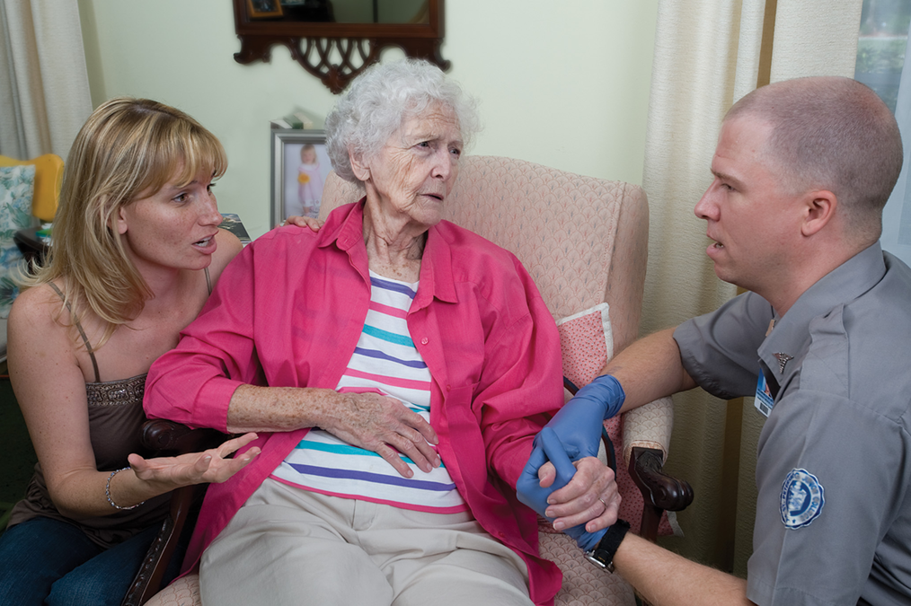
Communication Techniques (1 of 3)
Communicating with patients and others who are in crisis requires skill and tact.
Notes:
Covers Objective: 17.2
Discussion Topic: How might personal space and body language impact communication? What are some steps that an EMT might take to improve these elements?
Knowledge Application: Use a programmed patient and simulate assessment scenarios. Present barriers to communication (loud music, overly aggressive family, and the like). Have students develop communication strategies to overcome these problems.

Slide 26
Therapeutic Communication (3 of 5)
Use language the patient can understand.
  Do not use medical terms.
  Explain procedures.
Be honest.
  Dishonesty ruins confidence and rapport.
Notes:
Covers Objective: 17.2
Critical Thinking Discussion: You are treating a patient who has had a stroke. As a result of the stroke, the patient cannot speak. How might you still be able to communicate with this patient?

Slide 27
Therapeutic Communication (4 of 5)
Use patient’s proper name.
  Sign of respect, especially with older patients
Listen.
  Important to establish trust
Notes:
Covers Objective: 17.2
Discussion Topic: Describe five steps that improve interpersonal communication.
Class Activity: Have a class discussion. Develop a list of positive communication traits based on students' personal experience. Brainstorm and then prioritize the list.
Knowledge Application: Create simulated assessments, but use students as patients. Have programmed providers use poor communication techniques; then discuss the impact on the assessment.

Slide 28
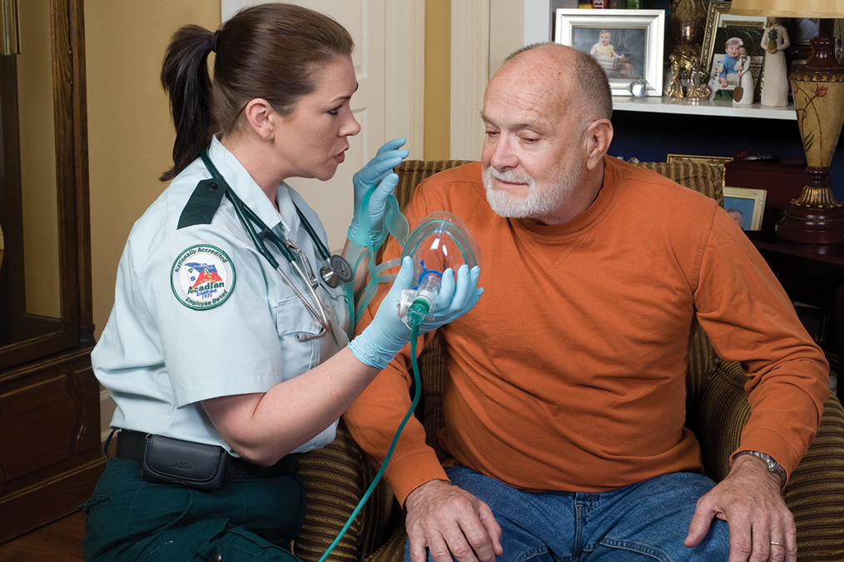
Communication Techniques (2 of 3)
Position yourself at or below the patient’s eye level to be less intimidating and to aid communication.
Notes:
Covers Objective: 17.2
Discussion Topic: Describe five steps that improve interpersonal communication.
Class Activity: Have a class discussion. Develop a list of positive communication traits based on students' personal experience. Brainstorm and then prioritize the list.
Knowledge Application: Create simulated assessments, but use students as patients. Have programmed providers use poor communication techniques; then discuss the impact on the assessment.

Slide 29
Therapeutic Communication (5 of 5)
Special considerations
  Always be compassionate and respectful if the patient:
    Has a mental disability
    Has visual or hearing impairments
    Has any language barriers
Notes:
Covers Objective: 17.2
Point to Emphasize: Pediatric, elderly, and other special populations of patients may require the EMT to adapt communication practices.

Slide 30
Pediatric Note
Pediatric patients
  Come down to their level.
  Be truthful.
Notes:
Covers Objective: 17.2
Point to Emphasize: Pediatric, elderly, and other special populations of patients may require the EMT to adapt communication practices.
Discussion Topic: Discuss how interpersonal communication with a child might be different from that with an adult.

Slide 31
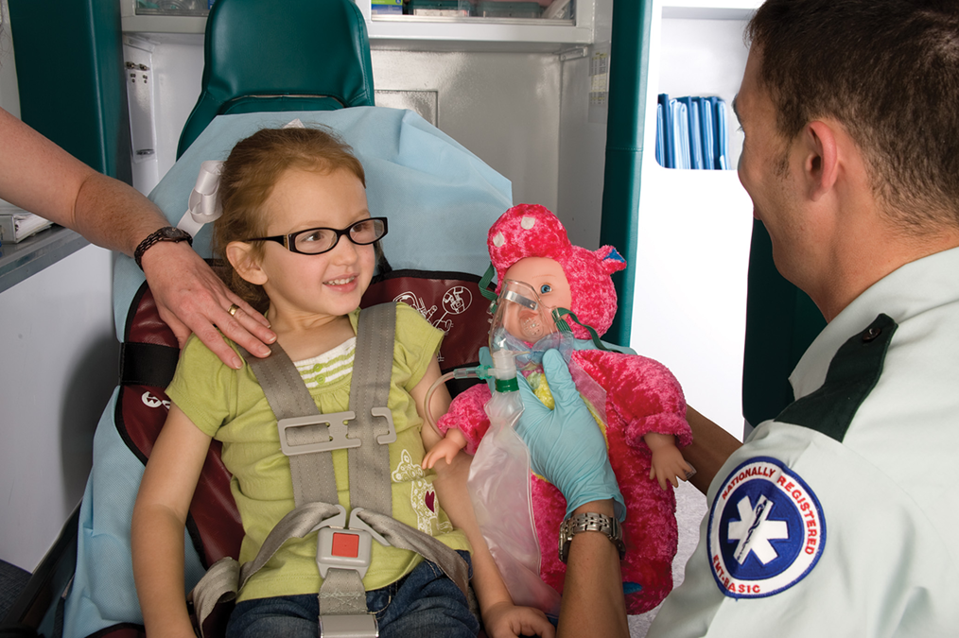
Communication Techniques (3 of 3)
Stay at a child’s eye level or lower.
Notes:
Covers Objective: 17.2
Point to Emphasize: Pediatric, elderly, and other special populations of patients may require the EMT to adapt communication practices.
Discussion Topic: Discuss how interpersonal communication with a child might be different from that with an adult.

Slide 32
Prehospital Care Report
Back to Topics
Notes:
Teaching Time: 25 minutes
Teaching Tips: Make documentation routine (as it is in EMS). Require documentation of all simulated calls. Consider take-home assignments to complete documentation. Discuss the path of a PCR. Detail who might review it and how it might be used beyond the level of the EMT. Discuss the role of PCRs within a quality assurance system. Present a state PCR (handwritten or electronic). Discuss its components. Use an electronic run reporting system to review key data entry elements.

Slide 33
Prehospital Care Report
Written documentation of what happened during a call
Several forms
  Handwritten
  Laptop
  Tablet
  Pen-based computers
Drop (transfer) report
Notes:
Covers Objective: 17.3
Point to Emphasize: The prehospital care report serves as the record of the EMT's interaction with the patient. The prehospital care report can take a variety of formats, from handwritten to electronic.
Discussion Topic: Describe how patient care is documented in your area. What are the required components?

Slide 34
Functions of the Prehospital Care Report (1 of 5)
Patient Care Record
  Documents findings and treatment
  Conveys picture of scene
  Entered into patient’s permanent medical record
Notes:
Covers Objective: 17.3
Points to Emphasize: Besides being a record of patient interaction, the prehospital care report also serves as a legal document, provides information for administrative functions, aids education and research, and contributes to quality improvement.
Class Activity: Present a scenario to the class. Discuss interactions and interventions.

Slide 35
Functions of the Prehospital Care Report (2 of 5)
Legal Document
  Can be subpoenaed and used as evidence
  May help patient win a case
  May be used against you in case of negligence
Notes:
Covers Objective: 17.3
Discussion Topic: Describe the role of the PCR as a legal document.
Critical Thinking Discussion: How might a properly documented PCR protect an EMT from liability? How might it defend an EMT in the event of a lawsuit?

Slide 36
Functions of the Prehospital Care Report (3 of 5)
Administrative Data
  Insurance information
  Billing address
Notes:
Covers Objective: 17.3

Slide 37
Functions of the Prehospital Care Report (4 of 5)
Education and Research
  Clinical research
  Statistics
  Continuing education
  Tracking E M T’s personal experience
Notes:
Covers Objective: 17.3

Slide 38
Functions of the Prehospital Care Report (5 of 5)
Quality Improvement
  Routine call review
  Ensures compliance to standards
  Can reveal providers deserving special recognition
  Can reveal opportunities for improvement
Notes:
Covers Objective: 17.3
Discussion Topic: Describe the role of the PCR within a QA system.

Slide 39
Elements of the Prehospital Care Report (1 of 7)
Data Elements
  Developed by National Highway Traffic Safety Administration (N H T S A)
    More than four hundred elements
    Minimum data set available nationwide
Notes:
Covers Objective: 17.3
Point to Emphasize: A prehospital care report consistently contains key elements, including the run data and patient information sections.

Slide 40
Elements of the Prehospital Care Report (2 of 7)
Run Data
  Agency name, date, times, call number, unit personnel and levels of certification, and other basic information mandated by service
  Use official time given by dispatch so all times in report match.
Notes:
Covers Objective: 17.3
Point to Emphasize: A prehospital care report consistently contains key elements, including the run data and patient information sections.
Discussion Topic: List and describe the essential elements of the "run data" section of a PCR.

Slide 41
Elements of the Prehospital Care Report (3 of 7)
Patient Information
  Name, address, phone number
  Sex, age, and date of birth
  Weight
  Race and/or ethnicity
  Billing and insurance information
Notes:
Covers Objective: 17.3
Discussion Topic: List and describe the essential elements of the "patient information" section of a PCR.
Knowledge Application: Have students write prehospital care reports for simulated calls. Review and grade the documentation.

Slide 42
Elements of the Prehospital Care Report (4 of 7)
Information Gathered during the Call
  General impression of patient
  Narrative summary of call
  Patient’s prior aid, past medical history, physical exam results, vital signs, E C G results, procedures and treatments, medications administered, and other information as required by your service
  Transport information
Notes:
Covers Objective: 17.3

Slide 43
Elements of the Prehospital Care Report (5 of 7)
Narrative Sections
  Objective information
    Observable, measurable, verifiable
  Subjective information
    Subject to interpretation or opinion (often reported by patient)
Notes:
Covers Objective: 17.3

Slide 44
Elements of the Prehospital Care Report (6 of 7)
Narrative Sections
  Chief complaint
    Primary complaint, as stated by patient
    Best recorded as a direct quote
  Pertinent negatives
    Important negative findings
Notes:
Covers Objective: 17.3
Knowledge Application: Practice narratives. While completing simulated calls, have students write brief narratives of the patient's information.

Slide 45
Elements of the Prehospital Care Report (7 of 7)
Narrative Sections
  Avoid radio codes and nonstandard abbreviations.
  Write legibly and use correct spelling.
    Information must be read easily and accurately.
    P C R is a reflection of your care.
  Use appropriate medical terminology.
  If it’s not written down, you didn’t do it.
Notes:
Covers Objective: 17.3
Knowledge Application: Create class QA committees. Have students submit their routine documentation to their peers for review.
Class Activity: Present a scenario to the class. Discuss interactions and interventions. Have each student complete a PCR at home and return it at the next class. Have students exchange patient care reports and correct each other's work. Discuss and critique.

Slide 46
Special Documentation Issues
Back to Topics
Notes:
Teaching Time: 25 minutes
Teaching Tips: Rigorously enforce confidentiality standards. Do not accept violations, even in routine class discussions. Use a class QA committee. Have students submit their routine documentation to their peers for review; critique documentation errors. Invite an attorney to class to discuss the role of confidentiality and proper documentation with regard to medical/legal situations.

Slide 47
Legal Issues (1 of 2)
Confidentiality
  Covered by the Health Insurance Portability and Accountability Act (H I P A A)
  Accountability and security
Patient Refusals
  High liability
  Document all details in a “refusal of care” form.
Notes:
Covers Objective: 17.3
Points to Emphasize: The prehospital care report itself and the information that it contains are strictly confidential. A properly documented patient care report is an essential component of patient refusal.
Discussion Topic: Describe the necessary documentation elements with regard to a patient refusal.
Class Activity: Have a mock trial. Choose a PCR from a simulation and accuse a student of wrongdoing. Can the student defend himself, based on the documentation?
Knowledge Application: Have students write prehospital care reports for simulated calls. Review and grade the documentation. Use simulated PCRs during clinical experiences. Have students write simulated patient care reports for patients whom they have seen; then compare and contrast with the actual PCR.

Slide 48
Legal Issues (2 of 2)
Falsification
  Covering up errors
  Recording something you forgot to do
Correction of Errors
  Mistakes in documentation
  Additions
Notes:
Covers Objective: 17.3
Points to Emphasize: Falsification of a patient care report can occur by either commission or omission. In either case, a serious offense has taken place. Proper procedures must be followed to correct a patient care report.
Discussion Topics: Explain the difference between errors of omission and errors of commission with regard to falsification of patient care reports. Describe the steps involved in correcting a patient care report.
Class Activity: Require students to modify a PCR. Assign specific changes and have students complete these changes as a homework assignment.
Knowledge Application: Create a student QA committee. Select random documentation from programmed patients and review the patient care report as a group. Discuss.

Slide 49
Think About It 1
You respond to a call for an unconscious male. Upon arrival the patient is awake, alert, and walking away. He states he was just sleeping, and does not need or want treatment or transport.
Notes:
Covers Objective: 17.3

Slide 50
Think About It 2
Is this a patient?
Is a complete assessment and physical exam needed?
How will you document this call?
Should you obtain a formal patient refusal?
Notes:
Covers Objective: 17.3
Talking Points: A complete assessment and head-to-toe physical exam is probably not needed. The patient did not call EMS and appears to not need it. Your limited interaction can give much information for documentation: "The patient is awake and alert, and in no obvious distress; he has no complaints of pain, illness, or injury; there is no obvious trauma; patient moves all extremities well and ambulates without assistance." Your chart should at least include this brief assessment, along with the other details of the event. Local policy may require a refusal; if so, do not forget a witness and a patient signature.

Slide 51
Special Situations (1 of 2)
Multiple-Casualty Incidents
  Logistical problem for E M S
  Documentation of information for individual patients may be difficult.
    Care and evaluation by several providers at different times and locations
    Important to keep information with patients from an M C I scene as they move through the system
Notes:
Covers Objective: 17.3
Discussion Topic: Describe how documentation must be adjusted in special situations such as an MCI.

Slide 52
Special Situations (2 of 2)
Special Situation Reports
  Exposure to infectious disease
  Injury to yourself or another E M T
  Hazardous or unsafe scenes
  Referrals to social service agencies
  Mandatory reports for child or elderly abuse
Notes:
Covers Objective: 17.3
Discussion Topic: List several examples of special situations that might require extraordinary levels of documentation.

Slide 53
Chapter Review

Slide 54
Chapter Review (1 of 7)
When calling in patient information, include these elements:
  Unit identification and level of provider
  Estimated time of arrival
  Patient’s age and sex
  Chief complaint
  Brief, pertinent history of the present illness

Slide 55
Chapter Review (2 of 7)
When calling in patient information, include these elements:
  Major past illnesses
  Mental status
  Baseline vital signs
  Pertinent findings of the physical exam
  Emergency medical care given
  Response to emergency medical care

Slide 56
Chapter Review (3 of 7)
When calling in patient information, include these elements:
  Contact made with medical direction if required or if you have questions
When completing the prehospital care report, or P C R, include the following:
  Patient’s name, address, date of birth, age, sex

Slide 57
Chapter Review (4 of 7)
When completing the prehospital care report, or P C R, include the following:
  Billing and insurance information (in many jurisdictions)
  Nature of the call
  Mechanism of injury
  Location where the patient was found

Slide 58
Chapter Review (5 of 7)
When completing the prehospital care report, or P C R, include the following:
  Treatment administered before arrival of the E M T (by bystanders, Emergency Medical Responders, or others)
  Signs and symptoms
  Baseline and subsequent vital signs

Slide 59
Chapter Review (6 of 7)
When completing the prehospital care report, or P C R, include the following:
  Secondary assessment
  Care administered and the effect that the care had on the patient (e.g., improved, no change)
  Changes in condition throughout the call

Slide 60
Chapter Review (7 of 7)
A P C R may be a legal document in a court proceeding.
The P C R should be completed as soon as possible after the completion of the call.
Data from P C Rs may help determine future treatments, trends, research, and quality improvement
Your report should “paint a picture” of your patient and their condition, accurately describing your contact with the patient throughout the call.

Slide 61
Remember (1 of 3)
Emergency medical communication comes in many forms and is essential to team-based patient care.
The medical radio report is structured to present pertinent facts about the patient without providing more detail than necessary.

Slide 62
Remember (2 of 3)
A proper verbal report will include the chief complaint, any history that was not given previously, additional treatment given, and additional vital signs taken en route.

Slide 63
Remember (3 of 3)
Interpersonal communication is often challenging in E M S. Adopting best practices can improve communication capabilities significantly.
Confidentiality, patient refusals, and falsification of records are all-important legal concepts that an E M T must consider when documenting a call.

Slide 64
Questions to Consider
How can you improve your interpersonal communication with patients and team members?
What is “objective” and “subjective” information in the narrative portion of the P C R?
Notes:
Talking Points: Students should evaluate their own communication characteristics and follow the pointers in the chapter to improve their techniques. They might want to do this with a partner.
Sometimes the boundary between objective and subjective may be unclear. Is a fact verifiable, or does it rest on someone's opinion? Remind students to err on the side of complete documentation.

Slide 65
Critical Thinking (1 of 5)
Organize this random information and present a radio report to the hospital.
  Chest pain radiating to shoulder
  56 years old
  Oxygen applied at 15 L/minute via nonrebreather
  Alert and oriented
  Female

Slide 66
Critical Thinking (2 of 5)
Organize this random information, and present a radio report to the hospital.
  Came on 20 minutes ago while mowing lawn
  History of high blood pressure and diabetes
  Pulse 86, respirations 22, skin cool and moist, blood pressure 110/66, S p O 2 96%

Slide 67
Critical Thinking (3 of 5)
Organize this random information, and present a radio report to the hospital.
  Oxygen relieved pain slightly
  Denies difficulty breathing
  Requesting orders from medical direction
  You are on Community B L S Ambulance 4

Slide 68
Critical Thinking (4 of 5)
Organize this random information, and present a radio report to the hospital.
  Lung sounds equal on both sides
  Placed in a position of comfort
  E T A 20 minutes

Slide 69
Critical Thinking (5 of 5)
Write a narrative report for the same call. Will you use different information?
Notes:
Talking Points: Discuss the different narrative reports that the students come up with. What differences and similarities are there?

Slide 70

Copyright
This work is protected by United States copyright laws and is provided solely for the use of instructors in teaching their courses and assessing student learning. Dissemination or sale of any part of this work (including on the World Wide Web) will destroy the integrity of the work and is not permitted. The work and materials from it should never be made available to students except by instructors using the accompanying text in their classes. All recipients of this work are expected to abide by these restrictions and to honor the intended pedagogical purposes and the needs of other instructors who rely on these materials.

