Slide 1
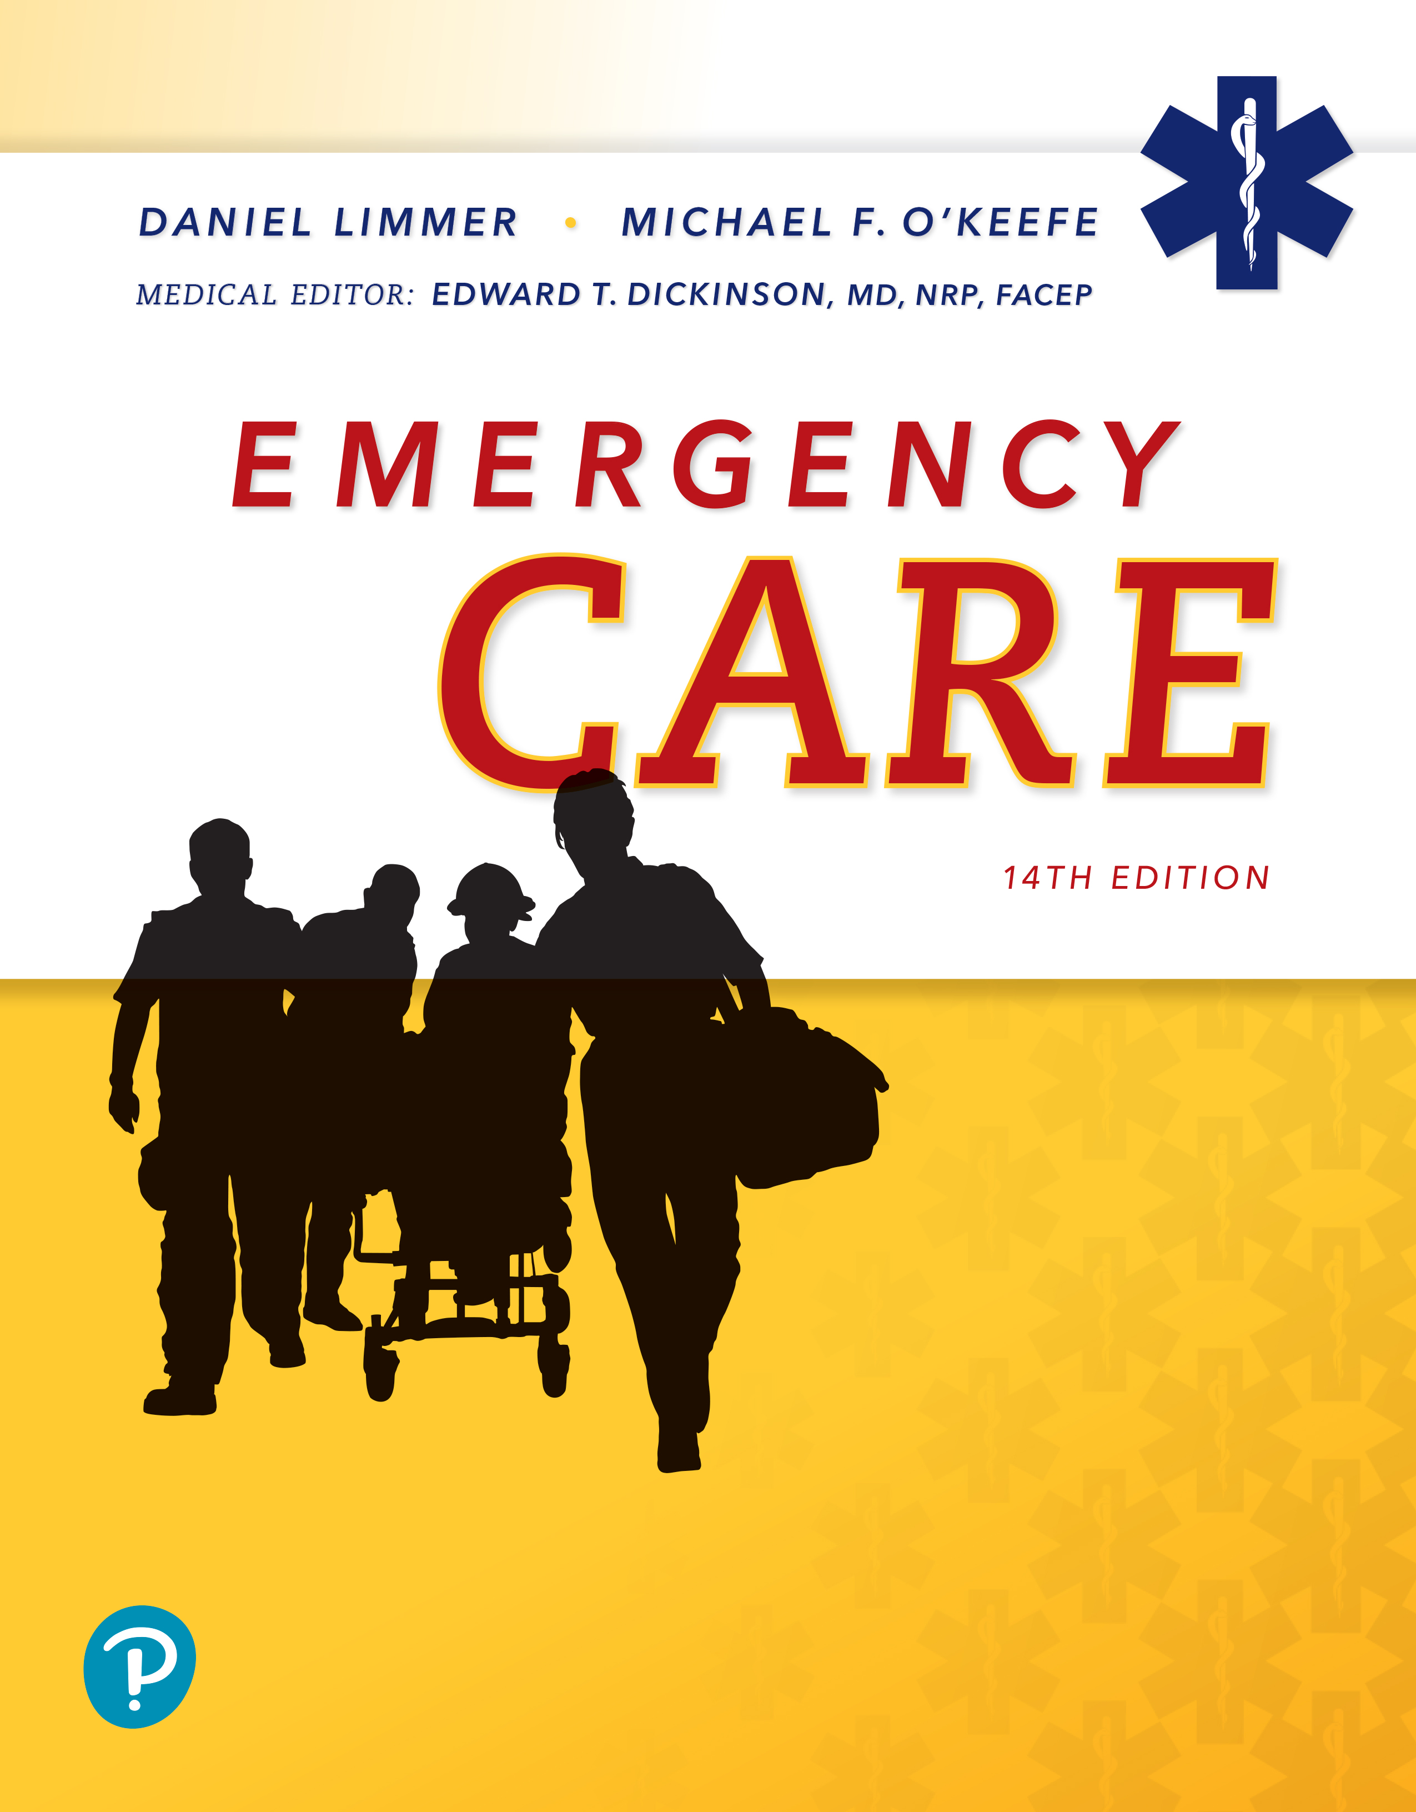
Emergency Care
Fourteenth Edition
Chapter 31
Chest and Abdominal Trauma
Slides in this presentation contain hyperlinks. JAWS users should be able to get a list of links by using INSERT+F7
Copyright © 2021, 2016, 2012 Pearson Education, Inc. All Rights Reserved
Notes:
If this PowerPoint presentation contains mathematical equations, you may need to check that your computer has the following installed:
1) MathType Plugin
2) Math Player (free versions available)
3) NVDA Reader (free versions available)

Slide 2
Topics
Anatomy and Physiology of the Chest and Abdomen
Chest Injuries
Abdominal Injuries
Notes:
Planning Your Time: Plan 110 minutes for this chapter.
Anatomy and Physiology of the Chest and Abdomen (20 minutes)
Chest Injuries (60 minutes)
Abdominal Injuries (30 minutes)
Note: The total teaching time recommended is only a guideline.
Core Concepts:
Anatomy, physiology, and pathophysiology of the chest and abdomen
Understanding chest injuries and emergency care for chest injuries
Understanding abdominal injuries and emergency care for abdominal injuries

Slide 3
Anatomy and Physiology of the Chest and Abdomen
Back to Topics
Notes:
Teaching Time: 20 minutes
Teaching Tip: Review the content of the chapters on Anatomy and Physiology, Principles of Pathophysiology, Respiratory Emergencies, Cardiac Emergencies, and Abdominal Emergencies for a more in-depth review of the anatomy and physiology of the chest and abdomen. Review the abdominal quadrants. Use landmarks to divide the abdomen and discuss organ location within the quadrants. Use multimedia graphics to illustrate abdominal anatomy.

Slide 4
Anatomy and Physiology of the Chest (1 of 3)
Chest cavity
  Extends from collarbones to diaphragm
  Dynamic because it depends on respiratory cycle
  Packed with organs, major blood vessels, and lung tissue
Notes:
Covers Objective: 31.1
Points to Emphasize: The chest cavity contains many vital organs necessary for life. Injuries to the chest cavity can be immediately life-threatening.

Slide 5
Anatomy and Physiology of the Chest (2 of 3)
Organs of the chest are well protected
  12 sets of ribs
  Sternum
  Thoracic spine vertebrae
  Scapula
Notes:
Covers Objective: 31.1

Slide 6
Anatomy and Physiology of the Chest (3 of 3)
Physiologic functions of the chest
  Heart beats to provide blood flow
  Large blood vessels enter and exit the heart
  Respiratory function
Notes:
Covers Objective: 31.1
Points to Emphasize: The ABCs that EMTs assess in the primary assessment are related to the physiological functions of the organs in the chest. Without adequate functioning of these organs, the body will go into shock and die. Never underestimate the severity of a chest injury.
Discussion Topic: Discuss how an injury to the chest would influence how you approach the ABCs. Consider different types of injuries to different organs.

Slide 7
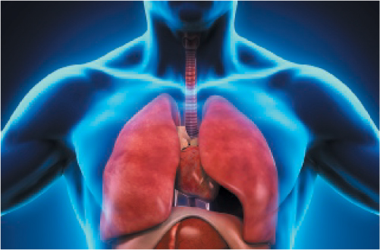
Anatomy of the Chest
Notes:
Covers Objective: 31.1
Knowledge Application: Have students label a blank diagram of the chest, either in class or as an online assignment.

Slide 8
The Mechanism of Breathing (1 of 2)
Chest wall, diaphragm, and lungs work together
  Change pressure within the chest cavity
  Cause air to be moved in and out
Notes:
Covers Objective: 31.1

Slide 9
The Mechanism of Breathing (2 of 2)
Inhalation
  Active process that uses negative pressure to draw air into the lungs
Exhalation
  Passive process that uses positive pressure to push air out of the lungs
Notes:
Covers Objective: 31.1

Slide 10
Anatomy and Physiology of the Abdomen (1 of 3)
Superior border is diaphragm
Abdominal organs extend to the lower regions of the pelvis
  Described in context of location relative to four abdominal quadrants
Notes:
Covers Objective: 31.1
Points to Emphasize: Many types of organs are housed within the abdominal cavity. The effects of trauma to these organs will vary.

Slide 11
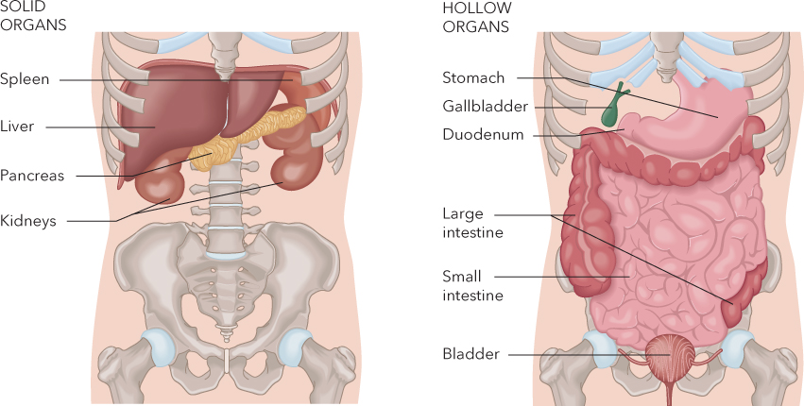
Anatomy of the Abdomen
For long description, see slide 83: Appendix 1
Notes:
Covers Objective: 31.1
Class Activity: Refresh students’ understanding of abdominal anatomy. Hand out blank diagrams of the abdominal vault. Have students illustrate the quadrants and then label the contents of each quadrant.

Slide 12
Anatomy and Physiology of the Abdomen (2 of 3)
Trauma assessment and care takes into consideration placement and function of abdominal organs.
Differentiate between hollow and solid organs
  Hollow organs tolerate trauma well.
  Solid organs do not tolerate trauma well.
Notes:
Covers Objective: 31.1
Discussion Topic: Discuss how an injury to the abdomen would influence how you approach the ABCs. Consider different types of injuries to different organs.

Slide 13
Anatomy and Physiology of the Abdomen (3 of 3)
Physiology of abdominal organs is dependent on individual function.
Abdominal cavity is dynamic depending on location of diaphragm.
There is always a large volume of blood in the abdomen.
Notes:
Covers Objective: 31.1

Slide 14
Pathophysiology of the Chest and Abdomen
Disruption of breathing
Hemorrhage and shock
Disruption of organ function
Infection
Notes:
Covers Objective: 31.1
Class Activity: Have students work in small groups. Assign each group an organ or structure in the chest or abdomen. Have groups discuss how trauma to that organ or structure relates to the four categories of pathophysiology outlined in this section. How would an EMT respond to each?

Slide 15
Chest Injuries
Back to Topics
Notes:
Teaching Time: 60 minutes
Teaching Tip: Use anatomical models, x-rays, and multimedia graphics to enhance your illustration of anatomy and specific injuries. There are many specific chest injuries to cover here. Use homework and research projects to enhance the level of detail.

Slide 16
Chest Injuries (1 of 2)
Blunt trauma
  Can fracture ribs, sternum, and costal (rib) cartilages
Penetrating trauma
  Bullets, knives, pieces of metal or glass, steel rods, pipes, other objects
  Can damage internal organs and impair respiration
Notes:
Covers Objective: 31.1
Points to Emphasize: Blunt trauma, penetrating trauma , and compression are mechanisms that can injure the chest. Chest injuries are classified as either open or closed. In a closed chest injury, the chest wall remains intact. In an open chest injury, the chest wall has been penetrated.

Slide 17
Chest Injuries (2 of 2)
Compression and shearing injuries
  Occurs when severe blunt trauma causes the chest to rapidly compress
  Shearing can damage the aorta and vena cava
Chest injuries are classified as either closed or open.
Notes:
Covers Objective: 31.1
Discussion Topic: Describe the three ways in which the chest can be injured.

Slide 18
Blunt Chest Injuries (1 of 4)
Rib fractures
  Painful but usually not life-threatening
  Can make breathing difficult
  Can lacerate blood vessels or lung tissue
Notes:
Covers Objective: 31.1

Slide 19
Blunt Chest Injuries (2 of 4)
Flail chest
  Fracture of two or more consecutive ribs in two or more places
  Leaves a portion of the chest wall unstable
  Leads to inadequate breathing and hypoventilation
Paradoxical motion
  Movement of flail segment is opposite to movement of the remainder of the chest cavities.
Notes:
Covers Objective: 31.1
Discussion Topic: Describe the pathophysiology of a flail chest. How does this injury interfere with breathing?

Slide 20
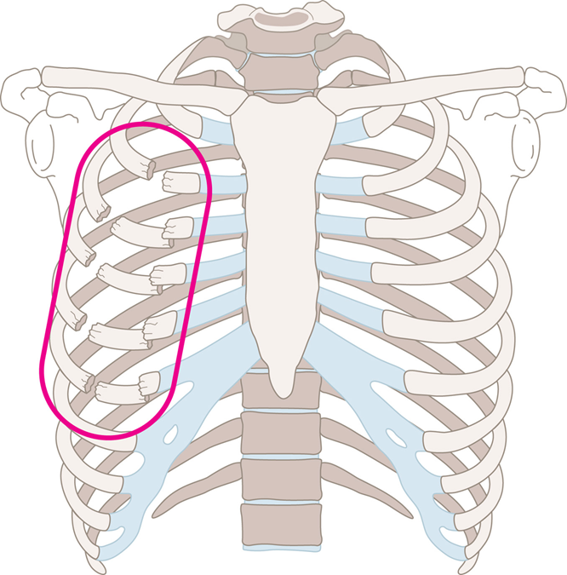
Blunt Chest Injuries (3 of 4)
Flail chest occurs when blunt trauma creates a fracture of two or more ribs in two or more places.
Notes:
Covers Objective: 31.1
Point to Emphasize: Flail chest is a fracture of two or more consecutive ribs in two or more places. This injury can create an unstable chest wall and can lead to inadequate breathing.
Class Activity: Obtain a rack of ribs from a butcher or supermarket. Apply blunt force trauma and discuss injury patterns.

Slide 21
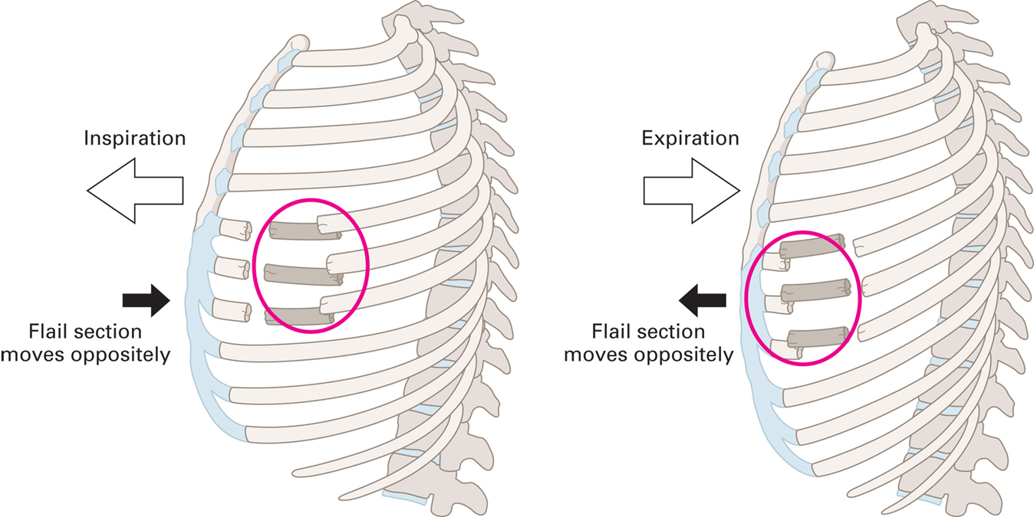
Blunt Chest Injuries (4 of 4)
For long description, see slide 84: Appendix 2
Paradoxical motion.
Notes:
Covers Objective: 31.1
Point to Emphasize: Flail chest is a fracture of two or more consecutive ribs in two or more places. This injury can create an unstable chest wall and can lead to inadequate breathing.
Class Activity: Obtain a rack of ribs from a butcher or supermarket. Apply blunt force trauma and discuss injury patterns.

Slide 22
Patient Assessment (1 of 13)
Rib fracture
  Consider mechanism of injury
  Pain at the site of injury that increases with breathing
  Tenderness
  Redness, swelling, or bruising of skin
  Respiratory distress, hypoxia, or respiratory failure
  Self-splinting
Notes:
Covers Objective: 31.2

Slide 23
Patient Assessment (2 of 13)
Flail chest
  Mechanism of injury capable of causing injury
  Difficulty breathing
  Pain at injury site
  Likely signs of shock and hypoxia
  Chest wall muscle contraction
Notes:
Covers Objective: 31.2

Slide 24
Patient Care (1 of 10)
Rib Fracture
  Consider need for A L S
  Allow patient to remain in position of comfort
    Unless spinal precautions are needed
  Treat hypoxia
  Allow patient to hold pillow or cushion against chest
Notes:
Covers Objective: 31.2

Slide 25
Patient Care (2 of 10)
Flail chest
  Primary assessment for life threats
  Administer oxygen.
  If patient is breathing inadequately, assist ventilation.
  Follow local protocols regarding using noninvasive positive pressure ventilations.
Notes:
Covers Objective: 31.2

Slide 26
Patient Care (3 of 10)
Flail chest
  Request A L S for pain management.
  Monitor patient carefully.
  Watch respiratory rate and depth.
  Do not restrict chest wall movement.
Notes:
Covers Objective: 31.2

Slide 27
Penetrating Chest Injuries
Difficult to tell what is injured from entrance wound
Assume all wounds are life-threatening.
Open wounds allow air into chest.
  Sets imbalance in pressure
  Causes lung to collapse
Notes:
Covers Objective: 31.2
Point to Emphasize: Due to the potential for damage to underlying vital structures and disruption of normal breathing, an open chest wound is a true emergency.
Discussion Topic: Define open and closed chest injuries. What determines whether a chest injury is open or closed?
Class Activity: Use common household items to create a model of the mechanics of breathing. Discuss how the body moves air.

Slide 28
Patient Assessment (3 of 13)
Determine description of object that penetrated
If one penetrating wound is found, look for others.
Visualize entire chest during assessment
Listen to lung sounds
  Identify pneumothorax or hemothorax
Notes:
Covers Objective: 31.2

Slide 29
Patient Assessment (4 of 13)
Lung damage signs and symptoms
  Difficulty breathing
  Absent or unequal lung sounds
  Hemoptysis
  Hypoxia
Notes:
Covers Objective: 31.2

Slide 30
Patient Assessment (5 of 13)
Other signs and symptoms
  Shock
  Tachycardia
  Tachypnea
  Pale skin
  Low blood pressure
Notes:
Covers Objective: 31.2

Slide 31
Patient Assessment (6 of 13)
“Sucking chest wound”
  Air drawn in through hole
  Wound to the chest
  Sucking sound
  Small air bubbles within wound
  Patient may gasp for air
Notes:
Covers Objective: 31.2
Discussion Topic: Describe the pathophysiology of a sucking chest wound. How does this injury interfere with breathing?

Slide 32
Patient Care (4 of 10)
Allow law enforcement to render scene safe.
Consider A L S.
Maintain open airway.
Seal wound.
Apply occlusive dressing.
Notes:
Covers Objective: 31.2
Point to Emphasize: Care for an open chest wound involves sealing the wound to prevent air from entering the chest cavity. Care also may include application of a dressing that will allow air to escape the chest cavity while preventing air from entering.

Slide 33
Patient Care (5 of 10)
Allow patient to remain in position of comfort if possible.
Administer high-concentration oxygen.
Treat for shock.
Immediate transport.
Notes:
Covers Objective: 31.2

Slide 34
Occlusive and Flutter-Valve Dressings (1 of 3)
Occlusive dressing seals wound to stop movement of air.
Flutter valve dressings involve taping dressing in place and leaving a side or corner of dressing unsealed
  As patient inhales, dressing will seal wound.
  As patient exhales, free corner or edge acts as flutter valve to release air trapped in chest cavity.
Notes:
Covers Objective: 31.2
Discussion Topic: Describe the process for applying an occlusive dressing. Describe how you might improvise an occlusive dressing if a commercial variation is not available.

Slide 35
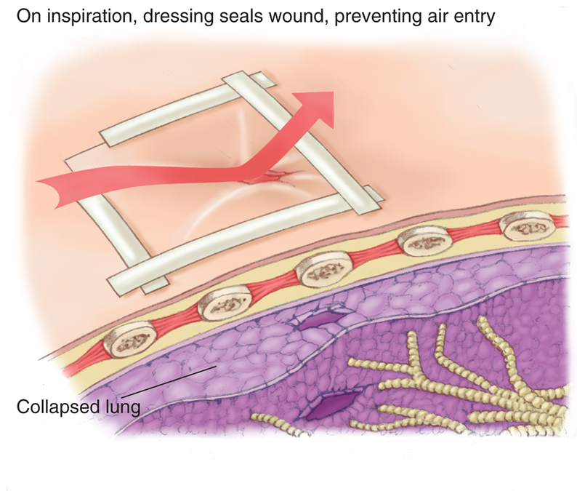
Occlusive and Flutter-Valve Dressings (2 of 3)
Creating a flutter valve to allow air to escape from the chest cavity.
Notes:
Covers Objective: 31.2
Knowledge Application: Use a manikin and simulate an open chest wound. Have students demonstrate the proper application of an occlusive dressing. Use various materials to create dressings.
Critical Thinking Discussion: Chest injuries are sealed to prevent air from entering the chest cavity. In what other areas of the body might it be appropriate to apply occlusive dressings to open injuries?

Slide 36
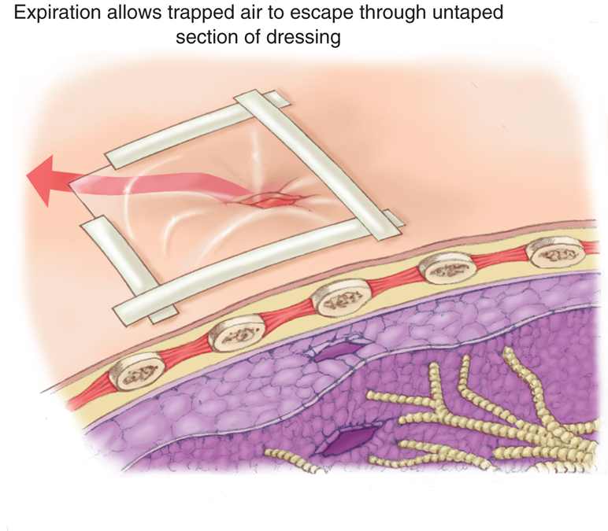
Occlusive and Flutter-Valve Dressings (3 of 3)
Creating a flutter valve to allow air to escape from the chest cavity.
Notes:
Covers Objective: 31.2

Slide 37
Think About It
Does the patient’s chest injury need to be treated during the primary assessment?
Does the open chest injury require an occlusive dressing?
Does the patient’s injury necessitate immediate transport to a trauma center?
Notes:
Covers Objective: 31.2

Slide 38
Injuries Within the Chest Cavity (1 of 12)
Pneumothorax and tension pneumothorax
Hemothorax and hemopneumothorax
Traumatic asphyxia
Cardiac tamponade
Aortic injury
Notes:
Covers Objective: 31.2
Knowledge Application: Have students work in small groups. Assign each group a specific chest injury. Have the group research and present on pathophysiology, signs, symptoms, and treatment.

Slide 39
Injuries Within the Chest Cavity (2 of 12)
Pneumothorax and tension pneumothorax
  Pneumothorax
    When air accumulates in chest cavity, possibly causing lung collapse
  Tension pneumothorax
    Pressure from air in chest cavity puts pressure on the heart and vena cava
Notes:
Covers Objective: 31.2
Point to Emphasize: Serious injuries can occur within the chest cavity itself, and these injuries often are not apparent on the outside. EMTs should evaluate mechanism of injury and should recognize the specific signs of these life-threatening problems.
Discussion Topic: Describe the pathophysiology of pneumothorax, tension pneumothorax, and hemothorax.
Critical Thinking Discussion: What are the key differences between a simple pneumothorax and a tension pneumothorax?

Slide 40
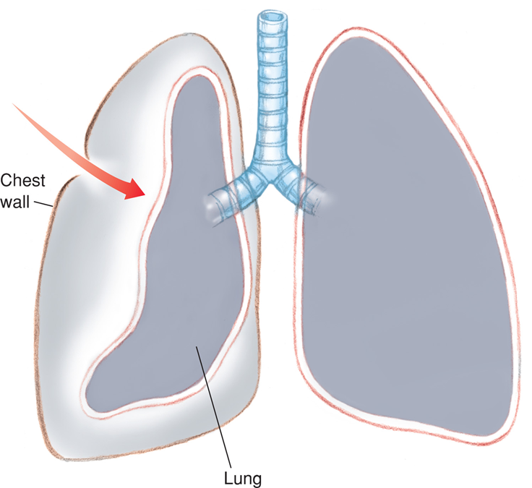
Injuries Within the Chest Cavity (3 of 12)
Air can enter the chest cavity through a puncture in the chest wall. This can cause the collapse of a lung and impaired breathing.
Notes:
Covers Objective: 31.2

Slide 41
Injuries Within the Chest Cavity (4 of 12)
Pneumothorax and tension pneumothorax
  Patients typically have diminished or absent lung sounds on affected side.
  Jugular veins may be distended.
  Trachea may shift to opposite side.
Notes:
Covers Objective: 31.2
Point to Emphasize: Serious injuries can occur within the chest cavity itself, and these injuries often are not apparent on the outside. EMTs should evaluate mechanism of injury and should recognize the specific signs of these life-threatening problems.

Slide 42
Injuries Within the Chest Cavity (5 of 12)
Hemothorax and hemopneumothorax
  Hemothorax
    Chest cavity fills will blood.
  Hemopneumothorax
    Chest cavity fills with both blood and air.
Notes:
Covers Objective: 31.2
Point to Emphasize: Serious injuries can occur within the chest cavity itself, and these injuries often are not apparent on the outside. EMTs should evaluate mechanism of injury and should recognize the specific signs of these life-threatening problems.

Slide 43
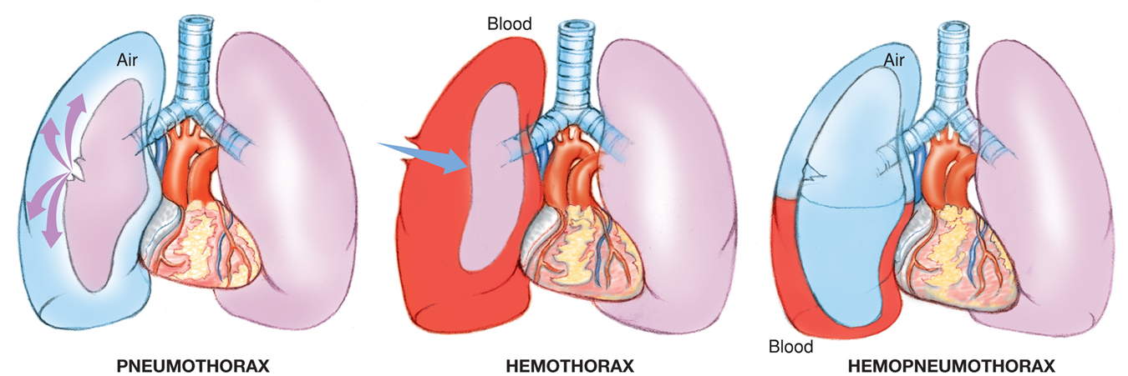
Hemothorax and Hemopneumothorax
For long description, see slide 85: Appendix 3
Pneumothorax, hemothorax, and hemopneumothorax.
Notes:
Covers Objective: 31.2

Slide 44
Injuries Within the Chest Cavity (6 of 12)
Traumatic asphyxia
  Sudden compression of chest forcing blood out of organs and rupturing blood vessels
  Neck and face are a darker color than rest of the body
  May cause bulging eyes, distended neck veins, broken blood vessels in face
Notes:
Covers Objective: 31.2
Discussion Topic: Describe the pathophysiology of traumatic asphyxia.

Slide 45
Injuries Within the Chest Cavity (7 of 12)
Cardiac tamponade
  Direct injury to heart causing blood to flow into the pericardial sac around the heart
  Pericardium is a tough sac that rarely leaks.
  Increased pressure on heart so chambers cannot fill
Notes:
Covers Objective: 31.2
Discussion Topic: Describe the pathophysiology of cardiac tamponade.

Slide 46
Injuries Within the Chest Cavity (8 of 12)
Cardiac tamponade
  Blood backs up into veins.
  Usually a result of penetrating trauma
  Distended neck veins
  Shock and narrowed pulse pressure
Notes:
Covers Objective: 31.2

Slide 47
Injuries Within the Chest Cavity (9 of 12)
Aortic injury
  Aorta is the largest artery in the body.
  Penetrating trauma can cause direct damage.
  Blunt trauma can sever or tear the aorta.
Notes:
Covers Objective: 31.2

Slide 48
Injuries Within the Chest Cavity (10 of 12)
Aortic injury
  Aortic dissection
    Inner layer of aorta begins to tear
    Blood flows between layers of aorta’s wall
    Often rapidly fatal
  Aneurysm
    Balloon-like protrusion of aorta
    Rupture leads to patient death
Notes:
Covers Objective: 31.2
Discussion Topic: Describe the pathophysiology of aortic dissection.

Slide 49
Injuries Within the Chest Cavity (11 of 12)
Aortic injury
  Patient complains of pain in chest, abdomen, or back.
  Signs of shock
  Differences in pulse or blood pressure between right and left arms or differences in pulses between arms and legs or the legs themselves
Notes:
Covers Objective: 31.2

Slide 50
Injuries Within the Chest Cavity (12 of 12)
Commotio cordis
  Uncommon condition
  Trauma to chest when heart is vulnerable
  If untreated, patient will go into ventricular fibrillation (V F).
  Treat like a V F patient.
    C P R, defibrillation
Notes:
Covers Objective: 31.2
Discussion Topic: What is commotio cordis? How is it different from other traumatic injuries to the chest?
Knowledge Application: Use programmed patients to simulate chest injuries. Have teams of students practice assessment and treatment.

Slide 51
Patient Assessment (7 of 13)
Pneumothorax
  Respiratory difficulty
  Uneven chest wall movement
  Reduction or absence of breath sounds on affected side
Notes:
Covers Objective: 31.2
Discussion Topic: Describe the assessment and care of a patient with a chest injury.

Slide 52
Patient Assessment (8 of 13)
Tension pneumothorax
  Increased respiratory difficulty and signs of hypoxia
  Shock
  Distended neck veins
  Tracheal deviation
Hemothorax
  Signs of pneumothorax
  Coughing up frothy-red blood
Notes:
Covers Objective: 31.2

Slide 53
Patient Assessment (9 of 13)
Traumatic asphyxia
  Distended neck veins
  Head, neck, and shoulders appear dark blue of purple
  Bloodshot and bulging eyes
  Swollen and blue tongue and lips
  Chest deformity or tenderness
Notes:
Covers Objective: 31.2

Slide 54
Patient Assessment (10 of 13)
Cardiac tamponade
  Distended neck veins
  Very weak pulse
  Low blood pressure
  Steadily decreasing pulse pressure
Notes:
Covers Objective: 31.2

Slide 55
Patient Assessment (11 of 13)
Aortic injury or dissection
  Tearing chest pain radiating to the back
  Differences in pulse or blood pressure between right and left extremities or between arms and legs
  Palpable pulsating mass
  Cardiac arrest
Notes:
Covers Objective: 31.2

Slide 56
Patient Care (6 of 10)
Pneumothorax or tension pneumothorax
  Contact A L S.
  Seal all open chest wounds.
  Allow air to be expelled for tension pneumothorax.
  Manage patient’s airway.
  Administer oxygen to treat hypoxia.
  Allow patient to remain in position of comfort.
Notes:
Covers Objective: 31.2

Slide 57
Patient Care (7 of 10)
Other injuries within the chest cavity
  Maintain open airway. Be prepared to apply suction.
  Administer supplemental oxygen.
  Follow local protocols for type of dressing.
  Care for shock.
  Transport as soon as possible.
  Consider A L S intercept.
Notes:
Covers Objective: 31.2
Critical Thinking Discussion: Review the Think Like an EMT feature with students and encourage discussion.

Slide 58
Abdominal Injuries
Back to Topics
Notes:
Teaching Time: 30 minutes
Teaching Tip: Build on previous lessons. Review the signs of internal bleeding and shock. Teach that these problems frequently are linked to abdominal trauma. Use sausage casings to simulate eviscerations. Practice appropriate treatment.

Slide 59
Abdominal Injuries (1 of 3)
Can be open or closed
Internal bleeding can be severe if organs or blood vessels are damaged or ruptured.
Evisceration may occur.
  Organs protruding through wound opening
Notes:
Covers Objective: 31.3
Points to Emphasize: Blunt or penetrating trauma can damage the abdomen. The level of damage typically depends upon the organ system injured beneath the skin. An abdominal injury can be either open or closed. In a closed injury, the abdominal wall remains intact. Structures such as the liver, spleen, and diaphragm are particularly vulnerable to blunt abdominal trauma.
Discussion Topics: Compare and contrast an open abdominal injury with a closed abdominal injury. What role does the integrity of the abdominal wall play? Discuss the major organ systems that are most vulnerable to abdominal trauma.

Slide 60
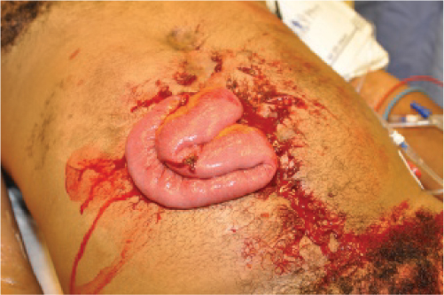
Abdominal Injuries (2 of 3)
An abdominal evisceration from a stab wound.
Notes:
Covers Objective: 31.3

Slide 61
Abdominal Injuries (3 of 3)
Blunt trauma to solid organs can cause life-threatening blood loss.
Injury to the diaphragm can cause detachment, allowing abdominal contents to enter thoracic cavity.
If hollow organs are injured, they can spill contents into the abdominal cavity
  Severe irritation and peritonitis
Notes:
Covers Objective: 31.3

Slide 62
Patient Assessment (12 of 13)
Pain, initially mild but rapidly becoming intolerable
Cramps
Nausea
Weakness
Thirst
Obvious lacerations and puncture wounds to abdomen
Notes:
Covers Objective: 31.4
Point to Emphasize: Because of the vulnerability of large vascular organs, internal bleeding should be assumed in most abdominal trauma. EMTs must watch carefully for shock and must initiate rapid transport to an appropriate facility.
Discussion Topic: Describe the signs and symptoms of a closed abdominal injury. What are the potential life threats?
Critical Thinking Discussion: Consider the mechanism of injury of a seatbelt used in a high-speed crash. What types of abdominal injuries could you predict?

Slide 63
Patient Assessment (13 of 13)
Lacerations and punctures wounds to pelvis, and middle and lower back
Indications of blunt trauma
Indications of developing shock
Coughing up or vomiting blood
Rigid and/or tender abdomen
Distended abdomen
Patient tries to lie very still.
Notes:
Covers Objective: 31.4
Class Activity: Feel an abdomen. Have students work in pairs and palpate their partner's abdomen. Feeling a normal abdomen will help them differentiate abnormal changes.

Slide 64
The Path of the Bullet
Patient with gunshot wound to lower ribs and same level in back should be treated for both chest wound and abdominal wound.
Bullets often do not take straight paths.
Notes:
Covers Objective: 31.4
Inside/Outside: The Path of the Bullet: Draw a relationship between what patients exhibit and what is occurring inside the body during a gunshot wound.

Slide 65
Patient Care (8 of 10)
Both closed and open abdominal injuries
  Stay alert for vomiting; keep airway open.
  Place patient on back with legs flexed at knees to reduce tension on abdominal muscles.
  Administer supplemental oxygen.
  Treat for shock.
  Give nothing to patient by mouth.
  Continuously monitor vital signs.
  Transport as soon as possible.
Notes:
Covers Objective: 31.4
Knowledge Application: Use programmed patients to simulate various abdominal injuries. Have teams of students practice assessment and treatment.

Slide 66
Patient Care (9 of 10)
Additional steps for open abdominal injuries
  Control external bleeding and dress all wounds.
  Do not touch or replace eviscerated organs.
    Apply sterile dressing moistened with sterile saline over wound site.
    For large evisceration, maintain warmth by placing layers of bulky dressing over occlusive dressing.
Notes:
Covers Objective: 31.4
Discussion Topics: Define evisceration. Discuss the steps for appropriate treatment.
Knowledge Application: Use a manikin or programmed patient to simulate an evisceration. Have students practice the appropriate treatment.

Slide 67
Patient Care (10 of 10)
Additional steps for open abdominal injuries
  Do not remove any impaled object.
    Stabilize with bulky dressings bandaged in place.
    Leave patient’s legs in position found to avoid muscular movement that may move impaled object.
Notes:
Covers Objective: 31.4
Knowledge Application: Use a manikin or programmed patient to simulate an impaled object. Have students practice stabilization.

Slide 68
Chapter Review

Slide 69
Chapter Review (1 of 6)
An open chest or abdominal wound is considered to be one that penetrates not only the skin but also the chest or abdominal wall to expose internal organs. Open chest and abdominal wounds are life-threatening. For both open and closed injuries, take appropriate Standard Precautions, note the mechanism of injury, protect the patient’s airway and breathing, treat for shock, and transport. If there are signs of hypoxia, or the patient’s vital signs indicate or suggest the potential for shock, administer oxygen.

Slide 70
Chapter Review (2 of 6)
A flail chest is characterized by paradoxical motion. If the patient is unable to adequately breathe, assist the patient’s ventilations.

Slide 71
Chapter Review (3 of 6)
Seal a penetrating chest wound with an occlusive dressing. Monitor the patient for changes, and be prepared to manually relieve any pressure in the chest.

Slide 72
Chapter Review (4 of 6)
Closed chest wounds are sometimes difficult to distinguish or may occur together. Assess the patient, including breath sounds, and maintain ventilation, oxygenation, and perfusion.

Slide 73
Chapter Review (5 of 6)
A patient who collapses in cardiac arrest after a force is applied to the center of the chest should receive C P R and defibrillation like any other patient in arrest from a cardiac cause.
If a patient develops signs of tension pneumothorax, arrange immediately for A L S intercept or transport promptly to a facility that can treat this injury.

Slide 74
Chapter Review (6 of 6)
When solid abdominal organs are injured, life-threatening amounts of blood loss can occur.
When hollow abdominal organs are injured, their contents spill into the abdominal cavity and cause irritation and peritonitis.

Slide 75
Remember (1 of 3)
Blunt trauma, penetrating trauma, and compression are mechanisms that can injure the chest and abdomen.
Open or closed pertains to the integrity of the chest or abdominal wall after injury.
Seal open chest wounds to prevent air from entering the chest cavity.

Slide 76
Remember (2 of 3)
Closed chest and abdominal wounds bear a high risk for underlying organ system damage and internal bleeding. Use mechanism of injury and patient assessment to recognize the signs and symptoms of shock.

Slide 77
Remember (3 of 3)
E M Ts should learn signs and symptoms, and treatment procedures for specific chest and abdominal injuries.

Slide 78
Questions to Consider (1 of 2)
Is the patient’s breathing adequate, inadequate, or absent?
Is the patient displaying signs of shock?
Is there an open wound in the chest that needs to be sealed?
Notes:
Talking Points: When students are discussing these questions, make sure to insert real-life details that will help them understand that the situations they find themselves in as EMTs will not necessarily follow the clear-cut order they find in their textbooks.

Slide 79
Questions to Consider (2 of 2)
Is the patient displaying signs of a tension pneumothorax?
Is there an open wound in the abdomen that needs to be dressed and covered?

Slide 80
Critical Thinking (1 of 2)
You are caring for a patient who was shot in the chest with a nail gun. You applied an occlusive dressing around the wound. The patient is suddenly deteriorating. He is having extreme difficulty breathing and his color has worsened.

Slide 81
Critical Thinking (2 of 2)
Breath sounds have become almost totally absent on the side with the impaled nail. What complication might you suspect is causing his worsening condition? How could this be corrected?
Notes:
Talking Points: The deterioration of the patient’s condition is likely because air is accumulating inside the chest cavity and developing a pneumothorax. Your goal is to relieve the air pressure by lifting the occlusive dressing, which will allow accumulated pressure to escape. Once the pressure is relieved, you should see a nearly immediate improvement in patient condition.

Slide 82

Copyright
This work is protected by United States copyright laws and is provided solely for the use of instructors in teaching their courses and assessing student learning. Dissemination or sale of any part of this work (including on the World Wide Web) will destroy the integrity of the work and is not permitted. The work and materials from it should never be made available to students except by instructors using the accompanying text in their classes. All recipients of this work are expected to abide by these restrictions and to honor the intended pedagogical purposes and the needs of other instructors who rely on these materials.

Slide 83
Appendix 1
The chart on the left depicts the placement of the solid organs in the human body including the spleen, liver, pancreas, and kidneys. The chart on the right depicts the hollow organs in the human body including the stomach, gallbladder, duodenum, large and small intestines, and bladder.
Return to presentation

Slide 84
Appendix 2
The first graphic shows a rib cage with three ribs broken at two ends. An arrow labeled, Inspiration points outward from the chest. Another arrow points in toward the chest and is labeled, Flail section moves oppositely. The second graphic shows a rib cage with three ribs broken at two ends. An arrow labeled, expiration points in toward the chest. Another arrow points outward from the chest and is labeled, Flail section moves oppositely.
Return to presentation

Slide 85
Appendix 3
With pneumothorax, air enters a chest cavity and collapses one of the lungs. With hemothorax, blood enters a chest cavity and collapses one of the lungs. With hemopneumothorax, blood and air enter a chest cavity and collapse one of the lungs.
Return to presentation

