Slide 1
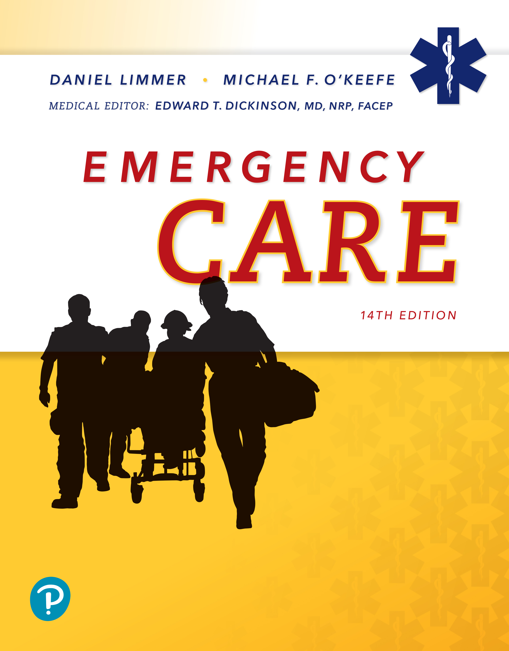
Emergency Care
Fourteenth Edition
Chapter 32
Musculoskeletal Trauma
Slides in this presentation contain hyperlinks. JAWS users should be able to get a list of links by using INSERT+F7
Copyright © 2021, 2016, 2012 Pearson Education, Inc. All Rights Reserved
Notes:
If this PowerPoint presentation contains mathematical equations, you may need to check that your computer has the following installed:
1) MathType Plugin
2) Math Player (free versions available)
3) NVDA Reader (free versions available)

Slide 2
Topics
Musculoskeletal System
General Guidelines for Emergency Care
Emergency Care of Specific Injuries
Notes:
Planning Your Time: Plan 95 minutes for this chapter.
Musculoskeletal System (20 minutes)
General Guidelines for Emergency Care (35 minutes)
Emergency Care of Specific Injuries (40 minutes)
Note: The total teaching time recommended is only a guideline.
Core Concepts:
Knowledge of bones, muscles, and other elements of the musculoskeletal system
Knowledge of general guidelines for emergency care of musculoskeletal injuries
Purposes and general procedures for splinting
Assessment and care of specific injuries to the upper and lower extremities

Slide 3
Musculoskeletal System
Back to Topics
Notes:
Teaching Time: 20 minutes
Teaching Tips: Use anatomical models (a skeleton) to demonstrate anatomy and physiology. Obtain a bone from a butcher or supermarket to help demonstrate bone anatomy. This section lends itself well to multimedia presentations. Use graphics to illustrate anatomy and physiology as well as various types of injuries.

Slide 4
Musculoskeletal System (1 of 2)
Bones
  Framework
Joints
  Bending
Muscles
  Movement
Notes:
Covers Objective: 32.1
Point to Emphasize: Joints are the places where bones articulate. They are a critical element in the body's ability to move.
Discussion Topic: Describe the anatomy and physiology of bones.

Slide 5
Musculoskeletal System (2 of 2)
Cartilage
  Flexibility
Ligaments
  Connect bone to bone
Tendons
  Connect muscle to bone
Notes:
Covers Objective: 32.1
Knowledge Application: Dissect an animal leg. Contact a butcher and obtain animal extremities. Dissect and discuss anatomy and physiology.

Slide 6
Anatomy of Bone (1 of 2)
Bones
  Formed of dense connective tissues
  Vascular and susceptible to bleeding on injury
  Covered by periosteum
Joints
  Where bones meet
Notes:
Covers Objective: 32.1
Point to Emphasize: Bones provide the body with structure, store salts and metabolic materials, and provide a site for the production of red blood cells.
Knowledge Application: Describe an injury. Ask students to classify the type of injury that you are describing.

Slide 7
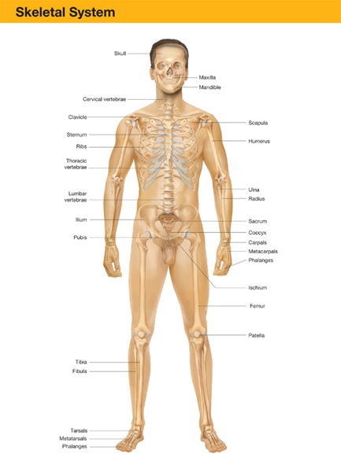
Bones
For long description, see slide 93: Appendix 1
Human skeleton.
Notes:
Covers Objective: 32.1
Discussion Topic: Describe the axial skeleton.

Slide 8
Anatomy of Bone (2 of 2)
Classification of shape
  Long
  Short
  Flat
  Irregular
Notes:
Covers Objective: 32.1
Discussion Topic: Describe the four classifications of bones.

Slide 9
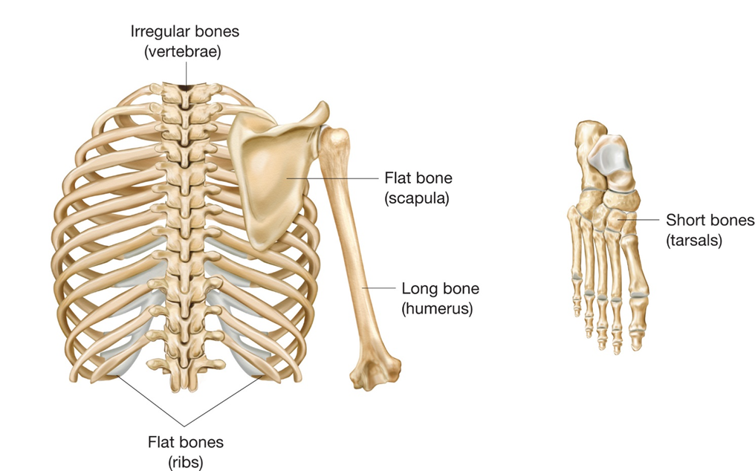
Shapes of Bones
Bones are classified by shape.
Notes:
Covers Objective: 32.1

Slide 10
Self-Healing Nature of Bone
Break causes soft tissue swelling and a blood clot in the fracture area.
Interruption of blood supply causes cells to die at injury site.
Cells further from fracture rapidly divide, forming tissue that heals the fracture and develops into new bone.
Notes:
Covers Objective: 32.1
Point to Emphasize: Because of the self-healing property of bones, it is very important for a broken bone to be immobilized quickly and to remain immobilized to heal properly.
Discussion Topic: Explain why it is important to immobilize a broken bone properly.
Critical Thinking Discussion: What is the role of the EMT with regard to immobilizing the bone to promote proper healing?

Slide 11
Muscles, Cartilage, Ligaments, and Tendons (1 of 4)
Kinds of muscles
  Skeletal (voluntary)
  Smooth (involuntary)
  Cardiac (myocardial)
Cartilage helps form flexible structures of the body.
Notes:
Covers Objective: 32.1
Point to Emphasize: Muscles, cartilage, ligaments, and tendons are the tissues that cause movement of body parts or organs.
Discussion Topic: Describe the three types of muscle.

Slide 12
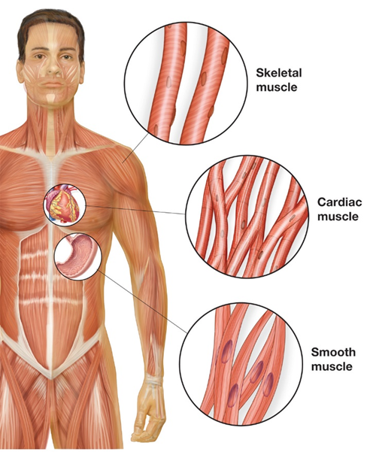
Muscles, Cartilage, Ligaments, and Tendons (2 of 4)
Three types of muscle.
Notes:
Covers Objective: 32.1

Slide 13
Muscles, Cartilage, Ligaments, and Tendons (3 of 4)
Tendons allow for the power of movement across joints.
  M T B = muscle-tendon-bone
Ligaments support joints by attaching bone ends to allow for stable range of motion
  B L B = bone-ligament-bone
Notes:
Covers Objective: 32.1
Discussion Topic: Describe the functions of muscles, ligaments, and tendons.

Slide 14
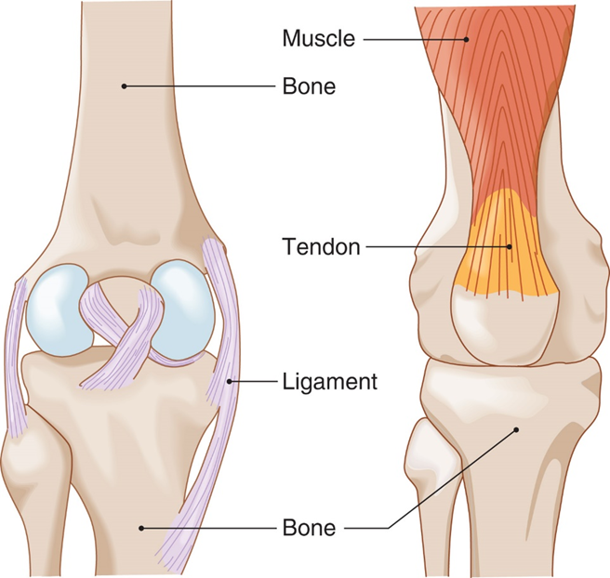
Muscles, Cartilage, Ligaments, and Tendons (4 of 4)
For long description, see slide 94: Appendix 2
Ligaments tie bone to bone. Tendons tie muscle to bone.
Notes:
Covers Objective: 32.1
Class Activity: Take apart a skeleton anatomy model. Have students work in groups to put the skeleton back together. Discuss articulation and joints.

Slide 15
General Guidelines for Emergency Care
Back to Topics
Notes:
Teaching Time: 35 minutes
Teaching Tips: Use specific multimedia graphics and illustrations of the various forces that cause musculoskeletal injuries. Although it is important to differentiate among the various types of injuries, make it clear that often a specific diagnosis is impossible and that the EMT should treat with the worst-case scenario in mind. Relate common signs and symptoms to your discussion of anatomy and physiology. How does disruption of function translate into signs and symptoms? Demonstrate treatment steps with a programmed patient. Have proper splinting equipment on hand and allow students to visualize the proper methods. Use moulage to simulate various types of wounds. Demonstrate treatment.

Slide 16
Mechanisms of Musculoskeletal Injury
Direct force
Twisting (rotational) force
Indirect force
Notes:
Covers Objective: 32.1
Point to Emphasize: There are three types of mechanisms that cause musculoskeletal injuries: direct force, twisting force, and indirect force.
Discussion Topic: Describe the three mechanisms that cause musculoskeletal injuries.
Knowledge Application: Have students work in small groups. Hand out sticks and have each group present an example of a specific force that causes musculoskeletal injury. Have groups discuss their examples.

Slide 17
Injury to Bones and Connective (1 of 4)
Fracture
  Any break in a bone, open or closed
  Comminuted
    Broken in several places
  Greenstick
    Incomplete break
  Angulated
    Bent at angle
Notes:
Covers Objective: 32.1
Points to Emphasize: There are four types of musculoskeletal injury: fracture, dislocation, sprain, and strain. A closed extremity injury is one in which the skin has not been broken. An open extremity injury is one in which the skin has been broken or torn through from the inside by the injured bone or from the outside by something that has caused a penetrating wound with associated injury to the bone.
Discussion Topic: Compare and contrast an open extremity injury to a closed extremity injury.

Slide 18
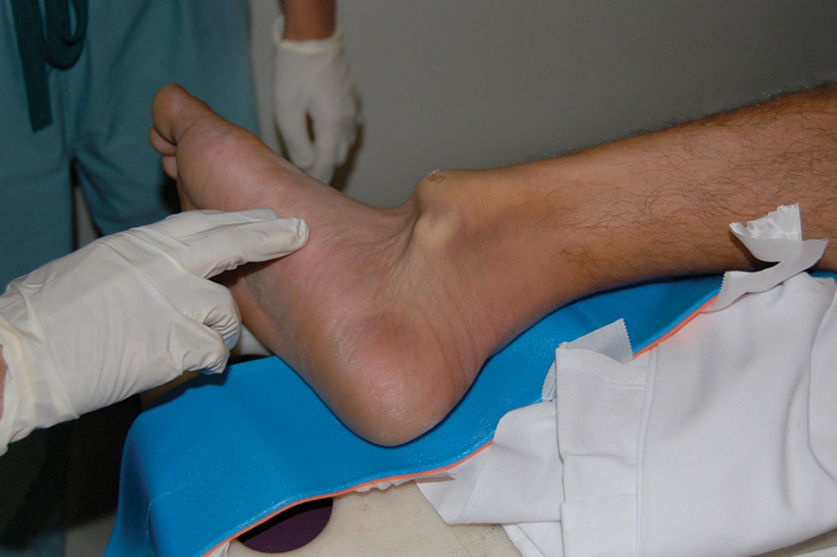
Injury to Bones and Connective (2 of 4)
Closed fracture.
© Edward T. Dickinson, M D
Notes:
Covers Objective: 32.1
Points to Emphasize: There are four types of musculoskeletal injury: fracture, dislocation, sprain, and strain. A closed extremity injury is one in which the skin has not been broken. An open extremity injury is one in which the skin has been broken or torn through from the inside by the injured bone or from the outside by something that has caused a penetrating wound with associated injury to the bone.

Slide 19
Injury to Bones and Connective (3 of 4)
Dislocation
  “Coming apart” of a joint
Sprain
  Stretching and tearing of ligaments
Strain
  Overstretching or overexertion of muscle
Notes:
Covers Objective: 32.1
Discussion Topic: Describe the four common musculoskeletal injuries as noted in student content.

Slide 20
Injury to Bones and Connective (4 of 4)
Not all injuries can be confirmed as a fracture in the field.
Treat all injuries with signs and symptoms of a fracture as a fracture.
A traction splint should be applied to a suspected femur fracture.
Splinting an extremity with a suspected fracture helps prevent blood loss from bone tissues.
Notes:
Covers Objective: 32.1
Critical Thinking Discussion: How might a pelvic fracture or a femur fracture actually be a life-threatening injury?

Slide 21
Assessment of Musculoskeletal Injuries
Rapidly identify and treat life-threatening conditions.
Be alert for injuries besides grotesque wound.
Cut or remove patient’s clothing to complete examination according to the environment and severity of situation.
Notes:
Covers Objective: 32.2
Point to Emphasize: Assessment always should focus on identifying life threats. It often is difficult to determine the exact type of musculoskeletal injury. EMTs always should assume a fracture.

Slide 22
Compartment Syndrome
Severe swelling in the extremity as a result of fracture
Progression
  Fracture or crush injury causes bleeding and swelling in extremity.
  Pressure and swelling become so great the body can no longer perfuse the tissues against pressure.
  Cellular damage occurs, causing additional swelling.
  Blood flow to the area is lost.
    Limb may also be lost if the pressure is not relieved.
Notes:
Covers Objective: 32.2

Slide 23
Patient Assessment (1 of 2)
Pain and tenderness
Deformity and angulation
Grating (crepitus)
Swelling and bruising
Exposed bone ends
Joints locked into position
Nerve/blood vessel compromise
Notes:
Covers Objective: 32.2
Class Activity: Facilitate a discussion about what other, more life-threatening injuries may be present in a musculoskeletal injury.
Knowledge Application: Discuss the assessment of a musculoskeletal injury. What are the immediate priorities? What signs might indicate and isolated injury?

Slide 24
Patient Assessment (2 of 2)
Six P’s of assessment
  Pain or tenderness
  Pallor (pale skin)
  Parasthesia (pins and needles)
  Pulses diminished or absent
  Paralysis
  Pressure
Notes:
Covers Objective: 32.2
Discussion Topic: Describe the signs and symptoms of musculoskeletal injuries. Include the "six P's."
Class Activity: Have students work in pairs to assess each other's circulatory, sensory, and motor functions.

Slide 25
Think About It
Do the patient’s musculoskeletal injuries add up to serious multiple trauma?
Does the patient have circulation, sensation, and motor function (C S M) distal to the suspected fracture or dislocation?
Notes:
Covers Objective: 32.2

Slide 26
Patient Care
Take Standard Precautions.
Perform primary assessment.
During secondary assessment, apply cervical collar if you suspect spine injury.
Splint any suspected extremity fractures after treating life-threatening conditions.
Cover open wounds with sterile dressings.
Notes:
Covers Objective: 32.2
Point to Emphasize: Effective splinting immobilizes adjacent joints and bone ends and minimizes the movement of disrupted joints and broken bone ends. If a primary assessment reveals that your patient is unstable, managing extremity injuries becomes a low priority. Do not take time to individually splint each injury. It is not in the patient's best interest to waste time treating minor injuries and delivering a perfectly packaged but unstable patient to the hospital.

Slide 27
Splinting
Advantages
  Minimizes movement of disrupted joints and broken bone ends
  Decreases pain
  Prevents additional injury to soft tissues
    Nerves, arteries, veins, muscles
  Can prevent a closed fracture from becoming an open fracture
  Minimizes blood loss
Notes:
Covers Objective: 32.2

Slide 28
Realignment of the Deformed Extremity (1 of 3)
Assists in restoring effective circulation to extremity and to simplify splinting
If not realigned, splint may be ineffective, causing increased pain and possible further injury.
Notes:
Covers Objective: 32.2

Slide 29
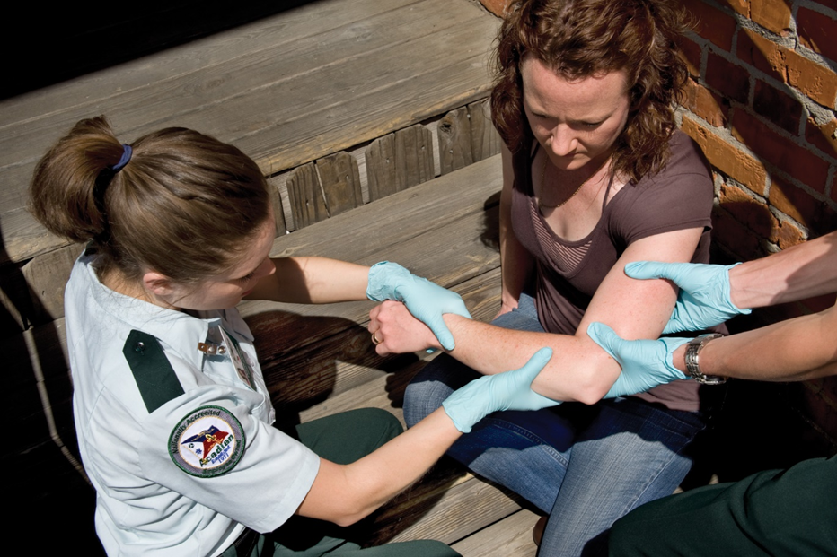
Realigning Deformed Extremity
Realigning an extremity.
Notes:
Covers Objective: 32.2

Slide 30
Realignment of the Deformed Extremity (2 of 3)
If not realigned, increased chance of nerves, arteries, and veins being compromised
Increased pain is only momentary.
Splint in the position found unless distal extremity is cyanotic or lacks pulses
If extremity is cyanotic or lacks pulses, align joint to neutral position using gentle traction
Notes:
Covers Objective: 32.2

Slide 31
Realignment of the Deformed Extremity (3 of 3)
Guidelines
  One E M T grasps distal extremity while partner place one hand above and below injury site.
  Partner supports first E M T who creates gentle manual traction in direction of long axis of extremity.
  If no resistance is felt, maintain gentle traction until extremity is properly aligned and splinted.
Notes:
Covers Objective: 32.2

Slide 32
Strategies for Splinting (1 of 4)
Effective splinting may require some ingenuity.
Three types available on E M S units
  Rigid splints
  Formable splints
  Traction splints
Notes:
Covers Objective: 32.2
Discussion Topic: Discuss the general rules for immobilization as they apply to splinting a possible fracture. Compare and contrast soft splints to rigid splints. How might their uses differ? Discuss how to improvise a splint. What everyday items might you use?

Slide 33
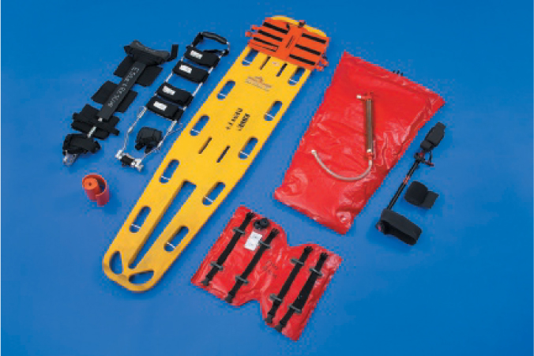
Strategies for Splinting (2 of 4)
Splints and accessories for musculoskeletal injuries.
Notes:
Covers Objective: 32.2
Point to Emphasize: Effective splinting immobilizes adjacent joints and bone ends and minimizes the movement of disrupted joints and broken bone ends. If a primary assessment reveals that your patient is unstable, managing extremity injuries becomes a low priority. Do not take time to individually splint each injury. It is not in the patient's best interest to waste time treating minor injuries and delivering a perfectly packaged but unstable patient to the hospital.

Slide 34
Strategies for Splinting (3 of 4)
Care for life-threatening problems first.
Expose injury site.
Assess distal C S M.
Align long-bone injuries to anatomical position.
Do not push protruding bones back into place.
Notes:
Covers Objective: 32.2
Knowledge Application: Describe signs and symptoms of a musculoskeletal injury. Ask the class to prioritize assessment and treatment. Emphasize treatment of primary assessment problems.

Slide 35
Strategies for Splinting (4 of 4)
Immobilize both injury site and adjacent joints.
Choose a method of splinting.
Splint before moving patient to stretcher or other location if possible.
Pad voids.
Notes:
Covers Objective: 32.2
Class Activity: Use programmed patients and moulage to simulate various musculoskeletal injuries. Have teams of students practice assessment and treatment.

Slide 36
Hazards of Splinting
“Splinting patient to death”
  Splinting before life-threatening conditions addressed
Not ensuring A B C’s
Too tight
  Compresses soft tissues
Too loose
  Allows too much movement
Splinting in deformed position
Notes:
Covers Objective: 32.2
Critical Thinking Discussion: Discuss the concept of “splinting to death.” When might it actually be hazardous to the patient to complete a thorough splinting of all possible fractures?

Slide 37
Splinting Long-Bone and Joint Injuries (1 of 3)
Take appropriate Standard precautions.
If possible, expose area to be splinted.
Manually stabilize injury site.
Notes:
Covers Objective: 32.2

Slide 38
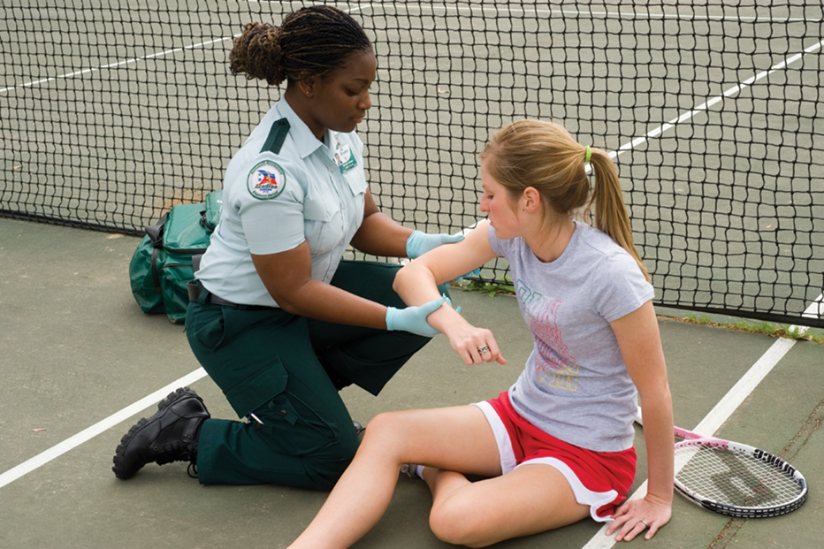
Treatment: Splinting Long-Bone and Joints (1 of 4)
First Take Standard Precautions.
1. Manually stabilize the injured joint—in the case illustrated here, an injured elbow.
Notes:
Covers Objective: 32.2

Slide 39
Splinting Long-Bone and Joint Injuries (2 of 3)
Assess circulation, sensation, and motor function (C S M).
Realign injury if deformed or if distal extremity is cyanotic or pulseless.
Notes:
Covers Objective: 32.2

Slide 40
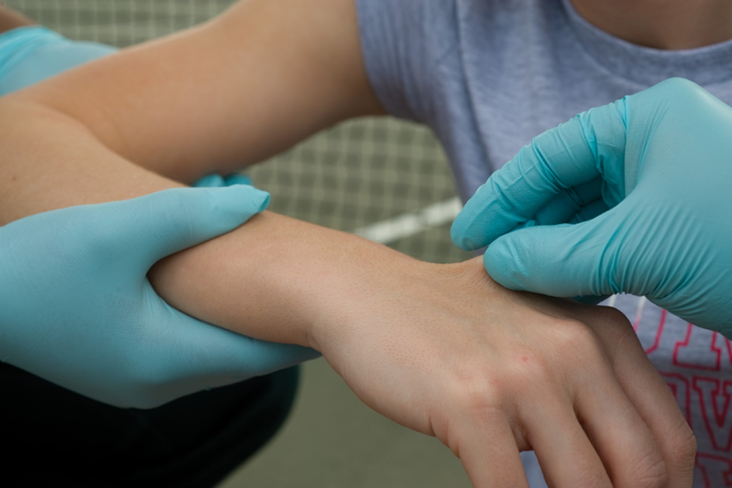
Treatment: Splinting Long-Bone and Joints (2 of 4)
2. Assess distal pulse, sensation, and motor function (C S M).
Notes:
Covers Objective: 32.2

Slide 41
Splinting Long-Bone and Joint Injuries (3 of 3)
Measure or adjust splint.
  Move it into position.
Apply and secure splint to immobilize injury site, adjacent joints.
Reassess C S M distal to injury.
Notes:
Covers Objective: 32.2

Slide 42
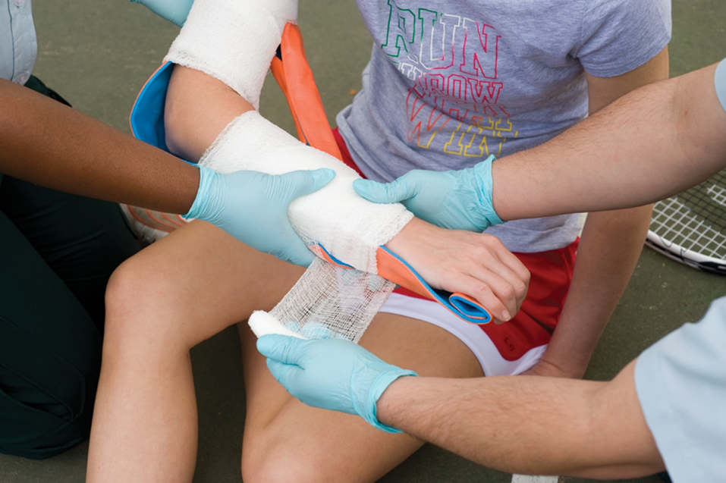
Treatment: Splinting Long-Bone and Joints (3 of 4)
4. Secure the splint.
Notes:
Covers Objective: 32.2

Slide 43
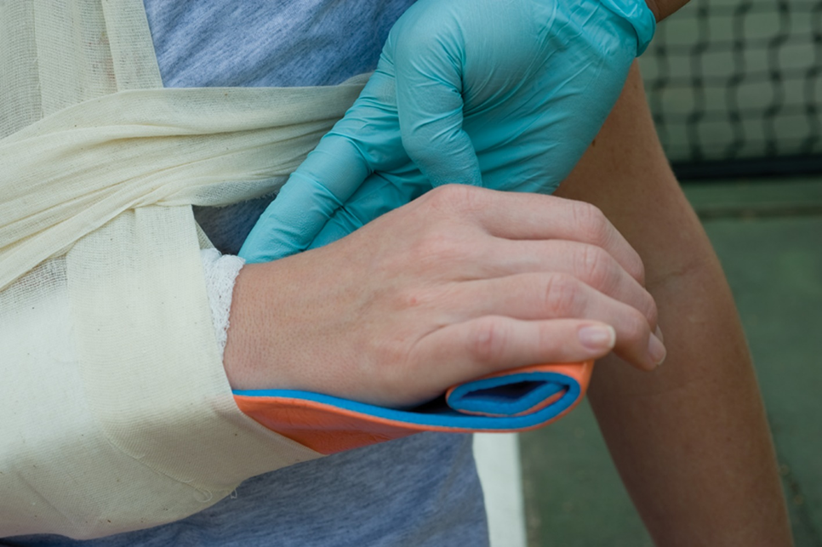
Treatment: Splinting Long-Bone and Joints (4 of 4)
5. Reassess distal C S M.
Notes:
Covers Objective: 32.2

Slide 44
Traction Splint (1 of 4)
Counteracts muscle spasms and greatly reduces pain
Types
  Bipolar
  Unipolar
Amount of traction applied should be roughly 10 percent of patient’s body weight
  Not exceeding 15 pounds
Notes:
Covers Objective: 32.2

Slide 45
Traction Splint (2 of 4)
Take Standard Precautions and, if possible, expose the area to be splinted.
Manually stabilize the leg and apply manual traction.
Assess C S M distal to the injury.
Adjust the splint to the proper length and position it at or under the injured leg.
Notes:
Covers Objective: 32.2

Slide 46
Traction Splint (3 of 4)
Apply the proximal securing device (ischial strap).
Apply the distal securing device (ankle hitch).
Apply mechanical traction.
Position and secure support straps.
Notes:
Covers Objective: 32.2

Slide 47
Traction Splint (4 of 4)
Reevaluate the proximal and distal securing devices and reassess C S M distal to the injury.
Secure the patient’s torso and the traction splint to a long spine board to immobilize the hip and to prevent movement of the splint.
Notes:
Covers Objective: 32.2

Slide 48
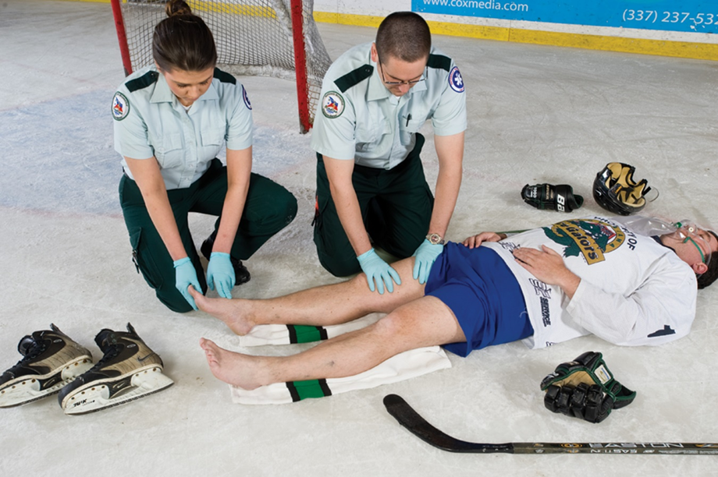
Treatment: Traction Splint (1 of 4)
1. Take Standard Precautions. Begin by assessing the limb.
Note: Assess the distal C S M both before and after immobilizing or splinting an extremity.
Notes:
Covers Objective: 32.2
Talking Points: A traction splint counteracts the muscle spasms and greatly reduces the pain associated with a long-bone femur fracture. Steps for using traction splint: (1) Take Standard Precautions. Begin by assessing the limb. (2) Manually stabilize the injured leg. (3) Assess circulation, sensation, and motor function (CSM). (4) Adjust the splint to proper length and position it next to the injured leg. (5) After lifting the extremity and positioning the split under it, apply the ischial securing device. (6) Apply an ankle hitch. (7) Apply manual traction, then mechanical traction. (8) Secure support straps, as appropriate. (9) Reevaluate the ischial securing device. (10) Reassess CMS function. (11) Secure the patient's torso to the long board to immobilize the hips. (12) If the patient exhibits signs and symptoms of shock, administer oxygen. Secure the splint to the long board to prevent movement of the splint.

Slide 49
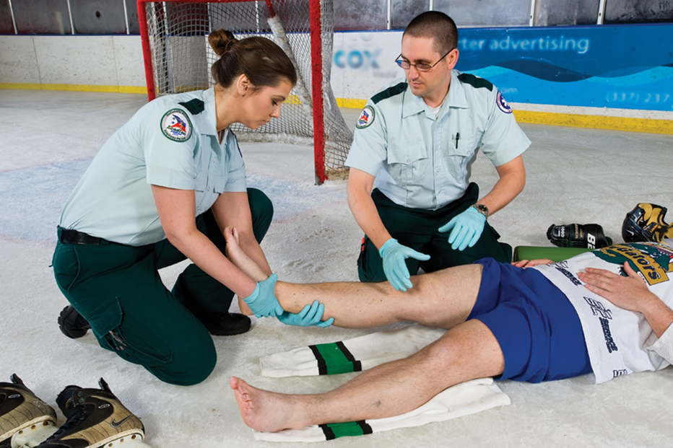
Treatment: Traction Splint (2 of 4)
2. Manually stabilize the injured leg.
Notes:
Covers Objective: 32.2
Talking Points: A traction splint counteracts the muscle spasms and greatly reduces the pain associated with a long-bone femur fracture. Steps for using traction splint: (1) Take Standard Precautions. Begin by assessing the limb. (2) Manually stabilize the injured leg. (3) Assess circulation, sensation, and motor function (CSM). (4) Adjust the splint to proper length and position it next to the injured leg. (5) After lifting the extremity and positioning the split under it, apply the ischial securing device. (6) Apply an ankle hitch. (7) Apply manual traction, then mechanical traction. (8) Secure support straps, as appropriate. (9) Reevaluate the ischial securing device. (10) Reassess CMS function. (11) Secure the patient's torso to the long board to immobilize the hips. (12) If the patient exhibits signs and symptoms of shock, administer oxygen. Secure the splint to the long board to prevent movement of the splint.

Slide 50
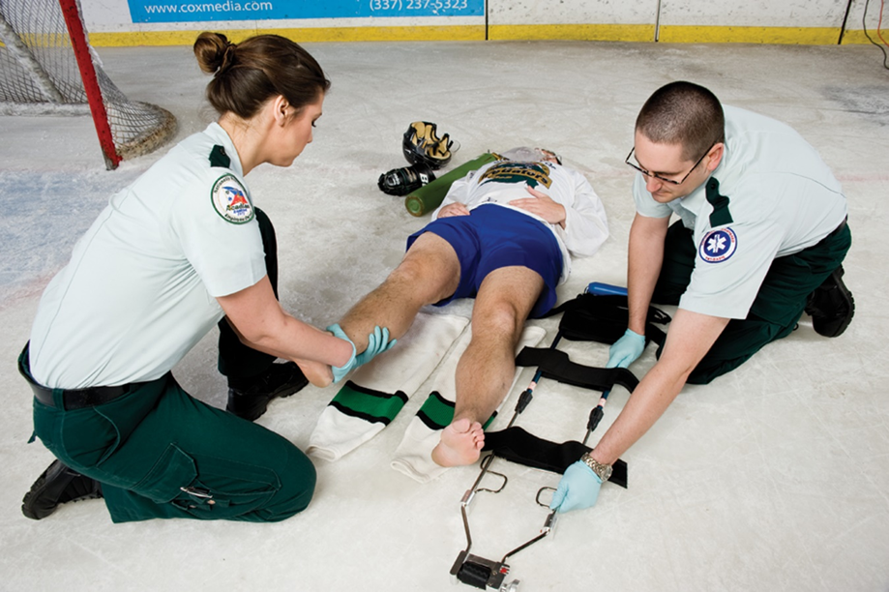
Treatment: Traction Splint (3 of 4)
4. Adjust the splint to the proper length, and position it next to the injured leg.
Notes:
Covers Objective: 32.2
Talking Points: A traction splint counteracts the muscle spasms and greatly reduces the pain associated with a long-bone femur fracture. Steps for using traction splint: (1) Take Standard Precautions. Begin by assessing the limb. (2) Manually stabilize the injured leg. (3) Assess circulation, sensation, and motor function (CSM). (4) Adjust the splint to proper length and position it next to the injured leg. (5) After lifting the extremity and positioning the split under it, apply the ischial securing device. (6) Apply an ankle hitch. (7) Apply manual traction, then mechanical traction. (8) Secure support straps, as appropriate. (9) Reevaluate the ischial securing device. (10) Reassess CMS function. (11) Secure the patient's torso to the long board to immobilize the hips. (12) If the patient exhibits signs and symptoms of shock, administer oxygen. Secure the splint to the long board to prevent movement of the splint.

Slide 51
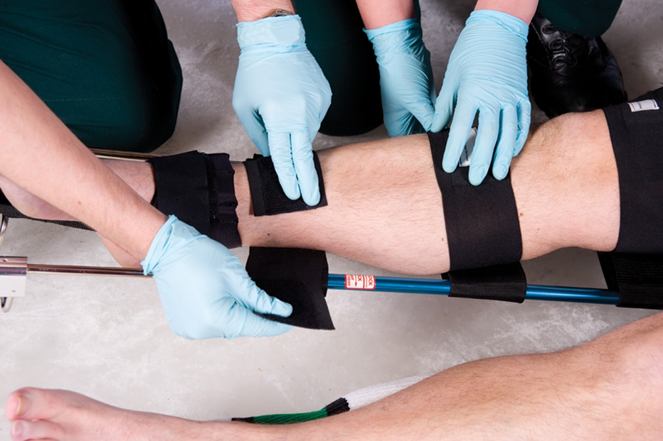
Treatment: Traction Splint (4 of 4)
8. Secure support straps, as appropriate.
Notes:
Covers Objective: 32.2
Talking Points: A traction splint counteracts the muscle spasms and greatly reduces the pain associated with a long-bone femur fracture. Steps for using traction splint: (1) Take Standard Precautions. Begin by assessing the limb. (2) Manually stabilize the injured leg. (3) Assess circulation, sensation, and motor function (CSM). (4) Adjust the splint to proper length and position it next to the injured leg. (5) After lifting the extremity and positioning the split under it, apply the ischial securing device. (6) Apply an ankle hitch. (7) Apply manual traction, then mechanical traction. (8) Secure support straps, as appropriate. (9) Reevaluate the ischial securing device. (10) Reassess CMS function. (11) Secure the patient's torso to the long board to immobilize the hips. (12) If the patient exhibits signs and symptoms of shock, administer oxygen. Secure the splint to the long board to prevent movement of the splint.

Slide 52
Emergency Care of Specific Injuries
Back to Topics
Notes:
Teaching Time: 40 minutes
Teaching Tips: Use multimedia graphics and anatomical models to demonstrate the different injuries that you are discussing. Have various types of splinting equipment on hand. Demonstrate examples of splints and immobilization devices. Teach creativity. Compare commercially available splints to improvised splints. Do not focus on one particular type of splint. Invite a wilderness EMT instructor to class. Most wilderness classes stress improvised devices. Such instructors will lend great insight to splinting.

Slide 53
Shoulder Girdle Injuries (1 of 2)
Patient assessment
  Pain in shoulder
  Dropped shoulder
  Severe blow to back over scapula
Notes:
Covers Objective: 32.2
Discussion Topics: Describe how you would use a sling and swathe. List the steps of application.

Slide 54
Shoulder Girdle Injuries (2 of 2)
Patient care
  Assess distal C S M.
  Use sling and swathe.
  If evidence of anterior dislocation of head of humerus, place pillow between patient’s arm and chest.
  Do not attempt to straighten or reduce.
  Reassess distal C S M.
Notes:
Covers Objective: 32.2
Point to Emphasize: EMTs should use a sling and swathe to immobilize an injury to the shoulder girdle.
Knowledge Application: Have students work in pairs to practice applying a sling and swathe.

Slide 55
Pelvic Injuries (1 of 3)
Patient assessment
  Pain in pelvis, hips, groin, or back
  Pain when pressure applied to iliac crests
  Cannot lift legs when lying supine
  Lateral rotation of foot
  Unexplained pressure in bladder
  Bleeding from urethra, rectum, or vaginal opening
Notes:
Covers Objective: 32.2
Point to Emphasize: Any force that is strong enough to fracture the pelvis also can cause injury to the spine and other vital internal structures.
Knowledge Application: Use a programmed patient to simulate various musculoskeletal injuries. Practice assessment and apply different types of splints and immobilization devices.

Slide 56
Pelvic Injuries (2 of 3)
Patient care
  Move patient as little as possible.
  Determine C S M distal to injury site.
  Straighten lower limbs to anatomical position.
  Stabilize lower limbs.
  Assume spinal injuries.
Notes:
Covers Objective: 32.2
Point to Emphasize: Consider using a pelvic wrap, pneumatic anti-shock garments, or a pelvic binder to immobilize an unstable pelvis.

Slide 57
Pelvic Injuries (3 of 3)
  Reassess distal C S M.
  Care for shock, provide high-concentration oxygen.
  Transport patient as soon as possible.
  Monitor vital signs.
Notes:
Covers Objective: 32.2

Slide 58
Pelvic Wrap (1 of 5)
Commercially available devices
  Can also use a sheet
Applied to patients who have pelvic deformity or instability whether or not signs of shock are present
Notes:
Covers Objective: 32.2

Slide 59

Pelvic Wrap (2 of 5)
A commercial pelvic splint.
Notes:
Covers Objective: 32.2
Talking Points: A pelvic wrap is one method of treating pelvic injuries. It can be performed with commercially available devices or formed from a sheet. The wrap reduces internal bleeding and pain while providing stabilization to the pelvis. To apply a sheet as a pelvic wrap: (1) Once you determine the patient is a candidate for pelvic stabilization, prepare a backboard with a sheet, folded flat, approximately 10 inches wide and lying across the backboard. (2) Carefully roll the patient to the backboard. Center the sheet at the patient's greatest trochanter. (3) Bring the sides of the sheet around to the front of the patient. As you bring the sides of the sheet together and tie them, you will cause compression and stabilization of the pelvis. The sheet should feel firm enough on the pelvis to keep it in normal position without overcompression. (4) Secure the sheet using ties or clamps so the compression is maintained.

Slide 60
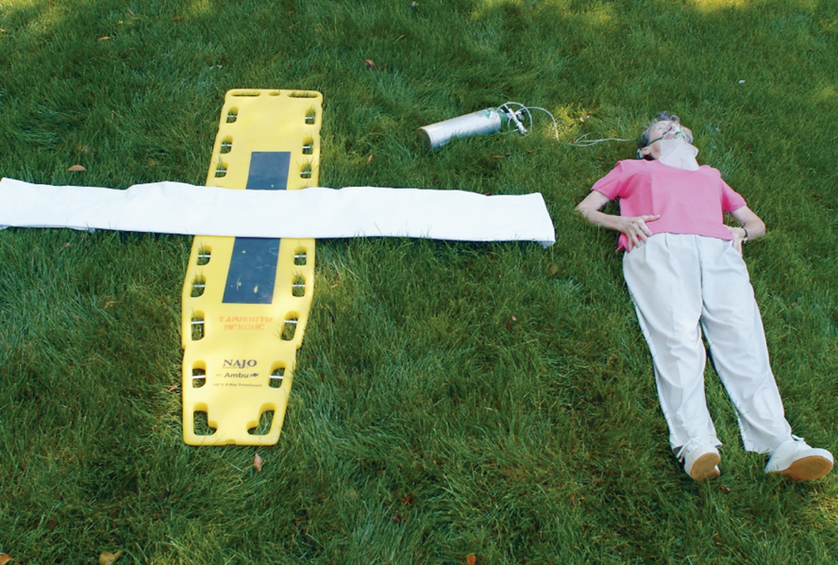
Pelvic Wrap (3 of 5)
To devise a pelvic wrap, lay a sheet, folded flat, approximately 10 inches wide onto the backboard.
Notes:
Covers Objective: 32.2
Talking Points: A pelvic wrap is one method of treating pelvic injuries. It can be performed with commercially available devices or formed from a sheet. The wrap reduces internal bleeding and pain while providing stabilization to the pelvis. To apply a sheet as a pelvic wrap: (1) Once you determine the patient is a candidate for pelvic stabilization, prepare a backboard with a sheet, folded flat, approximately 10 inches wide and lying across the backboard. (2) Carefully roll the patient to the backboard. Center the sheet at the patient's greatest trochanter. (3) Bring the sides of the sheet around to the front of the patient. As you bring the sides of the sheet together and tie them, you will cause compression and stabilization of the pelvis. The sheet should feel firm enough on the pelvis to keep it in normal position without overcompression. (4) Secure the sheet using ties or clamps so the compression is maintained.

Slide 61
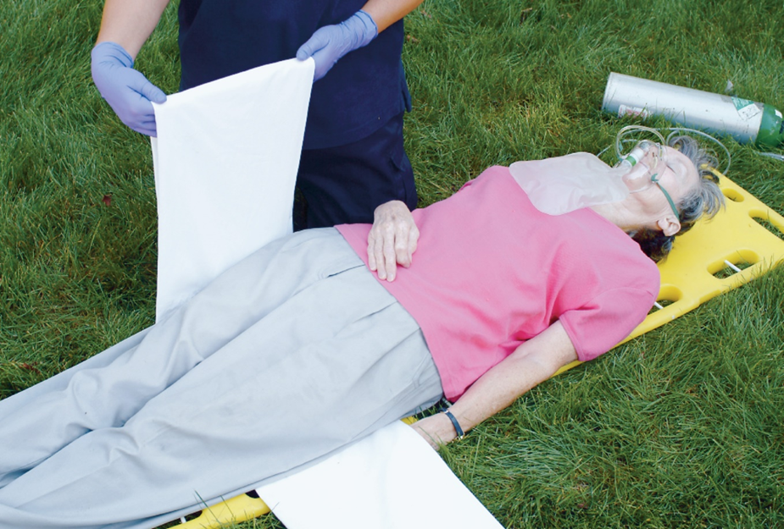
Pelvic Wrap (4 of 5)
Bring the sides of the sheet together.
Notes:
Covers Objective: 32.2
Talking Points: A pelvic wrap is one method of treating pelvic injuries. It can be performed with commercially available devices or formed from a sheet. The wrap reduces internal bleeding and pain while providing stabilization to the pelvis. To apply a sheet as a pelvic wrap: (1) Once you determine the patient is a candidate for pelvic stabilization, prepare a backboard with a sheet, folded flat, approximately 10 inches wide and lying across the backboard. (2) Carefully roll the patient to the backboard. Center the sheet at the patient's greatest trochanter. (3) Bring the sides of the sheet around to the front of the patient. As you bring the sides of the sheet together and tie them, you will cause compression and stabilization of the pelvis. The sheet should feel firm enough on the pelvis to keep it in normal position without overcompression. (4) Secure the sheet using ties or clamps so the compression is maintained.

Slide 62
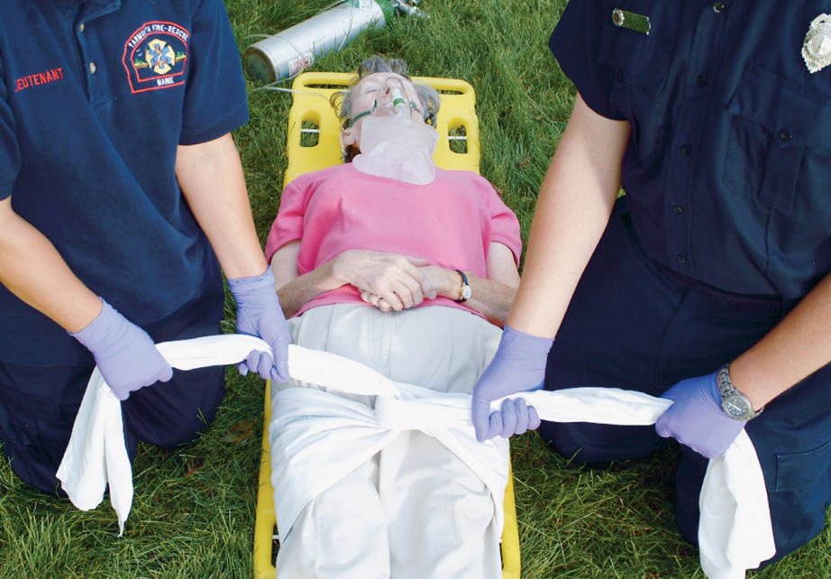
Pelvic Wrap (5 of 5)
Tie the sheet firmly without overcompression to complete the pelvic wrap.
Notes:
Covers Objective: 32.2
Talking Points: A pelvic wrap is one method of treating pelvic injuries. It can be performed with commercially available devices or formed from a sheet. The wrap reduces internal bleeding and pain while providing stabilization to the pelvis. To apply a sheet as a pelvic wrap: (1) Once you determine the patient is a candidate for pelvic stabilization, prepare a backboard with a sheet, folded flat, approximately 10 inches wide and lying across the backboard. (2) Carefully roll the patient to the backboard. Center the sheet at the patient's greatest trochanter. (3) Bring the sides of the sheet around to the front of the patient. As you bring the sides of the sheet together and tie them, you will cause compression and stabilization of the pelvis. The sheet should feel firm enough on the pelvis to keep it in normal position without overcompression. (4) Secure the sheet using ties or clamps so the compression is maintained.

Slide 63
Hip Dislocation (1 of 2)
Patient assessment
  Anterior hip dislocation
  Posterior hip dislocation
    Rotation of leg inward and knee is bent.
    Foot may hang loose and unable to flex the foot or lift toes.
    Lack of sensation in limb
Notes:
Covers Objective: 32.2

Slide 64
Hip Dislocation (2 of 2)
Patient care
  Assess distal C S M.
  Move patient onto long spine board.
  Immobilize limb with pillows and blankets.
  Secure patient to spine board.
  Reassess distal C S M.
  Care for shock.
  Transport, monitor vital signs, check for nerve and circulation impairment.
Notes:
Covers Objective: 32.2
Point to Emphasize: Be sure to assess for distal circulatory, sensory, and motor functions before and after immobilizing a hip dislocation. To immobilize a hip fracture, consider using padded boards, binding the legs together, or applying pneumatic anti-shock garments.

Slide 65
Geriatric Note
Older adults are more susceptible to hip fracture because of brittle bones or weakness from various diseases.
Notes:
Covers Objective: 32.2

Slide 66
Hip Fracture (1 of 2)
Patient assessment
  Pain is localized.
  Sensitive to pressure exerted on greater trochanter
  Surrounding tissues are discolored.
  Swelling may be evident.
  Unable to move limb while on back
  Unable to stand
  Foot on injured side turns outward.
  Injured limb appears shorter.
Notes:
Covers Objective: 32.2

Slide 67
Hip Fracture (2 of 2)
Patient care
  Place folded blanket between patient’s legs, and bind legs together with wide straps, or wide cravats.
  Use thin splints to push cravats or straps under patient at natural voids and readjust so they will pass across the chest, the abdomen just below the belt, below the crotch, above and below the knee, and at the ankle.
Notes:
Covers Objective: 32.2

Slide 68
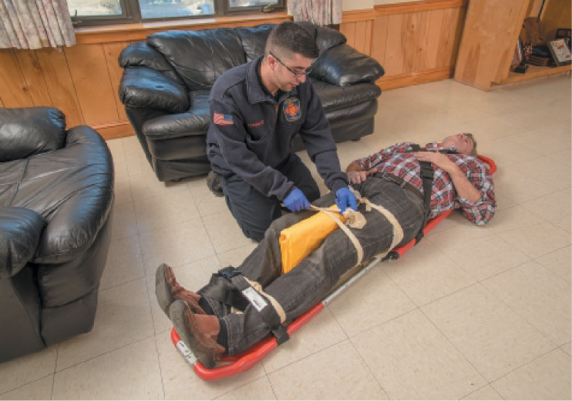
Hip Injuries
Binding together the legs of a patient with a hip injury.
Notes:
Covers Objective: 32.2
Point to Emphasize: Consider using a pelvic wrap, pneumatic anti-shock garments, or a pelvic binder to immobilize an unstable pelvis.

Slide 69
Femoral Shaft Fracture (1 of 2)
Patient assessment
  Intense pain
  Possibly open fracture
  Injured limb may be shortened
Notes:
Covers Objective: 32.2
Point to Emphasize: Use a traction splint to immobilize isolated femoral shaft fractures.

Slide 70
Femoral Shaft Fracture (2 of 2)
Patient care
  Control bleeding.
  Treat shock.
  Assess distal C S M.
  Apply traction splint.
  Reassess distal C S M.
Notes:
Covers Objective: 32.2
Point to Emphasize: Use a traction splint to immobilize isolated femoral shaft fractures.

Slide 71
Pediatric Note
When traction-splinting thigh injuries in children, be sure to use appropriately-sized splints.
Notes:
Covers Objective: 32.2

Slide 72
Knee Injury
Patient assessment
  Pain and tenderness
  Swelling
  Deformity with swelling
Patient care
  Assess distal C S M.
  Immobilize in current position.
  Reassess distal C S M.
Notes:
Covers Objective: 32.2
Point to Emphasize: Other musculoskeletal injuries require creativity and utilization of specific immobilization equipment. Always remember the basic principles of splinting.
Class Activity: Set up a splinting "round robin." Prepare stations for different types of injuries and immobilization devices. Have groups of students rotate through the stations.

Slide 73
Tibia or Fibula Injury
Patient assessment
  Pain and tenderness
  Swelling
  Possible deformity
Patient care
  Apply vacuum split.
  Apply air-inflated splint.
  Immobilize fracture using two rigid board splits.
  Apply single splint with ankle hitch.
Notes:
Covers Objective: 32.2

Slide 74
Ankle or Foot Injury (1 of 3)
Patient assessment
  Pain
  Swelling
  Possible deformity
Notes:
Covers Objective: 32.2

Slide 75
Ankle or Foot Injury (2 of 3)
Patient care
  Assess distal C S M.
  Stabilize limb.
  Lift limb.
  Place cravats under ankle.
  Lower limb onto pillow.
  Tie pillow around ankle.
Notes:
Covers Objective: 32.2
Discussion Topic: Describe the assessment findings and immobilization techniques for the following types of injuries: pelvic fracture, hip dislocation/fracture, femoral shaft fracture, knee injury, tibia/fibula fracture, and ankle/foot injury.
Critical Thinking Discussion: Improvise splints. Assemble common household items and ask students to create splints.

Slide 76
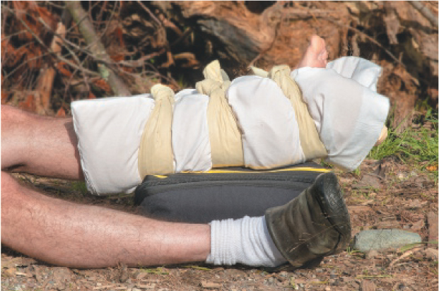
Ankle/Foot Injury
A pillow splint may be used for an injured ankle.
Notes:
Covers Objective: 32.2

Slide 77
Ankle or Foot Injury (3 of 3)
  Tie fourth cravat at arch of foot.
  Elevate with second pillow or blanket.
  Reassess distal C S M.
  Care for shock if needed.
  Apply cold pack as needed.
Notes:
Covers Objective: 32.2

Slide 78
Forearm, Wrist, and Hand Injuries
Signs
  Forearm
    Deformity and tenderness
  Wrist
    Deformity and tenderness
  Hand
    Deformity and pain
    Dislocated fingers
Notes:
Covers Objective: 32.2

Slide 79
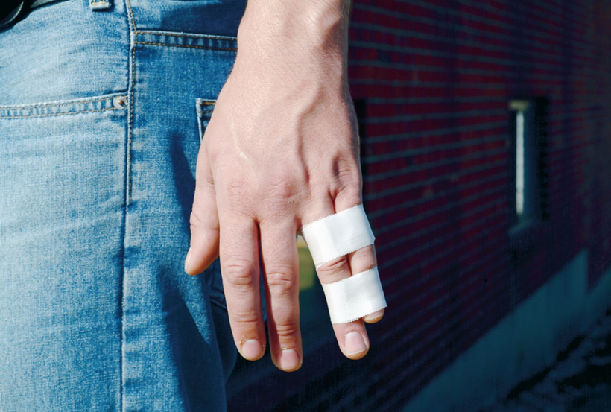
Splinting Forearm, Wrist, and Hand Injuries (1 of 2)
Splinting A Finger: An injured finger can be taped to an adjacent uninjured finger, which acts as a splint to the injured finger, or it can be splinted with a tongue depressor. Some emergency department physicians prefer that care to an injured finger be limited to a wrap of soft bandages. Do not try to “pop” dislocated fingers back into place.
Notes:
Covers Objective: 32.2

Slide 80
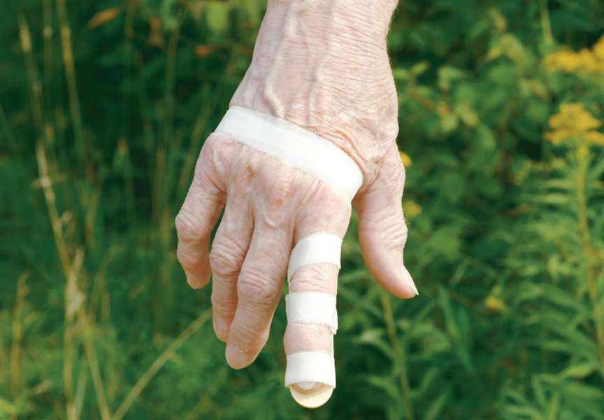
Splinting Forearm, Wrist, and Hand Injuries (2 of 2)
Splinting A Finger: An injured finger can be taped to an adjacent uninjured finger, which acts as a splint to the injured finger, or it can be splinted with a tongue depressor. Some emergency department physicians prefer that care to an injured finger be limited to a wrap of soft bandages. Do not try to “pop” dislocated fingers back into place.
Notes:
Covers Objective: 32.2

Slide 81
Chapter Review

Slide 82
Chapter Review (1 of 3)
Bones bleed. Fractures cause blood loss within the bone as well as from tissue damage around the bone ends. Serious or multiple fractures can cause shock.
Splinting of long-bone fractures involves immobilizing the bone ends as well as the adjacent joints.

Slide 83
Chapter Review (2 of 3)
Splinting protects the patient from further injury, reduces pain, and helps control bleeding.
You may need to be creative while splinting. There are many correct ways to splint the same extremity.
Injuries to bones and joints should be splinted prior to moving the patient.

Slide 84
Chapter Review (3 of 3)
If patient has multiple trauma or appears to have shock (or a significant potential for shock), do not waste time splinting individual fractures. Place the patient on a long spine board and secure the limbs to the board. You can splint individual fractures en route if time and priorities allow.

Slide 85
Remember (1 of 4)
Bones, joints, muscles, cartilage, tendons, and ligaments make up the musculoskeletal system.
Bones provide the body with structure, store metabolic materials, and produce red blood. Joints are the places where bones articulate to create movement.

Slide 86
Remember (2 of 4)
Fractures, dislocations, sprains, and strains are musculoskeletal injuries that are caused by direct force, indirect force, and twisting force. Injuries should be splinted prior to moving the patient.

Slide 87
Remember (3 of 4)
A closed extremity injury is one in which the skin has not been broken. An open extremity injury is one in which the skin has been broken.
Pelvic fractures and femoral shaft fractures often indicate more severe internal injuries.

Slide 88
Remember (4 of 4)
E M Ts must learn specific techniques for immobilizing particular injuries but at the same time must foster creativity while applying the general rules of splinting.

Slide 89
Questions to Consider (1 of 2)
Have I fully addressed life threats and maintained my priorities even in the presence of a grossly deformed extremity?
Does the patient have an injury that requires splinting?
Notes:
Talking Points: Remind students that they need to use their senses of sight, touch, and hearing during their assessment of patients with musculoskeletal injuries. They will need to look past obvious signs and probe for multiple injuries in order to make a complete assessment of the patient.

Slide 90
Questions to Consider (2 of 2)
Does the patient have multiple fractures, multiple trauma, or shock?
Does the patient have adequate C S M distal to the musculoskeletal injury?
Should I align the angulated extremity fracture?

Slide 91
Critical Thinking
Patients who suffer fractures can be in extreme pain. Pain can cause anxiety and elevated pulse rates. How could you differentiate between a patient with a rapid pulse and anxiety from pain versus a patient with rapid pulse and anxiety from shock?
Notes:
Talking Points: Remind students that they should always be looking for the signs of shock in any primary assessment.

Slide 92

Copyright
This work is protected by United States copyright laws and is provided solely for the use of instructors in teaching their courses and assessing student learning. Dissemination or sale of any part of this work (including on the World Wide Web) will destroy the integrity of the work and is not permitted. The work and materials from it should never be made available to students except by instructors using the accompanying text in their classes. All recipients of this work are expected to abide by these restrictions and to honor the intended pedagogical purposes and the needs of other instructors who rely on these materials.

Slide 93
Appendix 1
A skeleton superimposed on the image of a male. At the top of the body is the skull, with the maxilla of the upper jaw and mandible of the lower jaw. The neck consists of the cervical vertebrae, which lead down the spine to the thoracic vertebrae, lumbar vertebrae, sacrum, and coccyx. At the top of the chest are the clavicles, which are followed by the ribs that connect together in the front at the sternum. At the back of the shoulders are the scapula, which lead down to the humerus in the upper arms, the ulna and radius in the lower arms, the carpals in the wrists, the metacarpals in the hand, and the phalanges in the fingers. The pelvis consists of the pubis in front and the ilium in back. The femur in the upper legs leads to the patella in the knees, the tibia and fibula in the lower legs, the tarsals in the ankles, the metatarsals in the feet, and the phalanges in the toes.
Return to presentation

Slide 94
Appendix 2
Side by side illustrations of a joint show the bones, ligaments and tendons. One drawing shows a gray colored tissue, labeled ligament, connecting the bone above the joint to the bone below. The other drawing shows a large red fiber, labeled muscle, narrowing to a yellowish orange fiber, labeled tendon, and then connecting to the bone, all taking place above the joint.
Return to presentation

