Slide 1
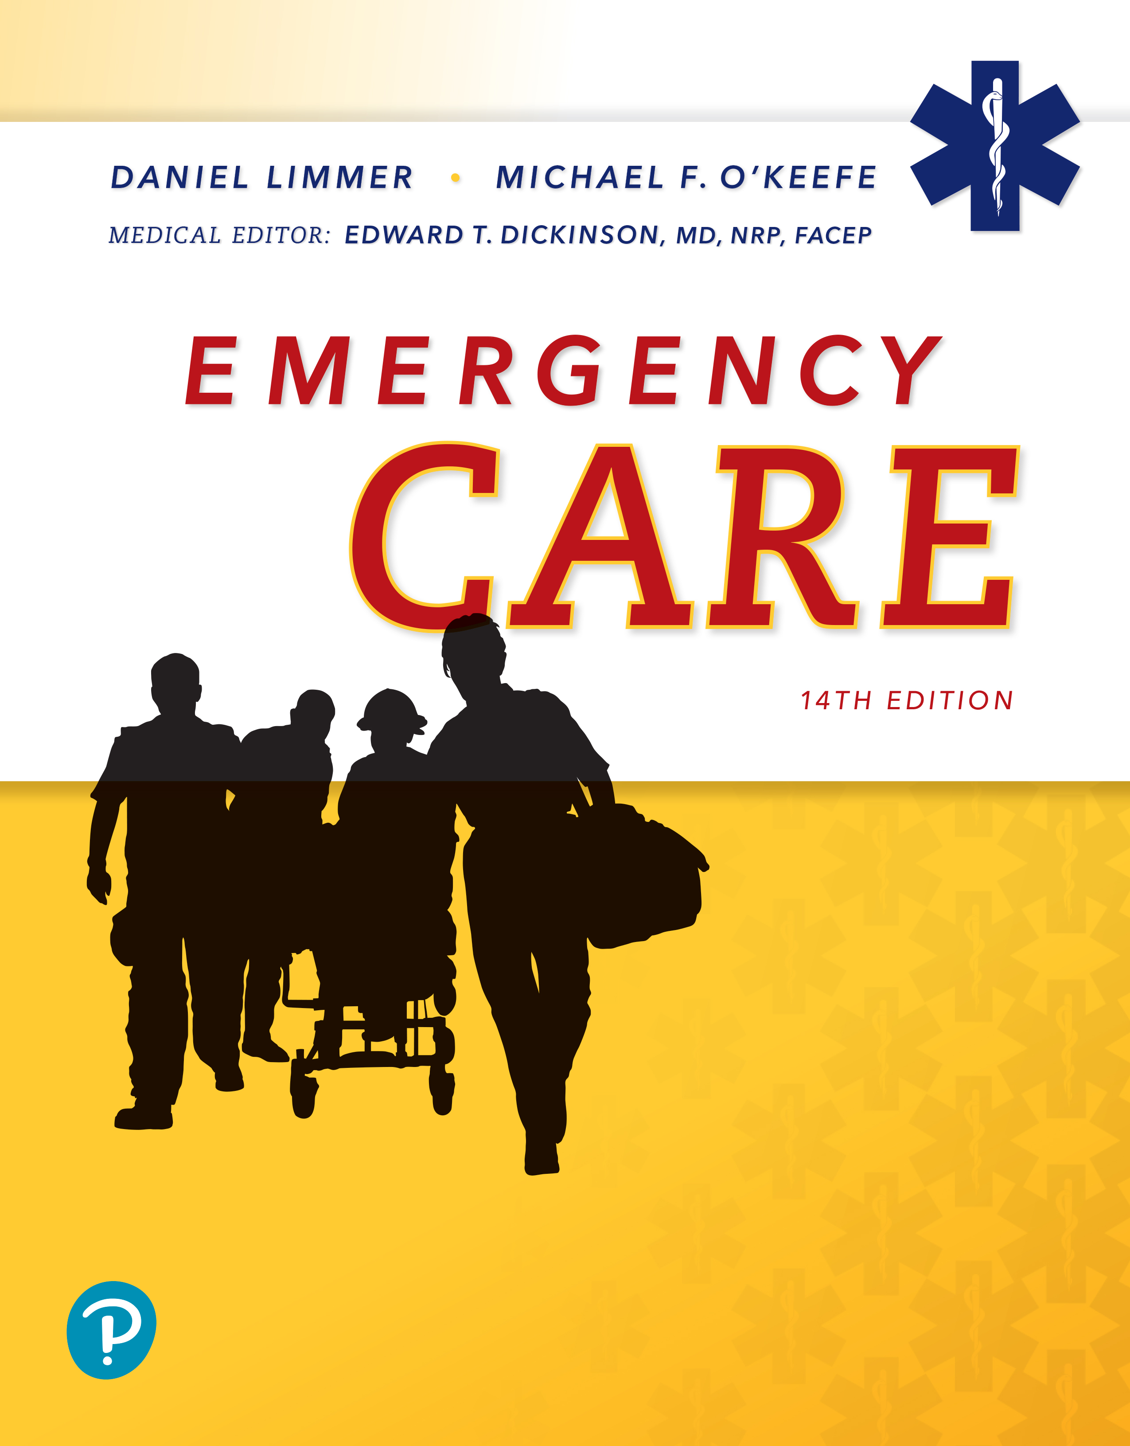
Emergency Care
Fourteenth Edition
Chapter 10
Respiration and Artificial Ventilation
Slides in this presentation contain hyperlinks. JAWS users should be able to get a list of links by using INSERT+F7
Copyright © 2021, 2016, 2012 Pearson Education, Inc. All Rights Reserved
Notes:
If this PowerPoint presentation contains mathematical equations, you may need to check that your computer has the following installed:
1) MathType Plugin
2) Math Player (free versions available)
3) NVDA Reader (free versions available)

Slide 2
Topics
Physiology and Pathophysiology
Respiration
Positive Pressure Ventilation
Oxygen Therapy
Special Considerations
Assisting with Advanced Airway Devices
Notes:
Planning Your Time: Plan 195 to 205 minutes for this chapter.
Introduction (5 minutes)
Physiology and Pathophysiology (45 minutes)
Respiration (45 minutes)
Positive Pressure Ventilation (30 minutes)
Oxygen Therapy (40 minutes)
Special Considerations (15 minutes)
Assisting with Advanced Airway Devices (15 minutes)
Note: The total teaching time recommended is only a guideline.
Teaching Tips: Proper airway management must always be paired with assessment of adequate breathing to ensure that both of these critical functions are occurring.

Slide 3
Physiology and Pathophysiology
Back to Topics
Notes:
Teaching Time: 45 minutes
Teaching Tips: This lesson lends itself well to multimedia presentations. Anatomical models and web graphics will enhance your presentation on physiology and pathophysiology. Use real-life examples. Adults grasp pathophysiology best when they can apply it to actual situations. For each disorder, discuss actual examples and move from theory to reality. Reach back to include the concepts of minute volume and alveolar ventilation. Describe how they influence respiration.

Slide 4
Physiology and Pathophysiology—Mechanics of Breathing (1 of 3)
Ventilation is the process of moving air into (inhalation) and out of (exhalation) the chest
Inhalation is an active process
  Chest muscles expand and the diaphragm contracts
  The size of the chest increases
  Negative pressure pulls air into lungs
Notes:
Covers Objective: 10.1
Class Activity: Have students work in groups, using household items to construct a model of respiratory function that uses negative pressure to move air. Have groups present their models to the class and describe their particular processes of moving air.

Slide 5
Physiology and Pathophysiology—Mechanics of Breathing (2 of 3)
Exhalation is a passive process
  Chest muscles and the diaphragm relax
  The size of the chest decreases
  Positive pressure pushes air out of the lungs
Tidal volume is the mount of air moved in one breath
Minute volume is the amount of air moved into and out of the lungs per minute
Notes:
Covers Objective: 10.1
Knowledge Application: Have students describe the pressures of breathing. Discuss the role of both positive and negative pressure in moving air.

Slide 6
Physiology and Pathophysiology—Mechanics of Breathing (3 of 3)
Ventilation is designed to move air to and from the alveoli for gas exchange
  Not all of the air breathed reaches the alveoli
  Some air occupies dead space
Alveolar ventilation refers to the amount of air that actually reaches the alveoli
  It can be altered by changes in rate or volume
  It depends heavily on tidal volume, but is affected by very fast or very slow rates
Notes:
Covers Objective: 10.1
Discussion Topics: Mechanically speaking, describe how the body moves air into and out of the lungs. Discuss the role of rate and tidal volume with regard to minute volume. Using examples, explain how changes to either of these elements affect minute volume. Define alveolar ventilation. Give examples of how changes in rate and volume impact alveolar ventilation.
Critical Thinking Discussion: How would a disease such as asthma interfere with alveolar ventilation?

Slide 7
Physiology and Pathophysiology— Physiology of Respiration (1 of 3)
Alveoli form the ends of the bronchiole tubes
  Bunches of sacs are inflated and ventilated as air moves in and out
  Each alveolus is a bubble-like structure
Pulmonary capillaries bring blood close to the sacs
Thin alveoli and capillary walls allow for gas exchange
  Oxygen in the alveoli moves into the blood
  Carbon dioxide in the blood moves into the alveoli
Notes:
Covers Objective: 10.1
Teaching Tip: An understanding of alveolar ventilation will improve the assessment of respiratory dysfunction. When later discussing pathophysiology, bring the discussion back to the overall impact on alveolar ventilation.
Knowledge Application: Instructors have traditionally “traced the flow of a drop of blood through the heart.” Consider tracing the flow of a molecule of oxygen through the respiratory system. Discuss the various factors that influence the ability of oxygen to reach the alveoli.

Slide 8
Physiology and Pathophysiology— Physiology of Respiration (2 of 3)
Diffusion is movement of gases from an area of high concentration to an area of low concentration
Pulmonary respiration is diffusion of oxygen and carbon dioxide between the alveoli and the circulating blood
Cellular respiration is diffusion of oxygen and carbon dioxide between the cells and the circulating blood
Notes:
Covers Objective: 10.1
Teaching Tip: Spend time on the process of diffusion. An understanding of this fundamental concept will enhance comprehension of later lectures on pathophysiology.

Slide 9
Physiology and Pathophysiology— Physiology of Respiration (3 of 3)
In order for pulmonary and cellular respiration to occur, the respiratory and circular systems work in conjunction
  This is sometimes called the cardiopulmonary system
  It may also be called a ventilation-perfusion (V/Q) match
When either the respiratory or circular system fails, the process of respiration is defeated
Notes:
Covers Objective: 10.1
Discussion Topic: Describe how the respiratory system relies on the cardiovascular system to provide normal physiologic function.
Critical Thinking Discussion: How would hypovolemic shock hurt the body’s ability to conduct diffusion and transfer gasses like oxygen and carbon dioxide? Anticipate the pathophysiology lecture by asking this question: How might a respiratory challenge (such as asthma) affect minute volume and alveolar ventilation?

Slide 10
Physiology and Pathophysiology—Cardiopulmonary Pathophysiology (1 of 3)
Mechanical failures of the cardiopulmonary system limit the ability of the chest to create pressure changes
  Stab wounds allow air into the cavity and make it impossible to create negative pressure
  Loss of nervous control makes it impossible to innervate respiratory muscles
  Painful chest wall injuries limit chest wall movement
  Airway problems like bronchoconstriction limit air flow
Notes:
Covers Objective: 10.2
Teaching Tip: Connecting the function of the pulmonary system and the cardiovascular system is important not just to this lesson, but to many lessons that will follow. Continue a discussion of cardiopulmonary pathophysiology throughout your overall lesson plan.
Discussion Topic: Describe how the mechanics of breathing can be disrupted.

Slide 11
Physiology and Pathophysiology—Cardiopulmonary Pathophysiology (2 of 3)
Interrupted gas exchange impairs the ability to diffuse oxygen and carbon dioxide
  Low oxygen levels in outside air limit the amount of oxygen that can be inhaled
  Diffusion problems caused by alveoli that do not work properly limit the ability to exchange gases
Notes:
Covers Objective: 10.2
Discussion Topic: Describe how gas exchange is disrupted.

Slide 12
Physiology and Pathophysiology—Cardiopulmonary Pathophysiology (3 of 3)
Circulation issues prevent blood from carrying enough oxygen to the cells of the body
  Significant blood loss reduces the amount of blood circulated to the alveoli
  Insufficient hemoglobin or hemoglobin that is not working properly limits the transport of oxygen
Notes:
Covers Objective: 10.2
Discussion Topic: Describe common circulation issues that lead to cardiopulmonary dysfunction.
Knowledge Application: Discuss the pathophysiology (the negative impact) of the following disorders on both pulmonary and cellular respiration: severe bronchospasm, severe external hemorrhage, and slowed breathing due to narcotic overdose.

Slide 13
Respiration
Back to Topics
Notes:
Teaching Time: 45 minutes
Teaching Tips: Teach assessment in the context of decision making—for example, “As an EMT, you will use these findings to identify inadequate breathing.” Many of the findings of inadequate breathing are visual. Use pictures and other multimedia graphics to illustrate potential findings. Relate inadequate breathing to hypoxia. Describe how signs and symptoms overlap. Practice decision making. Make decision making part of every use of artificial ventilation.

Slide 14
Respiration—Adequate and Inadequate Breathing (1 of 4)
Brain and body cells need a steady supply of oxygen to maintain normal function
  Hypoxia is a low level of oxygen function
  Hypercapnia is a high level of carbon dioxide
Assess the cardiopulmonary system by evaluating how well it is oxygenating and removing carbon dioxide
Notes:
Covers Objective: 10.3
Discussion Topic: Describe three different examples that show how a patient might become hypoxic.

Slide 15
Respiration—Adequate and Inadequate Breathing (2 of 4)
When the cardiopulmonary system fails, the body compensates for hypoxia or hypercapnia
  Chemoreceptors stimulate the respiratory system to breathe more rapidly
  Respiratory rate and heart rate increase and blood vessels constrict
Notes:
Covers Objective: 10.3
Class Activity: List specific compensatory steps. Have students explain why these steps might fail over time, and discuss the net effect on respiration when the failure occurs.

Slide 16
Respiration—Adequate and Inadequate Breathing (3 of 4)
Respiratory distress
  Compensation is working
  The patient has normal mental status, skin color, and oximetry readings
Respiratory failure (inadequate breathing)
  Compensation is not working
  Metabolic needs of the body are not met
Respiratory failure is a precursor to respiratory arrest
Notes:
Covers Objective: 10.3
Discussion Topic: Discuss the changes that occur when compensation fails.
Class Activity: Describe a respiratory assessment. Based on the findings that you present, ask the class to classify your patient as being in either respiratory distress or respiratory failure. Discuss.

Slide 17
Respiration—Adequate and Inadequate Breathing (4 of 4)
Inadequate breathing occurs when a challenge is too great for body’s compensatory mechanisms
  Rate of breathing, depth of breathing, or both fall outside of normal ranges
  Recognition requires keen assessment skills and prompt action
Notes:
Covers Objective: 10.3
Discussion Topics: Explain how the body compensates for inadequate breathing. Discuss the changes that occur. Discuss how you would assess breathing. Consider both a conscious patient and an unconscious patient.

Slide 18
Respiration—Patient Assessment (1 of 4)
First, determine if the patient is breathing
Second, determine whether breathing is adequate
Signs of adequate breathing:
  Equal expansion of the chest is seen on inhalation
  Air is heard entering and leaving the nose, mouth, and chest
  Air is felt moving out of the nose or mouth
  Skin has typical coloration
  Rate, rhythm, quality, and depth of breath are typical
Notes:
Covers Objective: 10.4
Knowledge Application: Describe a patient scenario that includes a patient who is compensating for a respiratory challenge. Ask students to explain the origins of the signs and symptoms that they identify.

Slide 19
Respiration—Patient Assessment (2 of 4)
Signs of inadequate breathing:
  Mental status is altered
  Chest movements are absent, minimal, or uneven
  Pulse rate is slow (children)
  Breathing movements are limited to the abdomen
  No air is felt or heard at the nose or mouth
  Breath sounds are diminished or absent
  Wheezing, crowing, stridor, gurgling, or gasping are heard during breathing
Notes:
Covers Objective: 10.4
Knowledge Application: Discuss compensation for inadequate breathing. Describe specific compensatory steps and ask students to describe external findings. Compare and contrast respiratory distress and respiratory failure (inadequate breathing) in the following areas: lung sounds, respiratory

Slide 20
Respiration—Patient Assessment (3 of 4)
Signs of inadequate breathing:
  Rate of breathing is too rapid or too slow
  Breathing is very shallow, very deep, or labored
  Cyanosis is seen in skin, lips, tongue, ears, or nails
  Inspirations or expirations are prolonged
  Patient is unable to speak
  Retractions and nasal flaring are seen (children)
  Oxygen saturation readings are low (<95%)
  Body position indicates distress
Notes:
Covers Objective: 10.4
Knowledge Application: Describe a patient scenario that includes a patient who is compensating for a respiratory challenge. Ask students to explain the origins of the signs and symptoms that they identify.

Slide 21
Respiration—Patient Assessment (4 of 4)
Hypoxia is insufficient supply of oxygen to body tissues
  Common causes
    A patient is trapped in a fire
    A patient has emphysema
    A patient overdoses on a drug that depresses the respiratory system
    A patient has a heart attack, stroke, or embolism
  Signs include cyanosis and altered mental status
Address the cause and administer oxygen
Notes:
Covers Objective: 10.4
Critical Thinking Discussion: Certain conditions, such as diabetic ketoacidosis, make the body more acidic. This change in the pH decreases the hemoglobin’s ability to hold onto oxygen. What effect might an acidotic condition have upon pulmonary and cellular

Slide 22
Respiration—Patient Care
Provide artificial ventilation to the nonbreathing patient and the patient with inadequate breathing
Provide supplemental oxygen to the breathing patient
Intervene when you see signs of inadequate breathing
  The patient’s efforts are not meeting demands
  The condition will progress without intervention
  It is better to be too aggressive than not aggressive enough
Notes:
Covers Objective: 10.4
Knowledge Application: Use media resources or a detailed scenario to present students with a ventilation decision. Discuss.

Slide 23
Positive Pressure Ventilation
Back to Topics
Notes:
Teaching Time: 30 minutes
Teaching Tips: Describe the negative effects of positive pressure ventilation. Foster a cost-benefit analysis in the decision to provide artificial ventilation. Discuss the negative outcome associated with poor artificial ventilation techniques. Ground lessons in reality, not just a skill sheet.

Slide 24
Positive Pressure Ventilation (1 of 2)
Artificial ventilation is the use of positive pressure to force air or oxygen into the lungs
  It is also called positive pressure ventilation
  It is used when a patient has stopped breathing or has inadequate breathing
Positive pressure relies on a force that is exactly the opposite of the force the body normally uses
Notes:
Covers Objective: 10.5
Teaching Tips: Allocate the appropriate amount of time, and have enough assistance, to conduct an efficient psychomotor session. Closely monitor and frequently correct students. Use standardized skill sheets to assess competency when practicing the various methods of artificial ventilation.

Slide 25
Positive Pressure Ventilation (2 of 2)
Use of positive pressure has negative side effects:
  Cardiac output and blood pressure drop because the heart’s ability to refill its chambers is affected
  Gastric distention occurs because air may be diverted into the stomach
  Hyperventilation blows off too much carbon dioxide and leads to vasoconstriction
Notes:
Covers Objective: 10.5
Knowledge Application: Divide the class into two groups. Use a scenario to review the cost-benefit analysis of a “ventilate vs. not ventilate” decision. Have students debate both arguments. Discuss.

Slide 26
Positive Pressure Ventilation—Techniques of Artificial Ventilation (1 of 33)
Three methods are common:
  Mouth-to-mask
  Two-rescuer bag-valve mask
  One-rescuer bag-valve mask
Never ventilate a patient who is vomiting or has vomitus in the airway because the vomit will go into the lungs
Notes:
Covers Objective: 10.5
Discussion Topics: Discuss the negative impact of poor artificial ventilation technique. Consider the outcome of the following problems: rate too fast, too much volume, and inadequate mask seal. Discuss the procedure for ventilating a patient with a pocket mask, and a bag-valve mask.

Slide 27
Positive Pressure Ventilation—Techniques of Artificial Ventilation (2 of 33)
To ensure adequate ventilations:
  Watch the chest rise and fall with each ventilation
  Ensure the rate of ventilation is sufficient
Inadequate ventilations occur when the chest does move, air escapes, or the rate is too fast or slow
Techniques should always ensure adequate protection from the patient’s body fluids
  Do not use mouth-to-mouth ventilation
  Do use a barrier device
Notes:
Covers Objective: 10.5
Knowledge Application: Discuss scenarios with the class. Ask the class to determine the need for artificial ventilation. Discuss the decision-making process.

Slide 28
Positive Pressure Ventilation—Techniques of Artificial Ventilation (3 of 33)
When ventilating a patient who is breathing rapidly:
  Carefully assess the adequacy of respiration
  Explain the procedure to patient
  Place the mask over the patient’s mouth and nose
  After sealing the mask on patient’s face, squeeze the bag with the patient’s inhalation
  Adjust rate over the next few breaths to ventilate fewer times with greater volume
Notes:
Covers Objective: 10.5

Slide 29
Positive Pressure Ventilation—Techniques of Artificial Ventilation (4 of 33)
When ventilating a patient who is breathing slowly:
  Carefully assess the adequacy of respiration
  Explain the procedure to patient
  Place the mask over the patient’s mouth and nose
  After sealing the mask on patient’s face, squeeze the bag with the patient’s inhalation
  Add ventilation in between the patient’s own to increase the rate to 12 per minute
Notes:
Covers Objective: 10.5

Slide 30
Positive Pressure Ventilation—Techniques of Artificial Ventilation (5 of 33)
Opening the airway
  Clear, suction, and position the airway
  Head-elevated, sniffing position is optimal
    Flex the neck forward
    Extend the head at the top of the neck
    Suprasternal notch is even with the ear hole and face is parallel with the ceiling
  Adjust padding based on the patient’s anatomy
  Young pediatric patients are challenging to position
Notes:
Covers Objective: 10.5

Slide 31
Positive Pressure Ventilation—Techniques of Artificial Ventilation (6 of 33)
Opening the airway
  Use the ramp position with obese patients
    Raise the torso to a 45-degree angle
    Plateau the head at the top of the ramp
    Suprasternal notch is even with the ear hole and face is parallel with the ceiling
  Ventilate spine injury patients with the head in a neutral position if possible
Notes:
Covers Objective: 10.5

Slide 32
Positive Pressure Ventilation—Techniques of Artificial Ventilation (7 of 33)
Sealing the mask
  A proper seal allows air to move into the lungs
    The mask should extend from the bridge of the nose to the cleft of the chin
    The mask should be wide enough to cover the entire mouth
    Two hands should be used to create a seal
Notes:
Covers Objective: 10.5

Slide 33
Positive Pressure Ventilation—Techniques of Artificial Ventilation (8 of 33)
Sealing the mask
  Patient characteristics can make it hard to get a seal
    Large, bushy beards should be wetted with water or water-soluble lubricant
    Dentures should be left in place
Several things can optimize mask use:
  Raising the patient’s head at a 30-degree angle
  Using an airway adjunct
  Using a team to ventilate
Notes:
Covers Objective: 10.5

Slide 34
Positive Pressure Ventilation—Techniques of Artificial Ventilation (9 of 33)
Mouth-to mask ventilation is performed using a pocket face mask
  Masks are made of soft, collapsible plastic
  They have infection control features
  They may have oxygen inlets
  They are made of clear plastic that allows observation of the patient’s mouth and lips
  They may have a strap to put around the patient’s head
Notes:
Covers Objective: 10.5
Class Activity: Distribute clean face masks. Have students choose a partner and practice obtaining good hand position and face seal using a pocket mask or BVM face mask. (Do not ventilate.) Try obtaining the seal in different positions (patient supine, patient sitting up, and so on).

Slide 35
Positive Pressure Ventilation—Techniques of Artificial Ventilation (10 of 33)
Pocket face mask. © Laerdal Corporation
Notes:
Covers Objective: 10.5

Slide 36
Positive Pressure Ventilation—Techniques of Artificial Ventilation (11 of 33)
Mouth-to-mask for a patient without spine injury
  E M T at the top of the patient’s head
    Position yourself directly above the patient’s head
    Place the patient in a head-elevated, sniffing position and insert an adjunct
    Apply the mask to the patient
    Thumbs over the top of the mask, index fingers over the bottom of the mask, and fingers under the jaw
Notes:
Covers Objective: 10.5
Class Activity: (Skill Demonstration) Referring to a standardized skill competency sheet, and using an airway manikin, demonstrate the proper procedure for delivering artificial ventilations using a pocket mask.

Slide 37
Positive Pressure Ventilation—Techniques of Artificial Ventilation (12 of 33)
Mouth-to-mask for a patient without spine injury
  E M T at the top of the patient’s head
    Lift the jaw to the mask as you tilt patient’s head backward and place remaining under the jaw
    While lifting the jaw, squeeze the mask with your thumbs to achieve a seal
    Give breaths into one-way valve and watch for the chest to rise
Notes:
Covers Objective: 10.5

Slide 38
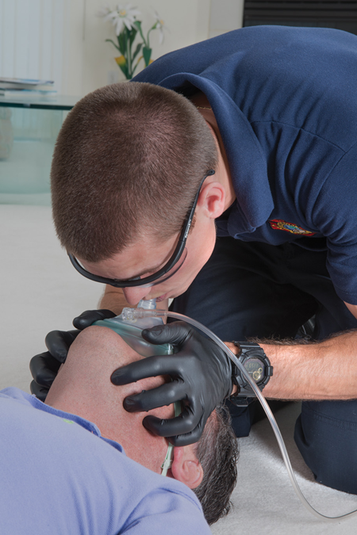
Positive Pressure Ventilation—Techniques of Artificial Ventilation (13 of 33)
Use only a pocket mask with a one-way valve
Notes:
Covers Objective: 10.5

Slide 39
Positive Pressure Ventilation—Techniques of Artificial Ventilation (14 of 33)
Mouth-to-mask for a patient without spine injury
  E M T beside the patient’s head
    Position yourself beside the patient’s head
    Place the patient in a head-elevated, sniffing position and insert an adjunct
    Apply the mask to the patient
    Place index finger and thumb of hand toward the top of the head along the top border of the mask
Notes:
Covers Objective: 10.5

Slide 40
Positive Pressure Ventilation—Techniques of Artificial Ventilation (15 of 33)
Mouth-to-mask for a patient without spine injury
  E M T beside the patient’s head
    Place thumb of hand toward the feet on the lower margin of the mask and fingers along the jaw
    Lift the jaw while performing a head-tilt, chin-lift maneuver
    Compress the mask against the face
    Give breaths into one-way valve and watch for the chest to rise
Notes:
Covers Objective: 10.5

Slide 41
Positive Pressure Ventilation—Techniques of Artificial Ventilation (16 of 33)
Mouth-to-mask for a patient with spine injury
  E M T at the top of the patient’s head
    Position yourself directly above the patient’s head
    Place the patient in a head-elevated, sniffing position and insert an adjunct
    Apply the mask to the patient
    Thumb sides of the hands along the mask to hold it on the face
Notes:
Covers Objective: 10.5

Slide 42
Positive Pressure Ventilation—Techniques of Artificial Ventilation (17 of 33)
Mouth-to-mask for a patient with spine injury
  E M T at the top of the patient’s head
    Lift the angle of the jaw but do not tilt the head backward
    While lifting the jaw, squeeze the mask with your thumbs and fingers to seal
    Give breaths into one-way valve and watch for the chest to rise
Notes:
Covers Objective: 10.5

Slide 43
Positive Pressure Ventilation—Techniques of Artificial Ventilation (18 of 33)
Bag-valve masks (B V M) are used to ventilate nonbreathing patients or to assist patients in respiratory failure
They provide an infection-control barrier
They come in adult, child, and infant sizes
They consist of a self-refilling shell and a non-jam valve that allows an oxygen inlet of 15 liters per minute
Notes:
Covers Objective: 10.5

Slide 44
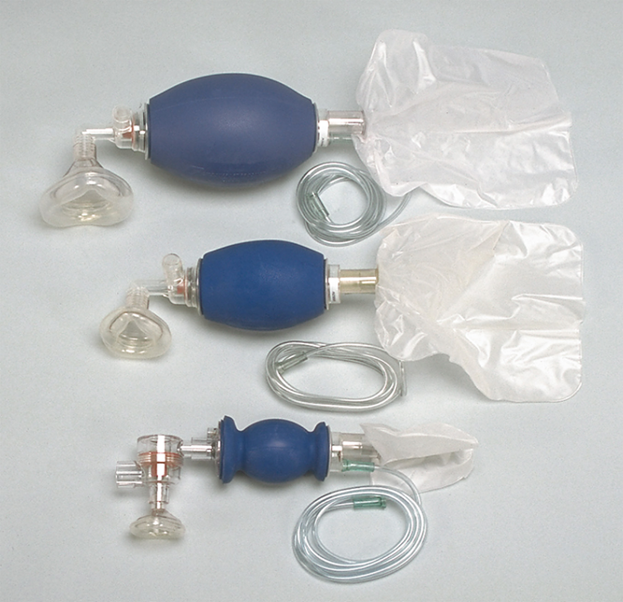
Positive Pressure Ventilation—Techniques of Artificial Ventilation (19 of 33)
Adult, child, and infant bag-valve-mask units.
Notes:
Covers Objective: 10.5

Slide 45
Positive Pressure Ventilation—Techniques of Artificial Ventilation (20 of 33)
Mechanical workings of B V M
  Oxygen is attached and enters the reservoir
  When squeezed, the air inlet closes and oxygen is delivered to the patient
  When released, the patient passively expires
  As the patient exhales, oxygen enters the reservoir
Notes:
Covers Objective: 10.5

Slide 46
Positive Pressure Ventilation—Techniques of Artificial Ventilation (21 of 33)
Two-rescuer B V M ventilation—no trauma suspected
  Place the patient is the head-elevated, sniffing position and insert adjunct
  Select correct B V M size
  Kneel at the patient’s head; position thumbs along the side of the mask and press the mask downward
  Place the apex of the triangular mask over the bridge of the nose; lower the mask over the mouth chin
Notes:
Covers Objective: 10.5

Slide 47
Positive Pressure Ventilation—Techniques of Artificial Ventilation (22 of 33)
Two-rescuer B V M ventilation—no trauma suspected
  Use the index, middle, and ring fingers to bring the jaw up to the mask; maintain head position
  Second rescuer connects and squeezes the bag until the chest begins to rise
  Second rescuer releases bag and lets the patient exhale passively
Notes:
Covers Objective: 10.5

Slide 48
Positive Pressure Ventilation—Techniques of Artificial Ventilation (23 of 33)
Two-rescuer B V M ventilation—spine injury suspected
  Place the patient is the head-elevated, sniffing position or neutral position and insert adjunct
  Select correct B V M size
  Kneel at the patient’s head; position thumbs along the side of the mask and press the mask downward
  Use the index, middle, and ring fingers to bring the jaw up to the mask without tilting the head or neck
  Second rescuer squeezes the bag as for a nonspine-injured patient
Notes:
Covers Objective: 10.5

Slide 49
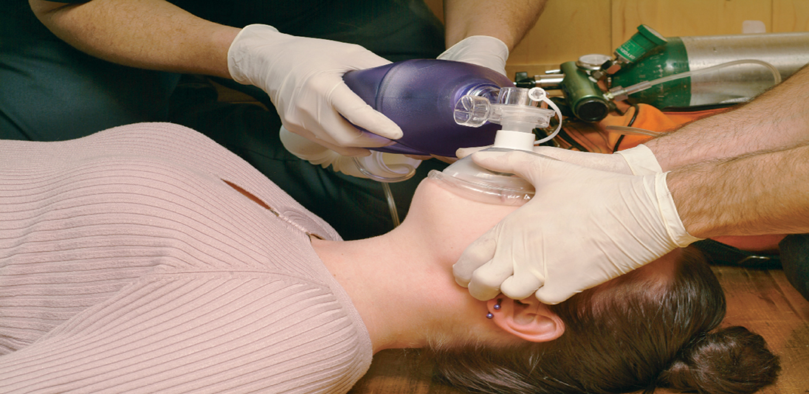
Positive Pressure Ventilation—Techniques of Artificial Ventilation (24 of 33)
For long description, see slide 115: Appendix 1
Delivering two-rescuer B V M ventilation while providing manual stabilization of the head and neck when trauma is suspected in the patient.
Notes:
Covers Objective: 10.5

Slide 50
Positive Pressure Ventilation—Techniques of Artificial Ventilation (25 of 33)
One-rescuer B V M ventilation
  Place the patient in the head-elevated, sniffing position and insert adjunct
  Select correct size mask and position on the face as for the two-rescuer technique
  Form a “C” around the ventilation port with the thumb and index finger; use the middle and little fingers to hold the jaw to mask
Notes:
Covers Objective: 10.5

Slide 51
Positive Pressure Ventilation—Techniques of Artificial Ventilation (26 of 33)
One-rescuer B V M ventilation
  Squeeze the bag with the other hand; the squeeze should cause the chest to rise
  Release the pressure on the bag and let the patient exhale passively
Notes:
Covers Objective: 10.5
Class Activity: (Skill Demonstration) Referring to a standardized skill competency sheet, and using an airway manikin, demonstrate the proper one- and two-person techniques for delivering ventilations using a bag-valve mask.

Slide 52
Positive Pressure Ventilation—Techniques of Artificial Ventilation (27 of 33)
If the chest does not rise and fall during B V M ventilation:
  Reposition head
  Check for escape of air around the mask and reposition your fingers and the mask
  Check for airway obstruction or obstruction in B V M system and resuction if needed
If none of these work, use an alternative method of artificial ventilation
Notes:
Covers Objective: 10.5
Knowledge Application: Describe a variety of patient scenarios. Ask students to choose a method to artificially ventilate the patient in each scenario. Discuss why the chosen method would be appropriate or inappropriate.
Critical Thinking Discussion: If using a BVM was ineffective at ventilating a patient, what would the next step be? What are the alternatives?

Slide 53
Positive Pressure Ventilation—Techniques of Artificial Ventilation (28 of 33)
The B V M may be used during C P R
  The bag is squeezed once every time a ventilation is to be delivered
  In one-rescuer C P R, it is preferred to use a pocket mask with supplemental oxygen over a B V M
Notes:
Covers Objective: 10.5

Slide 54
Positive Pressure Ventilation—Techniques of Artificial Ventilation (29 of 33)
Artificial ventilation of a stoma breather
  Clear any mucus plugs or secretions from stoma
  Leave the head and neck in the neutral position
  Use a pediatric-sized mask to establish a seal around the stoma
  Ventilate at the appropriate rate for the patient’s age
  If unable to ventilate through stoma, seal the stoma and attempt ventilation through the mouth and nose
Notes:
Covers Objective: 10.5
Discussion Topic: Discuss the procedure for artificially ventilating a stoma patient.

Slide 55
Positive Pressure Ventilation—Techniques of Artificial Ventilation (30 of 33)
Improper ventilation rates can harm the patient
  Too slow can cause hypoventilation and hypoxia
  Too fast can cause hyperventilation and vasoconstriction
If possible, one rescuer should focus on ventilation while the other focuses on maintaining the airway and seal
Adults should be ventilated 10–12 times per minute
Children should be ventilated 12–20 times per minute
Notes:
Covers Objective: 10.5

Slide 56
Positive Pressure Ventilation—Techniques of Artificial Ventilation (31 of 33)
Improper ventilation volume can also harm the patient
  Too much pressure causes gastric distention
  Too much volume can cause lung tissue trauma
Pressure should be slow and gentle
One hand or 2–3 fingers can be used to squeeze
Ventilations should be delivered over 1 second
Ventilate only until the chest begins to move—do not ventilated to full expansion
Notes:
Covers Objective: 10.5

Slide 57
Positive Pressure Ventilation—Techniques of Artificial Ventilation (32 of 33)
An automatic transport ventilator (A T V) provides positive pressure ventilations during respiratory arrest
It has settings for rate and volume
It is easily portable
It may be beneficial when prolonged ventilation is necessary and there is only one rescuer available
The provider must ensure the respiratory rate is appropriate for the patient’s size and condition and ensure a proper mask seal
Notes:
Covers Objective: 10.5
Critical Thinking Discussion: Review the Think Like an EMT feature with students and encourage discussion.

Slide 58
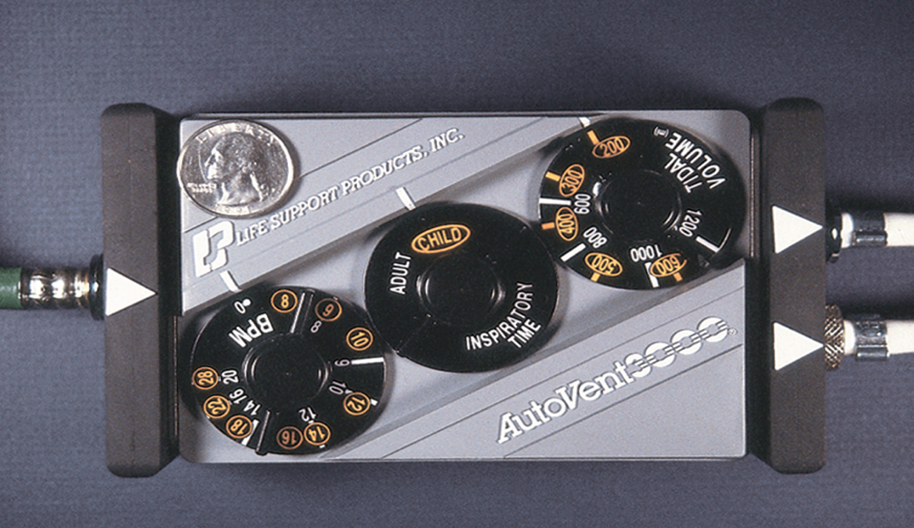
Positive Pressure Ventilation—Techniques of Artificial Ventilation (33 of 33)
An automatic transport ventilator. The coin is shown for scale.
© Edward T. Dickinson, M D
Notes:
Covers Objective: 10.5

Slide 59
Oxygen Therapy
Back to Topics
Notes:
Teaching Time: 40 minutes
Teaching Tips: Oxygen therapy is sometimes a controversial and evolving topic. Embrace the discussion and use it to demonstrate the dynamic nature of health science.

Slide 60
Oxygen Therapy—Importance of Supplemental Oxygen
Oxygen is an important and beneficial treatment
There are three major issues with supplemental oxygen:
  Oxygen is a drug—It is possible to give too much or too little of it
  Oxygen can cause harm—It can cause damage to heart attack and stroke patients
  Oxygen administration is based on evaluation—Saturation below 94, hypoxia, and decompensation all suggest it is necessary
Always ventilate cardiac arrest patients
Notes:
Covers Objective: 10.6
Discussion Topic: oxygen. What conditions might benefit from supplemental oxygen?

Slide 61
Oxygen Therapy—Oxygen Therapy Equipment (1 of 13)
Oxygen equipment in the field must be safe, lightweight, portable, and dependable
Most systems contain cylinders, pressure regulates, and a delivery device
Other devices like B V M and pocket masks can be used to force oxygen into the patient’s lungs
Notes:
Covers Objective: 10.6
Teaching Tip: Prepare a variety of oxygen-related visual aids prior to this lesson. This section references many parts and pieces and is significantly enhanced by examples.
Discussion Topic: Describe the common components of an oxygen delivery system.

Slide 62
Oxygen Therapy—Oxygen Therapy Equipment (2 of 13)
Cylinders are seamless steel or alloy canisters filled with oxygen under pressure
They come in various sizes identified by letter
  D cylinder = 350 liters of oxygen
  E cylinder = 625 liters of oxygen
  M cylinder = 3,000 liters of oxygen
  G cylinder = 5,300 liters of oxygen
  H cylinder = 6,900 liters of oxygen
They are green or green and white
Notes:
Covers Objective: 10.6
Discussion Topic: Describe the characteristics of different oxygen cylinders.

Slide 63
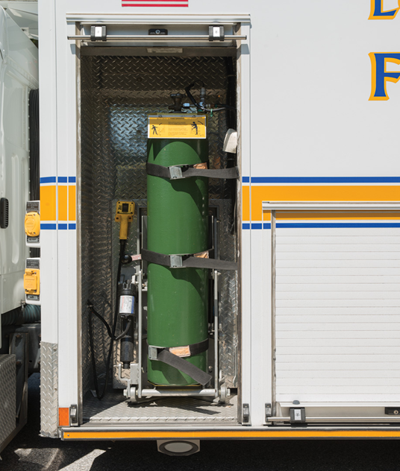
Oxygen Therapy—Oxygen Therapy Equipment (3 of 13)
Larger cylinders are used for fixed systems on ambulances.
Notes:
Covers Objective: 10.6

Slide 64
Oxygen Therapy—Oxygen Therapy Equipment (4 of 13)
Cylinder safety
  Always use pressure gauges, regulators, and tubing intended for use with oxygen
  Always use nonferrous wrenches
  Always ensure valve seat inserts and gaskets are in good condition
  Always use medical-grade oxygen
  Always open the valve fully then close it half a turn to prevent someone trying to force the valve
Notes:
Covers Objective: 10.6

Slide 65
Oxygen Therapy—Oxygen Therapy Equipment (5 of 13)
Cylinder safety
  Always store reserve cylinders in a cool, ventilated room, properly secured in place
  Always have oxygen cylinders hydrostatically tested every five years
  Never drop a cylinder or let it fall against any object
  Never leave an oxygen cylinder standing in an upright position without being secured.
  Never allow smoking around oxygen equipment in use
Notes:
Covers Objective: 10.6

Slide 66
Oxygen Therapy—Oxygen Therapy Equipment (6 of 13)
Cylinder safety
  Never use oxygen equipment around an open flame
  Never use grease, oil, or fat-based soaps on devices that will be attached to a cylinder
  Never use adhesive tape on a cylinder
  Never try to move an oxygen cylinder by dragging it or rolling it on its side or bottom
Notes:
Covers Objective: 10.6
Discussion Topic: Describe common safety considerations surrounding the use and storage of oxygen.

Slide 67
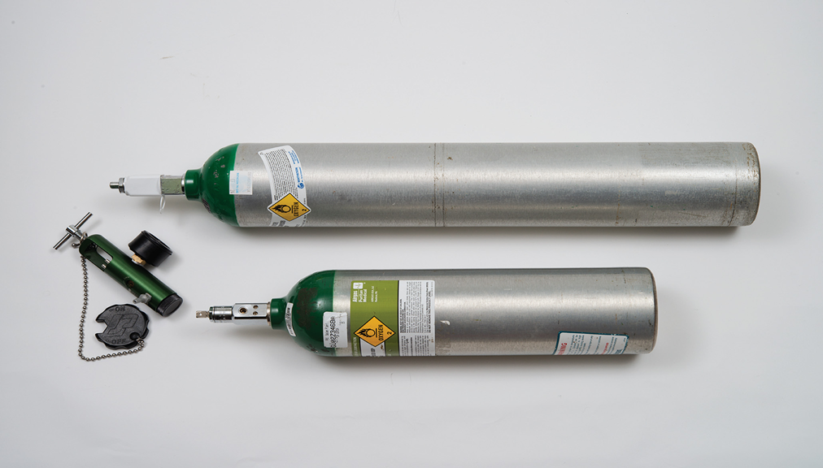
Oxygen Therapy—Oxygen Therapy Equipment (7 of 13)
For safety, to prevent them from tipping over, oxygen cylinders must be placed in a horizontal position or, if upright, must be securely supported.
Notes:
Covers Objective: 10.6

Slide 68
Oxygen Therapy—Oxygen Therapy Equipment (8 of 13)
A pressure regulator must be connected to a cylinder to provide a safe working pressure of 30 to 70 p s i
  On cylinders E size or smaller, the regulator is secured using a yoke assembly
  On cylinders larger than E size, the regulator is secured with a threaded outlet
Before connecting a regulator to a cylinder, open the main valve slightly to clear dirt and dust
Notes:
Covers Objective: 10.6
Class Activity: Using an oxygen cylinder and regulator have students prepare an oxygen delivery system per the guidance of a standardized skill sheet.

Slide 69
Oxygen Therapy—Oxygen Therapy Equipment (9 of 13)
Flowmeters allow control of the flow of oxygen in liters per minute
There are two types of low-pressure flowmeters
  Pressure-compensated flowmeters are used for larger cylinders in the ambulance
  Constant flow selector valve can be used with any size cylinder
High-pressure flowmeters may be necessary for oxygen-powered devices or respirators and ventilators
Notes:
Covers Objective: 10.6
Class Activity: Have a class scavenger hunt. Assign students to a station or a medical facility and have them photograph as many oxygen delivery devices as they can. Discuss.

Slide 70
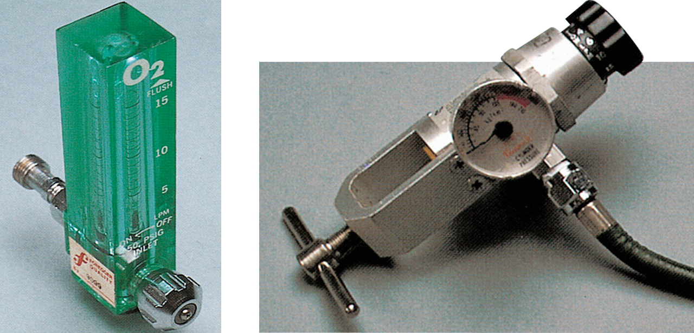
Oxygen Therapy—Oxygen Therapy Equipment (10 of 13)
For long description, see slide 116: Appendix 2
Low-pressure flowmeters: (Left) A pressure-compensated flowmeter; (Right) a constant flow selector valve.
Notes:
Covers Objective: 10.6

Slide 71
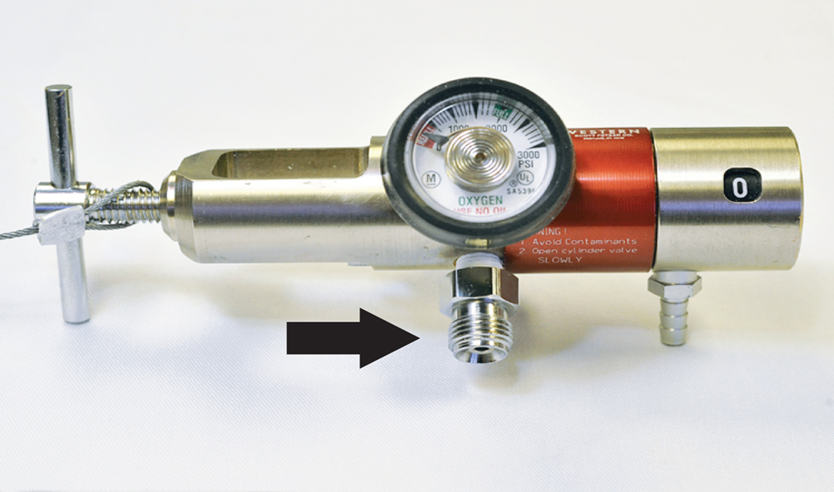
Oxygen Therapy—Oxygen Therapy Equipment (11 of 13)
High-pressure flowmeter. High-pressure oxygen is delivered through hoses attached to a threaded connector.
Notes:
Covers Objective: 10.6

Slide 72
Oxygen Therapy—Oxygen Therapy Equipment (12 of 13)
Humidifiers can be connected to the flowmeter to moisten dry oxygen from the cylinder
  They are basically a non-breakable jar of water that the oxygen bubbles through
  They must be kept clean
Humidifiers are often not used by E M S because transports are short and they increase infection risk
Notes:
Covers Objective: 10.6
Class Activity: Consider taking a field trip to the back of an ambulance. Many of the referenced systems and appliances will be present there.

Slide 73
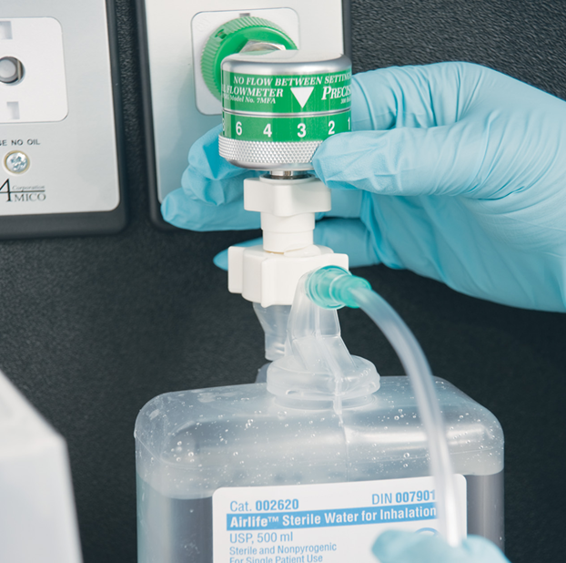
Oxygen Therapy—Oxygen Therapy Equipment (13 of 13)
Humidifier in use on board an ambulance.
Notes:
Covers Objective: 10.6

Slide 74
Oxygen Therapy—Hazards of Oxygen Therapy (1 of 2)
Nonmedical hazards are extremely rare and can be avoided by treating equipment properly
  If a tank is punctured or a valve breaks off, the supply tank can become a missile.
  Oxygen can cause fire to burn more rapidly
  Oxygen under pressure and oil create a severe, explosive reaction
Notes:
Covers Objective: 10.6
Discussion Topic: Discuss the potential dangers associated with the handling of oxygen and compressed gas in general.

Slide 75
Oxygen Therapy—Hazards of Oxygen Therapy (2 of 2)
Medical hazards can occur but take time to develop and are rarely seen by E M Ts
  Oxygen toxicity or air sac collapse occurs when there is an “overload” of oxygen
  Eye damage may occur when premature infants receive oxygen over a long period
  Respiratory depression or respiratory arrest occur when hypoxic drive is depressed in C O P D patients
  Underlying conditions can be exacerbated, as with myocardial infarction or stroke
Notes:
Covers Objective: 10.6
Teaching Tip: Oxygen can be a hazardous substance. Demand appropriate respect for it, in this lesson and in others to come.

Slide 76
Oxygen Therapy—Administering Oxygen
Various delivery devices are available
Work with your instructor or follow your instructor’s directions to understand how to use specific equipment
Notes:
Covers Objective: 10.6
Teaching Tips: This section deals primarily with psychomotor skills. Although there are didactic components, be sure to allot enough time for skills practice. Have appropriate assistance. Closely monitor and frequently correct students. Use standardized skill sheets to assess competency when practicing the various methods of administering supplemental oxygen.

Slide 77
Oxygen Therapy—Supplemental Oxygen for Patients with Chest Pain (1 of 14)
Supplemental oxygen should be used when there is shortness of breath, hypoxia, or low oxygen saturation
  For mild distress, administer low-concentration oxygen via nasal cannula
  For moderate to severe distress, administer high-concentration oxygen via nonrebreather mask
  Local protocols may offer additional guidance
Notes:
Covers Objective: 10.6
Discussion Topic: Discuss the general procedure for administering supplemental oxygen.

Slide 78
Oxygen Therapy—Supplemental Oxygen for Patients with Chest Pain (2 of 14)
A nonrebreather mask is the best way to deliver high concentrations of oxygen to breathing patients
  It must be placed properly on the face to provide the necessary seal
  You must inflate the reservoir bag before putting the mask on the patient’s face
The reservoir must always contain enough oxygen so it does not deflate by more than one-third
  This is maintained at a flow of 15 liter per minute
  This provides concentrations from 80 to 90 percent
Notes:
Covers Objective: 10.6

Slide 79
Oxygen Therapy—Supplemental Oxygen for Patients with Chest Pain (3 of 14)
Exhaled air escapes through a flutter valve and does not return to the reservoir
A safety feature is an emergency port that enables the patient to receive atmospheric air if the oxygen fails
Nonrebreather masks should be used in patients with signs of hypoxia with shortness of breath, chest pain, and altered mental status
Notes:
Covers Objective: 10.6

Slide 80
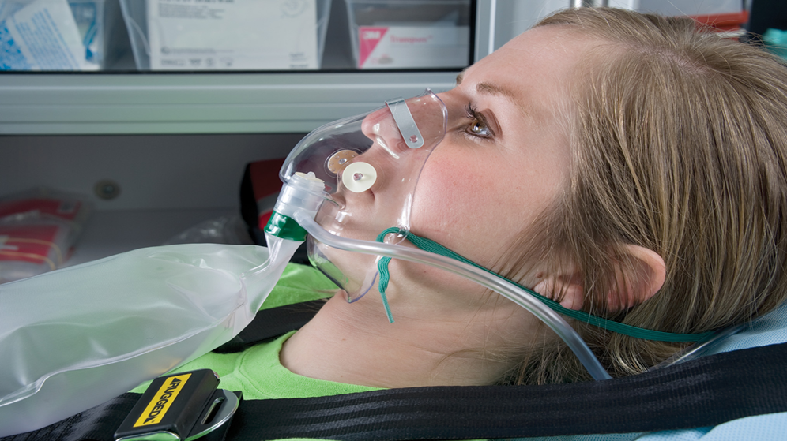
Oxygen Therapy—Supplemental Oxygen for Patients with Chest Pain (4 of 14)
Nonrebreather mask. Note the round disks—flutter valves that allow air exhaled by the patient to escape so it is not rebreathed.
Notes:
Covers Objective: 10.6

Slide 81
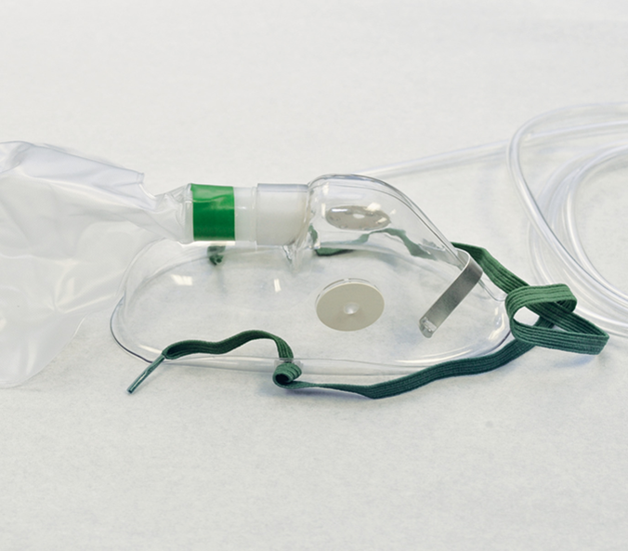
Oxygen Therapy—Supplemental Oxygen for Patients with Chest Pain (5 of 14)
Nonrebreather mask. Note the round disks—flutter valves that allow air exhaled by the patient to escape so it is not rebreathed.
Notes:
Covers Objective: 10.6

Slide 82
Oxygen Therapy—Supplemental Oxygen for Patients with Chest Pain (6 of 14)
A nasal cannula provides low concentrations of oxygen (24 to 44 percent)
  Oxygen is delivered by two prongs in the nostrils
  Cannula is held in place by placing tubing over the ears and using a slip-loop under the chin
  Oxygen delivered by the cannula should not exceed 4 to 6 liters per minute
The cannula is the best choice for a patient who refuses to wear an oxygen face mask
Notes:
Covers Objective: 10.6

Slide 83
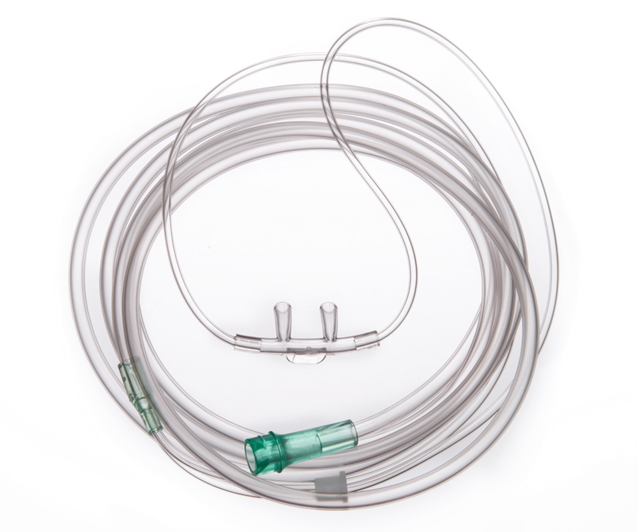
Oxygen Therapy—Supplemental Oxygen for Patients with Chest Pain (7 of 14)
Nasal cannula
Notes:
Covers Objective: 10.6

Slide 84
Oxygen Therapy—Supplemental Oxygen for Patients with Chest Pain (8 of 14)
A partial rebreather mask is very similar to nonrebreather mask
  It does not have a one-way valve like the nonrebreather mask
  It allows the patient to rebreathe about one-third of the exhaled air
  This is useful to preserve carbon dioxide levels to stimulate breathing
The partial rebreather mask delivers 40 to 60 percent oxygen at 9–10 liters per minute
Notes:
Covers Objective: 10.6

Slide 85
Oxygen Therapy—Supplemental Oxygen for Patients with Chest Pain (9 of 14)
A Venturi mask delivers specific concentrations of oxygen by mixing oxygen with inhaled air
  Mask package contains different tips that provide different concentrations of oxygen
  Most commonly used on C O P D patients
Notes:
Covers Objective: 10.6
Critical Thinking Discussion: You are treating an end-stage COPD patient who is complaining of respiratory distress. You note cyanosis in his lips and nail beds. As you begin to prepare your oxygen tank for delivery of supplemental oxygen, the patient’s home health nurse tells you that the patient cannot have oxygen due to his COPD. Given this information, what do you do?

Slide 86
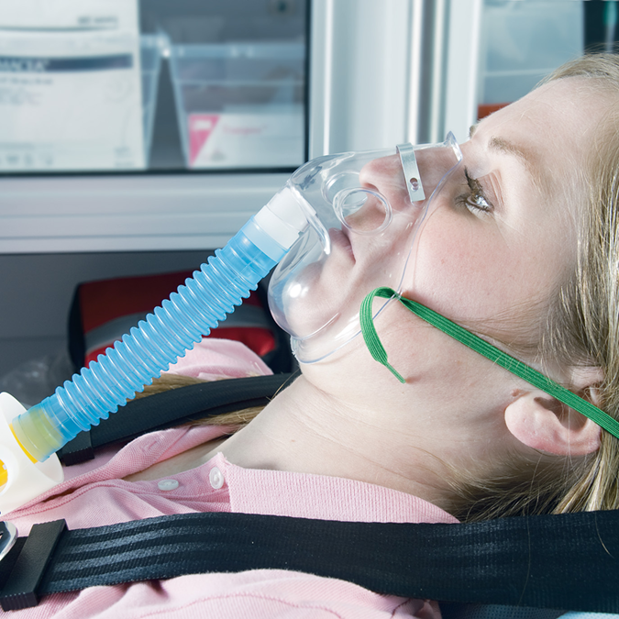
Oxygen Therapy—Supplemental Oxygen for Patients with Chest Pain (10 of 14)
Venturi mask
Notes:
Covers Objective: 10.6

Slide 87
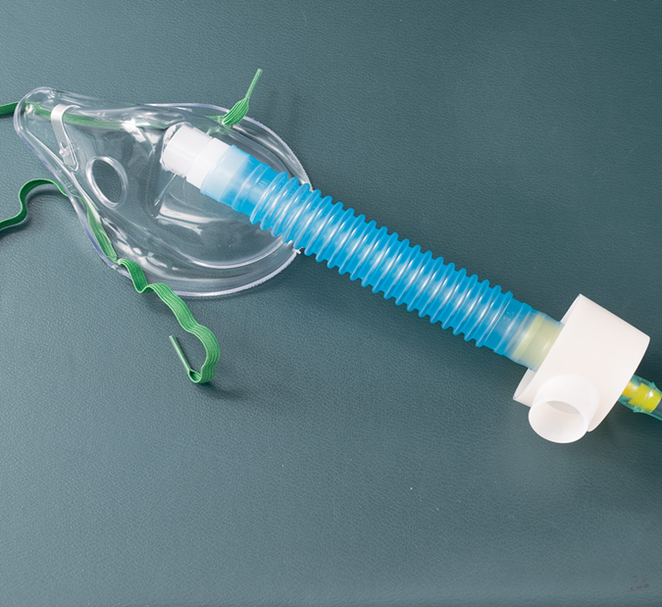
Oxygen Therapy—Supplemental Oxygen for Patients with Chest Pain (11 of 14)
Venturi mask
Notes:
Covers Objective: 10.6

Slide 88
Oxygen Therapy—Supplemental Oxygen for Patients with Chest Pain (12 of 14)
A tracheostomy mask is placed over a stoma or tracheostomy tube to provide supplemental oxygen
  It is typically a small, cuplike mask that fits over the tracheostomy
  It is connected to 8 to 10 liters per minute of oxygen via supply tubing
Notes:
Covers Objective: 10.6
Discussion Topic: Describe the differences among oxygen delivery devices. Cite specific capabilities of the following: a nonrebreather mask, a nasal cannula, a partial rebreather mask, and a Venturi mask.
Knowledge Application: Describe a series of patients who require supplemental oxygen. Have students choose an oxygen delivery device and explain why they feel that the particular device would work for the specific patient. Discuss.

Slide 89
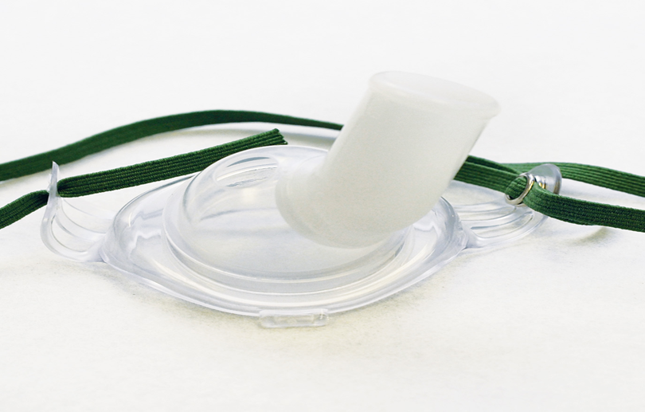
Oxygen Therapy—Supplemental Oxygen for Patients with Chest Pain (13 of 14)
Tracheostomy mask
Notes:
Covers Objective: 10.6

Slide 90
Oxygen Therapy—Supplemental Oxygen for Patients with Chest Pain (14 of 14)
High-concentration oxygen should be administered to children in respiratory distress, with inadequate respirations, or in possible shock
Infants and children may benefit from the blow-by technique
  Hold tubing or a nonrebreather mask 2 inches from the face
  Oxygen passes over the face and is inhaled
Notes:
Covers Objective: 10.6

Slide 91
Special Considerations
Back to Topics
Notes:
Teaching Time: 15 minutes
Teaching Tip: Multimedia graphics of facial injuries may enhance comprehension of special ventilatory circumstances.

Slide 92
Special Considerations (1 of 4)
Facial injuries
  Bleeding may require frequent suctioning
  An airway adjunct or endotracheal tube may be needed
Obstructions
  Suction units are not adequate for removing solid objects
  Use abdominal thrusts, chest thrusts, or finger sweeps
Notes:
Covers Objective: 10.6
Discussion Topic: Discuss how a facial injury or airway obstruction might interfere with your ability to provide artificial ventilation.
Knowledge Application: Provide examples of facial injuries (and/or show graphics) and discuss methods for properly administering artificial ventilations. Particularly highlight how such injuries might alter normal procedures. Divide the class into small groups. Assign each group a special consideration such as a facial injury, a pediatric patient, dentures, and so on. Have each group discuss the potential challenges, improvise a solution, and present its findings to the class.

Slide 93
Special Considerations (2 of 4)
Dental appliances
  Dentures should be left in place during airway procedures
  Partial dentures may become dislodged during an emergency
  Be prepared to remove a device if it endangers the airway
Notes:
Covers Objective: 10.6
Critical Thinking Discussion: In this section we highlighted some specific circumstances that might make artificial ventilations and supplemental oxygen delivery more difficult. There are many other difficult situations. What others can you think of? Discuss.

Slide 94
Special Considerations (3 of 4)
Infants and children
  Anatomic considerations
    The tongue takes up more space
    The trachea is softer and more flexible and the head is proportionately larger
    Chest wall is softer and diaphragm breathing is more important
    Oxygen burn rate is twice the adult rate
Notes:
Covers Objective: 10.6
Teaching Tip: Have pediatric anatomy models on hand to illustrate differences.
Discussion Topic: Describe examples of pediatric airway anatomy (or pediatric anatomy in general) that might make providing artificial ventilations more difficult.

Slide 95
Special Considerations (4 of 4)
Infants and children
  Management considerations
    Avoid excessive pressure and volume.
    Use properly sized face masks.
    Use pediatric-sized nonrebreather masks and nasal cannulas
    Gastric distention may impair adequate ventilations
Notes:
Covers Objective: 10.6
Teaching Tip: Demonstrate pediatric-specific airway equipment.
Class Activity: (Skill Demonstration) Referring to a standardized skill competency sheet, and using pediatric airway manikins, demonstrate the proper one- and two-person techniques for delivering ventilations using a bag-valve mask on an infant and a child.

Slide 96
Assisting with Advanced Airway Devices
Back to Topics
Notes:
Teaching Time: 15 minutes
Teaching Tip: Invite an advanced provider to discuss the teamwork associated with advanced airway placement.

Slide 97
Assisting with Advanced Airway Devices —Preparing the Patient for Intubation (1 of 3)
Before a paramedic places a tube, you may be asked to give the patient extra oxygen
The paramedic will then position the patient’s head in the head-elevated, sniffing position
The paramedic will remove the oral airway and pass the endotracheal tube into place
You may be asked to help with the B U R P maneuver
Notes:
Covers Objective: 10.7
Discussion Topic: Explain the importance of hyperoxygenation prior to the insertion of an advanced airway.

Slide 98
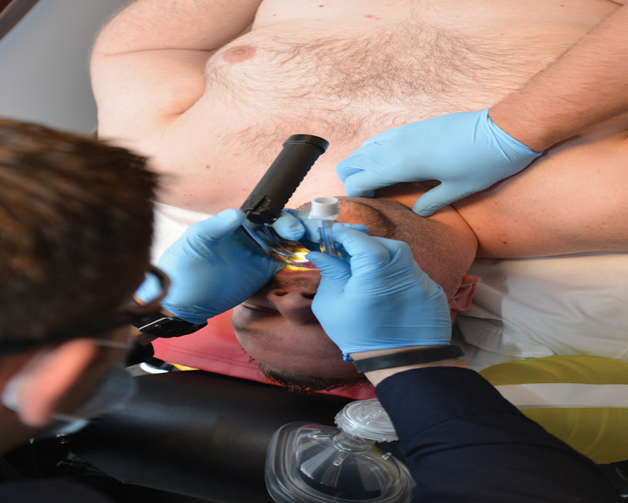
Assisting with Advanced Airway Devices —Preparing the Patient for Intubation (2 of 3)
In the B U R P maneuver, press your thumb and index finger on either side of the throat over the cricoid cartilage and gently direct the throat upward and toward the patient’s right. © Edward T. Dickinson, M D
Notes:
Covers Objective: 10.7

Slide 99
Assisting with Advanced Airway Devices —Preparing the Patient for Intubation (3 of 3)
Once the tube is placed, the paramedic assures proper placement via two methods
The tube is then anchored with a commercial restraint
You may be asked to monitor lung and epigastric sounds
Take care not to disturb the tube once it has been placed and secured
Notes:
Covers Objective: 10.7
Discussion Topic: Discuss the role of an EMT in the process of inserting an advanced airway. Discuss the importance of confirming an endotracheal tube’s placement. Discuss methods that you might use.

Slide 100
Assisting with Advanced Airway Devices —Ventilating the Intubated Patient (1 of 2)
Very little movement can displace an endotracheal tube
Ventilate about 10 times per minute
Hold the tube against the patient’s teeth with two fingers of one hand
Work the B V M with the other hand
If ventilating a breathing patient, time ventilations with respiratory effort as much as possible
Notes:
Covers Objective: 10.7
Teaching Tips: Have advanced airway devices and associated equipment on hand for familiarization. Focus on confirmation. This is an absolutely essential goal for the entire team.

Slide 101
Assisting with Advanced Airway Devices —Ventilating the Intubated Patient (2 of 2)
Pay attention to resistance to ventilations; report any changes
If patient is defibrillated, carefully remove the bag from the tube
Watch for any change in the patient’s mental status.
During cardiac arrest, you may be asked to remove the B V M so medication can be injected
Notes:
Covers Objective: 10.7
Critical Thinking Discussion: What is the role of the EMT when an advanced airway fails? How might an EMT help in a “failure to intubate” situation?

Slide 102
Assisting with Advanced Airway Devices —Assisting with Trauma Intubation (1 of 2)
Provide manual in-line stabilization throughout procedure
The paramedic will hold manual stabilization while you apply a cervical collar
You will then stabilize the head from the patient’s side
The paramedic will lean back, use a laryngoscope, and tube the patient
Notes:
Covers Objective: 10.7
Discussion Topic: Describe the teamwork necessary to intubate a trauma patient.
Class Activity: Join with an advanced class and practice the teamwork necessary to insert an advanced airway.

Slide 103
Assisting with Advanced Airway Devices —Assisting with Trauma Intubation (2 of 2)
After intubation, you will hold the tube against the teeth until placement is confirmed
The tube will then be anchored
You must hold manual stabilization in addition to a collar until the head is taped in place on the backboard
Notes:
Covers Objective: 10.7
Knowledge Application: Using an airway manikin, practice the hand position necessary to maintain stabilization during a trauma intubation.

Slide 104
Chapter Review

Slide 105
Chapter Review (1 of 2)
Respiratory failure is the result of inadequate breathing, breathing that is insufficient to support life.
A patient in respiratory failure or respiratory arrest must receive artificial ventilations.
Oxygen can be delivered to the nonbreathing patient as a supplement to artificial ventilation.

Slide 106
Chapter Review (2 of 2)
Oxygen can also be administered as therapy to the breathing patient whose breathing is inadequate or who is cyanotic, cool and clammy, short of breath, suffering chest pain, suffering severe injuries, or displaying an altered mental status.

Slide 107
Remember (1 of 3)
Always use proper personal protective equipment when managing an airway.
Assessment of breathing must be an ongoing process; respiratory status can change over time.
Inadequate breathing requires immediate action.

Slide 108
Remember (2 of 3)
Positive pressure ventilations are very different from normal breathing and can have negative side effects.
Select the most appropriate method of positive pressure ventilations based upon the needs of the individual.

Slide 109
Remember (3 of 3)
Always use appropriate safety measures when handling oxygen.
Select the appropriate delivery device to provide supplemental oxygen.

Slide 110
Questions to Consider (1 of 2)
What are the signs of respiratory distress?
What are the signs of respiratory failure?
For B V M ventilation, what are recommended variations in technique for one or two rescuers?

Slide 111
Questions to Consider (2 of 2)
How does the way positive pressure ventilation moves air differ from how the body normally moves air?
Describe a patient problem that would benefit from administration of oxygen and explain how to decide what oxygen delivery device should be used.

Slide 112
Critical Thinking (1 of 2)
On arrival at the emergency scene, you find an adult female patient who is semiconscious. Her respiratory rate is 7 per minute. She appears pale and slightly blue around her lips.

Slide 113
Critical Thinking (2 of 2)
Is this patient in respiratory failure, and if so what signs and symptoms indicate this? Does this patient require artificial ventilations?

Slide 114

Copyright
This work is protected by United States copyright laws and is provided solely for the use of instructors in teaching their courses and assessing student learning. Dissemination or sale of any part of this work (including on the World Wide Web) will destroy the integrity of the work and is not permitted. The work and materials from it should never be made available to students except by instructors using the accompanying text in their classes. All recipients of this work are expected to abide by these restrictions and to honor the intended pedagogical purposes and the needs of other instructors who rely on these materials.

Slide 115
Appendix 1
The E M T positions the mask over the rescuer’s face and forms a C position with thumb and index finger and also places the middle, ring and little fingers along the patient’s jaw. Another nurse holds the bag valve connected to the oxygen mask and pumps by his two hands.
Return to presentation

Slide 116
Appendix 2
The first picture is a low pressure flow meter that is kept in upright position. The low pressure unit has a calibrated glass tube. A valve is present at the bottom of the meter. The second picture represents the slanting view of selector valve. The valve has manual regulator at the bottom. The meter is at the center of the valve and a tube is connected downward from the meter.
Return to presentation

