Slide 1
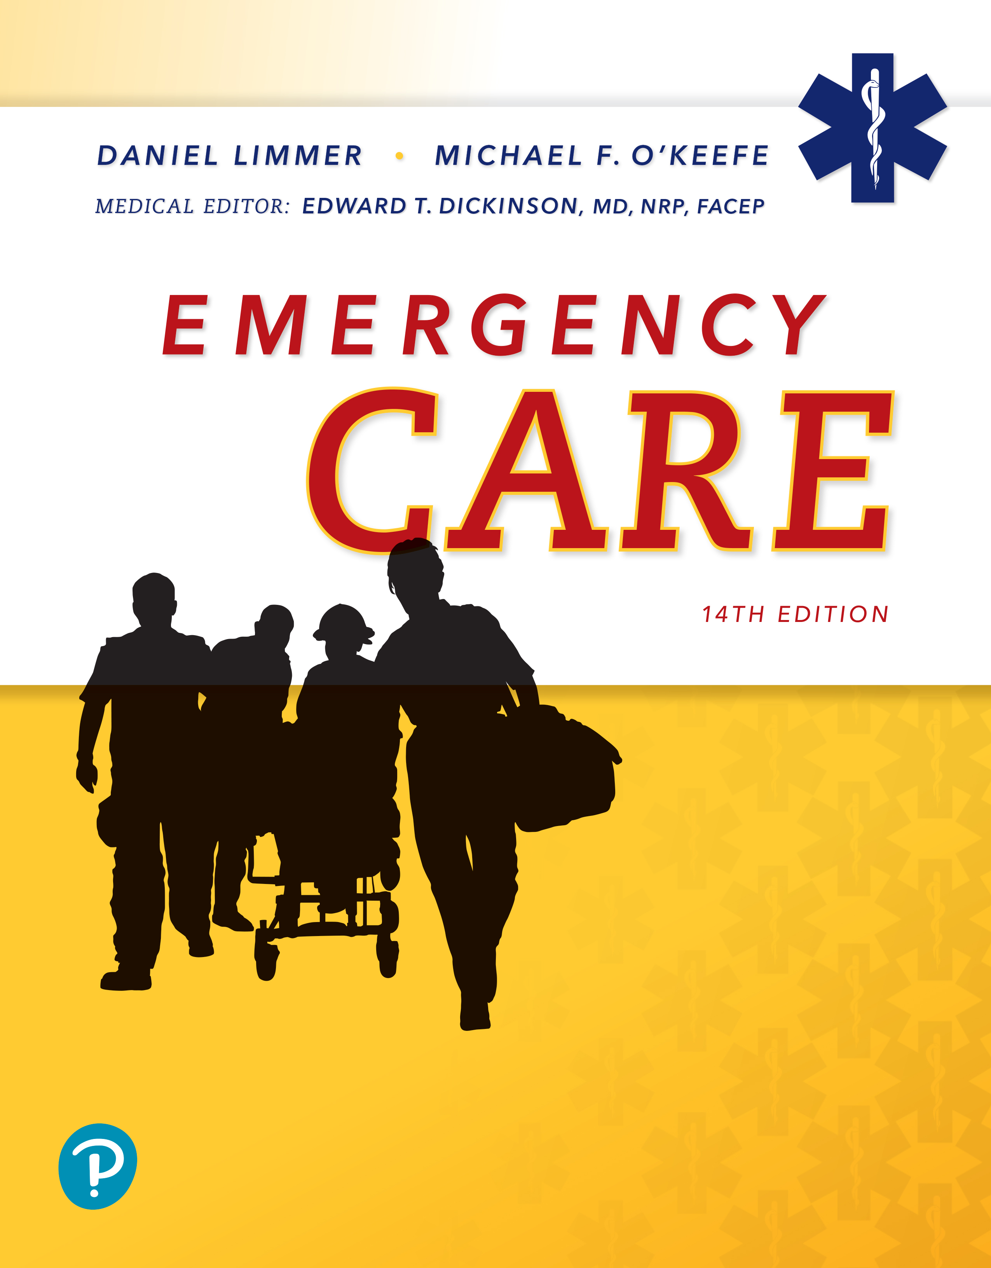
Emergency Care
Fourteenth Edition
Chapter 24
Infectious Diseases and Sepsis
Slides in this presentation contain hyperlinks. JAWS users should be able to get a list of links by using INSERT+F7
Copyright © 2021, 2016, 2012 Pearson Education, Inc. All Rights Reserved
Notes:
If this PowerPoint presentation contains mathematical equations, you may need to check that your computer has the following installed:
1) MathType Plugin
2) Math Player (free versions available)
3) NVDA Reader (free versions available)

Slide 2
Topics
Infectious Diseases
Sepsis
Selected Common Communicable Diseases
Notes:
Planning Your Time: Plan 140 minutes for this chapter.
Infectious Diseases (15 minutes)
Sepsis (30 minutes)
Selected Common Communicable Diseases (95 minutes)
Core concepts:
• Pathophysiology of infectious disease and sepsis
• How infectious diseases spread
• Recognition and management of patients with infectious diseases
• Recognition and management of the possibly septic patient

Slide 3
Infectious Diseases
Back to Topics
Notes:
Teaching Time: 15 minutes
Teaching Tips: This lesson lends itself well to real-world examples of communicable disease outbreaks pulled from the news as well as use of photographs to illustrate signs of different diseases. Review the anatomy and physiology of parts of the body that help defend against infection, such as the immune and lymphatic systems, blood, and integumentary system. Review the anatomy and physiology of the parts of the body that are most susceptible to infection, such as the skin, respiratory system, and gastrointestinal system.

Slide 4
How Diseases Spread (1 of 3)
Infectious diseases
  Bacteria
  Viruses
  Other microbes
Communicable diseases
  Direct contact
  Contact with secretions
Notes:
Covers Objective: 24.1
Points to Emphasize: An infectious disease is caused by bacteria, viruses, and other microbes and may not be communicable.
Discussion Topic: Distinguish between infectious and communicable diseases. Identify the types of microbes and differentiate between them.

Slide 5
How Diseases Spread (2 of 3)
When an infection does cause illness, the time from exposure to development of the first symptoms is called the incubation period.
The interval when the patient is shedding or releasing infectious material is the communicable period, when the microbe can be potentially transmitted.
Notes:
Covers Objective: 24.1
Point to Emphasize: Every infectious disease has an incubation period. Every communicable disease has a communicable period.

Slide 6
How Diseases Spread (3 of 3)
Factors causing infection and illness after exposure
  Virulence
  Dose
  Route
  Body’s resistance
Notes:
Covers Objective: 24.1
Discussion Topic: List and describe the factors that determine whether exposure to a microbe causes infection and illness.

Slide 7
Sepsis
Back to Topics
Notes:
Teaching Time: 30 minutes
Teaching Tips: Review the chapters on Principles of Pathophysiology and Bleeding and Shock. Add the progression of sepsis to septic shock to physiology and pathophysiology as previously discussed. Identification of sepsis is important but the criteria are not definitive. Discuss with students the efficacy and goals of sepsis-related assessment criteria. Teach that providing sepsis alerts to ED staff for potentially septic patients is crucial and how to make the determination that an alert is necessary.

Slide 8
Pathophysiology (1 of 2)
Sepsis is a life-threatening condition resulting from an abnormal and counterproductive response by the body that causes damage to tissues and organs.
  The body overreacts and secretes substances that, instead of helping, hurt cells, tissues, and organs.
Septic shock occurs when these changes result in shock and hypotension that do not respond to intravenous fluids.
Notes:
Covers Objective: 24.2
Points to Emphasize: Sepsis involves an abnormal and counterproductive response by the body that damages tissue and organs. It can progress to septic shock.
Critical Thinking Discussion: What can prevent sepsis from progressing to septic shock?

Slide 9
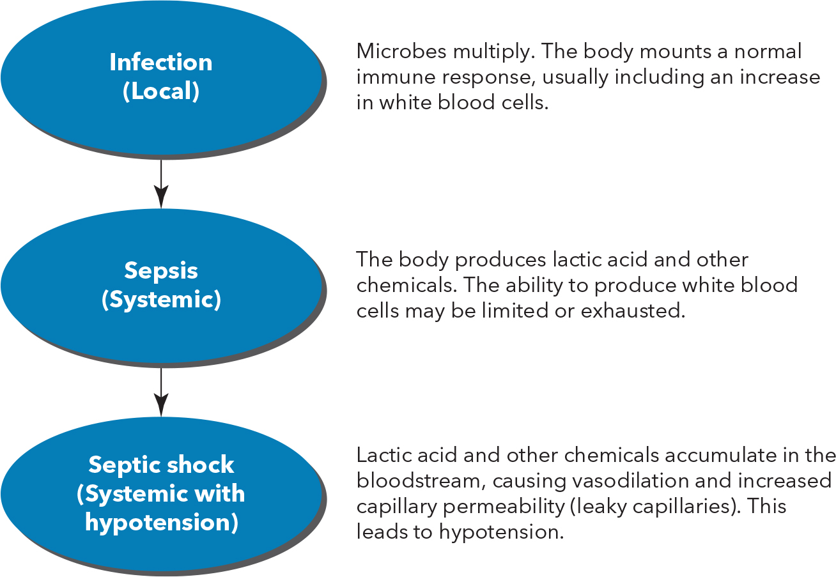
Pathophysiology (2 of 2)
For long description, see slide 70: Appendix 1
Stages of sepsis.
Notes:
Covers Objective: 24.2
Discussion Topic: List the steps of the progression from sepsis from septic shock.

Slide 10
Common Causes (1 of 2)
Locations of body likely to be associated with sepsis
  Lungs
    Pneumonia
  Gastrointestinal tract
    Abdominal surgery
    Pancreatitis
  Genitourinary tract
    Kidney or prostate infections
    Urinary catheter
Notes:
Covers Objective: 24.2
Point to Emphasize: Sepsis can arise from a variety of causes in many parts of the body.

Slide 11
Common Causes (2 of 2)
Locations of body likely to be associated with sepsis
  Skin
    Long-term intravenous catheter
    Tracheostomy
    Gastrostomy tube
    Pressures sores
Much about sepsis still unknown
Notes:
Covers Objective: 24.2
Point to Emphasize: The exact pathway for the development of sepsis is unclear, many cases do not have clearly defined sources, the definition is still changing, and treatment is still improving.

Slide 12
Patient Assessment (1 of 2)
Systemic inflammatory response syndrome (S I R S) criteria
  Temperature
    Lower than 96.8° F (36° C)
    Higher than 101° F (38.3° C)
  Heart rate over 90
  Respiratory rate over 20
  Systolic B P lower than 90 m m H g
  New-onset altered mental status or worsened mental status
Notes:
Covers Objective: 24.2
Points to Emphasize: SIRS criteria are fairly vague. Many patients without sepsis will have two or more abnormal findings, as in the case of trauma patients. A number of patients with sepsis will not have two or more abnormal findings.
Critical Thinking Discussion: What role does reassessment play when treating a patient with sepsis? How can your initial findings change?

Slide 13
Patient Assessment (2 of 2)
Quick sepsis-related organ failure assessment (q S O F A)
  Resembles S I R S criteria
  Does not predict whether someone is septic
  Predicts whether septic patient will have longer to stay in I C U or be more likely to die
Notes:
Covers Objective: 24.2
Points to Emphasize: Follow local protocols and own clinical judgment when determining whether patient may be septic.
Discussion Topics: Describe the assessment findings for sepsis. What are the differences between SIRS and qSOFA?

Slide 14
Patient Care
Look for signs of sepsis in an infected patient.
Provide supportive care.
If patient meets S I R S or similar criteria, inform the E D (sepsis alert).
Notes:
Covers Objective: 24.2
Discussion Topic: Describe the steps of care for a patient with sepsis.
Knowledge Application: For a programmed patient, have the class use SIRS criteria to assess the patient for sepsis. Challenge the class to indicate why these criteria might not be definitive for this patient.
Class Activities: Discuss the signs and symptoms of a variety of patients with problems indicating sepsis. Work with the class to develop strategies to identify treatment approaches for these patients. Assign a take-home assignment in which students list signs and symptoms indicating potential sepsis in a patient, then have students identify appropriate treatment steps.

Slide 15
Selected Common Communicable Diseases
Back to Topics
Notes:
Teaching Time: 95 minutes
Teaching Tips: This lesson will apply to the scenario and simulation environment. Strictly enforce Standard Precautions practices and integrate assessment of communicable diseases in the scenario setting. Use real-life examples. Adults grasp pathophysiology best when they can apply it to actual situations. For each subsection of disorder, discuss actual examples and move from theory to reality. For communicable diseases that have visible signs such as a rash, use multimedia graphics to enhance learning and differentiation among diseases.

Slide 16
Patient Assessment and Care (1 of 2)
Prevention
  Appropriate vaccinations
  Standard Precautions
Assessment
  Has the patient travelled?
  Has the patient received recommended vaccinations?
Notes:
Covers Objective: 24.3
Point to Emphasize: To protect yourself and patients from infectious diseases, get appropriate vaccinations and use Standard Precautions. When you encounter patients with a fever, vague symptoms, or an ill-defined complaint, ask them where they have traveled in the previous several weeks and received the recommended vaccinations.

Slide 17
Patient Assessment and Care (2 of 2)
Care
  Understand how the patient feels.
  Wear personal protective equipment.
  Get further testing and/or receive preventative prophylactic antibiotics.
Notes:
Covers Objective: 24.3
Discussion Topic: Describe the general approach to assessment of and care for a patient with a communicable disease.

Slide 18
Chickenpox (1 of 3)
Caused by varicella-zoster virus (V Z V)
Signs and symptoms
  Starts with vague symptoms resembling cold
  Followed by fever and rash that itches and looks like blisters
Very contagious
  Direct person-to-person contact
  Airborne from rash on skin or mucous membranes
  Dried scabs do not spread disease.
Notes:
Covers Objective: 24.3
Points to emphasize: Chickenpox can spread from 1 to 2 days after lesions appear until they dry.
Discussion Topic: Describe the patient assessment findings that would indicate the presence of chickenpox.

Slide 19
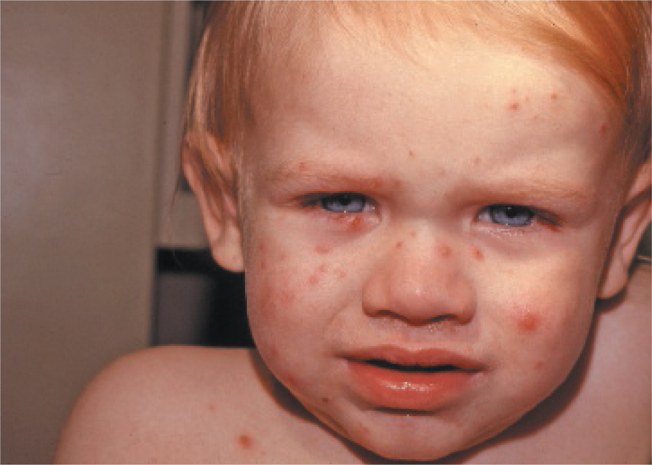
Chickenpox (2 of 3)
Child with chickenpox.
Notes:
Covers Objective: 24.3

Slide 20
Chickenpox (3 of 3)
Treatment and prevention
  Isolation of patients until lesions dry.
  Antiviral medications to shorten course of disease and prevent complications
  Vaccination
Receive vaccine within 3 days of exposure.
Notes:
Covers Objective: 24.3
Points to emphasize: Chickenpox is traditionally a childhood disease but can return in adults in different form (shingles). When it reactivates later in life, this is often in response to stress. The rash persists for 7 to 10 days and heals within a month. A small but significant number of patients experience postherpetic neuralgia.
Discussion Topic: Describe the transmission, prevention, and treatment of chickenpox.
Critical Thinking Discussion: If you encounter a patient with chickenpox, what concerns should you have?

Slide 21
Measles (1 of 3)
Also called rubeola, a highly infectious viral disease
Signs and symptoms
  Starts with fever, cough, eye irritation
  Small white or bluish-white spots on inside of cheek (Koplik spots)
  Red-blotchy rash
Notes:
Covers Objective: 24.3
Point to Emphasize: Measles is a highly infection disease that can easily spread and requires Standard Precautions.
Discussion Topic: Describe the patient assessment findings that would indicate the presence of measles.

Slide 22
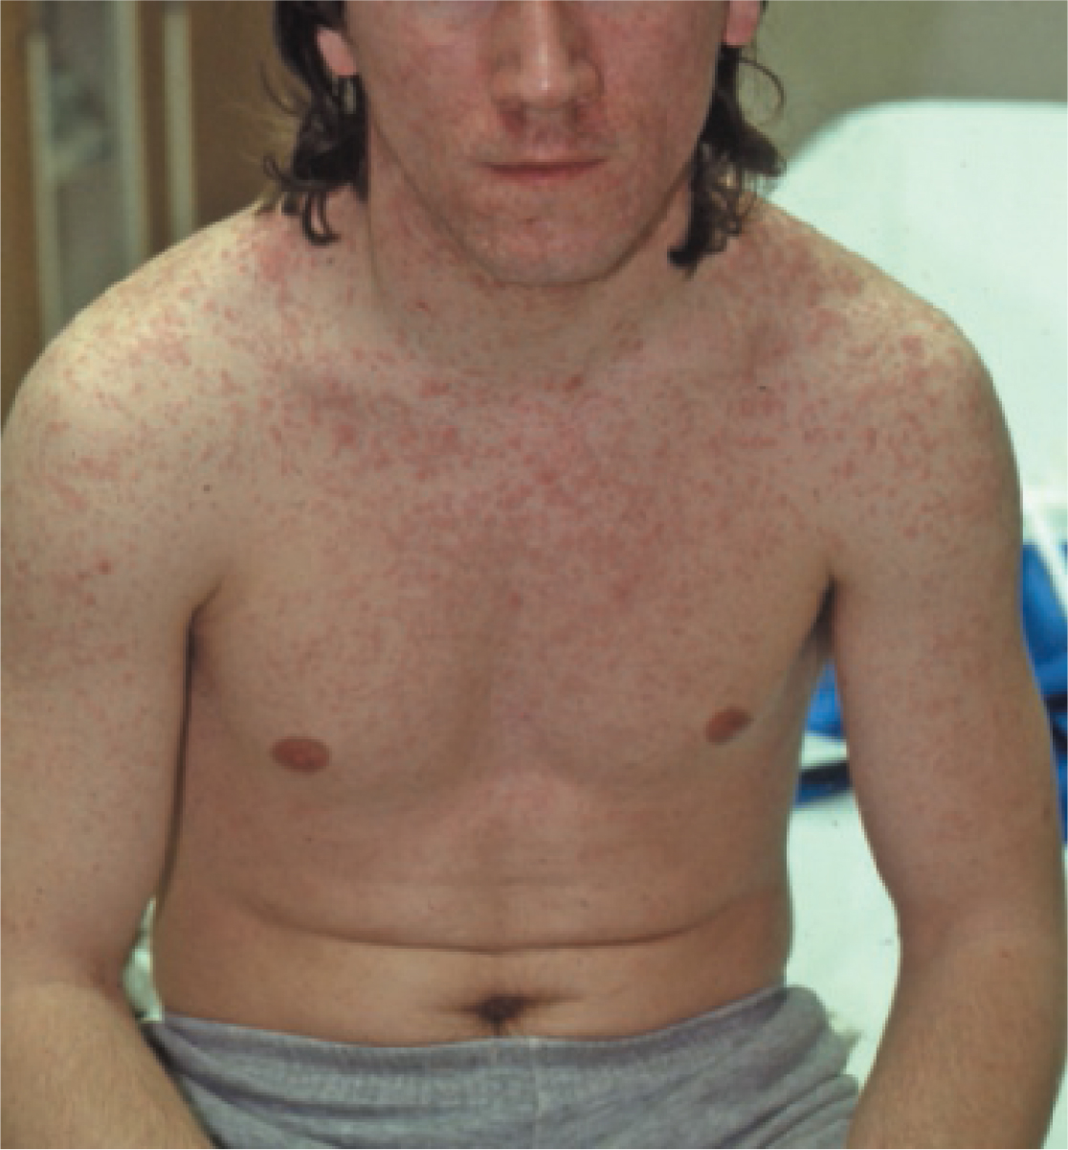
Measles (2 of 3)
Measles rash.
Notes:
Covers Objective: 24.3

Slide 23
Measles (3 of 3)
Easily spread
  Inhaled droplets in air
  Contact with nose and throat secretions
No specific treatment
Prevention
  Vaccination
  Quarantine
  Hand hygiene
Notes:
Covers Objective: 24.3
Point to Emphasize: Patients at high risk (infants less than 1 year old, pregnant women, immunocompromised individuals) may receive immune globulin for protection. Measles is a reportable disease and increasing numbers of outbreaks have occurred in recent years among unvaccinated patients. Contact receiving facility to ensure they can handle patient properly.
Discussion Topic: Describe the transmission, prevention, and treatment of measles.

Slide 24
Mumps (1 of 3)
Caused by paramyxovirus
Signs and symptoms
  Starts with vague symptoms such as muscle aches, loss of appetite, headache
  Progresses to swelling and inflammation of one or both parotids
  Parotitis lasts 7 to 10 days
Notes:
Covers Objective: 24.3
Point to Emphasize: The incubation period for mumps is 16 to 18 days. Patient most infectious from 2 days before the parotid swelling appears to 5 days after.
Discussion Topic: Describe the patient assessment findings that would indicate the presence of mumps.

Slide 25
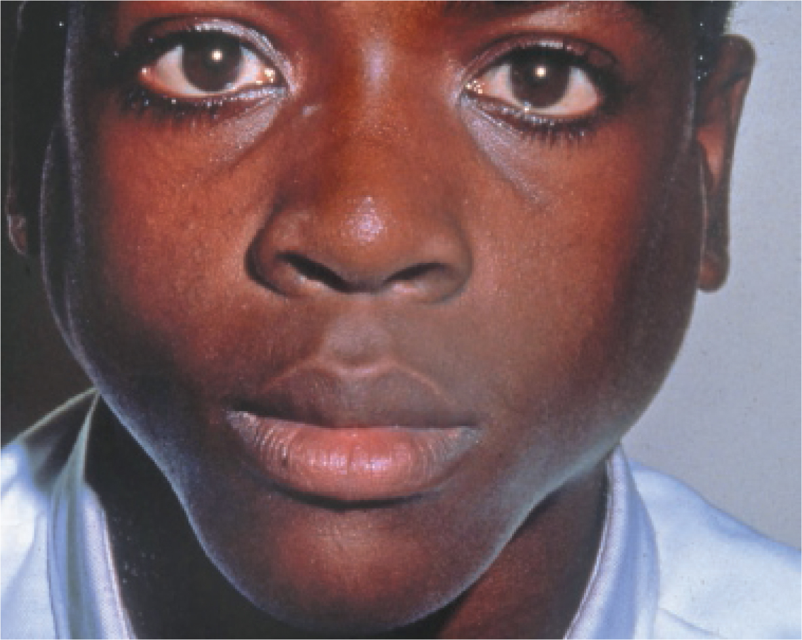
Mumps (2 of 3)
Mumps showing characteristic parotid gland swelling.© David Effron, M D
Notes:
Covers Objective: 24.3

Slide 26
Mumps (3 of 3)
Transmission
  Droplets
  Direct contact with saliva
Prevention
  Vaccination
  Quarantine of patients for 5 days after swelling appears
Notes:
Covers Objective: 24.3
Point to Emphasize: Treatment of mumps is supportive with no specific postexposure actions. Approximately a quarter of adult males who get mumps get orchitis. Sterility has resulted in a few cases but is rare.
Discussion Topic: Describe the transmission, prevention, and treatment of mumps.
Critical Thinking Discussion: Discuss the importance of vaccinations for preventing communicable diseases. How can EMTs help the public understand the need to be vaccinated? What should you do if you encounter a patient (or parent) who refuses to allow vaccination?

Slide 27
Hepatitis A (1 of 3)
Hepatitis is a general term that means inflammation of liver
Signs and symptoms
  Fever
  Nausea
  Loss of appetite
  Malaise
  Abdominal pain
  Jaundice a few days later
  Generally worse in older patients
Notes:
Covers Objective: 24.3
Point to Emphasize: Hepatitis A is one of several types of hepatitis and starts suddenly in adults.
Discussion Topic: Describe the patient assessment findings that would indicate the presence of hepatitis A.

Slide 28
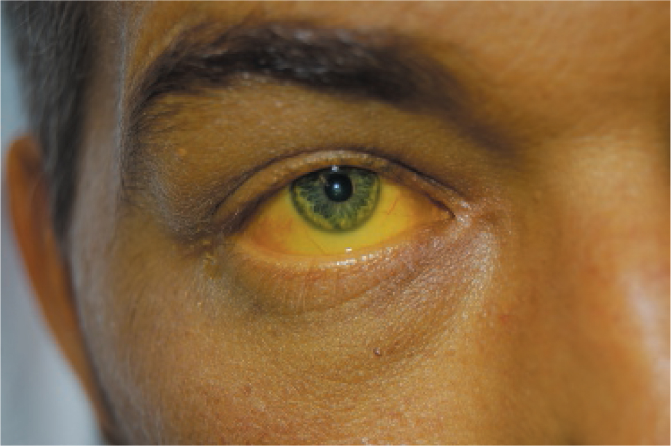
Hepatitis A (2 of 3)
Jaundice from hepatitis A. © Edward T. Dickinson, M D
Notes:
Covers Objective: 24.3

Slide 29
Hepatitis A (3 of 3)
Spread by fecal−oral route
No specific treatment
Prevention
  Hand hygiene
  Proper food preparation
  Vaccination
Notes:
Covers Objective: 24.3
Point to Emphasize: Treatment of hepatitis A is supportive. Postexposure actions involve vaccination and, in some cases, immune globulin. Hepatitis A may spread easily when people crowd together, especially under unplanned circumstances. Hepatitis E is spread by the same route but caused by a different virus. It is much more common outside the United States and Europe.
Discussion Topic: Describe the transmission, prevention, and treatment of hepatitis A.
Critical Thinking Discussion: Why does hepatitis A spread easily in places such as emergency shelters? What other places may be of concern for the spread of hepatitis A?

Slide 30
Hepatitis B (1 of 3)
Infection with the hepatitis B virus (H B V) is very common in many parts of the world.
Signs and symptoms
  Nausea
  Vomiting
  Loss of appetite
  Vague abdominal pain
  Progresses to jaundice
  Younger patients have fewer or no symptoms but much more likely to develop chronic infection.
Notes:
Covers Objective: 24.3
Point to Emphasize: Hepatitis B is very different from hepatitis A. It is a more serious disease with sometimes life-threatening consequences. Before development of a vaccine and changes in injection practices, hundreds of health care workers (including EMS providers) died every year in the United States from occupationally acquired hepatitis B.
Discussion Topic: Describe the patient assessment findings that would indicate the presence of hepatitis B.
Critical Thinking Discussion: What are the differences between hepatitis A and hepatitis B? How does this affect the PPE you choose and the treatment you provide?

Slide 31
Hepatitis B (2 of 3)
Transmission
  Blood and any fluid that contains blood
  Semen
  Cerebrospinal fluid
  Amniotic fluid
  Vaginal secretions
  A few other fluids
Notes:
Covers Objective: 24.3
Point to Emphasize: Routes of transmission for hepatitis B include blood transfusion, shared needles during drug injection, sexual intercourse, close household contacts, reuse of lancets for glucose testing, and childbirth (mother to neonate). HBV is very hardy and can survive for a week on surfaces outside the body.

Slide 32
Hepatitis B (3 of 3)
No specific treatment
Prevention
  Vaccination
  Proper decontamination of equipment after a call
Postexposure actions
  Wash exposure site with soap and water.
  See health care provider right away.
  Vaccination
  Possible immune globulin injection
Notes:
Covers Objective: 24.3
Point to Emphasize: Treatment of hepatitis B is supportive. The safety and efficacy of antiviral medications administered in some countries is unclear. Hepatitis D can occur only in patients who have HBV infection. It has similar signs and symptoms but is more sudden in onset and has a shorter incubation (2–8 weeks). There is no vaccine for hepatitis D, but if you are immunized against hepatitis B, you cannot be infected with hepatitis D. There is a treatment, but it is administered over the course of almost a year.
Discussion Topic: Describe the transmission, prevention, and treatment of hepatitis B.

Slide 33
Hepatitis C (1 of 2)
Hepatitis C is very similar to hepatitis B in many ways.
Signs and symptoms
  Nausea
  Vomiting
  Loss of appetite
  Vague abdominal pain
Notes:
Covers Objective: 24.3
Point to Emphasize: Although hepatitis C is very similar to hepatitis B in many ways, jaundice is less common in hepatitis C and more patients (approximately three-quarters) are infected without showing symptoms.
Discussion Topic: Describe the patient assessment findings that would indicate the presence of hepatitis C.

Slide 34
Hepatitis C (2 of 2)
Transmission
  Bloodborne through shared needles
  Less commonly through sexual intercourse or childbirth
Several safe medication regimens but no vaccine
Prevention
  Standard Precautions
  Proper use and disposal of sharps
Notes:
Covers Objective: 24.3
Point to Emphasize: Hepatitis C may be communicable forever in those with a chronic infection. The precautions for hepatitis C are the same as for any exposure, but there is no specific treatment to prevent or reduce risk of developing the disease. Hepatitis C can linger in body for decades before producing cirrhosis or liver cancer. Safe and effective treatments prevent these conditions from occurring.
Discussion Topic: Describe the transmission, prevention, and treatment of hepatitis C.
Critical Thinking Discussion: What is the importance of a thorough patient history for preventing the spread of a chronic infection such as hepatitis C?

Slide 35
H I V/AIDS (1 of 4)
Signs and symptoms
  For some patients, flu-like symptoms within a few week of H I V infection
  Fever
  Sore throat
  Fatigue
AIDS characterized by opportunistic infections.
  Pneumocystis carinii
  Kaposi’s sarcoma
  Tuberculosis
Notes:
Covers Objective: 24.3
Point to Emphasize: AIDS is still one of the few diseases for which people experience discrimination, but treatments that have reduced the level of infectivity have made tremendous differences in the length and quality of life for these patients.
Discussion Topic: Describe the difference between a patient with AIDS and a patient with an HIV infection that has not developed into AIDS.

Slide 36
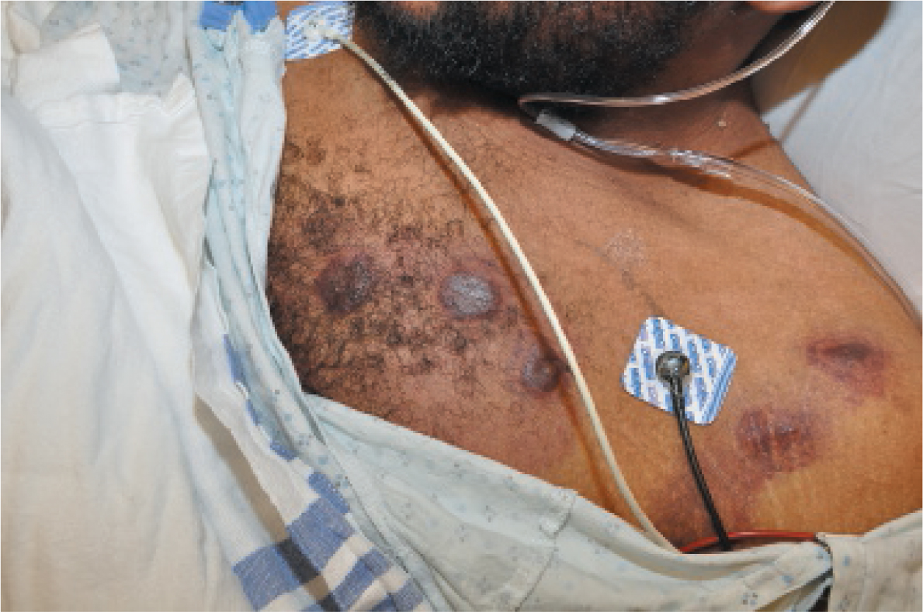
H I V/AIDS (2 of 4)
Kaposi’s sarcoma. © Edward T. Dickinson, M D
Notes:
Covers Objective: 24.3

Slide 37
H I V/AIDS (3 of 4)
Routes of transmission
  Shared needles
  Unprotected sex between men
  Any penetrative activity involving blood and semen
  During delivery or breastfeeding from mother to newborn
Notes:
Covers Objective: 24.3

Slide 38
H I V/AIDS (4 of 4)
Antiviral medications reduce and suppress H I V viral load.
Prevention
  Standard Precautions
  Public measures to reduce shared needle use and promote condom use
Following significant exposure to blood or other body fluids
  Wash the area.
  Consult a health care provider.
Notes:
Covers Objective: 24.3
Point to Emphasize: Panic about HIV persists in some areas. To help reduce fear about HIV/AIDS, the EMT may explain simple precautions to prevent HIV infection and treat all patients with respect and courtesy.
Discussion Topic: Describe the transmission, prevention, and treatment of HIV/AIDS.
Critical Thinking Discussion: Why is there a lingering stigma against patients with AIDS? What can you do as an EMT to reduce this stigma?

Slide 39
Influenza (1 of 3)
Common viral illness
Signs and symptoms
  Fever
  Nonproductive cough
  Severe muscle aches
  Sore throat
  Headache
  Severe weakness
Notes:
Covers Objective: 24.3
Point to Emphasize: Influenza is a common viral illness that tends to occur at certain times of the year but can occur at any time. It is caused by more than two dozen viruses.
Discussion Topic: Describe the patient assessment findings that would indicate the presence of influenza.

Slide 40
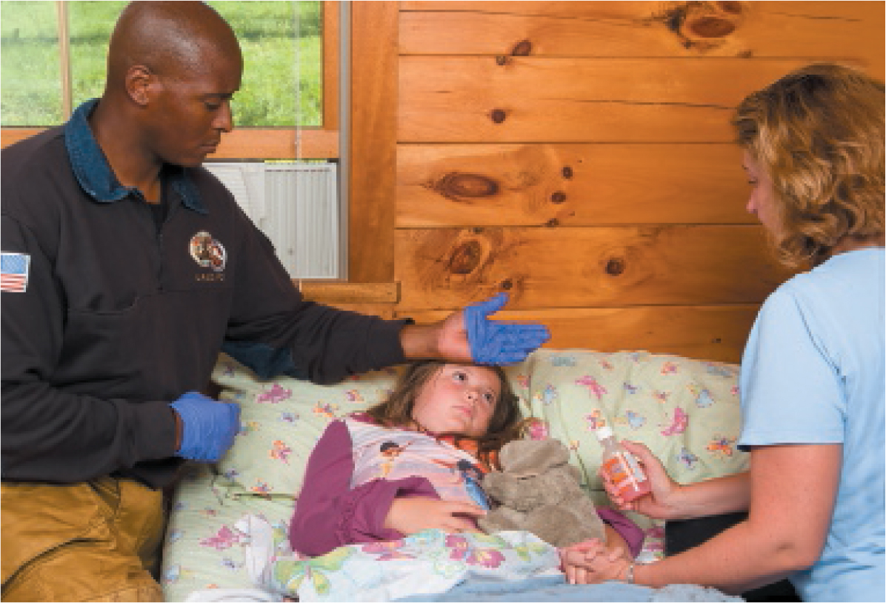
Influenza (2 of 3)
Child with influenza showing signs of a fever.
Notes:
Covers Objective: 24.3

Slide 41
Influenza (3 of 3)
Spread by droplets or direct contact
Antiviral medications lessen the severity and shorten but must be taken within 48 hours of symptom onset.
Prevention
  Hand hygiene
  Surgical masks
  Vaccination
Notes:
Covers Objective: 24.3
Point to Emphasize: Antiviral medications can be taken postexposure. When the CDC identifies a new strain of influenza, it is recommended that health care providers take respiratory precautions, including N-95 masks, until droplet precautions are confirmed to be sufficient. To date, standard surgical masks are sufficient for all forms of influenza. The populations more prone to influenza are the very young, the elderly, and patients with chronic conditions.
Discussion Topic: Describe the transmission, prevention, and treatment of influenza.

Slide 42
Croup (1 of 2)
Also known as laryngotracheobronchitis, caused by human parainfluenza virus (H P I V)
  Signs and symptoms
  Inflammation and swelling of larynx, trachea, and bronchi
  Children between 6 months and 3 years
    Most susceptible
    Present with history of upper respiratory infection that later produces characteristic seal bark cough.
    Symptoms often worse at night
Notes:
Covers Objective: 24.3
Point to Emphasize: Despite the resemblance of their names, parainfluenza and influenza are completely separate organisms and cause different signs and symptoms.
Discussion Topic: Describe the patient assessment findings that would indicate the presence of croup.
Critical Thinking Discussion: Patients with croup are usually young children. How does this affect your approach to assessment and treatment?

Slide 43
Croup (2 of 2)
Transmission by droplets from coughs or sneezes or that survive on objects
Assess child as for any patient with shortness of breath.
Prevention
  Hand hygiene
  Refrain from touching nose, eyes, and mouth.
Notes:
Covers Objective: 24.3
Point to Emphasize: Treatment for croup is symptomatic. There is no vaccine.
Discussion Topic: Describe the transmission, prevention, and treatment of croup.

Slide 44
Pertussis (Whooping Cough) (1 of 2)
Respiratory infection caused by Bordetella pertussis bacteria
Signs and symptoms
  Begins like a typical upper respiratory infection
  Worsens into fits of uninterrupted coughing followed by “whooping” sound on inspiration
Notes:
Covers Objective: 24.3
Point to Emphasize: Diagnosis involves of pertussis involves a cough for at least 2 weeks plus at least one of these: coughing paroxysms, inspiratory whooping, and/or post-tussive vomiting.
Discussion Topic: Describe the patient assessment findings that would indicate the presence of pertussis.

Slide 45
Pertussis (Whooping Cough) (2 of 2)
Spread by large droplets in air
Treatment with antibiotics
Prevention with vaccine
  Hand hygiene
  Refrain from touching nose, eyes, and mouth.
Notes:
Covers Objective: 24.3
Point to Emphasize: Postexposure, antibiotics are considered for women in the last 3 weeks of pregnancy and infants younger than 1 year old. Vaccinations are helpful in long term. There has been a major recurrence of pertussis. It is fatal in infants. Prevention in adults is the best way to prevent illness in the very young.
Discussion Topic: Describe the transmission, prevention, and treatment of pertussis.

Slide 46
Pneumonia (1 of 3)
Signs and symptoms
  Fever
  Chills
  Shortness of breath
  Tachypnea
  Pleuritic pain
  Productive cough
  Inflammation consolidated in part of lung on x-ray
  Potential febrile seizures in young children and infants
  Altered mental status common sign in elderly patients
Notes:
Covers Objective: 24.3
Point to Emphasize: Pneumonia is the result of infection by any one of a number of different microbes. This section focuses on pneumococcal pneumonia, one of the types an EMT is more likely to see, and which is caused by the bacterium Streptococcus pneumoniae.
Discussion Topic: Describe the patient assessment findings that would indicate the presence of pneumonia.
Critical Thinking Discussion: You suspect a patient has pneumonia. How does this affect your approach to the ABCs?

Slide 47
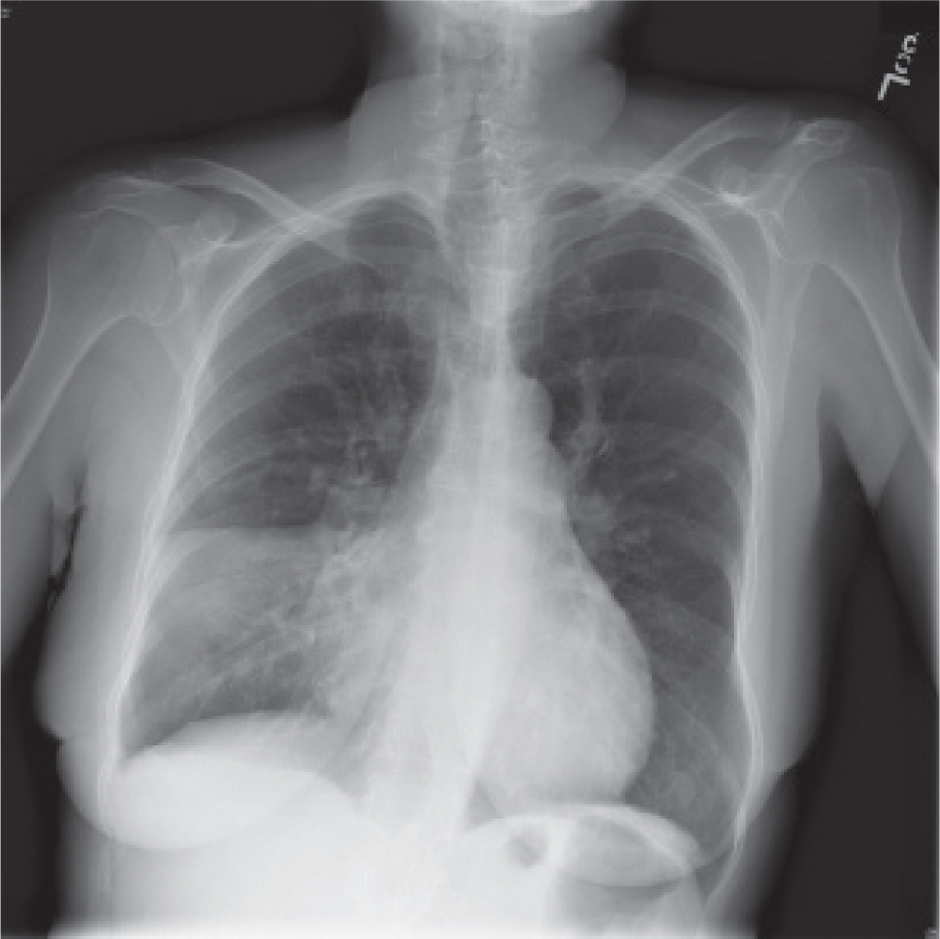
Pneumonia (2 of 3)
Chest X-ray showing inflammation in the lung. Note the area in the lower right lung that appears cloudy. This is where the pneumonia is located. © David Effron, M D
Notes:
Covers Objective: 24.3

Slide 48
Pneumonia (3 of 3)
Spread by droplets but requires close contact of several days
Treatment with antibiotics
Prevention
  Vaccination
  Hand hygiene
  Cough etiquette
Notes:
Covers Objective: 24.3
Point to Emphasize: Pneumonia has many different causes, including viral. It is a common cause of sepsis in patients at the extremes of age or with compromised immune systems.
Discussion Topic: Describe the transmission, prevention, and treatment of pneumonia.

Slide 49
Tuberculosis (1 of 2)
Caused by bacterium Mycobacterium tuberculosis
Signs and symptoms
  Cough (initially dry, later productive of purulent sputum)
  Fever
  Night sweats
  Weight loss
Notes:
Covers Objective: 24.3
Point to Emphasize: Latent TB is common in people who are exposed and means they have an infection but no symptoms.
Discussion Topic: Describe the patient assessment findings that would indicate the presence of tuberculosis.

Slide 50
Tuberculosis (2 of 2)
Spread by coughing, singing, or sneezing
Treatment with antibiotics
Prevention with vaccine
  High index of suspicion
  Airborne disease precautions including N-95 respirator
Notes:
Covers Objective: 24.3
Point to Emphasize: The EMT must report exposure to a TB-infected patient and follow agency procedures for evaluation by a qualified health care provider. TB is more common in settings where people with poor health are gathered. Patients with HIV are at higher risk.
Discussion Topic: Describe the transmission, prevention, and treatment of tuberculosis.
Critical Thinking Discussion: Discuss the importance of a high index of suspicion and use of appropriate PPE for patients with respiratory symptoms that could indicate a tuberculosis infection.

Slide 51
Meningitis (1 of 3)
Inflammation of meninges caused by bacterium Neisseria meningitidis
Signs and symptoms
  Abrupt onset of fever
  Nausea
  Vomiting
  Severe headache
  Nuchal rigidity
  Photophobia
  Possible petechiae
Notes:
Covers Objective: 24.3
Point to Emphasize: Meningitis is an inflammation of the meninges, the membranes that surround the brain and spinal cord. There are a number of causes of this condition, but this section will focus on meningococcal meningitis. Meningitis has numerous potential complications, including shock, multiple-organ failure, blood-clotting problems, brain damage, deafness, and loss of one or more limbs.
Discussion Topic: Describe the patient assessment findings that would indicate the presence of meningitis.

Slide 52
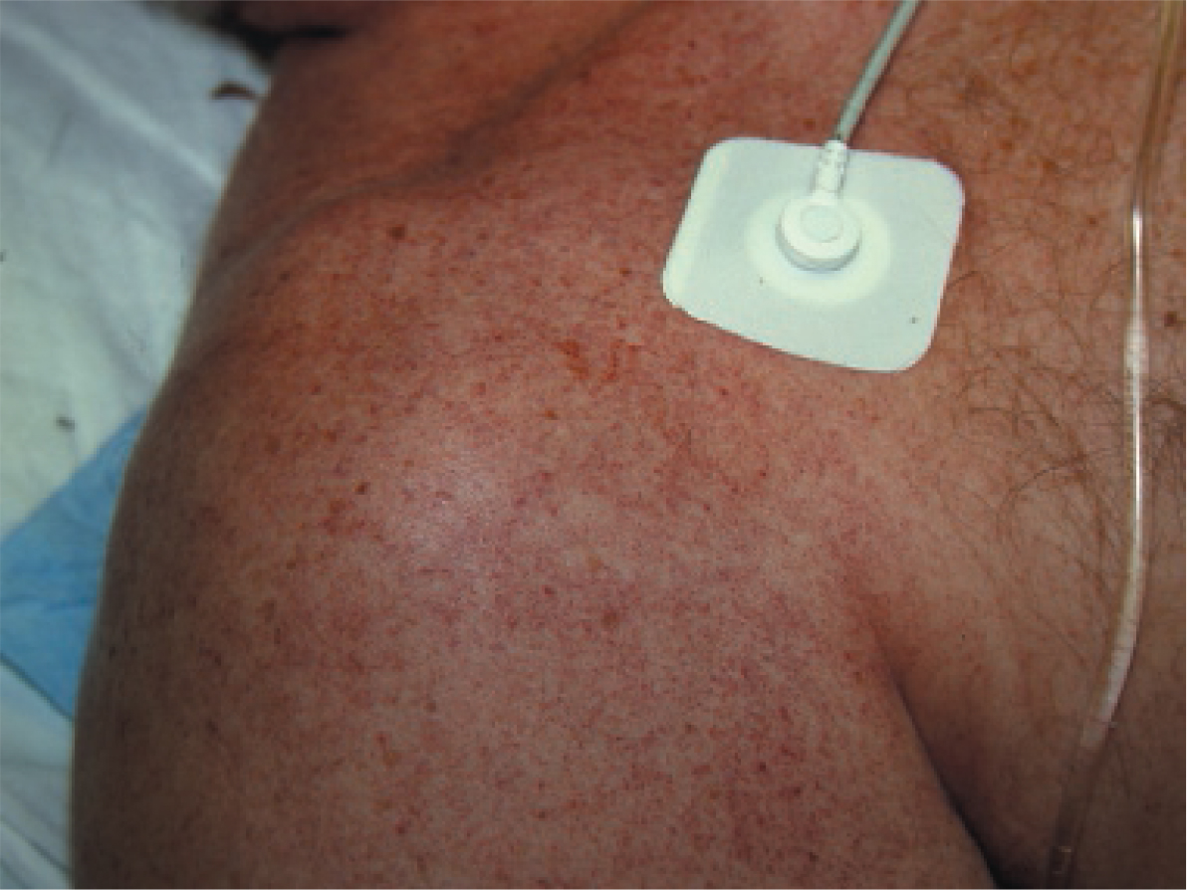
Meningitis (2 of 3)
Petechial rash associated with meningitis.© Edward T. Dickinson, M D
Notes:
Covers Objective: 24.3

Slide 53
Meningitis (3 of 3)
Spread by direct contact
Treatment with antibiotics for meningococcal meningitis
Prevention by vaccination
Notes:
Covers Objective: 24.3
Point to Emphasize: Treatment for meningitis is supportive. Standard Precautions should be sufficient protection against exposure, but some more virulent and communicable forms may require prophylactic antibiotics.
Discussion Topic: Describe the transmission, prevention, and treatment of meningitis.

Slide 54
Sexually Transmitted Infections (1 of 2)
Viral S T I s
  H I V
  Hepatitis A, B, and C
  Genital herpes
  Human papilloma virus (H P V)
Bacterial S T I s
  Chlamydia
  Gonorrhea
  Syphilis
Notes:
Covers Objective: 24.3
Knowledge Application: Have students research and then describe the cause, presentation, and treatment for specific STIs.

Slide 55
Sexually Transmitted Infections (2 of 2)
Prevention
  Condoms
  Vaccination
S T Is not a common reason for patients to access 911 emergency services except for women who develop pelvic inflammatory disease (P I D).
  Most commonly caused by gonorrhea or chlamydia
  Causes severe lower abdominal pain that may or may not be associated with increased vaginal discharge
Notes:
Covers Objective: 24.3
Discussion Topic: Discuss an EMT’s potential role in public education efforts to prevent the spread of STIs.
Knowledge Application: Have students work in small groups to list the characteristics of specific STIs. Other students guess each group’s STI from hearing its characteristics.

Slide 56
Diseases Carried by Ticks
Tick bites transmit Lyme disease.
Most patients display rash (erythema migrans) within a week that looks like a bull’s-eye.
Treatment with antibiotics
Prevention in backcountry rescue and wooded areas
  Cover arms and legs.
  Check frequently for ticks.
  Remove ticks with tweezers.
Notes:
Covers Objective: 24.3
Points to emphasize: Other diseases such as Rocky Mountain Spotted Fever are carried by ticks. If you live or work in an area with ticks, consider becoming familiar with which diseases are more common in your area.
Discussion Topic: Discuss the potential complications of Lyme disease.

Slide 57
Emerging and Newly Recognized Infectious Diseases (1 of 3)
In some cases, antibiotics that used to be effective no longer work.
  Result of bacteria developing resistance
  Patients may get infections that are no longer treatable, and patients may die from diseases that were easily cured a few years ago.
  Use Standard Precautions to protect yourself, your co-workers, and other patients.
Notes:
Covers Objective: 24.4
Point to Emphasize: Increasing bacterial resistance has led to several conditions that EMTs deal with regularly, including methicillin-resistant Staphylococcus aureus (MRSA), vancomycin-resistant Enterococcus
(VRE), and Clostridium difficile (C. diff). A less common but still important example is multidrug-resistant tuberculosis (MDR-TB). As bacteria evolve, this list will grow.
Discussion Topic: Discuss the reasons why some bacteria are developing resistance to antibiotics.

Slide 58
Emerging and Newly Recognized Infectious Diseases (2 of 3)
Recently emerged or newly discovered diseases
  H I V/AIDS
  Severe acute respiratory syndrome (S A R S)
  Ebola virus disease (E V D)
  Middle East respiratory syndrome (M E R S-C o V)
  Zika virus
Notes:
Covers Objective: 24.4

Slide 59
Emerging and Newly Recognized Infectious Diseases (3 of 3)
When the next outbreak occurs
  Remain calm.
  Understand that news reports may exaggerate the extent of the number of ill or the ease with which the disease is spread.
  Follow the recommendations of the C D C and your local health department.
Notes:
Covers Objective: 24.4
Points to Emphasize: When new infections have emerged, several common events occur. Reports of outbreaks led to panic or near-panic states. The CDC, the World Health Organization, and other national and international agencies worked diligently to discover the microbes that cause the diseases, effective treatment for them, and how to prevent their spread. This information was disseminated to health care providers and institutions so that it could be implemented. Health care workers implemented appropriate steps and significantly reduced the number of people who became infected and ill.
Critical Thinking Discussion: If you were watching the news and saw a story about an outbreak of a new communicable disease in a nearby city, what would you do as an EMT in response?

Slide 60
Chapter Review

Slide 61
Chapter Review (1 of 4)
Sepsis is a life-threatening condition resulting from an abnormal and counterproductive response by the body that causes damage to tissues and organs. Septic shock occurs when these changes result in shock and hypotension that does not respond to intravenous fluids.
Common sources of infections that lead to sepsis include the pulmonary system, gastrointestinal system, genitourinary system, and central nervous system.

Slide 62
Chapter Review (2 of 4)
The S I R S criteria are far from perfect, but may help in detecting sepsis. In a patient with an infection (either confirmed or suspected), look for:
  Temperature lower than 96.8° F (36° C) or higher than 101° F (38.3° C)
  Heart rate over 90
  Respiratory rate greater than 20
  Systolic blood pressure less than 90 m m H g
  New-onset altered mental status or worsened mental status compared with normal

Slide 63
Chapter Review (3 of 4)
In the septic patient who does not need resuscitation, the most important thing you can do is notify the receiving hospital of a sepsis alert.
When evaluating a patient with a fever or other signs and symptoms suggestive of an infectious disease, ask the patient about recent travel.

Slide 64
Chapter Review (4 of 4)
The most important and effective ways to avoid getting an infectious disease on an E M S call are to make sure you have the appropriate vaccinations and to use Standard Precautions.
When new (or newly rediscovered) infectious disease outbreaks occur, follow the advice of the Centers for Disease Control and Prevention and your local health department.

Slide 65
Remember
Determine whether a patient potentially has sepsis using S I R S criteria and alert the E D staff if you have an index of suspicion for sepsis.
Know what personal protective equipment you need to wear to prevent infection from different infectious diseases.

Slide 66
Questions to Consider (1 of 2)
What are the S I R S criteria?
What body systems are the most common sources of sepsis?
What is the difference between the incubation period and the period in which a disease is transmissible?
Notes:
Talking Points: Although patients with serious infections usually have a fever, some patients with sepsis are actually slightly hypothermic, so do not ignore the possibility of sepsis in a patient with a lower-than-normal temperature. Unfortunately, the SIRS criteria are fairly vague, and many patients without sepsis will have two or more abnormal findings, as in the case of trauma patients. Similarly, there are a number of patients with sepsis who will not have two or more abnormal findings.

Slide 67
Questions to Consider (2 of 2)
Have you had the vaccinations you need to take care of patients without getting sick yourself?
What are the differences in transmission routes, symptoms, severity of symptoms, prevention, and treatment among hepatitis A, B, and C?
What are the symptoms of meningococcal meningitis? What is unusual about the rash?
Notes:
Talking Points: Get the appropriate vaccinations and always use Standard Precautions, including appropriate use of disposable gloves, eyewear, face protection, and respiratory protection. When assessing patients with an infectious disease, remember to ask them if they have travelled recently (and if they got the recommended vaccinations if they did). Also remember to be empathetic and respond appropriately to how the patient feels.

Slide 68
Critical Thinking
A 2-year-old girl wakes her parents one night with a very loud cough that sounds like a seal barking. They have never experienced anything like this before and are near panic. How should you deal with this situation?
Notes:
Talking Points: A cough like a seal barking is characteristic of croup, which tends to get worse at night. Although the volume and nature of the cough is alarming, you should reassure the parents that the cough isn’t as bad as it sounds. Taking Standard Precautions, provide supportive treatment, and assess the child for shortness of breath. Remember that ALS providers may be able to nebulize epinephrine, which may reduce swelling in the airway, and to administer a steroid, which will further reduce inflammation. A few patients with croup have enough inflammation and swelling of their airways to be admitted to a hospital, so look for signs of hypoxia.

Slide 69

Copyright
This work is protected by United States copyright laws and is provided solely for the use of instructors in teaching their courses and assessing student learning. Dissemination or sale of any part of this work (including on the World Wide Web) will destroy the integrity of the work and is not permitted. The work and materials from it should never be made available to students except by instructors using the accompanying text in their classes. All recipients of this work are expected to abide by these restrictions and to honor the intended pedagogical purposes and the needs of other instructors who rely on these materials.

Slide 70
Appendix 1
The three stages are as follows.
Infection or local
Sepsis or Systemic
Septic shock or systemic with hypotension
Arrowheads extend downward from one stage to another.
In infection stage, microbes multiply. The body mounts a normal immune response, usually including an increase in white blood cells. In sepsis, the body produces lactic acid and other chemicals. The ability to produce white blood cells may be limited or exhausted. In septic shock, lactic acid and other chemicals accumulate in the bloodstream, causing vasodilation and increased capillary permeability (leaky capillaries). This leads to hypotension.
Return to presentation

