Slide 1

Emergency Care
Fourteenth Edition
Chapter 19
Respiratory Emergencies
Slides in this presentation contain hyperlinks. JAWS users should be able to get a list of links by using INSERT+F7
Copyright © 2021, 2016, 2012 Pearson Education, Inc. All Rights Reserved
Notes:
If this PowerPoint presentation contains mathematical equations, you may need to check that your computer has the following installed:
1) MathType Plugin
2) Math Player (free versions available)
3) NVDA Reader (free versions available)

Slide 2
Topics
Respiration
Breathing Difficulty
Respiratory Conditions
The Prescribed Inhaler
The Small-Volume Nebulizer
Notes:
Planning Your Time: Plan 150 minutes for this chapter.
Respiration (20 minutes)
Breathing Difficulty (45 minutes)
Respiratory Conditions (55 minutes)
The Prescribed Inhaler (15 minutes)
The Small-Volume Inhaler (15 minutes)
Note: The total teaching time recommended is only a guideline.
Core concepts:
How to identify adequate breathing
How to identify inadequate breathing
How to identify and treat a patient with breathing difficulty
Use of continuous positive airway pressure (CPAP) to relieve difficulty breathing
Use of a prescribed inhaler and how to assist a patient with one
Use of a prescribed small-volume nebulizer and how to assist a patient with one

Slide 3
Respiration
Back to Topics
Notes:
Teaching Time: 20 minutes
Teaching Tips: Review the lessons of previous chapters. Add assessment to physiology and pathophysiology as previously discussed. Identification of inadequate breathing is one of the most important lessons that you will teach. Spend time here to ensure comprehension. Teach that inadequate breathing means intervention. Prepare students to face a difficult decision that requires action. This lesson will apply to many others and, in particular, to the scenario and simulation environment. Strictly enforce good artificial ventilation practices and integrate assessment of artificial ventilation in the scenario setting.

Slide 4
Respiratory Anatomy and Physiology (1 of 4)
To move air, the respiratory system changes pressure within the chest cavity.
  Negative pressure is used to move air in and positive pressure is used to move air out.
  These changes in pressure are generated by contraction and relaxation of the respiratory system muscles.
Notes:
Covers Objective: 19.1
Points to Emphasize: Review Chapter 6, “Anatomy and Physiology.” Make sure you are familiar with the following structures of the respiratory system: nose, mouth, oropharynx, nasopharynx, epiglottis, trachea, cricoid cartilage, larynx, bronchi, lungs, alveoli, and diaphragm.
Discussion Topic: Describe the components of the respiratory system.

Slide 5
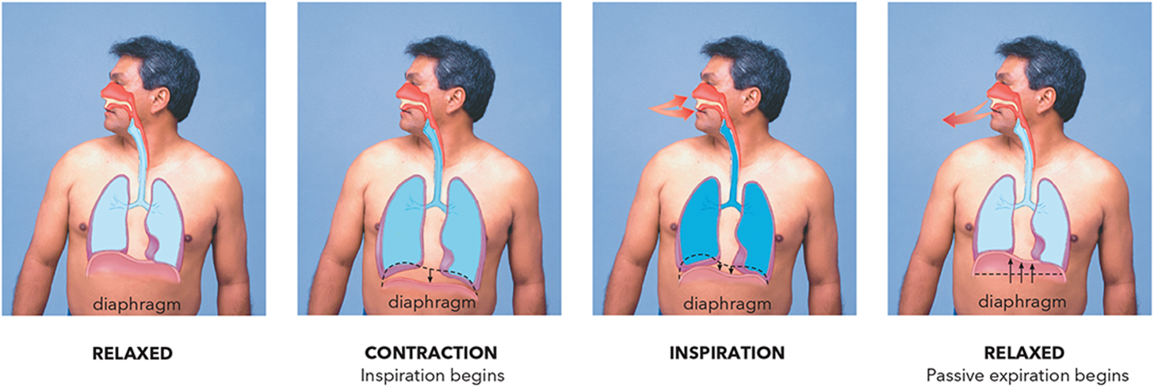
Respiratory Anatomy and Physiology (2 of 4)
For long description, see slide 111: Appendix 1
The process of respiration.
Notes:
Covers Objective: 19.1

Slide 6
Respiratory Anatomy and Physiology (3 of 4)
Inspiration
  Active process
    Uses muscle contraction to increase size of chest cavity
  Intercostal muscles and diaphragm contract.
  Diaphragm lowers; ribs move upward and outward.
  Air is pulled into lungs.
Notes:
Covers Objective: 19.1
Point to Emphasize: Contraction of chest muscles and the diaphragm changes pressures in the chest to enable the movement of air.

Slide 7
Respiratory Anatomy and Physiology (4 of 4)
Expiration
  Passive process
  Rib muscles and diaphragm relax.
  Size of chest cavity decreases.
  Air flows out of lungs.
Notes:
Covers Objective: 19.1
Discussion Topic: Describe the physiology of respiration.

Slide 8
Adequate Breathing (1 of 2)
Breathing sufficient to support life
Signs
  Generally normal mental status and moving air when breathing
  Ability to speak relatively normally without having to catch their breath
  Normal color and oxygen saturation typically in normal range
Notes:
Covers Objective: 19.2
Point to Emphasize: Adequate breathing is breathing that is sufficient to support life. Normal rate, rhythm, and quality are typical signs of adequate breathing.

Slide 9
Adequate Breathing (2 of 2)
May be determined by observing rate, rhythm, quality
  12 to 20 breaths/minute for adult
  18 to 30 breaths/minute for school-age child
  30 to 60 breaths/minute for infant
  Rhythm usually regular
  Breath sounds normally present and equal
Notes:
Covers Objective: 19.2
Discussion Topic: Describe the assessment findings of adequate respiration.

Slide 10
Inadequate Breathing (1 of 2)
Breathing not sufficient to support life.
Signs
  Rate out of normal range
    Too fast
    Slowing and irregular
  Inability to speak
  Silent chest
Notes:
Covers Objective: 19.2
Point to Emphasize: Inadequate breathing is breathing that is not sufficient to support life. An abnormally fast rate, irregular rhythm, and poor air movement are signs that point to inadequate breathing.

Slide 11
Inadequate Breathing (2 of 2)
Signs
  Low oxygen saturation despite supplemental oxygen
  Agonal respirations
  Irregular rhythm
  Diminished or absent lung sounds
  Poor tidal volume
Notes:
Covers Objective: 19.2
Point to Emphasize: Inadequate breathing is breathing that is not sufficient to support life. An abnormally fast rate, irregular rhythm, and poor air movement are signs that point to inadequate breathing.
Class Activities: Discuss the signs and symptoms of a variety of patients with difficulty breathing. Work with the class to develop strategies to identify rapidly those patients in respiratory failure. Assign a take-home assignment. List signs and symptoms; then have students identify respiratory distress or respiratory failure.

Slide 12
Pediatric Note (1 of 2)
Structure of an infant’s and child’s airway differs from that of an adult.
  Smaller airway easily obstructed
  Proportionately larger tongues
  Smaller, softer, more flexible trachea
  Less developed, less rigid cricoid cartilage
  Heavy dependence on diaphragm for respiration
Notes:
Covers Objective: 19.2
Point to Emphasize: Assessment of breathing adequacy must be adjusted to account for the anatomical differences of pediatric patients.

Slide 13
Pediatric Note (2 of 2)
Signs of inadequate breathing in infants and children
  Nasal flaring
  Grunting
  Seesaw breathing
  Retractions
Notes:
Covers Objective: 19.2
Knowledge Application: Use multimedia graphics to present patients in respiratory distress. Discuss the classification of inadequate breathing and have students defend their decisions.

Slide 14
Patient Care (1 of 4)
Inadequate Breathing
  Assisted ventilation with supplemental oxygen
    Pocket face mask with supplemental oxygen
    Two-rescuer bag-valve mask with supplemental oxygen
    One-rescuer bag-valve mask with supplemental oxygen
Notes:
Covers Objective: 19.3
Point to Emphasize: Care for inadequate breathing must include ventilatory support with supplemental oxygen.
Discussion Topic: Describe the treatment steps for dealing with inadequate respiration.
Knowledge Application: Use programmed patients to simulate patients in respiratory distress. Have groups of students assess and determine adequacy of breathing and simulate treatment.

Slide 15
Adequate and Inadequate Artificial Ventilation (1 of 2)
Chest rise and fall should be visible with each breath.
Adequate artificial ventilation rates
  10 to 12 breaths per minute for adults
  12 to 20 breaths per minute for infants and children
Notes:
Covers Objective: 19.3

Slide 16
Adequate and Inadequate Artificial Ventilation (2 of 2)
Increasing pulse rates can indicate inadequate artificial ventilation in adults.
Decreasing pulse rates can indicate inadequate artificial ventilation in pediatric patients.
Notes:
Covers Objective: 19.3
Discussion Topic: Describe the process of assessing the adequacy of artificial ventilation.
Critical Thinking Discussion: What role does reassessment play when treating a patient with adequate respirations? How can your initial findings change?

Slide 17
Think About It 1
How might you recognize the progression from adequate breathing to inadequate breathing in the assessment of your patient?
How might your patient change during this transition?
Notes:
Covers Objective: 19.3
Talking Points: When a patient has adequate breathing, their rhythm will be regular and breath sounds will be normally present and equal. As the patient progresses to inadequate breathing, you will notice that their breathing rate falls outside of the normal range, their breathing becomes irregular, diminished or absent lung sounds, and poor tidal volume.

Slide 18
Breathing Difficulty
Back to Topics
Notes:
Teaching Time: 45 minutes
Teaching Tips: This lesson lends itself to multimedia graphics and audio. Use these tools to reinforce and add reality to an otherwise static lecture. Integrate audio clips of lung sounds (or use high fidelity simulation) to add realism. There is no substitute for actual lung sounds. Give students every opportunity to practice this skill. This lesson lends itself well to multimedia presentations. Very good web-based graphics exist. Consider using these types of examples to underscore your lecture. Expand upon the initial lesson on inadequate breathing. Put it now in the context of the larger respiratory assessment.

Slide 19
Breathing Difficulty (1 of 14)
Patient’s subjective perception
Feeling of labored or difficult breathing
Amount of distress felt may or may not reflect actual severity of condition.
Notes:
Covers Objective: 19.4
Points to Emphasize: For the patient, difficulty breathing is a subjective perception. The amount of distress that the patient feels may or may not reflect the actual severity of the condition. Further assessment of a patient in respiratory distress includes observation, auscultation, and evaluation of vital signs. Assessment of breathing adequacy is an important element of assessing any patient with difficulty breathing.

Slide 20
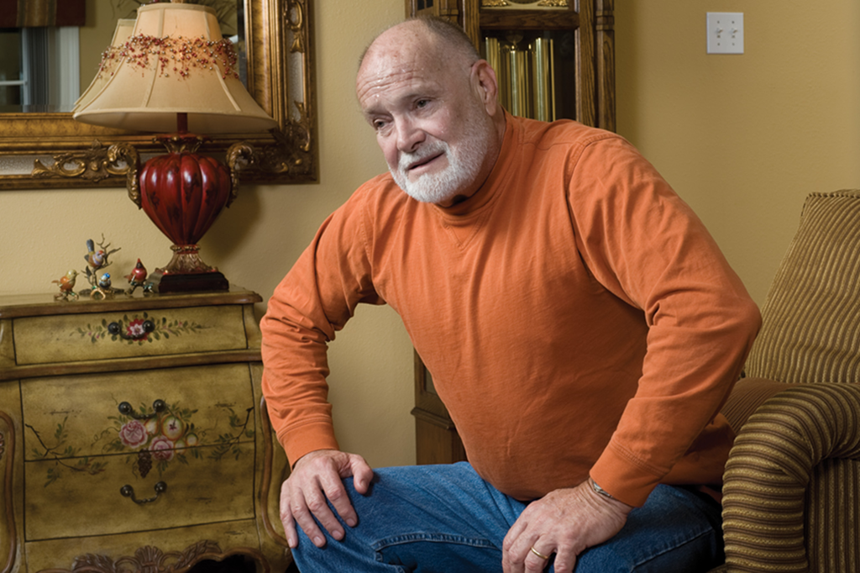
Breathing Difficulty (2 of 14)
1. Assess to be sure that the patient meets the criteria for C P A P.
Notes:
Covers Objective: 19.4

Slide 21
Breathing Difficulty (3 of 14)
Onset
  When did the difficulty breathing begin?
Provocation
  What were you doing when this came on?
Quality
  Do you have a cough? Are you bringing anything up with it?
Notes:
Covers Objective: 19.4
Point to Emphasize: OPQRST is a memory aid that can be very useful for gathering a history from a patient in respiratory distress.

Slide 22
Breathing Difficulty (4 of 14)
Radiation
  Do you have pain or discomfort anywhere else in your body? Does it seem to spread to any other part of your body?
Notes:
Covers Objective: 19.4

Slide 23
Breathing Difficulty (5 of 14)
Severity
  On a scale of 1 to 10, how bad is your breathing trouble?
Time
  How long have you had this feeling?
Notes:
Covers Objective: 19.4
Discussion Topic: Describe how the mnemonic OPQRST can be used to assess a respiratory patient.

Slide 24
Breathing Difficulty (6 of 14)
Observing
  Altered mental status
  Unusual anatomy
    Barrel chest
  Patient’s position
    Tripod position
    Sitting with feet dangling, leaning forward
Notes:
Covers Objective: 19.4
Point to Emphasize: Further assessment of a patient in respiratory distress includes observation, auscultation, and evaluation of vital signs.
Knowledge Application: Have students conduct a respiratory assessment on the person seated next to them.

Slide 25
Breathing Difficulty (7 of 14)
Observing
  Work of breathing
    Retractions
    Use of accessory muscles
    Flared nostrils
    Pursed lips
    Number of words patient can say without stopping
Notes:
Covers Objective: 19.4

Slide 26
Breathing Difficulty (8 of 14)
Observing
  Pale, cyanotic, or flushed skin
  Pedal edema
  Sacral edema
  Oxygen saturation, or S p O₂, reading less than 95 percent on the pulse oximeter
Notes:
Covers Objective: 19.4

Slide 27
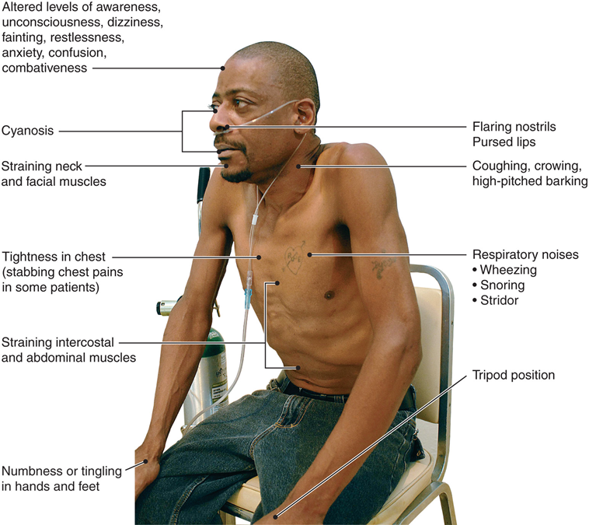
Breathing Difficulty (9 of 14)
For long description, see slide 112: Appendix 2
Signs and symptoms of breathing difficulty.
© Ray Kemp/911 Imaging
Notes:
Covers Objective: 19.4

Slide 28
Breathing Difficulty (10 of 14)
Observing
  Noisy breathing
    Audible wheezing (heard without stethoscope)
    Gurgling
    Snoring
    Stridor
    Coughing
Notes:
Covers Objective: 19.4

Slide 29
Breathing Difficulty (11 of 14)
Auscultating
  Lung sounds on both sides during inspiration and expiration
Notes:
Covers Objective: 19.4
Discussion Topic: Describe the correct locations for assessing lung sounds.
Class Activity: Ask students to listen to each other's lung sounds. Have students practice auscultation of lung sounds on the student next to them.

Slide 30
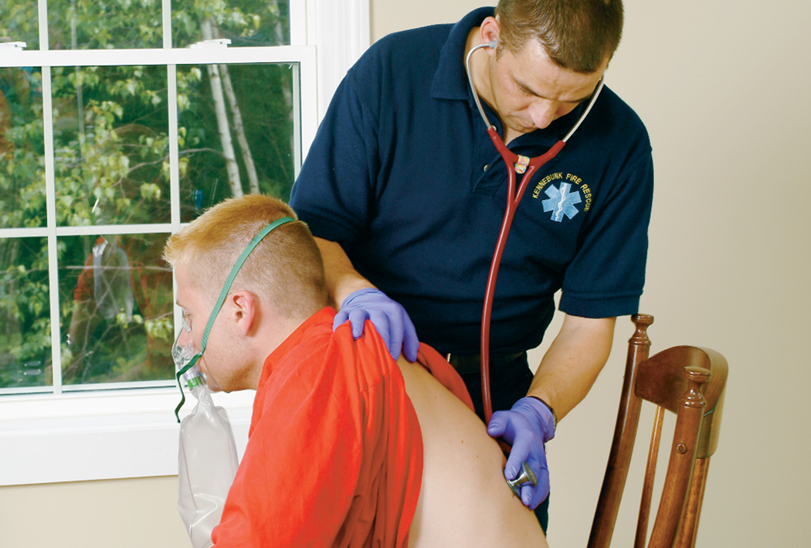
Assessment: Auscultation
6. Reassess the patient’s level of distress and vital signs.
Notes:
Covers Objective: 19.4
Discussion Topic: Describe the correct locations for assessing lung sounds.

Slide 31
Breathing Difficulty (12 of 14)
Auscultating
  Wheezes
    High-pitched sounds created by air moving through narrowed air passages
  Crackles
    Fine crackling or bubbling sound heard on inspiration and caused by fluid in alveoli or by opening of closed alveoli
Notes:
Covers Objective: 19.4

Slide 32
Breathing Difficulty (13 of 14)
Auscultating
  Rhonchi
    Lower-pitched sounds resembling snoring or rattling, caused by secretions in larger airways
  Stridor
    High-pitched, upper-airway sounds indicating partial obstruction of trachea or larynx
Notes:
Covers Objective: 19.4
Discussion Topic: Describe the most common lung sounds and their etiologies.
Knowledge Application: Assign 20 lung sound evaluations as homework. Ask students to document and describe the assessments in a journal.
Class Activity: Have students work in small groups. Assign each group an abnormal lung sound. Have the group research and discuss how the sound is generated and associated conditions.
Critical Thinking Discussion: Children often will present with a condition referred to as "silent chest." In this case, what is the significance of hearing no lung sounds at all?

Slide 33
Breathing Difficulty (14 of 14)
Evaluating vital sign changes, which may include:
  Increased or decreased pulse rate
  Changes in breathing rate
  Changes in breathing rhythm
  Hypertension or hypotension
Notes:
Covers Objective: 19.4

Slide 34
Patient Care (2 of 4)
Breathing difficulty
  Assure adequate ventilations.
  If breathing is inadequate, begin artificial ventilation.
  If breathing is adequate, use a nonrebreather mask at 15 liters per minute or a nasal cannula at 6 liters per minute.
Notes:
Covers Objective: 19.5

Slide 35
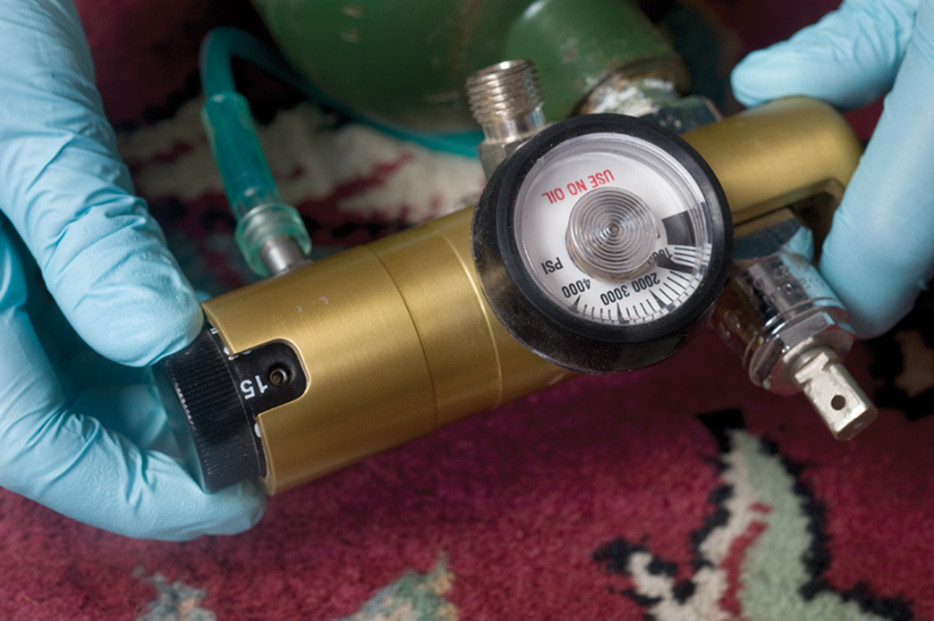
Patient Care (3 of 4)
4. Use settings as defined in your protocols.
Notes:
Covers Objective: 19.5

Slide 36
Patient Care (4 of 4)
Breathing difficulty
  Place patient in position of comfort.
  Administer prescribed inhaler.
  Administer continuous positive airway pressure (C P A P).
Notes:
Covers Objective: 19.5
Discussion Topic: Describe the key elements of care for a patient with a respiratory complaint.

Slide 37
Continuous Positive Airway Pressure (C P A P) (1 of 8)
Continuous positive airway pressure (C P A P) is a form of noninvasive positive pressure ventilation consisting of a mask and a means of blowing oxygen or air into the mask.
  Blowing oxygen or air continuously at low pressure into airway prevents alveoli from collapsing.
  Can prevent fluid from entering the alveoli in pulmonary edema
Notes:
Covers Objective: 19.5

Slide 38
Continuous Positive Airway Pressure (C P A P) (2 of 8)
Common uses
  Pulmonary edema
  Drowning
  Asthma and C O P D
  Respiratory failure in general
Notes:
Covers Objective: 19.5

Slide 39
Continuous Positive Airway Pressure (C P A P) (3 of 8)
Contraindications
  Severely altered mental status
  Lack of normal, spontaneous respiratory rate
  Inability to sit up
  Hypotension/shock
Notes:
Covers Objective: 19.5

Slide 40
Continuous Positive Airway Pressure (C P A P) (4 of 8)
Contraindications
  Nausea and vomiting
  Chest trauma
  Shock
  Upper G I bleeding or recent gastric surgery
  Conditions preventing good mask seal
Notes:
Covers Objective: 19.5

Slide 41
Continuous Positive Airway Pressure (C P A P) (5 of 8)
Side effects
  Hypotension
  Pneumothorax
  Increased risk of aspiration
  Drying of corneas
Notes:
Covers Objective: 19.5

Slide 42
Continuous Positive Airway Pressure (C P A P) (6 of 8)
Explain procedure to patient.
Start with low-level C P A P.
Notes:
Covers Objective: 19.5

Slide 43
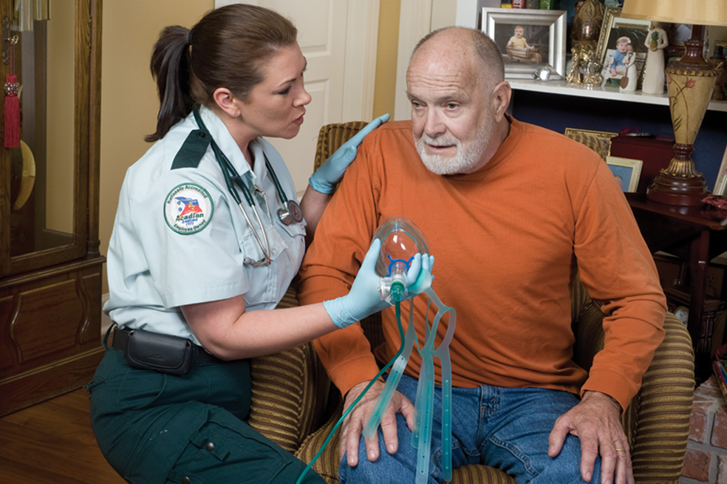
Patient Care: Using C P A P 1
2. Explain the device to the patient. The mask and snug seal may initially cause the patient to feel smothered and anxious.
Notes:
Covers Objective: 19.5

Slide 44
Continuous Positive Airway Pressure (C P A P) (7 of 8)
Reassess patient’s mental status, vital signs, and dyspnea level frequently.
Raise C P A P level if no relief within a few minutes.
Notes:
Covers Objective: 19.5

Slide 45
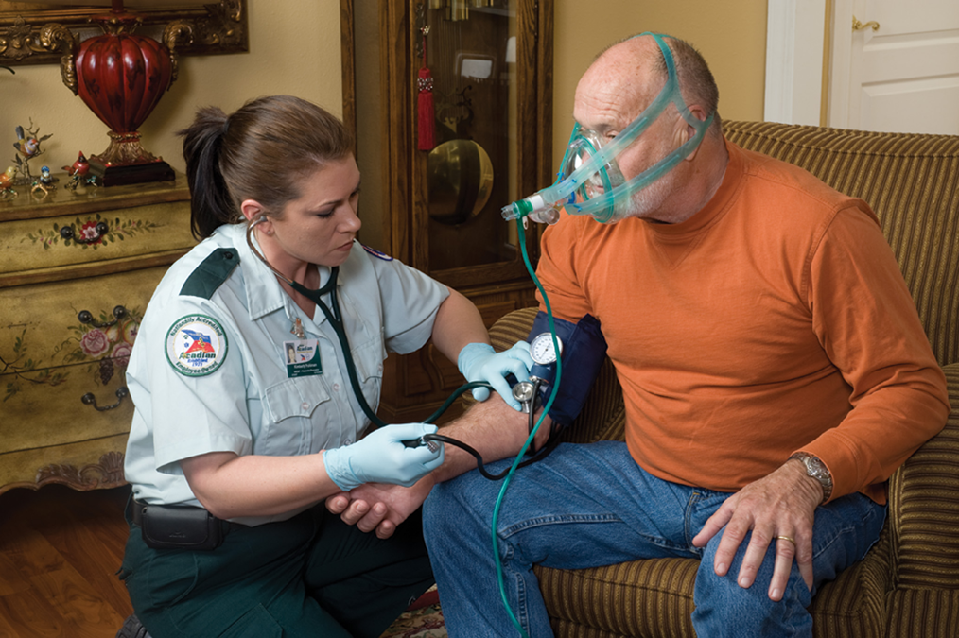
Patient Care: Using C P A P 2
5. Reassess and monitor the patient.
Notes:
Covers Objective: 19.5

Slide 46
Continuous Positive Airway Pressure (C P A P) (8 of 8)
If patient deteriorates, remove C P A P and begin ventilating with bag mask.
Notes:
Covers Objective: 19.5
Discussion Topic: Describe the indications and use of CPAP for a patient in respiratory distress.

Slide 47
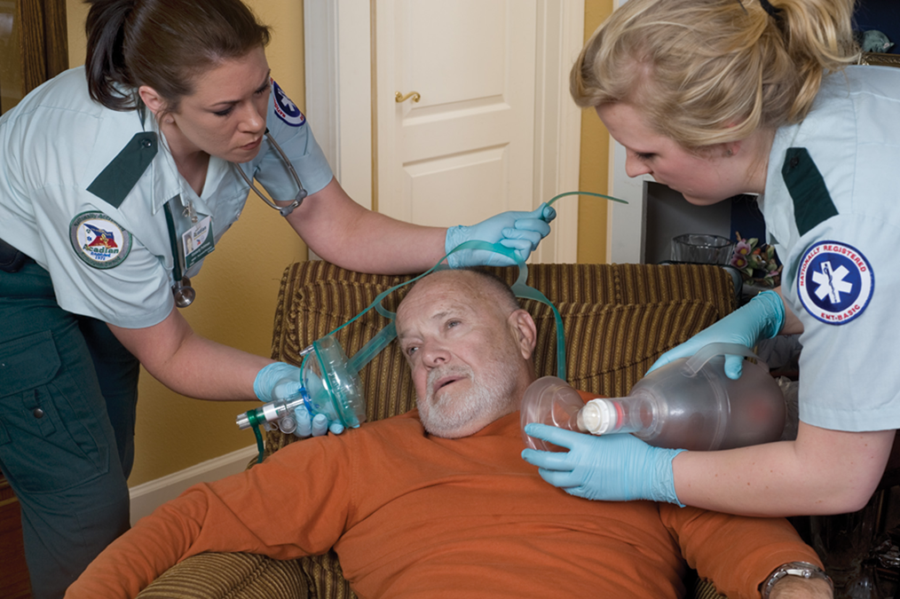
Patient Care: Using C P A P 3
6. Discontinue C P A P and ventilate the patient if breathing becomes inadequate.
Notes:
Covers Objective: 19.5

Slide 48
Respiratory Conditions
Back to Topics
Notes:
Teaching Time: 55 minutes
Teaching Tips: This lesson lends itself well to multimedia presentations. Very good web-based pathophysiology graphics exist. Show media-based examples of dysfunction to underscore your points. Use real-life examples. Adults grasp pathophysiology best when they can apply it to actual situations. For each subsection of disorder, discuss actual examples and move from theory to reality.

Slide 49
Chronic Obstructive Pulmonary Disease (C O P D) (1 of 3)
Broad classification of chronic lung diseases
  Includes emphysema, chronic bronchitis, and many undetermined respiratory illnesses
Overwhelming majority of cases are caused by cigarette smoking.
Notes:
Covers Objective: 19.6
Point to Emphasize: The term chronic obstructive pulmonary disease (COPD) refers to a variety of chronic lung diseases. EMS typically becomes involved when a secondary problem worsens the ongoing disease.

Slide 50
Chronic Obstructive Pulmonary Disease (C O P D) (2 of 3)
Chronic bronchitis
  Bronchiole lining inflamed
  Excess mucus produced
  Cells in bronchioles that normally clear away mucus accumulations are unable to do so.
Notes:
Covers Objective: 19.6

Slide 51
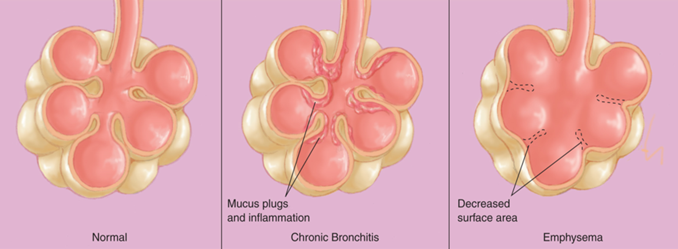
C O P D: Chronic Bronchitis
For long description, see slide 113: Appendix 3
Chronic bronchitis and emphysema are chronic obstructive pulmonary diseases.
Notes:
Covers Objective: 19.6

Slide 52
Chronic Obstructive Pulmonary Disease (C O P D) (3 of 3)
Emphysema
  Alveoli walls break down.
    Surface area for respiratory exchange is greatly reduced.
  Lungs lose elasticity.
  Results in air laden with carbon dioxide being trapped in lungs, reducing effectiveness of normal breathing
Notes:
Covers Objective: 19.6

Slide 53
Asthma (1 of 2)
Chronic disease with episodic exacerbations
During attack, small bronchioles narrow (bronchoconstriction); mucus is overproduced.
Results in small airway passages practically closing down, severely restricting air flow
Notes:
Covers Objective: 19.6

Slide 54
Asthma (2 of 2)
Airflow mainly restricted in one direction
Inhalation
  Expanding lungs exert outward pull, increasing diameter of airway and allowing air flow into lungs.
Exhalation
  Opposite occurs and air becomes trapped in lungs.
Notes:
Covers Objective: 19.6
Point to Emphasize: Asthma is a chronic disease that has episodic exacerbations. Narrowing of small bronchial tubes and overproduction of mucus impedes airflow and causes gas exchange problems.
Talking Points: Air trapping in an asthma attack requires the patient to exhale the air forcefully, producing the characteristic wheezing sounds associated with asthma.

Slide 55
Pulmonary Edema (1 of 5)
Abnormal accumulation of fluid in alveoli
Patients with congestive heart failure (C H F) may experience difficulty breathing because of this.
Notes:
Covers Objective: 19.6
Point to Emphasize: Pulmonary edema typically occurs due to a dysfunction of the left ventricle. Fluid accumulates in and around the alveoli and disrupts gas exchange.

Slide 56
Pulmonary Edema (2 of 5)
Pressure builds up in pulmonary capillaries.
Fluid crosses the thin barrier and accumulates in the alveoli.
Fluid occupying lower airways makes it difficult for oxygen to reach blood.
Patient experiences dyspnea.
Notes:
Covers Objective: 19.6
Discussion Topic: Describe the pathophysiology of pulmonary edema.

Slide 57
Pulmonary Edema (3 of 5)
Common signs and symptoms
  Dyspnea
  Anxiety
  Pale and sweaty skin
  Tachycardia
  Hypertension
  Respirations are rapid and labored.
  Low oxygen saturation
Notes:
Covers Objective: 19.6
Knowledge Application: Have students work in small groups. Assign one type of respiratory dysfunction to each group. Have the groups research their dysfunction and present their findings to the class. Findings should include a discussion of the ways in which their dysfunction interferes with normal function of the respiratory system.

Slide 58
Pulmonary Edema (4 of 5)
Common signs and symptoms
  In severe cases, gurgling may be heard even without auscultation every time the patient breathes, and on auscultation, crackles or sometimes wheezes may be audible.
  Patients may cough up frothy sputum, usually white, but sometimes tinged pink.
Notes:
Covers Objective: 19.6
Discussion Topic: Describe the patient assessment findings that would indicate the presence of pulmonary edema.

Slide 59
Pulmonary Edema (5 of 5)
Treatment
  Assess for and treat inadequate breathing.
  High-concentration oxygen
  If possible, keep patient’s legs in dependent position.
  C P A P may be used to push fluid back out of lungs and into capillaries.
Notes:
Covers Objective: 19.6

Slide 60
Think About It 2
Might it be possible for a patient to have multiple respiratory disorders?
Could a person with an underlying diagnosis of C O P D also have pulmonary edema?
Notes:
Covers Objective: 19.6
Talking Points: Yes it is possible for a patient to have multiple respiratory disorders. Yes a patient could have an underlying diagnosis of COPD and pulmonary edema.

Slide 61
Pneumonia (1 of 4)
Infection of one or both lungs caused by bacteria, viruses, or fungi
Results from inhalation of certain microbes
Microbes grow in lungs and cause inflammation.
Notes:
Covers Objective: 19.6
Point to Emphasize: Pneumonia occurs due to an infection in the lungs and can interfere with normal gas exchange.

Slide 62
Pneumonia (2 of 4)
Signs and symptoms
  Shortness of breath with or without exertion
  Coughing
  Fever and severe chills
  Chest pain (often sharp and pleuritic, worsening on inhalation)
Notes:
Covers Objective: 19.6

Slide 63
Pneumonia (3 of 4)
Signs and symptoms
  Headache
  Pale, sweaty skin
  Fatigue
  Confusion
Notes:
Covers Objective: 19.6

Slide 64
Pneumonia (4 of 4)
Treatment
  Care mostly supportive
  Assess for and treat inadequate breathing.
  If the patient is hypoxic, administer supplemental oxygen.
  In some E M S systems, E M Ts apply C P A P to these patients.
  In some cases, pneumonia can be severe enough to cause inadequate breathing, and will require artificial respirations.
Notes:
Covers Objective: 19.6
Discussion Topic: Describe the pathophysiology and treatment modalities of pneumonia.

Slide 65
Spontaneous Pneumothorax (1 of 3)
Lung collapses without injury or other obvious cause.
Higher risk for this condition
  Patients with C O P D and history of smoking at highest risk
  Tall, thin people
Notes:
Covers Objective: 19.6
Point to Emphasize: A pneumothorax occurs when air builds up in the space between the lung and the chest wall. The pressure can collapse the lung.
Talking Points: Spontaneous pneumothorax is usually the result of the rupture of a bleb, a small section of the lung that is weak. Once the bleb ruptures, the lung collapses and air leaks into the thorax.

Slide 66
Spontaneous Pneumothorax (2 of 3)
Signs and symptoms
  Sharp, pleuritic chest pain
  Shortness of breath
  Easily tired
  Low oxygen saturation, cyanosis
  Tachycardia
  Fast breathing
  Decreased or absent lung sounds on side with injured lung
  With worsening, J V D and hypotension
Notes:
Covers Objective: 19.6

Slide 67
Spontaneous Pneumothorax (3 of 3)
Treatment
  Contact A L S immediately if pneumothorax is suspected and patient has significant respiratory distress.
  Administer oxygen.
  C P A P contraindicated
  Transport for definitive care, as patients frequently require a small catheter or larger chest tube.
Notes:
Covers Objective: 19.6
Discussion Topic: Describe the pathophysiology and treatment modalities of spontaneous pneumothorax.

Slide 68
Pulmonary Embolism (1 of 3)
Blockage in blood supply to lungs
Commonly caused by deep vein thrombosis (D V T)
Common reasons for D V T
  Lying down or sitting in the same position for an extended period
  Having active cancer
  Having a limb immobilized in a cast
Notes:
Covers Objective: 19.6
Point to Emphasize: Pulmonary emboli are arterial obstructions in the pulmonary blood flow. These blockages can disrupt perfusion of lung tissue.

Slide 69
Pulmonary Embolism (2 of 3)
Signs and symptoms
  Sharp, pleuritic chest pain
  Shortness of breath
  Anxiety
  Coughing
  Tachycardia
  Tachypnea
  Lightheadedness/dizziness
  Pain and swelling in one or both legs
  Hypotension and cardiac arrest
Notes:
Covers Objective: 19.6

Slide 70
Pulmonary Embolism (3 of 3)
Treatment
  Difficult to differentiate in field
  Administer oxygen and treat patient like anyone else with shortness of breath.
  Transport to definitive care.
Notes:
Covers Objective: 19.6
Discussion Topic: Describe the pathophysiology and treatment modalities of a pulmonary embolism.
Critical Thinking Discussion: Finding the specific nature of the respiratory disorder often may not be possible. What common treatment steps can an EMT take, even when the diagnosis is unclear?

Slide 71
Epiglottitis (1 of 3)
Infection causing swelling around and above the epiglottis
In severe cases, swelling can cause airway obstruction.
Notes:
Covers Objective: 19.6

Slide 72
Epiglottitis (2 of 3)
Signs and symptoms
  Sore throat, painful or difficult swallowing
  Tripod position
  Sick appearance
  Muffled voice
  Fever
  Drooling
  Stridor
Notes:
Covers Objective: 19.6

Slide 73
Epiglottitis (3 of 3)
Treatment
  Keep patient calm and comfortable.
  Do not inspect throat.
  Administer high-concentration oxygen if possible without alarming patient.
  Transport.
Notes:
Covers Objective: 19.6
Discussion Topic: Describe the pathophysiology and treatment modalities of epiglottitis.

Slide 74
Croup (1 of 3)
Caused by a group of viral illnesses that result in inflammation of the larynx, trachea, and bronchi
Tissues in the airway (particularly the upper airway) become swollen and restrict the passage of air.
Notes:
Covers Objective: 19.6

Slide 75
Croup (2 of 3)
Signs and symptoms
  Loud, barking cough
  Hoarse voice
  Associated breathing difficulty typically resolves when the child moves to an upright position.
  Inadequate breathing, indicated by signs of hypoxia (cyanosis, altered mental status, etc.)
  Signs of significant breathing difficulty (inspiratory stridor)
Notes:
Covers Objective: 19.6

Slide 76
Croup (3 of 3)
Treatment
  If signs of inadequate breathing are present, initiate artificial respirations and transport immediately.
  If the patient is in respiratory distress but is breathing adequately, call advanced life support (A L S) and initiate gentle transport.
  Consider supplemental oxygen if the patient is hypoxic.
  Allow the patient to remain in a position of comfort.
Notes:
Covers Objective: 19.6
Discussion Topic: Describe the pathophysiology and treatment modalities of croup.

Slide 77
Bronchiolitis (1 of 3)
Small airways become inflamed because of viral infection.
Most common cause is the respiratory syncytial virus, or R S V.
Notes:
Covers Objective: 19.6

Slide 78
Bronchiolitis (2 of 3)
Signs and symptoms
  Commonly associated with other cold-like symptoms such as a runny nose, fever, and general illness
  Symptoms typically progress over a few days and worsen to include respiratory distress.
  Common for multiple children in the house to be sick with similar symptoms
  Can cause significant respiratory distress and progress to inadequate breathing
Notes:
Covers Objective: 19.6

Slide 79
Bronchiolitis (3 of 3)
Treatment
  Artificial ventilation may be necessary.
  If the patient is hypoxic or shows signs of hypoxia, treat with supplemental oxygen.
  Consider using a bulb syringe to suction the nose if it is obstructed by mucus.
  Clearing the nose of an infant can significantly improve minute ventilation.
Notes:
Covers Objective: 19.6
Discussion Topic: Describe the pathophysiology and treatment modalities of bronchiolitis.

Slide 80
Cystic Fibrosis (1 of 3)
Genetic disease typically appearing in childhood
Causes thick, sticky mucus accumulating in the lungs and digestive system
Mucus can cause life-threatening lung infections and serious digestion problems.
Notes:
Covers Objective: 19.6

Slide 81
Cystic Fibrosis (2 of 3)
Signs and symptoms
  Coughing with large amounts of mucus
  Fatigue
  Frequent occurrences of pneumonia
  Abdominal pain and distention
  Coughing up blood
  Nausea
  Weight loss
Notes:
Covers Objective: 19.6

Slide 82
Cystic Fibrosis (3 of 3)
Treatment
  Patient or caregiver often best resource for baseline assessment of patient.
  Patient or caregivers can often guide treatment.
Notes:
Covers Objective: 19.6
Discussion Topic: Describe the pathophysiology and treatment modalities of cystic fibrosis.
Knowledge Application: Use programmed patients and simulate specific respiratory dysfunctions. Have teams of students practice assessment and simulate care.

Slide 83
Viral Respiratory Infections (1 of 3)
Infection of respiratory tract
Common in adults, affecting more than 17 billion people each year
Notes:
Covers Objective: 19.6

Slide 84
Viral Respiratory Infections (2 of 3)
Signs and symptoms
  Often starts with sore or scratchy throat with sneezing, runny nose, and fatigue
  Fever and chills
  Infection can spread into lungs, causing shortness of breath.
  Cough can be persistent.
    May produce yellow or greenish sputum
Notes:
Covers Objective: 19.6
Class Activity: Assign a research paper. Give students a specific topic and have them research and write a paper.

Slide 85
Viral Respiratory Infections (3 of 3)
Supportive treatment
  Supplemental oxygen for hypoxia
  Bronchodilators for wheezing
Infection is viral and cannot be helped by antibiotics.
Good hygiene can prevent viral respiratory infections.
Notes:
Covers Objective: 19.6
Discussion Topic: Describe the pathophysiology and treatment modalities of viral respiratory infections.
Knowledge Application: Use programmed patients and simulate specific respiratory dysfunctions. Have teams of students practice assessment and simulate care.

Slide 86
The Prescribed Inhaler
Back to Topics
Notes:
Teaching Time: 15 minutes
Teaching Tips: Have examples of metered-dose inhalers on hand. Allow students to familiarize themselves with the various types of inhalers. Training devices allow for simulation of the delivery of inhaled medications. This will allow students to practice the steps involved in using a metered-dose inhaler. Relate the use of a metered-dose inhaler to pharmacology lessons learned previously. Require students to consider the “five rights” prior to any administration of medications.

Slide 87
The Prescribed Inhaler (1 of 5)
Metered-dose inhaler
Provides a metered (exactly measured) inhaled dose of medication
Most commonly prescribed for conditions causing bronchoconstriction
Notes:
Covers Objective: 19.7
Points to Emphasize: The metered-dose inhaler gets its name from the fact that each activation provides a measured dose of medication. A metered-dose inhaler is typically prescribed for patients with respiratory problems that cause bronchoconstriction.
Knowledge Application: Have students use drug resources to research and then describe medications delivered in the form of metered-dose inhalers. Discuss indications.

Slide 88
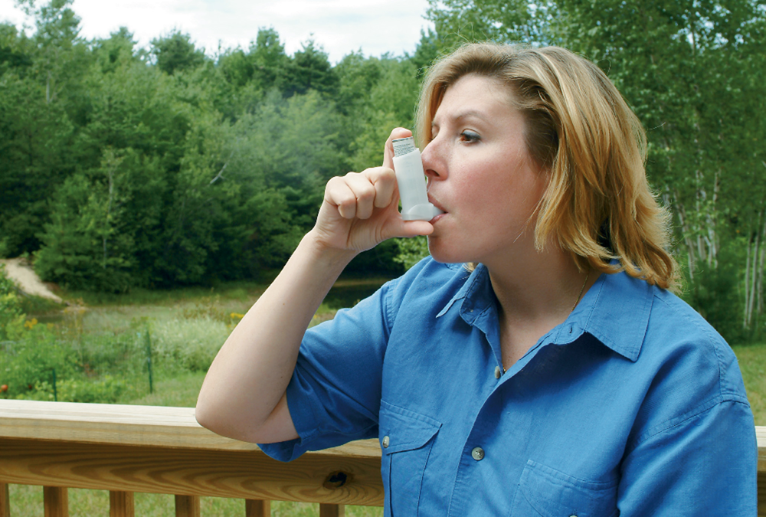
The Prescribed Inhaler (2 of 5)
Prescribed Inhaler
Notes:
Covers Objective: 19.7

Slide 89
The Prescribed Inhaler (3 of 5)
Before administering inhaler
  Ensure right patient, right time, right medication, right dose, right route.
  Check expiration date.
  Shake inhaler vigorously.
Patient alert enough to use inhaler
  Use spacer device if patient has one.
Notes:
Covers Objective: 19.7

Slide 90
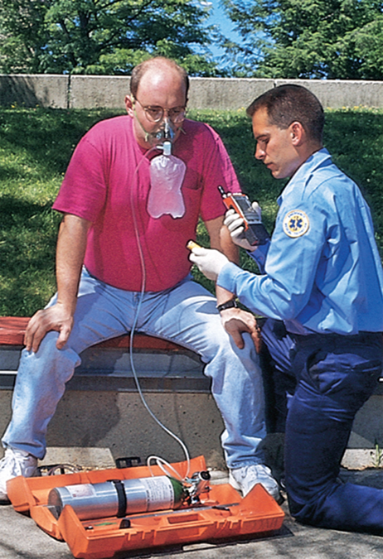
The Prescribed Inhaler (4 of 5)
3. Ensure the five “rights”: 1. Right patient; 2. Right time; 3. Right medication; 4. Right dose; 5. Right route.
Notes:
Covers Objective: 19.7

Slide 91
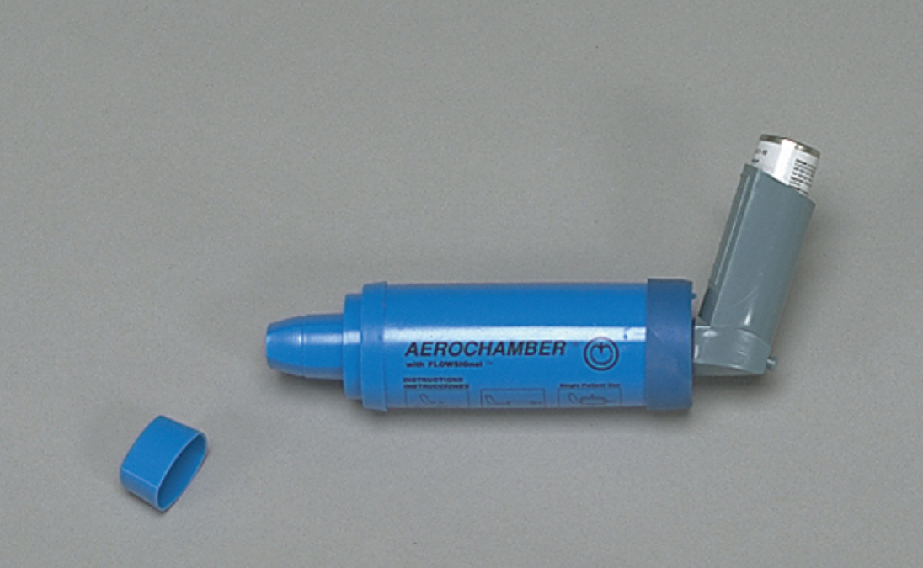
Spacer Device
A spacer between the inhaler and patient makes the timing during inhaler use less critical.
Notes:
Covers Objective: 19.7

Slide 92
The Prescribed Inhaler (5 of 5)
To administer inhaler:
  Have patient exhale deeply.
  Have patient put lips around opening.
  Press inhaler to activate spray as patient inhales deeply.
  Make sure patient holds breath as long as possible so that medication can be absorbed.
Notes:
Covers Objective: 19.7
Point to Emphasize: Following the appropriate steps for administration of a metered-dose inhaler will optimize the delivery of inhaled medication.
Discussion Topics: Explain how a metered dose inhaler delivers medication. List and describe the steps involved in administering a medication via a metered-dose inhaler.
Knowledge Application: Have students work in small groups, with members taking turns explaining the use of metered-dose inhalers to each other (as they would for a patient). Critique and practice.
Critical Thinking Discussion: Should metered-dose inhalers be administered to all patients with respiratory distress? What types of respiratory distress should not receive bronchodilator medications?

Slide 93
The Small-Volume Nebulizer
Back to Topics
Notes:
Teaching Time: 15 minutes
Teaching Tips: Have examples of small-volume nebulizers on hand. Allow students to practice assembly and use. Simulate medication nebulization by using water. This provides a cheap and simple method of practicing the correct administration procedures. Build upon pathophysiology and pharmacology lessons that were discussed when reviewing metered-dose inhalers. Typically the same medications are used.

Slide 94
The Small-Volume Nebulizer (1 of 3)
Medications used in metered-dose inhalers can also be administered by a small-volume nebulizer (S V N).
Nebulizing
  Running oxygen or air through liquid medication
Patient breathes vapors created.
Notes:
Covers Objective: 19.7
Points to Emphasize: Many medications administered in a metered-dose inhaler also can be administered through a small-volume nebulizer. Nebulization involves running oxygen or air through a liquid medication to create vapors that the patient can inhale.
Knowledge Application: Have students work in small groups, with members taking turns explaining the use of a small-volume nebulizer. Critique each other and practice.

Slide 95
The Small-Volume Nebulizer (2 of 3)
Produces continuous flow of aerosolized medication that can be taken in during multiple breaths over several minutes
Gives patient greater exposure to medication
Notes:
Covers Objective: 19.7
Points to Emphasize: A nebulizer produces a continuous flow of aerosolized medication that can be taken in during multiple breaths over several minutes. Not all systems allow EMTs to use small-volume nebulizers. Providers always should follow local protocols.
Discussion Topics: Explain the benefits of delivering respiratory medications through a small-volume nebulizer. Describe the steps involved in the proper administration of nebulized medications.
Critical Thinking Discussion: You determine that a patient has inadequate respirations due to asthma. Should you administer inhaled respiratory medications immediately, or might you have other priorities?

Slide 96
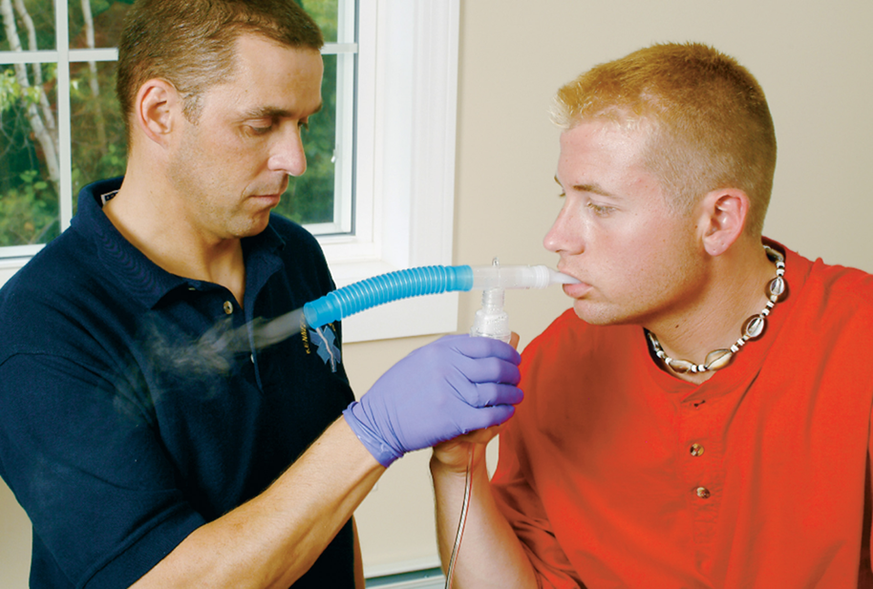
The Small-Volume Nebulizer (3 of 3)
Have the patient seal the lips around the mouthpiece and breathe deeply and then hold the breath for 2 to 3 seconds, if possible. Continue until the medication is gone from the chamber.
Notes:
Covers Objective: 19.7
Point to Emphasize: Following the appropriate steps for administration of a metered-dose inhaler will optimize the delivery of inhaled medication.
Knowledge Application: Have students work in small groups, with members taking turns explaining the use of metered-dose inhalers to each other (as they would for a patient). Critique and practice.
Critical Thinking Discussion: You determine that a patient has inadequate respirations due to asthma. Should you administer inhaled respiratory medications immediately, or might you have other priorities?

Slide 97
Chapter Review

Slide 98
Chapter Review (1 of 6)
Respiratory emergencies are common complaints for E M Ts. It is important to understand the anatomy, physiology, pathophysiology, assessment, and care for patients experiencing these emergencies.

Slide 99
Chapter Review (2 of 6)
Patients with respiratory complaints (which are closely related to cardiac complaints) may exhibit inadequate breathing. Rapid respirations indicate serious conditions, including hypoxia, cardiac and respiratory problems, and shock.

Slide 100
Chapter Review (3 of 6)
Very slow and shallow respirations are often the endpoint of a serious condition and are a precursor to death.

Slide 101
Chapter Review (4 of 6)
The history usually provides significant information about the patient’s condition. In addition to determining a pertinent past history and medications, determine the patient’s signs and symptoms with a detailed description including O P Q R S T and events leading up to the episode.

Slide 102
Chapter Review (5 of 6)
Important physical examination points include checking the patient’s work of breathing, inspecting accessory muscle use, gathering pulse oximetry readings, assuring adequate and equal lung sounds bilaterally, examining for excess fluid (lungs, ankles, and abdomen), and gathering vital signs.

Slide 103
Chapter Review (6 of 6)
Several medications are available that may help correct a patient’s difficulty in breathing.

Slide 104
Remember (1 of 3)
Determine if the patient’s breathing is adequate, inadequate, or absent.
Choose the appropriate oxygenation or ventilation therapy.

Slide 105
Remember (2 of 3)
Consider whether to assist a patient with or administer respiratory medications.
  Do I have protocols and medications that may help this patient?
  Does the patient have a presentation and condition that may fit these protocols?

Slide 106
Remember (3 of 3)
Consider whether to assist a patient with or administer respiratory medications.
  Are there any contraindications or risks to using medications in my protocols?

Slide 107
Questions to Consider (1 of 2)
What would you expect a patient’s respiratory rate to do when the patient gets hypoxic? Why?
What would you expect a patient’s pulse rate to do when the patient gets hypoxic? Why?
List the signs of inadequate breathing.
Notes:
Talking Points: In most patients the respiratory rate increases as the patient becomes hypoxic. However, the rate may slow as the patient fatigues. In adults, the heart rate generally increases as the patient becomes hypoxic. In children the heart rate often slows. The signs of inadequate breathing include improper rate, rhythm, altered mental status, and signs of hypoxia.

Slide 108
Questions to Consider (2 of 2)
Would you expect to assist a patient with their prescribed inhaler when they are experiencing congestive heart failure? Why or why not?
List some differences between adult and infant/child respiratory systems.
Notes:
Talking Points: Inhalers are generally not used in CHF as they frequently cause increased cardiac workload. CHF patients typically do not benefit from this side effect and it can be dangerous. Children have smaller airways, larger tongues, more pliable chest walls and tracheas.

Slide 109
Critical Thinking
A 72-year-old female complains of severe shortness of breath. Her husband notes she is confused. You note a respiratory rate of 8 breaths/minute and cyanosis. Patient has a history of C O P D and C H F. Discuss the treatment steps to assist this patient.
Notes:
Talking Points: With an altered mental status and a slow respiratory rate, this patient is in respiratory failure and needs immediate artificial ventilation. A more thorough assessment and history can be completed after the airway and breathing needs have been addressed.

Slide 110

Copyright
This work is protected by United States copyright laws and is provided solely for the use of instructors in teaching their courses and assessing student learning. Dissemination or sale of any part of this work (including on the World Wide Web) will destroy the integrity of the work and is not permitted. The work and materials from it should never be made available to students except by instructors using the accompanying text in their classes. All recipients of this work are expected to abide by these restrictions and to honor the intended pedagogical purposes and the needs of other instructors who rely on these materials.

Slide 111
Appendix 1
The position of the diaphragm in each of the four images is as follows.
In relaxed stage, the diaphragm is in a neutral position.
In contraction stage, the diaphragm is slightly contracted. A text reads, inspiration begins.
In inspiration stage, the diaphragm has contracted to expand the lungs.
In the final relaxed stage, the diaphragm is relaxed and rising, allowing air to flow out of the lungs. A text reads, passive expiration begins.
Return to presentation

Slide 112
Appendix 2
Labels indicating, Altered levels of awareness, unconsciousness, dizziness, fainting, restlessness, anxiety, confusion, combativeness. Cyanosis, pale or blue tinged lip and nose area. Flaring nostrils and pursed lips. Straining neck and facial muscles. Coughing, crowing, or high pitched barking sounds. Tightness in chest, stabbing chest pains in some patients. Respiratory noises such as wheezing, snoring, or stridor. Straining or contracted intercostal and abdominal muscles. Numbness or tingling in hands and feet. Sitting in the tripod position.
Return to presentation

Slide 113
Appendix 3
First image labeled, normal has 5 clear, well defined air sacs. Second image labeled, chronic bronchitis has slightly deformed air sacs containing mucus plugs and showing reddened inflammation on some of the sac lining. Third image labeled, Emphysema has no clearly defined air sacs, which indicates a decreased surface area.
Return to presentation

