Slide 1

Emergency Care
Fourteenth Edition
Chapter 33
Trauma to the Head, Neck, and Spine
Slides in this presentation contain hyperlinks. JAWS users should be able to get a list of links by using INSERT+F7
Copyright © 2021, 2016, 2012 Pearson Education, Inc. All Rights Reserved
Notes:
If this PowerPoint presentation contains mathematical equations, you may need to check that your computer has the following installed:
1) MathType Plugin
2) Math Player (free versions available)
3) NVDA Reader (free versions available)

Slide 2
Topics
Nervous and Skeletal Systems
Injuries to the Skull and Brain
Wounds to the Neck
Injuries to the Spine
Notes:
Planning Your Time: Plan 200 to 210 minutes for this chapter.
Introduction (5 minutes)
Nervous and Skeletal Systems (20 minutes)
Injuries to the Skull and Brain (50 minutes)
Wounds to the Neck (15 minutes)
Injuries to the Spine (110 minutes)
Note: The total teaching time recommended is only a guideline.
Teaching Tip: The care of spinal injuries is rapidly evolving. This lesson should not only teach skills, but also discuss the current conversation surrounding this topic.

Slide 3
Nervous and Skeletal Systems
Back to Topics
Notes:
Teaching Time: 20 minutes
Teaching Tips: Use anatomical models and multimedia graphics to illustrate anatomy and physiology. Present anatomy in terms of protection. Describe how structures are protected and how trauma violates this protection.

Slide 4
Nervous and Skeletal Systems—Nervous System (1 of 3)
The nervous system controls thought, sensations, and motor functions
It has two subdivisions:
  The central nervous system consists of the brain and spinal cord
  The peripheral nervous system consists of vertebral nerves, cranial nerves, and motor and sensory nerves
Neurons are specialized nerve cells that transmit nervous impulses through the body
Notes:
Covers Objective: 33.1
Point to Emphasize: The nervous system is divided into two subsystems: the central nervous system and the peripheral nervous system.
Discussion Topic: Describe the components of the nervous system. Discuss the function of the various components.

Slide 5
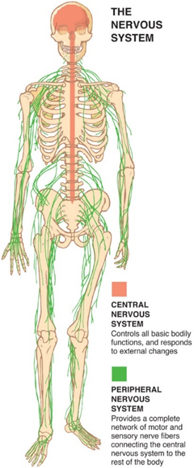
Nervous and Skeletal Systems—Nervous System (2 of 3)
For long description, see slide 87: Appendix 1
Nervous system.
Notes:
Covers Objective: 33.1
Point to Emphasize: The nervous system is divided into two subsystems: the central nervous system and the peripheral nervous system.
Discussion Topic: Describe the components of the nervous system. Discuss the function of the various components.
Knowledge Application: Have students work in small groups. Assign each group a component of the nervous system. Ask the group to research and present on the function of its particular component.

Slide 6
Nervous and Skeletal Systems—Nervous System (3 of 3)
Sensory nerves carry messages from the body to the brain
Motor nerves carry messages from the brain to the body
  Motor messages control voluntary movement
  Motor nerves cross to the opposite side of the body, with the left brain controlling the right body
Nerves of the autonomic nervous system control involuntary functions
Notes:
Covers Objective: 33.1
Knowledge Application: Have students work in small groups. Assign each group a component of the nervous system. Ask the group to research and present on the function of its particular component.

Slide 7
Nervous and Skeletal Systems—Anatomy of the Head (1 of 3)
The skull is made up of the cranium and facial bones
  The cranium contains the frontal bone, parietal bones, temporal bones, and occipital bone
  Facial bones include the mandible, maxillae, nasal bones, malars, and orbits
Most cranial and facial bones have immovable joints
  The mandible joins the skull at the temporal bones
  This forms the movable temporomandibular joint
Notes:
Covers Objective: 33.1
Discussion Topic: Describe the anatomy of the skull. Explain how the skull's structure protects the brain.
Class Activity: Give students a blank diagram of the skull and have them label the major structures.
Knowledge Application: Use a programmed patient or model. Demonstrate anatomy based on external landmarks.

Slide 8
Nervous and Skeletal Systems—Anatomy of the Head (2 of 3)
The brain is held within the skull
The spinal cord exits the base of the brain and leaves the skull through the foramen magnum
Cerebrospinal fluid (C S F) bathes brain and circulates down the spine
Notes:
Covers Objective: 33.1
Critical Thinking Discussion: If the brain and spinal cord are so well protected, why are there so many injuries? How does human activity overcome these basic protective structures?

Slide 9
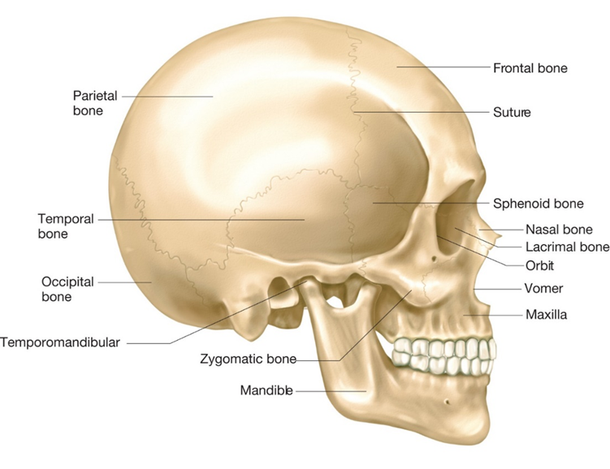
Nervous and Skeletal Systems—Anatomy of the Head (3 of 3)
For long description, see slide 88: Appendix 2
Bones of the cranium and face.
Source: “Figure 04.05–Bones of The Skull” from Medical Terminology: A Living Language, 5e by Bonnie F. Fremgen and Suzanne S. Frucht. Published by Pearson Education, Inc © 2013.
Notes:
Covers Objective: 33.1

Slide 10
Nervous and Skeletal Systems—Anatomy of the Spine (1 of 4)
The spinal cord is a bundle of nervous tissue that extends from the brainstem to the small of the back
  It is the main pathway for nerve messages
  Spinal nerves branch out to carry messages
  The cauda equina emerges from the end of the cord
The tough, fibrous meninges surround the spinal cord inside of the spinal column
Notes:
Covers Objective: 33.1
Discussion Topic: Describe the anatomy of the spinal column. Discuss how the spinal cord is protected.
Class Activity: Using a skeleton anatomy model, have students label the regions of the spinal column.

Slide 11
Nervous and Skeletal Systems—Anatomy of the Spine (2 of 4)
The spinal column is made up of 33 vertebrae
  Vertebrae are stacked one on top of the other and interlock
  They are held together with ligaments and supported by back muscles
  Every vertebrae has a donut hole that allows the spinal cord to run through the spinal column
Notes:
Covers Objective: 33.1

Slide 12
Nervous and Skeletal Systems—Anatomy of the Spine (3 of 4)
Vertebrae are divided into five areas:
  Cervical (group of 7 located in the neck)
  Thoracic (group of 12 to which ribs attach)
  Lumbar (group of 5 located in the mid-back)
  Sacral (group of 5 located in the lower back)
  Coccygeal (group of 4 located in the tailbone)
    Sacral and coccygeal vertebrae are fused to form the posterior part of the pelvis
    All vertebrae have a spinous process
Notes:
Covers Objective: 33.1
Knowledge Application: Line up students to form the five regions of the spinal column. Have each group discuss its role and its vulnerabilities.

Slide 13
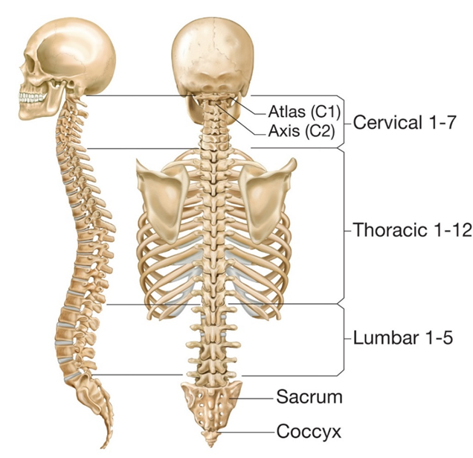
Nervous and Skeletal Systems—Anatomy of the Spine (4 of 4)
For long description, see slide 89: Appendix 3
Divisions of the spinal column.
Notes:
Covers Objective: 33.1

Slide 14
Injuries to the Skull and Brain
Back to Topics
Notes:
Teaching Time: 40 minutes
Teaching Tips: Take care to differentiate the concept of open and closed head injuries from other open and closed wounds. This often can be confusing. Discuss the role of pressure. Describe how increasing pressure threatens the contents of a closed container. Relate this to the signs of herniation. Emphasize the need for reassessment in brain injuries. Require that students learn the Glascow Coma Scale. It is part of the language of health care. Make it a routine part of practice.

Slide 15
Injuries to the Skull and Brain—Scalp Injuries
The scalp has many small blood vessels
Scalp injuries may bleed profusely
  Control scalp bleeding with direct pressure
  Dress as you would any other soft-tissue injury
  If there is a possible skull injury, use a loose gauze dressing instead of direct pressure
Notes:
Covers Objective: 33.1
Points to Emphasize: Scalp, skull, and brain are the different classifications of a head injury. These injuries can be further subdivided into concussions, contusions, lacerations, and hematomas.
Discussion Topics: Describe the treatment for a bleeding scalp injury.
Critical Thinking Discussion: Why might scalp bleeding distract assessment away from more dangerous injuries?

Slide 16
Injuries to the Skull and Brain—Skull Injuries (1 of 2)
Skull injuries include facial and cranial fractures
Skull injuries may be open or closed
  Open head injury occurs when the bones of the cranium are fractured
  Closed head injury occurs when the scalp is lacerated but the cranium is intact
It is safest to assume open head injury beneath any contusion or laceration of the scalp
Always suspect spine injury with brain or skull injury
Notes:
Covers Objective: 33.1
Points to Emphasize: The skull is fractured in an open head injury. The skull is intact in a closed head injury. Whenever you suspect a skull or brain injury, also suspect spine injury.
Discussion Topics: Discuss the difference between a closed head injury and an open head injury. Describe the assessment findings associated with an open head injury.
Critical Thinking Discussion: Why might a closed head injury be more dangerous than an open head injury?

Slide 17
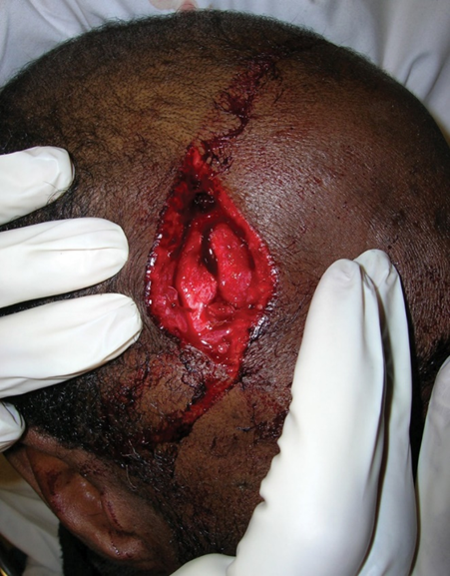
Injuries to the Skull and Brain—Skull Injuries (2 of 2)
An open skull fracture.
© Edward T. Dickinson, M D
Notes:
Covers Objective: 33.1

Slide 18
Injuries to the Skull and Brain—Brain Injuries (1 of 8)
Direct injuries occur with open head injuries
  Brain is lacerated, punctured, or bruised by broken bones or by a foreign object
Indirect injuries occur with open or closed head injuries
  Shock of impact on the skull is transferred to the brain
  Includes concussions and contusions
Notes:
Covers Objective: 33.1
Discussion Topics: Describe the findings associated with the diagnosis of concussion. Describe the assessment findings associated with an open head injury.
Class Activity: Describe signs and symptoms of a head injury. Ask the class to decide if it is open or closed. Discuss treatment strategies.

Slide 19
Injuries to the Skull and Brain—Brain Injuries (2 of 8)
Traumatic brain injury (T B I) disrupts the normal functioning of the brain and may be brief or long-term
  Concussion occurs when the head is struck and force is transferred to the brain
    Should be taken seriously even with mild symptoms
  Contusion is a bruised brain caused by a blow forceful enough to rupture blood vessels in the brain
    Coup injury occurs on the side of the blow
    Contrecoup injury occurs on the opposite side
Notes:
Covers Objective: 33.1
Knowledge Application: Use a programmed patient to simulate head injury scenarios. Have groups of students practice assessment and appropriate treatment.

Slide 20
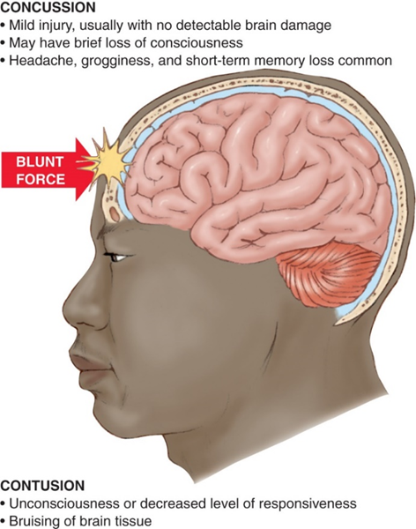
Injuries to the Skull and Brain—Brain Injuries (3 of 8)
Closed head injuries: concussion and contusion.
Notes:
Covers Objective: 33.1

Slide 21
Injuries to the Skull and Brain—Brain Injuries (4 of 8)
Traumatic brain injury (T B I) disrupts the normal functioning of the brain and may be brief or long-term
  Laceration is a cut to the brain caused by the same forces that cause contusion
  Hematoma is a collection of blood within brain tissue
    Subdural: Blood collects between the brain and dura
    Epidural: Blood collects between the dura and skull
    Intracerebral: Blood pools within the brain
Notes:
Covers Objective: 33.1
Knowledge Application: Use a programmed patient to simulate head injury scenarios. Have groups of students practice assessment and appropriate treatment.
Discussion Topic: Describe the treatment priorities for a traumatic brain injury.

Slide 22
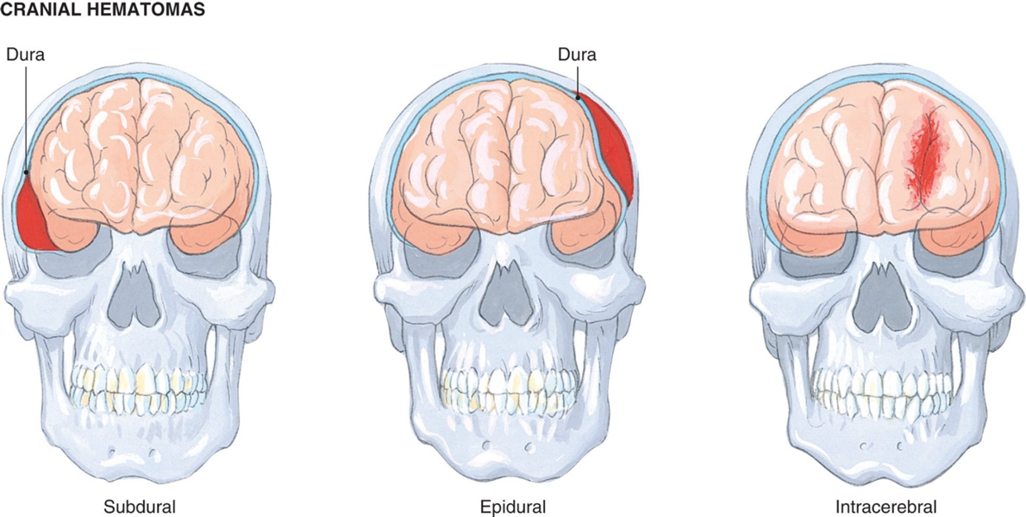
Injuries to the Skull and Brain—Brain Injuries (5 of 8)
For long description, see slide 90: Appendix 4
Hematomas within the cranium.
Notes:
Covers Objective: 33.1

Slide 23
Injuries to the Skull and Brain—Brain Injuries (6 of 8)
As a hematoma develops, intracranial pressure (I C P) increases inside the skull
As I C P builds, brain tissue compresses and progressive neurological abnormalities develop
Rising I C P forces the brain toward the foramen magnum
The time it takes for symptoms to develop depends on the rate of bleeding into the skull and the location of the bleed
Notes:
Covers Objective: 33.1
Discussion Topic: Describe the signs and symptoms of rising intracranial pressure. How would you recognize herniation?
Knowledge Application: Present assessment and vital sign trends. Ask students to recognize increasing ICP. What further changes should an EMT anticipate?
Critical Thinking: How might the signs of rising intracranial pressure mimic the effects of alcohol intoxication? How might an EMT differentiate the two?

Slide 24
Injuries to the Skull and Brain—Brain Injuries (7 of 8)
When I C P increases, blood pressure increases to pump blood into and perfuse the brain
  The heart rate may slow in response to the blood pressure or due to vagus nerve compression
  Rising blood pressure and slowing heart rate together is known as Cushing reflex
As I C P increases and perfusion decreases, carbon dioxide levels increase and brain tissue swells
Notes:
Covers Objective: 33.1
Critical Thinking Discussion: How might the signs of rising intracranial pressure mimic the effects of alcohol intoxication? How might an EMT differentiate the two?

Slide 25
Injuries to the Skull and Brain—Brain Injuries (8 of 8)
As the hematoma grows and swelling worsens, the brainstem is compressed and breathing patterns change
  Tachypnea
  Cheyne-Stokes breathing
  Central neurogenic hyperventilation
  Ataxic respirations
As the brain herniates, decorticate or decerebrate posturing and neurogenic posturing may occur
Signs and symptoms of rising I C P may be immediate or delayed in onset
Notes:
Covers Objective: 33.1
Discussion Topic: Describe the signs and symptoms of rising intracranial pressure. How would you recognize herniation?
Knowledge Application: Present assessment and vital sign trends. Ask students to recognize increasing ICP. What further changes should an EMT anticipate?

Slide 26
Injuries to the Skull and Brain—Patient Assessment (1 of 4)
Signs and symptoms of skull fractures and brain injuries:
  Visible bone fragments and brain tissue
  Altered mental status
  Deep laceration or severe bruise or hematoma on the scalp or forehead
  Depressions, deformity, or swelling on the skull
  Severe pain at the injury site
  Bruising behind the ear (Battle sign)
  Pupils unequal or nonreactive to light
Notes:
Covers Objective: 33.2

Slide 27
Injuries to the Skull and Brain—Patient Assessment (2 of 4)
Signs and symptoms of skull fractures and brain injuries:
  “Raccoon eyes,” black eyes, or discoloration of soft tissues under both eyes
  One eye appears to be sunken
  Blood or clear fluid flowing from the ears or nose
  Personality change
  Increased blood pressure and decreased pulse rate (Cushing reflex)
  Irregular breathing patterns
  Blurred or multiple-image vision
Notes:
Covers Objective: 33.2

Slide 28
Injuries to the Skull and Brain—Patient Assessment (3 of 4)
Signs and symptoms of skull fractures and brain injuries:
  Impaired hearing or ringing in the ears
  Equilibrium problems
  Forceful or projectile vomiting
  Decorticate or decerebrate posturing
  Paralysis or disability on one side of the body
  Seizures
  Temperature increase
  Deteriorating vital signs
Notes:
Covers Objective: 33.2

Slide 29
Injuries to the Skull and Brain—Patient Assessment (4 of 4)
If there is shock with head injury in adult patients, look for indications of blood loss elsewhere on the body
Assume skull or brain injury when M O I and location of the injury indicate a possible head injury
Notes:
Covers Objective: 33.2

Slide 30
Injuries to the Skull and Brain—Patient Care (1 of 2)
Take appropriate Standard Precautions.
Consider possibility of spine injury.
Open and maintain airway.
Monitor the unconscious patient for changes in breathing.
If indicated, apply a rigid cervical collar.
Control bleeding.
Keep the patient at rest.
Notes:
Covers Objective: 33.2

Slide 31
Injuries to the Skull and Brain—Patient Care (2 of 2)
Talk to a conscious patient and provide emotional support.
Dress and bandage open wounds and stabilize penetrating objects.
Manage the patient for shock.
Be prepared for vomiting.
Transport the patient promptly.
Monitor vital signs every 5 minutes en route to the hospital.
Notes:
Covers Objective: 33.2
Decision Points: Does my patient have a serious or potentially serious head injury? Should he be transported to a trauma center? Do my patient’s assessment findings indicate spinal precautions? Does the patient have increasing intracranial pressure?

Slide 32
Injuries to the Skull and Brain—Glasgow Coma Scale (1 of 3)
Some agencies use the Glasgow Coma Scale (G C S) with A V P U for neurologic assessment
Considerations when using G C S:
  Eye opening
  Verbal response
    Orientated
    Confused
    Inappropriate words
    Incomprehensible sounds
    No verbal response
Notes:
Covers Objective: 33.2
Point to Emphasize: Constant reassessment of the brain-injured patient is essential. Mental status can deteriorate rapidly, and primary treatments such as airway management may become necessary.
Knowledge Application: Describe a variety of brain-injured patients and have students assign a GCS score.

Slide 33
Injuries to the Skull and Brain—Glasgow Coma Scale (2 of 3)
Considerations when using G C S:
  Motor response
    Obeys command
    Localizes pain
    Withdraws after painful stimulation
    Posturing after painful stimulation
    No motor response to pain
Calculate the G C S score en route rather than spending time on the scene
Notes:
Covers Objective: 33.2
Discussion Topic: Describe the process for determining a patient’s Glasgow Coma Score.

Slide 34
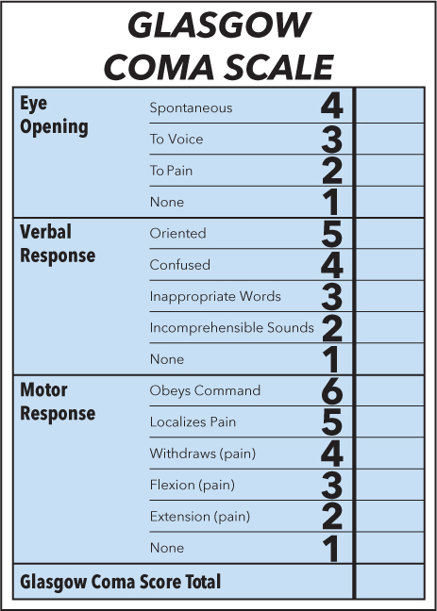
Injuries to the Skull and Brain—Glasgow Coma Scale (3 of 3)
For long description, see slide 91: Appendix 5
Notes:
Covers Objective: 33.2
Teaching Tip: Require the use of GCS in future simulations and scenarios.

Slide 35
Injuries to the Skull and Brain—Cranial Injuries with Impaled Objects
Do not remove an impaled object—stabilize it in place with a bulky dressing
If an impaled object is too long to transport the patient:
  Pad around the object with bulky dressings
  Stabilize the object on both sides
  Cut with a tool that will not cause the object to move or vibrate when it is severed
  Seek advice from medical direction
Notes:
Covers Objective: 33.2
Discussion Topic: Describe the treatment for a patient with an impaled object in the skull.

Slide 36
Injuries to the Skull and Brain—Injuries to the Face and Jaw (1 of 2)
Facial fractures are usually caused by an impact
  Be prepared to remove airway obstructions from the mouth and to use suction
  Treat the patient as for a suspected skull or brain injury
The mandible is subject to dislocation and fracture
  Signs include pain, discoloration, swelling, and facial distortion
  The patient may be unable to move the jaw, have difficulty speaking, and show improper tooth alignment
Notes:
Covers Objectives: 33.3
Teaching Tips: Teach the connection between face and jaw injuries and airway obstruction.

Slide 37
Injuries to the Skull and Brain—Injuries to the Face and Jaw (2 of 2)
When treating a facial or jaw injury:
  Be prepared to suction to remove debris
  Use the jaw-thrust maneuver to open the airway if spinal injury is suspected
  Control profuse bleeding
  Consider the need for spinal immobilization
  Position the patient to allow drainage from the mouth
  Treat for shock
Notes:
Covers Objectives: 33.3
Discussion Topic: Describe the assessment and treatment for a patient with a facial or jaw injury.
Critical Thinking Discussion: How might spinal immobilization affect a patient with bleeding around the airway? Why might an upright position be preferred?

Slide 38
Injuries to the Skull and Brain—Nontraumatic Brain Injuries
Many signs of brain injury may be caused by an internal brain event like a hemorrhage or blood clot
Signs or nontraumatic stroke differ from traumatic injury in that only one side is likely to be affected
Notes:
Covers Objective: 33.3
Teaching Tip: Link this lesson back to the discussion around stroke.
Discussion Topic: Compare and contrast the signs or traumatic brain injury and non-traumatic

Slide 39
Wounds to the Neck
Back to Topics
Notes:
Teaching Time: 15 minutes
Teaching Tips: Use multimedia graphics to illustrate neck anatomy. Relate the discussion about air emboli to prior discussions about sucking chest wounds. The principles of occlusive dressings are the same. Emphasize the potential for spinal injury in the presence of neck trauma.

Slide 40
Wounds to the Neck (1 of 2)
Large arteries and veins close to the surface of the neck create the potential for serious bleeding
Pressure in large vein is lower than atmospheric pressure
  The possibility of air being sucked in and causing an air embolism is great
  The embolus can travel to the lungs and become a pulmonary air embolism
  This can lead to cardiac arrest
Notes:
Covers Objective: 33.3
Knowledge Application: Present different types of occlusive dressings. Have students practice application of an occlusive dressing to a neck wound.

Slide 41
Wounds to the Neck (2 of 2)
Direct pressure is a lifesaving step in treating hemorrhage from neck wounds
  First priority is stopping bleeding
  Second priority is preventing an embolus
Take care to avoid interfering with breathing when applying pressure
Notes:
Covers Objective: 33.3
Points to Emphasize: Because large arteries and veins lie close to the surface of the neck, the potential for serious bleeding from an open wound is great. Because the pressure in a large vein is likely to be lower than atmospheric pressure, the risk of an air embolus is great.
Discussion Topic: Describe the risks of trauma to the neck. Discuss the two major life threats associated with neck wounds.

Slide 42
Wounds to the Neck—Patient Care
Ensure an open airway.
Place a gloved hand over wound.
Apply an occlusive dressing.
Place a dressing over the occlusive dressing.
Apply pressure to stop the bleeding.
Bandage the dressing in place.
Immobilize the spine if the M O I suggests cervical injury.
Notes:
Covers Objective: 33.3
Point to Emphasize: Occlusive dressings should be applied to open neck wounds to prevent air emboli.
Discussion Topics: Discuss why an occlusive dressing should be applied to a neck wound. Describe the treatment priorities for treating a patient with a serious neck wound.
Knowledge Application: Use moulage (especially moulage blood) and a programmed patient to present neck wound scenarios. Have groups of students practice assessment and treatment.
Critical Thinking Discussion: What types of injuries to airway structures could a serious neck wound present? What effect on the movement of air could these types of injuries have?

Slide 43
Injuries to the Spine
Back to Topics
Notes:
Teaching Time: 30 minutes
Teaching Tips: Use an anatomical model or skeleton to demonstrate in-line neutral position. Discuss how moving one part of the spinal column affects other parts. Use multimedia graphics to illustrate different mechanisms of injury. Discuss the potential for particular spinal injuries in each. Use a programmed patient or model to demonstrate proper assessment of the spinal column. Teach a thorough neurological examination. Teach providers to pick up the subtle nerve deficit.

Slide 44
Injuries to the Spine—Identifying Potential Spine and Spinal Cord Injury (1 of 5)
When bones, ligaments, and cartilage of the spinal column are damaged, the spinal cord may also be damaged
Specific spinal column injuries:
  Fractures with or without bone displacement
  Dislocations
  Muscular strains
  Disk injury including compression
These injuries can occur without cord damage, but the risk must always be taken into consideration
Notes:
Covers Objective: 33.4
Points to Emphasize: Injuries to the spine must be considered whenever there is serious trauma to any part of the body.
Discussion Topics: Discuss the forces that can cause spinal injuries. Describe different mechanisms of injury and relate them to actual injuries. Explain why some areas of the spine are more vulnerable to injury than others.

Slide 45
Injuries to the Spine—Identifying Potential Spine and Spinal Cord Injury (2 of 5)
The spinal cord can be lacerated, contused, or impinged
Primary injuries occur immediately due to direct force
Secondary injuries occur after the initial insult
  They can cause greater harm than primary injuries
  They are not typically caused by damaged bone ends moving into the spinal cord, as once thought
  Hypoxia, shock, cord swelling, and hypoglycemia can lead to devasting cord damage
Notes:
Covers Objective: 33.4
Discussion Topic: Define and describe primary and secondary spinal injuries.
Critical Thinking Discussion: Does nerve impingement always mean “no feeling”? What are other signs of disruption to the nervous pathway?

Slide 46
Injuries to the Spine—Identifying Potential Spine and Spinal Cord Injury (3 of 5)
Assessment must account for the possibility of spinal involvement in any traumatic injury
  Not every trauma patient has spinal injury
  Physical findings and M O I must be evaluated to make appropriate decisions about risk of spinal damage
Potential spinal injury identification must take both M O I and the patient’s physical condition into account
Notes:
Covers Objective: 33.4
Discussion Topic: Describe the signs and symptoms of a spinal cord injury.
Knowledge Application: Have students work in small groups. Assign each group a specific mechanism of spinal injury. Have groups research and present on the pathophysiology of their mechanism. Use specific examples.

Slide 47
Injuries to the Spine—Identifying Potential Spine and Spinal Cord Injury (4 of 5)
The spine is most often injured by energy that forces the spine beyond its normal range of motion
  Flexion and extension injuries (whiplash)
  Overrotation (twisting sports injury)
  Compression (shallow-water diving)
  “Distraction” injury (hanging)
  Penetrating trauma
  Lateral bending or disk injury (improper lifting)
Notes:
Covers Objective: 33.4
Knowledge Application: Assign each student a specific sign or symptom of spinal injury. Have the student research and present the pathophysiology that makes his sign or symptom occur.

Slide 48
Injuries to the Spine—Identifying Potential Spine and Spinal Cord Injury (5 of 5)
Cervical and lumbar vertebrae are most susceptible to injury because they are not supported by other structures
Some medical conditions make the spine more vulnerable to injury
  Osteoporosis in older adults
  Ligament laxity in pregnant women and patients with Down syndrome
  Fused vertebrae and fixed flexion deformities in ankylosing spondylitis
Notes:
Covers Objective: 33.4
Discussion Topic: Describe the common underlying conditions that make a person more susceptible to spinal injury.

Slide 49
Injuries to the Spine—Mechanisms of Spine Injury (1 of 4)
Some M O I have a high risk for spinal injury
  Falls from greater than 1 meter (3 feet) or down more than 5 stairs
  Axial loading (compression injuries) such as those that occur in diving injuries
  High-speed motor-vehicle crashes, especially with rollover or ejection of the patient
  Motorized recreational vehicle (A T V) crashes
  Bicycle collisions
Notes:
Covers Objective: 33.4

Slide 50
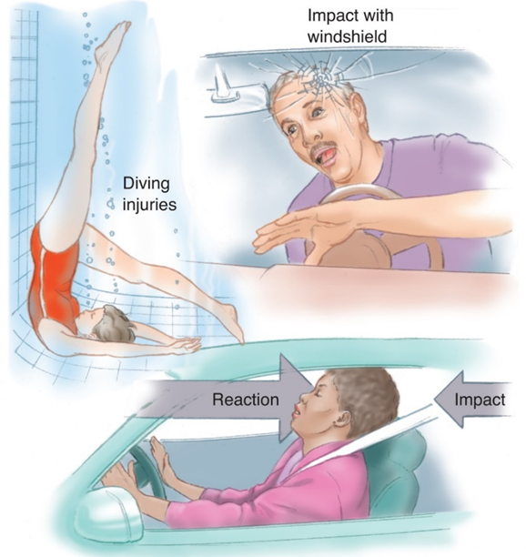
Injuries to the Spine—Mechanisms of Spine Injury (2 of 4)
For long description, see slide 92: Appendix 6
Mechanisms that may cause spine injury.
Notes:
Covers Objective: 33.4

Slide 51
Injuries to the Spine—Mechanisms of Spine Injury (3 of 4)
Maintain a high degree of suspicion for spine injury when your patient:
  Is a victim of a motor vehicle or motorcycle collision
  Was struck by a vehicle
  Received blunt injury to the spine or above the clavicle
  Was involved in a diving accident
  Was found hanging by the neck
  Was found unconscious from trauma
Notes:
Covers Objective: 33.4

Slide 52
Injuries to the Spine—Mechanisms of Spine Injury (4 of 4)
Some M O I are low-risk mechanisms
  Low-energy M O I pose a low threat of spinal injury
  Penetrating trauma is low risk unless the trauma was to the spine itself
  Spine fractures in the elderly are often caused by falls or spontaneous fractures of brittle bones
Consider how underlying factors like preexisting conditions could make otherwise minor M O I into serious threats
Many other mechanisms of injury can cause spinal injuries.
Notes:
Covers Objective: 33.4

Slide 53
Injuries to the Spine—Physical Assessment for Spine and Spinal Cord Injuries
Mechanism alone does not identify injury
Assessment should specifically look for physical indicators of spinal injury
Pain and tenderness in the area of the spine are important findings
Notes:
Covers Objective: 33.4

Slide 54
Injuries to the Spine—Relating Spinal Function to Injury (1 of 2)
Damage to the spinal cord can isolate a part of the body from the brain, causing loss of function to a body region
A dermatome is an area of the body surface innervated by a single spinal nerve
  This can be used to identify loss of function at particular area of the cord
Notes:
Covers Objective: 33.4
Point to Emphasize: Injury to the spine can interrupt nervous system control of body functions.
Discussion Topic: Describe the signs and symptoms of a spinal cord injury.

Slide 55
Injuries to the Spine—Relating Spinal Function to Injury (2 of 2)
Additional key indicators of spinal injury:
  Paralysis of extremities
  Changes in neurological function
  Pain with or without movement
  Tenderness anywhere along spine
  Impaired breathing
  Priapism
  Loss of bowel or bladder control
  Deformity
  Neurogenic shock
Notes:
Covers Objective: 33.4
Class Activity: Have students assess the spine of the student sitting next to them. Discuss normal findings and compare them to the signs of injury.
Discussion Topic: Discuss the pathophysiology of hypoperfusion in neurogenic shock.

Slide 56
Injuries to the Spine—Patient Assessment
Most algorithms used to identify the likelihood of spinal injury are based on N E X U S
Key elements of N E X U S:
  Is the patient reliable?
  Is there any pain or tenderness along the midline spine?
  Are there focal or neurologic signs or symptoms?
  Is there a distracting injury or circumstance?
  What is the M O I in a pediatric patient?
Notes:
Covers Objective: 33.4
Discussion Topics: Describe the development of spinal assessment protocols. List the key elements of the NEXUS evaluation.
Knowledge Application: Use programmed patients to simulate spinal injuries. Have teams of students practice assessment.
Decision Point: Has a spine injury affected the efficiency or function of the respiratory system or circulatory system? How can I support these vital functions?

Slide 57
Injuries to the Spine—The Evolution of Spinal Care (1 of 4)
Modern spinal care is based on thoughtful assessment and good decision making by the E M T
Rigid spinal immobilization can have negative side effects
  Flat immobilization of patients with lung injury can be uncomfortable and deadly
  Even short periods on a spine board can cause hypothermia and pressure sores
Notes:
Covers Objective: 33.4
Teaching Tips: Spinal care is a rapidly evolving topic. Teach students flexibility and make sure to stay current with new developments. Understand local protocol and guidelines. Use an anatomical model or skeleton to demonstrate in-line neutral position. Discuss how moving one part of the spinal column affects other parts. Use an anatomical model spine in conjunction with immobilization equipment to demonstrate the procedure for maintaining in-line stabilization.

Slide 58
Injuries to the Spine—The Evolution of Spinal Care (2 of 4)
For any spinal injury, you must:
  Aggressively assure oxygenation and ventilation
  Actively treat severe bleeding
  Pay attention to blood glucose if capable
Primary assessment aims to identify potential for spinal injury and immediate interventions for hypoxia and shock
  Treating hypoxia and shock is the same priority as spinal motion restriction
Notes:
Covers Objective: 33.4
Discussion Topic: List the three centers of mass of the body that must be restricted during spinal motion restriction.

Slide 59
Injuries to the Spine—The Evolution of Spinal Care (3 of 4)
Err on the side of caution and protect against broken bone ends even though the level of risk is unclear
  Prevent movement of an unstable vertebra by limiting movement of the entire spine
  This is the basic principle of prehospital spinal care
Spinal motion restriction prevents secondary cord damage by limiting the movement of individual vertebrae
Notes:
Covers Objective: 33.4
Class Activity: Assign different spinal motion restriction protocols to groups in class. Compare and contrast the differing protocols and discuss their implications.

Slide 60
Injuries to the Spine—The Evolution of Spinal Care (4 of 4)
The three centers of mass in the body are the head, shoulder girdle, and pelvis
  When these areas are prevented from moving, the spine generally remains stable
The spine has a natural S-shaped curve and is not a straight line
  Spinal motion restriction accounts for this curvature
  Vertebrae are maintained in a position of function that best represents their natural anatomic position
  This is known as an inline neutral position
Notes:
Covers Objective: 33.4

Slide 61
Injuries to the Spine—Spinal Motion Restriction of the Cervical Spine (1 of 2)
Manual stabilization of the head is the first step in spinal motion restriction
  Manually restrict head movement by placing your hands on either side of patient’s head
  Gently stop movement and maintain an inline neutral position
  If the head is out of the natural position, you can attempt to move it unless the patient complains of pain
Notes:
Covers Objective: 33.4
Discussion Topics: Describe the steps involved with spinal motion restriction of the cervical spine. Describe the steps for measuring and applying a cervical collar.

Slide 62
Injuries to the Spine—Spinal Motion Restriction of the Cervical Spine (2 of 2)
A collar wraps around the neck and provides a rigid form to help prevent movement
  Collars must be properly sized
  Collars must be applied in a way that does not obstruct the airway
Maintain manual stabilization even after the collar is in place until the patient is secured to a backboard
Once motion is restricted, establish a baseline for sensory, motor, and circulatory function in the extremities
Notes:
Covers Objective: 33.4
Knowledge Application: Using a manikin or programmed patient, practice measuring and applying cervical collars.
Class Activity: Have students measure the student next to them for a cervical collar.

Slide 63
Injuries to the Spine—Spinal Motion Restriction Devices (1 of 3)
Once the cervical spine is immobilized, the remainder of the spinal column’s motion must be restricted
Ambulance stretchers are now considered padded backboards that provide appropriate spinal protection in combination with collars and straps
Rigid backboards are less commonly used today than in the past
Notes:
Covers Objective: 33.4
Discussion Topic: Discuss the National Association of EMS Physicians guidance on backboards.

Slide 64
Injuries to the Spine—Spinal Motion Restriction Devices (2 of 3)
Backboards are still used in some situations
  When transport time is short
  When a “big splint” is needed for multiple injuries
  When the patient will likely need C P R
  When moving from a backboard to a stretcher is likely to cause excessive movements
Respiratory distress and conditions that impact breathing are contraindications for backboards
Scoop stretchers are helpful for moving patients from the floor to the stretcher
Notes:
Covers Objective: 33.4
Critical Thinking Discussion: Why might two different states disagree on how best to care for a patient with a spinal injury? Why do you think there is not more research available on the best methodology to treat spinal injuries?

Slide 65
Injuries to the Spine—Spinal Motion Restriction Devices (3 of 3)
Vacuum mattresses have the positive aspects of backboards but accommodate a natural anatomic position
  They are hollow bags that allow air to be pumped out to create a rigid form
  They are move comfortable than backboards
  They can leak air and lose rigidity over time
  They can rob heat from the patient
Following application of any restriction device, reassess sensory and motor function in the extremities
Notes:
Covers Objective: 33.4

Slide 66
Spinal Motion Restriction Decision Making—Seated Patient (1 of 3)
There are two basic options for spinal motion restriction in a seated patient:
  Place a long spine board under the patients buttocks and lower the patient to the board in a supine position
  Have the patient self-extricated by standing and then sitting on the ambulance stretcher
Other seated extrication options are no longer recommended in the field but may be tested on exams
Notes:
Covers Objective: 33.4
Discussion Topic: Describe the technique for immobilizing a seated patient, including the use of rapid extrication and a short board or vest-style extrication device. Discuss the debate on the necessity of using extrication devices to move a seated patient.
Knowledge Application: Use an automobile and a programmed patient. Have groups of students practice extrication techniques.

Slide 67
Spinal Motion Restriction Decision Making—Seated Patient (2 of 3)
If using a flexible extrication device or short spine board, secure the torso first and the head last
Special considerations when applying a short board:
  Assess the back, shoulder blades, arms, and collarbones before placing the device
  The E M T applying the board must angle it to fit between the arms of the rescuer stabilizing the head
  The uppermost holes must be level with the patient’s shoulders; the base should not extend past the coccyx
Notes:
Covers Objective: 33.4
Knowledge Application: Use a programmed patient and standardized skill sheet to simulate spinal injury scenarios. Have teams of students practice spinal motion restriction techniques.

Slide 68
Spinal Motion Restriction Decision Making—Seated Patient (3 of 3)
Special considerations when applying a short board:
  Never place a chin cup or strap on the patient
  Avoid applying the first torso strap too tightly
  Some buckles have quick-release mechanisms
  Do not pad between the collar and the board; only pad to fill an occipital void
  Follow the manufacturer instructions for the device
Follow local protocols for vests and short boards
Notes:
Covers Objective: 33.4

Slide 69
Spinal Motion Restriction Decision Making—Applying a Long Backboard (1 of 2)
Log-roll the patient to apply the backboard
Pad voids between the board and head and torso
Secure the head last
Use foam-filled cushions, commercial devices, or blanket rolls to provide additional head immobilization
Tilt pregnant patients to the left after immobilization
Strap across the upper chest, pelvis, and thighs.
Notes:
Covers Objective: 33.4
Point to Emphasize: To immobilize a patient using a long board, EMTs should position the patient using a log roll. They should pad void spaces and should secure the patient at the thighs, pelvis, and upper chest, securing the head last.
Discussion Topic: Describe the steps for properly transferring your patient to a long backboard.

Slide 70
Spinal Motion Restriction Decision Making—Applying a Long Backboard (2 of 2)
If your service transports by helicopter, make sure the backboard fits
Use specialty backboards for water rescue that are designed to float up beneath the patient
For children 6 and under, pad beneath the shoulder blades to establish a neutral position for the head
Notes:
Covers Objective: 33.4
Knowledge Application: Demonstrate the function of a variety of immobilization equipment such as collars, backboards, and other immobilization devices. Using a standardized skill sheet and a programmed patient, apply spinal motion restriction using a long backboard.

Slide 71
Spinal Motion Restriction Decision Making—Standing Patient (1 of 3)
Apply a cervical collar and have the patient carefully sit down on the stretcher
Guide the patient into a supine or semi-sitting position on the stretcher
The stretcher straps will secure the patient and help limit movement
Notes:
Covers Objective: 33.4
Teaching Tip: Recommendations for dealing with a standing patient vary from state to state. Follow local protocol, but teach the varying viewpoints.
Knowledge Application: Work in small groups and using a programmed patient practice applying spinal motion restriction to a standing patient.

Slide 72
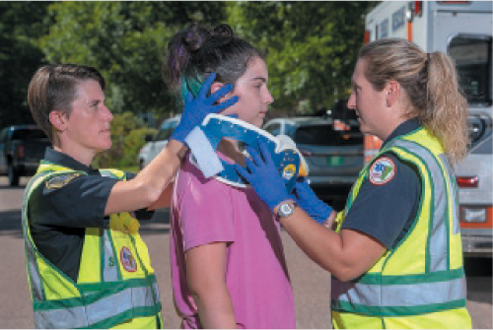
Spinal Motion Restriction Decision Making—Standing Patient (2 of 3)
Apply a cervical collar.
Notes:
Covers Objective: 33.4

Slide 73
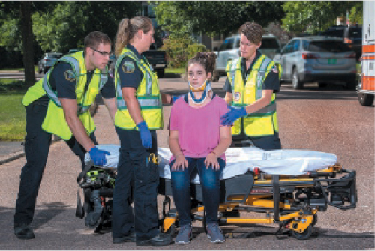
Spinal Motion Restriction Decision Making—Standing Patient (3 of 3)
Assist the patient to sit on the stretcher.
Notes:
Covers Objective: 33.4

Slide 74
Spinal Motion Restriction Decision Making—Patient Wearing a Helmet (1 of 3)
Face, neck, and spine care and airway management or resuscitation may require helmet removal
If the helmet is left on, lift shields and remove guards
If the airway is intact, do not attempt to remove a helmet if doing so causes pain or if the helmet is difficult to remove
Notes:
Covers Objective: 33.4
Point to Emphasize: Carefully judge the need to remove a helmet. When necessary, assure that appropriate resources are available.

Slide 75
Spinal Motion Restriction Decision Making—Patient Wearing a Helmet (2 of 3)
When to leave a helmet in place:
  It fits snugly, allowing little or no movement
  There are absolutely no airway or breathing issues
  Removal would cause further injury
  Proper spinal immobilization can be done with the helmet in place
  It does not interfere with E M T’s ability to assess airway or breathing
Notes:
Covers Objective: 33.4
Teaching Tip: Helmet removal is controversial surrounding spinal injury care. Embrace the discussion and encourage students to recognize the challenges of evidence-based medicine.

Slide 76
Spinal Motion Restriction Decision Making—Patient Wearing a Helmet (3 of 3)
When to remove a helmet:
  It interferes with the E M T’s ability to assess and manage the airway
  It is improperly fitted
  It interferes with immobilization
  Cardiac arrest is present
If an athlete is wearing shoulder pads and a helmet, either remove both or remove neither
If a helmet must be removed, use a two-rescuer procedure
Notes:
Covers Objective: 33.4
Teaching Tip: This is a psychomotor lesson. Have appropriate equipment and supervision on hand to effectively run this practical session.
Discussion Topics: Describe the indications for leaving a helmet in place and for removing a helmet.
Describe the steps involved in removing a helmet. Discuss why EMS and an athletic trainer might be better suited to helmet removal than an emergency room staff.

Slide 77
Chapter Review

Slide 78
Chapter Review (1 of 3)
The two main divisions of the nervous system are the central nervous system and the peripheral nervous system.
You should maintain a high index of suspicion for head or spine injury whenever there is a relevant mechanism of injury (M O I).

Slide 79
Chapter Review (2 of 3)
You must provide cervical spinal motion restriction before beginning any other patient care when head or spine injury is suspected.
Altered mental status is an early and important indicator of head injury. Monitor and document your patient’s mental status throughout the call.

Slide 80
Chapter Review (3 of 3)
A traumatic brain injury is any injury that disrupts function of the brain and may include anything from a slight concussion to a severe hematoma.
Always secure the torso to the backboard before the head.

Slide 81
Remember (1 of 3)
The key components of the nervous system are the brain and the spinal cord. These organs regulate thought, sensations, and motor functions.
The skull, vertebrae, and cerebrospinal fluid efficiently protect the brain and spinal cord.

Slide 82
Remember (2 of 3)
In a closed head injury, the skull remains intact. This is dangerous because the skull is a closed container with little room for bleeding or swelling.
Neck wounds are at risk for massive bleeding and air entry, causing emboli.
The spine is injured most often by compression or excessive flexion, by extension, or rotation from falls, by diving injuries, and by motor-vehicle collisions. These injuries can interrupt nervous system control of body functions.

Slide 83
Remember (3 of 3)
In-line immobilization of 33 spinal bones is the essential component of spinal injury immobilization.
Specific procedures apply to different immobilization and extrication situations. E M Ts should be proficient in handling the basics of these procedures.

Slide 84
Questions to Consider
Does my patient have a mechanism of injury that would indicate the need for spinal immobilization?
Do my patient’s potential head or spine injuries require prompt transport to a trauma center?
Notes:
Talking Points: Have students review the types of MOI that suggest spinal injury. Remind students of the importance of identifying increasing intracranial pressure in their judgment of whether a patient should be promptly transported.

Slide 85
Critical Thinking
You are treating a patient with a head injury. He has an altered mental status and a significant M O I to the head. Your partner thinks you should hyperventilate. When should you hyperventilate? What are the signs and symptoms that would indicate this is necessary?
Notes:
Talking Points: In some EMS systems, if the patient shows signs of increased intracranial pressure (such as decreased mental status associated with dilated pupils or sluggish pupil reaction, abnormal respiration patterns, increased systolic blood pressure, and a decreased pulse rate), EMTs are instructed to ventilate the patient with supplemental oxygen at the rate of approximately 20 breaths per minute. This slight hyperventilation will help reduce brain tissue swelling by lowering carbon dioxide levels and raising oxygen levels. The procedure is not without risk however. Too much ventilation can decrease blood flow to the brain. It is reserved for patients with critical head injuries, where the benefit is felt to outweigh the risk. Hyperventilating a breathing patient with a bag-valve mask and oral airway is extremely difficult to do and runs a serious risk of inflating the stomach and causing aspiration of stomach contents. Hyperventilation is not a routine part of the management for all head injury patients—only those who are believed to have increasing intracranial pressure.

Slide 86

Copyright
This work is protected by United States copyright laws and is provided solely for the use of instructors in teaching their courses and assessing student learning. Dissemination or sale of any part of this work (including on the World Wide Web) will destroy the integrity of the work and is not permitted. The work and materials from it should never be made available to students except by instructors using the accompanying text in their classes. All recipients of this work are expected to abide by these restrictions and to honor the intended pedagogical purposes and the needs of other instructors who rely on these materials.

Slide 87
Appendix 1
A skeleton with the central nervous system highlighted in orange and the peripheral nervous system highlighted in green. The central nervous system includes the brain and spinal cord, and the peripheral nervous system includes the nerve fibers throughout the body. The central nervous system controls all basic bodily functions and responds to external changes. The peripheral nervous system provides a complete network of motor and sensory nerve fibers connecting the central nervous system to the rest of the body.
Return to presentation

Slide 88
Appendix 2
The profile of a skull with various bones labeled, including the frontal bone located at the forehead, the sphenoid bone located at the middle front part of the skull, the nasal bone located at the bridge of the nose, the orbits located around the eyes, the lacrimal bone located near the orbits, the maxilla located at the upper jaw, the vomer located near the nasal septum, the mandible located at the lower jaw, the zygomatic bone located at the cheek, the temporomandibular, which is the joint between the mandible and temporal bone, the occipital bone located at the back lower part of the skull, the temporal bone located at the side of the skull, and the parietal bone located at the side of the skull just behind the frontal bone.
Return to presentation

Slide 89
Appendix 3
A side view and a back view of a skeleton’s skull and spine. The side view is labeled to show the seven cervical vertebrae in the neck, the twelve thoracic vertebrae from the base of the neck to the lower ribs, and the five lumbar vertebrae in the mid back. The back view is labeled to show the atlas C1 vertebrae and axis C2 vertebrae in the upper neck and the sacrum and coccyx at the base of the spine.
Return to presentation

Slide 90
Appendix 4
Three skulls with brain visible in each. The first skull shows bleeding between the brain and dura which is known as a subdural hematoma. The second skull shows bleeding between the brain and skull which known as an epidural hematoma. The third skull shows bleeding within the brain which is known as an intracerebral hematoma.
Return to presentation

Slide 91
Appendix 5
A Glasgow Coma Scale, which has three categories, eye opening, verbal response, and motor response. If a patient demonstrates spontaneous eye opening, he or she should receive a score of four, eye opening to voice indicates a score of three, eye opening to pain indicates a score of two, and no eye opening indicates a score of one. If a patient demonstrates oriented verbal response, he or she should receive a score of five, confused verbal response indicates a score of four, inappropriate words indicates a score of three, incomprehensible sounds indicates a score of two, and no verbal response indicates a score of one. If a patient demonstrates the motor response of obeying commands, he or she should receive a score of six, motor response for localized pain indicates a score of five, motor response for withdrawing from pain indicates a score of four, motor response for flexion pain indicates a score of three, motor response for extension pain indicates a score of two, and no motor response indicates a score of one. The bottom of the scale contains a spot for calculating the patient’s total score.
Return to presentation

Slide 92
Appendix 6
Diagram consists of three illustrations. The first illustration shows a woman injuring her spine after diving and hitting her spine and neck on the bottom of the pool. The second picture shows a man injuring his spine during a car accident by hitting his head on the car windshield. The third picture shows a woman injuring her spine during a car accident due to her natural reaction to move her head back and the impact coming from behind.
Return to presentation

