Slide 1

Emergency Care
Fourteenth Edition
Chapter 15
Secondary Assessment
Slides in this presentation contain hyperlinks. JAWS users should be able to get a list of links by using INSERT+F7
Copyright © 2021, 2016, 2012 Pearson Education, Inc. All Rights Reserved
Notes:
If this PowerPoint presentation contains mathematical equations, you may need to check that your computer has the following installed:
1) MathType Plugin
2) Math Player (free versions available)
3) NVDA Reader (free versions available)

Slide 2
Topics
The Secondary Assessment
Secondary Assessment of the Medical Patient
Secondary Assessment of the Trauma Patient
Detailed Physical Exam
Notes:
Planning Your Time: Plan 105 minutes for this chapter.
The Secondary Assessment (10 minutes)
Secondary Assessment of the Medical Patient (30 minutes)
Secondary Assessment of the Trauma Patient (50 minutes)
Detailed Physical Exam (15 minutes)
Note: The total teaching time recommended is only a guideline.
Core Concepts:
Components of the secondary assessment
Secondary assessment of the responsive medical patient
Secondary assessment of the unresponsive medical patient
Secondary assessment of the trauma patient with minor injury
Secondary assessment of the trauma patient with serious injury or multisystem trauma
Detailed physical exam

Slide 3
The Secondary Assessment
Back to Topics
Notes:
Teaching Time: 10 minutes
Teaching Tips: Build on previous lessons. Link secondary assessment to scene size-up and primary assessment. Use real-life examples to underscore the importance of an assessment that continues beyond the primary assessment. Students must learn flexibility from an early point. It is very important to underscore how a secondary assessment may be different based on patient condition.

Slide 4
Components of the Secondary Assessment (1 of 3)
Three categories of patients
  Medical patient
  Trauma patient
  Unknown patient
Notes:
Covers Objective: 15.1
Discussion Topic: Describe how the order of the secondary assessment might change depending on patient severity.

Slide 5
Components of the Secondary Assessment (2 of 3)
Physical examination
Patient history
  History of the present illness (H P I)
  Past medical history (P M H)
Vital signs
Notes:
Covers Objective: 15.1
Critical Thinking Discussion: Describe a patient situation where you might not be able to complete a secondary assessment.

Slide 6
Components of the Secondary Assessment (3 of 3)
Sign
  Something you can see
Symptom
  Something the patient tell you
Reassessment is a continual process.
Notes:
Covers Objective: 15.1
Discussion Topic: Describe the difference between a sign and a symptom.

Slide 7
Secondary Assessment of the Medical Patient
Back to Topics
Notes:
Teaching Time: 30 minutes
Teaching Tips: Use programmed patients of different ages and cultures to add reality to patient interview practice. Do not discount the value of physical examination in the medical patient. Utilize standardized skill sheets for patient history to provide students with a practice reference. Assessment of an unresponsive patient is a psychomotor skill. Use practical sessions to reinforce this lesson.

Slide 8
Secondary Assessment of the Medical Patient
Assessment varies depending on patient’s ability to communicate.
  Responsive medical patient
    Can answer history questions
  Unresponsive medical patient
    Cannot answer history questions
Notes:
Covers Objective: 15.2
Knowledge Application: Prior to the lesson, brainstorm with students to define what they feel are the important elements of a patient history.

Slide 9
Responsive Medical Patient
Obtain a patient history.
Perform physical exam.
Obtain baseline vital signs.
Administer interventions and transport the patient.
Notes:
Covers Objective: 15.2
Discussion Topic: Describe the assessment and examination of a responsive medical patient.

Slide 10
Obtain a Patient History
Obtain from patient first.
Obtain from family or bystanders if patient is unable to communicate.
Base questions on chief complaint or observations.
Ask open-ended questions.
Use SAMPLE mnemonic.
Notes:
Covers Objective: 15.2
Point to Emphasize: Speaking to a medical patient often provides important assessment information.
Discussion Question: Describe the procedure for establishing the history of the present illness in a medical patient. Describe the importance of using the mnemonics OPQRST and SAMPLE.

Slide 11
Tailoring the Physical Exam for Specific Chief Complaints
Important information can be gained by tailoring history to patient’s chief complaint.
Ask questions pertinent to chief complaint
Notes:
Covers Objective: 15.2

Slide 12
Perform a Physical Exam
Usually brief
Examine areas of concern based on chief complaint.
Notes:
Covers Objective: 15.2
Class Activity: Take a field trip. Visit a local nursing home and practice the assessment of a conscious medical patient with residents there.

Slide 13
Obtain Baseline Vital Signs (1 of 2)
Essential to assessment of medical patient
Later assessments of vital signs will be compared to baseline.
Take manual blood pressure to verify accuracy of automatic blood pressure device.
Notes:
Covers Objective: 15.2
Class Activity: (Skill Demonstration) Using standardized skill sheets and a programmed patient in a medical scenario of your choice, demonstrate the appropriate steps of a secondary assessment.

Slide 14
Administer Interventions and Transport the Patient
Remember a decision for prompt transportation of critical patients or those with specific complaints is part of a treatment plan.
Notes:
Covers Objective: 15.2
Knowledge Application: Have students work in pairs and conduct a simulated secondary assessment on their partner. Use cards to program specific complaints and elements of history.

Slide 15
Pediatric Note
Get on same level with child.
Put questions in simple language.
Gather information from caregivers.
Notes:
Covers Objective: 15.2

Slide 16
Think About It 1
Where would you focus your physical examination on a patient complaining of shortness of breath?
Notes:
Covers Objective: 15.2
Talking Points: You would focus on the chest and the respiratory system in general. Look at the chest. Listen to lung sounds. Palpate the chest looking for abnormalities.

Slide 17
Unresponsive Medical Patient
Begin with physical exam and baseline vital signs
Then gather history from relatives or bystanders
Do rapid assessment of entire body
Notes:
Covers Objective: 15.2
Point to Emphasize: In an unresponsive medical patient, physical findings and vital signs will guide the patient assessment.
Class Activity: Assign each student a medical scenario. Ask the student to determine which medical assessment strategy would be most appropriate.
Critical Thinking: In what ways might the assessment of an unconscious medical patient be similar to the assessment of a patient who does not speak your native language?

Slide 18
Perform a Rapid Physical Exam (1 of 3)
Similar to head-to-toe physical exam for trauma patient
Assess head, neck, chest, abdomen, pelvis, extremities, and posterior.
Notes:
Covers Objective: 15.2
Discussion Topic: Describe the process of assessing and examining an unresponsive medical patient.

Slide 19
Perform a Rapid Physical Exam (2 of 3)
Neck
  Jugular vein distention, medical identification devices
Chest
  Breath sounds
Abdomen
  Distention, firmness, or rigidity
Notes:
Covers Objective: 15.2

Slide 20
Perform a Rapid Physical Exam (3 of 3)
Pelvis
  Incontinence of urine or feces
Extremities
  Pulse, motor function, sensation, oxygen saturation, medical identification devices
Check for Medical I D devices.
Check pupils.
Notes:
Covers Objective: 15.2

Slide 21
Obtain Baseline Vital Signs (2 of 2)
Assess:
  Pulse
  Respirations
  Skin
  Pupils
  Blood pressure
Take note of any abnormalities.
Determine oxygen saturation.
Notes:
Covers Objective: 15.2
Class Activity: Use patient simulators and or programmed patients and have students perform medical assessments. Use a standardized skill sheet to teach the steps and to assess competency.

Slide 22
Consider a Request for A L S Personnel
Follow local protocols.
Consider if paramedics would benefit your patient.
Some areas may not have A L S options.
Consider the closest options for health facilities.
Notes:
Covers Objective: 15.2

Slide 23
Obtain a Patient History (1 of 2)
Question bystanders
  What is the patient’s name?
  What happened?
  Did you see anything else?
  Did the patient complain before this happened?
  Does patient have any known illnesses or problems?
  Is the patient taking any medications?
Notes:
Covers Objective: 15.2
Discussion Topics: Discuss how assessment of an unresponsive medical patient will differ from assessment of a responsive medical patient.
Knowledge Application: Divide the class into small groups. Use programmed patients to present a variety of assessment scenarios. Discuss assessment strategies.

Slide 24
Administer Interventions and Transport Patient
Look for mechanism of injury or signs that suggest a spine injury.
If needed, immobilize the patient’s spine.
Notes:
Covers Objective: 15.2

Slide 25
Think About It 2
What other mechanisms might you have to obtain patient history other than speaking to bystanders?
Notes:
Covers Objective: 15.2
Talking Points: Consider contacting the patient's family. Review the patient's medications. Review the scene for additional clues such as medical devices.

Slide 26
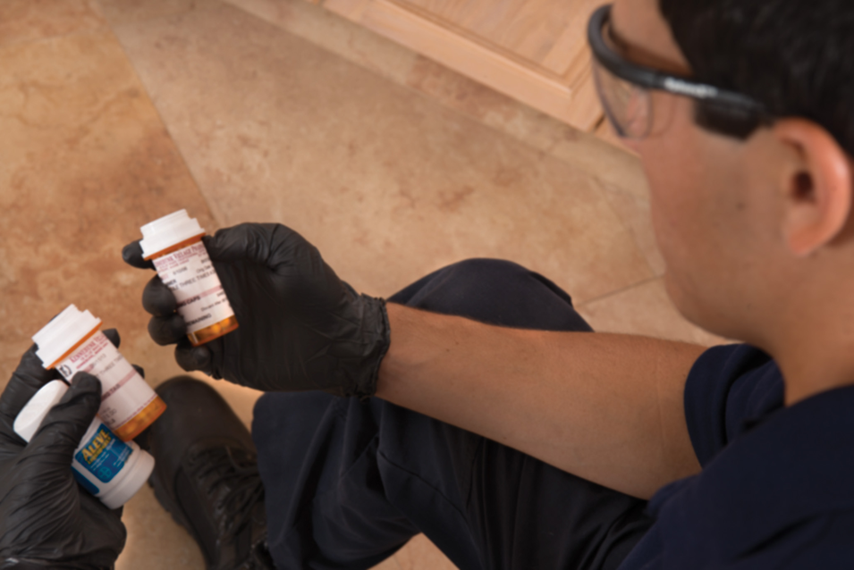
Think About It 3
Medical History. Interview family and bystanders for information about the present illness (O P Q R S T) and also the Sample history.
Notes:
Covers Objective: 15.2
Talking Points: Consider contacting the patient's family. Review the patient's medications. Review the scene for additional clues such as medical devices.

Slide 27
Mid-Chapter Review (1 of 11)
The secondary assessment of the medical patient takes two forms, depending on whether the patient is responsive.

Slide 28
Mid-Chapter Review (2 of 11)
You assess the responsive patient by obtaining a patient history, then performing a physical exam of affected parts of the body before getting baseline vital signs.

Slide 29
Mid-Chapter Review (3 of 11)
Since unresponsive medical patients cannot communicate, it is appropriate to start the assessment with a rapid physical exam. Baseline vital signs come next; then you interview family, friends, and bystanders to get any history that can be obtained.

Slide 30
Mid-Chapter Review (4 of 11)
You might not change any field treatment as a result of the information gathered here, but the results of the assessment may be very important to the emergency department staff.

Slide 31
Secondary Assessment of the Trauma Patient
Back to Topics
Notes:
Teaching Time: 50 minutes
Teaching Tips: Use a standardized skill sheet to give students a frame of reference from which to work. Use a programmed patient or anatomical model to demonstrate assessment technique. Initially, keep scenarios standardized. As students progress, add realistic twists.

Slide 32
Secondary Assessment of the Trauma Patient (1 of 2)
Injuries can range from slight to severe.
To determine how serious an injury is consider:
  Location of injury or injuries on patient
  Patient’s mental status
Notes:
Covers Objectives: 15.3 and 15.4
Points to Emphasize: The primary assessment evaluation and treatment must be completed before the secondary assessment. The secondary assessment of a trauma patient will be driven primarily by the mechanism of injury. EMTs generally assume spinal injury in the assessment of a trauma patient.
Talking Points: Enough time must be spent at the scene to adequately assess the patient and give proper emergency care. If the mechanism of injury is significant, you will do the focused history and physical exam differently than if the mechanism of injury is not significant.

Slide 33
Secondary Assessment of the Trauma Patient (2 of 2)
To determine how serious an injury is consider:
  Patient’s airway status
  Vital signs
  Mechanism of injury
  Patient’s age or preexisting conditions
Notes:
Covers Objectives: 15.3 and 15.4
Points to Emphasize: The primary assessment evaluation and treatment must be completed before the secondary assessment. The secondary assessment of a trauma patient will be driven primarily by the mechanism of injury. EMTs generally assume spinal injury in the assessment of a trauma patient.
Talking Points: Enough time must be spent at the scene to adequately assess the patient and give proper emergency care. If the mechanism of injury is significant, you will do the focused history and physical exam differently than if the mechanism of injury is not significant.

Slide 34
Trauma Patient with Minor Injury/Low Priority
Assessment is focused on areas patient notes are painful or that mechanism of injury indicates.
Determine the chief complaint
Conduct a history of present illness to gain information on how injury occurred
Notes:
Covers Objective: 15.4
Point to Emphasize: Although it is important to consider mechanism OF injury, a better way to look at this is to consider mechanism OR injury, because not just the mechanism of injury but also actual injuries to the patient must be assessed in forming a complete evaluation of the severity or potential severity of the patient's condition. In a trauma patient with no significant mechanism of injury, the secondary exam will focus on areas identified in the chief complaint and by the mechanism of injury.
Discussion Topic: Describe the process for assessing and examining a trauma patient with no significant mechanism of injury.

Slide 35
Determine the Chief Complaint
What the patient tells you is the matter
Notes:
Covers Objective: 15.4

Slide 36
Obtain a Patient History (2 of 2)
Nature of force involved
Direction and strength of force
Protective equipment used by patient
Actions taken to prevent or minimize injury
Areas of pain and injuries resulting from incident
Notes:
Covers Objective: 15.4
Point to Emphasize: When getting the patient history for a trauma patient, gather information on how the injury occurred in addition to relevant details. This information typically includes the nature of the force involved; the direction and strength of the force; equipment used to protect the patient; actions taken to prevent or minimize injury, and areas of pain and injuries resulting from the incident.

Slide 37
Perform an Physical Exam (1 of 5)
Areas assessed depend on injuries and chief complaint.
Mechanism of injury may point to potential injuries.
Three techniques: observation, palpation, and auscultation
Notes:
Covers Objective: 15.4
Point to Emphasize: When performing a physical exam, your decision on which areas of a patient's body to assess will depend partly on what you can see and what the patient tells you (the chief complaint). Mechanism of injury must also be considered.
Discussion Topic: What criteria should an EMT use to determine the “focus” of a focused exam?

Slide 38
Perform an Physical Exam (2 of 5)
Observe for abnormalities in:
  Symmetry
  Color
  Shape
  Movement
Notes:
Covers Objective: 15.4
Point to Emphasize: There are three techniques of physical examination that an EMT must master: observe, palpation, and auscultation.

Slide 39
Perform an Physical Exam (3 of 5)
Palpate for abnormalities in:
  Shape
  Temperature
  Texture
  Sensation
Notes:
Covers Objective: 15.4

Slide 40
Perform an Physical Exam (4 of 5)
Auscultate for:
  Decreased or absent breath sounds
Notes:
Covers Objective: 15.4

Slide 41
Perform an Physical Exam (5 of 5)
D C A P-B T L S
  Deformities
  Contusions
  Abrasions
  Punctures and penetrations
  Burns
  Tenderness
  Lacerations
  Swelling
Notes:
Covers Objective: 15.4
Point to Emphasize: DCAP-BTLS is a memory aid that is used when performing the physical examination. It stands for deformities, contusions, abrasions, punctures and penetrations, burns, tenderness, lacerations, and swelling.
Discussion Topic: Define and describe DCAP-BTLS.

Slide 42
Obtain Baseline Vital Signs
Early vital signs provide snapshot of stability.
Vital signs provide baseline for future assessment.
Notes:
Covers Objective: 15.4
Knowledge Applications: Prepare the students for practical sessions with a written exercise. Have students write out and practice the steps of the secondary exam.
Class Activity: (Skill Demonstration) Using standardized skill sheets and a programmed patient in a trauma scenario of your choice demonstrate the appropriate steps of a secondary assessment.

Slide 43
Spinal Motion Restriction–Applying a Cervical Collar (1 of 6)
Apply a cervical collar to any patient who requires spinal precautions.
Cervical-spine immobilization device should be rigid.
Make sure collar is right size.
Notes:
Covers Objective: 15.3
Point to Emphasize: Apply a cervical collar to any patient who may have an injury to the spine based on mechanism of injury, history, or signs and symptoms.

Slide 44
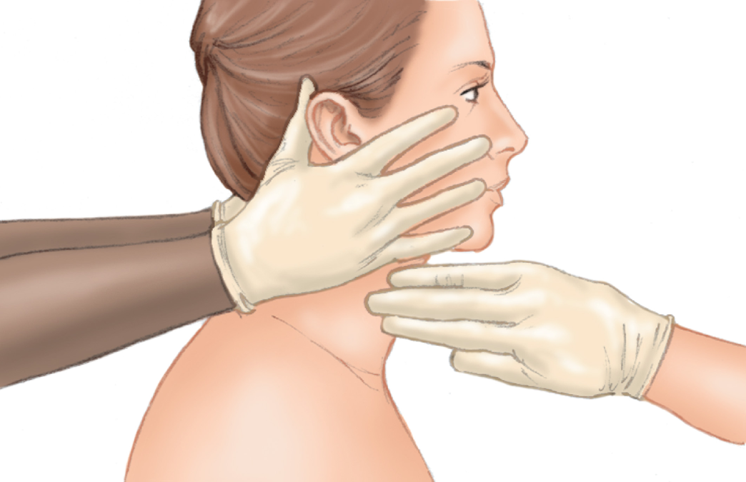
Spinal Motion Restriction–Applying a Cervical Collar (2 of 6)
Sizing a Cervical Collar: 1. Measure the patient’s neck.
Notes:
Covers Objective: 15.3
Point to Emphasize: Apply a cervical collar to any patient who may have an injury to the spine based on mechanism of injury, history, or signs and symptoms.

Slide 45
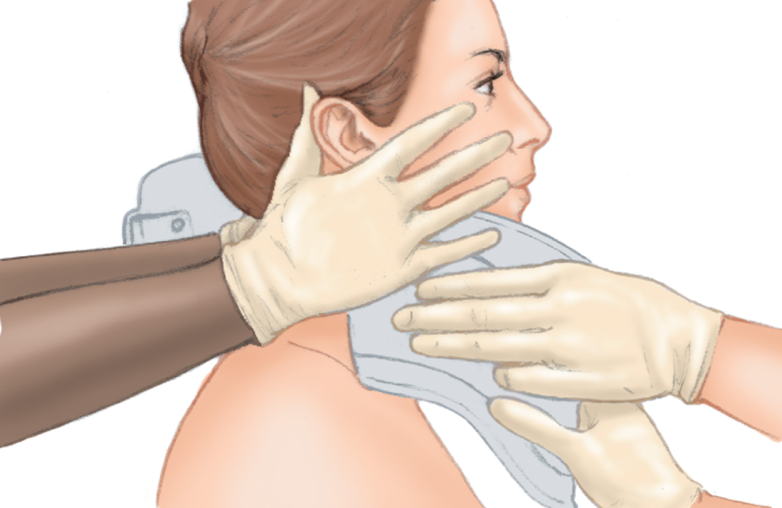
Spinal Motion Restriction–Applying a Cervical Collar (3 of 6)
For long description, see slide 95: Appendix 1
Sizing a Cervical Collar: 2. Measure the collar. The chin piece should not lift the patient’s chin and hyperextend the neck. Make sure the collar is not too small or tight, which would make the collar act as a constricting band.
Notes:
Covers Objective: 15.3
Point to Emphasize: Apply a cervical collar to any patient who may have an injury to the spine based on mechanism of injury, history, or signs and symptoms.

Slide 46
Spinal Motion Restriction–Applying a Cervical Collar (4 of 6)
Complete the primary assessment and care for life-threatening problems before applying the collar.
Use mechanism of injury and patient condition to determine the need for cervical immobilization.
Assess patient’s neck prior to placing collar.
Reassure patient.
Notes:
Covers Objective: 15.3

Slide 47
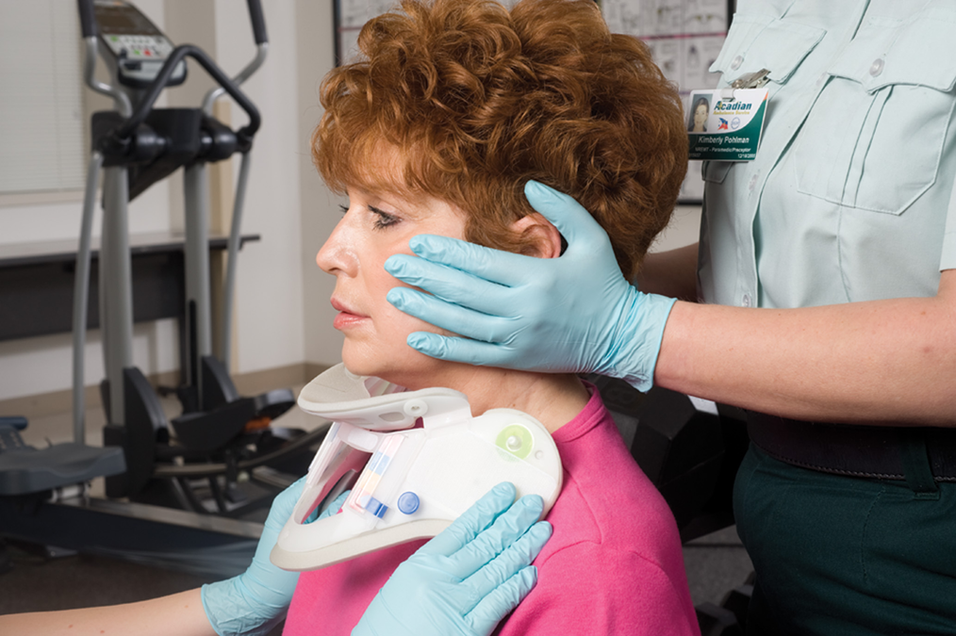
Spinal Motion Restriction–Applying a Cervical Collar (5 of 6)
For long description, see slide 96: Appendix 2
Applying an Adjustable Collar to a Seated Patient
Notes:
Covers Objective: 15.3
Class Activity: Bring several types and sizes of cervical-spine immobilization devices to class and allow students to fit other students with the appropriate size device and practice securing the collar.

Slide 48
Spinal Motion Restriction–Applying a Cervical Collar (6 of 6)
Size collar.
Remove jewelry and move hair.
Keep patient’s head in the in-line anatomical position.
Notes:
Covers Objective: 15.3

Slide 49
Trauma Patient with Serious Injury or Multisystem Trauma/High Priority (1 of 2)
Continue spinal stabilization
Consider a request for Advanced Life Support (A L S) personnel
Perform a rapid trauma assessment
  Complete head-to-toe assessment
Notes:
Covers Objectives: 15.3 and 15.4
Point to Emphasize: In a trauma patient with a significant mechanism of injury, a rapid trauma exam will provide a more expedited physical exam in anticipation of rapid transport. Additionally, there are additional steps that you will need to perform on a patient with a significant mechanism of injury compared to the steps for the patient with no significant mechanism of injury.
Discussion Topic: How might a secondary assessment in a trauma patient with no significant mechanism of injury differ from a secondary assessment in a trauma patient with a significant mechanism of injury?

Slide 50
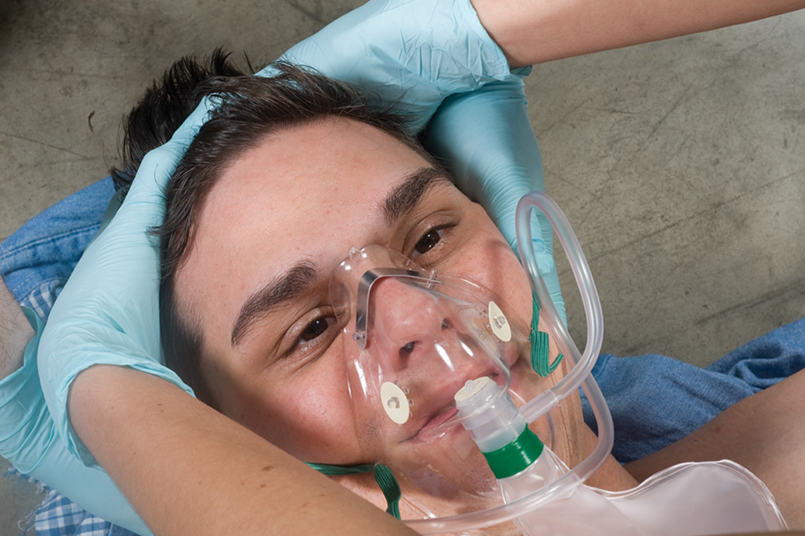
Physical Examination of the Trauma Patient (1 of 5)
Rapid trauma assessment: Rapidly assess each part of the body. Head: Check for wounds, tenderness, and deformities plus crepitation.
Notes:
Covers Objectives: 15.3 and 15.4

Slide 51
Trauma Patient with Serious Injury or Multisystem Trauma/High Priority (2 of 2)
Consider hidden injuries
  Seat belt injuries
  Airbag injuries
  Steering wheel injuries
Notes:
Covers Objectives: 15.3 and 15.4
Point to Emphasize: Although the mechanism of injury can provide a lot of information about the kinds of injuries a patient may have, there is still the possibility that patients will have "hidden injuries."
Knowledge Application: Use multimedia graphics to illustrate various mechanisms of injury. Present scenarios and have students discuss the type of secondary assessment that they would use in each case.

Slide 52
Continue Spinal Precautions
Manually stabilize the patient’s head.
Follow local protocols.
Notes:
Covers Objectives: 15.3 and 15.4

Slide 53
Consider a Request for Advanced Life Support Personnel
Paramedics can provide additional interventions.
Follow local protocols.
Familiarize yourself with the types of patients local clinics can help.
Notes:
Covers Objectives: 15.3 and 15.4

Slide 54
Perform a Rapid Trauma Assessment (1 of 6)
Requires only a few moments
Should be performed at scene
Care provided en route will be based on this assessment.
Notes:
Covers Objectives: 15.3 and 15.4
Discussion Topic: Describe the steps involved in a rapid trauma assessment.

Slide 55
Perform a Rapid Trauma Assessment (2 of 6)
Rapid assessment of the head
  Palpate cranium, face, ears, eyes, nose, and mouth
  Blood or clear fluid and Battle’s sign are serious findings.
Rapid assessment of the neck
  Wounds, tenderness, deformities, and jugular vein distention
  Stoma or tracheostomy
Notes:
Covers Objectives: 15.3 and 15.4
Knowledge Application: Use manikins to practice rapid trauma assessments. Coach this session well and have a keen eye for time. Do not let students turn rapid trauma assessments into detailed assessments.

Slide 56
Perform a Rapid Trauma Assessment (3 of 6)
Application of a cervical collar
  Size and apply if indicated by protocols
Rapid assessment of the chest
  Paradoxical motion, crepitation, and breath sounds
  Rib cage and chest must be exposed.
Notes:
Covers Objectives: 15.3 and 15.4
Knowledge Application: Use manikins to practice rapid trauma assessments. Coach this session well and have a keen eye for time. Do not let students turn rapid trauma assessments into detailed assessments.
Critical Thinking Discussion: You are treating a trauma patient approximately three blocks away from the hospital, and you find yourself needing to maintain his airway. How will you complete the secondary assessment of this patient?

Slide 57
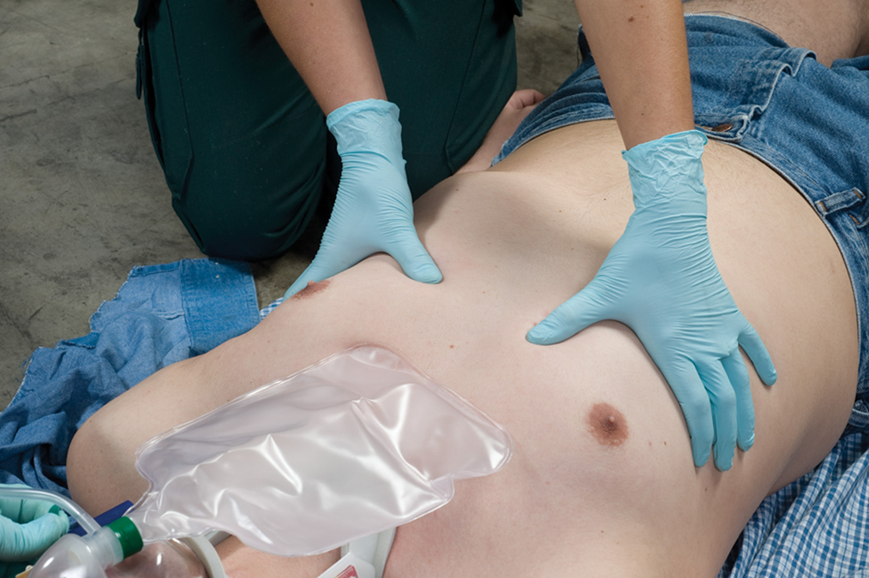
Physical Examination of the Trauma Patient (2 of 5)
Rapid trauma assessment: Rapidly assess each part of the body. Chest: Inspect and palpate for wounds, tenderness, and deformities, plus crepitation and paradoxical motion.
Notes:
Covers Objectives: 15.3 and 15.4

Slide 58
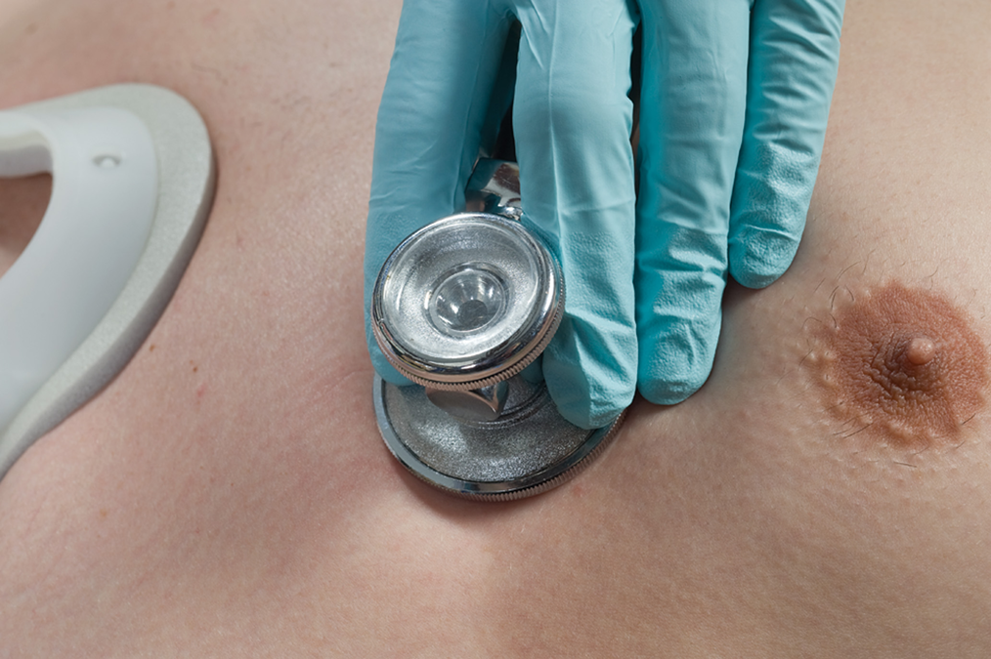
Physical Examination of the Trauma Patient (3 of 5)
Rapid trauma assessment: Rapidly assess each part of the body.
Chest: Auscultate for breath sounds (presence, absence, and equality).
Notes:
Covers Objectives: 15.3 and 15.4

Slide 59
Perform a Rapid Trauma Assessment (4 of 6)
Rapid assessment of the abdomen
  Distention, pulsating mass
  Gently press down on quadrants.
Rapid assessment of the pelvis
  Bleeding
  Priapism
Notes:
Covers Objectives: 15.3 and 15.4
Knowledge Application: Use manikins to practice rapid trauma assessments. Coach this session well and have a keen eye for time. Do not let students turn rapid trauma assessments into detailed assessments.

Slide 60
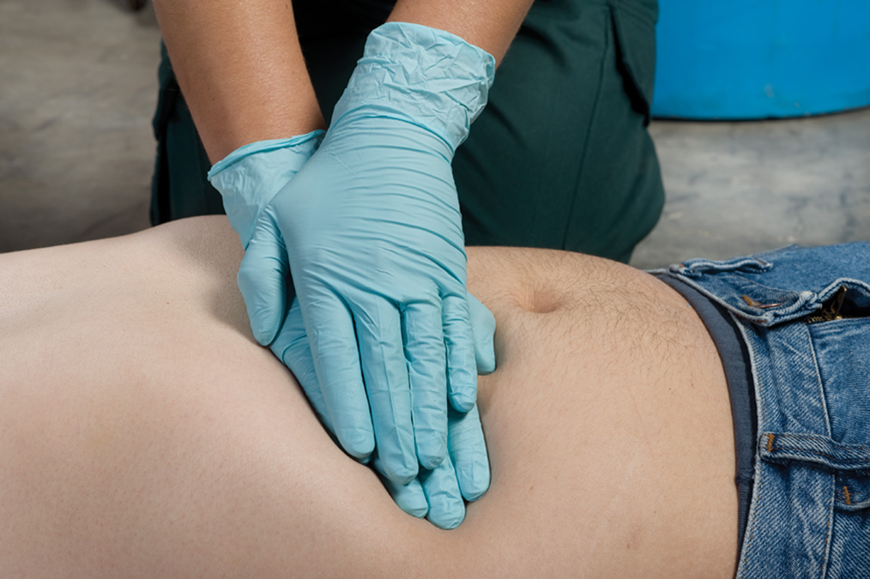
Physical Examination of the Trauma Patient (4 of 5)
Rapid trauma assessment: Rapidly assess each part of the body.
Abdomen: Check for wounds, tenderness, and deformities plus firm, soft, and distended areas.
Notes:
Covers Objectives: 15.3 and 15.4

Slide 61
Perform a Rapid Trauma Assessment (5 of 6)
Rapid assessment of the extremities
  Wounds, tenderness, deformities
  Circulation, sensation, and motor function
Notes:
Covers Objectives: 15.3 and 15.4
Knowledge Application: Use manikins to practice rapid trauma assessments. Coach this session well and have a keen eye for time. Do not let students turn rapid trauma assessments into detailed assessments.

Slide 62
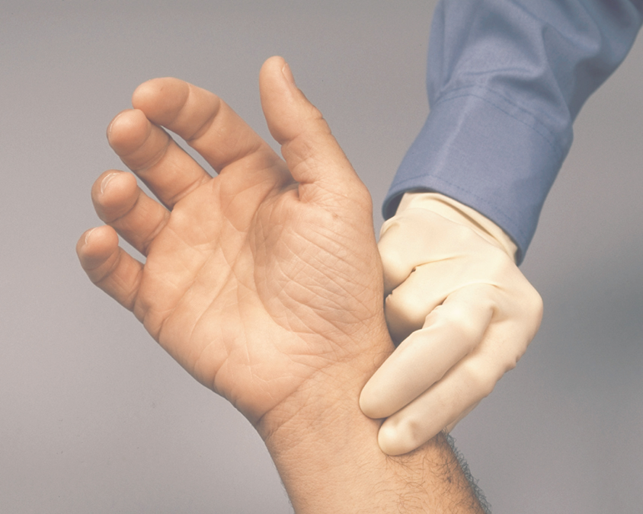
Assessing Distal Function (1 of 4)
1. Assess distal circulation in the upper extremities by feeling for radial pulses.
Notes:
Covers Objectives: 15.3 and 15.4

Slide 63
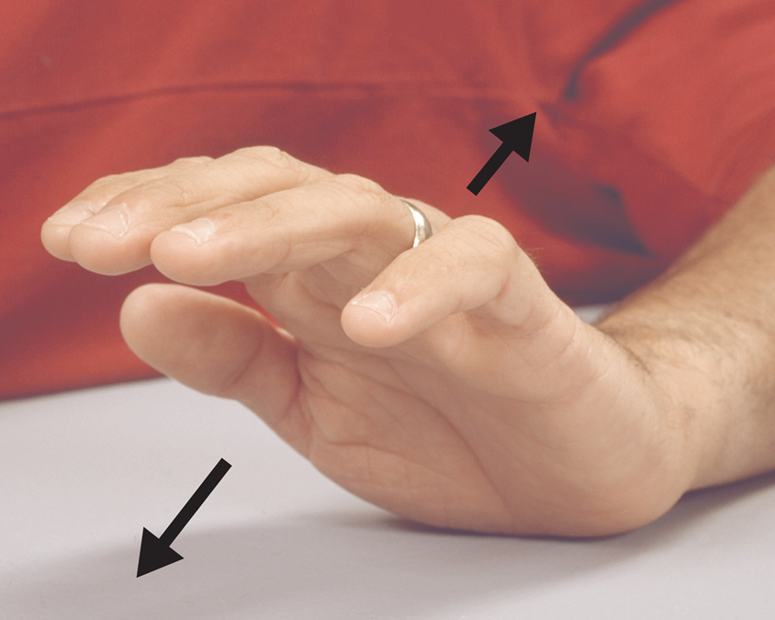
Assessing Distal Function (2 of 4)
2. Assess distal motor function by checking the patient’s ability to move both hands.
Notes:
Covers Objectives: 15.3 and 15.4

Slide 64
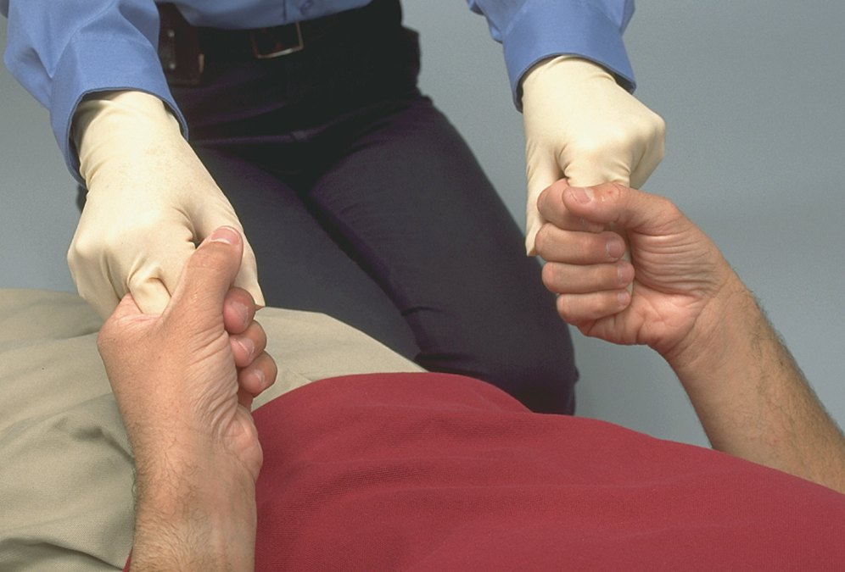
Assessing Distal Function (3 of 4)
3. Assess strength in the hands by asking the patient to squeeze your fingers.
Notes:
Covers Objectives: 15.3 and 15.4

Slide 65
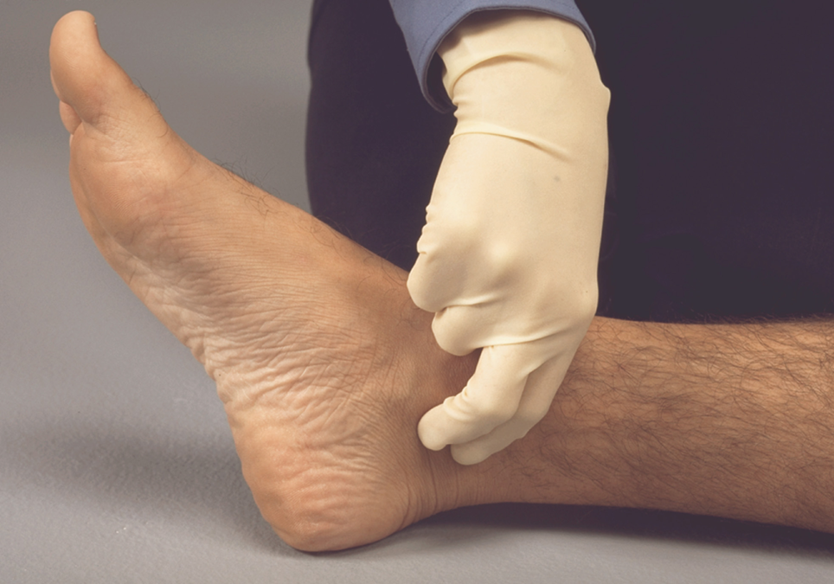
Assessing Distal Function (4 of 4)
5. Check distal circulation in the lower extremities by feeling the posterior tibial pulse just behind the medial malleolus of the ankle.
Notes:
Covers Objectives: 15.3 and 15.4

Slide 66
Perform a Rapid Trauma Assessment (6 of 6)
Rapid assessment of the posterior body
  Roll patient on side, then assess
  Slide in an extrication device to enable movement of the patient
Obtain baseline vital signs and past medical history
  Use pulse oximeter if applicable
Notes:
Covers Objectives: 15.3 and 15.4
Knowledge Application: Use manikins to practice rapid trauma assessments. Coach this session well and have a keen eye for time. Do not let students turn rapid trauma assessments into detailed assessments.
Class Activity: (Skill Demonstration) Using standardized skill sheets and a programmed patient in a trauma scenario of your choice, demonstrate the appropriate steps of a secondary assessment.

Slide 67
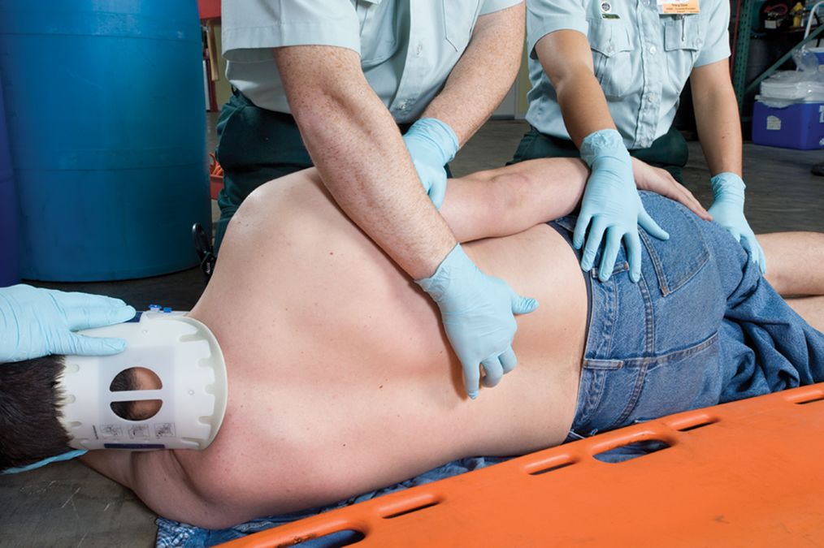
Physical Examination of the Trauma Patient (5 of 5)
Rapid trauma assessment: Rapidly assess each part of the body. Posterior: Check for wounds, tenderness, and deformities. (To examine posterior, roll patient using spinal precautions.)
Notes:
Covers Objectives: 15.3 and 15.4
Discussion Topic: Describe the assessment and physical examination of a trauma patient with a significant mechanism of injury.

Slide 68
Some General Principles
Tell patient what you are going to do.
Expose injured area before examining it.
Maintain eye contact.
Apply spinal protocols.
Stop or alter assessment process to provide care.
Notes:
Covers Objectives: 15.3 and 15.4
Talking Points: Respect cultural modesties and differences as you lay hands on a patient. Be sensitive to their feelings and misgivings. Communicate.
Discussion Topic: Describe the importance of communicating with your patient during assessment.

Slide 69
Pediatric Examination (1 of 4)
Head
  Do not apply pressure to fontanelles
  Collisions can produce head injuries
Nose and ears
  Look for blood and clear fluids
  Mucus or blood clot obstructions can disrupt breathing
Notes:
Covers Objectives: 15.3 and 15.4
Discussion Topic: Discuss the differences in pediatric examination compared to adult examination.

Slide 70
Pediatric Examination (2 of 4)
Neck
  Proportionately larger heads increase chance of spinal cord injury
  Can have spinal cord injury without spinal bone fractures
Airway
  Keep infant’s head in neutral position
  Keep child’s head in neutral-plus or sniffing position
Notes:
Covers Objectives: 15.3 and 15.4
Class Activity: Assign each student a pediatric trauma scenario. Ask the student to determine which type of secondary assessment would be most appropriate under the circumstances.

Slide 71
Pediatric Examination (3 of 4)
Chest
  Check for even breath sounds
  Check for symmetry, bruising, paradoxical movement, and retraction
Abdomen
  Note rigid or tender areas and distention
  Injury that impedes movement of diaphragm can compromise breathing
Notes:
Covers Objectives: 15.3 and 15.4

Slide 72
Pediatric Examination (4 of 4)
Pelvis
  Check stability of pelvic girdle
Extremities
  Capillary refill and distal pulse
  Check for painful, swollen, and deformed injury sites
Notes:
Covers Objectives: 15.3 and 15.4

Slide 73
Think About It 4
What criteria would you use to decide whether to perform a focused physical exam or a rapid trauma exam?
Notes:
Covers Objectives: 15.3 and 15.4
Talking Points: A focused physical exam is used for patients with no significant mechanism of injury. A rapid trauma exam is used for severely injured patients, patients who are unable to communicate with providers, or patients with a significant mechanism of injury.

Slide 74
Detailed Physical Exam
Back to Topics
Notes:
Teaching Time: 15 minutes
Teaching Tips: Emphasize a “hands on” approach. This lesson is easy to verbalize; however, a good detailed assessment requires actual contact with the patient.

Slide 75
Detailed Physical Exam
Typically completed en route to hospital
Gathers additional information
Helps determine treatment for patient
Information will assist emergency department staff
Performed most often on trauma patient with significant injury
Notes:
Covers Objective: 15.4
Points to Emphasize: Performing a detailed physical exam is always a lower priority than addressing life-threatening problems. The purpose of the detailed physical exam is to gather additional information about the patient's injuries that was not found in the primary or secondary assessments.
Talking Points: It is reasonable to defer the detailed exam for critical intervention. Frequently this will mean that a detailed exam does not get initiated before arrival at the ED. This is acceptable. However, when possible the detailed assessment should be completed because it may identify problems not found in the less detailed rapid trauma exam.
Discussion Topics: Considering the overall patient assessment, discuss when a detailed assessment would be utilized.

Slide 76
Trauma Patient with a Significant Injury
For these patients, you will have assessed almost the entire body during the rapid trauma assessment.
Now need to assess the entire body more thoroughly to possibly reveal signs or symptoms of injury you may have missed or have changed since the rapid trauma assessment.
Notes:
Covers Objective: 15.4
Points to Emphasize: The detailed assessment is similar to the rapid trauma assessment but is conducted with a higher level of scrutiny. The more severe the mechanism of injury, the higher the requirement to search for subtle injuries (if time and patient status allow).
Discussion Topic: Compare and contrast the detailed assessment and the rapid trauma assessment. How are they similar? How are they different?
Class Activity: Have students write out a detailed assessment. Assign homework to list the components of a detailed assessment. Ask students to attempt to list from memory first and then to correct the list using resources.
Knowledge Applications: Assign detailed assessments as homework. Have students complete standardized skill sheets at home. Assign five detailed assessments to be completed prior to the next session. Have students work in groups. Assign each group a region of the body; then have the groups discuss the potential traumatic findings associated with a detailed assessment.

Slide 77
Before Beginning the Detailed Physical Exam
Remember to perform this only after you have performed all critical interventions.
If you are treating a severely injured patient and are too busy to complete the detailed exam, it is not a failure.
  It is your responsibility to give the patient the best care possible, which may mean skipping the exam in order to maintain A B Cs.
Notes:
Covers Objective: 15.4

Slide 78
Performing the Detailed Physical Exam
Expose patient.
Noise and motion may interfere with some procedures.
Work around immobilization equipment.
Components similar to rapid trauma exam
  More detail and focus
Notes:
Covers Objective: 15.4

Slide 79
Trauma Patient Who Is Not Seriously Injured
Generally does not need a detailed physical exam
Keep a high index of suspicion, and when in doubt perform a detailed physical exam.
Be aware of patient’s fear and need for emotional support.
Notes:
Covers Objective: 15.4
Critical Thinking Discussion: What findings might you look for in the detailed assessment of a medical patient?
Knowledge Applications: Have students work in groups. Assign each group a trauma scenario and a specific type of patient. Have the groups discuss how and when they would conduct their detailed assessments.

Slide 80
Think About It 5
Is it necessary to always complete a detailed assessment on a trauma patient with no significant mechanism or injury?
Notes:
Covers Objective: 15.4
Talking Points: This is a difficult question. Although it may not be absolutely necessary, you must assure that all the elements of a detailed assessment can be addressed. This may mean communicating with the conscious patient or it may mean actually completing a detailed assessment. Each situation must be judged individually, and this decision depends greatly upon your confidence level and the patient's ability to communicate problems.

Slide 81
Chapter Review

Slide 82
Mid-Chapter Review (5 of 11)
The patient without a significant mechanism of injury receives a history of the present illness and physical exam focused on areas that the patient complains about and areas that you think may be injured based on the mechanism of injury.
Next, gather a set of baseline vital signs and a past medical history.

Slide 83
Mid-Chapter Review (6 of 11)
For the patient with a significant injury or M O I, provide spinal precautions, consider whether to call advanced life support personnel (if available), get a brief patient history, and perform a rapid trauma assessment.

Slide 84
Mid-Chapter Review (7 of 11)
In the rapid trauma assessment, look for wounds, tenderness, and deformities, plus certain additional signs appropriate to the part being assessed (as summarized in Table 15-5). Systematically examine the head, neck, chest, abdomen, pelvis, extremities, and posterior body.

Slide 85
Mid-Chapter Review (8 of 11)
After assessing the neck, it may be appropriate to apply a cervical collar. After completing the physical assessment, provide spine motion restrictions and get a baseline set of vital signs and a past medical history.

Slide 86
Mid-Chapter Review (9 of 11)
After you have performed the appropriate critical interventions and begun transport, the patient may receive a detailed physical exam en route to the hospital.

Slide 87
Mid-Chapter Review (10 of 11)
The detailed physical exam is very similar to the rapid trauma assessment, but there is time to be more thorough in the assessment. The detailed physical exam does not take place before transport unless transport is delayed.

Slide 88
Mid-Chapter Review (11 of 11)
The detailed physical exam is most appropriate for the trauma patient who is unresponsive or has a significant injury or unknown M O I.
A responsive trauma patient with no significant injury or M O I will seldom require a detailed physical exam.

Slide 89
Remember
Use M O I to determine the need for a rapid trauma assessment.
Assume spinal injury.
Work as a team to complete the assessment.

Slide 90
Questions to Consider (1 of 2)
How do the focused physical exam of a trauma patient with a significant M O I differ from those for a trauma patient with no significant M O I?
Notes:
Talking Points: A focused physical exam is used for patients with no significant MOI. In this case, a conscious patient will direct you to specific areas of pain or injury. In some cases, MOI will help focus your assessment. A rapid trauma exam is used for severely injured patients, patients who are unable to communicate with providers, or patients with a significant MOI. In this case, the exam covers the entire body to identify unseen injuries and potential life threats. MOI guides this, but the scope is the entire body.

Slide 91
Questions to Consider (2 of 2)
List the steps and areas covered in the rapid trauma assessment. How are these steps different in the detailed assessment?
Notes:
Talking Points: The areas covered include the head, neck, chest, abdomen, pelvis, back, extremities, and baseline vitals. These areas are the same in a detailed assessment, but the level of detail and time spent in each area is greater.

Slide 92
Critical Thinking (1 of 2)
You are assessing a patient who fell three stories. He is unresponsive and bleeding into his airway. The driver of the ambulance is positioning the vehicle and bringing equipment to you.

Slide 93
Critical Thinking (2 of 2)
How do you balance the patient’s need for airway control (he requires frequent suctioning) with the need to assess his injuries?
Notes:
Talking Points: In this case, airway management takes priority over assessment. Any time a life threat is identified, care must begin.

Slide 94

Copyright
This work is protected by United States copyright laws and is provided solely for the use of instructors in teaching their courses and assessing student learning. Dissemination or sale of any part of this work (including on the World Wide Web) will destroy the integrity of the work and is not permitted. The work and materials from it should never be made available to students except by instructors using the accompanying text in their classes. All recipients of this work are expected to abide by these restrictions and to honor the intended pedagogical purposes and the needs of other instructors who rely on these materials.

Slide 95
Appendix 1
Measure the collar. The chin piece should not lift the patient’s chin and hyperextend the neck. Make sure the collar is not too small or tight, which would make the collar act as a constricting band.
Return to presentation

Slide 96
Appendix 2
An Emergency Medical Technician holds a patient’s head and neck inline to stabilize the spine while a second Emergency Medical Technician approaches the patient from the front and properly angles a cervical collar.
Return to presentation

