Slide 1
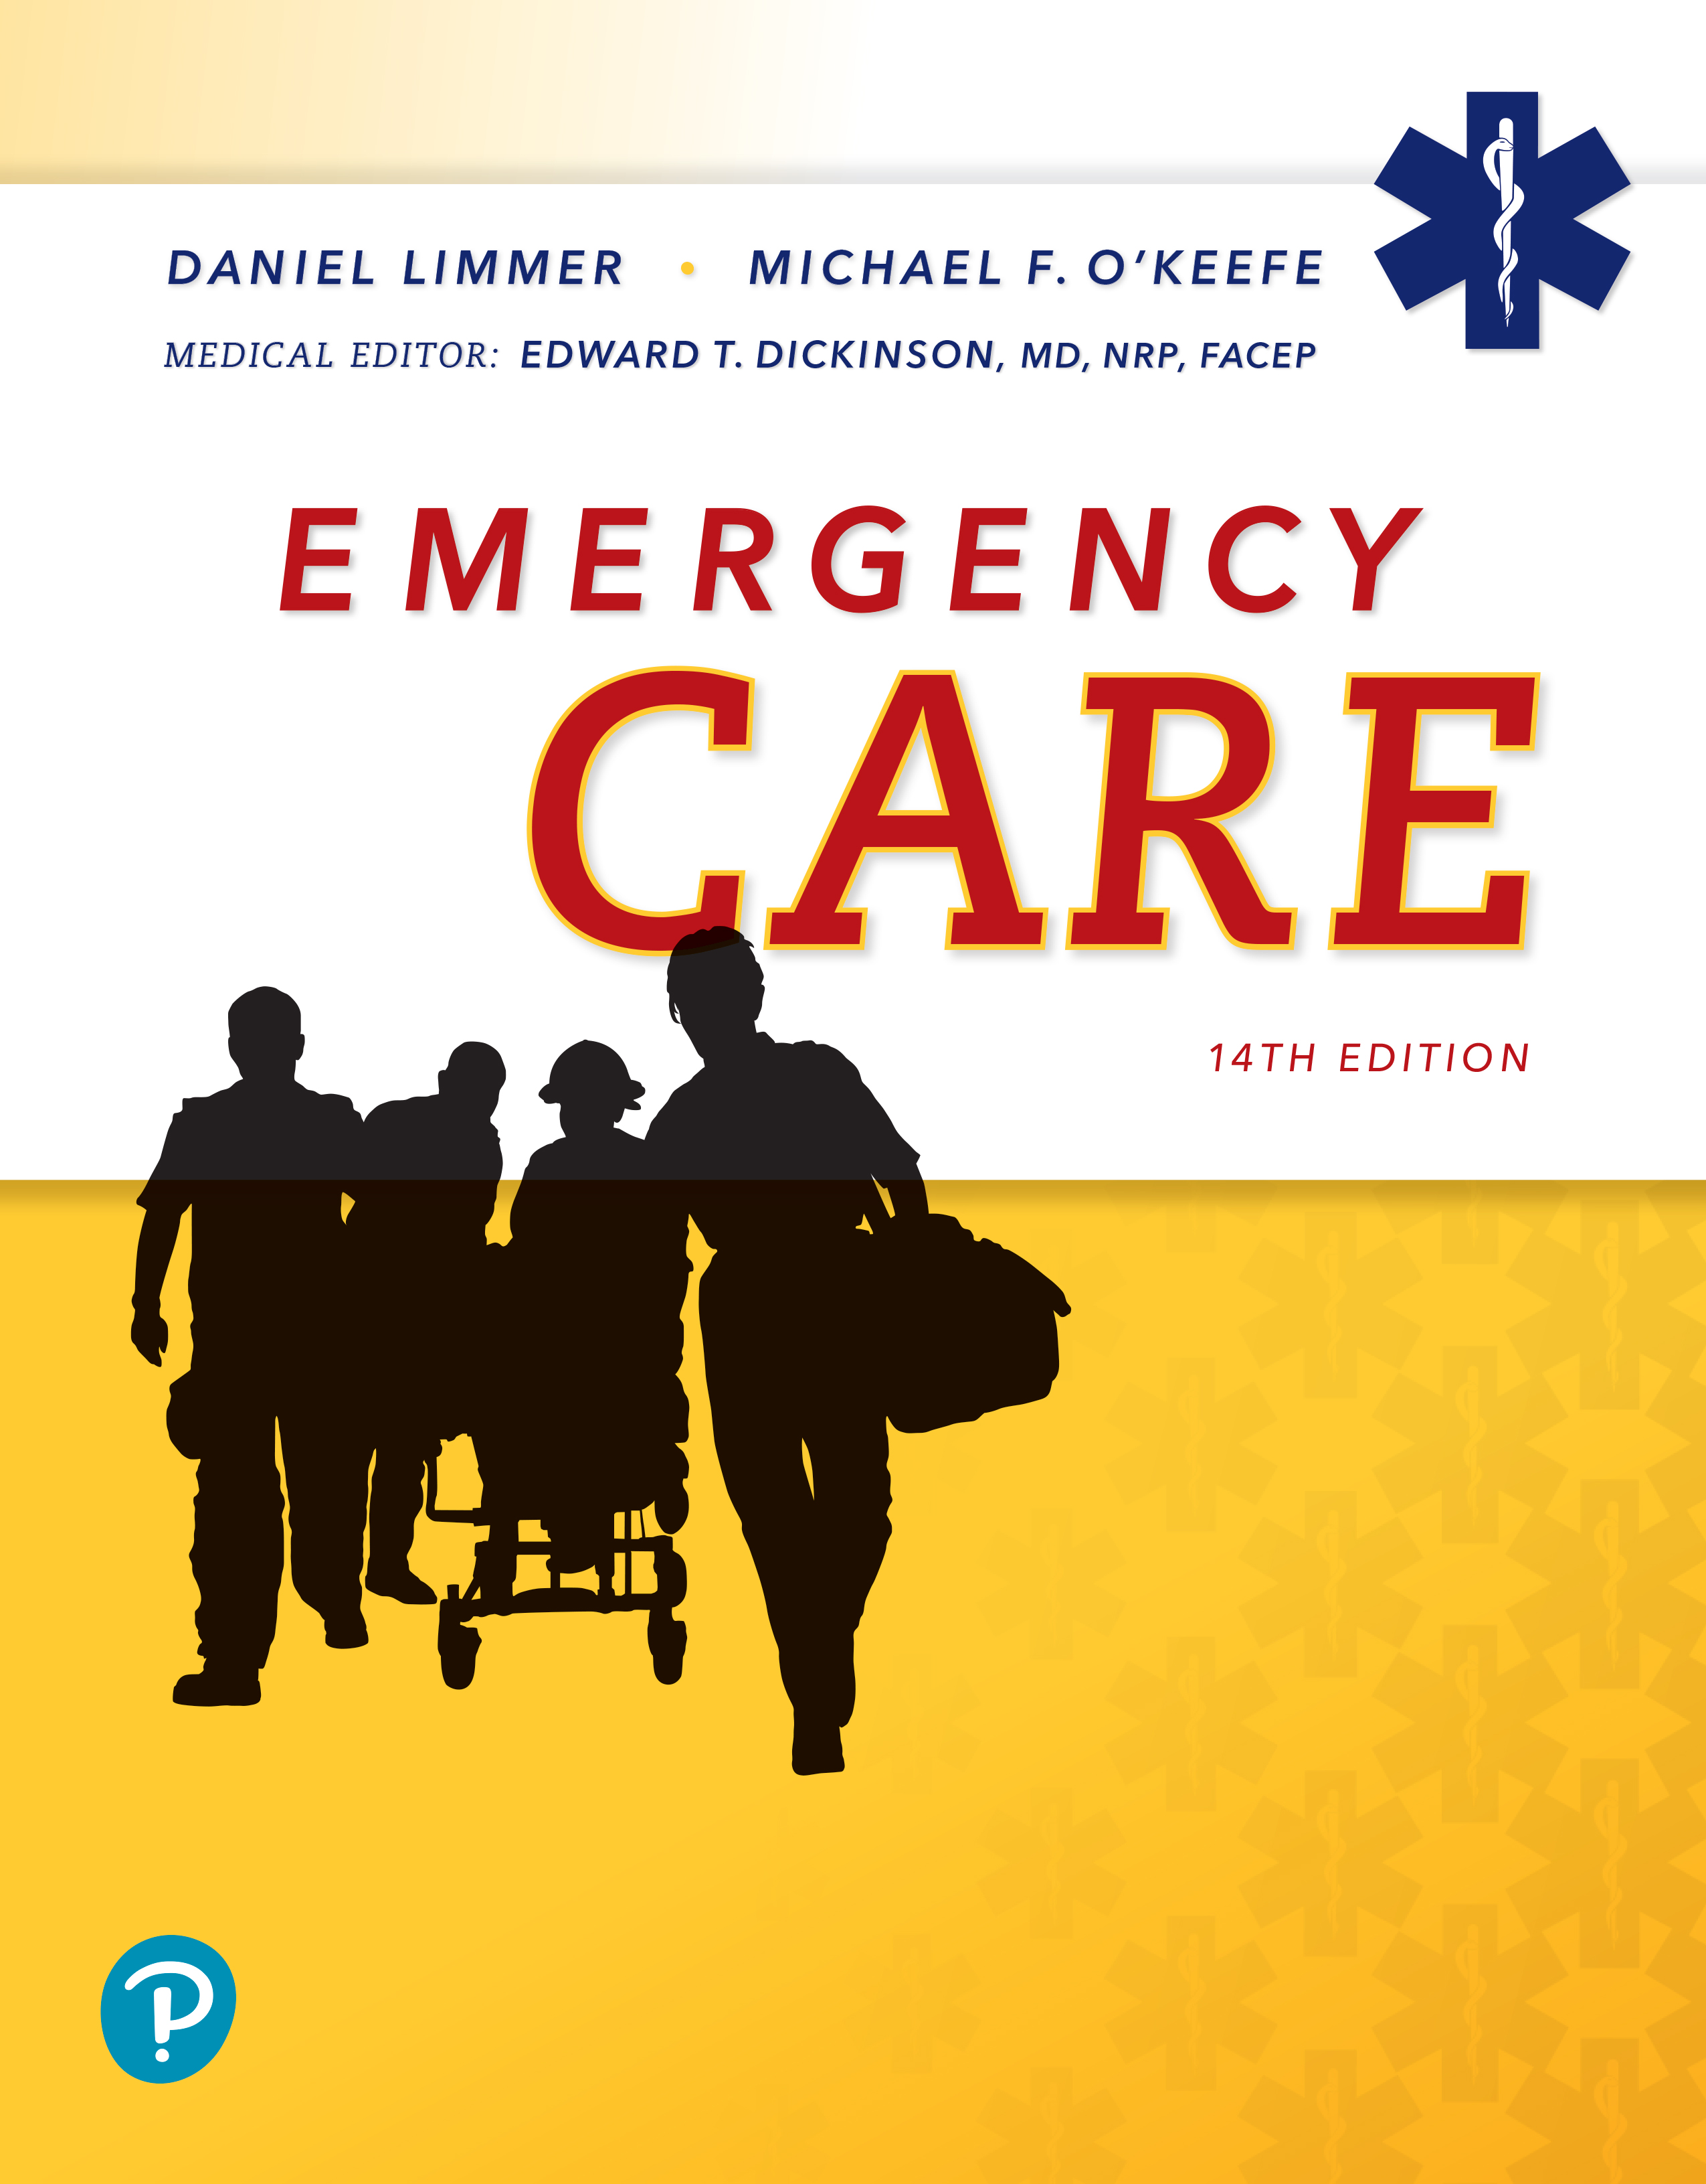
Emergency Care
Fourteenth Edition
Chapter 13
Vital Signs and Monitoring Devices
Slides in this presentation contain hyperlinks. JAWS users should be able to get a list of links by using INSERT+F7
Copyright © 2021, 2016, 2012 Pearson Education, Inc. All Rights Reserved
Notes:
If this PowerPoint presentation contains mathematical equations, you may need to check that your computer has the following installed:
1) MathType Plugin
2) Math Player (free versions available)
3) NVDA Reader (free versions available)

Slide 2
Topics
Gathering the Vital Signs
Vital Signs
Monitoring Devices
Notes:
Planning Your Time: Plan 110 minutes for this chapter.
Gathering the Vital Signs (10 minutes)
Vital Signs (60 minutes)
Monitoring Devices (40 minutes)
Note: The total teaching time recommended is only a guideline.
Core Concepts:
How to obtain vital signs, including pulse, respirations, blood pressure, skin, temperature, and pupils
How to document vital signs on a prehospital care report
How to use various monitoring devices

Slide 3
Gathering the Vital Signs
Back to Topics
Notes:
Teaching Time: 10 minutes
Teaching Tips: Describe the consequences of not obtaining vital signs. Use real-world examples. Describe specific treatment scenarios that prevent assessment of vital signs. Emphasize that these scenarios are the exception and that they come with consequences.

Slide 4
Gathering the Vital Signs
Vital signs
  Major components of assessment that will take a few minutes to complete
  Vast majority of patients should have an assessment that includes vital signs measurement
  Help indicate important conditions or trends in patient conditions that require particular treatments in the field or that prompt transport to a hospital
  Taken during secondary assessment after primary assessment to find and treat immediate life threats
Notes:
Covers Objective: 13.1
Points to Emphasize: Whenever possible, EMTs should obtain vital signs on every patient. Occasionally, emergency treatment will prevent obtaining a full set of vital signs.
Discussion Topics: Discuss why it is important to obtain vital signs on every patient. Describe a specific treatment that might prevent you from obtaining a full set of vital signs.
Knowledge Application: Discuss the importance of vital signs. Ask students to brainstorm why these signs are important. List the responses. Present a variety of verbal scenarios. Ask the class whether the treatments detailed in the scenarios would interfere with the assessment of vital signs. Discuss why and what the consequences might be.
Critical Thinking Discussion: You are assessing a 72-year-old man who had a "fainting spell." He is refusing care, and he tells you that he does not want you to take his vital signs. What do you do? Why might vitals be particularly important for this patient?

Slide 5
Vital Signs
Back to Topics
Notes:
Teaching Time: 60 minutes
Teaching Tips: Teach the technique of measuring vital signs in this lesson, but continue practicing it throughout the class. Instead of verbalizing vitals in scenarios and practice, require students actually to obtain them. Relate vital signs to previous discussions of anatomy and physiology. Add meaning to these technical skills. Practice, practice, practice! Repetition of obtaining normal vital signs will improve students' ability to obtain abnormal vital signs.

Slide 6
What Are Vital Signs? (1 of 2)
Outward signs of what is going on inside the body
  Pulse
  Respiration
  Skin color, temperature, and condition (plus capillary refill in infants and children)
  Pupils
  Blood pressure
Oxygen saturation not a vital sign but often included with consideration of vital signs
Notes:
Covers Objective: 13.1
Point to Emphasize: Evaluation of pulse, respiration, skin, pupils, and blood pressure provides a valuable baseline assessment tool.
Knowledge Application: If equipment permits, assign each student twenty vital signs as homework. In this exercise, each student must obtain and log the vital signs of twenty different people.

Slide 7
What Are Vital Signs? (2 of 2)
Baseline vital signs
  First vital signs obtained
Repeat vital signs
  Gain further information by establishing trends
Notes:
Covers Objective: 13.1

Slide 8
Pulse (1 of 3)
Palpable pressure of heart beating, causing blood to move through arteries in waves
Can be felt by placing fingertip over artery where it lies close to body’s surface and crosses over bone
Notes:
Covers Objective: 13.1
Point to Emphasize: Evaluate both rate and quality when assessing the pulse.
Discussion Topic: Explain how a pulse is created.

Slide 9
Pulse (2 of 3)
Taking a patient’s pulse concerns two factors
  Rate
  Quality
Notes:
Covers Objective: 13.1
Point to Emphasize: Evaluate both rate and quality when assessing the pulse.

Slide 10
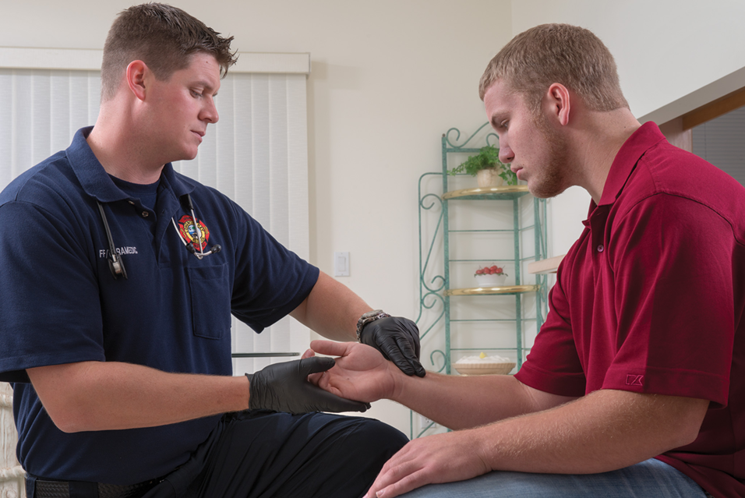
Pulse (3 of 3)
Assess pulse rate and quality. Count for 30 seconds and multiply by 2.
Notes:
Covers Objective: 13.1

Slide 11
Pulse Rate (1 of 2)
Number of beats per minute
Normal rate for adult at rest is between 60 and 100 beats per minute.
Tachycardia
  Rate above 100 beats per minute is rapid.
Bradycardia
  Rate below 60 beats per minute is considered slow.
Notes:
Covers Objective: 13.1

Slide 12
Pulse Rate (2 of 2)
Above 150 beats per minute, or above 120 beats or below 50 beats per minute across several measurements, is considered a serious finding.
During an emergency, it is not unusual for pulse rate to temporarily be between 100 and 140 beats.
Notes:
Covers Objective: 13.1

Slide 13
Think About It
What normal situations might account for a heart rate outside the normal range?
Notes:
Covers Objective: 13.1
Talking Points: For fast heart rates consider the level of exercise or anxiety. Either of those situations could increase heart rate in a benign fashion. For slow rates, also consider level of activity and level of physical fitness. Athletes often normally have a slow heart rate.

Slide 14
Pulse Quality (1 of 6)
Two factors determine pulse quality.
  Rhythm
    Reflects regularity
      Regular when intervals between beats are constant
      Irregular when intervals are not constant
Notes:
Covers Objective: 13.1

Slide 15
Pulse Quality (2 of 6)
Two factors determine pulse quality.
  Force
    Pressure of pulse wave as it expands artery
    Pulse should feel strong.
    Thready
      When pulse feels weak and thin
Notes:
Covers Objective: 13.1

Slide 16
Pulse Quality (3 of 6)
Common pulse locations
  Radial
    Used in patients 1 year and older
    Wrist pulse
    Found by placing first three fingers on thumb side of patient’s wrist just above the crease
Notes:
Covers Objective: 13.1

Slide 17
Pulse Quality (4 of 6)
Common pulse locations
  Brachial
    Used in patients 1 year old or younger
    Upper arm pulse
Notes:
Covers Objective: 13.1

Slide 18
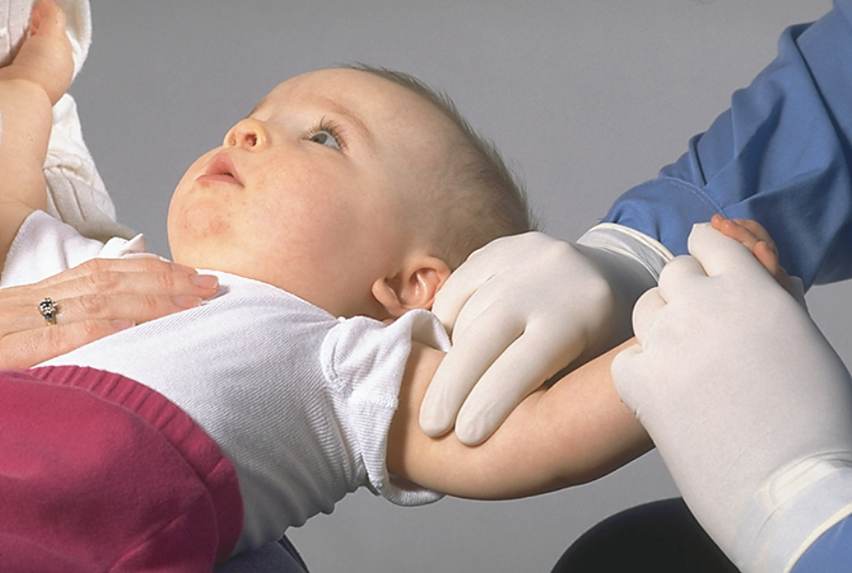
Brachial Pulse
Palpating a brachial pulse in an infant.
Notes:
Covers Objective: 13.1

Slide 19
Pulse Quality (5 of 6)
Common pulse locations
  Carotid
    Felt along large carotid artery on either side of the neck
Notes:
Covers Objective: 13.1
Talking Points: Be careful when palpating a carotid pulse. Excessive pressure on the carotid artery can result in slowing of the heart, especially in older patients. If you have difficulty finding the carotid pulse on one side, try the other side, but do not assess the carotid pulses on both sides at the same time.

Slide 20
Pulse Quality (6 of 6)
Assessing pulse
  Count pulsations for 30 seconds and multiply by 2.
  If rate, rhythm, or force is not normal, continue with count for full 60 seconds.
  Judge rhythm and force.
Notes:
Covers Objective: 13.1
Knowledge Application: Create a county fair. Set up multiple "booths" for students to visit. At each booth, the student will be asked to obtain a different vital sign. Practice and log variations such as brachial pulses and palpated blood pressures.
Discussion Topic: Describe the process of taking a pulse.

Slide 21
Respiration
With regard to vital signs, respiration means the act of breathing in and out.
Measurement includes both rate and quality.
Notes:
Covers Objective: 13.1
Point to Emphasize: Evaluate rate, quality, and rhythm when assessing respirations.

Slide 22
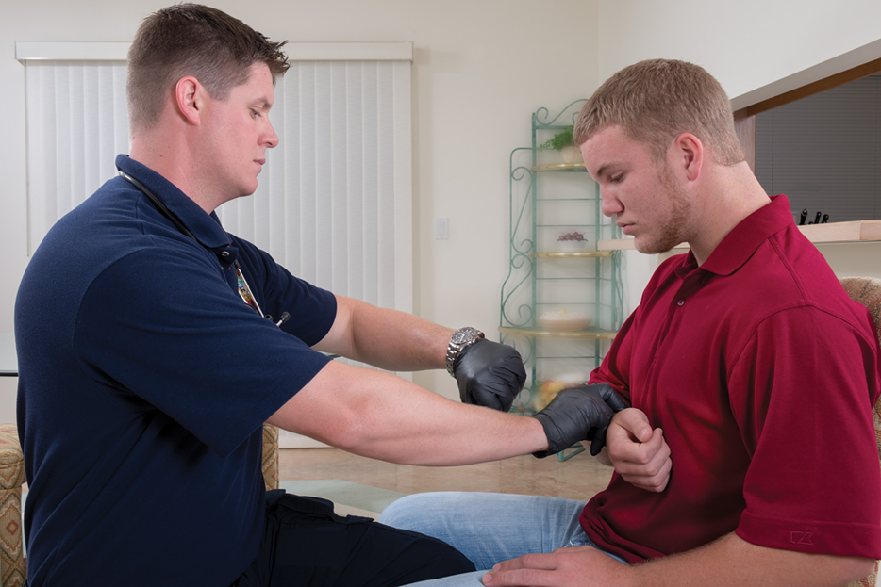
Radial Pulse
Assess respiration rate and quality. Count for 30 seconds and multiply by 2.
Notes:
Covers Objective: 13.1

Slide 23
Respiration Rate
Number of breaths the patient takes in one minute
Rate of respiration is classified as normal, rapid, or slow.
Normal rate for adult at rest is between 12 and 20 breaths per minute.
Age, sex, size, physical conditioning, and emotional state influence breathing rates.
Unusually fast or slow respiratory rates may require oxygen administration or providing ventilations to the patient in respiratory failure.
Notes:
Covers Objective: 13.1
Discussion Topic: Describe the factors that influence a patient’s respiratory rate.

Slide 24
Respiration Quality
Four categories
  Normal
  Shallow
  Labored
  Noisy
Notes:
Covers Objective: 13.1
Discussion Topic: Discuss how quality is measured when assessing a patient’s respirations.

Slide 25
Respiration Rhythm
If you observe irregular respirations in an unconscious patient, you should report and document it.
Count respirations after assessing pulse rate.
  Count number of breaths taken over 30 seconds and multiply by 2.
  Note rate, quality, and rhythm of respiration.
Notes:
Covers Objective: 13.1
Discussion Topic: Describe the technique of evaluating respirations.
Knowledge Application: If equipment permits, assign each student twenty vital signs as homework. In this exercise, each student must obtain and log the vital signs of twenty different people.

Slide 26
Skin (1 of 4)
Color, temperature, and condition of skin can provide valuable information regarding circulation.
Notes:
Covers Objective: 13.1
Point to Emphasize: Assessing the skin can provide information regarding the cardiovascular system.
Discussion Topic: Discuss how assessment of the skin relates to the patient's cardiovascular system.

Slide 27
Skin (2 of 4)
Color
  Best places to assess skin color in adults
    Nail beds
    Inside of cheek
    Inside of lower eyelids
  In infants and children
    Palms of hands
    Soles of feet
  In patients with dark skin
    Lips and nail beds
Notes:
Covers Objective: 13.1
Talking Points: These sites are typically consistent even in patients with dark skin tones.

Slide 28
Skin (3 of 4)
Color
  Abnormal skin colors
    Pale
    Cyanotic (blue-gray)
    Flushed (red)
    Jaundiced (yellow)
Notes:
Covers Objective: 13.1

Slide 29
Skin (4 of 4)
Temperature
  Feel patient’s skin with back of hand.
  Note if skin feels normal (warm), hot, cool, or cold.
Notes:
Covers Objective: 13.1
Discussion Topic: Describe the process for evaluating a patient’s skin.

Slide 30
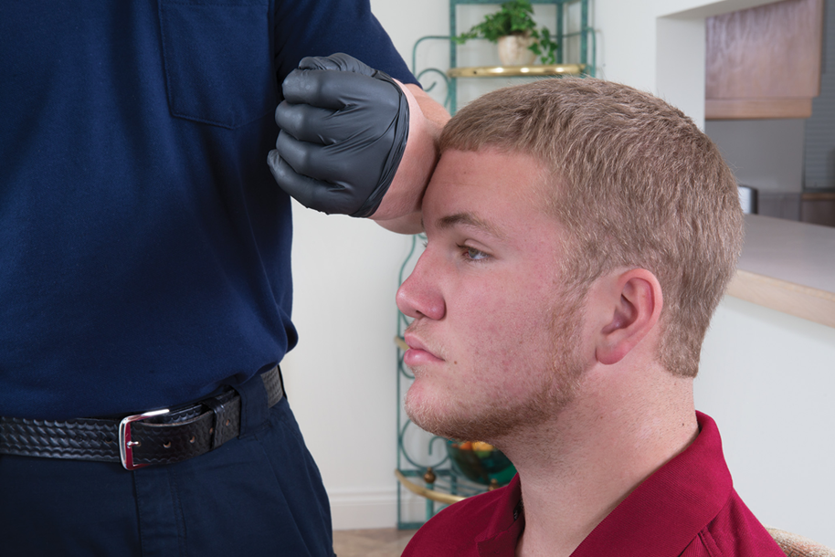
Skin Temperature
Determining skin temperature.
Notes:
Covers Objective: 13.1

Slide 31
Pediatric Note
For children under 6 years, also evaluate capillary refill.
  Press on nail bed or top of hand or foot and release.
  Observe how long it takes normal pink color to return.
  Normal
    Less than 2 seconds
Notes:
Covers Objective: 13.1
Talking Points: Delayed capillary refill can indicate poor circulation. Remember that cold temperatures can cause delayed capillary refill times as well.

Slide 32
Pupils (1 of 3)
Black center of eye
Dim environment
  Pupil will dilate.
Bright environment
  Pupil will constrict.
Notes:
Covers Objective: 13.1

Slide 33
Pupils (2 of 3)
Assessing
  Look for:
    Size
    Equality
    Reactivity
Notes:
Covers Objective: 13.1

Slide 34
Pupils (3 of 3)
Assessing
  Note baseline size.
  Cover one eye and shine a light into other eye.
  Repeat with other eye.
Notes:
Covers Objective: 13.1
Talking Points: The pupil should constrict when a light is shining into it and enlarge when you remove the light. Pupils that are dilated, constricted to pinpoint size, unequal in size or reactivity, or nonreactive may indicate a variety of conditions; the influence of a topical drug (one placed directly on the eye, such as an eye drop) or of head or eye injury.

Slide 35
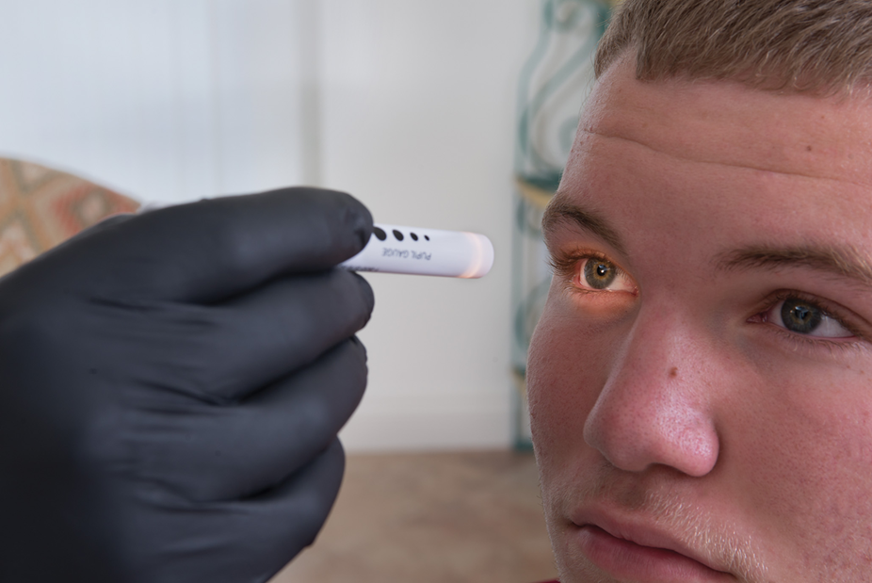
Assessing Pupils (1 of 3)
Examining the pupils.
Notes:
Covers Objective: 13.1
Talking Points: The pupil should constrict when a light is shining into it and enlarge when you remove the light. Pupils that are dilated, constricted to pinpoint size, unequal in size or reactivity, or nonreactive may indicate a variety of conditions; the influence of a topical drug (one placed directly on the eye, such as an eye drop) or of head or eye injury.

Slide 36
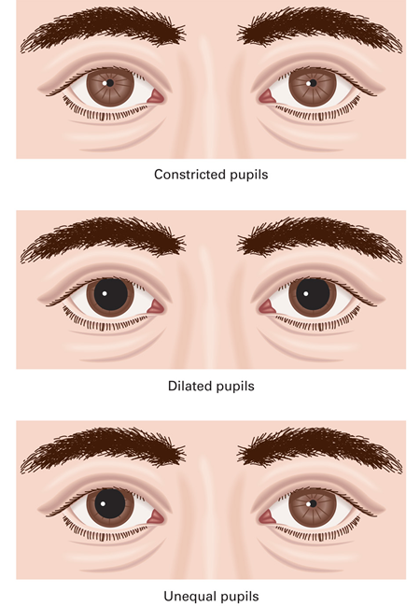
Assessing Pupils (2 of 3)
(A) Constricted, (B) dilated, and (C) unequal pupils.
Notes:
Covers Objective: 13.1
Discussion Topic: Describe the potential medical conditions that relate to abnormal pupil findings.

Slide 37
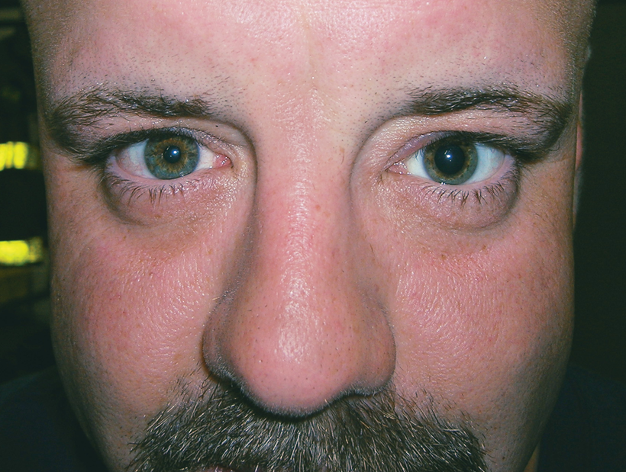
Assessing Pupils (3 of 3)
Unequal pupils can be a sign of the influence of a topical drug (one placed directly on the eye, such as an eye drop) or of head or eye injury. © Edward T. Dickinson, M D
Notes:
Covers Objective: 13.1
Discussion Topic: Describe the potential medical conditions that relate to abnormal pupil findings.

Slide 38
Blood Pressure (1 of 3)
Force of blood against the walls of the blood vessels
  Systolic pressure created when the heart contracts and forces blood into the arteries
  Diastolic pressure remaining in the arteries when the left ventricle relaxes and refills
Normal pressure
  Systolic no greater than 120 m m H g
  Diastolic no greater than 80 m m H g
Change can indicate something very significant.
Notes:
Covers Objective: 13.1
Point to Emphasize: Blood pressure is more valuable when measured in a trend. Single blood pressure measurements typically do not tell the complete story.

Slide 39
Blood Pressure (2 of 3)
Measured with a sphygmomanometer and stethoscope
  Cuff should cover two-thirds of upper arm, elbow to shoulder.
Notes:
Covers Objective: 13.1

Slide 40
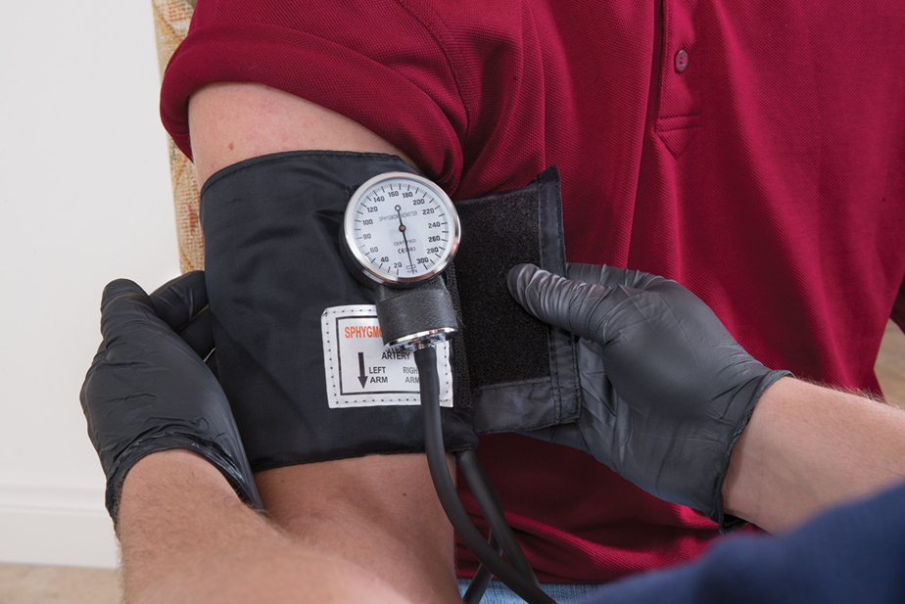
Measuring Blood Pressure
Positioning blood pressure cuff.
Notes:
Covers Objective: 13.1

Slide 41
Blood Pressure (3 of 3)
Measured with a sphygmomanometer and stethoscope
  Wrap cuff around patient’s upper arm.
  Place lower edge of cuff about 1 inch above crease of elbow.
  Place center of bladder over brachial artery.
Notes:
Covers Objective: 13.1

Slide 42
Determining Blood Pressure by Auscultation (1 of 4)
Prepare patient.
Position cuff and stethoscope.
  Palpate brachial artery at crease of elbow.
  Position stethoscope.
  Position diaphragm of stethoscope directly over brachial pulse or medial anterior elbow.
Notes:
Covers Objective: 13.1

Slide 43
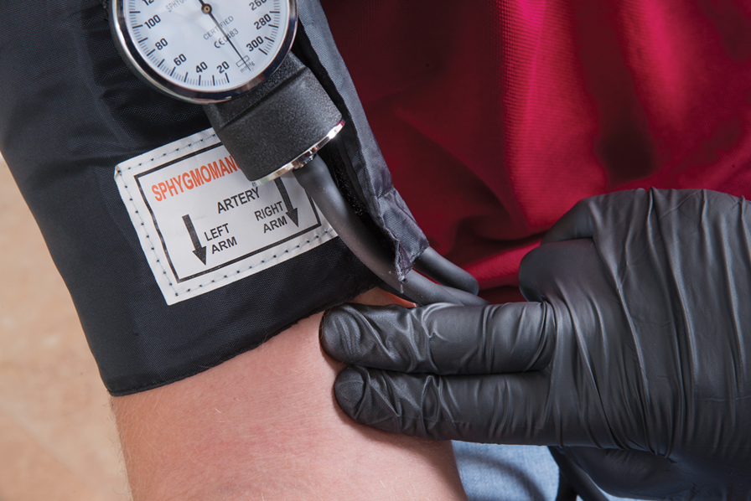
Determining Blood Pressure by Auscultation (2 of 4)
When measuring blood pressure by auscultation, locate the brachial artery by palpation before placing the stethoscope.
Notes:
Covers Objective: 13.1

Slide 44
Determining Blood Pressure by Auscultation (3 of 4)
Inflate cuff.
  Listen and inflate until gauge reads 30 millimetre higher than the point the pulse sound disappeared.
Obtain systolic pressure.
  Slowly release air from cuff.
  When you hear the first of these sounds, note the reading on gauge.
Notes:
Covers Objective: 13.1

Slide 45
Determining Blood Pressure by Auscultation (4 of 4)
Obtain diastolic pressure.
  Continue to deflate cuff.
  When sounds turn to dull, muffled thuds, the reading on the gauge is diastolic pressure.
Record measurements.
Notes:
Covers Objective: 13.1
Discussion Topic: Describe the process for auscultating a blood pressure.

Slide 46
Determining Blood Pressure by Palpation
Position cuff and find radial pulse.
Inflate cuff.
Obtain and record systolic pressure.
  Slowly deflate cuff.
  Note reading when radial pulse returns (systolic pressure).
Notes:
Covers Objective: 13.1
Talking Points: Inflate the cuff until you can no longer feel the radial pulse and continue to inflate the cuff 30 mmHg beyond this point.
Discussion Topic: Describe the process for palpating a blood pressure.

Slide 47
Pediatric Note 1
Difficult to obtain on infants and children younger than three years
More useful information about the condition of an infant or very young child comes from observing for conditions such as sick appearance, respiratory distress, or unconsciousness
Notes:
Covers Objective: 13.9

Slide 48
Determining Blood Pressure by Blood Pressure Monitor
Position the cuff.
Inflate the cuff.
Obtain and record the systolic pressure.
  Slowly deflate the cuff.
Notes:
Covers Objective: 13.6e
Talking Points: Inflate the cuff until you can no longer feel the radial pulse and continue to inflate the cuff 30 mmHg beyond this point.

Slide 49
Temperature (1 of 3)
Narrow range of temperature allows chemical reactions and other activities to take place inside the body.
Core temperature reflects level of heat inside trunk.
Notes:
Covers Objective: 13.1
Discussion Topic: Describe the most common methods for assessing a patient’s body temperature.

Slide 50
Temperature (2 of 3)
Normal temperature depends on:
  Time of day
  Activity level
  Age
  Where measured
Notes:
Covers Objective: 13.6c
Discussion Topic: Describe “normal” variations in body temperature.

Slide 51
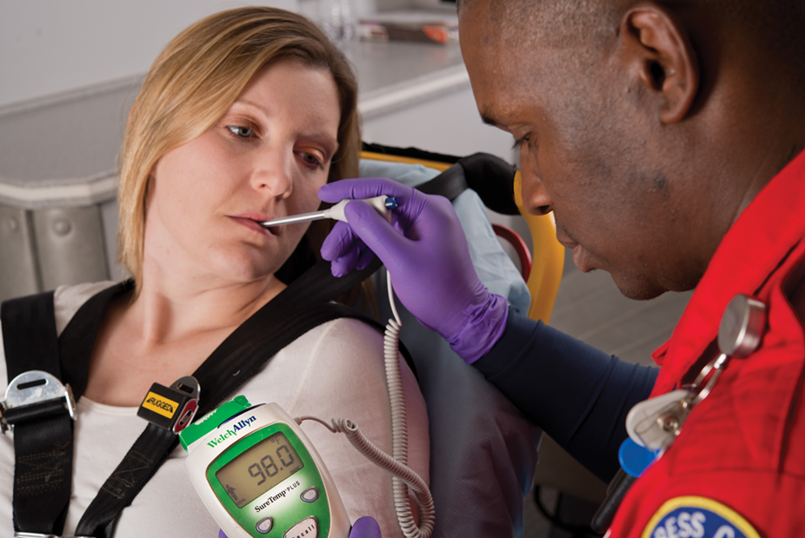
Temperature (3 of 3)
An electronic thermometer is safer, more hygienic, and quicker to produce a reading than a glass thermometer.
Notes:
Covers Objective: 13.1
Class Activity: Take a field trip. Visit a local nursing home or day care center to obtain vital signs on different types of patients.
Knowledge Application: Use programmed patients to include vital signs in assessment scenarios. Include situations in which treatments might take priority.

Slide 52
Monitoring Devices
Back to Topics
Notes:
Teaching Time: 40 minutes
Teaching Tips: This lesson is an important point to emphasize the value of treating the patient and not just a monitor or lab value. Oxygen saturation and blood glucose evaluation are psychomotor skills. Move this lesson into the psychomotor domain. Blood glucose monitoring is often regulated by local protocol. Discuss regional limitations as part of this lesson. Attempt to demonstrate several different types of blood glucose meters.

Slide 53
Oxygen Saturation (1 of 2)
Also called S p O₂, the ratio of the amount of oxygen present in the blood to the amount that could be carried, expressed as a percentage
Measured with pulse oximeter
Notes:
Covers Objective: 13.2

Slide 54
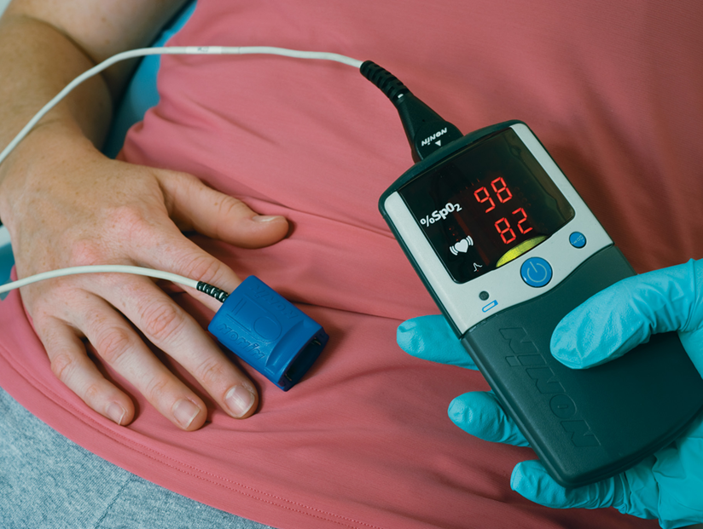
Oxygen Saturation (2 of 2)
A pulse oximeter with sensor applied to the patient’s finger.
Notes:
Covers Objective: 13.2

Slide 55
When to Use a Pulse Oximeter
Protocol should govern when to use a pulse oximeter if service has one.
Generally includes all patients complaining of respiratory problems or otherwise at risk for hypoxia
Notes:
Covers Objective: 13.2
Discussion Topic: Discuss the circumstances where a pulse oximeter would be commonly used.

Slide 56
Interpreting Pulse Oximeter Readings (1 of 2)
Normal
  96 to 100 percent
Mild hypoxia
  91 to 95 percent
Significant or moderate hypoxia
  86 to 90 percent
Severe hypoxia
  85 percent or less
Notes:
Covers Objective: 13.2
Talking Points: A reading above 96 percent does not mean you should withhold oxygen from a patient with signs and symptoms that indicate the need for oxygen.

Slide 57
Interpreting Pulse Oximeter Readings (2 of 2)
Accuracy of reading can be affected by:
  Shock, hypothermia
  Carbon monoxide and certain other uncommon types of poisoning
  Excessive movement
  Nail polish
  Anemia
  Hypovolemia
Notes:
Covers Objective: 13.2
Discussion Topic: Discuss the factors that can alter the accuracy of a pulse oximeter.

Slide 58
Blood Glucose Meters (1 of 2)
Measures quantity of glucose in the bloodstream
Can help identify some diabetic emergencies
Notes:
Covers Objective: 13.2
Discussion Topic: Describe the importance of blood glucose analysis.

Slide 59
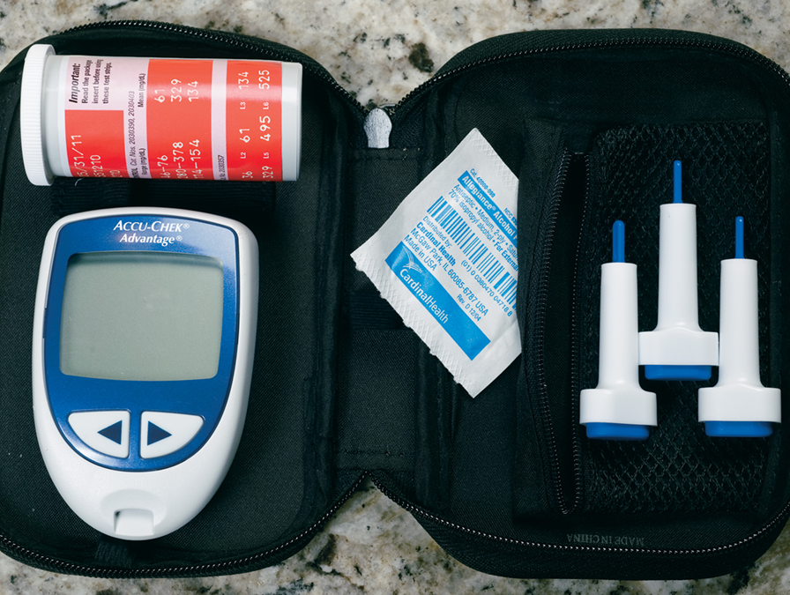
Blood Glucose Meters (2 of 2)
Many E M S systems allow E M Ts to use blood glucose meters that are carried on the ambulance.
Notes:
Covers Objective: 13.2

Slide 60
Using a Blood Glucose Meter (1 of 3)
Permission from medical direction or by local protocol is required to perform blood glucose monitoring using a blood glucose meter
Monitors must be calibrated and stored according to manufacturer’s recommendations
Notes:
Covers Objective: 13.2
Discussion Topic: Discuss the importance of routine maintenance and calibration of a glucose meter.

Slide 61
Using a Blood Glucose Meter (2 of 3)
Prepare device, test strip, and lancet.
Cleanse patient’s finger with alcohol.
Perform finger stick with lancet.
Apply blood to test strip.
Use glucose meter to analyze sample and provide reading.
Notes:
Covers Objective: 13.2
Discussion Topic: Describe the process of measuring a patient’s blood glucose level.

Slide 62
Using a Blood Glucose Meter (3 of 3)
Normal level
  Usually at least 70 to 100 milligram/deciLiter
  Depends on the manufacturer’s instructions and local protocols
Notes:
Covers Objective: 13.2
Talking Points: Chapter 22, "Diabetic Emergencies and Altered Mental Status," discusses how to interpret this information and apply it to the care of a patient.

Slide 63
Capnography (1 of 2)
Measures amount of carbon dioxide exhaled
  End-tidal carbon dioxide, or E T C O₂
  Normal level 35 to 45 m m H g
Indirectly indicates how well tissues are using oxygen and performing other physiological functions
Notes:
Covers Objective: 13.2
Discussion Topic: Discuss the circumstances in which capnography would be commonly used.

Slide 64
Capnography (2 of 2)
Methods
  Patient breathing spontaneously has special nasal cannula applied.
  In the ventilated patient, a plastic “collar” fits between the bag–valve and the mask (or advanced airway).
Notes:
Covers Objective: 13.2
Discussion Topic: Describe the process of using capnography.
Critical Thinking Discussion: Why is the use of capnography essential for patients who have an advanced airway or who are being ventilated?

Slide 65
Chapter Review
Notes:
Teaching Time: 30 minutes
Teaching Tips: Students should review Chapter 10 for a more thorough discussion of rescue breathing. This section is meant only to be a brief review. The value of mouth-to-mask ventilation should be emphasized. It has a special context within the cardiac arrest setting that is different from other situations. Gastric distention is an important topic. Use this discussion to drive home the negative impact of poor rescue breathing technique. Demonstrate the recovery position, using a programmed patient or student volunteer.

Slide 66
Chapter Review (1 of 2)
You can gain a great deal of information about a patient’s condition by taking a complete set of baseline vital signs, including pulse, respirations, skin, pupils, and blood pressure.
The E M T must become familiar with normal ranges for pulse, respirations, and blood pressure in adults and children.
Notes:
Talking Points: Review the basics of opening an airway. See Chapter 9 for additional information.

Slide 67
Chapter Review (2 of 2)
Trends in patient’s condition will become apparent only when vital signs are repeated, an important step in continuing assessment.
How often you repeat vital signs will depend on patient’s condition: at least every 15 minutes for stable patients and at least every 5 minutes for unstable patients.

Slide 68
Remember (1 of 2)
Consider if there is time to obtain vital signs or if you must wait to obtain them en route to the hospital.
Consider when to apply a pulse oximeter. Should you apply it to a patient with difficulty breathing? Without difficulty breathing?

Slide 69
Remember (2 of 2)
Consider whether abnormal vital signs are a result of an illness or injury or the result of some other factor.

Slide 70
Questions to Consider (1 of 2)
Name the vital signs.
Explain why vital signs should be taken more than once.
How much time should the E M T spend looking for a pulse when the radial pulse is absent or extremely weak?
Notes:
Talking Points: Vital signs include pulse, respirations, blood pressure, skin quality, mental status, pulse oximetry, and pupils.
Obtaining more than one set of vital signs allows you to identify trends of either improvement or deterioration.
The American Heart Association notes that you should look for a pulse for no more than 10 seconds. If it is difficult to feel, it may not be there.

Slide 71
Questions to Consider (2 of 2)
How should you react when the blood pressure monitor gives a reading that is extremely different from previous readings?
How can you get an accurate pulse oximeter reading on a patient with thick artificial nails?
Notes:
Talking Points: Blood pressure monitors are sometimes inaccurate. You should trust the trend and obtain a manual pressure to confirm.
If possible, remove the artificial nails. If this is impossible, consider an alternate site for the pulse oximetry probe; perhaps an earlobe or a toe. Always follow manufacturer's recommendations for your monitor.

Slide 72
Critical Thinking
Sometimes a patient’s heart will have an electrical problem and beat more than 200 times a minute. Why is the pulse so weak in such a patient?
Notes:
Talking Points: Fast heart rates can prevent filling of the heart. With this drop in preload, cardiac output also suffers. If little blood is being ejected from the heart, pressure will not be normal and pulse will be weak.

Slide 73

Copyright
This work is protected by United States copyright laws and is provided solely for the use of instructors in teaching their courses and assessing student learning. Dissemination or sale of any part of this work (including on the World Wide Web) will destroy the integrity of the work and is not permitted. The work and materials from it should never be made available to students except by instructors using the accompanying text in their classes. All recipients of this work are expected to abide by these restrictions and to honor the intended pedagogical purposes and the needs of other instructors who rely on these materials.

