Slide 1

Emergency Care
Fourteenth Edition
Chapter 18
General Pharmacology
Slides in this presentation contain hyperlinks. JAWS users should be able to get a list of links by using INSERT+F7
Copyright © 2021, 2016, 2012 Pearson Education, Inc. All Rights Reserved
Notes:
If this PowerPoint presentation contains mathematical equations, you may need to check that your computer has the following installed:
1) MathType Plugin
2) Math Player (free versions available)
3) NVDA Reader (free versions available)

Slide 2
Topics
Medications E M Ts Can Administer
E M Ts Assisting with Prescribed Medications
General Information about Medications
Assisting with I V Therapy
Notes:
Planning Your Time: Plan 130 to 140 minutes for this chapter.
Medications EMTs Can Administer (15 minutes)
EMTs Assisting with Prescribed Medications (15 minutes)
General Information about Medications (65 minutes)
Assisting with IV Therapy (20 minutes)

Slide 3
Medications E M Ts Can Administer
Back to Topics
Notes:
Teaching Time: 15 minutes
Teaching Tips: Have examples of medications on hand. Demonstrate common packaging and medication labels. Use medication resources such as drug manuals and online pharmacology sites. Discuss how students might use such resources as well.

Slide 4
Medications on the Ambulance
Aspirin
Oral Glucose
Oxygen
Activated Charcoal
Naloxone
Notes:
Covers Objective: 18.1

Slide 5
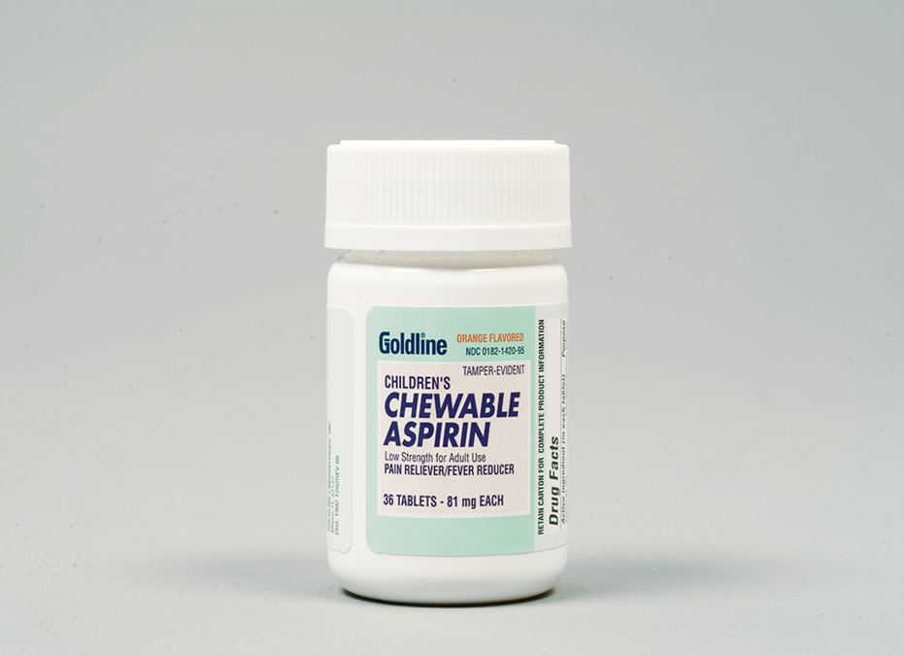
Aspirin
Aspirin is administered to patients with chest pain of a suspected cardiac origin.
Notes:
Covers Objective: 18.1
Point to Emphasize: Aspirin is given to suspected cardiac chest pain patients to reduce the blood's ability to clot.
Knowledge Application: Have students work in small groups. Assign each group a medication and a drug resource. Have groups research and discuss important pharmacology and administration information.

Slide 6

Oral Glucose
Oral glucose may help a patient with diabetes.
Notes:
Covers Objective: 18.1
Point to Emphasize: Oral glucose is commonly administered to reverse life-threatening low blood sugar.
Knowledge Application: Have students work in small groups. Assign each group a disease or similar pathology. Ask group members to describe how a medication would help treat the particular disorder.

Slide 7
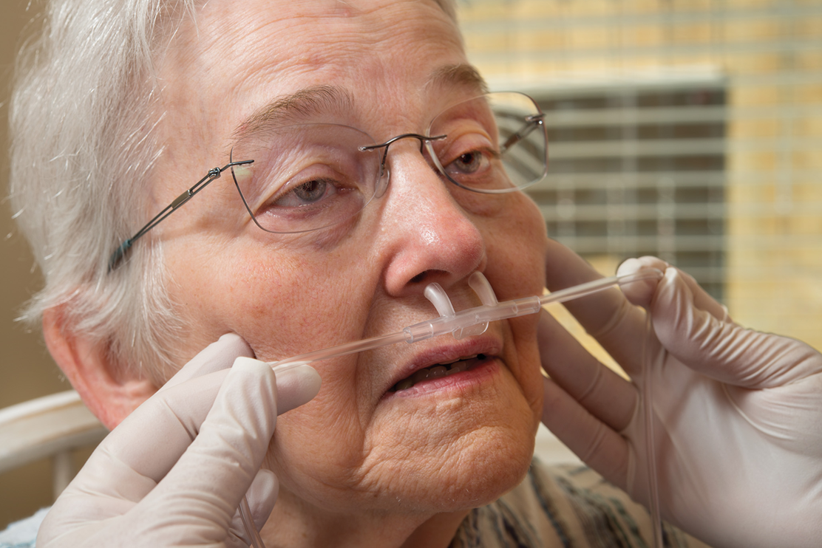
Oxygen
Oxygen is a commonly used, but powerful, medication.
Notes:
Covers Objective: 18.1
Point to Emphasize: Supplemental oxygen is valuable in treating hypoxia.

Slide 8
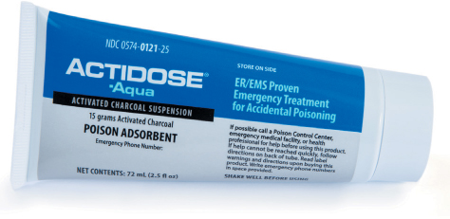
Activated Charcoal
Activated charcoal is only occasionally used in poisoning cases.
Notes:
Covers Objective: 18.1

Slide 9
Naloxone
Naloxone
  Antidote for a patient who is unconscious and in respiratory failure after taking a narcotic
  Does not work if patient has not had a narcotic
Notes:
Covers Objective: 18.2

Slide 10
E M Ts Assisting with Prescribed Medications
Back to Topics
Notes:
Teaching Time: 15 minutes
Teaching Tips: Invite a hospital pharmacist to discuss these medications. This is a psychomotor lesson. Have appropriate equipment and supervision to review practical skills associated with medication administration. Use standardized skill sheets to assess and demonstrate competency on autoinjector use.

Slide 11
Bronchodilator Inhaler
A prescribed inhaler may help a patient who has respiratory problems.
Notes:
Covers Objective: 18.2
Point to Emphasize: EMTs frequently can assist patients with inhaled respiratory medications, sublingual nitroglycerine, and auto-injected epinephrine.
Talking Points: Examples of these medications include albuterol (Ventolin HFA, Proventil, Volmax) and levalbuterol (Xopenex).
Knowledge Application: Discuss a patient's medication list. Have students use drug resources to discuss why these medications may have been prescribed.

Slide 12
Prescribed Medications
Inhaler
Nitroglycerin
Epinephrine
Notes:
Covers Objective: 18.2

Slide 13
Bronchodilator Inhalers
Used in patients with asthma, emphysema, and chronic bronchitis
Enlarges constricted breathing tubes
Side effects
  Increased heart rate
  Patient jitteriness
Notes:
Covers Objective: 18.2

Slide 14
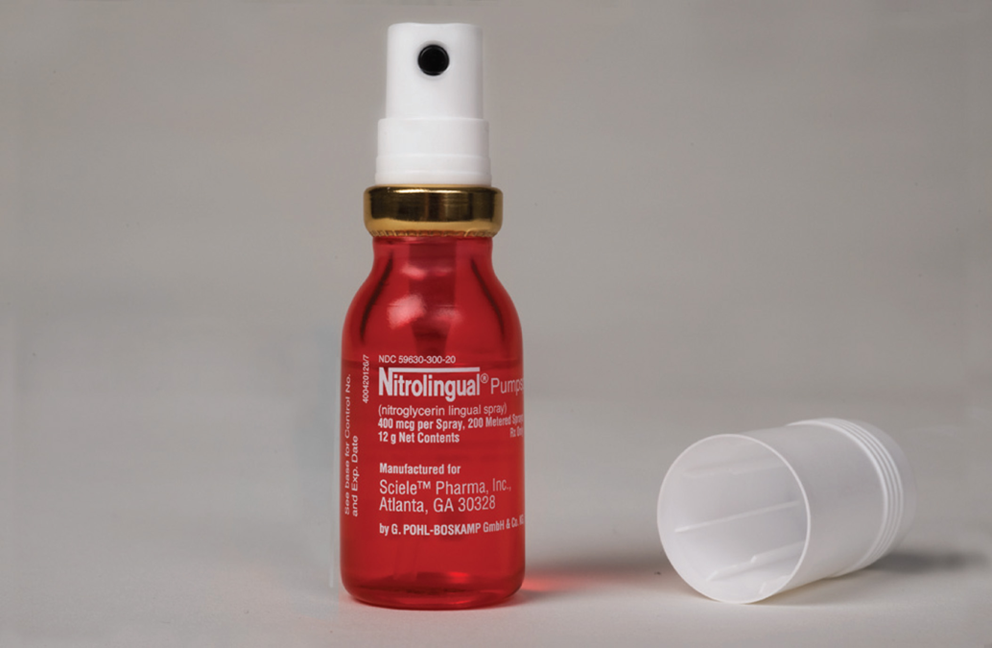
Nitroglycerin (1 of 2)
Nitroglycerin is often prescribed for chest pain. Forms of nitroglycerin include a spray.
Notes:
Covers Objective: 18.2
Knowledge Application: Discuss local protocols for medication administration. What are the rules in your area?

Slide 15
Nitroglycerin (2 of 2)
Taken by patients with history of chest pain of cardiac origin
Helps dilate coronary vessels
Contraindications
  Low blood pressure or taking medications for erectile dysfunction (Viagra, Levitra, Cialis, or similar)
Side effect
  Dropping blood pressure
Notes:
Covers Objective: 18.2
Critical Thinking Discussion: What role does documentation play in the administration of medications? Why might it be important to document each administration carefully?

Slide 16
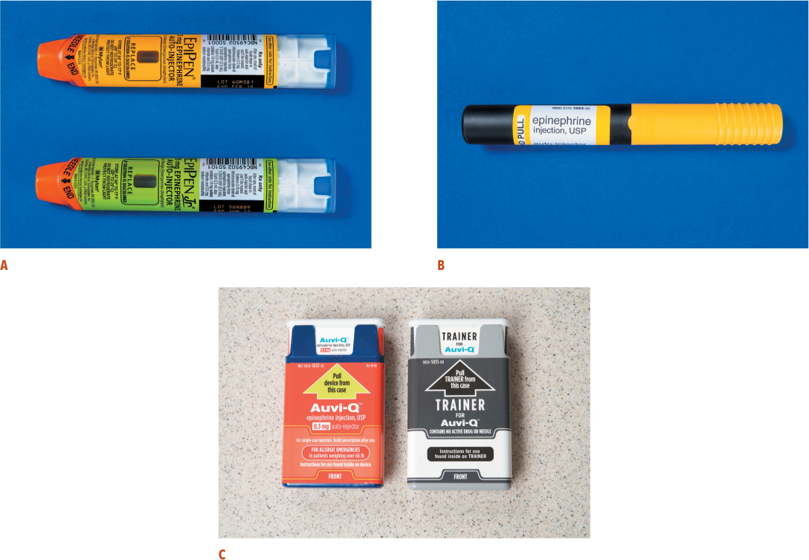
Epinephrine Auto-Injector
For long description, see slide 53: Appendix 1
An epinephrine auto-injector can reverse a severe allergic reaction.
Notes:
Covers Objective: 18.2
Discussion Topics: Describe the seven medications commonly administered by an EMT. Describe three patient medications with which an EMT may assist. Describe at least two categories of commonly prescribed patient medications.

Slide 17
Epinephrine Auto-Injectors
Prescribed and used for patients with severe allergic reactions classified as anaphylaxis
Vasoconstrictor
  Relaxes smooth muscles and airway passages
Side effects
  Increased heart rate and blood pressure
Notes:
Covers Objective: 18.2
Class Activity: After your discussion on drug resources, assign medication research. Have students research and discuss the pathophysiology (mechanism of action) of the commonly administered medications.

Slide 18
Force Protection Medications
Atropine auto-injector to treat responders in the event of an attack
Notes:
Covers Objective: 18.2

Slide 19
General Information About Medications
Back to Topics
Notes:
Teaching Time: 65 minutes
Teaching Tips: Demonstrate medication listings using drug resources. Discuss how an EMT can use these resources. Patient medications are frequently listed by either trade or generic name. Discuss with students how to use resources to identify patient medications. Invite a pharmacist to discuss medication administration. Demand strict adherence to discipline around medication administration. Invite your medical director to class to discuss online medication orders and to reinforce the verbal/radio report lesson. Make the “five rights” an ongoing lesson. Any time a student wishes to administer a medication in practice sessions, make him review these points. Have plenty of medication examples on hand. Demonstrate different forms and administration routes.

Slide 20
Drug Names
Each drug is listed by its generic name.
Each drug has at least three names:
  Chemical name
  Generic name
  Trade (brand) name
    One or more trade names given to the drug by manufacturers
Notes:
Covers Objective: 18.3
Point to Emphasize: Each drug has at least three names: the chemical name (B-(3, 4 dihydroxyphenyl)-a-methylaminoethanol), the generic name (epinephrine), and one or more trade (brand) names (Epi-Pen®).
Discussion Topic: Discuss the three names of a medication. What are the origin and significance of each name?

Slide 21
What You Need to Know When Giving a Medication (1 of 2)
Indications
Contraindications
Side effects
Untoward effects
Notes:
Covers Objective: 18.3
Point to Emphasize: Before administering a medication, an EMT must understand that drug's indications, contraindications, and side effects.
Knowledge Application: Have students work in small groups. Assign each group a medication. Ask the groups to use a drug resource to research information for their particular medication. Ask them to list the various names, indications, contraindications, and side effects.
Class Activity: Ask each student to research and list the indications, contraindications, and side effects of the six medications that EMTs commonly administer.

Slide 22
What You Need to Know When Giving a Medication (2 of 2)
Form of the medication
  Compressed powders or tablets
  Liquids
  Gels
  Suspensions
  Fine powder
  Gases
  Sublingual sprays
Notes:
Covers Objective: 18.3

Slide 23
Medication Safety and Clinical Judgment
Administering or assisting with medications is a serious responsibility.
Know the medication.
Use good judgment.
Notes:
Covers Objective: 18.3
Discussion Topic: Describe why it is important to link medication administration to a thorough patient assessment.

Slide 24
Medication Authorization
Off-line medical direction
  Do not speak to physician.
  Use “standing orders.”
On-line medical direction
  Speak directly to physician.
  Listen to order, then repeat order back.
  Ask for clarification if necessary.
Notes:
Covers Objective: 18.3
Discussion Topic: Describe the difference between on-line and off-line medical direction.

Slide 25
The Five Rights
Do I have the right patient?
Is it the right time to administer this medication?
Is this the right medication?
Is this the right dose?
Am I giving this medication by the right route of administration?
Notes:
Covers Objective: 18.3
Point to Emphasize: EMTs must have appropriate authorization to give a drug and always must follow the "five rights" of medication administration.
Knowledge Application: Describe a medication administration. Have students list the five rights to determine if the medication administration is feasible.

Slide 26
Think About It
What would be the potential risk to the patient if each of the “five rights” were not checked prior to administration?
Notes:
Covers Objective: 18.3
Talking Points: Checking each of the "five rights" ensures that the correct dosage of the correct medication is given to the correct person at the correct time through the right route. If any of these are not checked, the result could be a worsening of the patient's condition at best, with the possibility of more serious consequences.

Slide 27
Routes of Administration (1 of 2)
Oral, or swallowed
Sublingual, or dissolved under the tongue
Inhaled, or breathed into lungs, usually as tiny aerosol particles, such as from an inhaler, or as a gas, such as oxygen
Intranasal, or sprayed into the nostrils
Intravenous, or injected into vein
Notes:
Covers Objectives: 18.3
Point to Emphasize: Medications can be found in a variety of forms and can be administered through a variety of routes.

Slide 28
Routes of Administration (2 of 2)
Intramuscular, or injected into a muscle
Subcutaneous, or injected under the skin
Intraosseous, or injected into the bone marrow cavity
Endotracheal, or sprayed directly into a tube inserted into the trachea
Notes:
Covers Objectives: 18.3
Discussion Topic: Describe the common medication administration routes. Consider their advantages and disadvantages.

Slide 29
Pharmacodynamic Considerations
Pharmacodynamics
  Study of effects of medications on body
  What effect will medication have?
  How will this medication affect my patient specifically?
  Patient-specific factors change how medication works.
Notes:
Covers Objective: 18.3

Slide 30
Reassessment and Documentation
After administering medication, reassess patient.
Clearly document medications administered.
Notes:
Covers Objective: 18.3
Point to Emphasize: Reassessment and documentation are crucial following any medication administration.
Knowledge Application: Follow up any medication administration scenarios with a reassessment and documentation project. (Consider a homework assignment.)

Slide 31
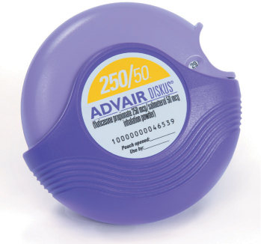
Medications Patients Often Take
Advair is a medication that may be prescribed to a patient for daily management of a respiratory disease. It should not be used for emergency treatment of an acute attack or breathing difficulty. © GlaxoSmithKline
Notes:
Covers Objective: 18.3
Points to Emphasize: Patient medications can indicate underlying health problems. Use drug resources to identify unknown patient medications.
Discussion Topics: Explain how knowledge of the patient's medications can help identify underlying health problems. Discuss how you might identify the purpose of a prescribed medication if you did not recognize it immediately.
Describe at least two categories of commonly prescribed medications. Why might each category be prescribed?
Class Activity: After your discussion on drug resources, assign medication research. Have students research and discuss the pathophysiology (mechanism of action) of the commonly administered medications.
Knowledge Application: Present patient medication lists. Using drug resources, ask students to hypothesize what the patient's medical history might include. Make two lists: common medications and categories of prescribed medications. Ask students to match medications to the appropriate categories.
Critical Thinking Discussion: Could a prescribed medication that your patient is taking affect a medication that you intend to administer? How might you make this determination?

Slide 32
Table 18-2 Herbal Agents and What They Are Sometimes Used For
Herbal Agent | Sometimes Used for
Gingko or gingko biloba | Dementia, poor circulation to the legs, ringing in the ears
St. John’s wort | Depression
Echinacea | Prevention and treatment of the common cold
Garlic | High cholesterol
Ginger root | Nausea and vomiting
Saw palmetto | Swollen prostate
Hawthorn leaf or flower | Heart failure
Evening primrose oil | Premenstrual syndrome
Feverfew leaf | Migraine prevention
Kava kava | Anxiety
Valerian root | Insomnia
Notes:
Covers Objective: 18.3

Slide 33
Assisting with I V Therapy
Back to Topics
Notes:
Teaching Time: 20 minutes
Teaching Tips: Have IV administration sets on hand for demonstration. This is a “hands on” lesson. Use a manikin arm or other simulator to demonstrate IV maintenance.

Slide 34
Setting Up an I V Fluid Administration Set (1 of 8)
Ways fluids and medications may be administered into the vein
  Heparin (saline) lock
    Catheter placed into vein
    Cap (lock) placed over end of catheter
    Lock contains port for administering medications.
Notes:
Covers Objective: 18.4
Points to Emphasize: Intravenous access is accomplished to provide a direct route for medication administration into the vein. Heparin/saline locks and constant infusion are two common methods of intravenous access.

Slide 35
Setting Up an I V Fluid Administration Set (2 of 8)
Ways fluids and medications may be administered into the vein
  Traditional I V bag
    Hangs above patient
    Constantly flows fluids and medications into patient
Notes:
Covers Objective: 18.4
Points to Emphasize: Intravenous access is accomplished to provide a direct route for medication administration into the vein. Heparin/saline locks and constant infusion are two common methods of intravenous access.

Slide 36
Setting Up an I V Fluid Administration Set (3 of 8)
Clear plastic tubing connecting fluid bag to needle or catheter
Three important parts
  Drip chamber
  Flow regulator
  Drug or needle port
Extension set makes it easier to carry or disrobe patient without pulling out the I V.
Notes:
Covers Objective: 18.4
Points to Emphasize: An EMT should understand the components and assembly of commonly used intravenous administration sets.
Discussion Topic: Describe the common components of an intravenous administration set. What is the role of each component?
Knowledge Application: Using a drawing, have students label the common components of an intravenous administration set.
Critical Thinking Discussion: What are the local rules and regulations regarding IV management in your area?

Slide 37
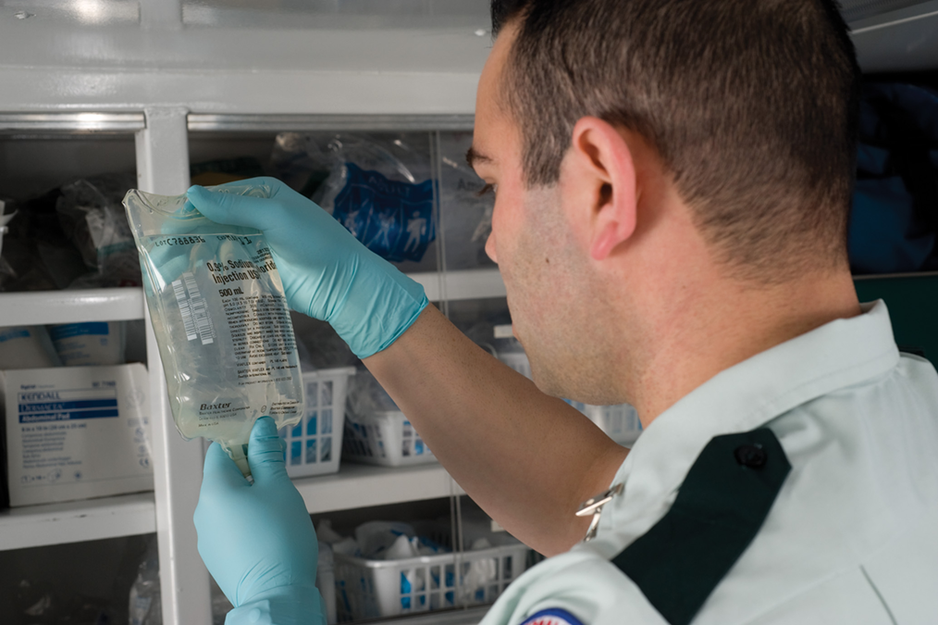
Setting Up an I V Fluid Administration Set (4 of 8)
Inspect the I V bag to be sure it contains the solution that was ordered, it is clear, it does not leak, and it has not expired.
Notes:
Covers Objective: 18.4

Slide 38
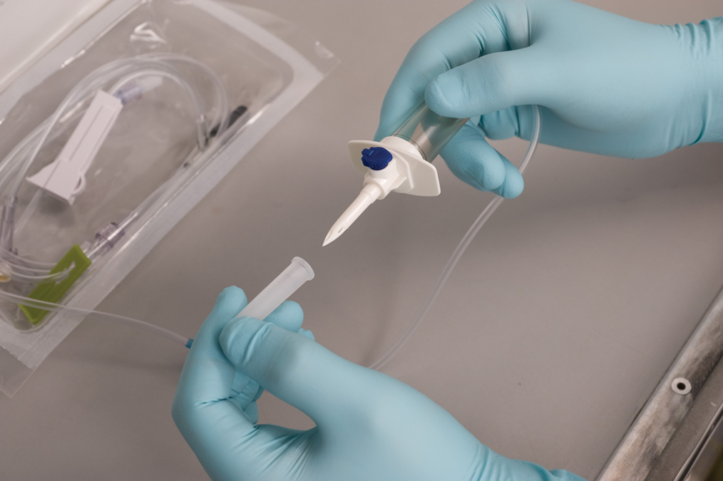
Setting Up an I V Fluid Administration Set (5 of 8)
Setting up the I V administration set includes removing the protective coverings from the port of the fluid bag and the spiked end of the tubing.
Notes:
Covers Objective: 18.4
Knowledge Application: Have students work in small groups. Provide each group with an IV administration set and ask group members to assemble it.

Slide 39
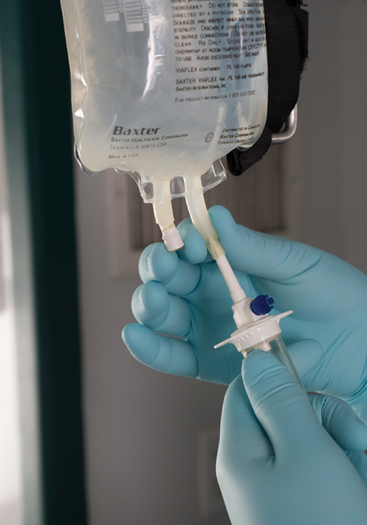
Setting Up an I V Fluid Administration Set (6 of 8)
Insert the spiked end of the tubing into the fluid bag.
Notes:
Covers Objective: 18.4

Slide 40
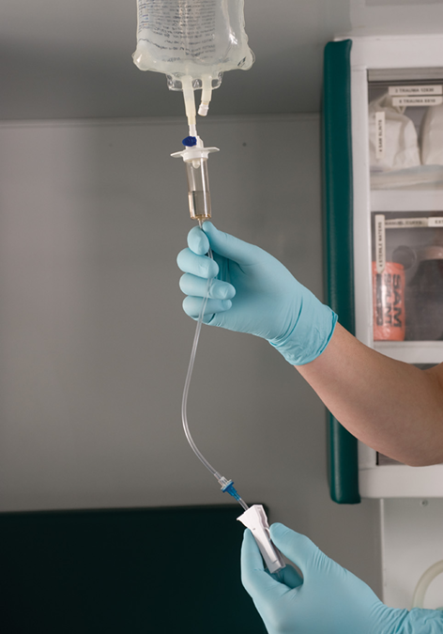
Setting Up an I V Fluid Administration Set (7 of 8)
Open the flow regulator.
Notes:
Covers Objective: 18.4

Slide 41
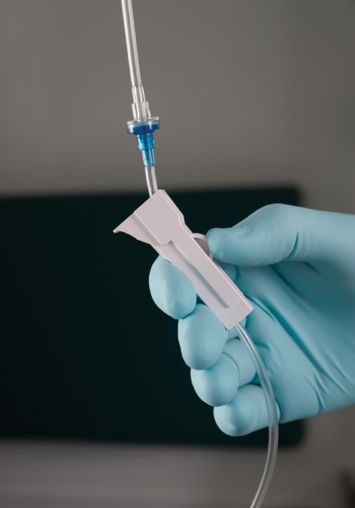
Setting Up an I V Fluid Administration Set (8 of 8)
Turn off the flow.
Notes:
Covers Objective: 18.4
Discussion Topic: Describe the steps involved in assembling an IV administration set.
Class Activity: Distribute providers among groups of students and have them prepare IV administration sets. Allow the providers to share their insights and tips.

Slide 42
Maintaining an I V
Troubleshoot flow problems.
Constricting bands left in place by mistake
  Flow regulator left closed
  Clamp closed on tubing
  Tubing kinked
  Tubing caught under patient or equipment
Adjust flow rate properly.
Monitor I V sites for infiltration.
Notes:
Covers Objective: 18.4
Point to Emphasize: IV maintenance may require an EMT to troubleshoot common problems with continuing flow.
Discussion Topic: Discuss the common problems that might cause an IV to stop running. What steps can an EMT take to troubleshoot these problems?
Knowledge Application: Present scenarios in which an IV is no longer running. Ask the class to work through troubleshooting practices. Discuss.

Slide 43
Chapter Review

Slide 44
Chapter Review (1 of 4)
Aspirin, oral glucose, and oxygen are medications that the E M T may administer to a patient under specific conditions that are carried on the ambulance.
The E M T may assist the patient in taking prescribed inhalers, nitroglycerin, and epinephrine in auto-injectors.
You may be able to administer intranasal naloxone, or may encounter patients who have received it from a layperson.

Slide 45
Chapter Review (2 of 4)
You may need to have permission from medical direction to administer or assist the patient with a medication. Follow local protocols.

Slide 46
Chapter Review (3 of 4)
There is a wide variety of medications that a patient may be taking. You will try to find out what medications a patient is taking when you take the SAMPLE history (signs and symptoms, allergies, medications, pertinent past history, last oral intake, and events leading to the injury or illness). These drugs may be identified by a variety of generic and trade names. Your main purpose in finding out what medications the patient is taking is to report this information to your medical director or hospital personnel.

Slide 47
Chapter Review (4 of 4)
When administering a medication, first check the expiration date. Keep the five rights in mind: right patient, right medication, right dose, right route, and right time. Fully document all medication administration as soon as possible.

Slide 48
Remember (1 of 2)
E M Ts administer aspirin, oral glucose, and oxygen as part of patient care.
E M Ts may assist with prescribed inhalers, nitroglycerine, and epinephrine auto-injectors.
E M Ts should understand the names, indications, contraindications, and side effects of medications that they intend to administer.

Slide 49
Remember (2 of 2)
E M Ts must have appropriate authorization to give a drug and always must follow the “five rights” of medication administration.
Reassessment and documentation are important elements of medication administration.

Slide 50
Questions to Consider
Should I administer a medication?
How can I get more information about a drug?
What are the necessary steps that must occur after medication administration?
Notes:
Talking Points: EMTs must look to local protocol and examine patient condition before giving any drug. In addition, EMTs must apply the "five rights" of medication administration.
EMTs should know how to access medication resources to gather additional information regarding an encountered medication.
EMTs must remember that reassessment and documentation are critical elements that must follow any intervention.

Slide 51
Critical Thinking
A patient is complaining of chest pain. Here’s some nitroglycerin,” says a family member. “Give him that.” What do you do?
Notes:
Talking Points: The essential point is to follow the "five rights" of administering medications. These will lead you to acting appropriately in each situation.

Slide 52

Copyright
This work is protected by United States copyright laws and is provided solely for the use of instructors in teaching their courses and assessing student learning. Dissemination or sale of any part of this work (including on the World Wide Web) will destroy the integrity of the work and is not permitted. The work and materials from it should never be made available to students except by instructors using the accompanying text in their classes. All recipients of this work are expected to abide by these restrictions and to honor the intended pedagogical purposes and the needs of other instructors who rely on these materials.

Slide 53
Appendix 1
The images are as follows.
Image A, displays 2 Epipen epinephrine auto injectors.
Image B, displays auto injector is inside its case.
Image C, displays 2 Auvi-Q epinephrine auto-injectors. The injector on the left is the actual injector while the injector on the right is a trainer that does not contain any active drugs or needle.
Return to presentation

