Slide 1

Emergency Care
Fourteenth Edition
Chapter 26
Abdominal Emergencies
Slides in this presentation contain hyperlinks. JAWS users should be able to get a list of links by using INSERT+F7
Copyright © 2021, 2016, 2012 Pearson Education, Inc. All Rights Reserved
Notes:
If this PowerPoint presentation contains mathematical equations, you may need to check that your computer has the following installed:
1) MathType Plugin
2) Math Player (free versions available)
3) NVDA Reader (free versions available)

Slide 2
Topics
Abdominal Anatomy and Physiology
Abdominal Pain or Discomfort
Abdominal Conditions
Assessment and Care of Abdominal Pain or Discomfort
Notes:
Planning Your Time: Plan 115 minutes for this chapter.
Abdominal Anatomy and Physiology (10 minutes)
Abdominal Pain or Discomfort (10 minutes)
Abdominal Conditions (50 minutes)
Assessment and Care of Abdominal Pain or Discomfort (45 minutes)
Note: The total teaching time recommended is only a guideline.
Core Concepts:
Understanding the nature of abdominal pain or discomfort
Becoming familiar with abdominal conditions that may cause pain or discomfort
How to assess and care for patients with abdominal pain or discomfort

Slide 3
Abdominal Anatomy and Physiology
Back to Topics
Notes:
Teaching Time: 10 minutes
Teaching Tip: Relate the four quadrants of the abdomen to external landmarks. Demonstrate positioning on an actual abdomen.

Slide 4
Abdominal Anatomy and Physiology (1 of 7)
Abdomen contains many organs from several different body systems.
Can cause confusion when determining the cause of abdominal emergencies
Thorough patient assessment key.
Specific diagnosis may not be necessary; treatment is the same for most conditions.
Notes:
Covers Objective: 26.1

Slide 5
Abdominal Anatomy and Physiology (2 of 7)
Abdomen
  Region between diaphragm and pelvis
  Contains many organs that provide the following functions:
    Digestive
    Reproductive
    Endocrine
    Regulatory
Notes:
Covers Objective: 26.1
Point to Emphasize: The abdomen contains a variety of organs that accomplish a range of functions for the body. Digestion, secretion of insulin, filtration of blood, and the removal of toxins from the body are functions performed by abdominal organs.

Slide 6
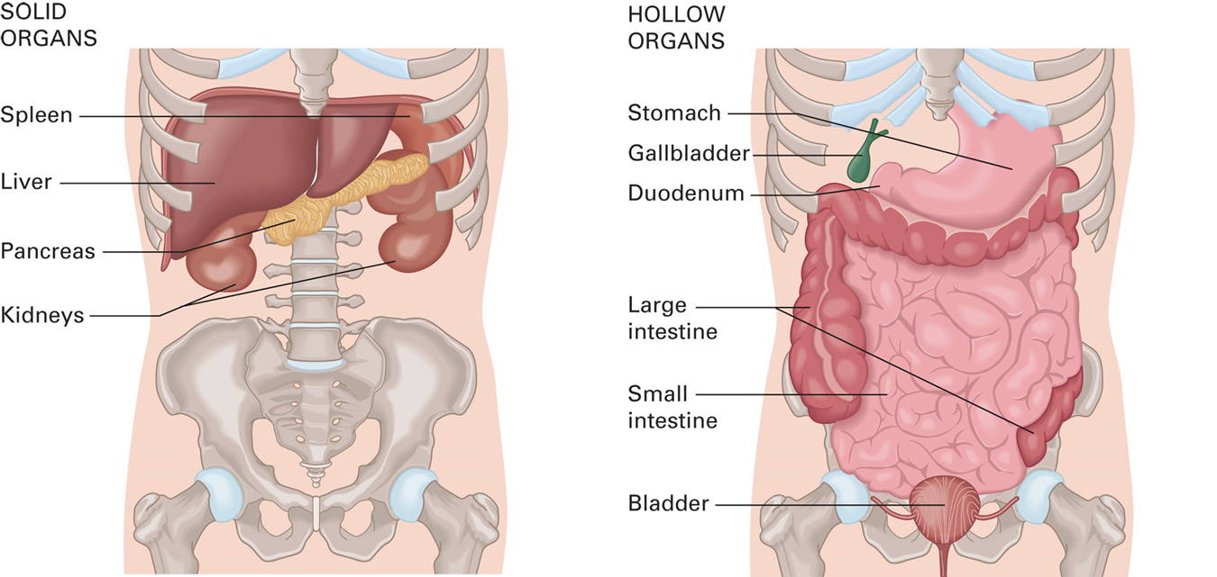
Organs of the Abdomen
For long description, see slide 65: Appendix 1
The structures and organs of the abdomen.
Notes:
Covers Objective: 26.1
Discussion Topics: How are the abdominal organs of a man different from the abdominal organs of a woman? Describe these differences.
Class Activity: Have students, using a blank anatomy diagram of the abdomen, correctly label and position the major organ systems.

Slide 7
Abdominal Anatomy and Physiology (3 of 7)
Abdomen divided into “quadrants”
  R U Q, L U Q, R L Q, L L Q
  Used to describe and identify areas of pain, tenderness, discomfort, injury, or other abnormalities
Notes:
Covers Objective: 26.1
Point to Emphasize: Anatomically, the abdomen is divided into four quadrants, using the midline and umbilicus as dividing points.

Slide 8
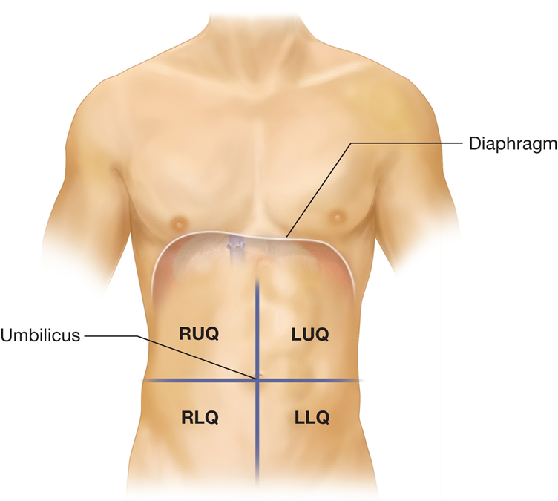
Abdominal Quadrants
The abdominal quadrants.
Notes:
Covers Objective: 26.1
Point to Emphasize: Anatomically, the abdomen is divided into four quadrants, using the midline and umbilicus as dividing points.

Slide 9
Abdominal Anatomy and Physiology (4 of 7)
Organs of the abdomen
  Peritoneum
    Thin membrane lining the abdominal cavity and covering each organ
  Parietal peritoneum attached to the abdominal wall
  Visceral peritoneum covers each organ.
Notes:
Covers Objective: 26.1

Slide 10
Abdominal Anatomy and Physiology (5 of 7)
Organs of the abdomen
  Most enclosed within parietal peritoneum
  A few lie in extraperitoneal space (outside the peritoneum).
    Kidneys, pancreas, part of aorta lie in retroperitoneal space, behind peritoneum.
    Bladder and part of rectum lie inferior to peritoneum.
Notes:
Covers Objective: 26.1
Points to Emphasize: Most organs are contained within the peritoneum, but some are located in the retroperitoneal space. Reproductive organs contained within the abdomen are different in women from what they are in men.
Discussion Topic: Explain what is meant by the term retroperitoneal. Discuss examples of retroperitoneal organs.
Knowledge Application: Have students work in small groups. Assign each group a specific abdominal organ. Have each group research and present the organ's location within the abdomen and its major function.
Critical Thinking Discussion: Consider penetrating trauma. How might knowledge of abdominal anatomy assist your assessment of mechanism of injury?

Slide 11
Abdominal Anatomy and Physiology (6 of 7)
Organs of the abdomen
  Female reproductive organs and structures lie within abdomen and pelvis
    Ovaries
    Fallopian tubes
    Uterus
Notes:
Covers Objective: 26.1

Slide 12
Abdominal Anatomy and Physiology (7 of 7)
Organs of the abdomen
  Largest blood vessels
    Aorta
    Inferior vena cava
    Hepatic artery
    Splenic artery
    Iliac artery and vein
Notes:
Covers Objective: 26.1

Slide 13
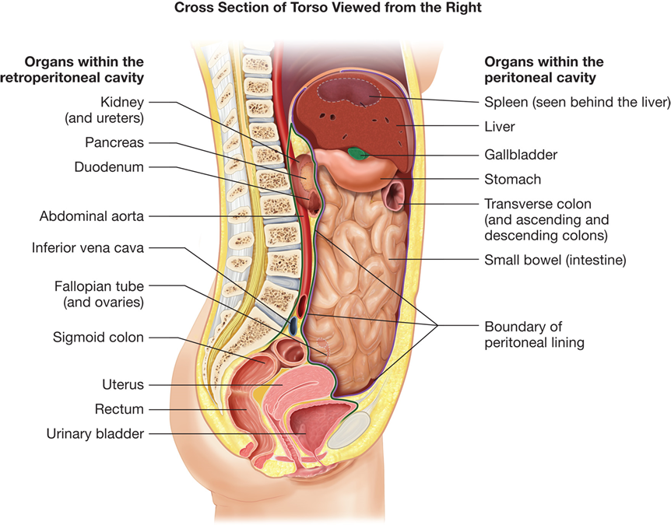
Peritoneal and Extraperitoneal Space
The peritoneum and extraperitoneal (including retroperitoneal) space.
Notes:
Covers Objective: 26.1
Knowledge Application: Using a manikin or programmed patient, use external landmarks to determine the location of abdominal organs. Point out where organs would be with regard to visible landmarks.

Slide 14
Abdominal Pain or Discomfort
Back to Topics
Notes:
Teaching Time: 10 minutes
Teaching Tip: Discuss etiology when describing the different classifications of abdominal pain. Give specific examples of organs that cause the particular type of pain. Use first-person testimony to describe the various types of pain. Students in class often have experienced the different pain classifications.

Slide 15
Abdominal Pain or Discomfort (1 of 4)
Visceral pain
  Originates from the organs within the abdomen
  Fewer nerve endings allow for only diffuse sensations of pain.
  Frequently described as “dull” or “achy”
  Intermittent, crampy, or colicky pain may result from hollow organs.
  Persistent or constant pain often originates from solid organs.
Notes:
Covers Objective: 26.2
Points to Emphasize: Both peritoneal and retroperitoneal organs can cause pain in the abdomen. Visceral pain originates in the organs within the abdomen and is often described as dull, achy, or intermittent.
Knowledge Application: Have students work in small groups. Assign each group an abdominal dysfunction. Ask the group to research and present on the type of pain that is likely to be associated with its particular dysfunction.

Slide 16
Abdominal Pain or Discomfort (2 of 4)
Parietal pain
  Originates from the parietal peritoneum
  Many nerve endings allow for pain that is easier to locate and describe
  Frequently described as “sharp”
  Pain is often constant and localized to a specific area
Notes:
Covers Objective: 26.2
Point to Emphasize: Parietal pain arises from the parietal peritoneum and often is described as sharp, constant, and localized to a particular area.
Discussion Topic: Compare and contrast visceral pain with parietal pain. How are they different?
Knowledge Application: Using programmed patients, practice assessing abdominal pain. Practice using the mnemonic OPQRST to aid evaluation of pain.

Slide 17
Abdominal Pain or Discomfort (3 of 4)
Tearing pain
  Not the most common type of abdominal pain
  Originates in the aorta or stomach
  Separation of layers of aorta caused by aneurysm
  Retroperitoneal location of aorta causes pain to be referred to back
  Ulcers in stomach can also cause tearing pain
Notes:
Covers Objective: 26.2
Point to Emphasize: Tearing pain typically refers to a dissection of the abdominal aorta.
Discussion Topic: Describe the etiology of tearing pain. Discuss the most likely cause.
Class Activities: List a classification of pain on a whiteboard. Have students come up and write an adjective that might describe that type of pain. Repeat until the pain is best defined. Assign a research project. Give students (or groups of students) a classification of pain. Ask them to research and present different types of abdominal problems that might be associated with their classification.

Slide 18
Abdominal Pain or Discomfort (4 of 4)
Referred pain
  Perception of pain in skin or muscles at distant locations
    Abdomen has many nerves from different parts of the nervous system.
    Nerve pathways overlap as they return to the spinal cord.
    Pain sensation is transmitted from one system to another.
Notes:
Covers Objective: 26.2
Point to Emphasize: Referred pain is felt in a place other than the place where the pain originates.
Discussion Topic: Give an example of an organ system that is likely to cause referred pain.
Critical Thinking Discussion: Are there non-abdominal organs that can cause abdominal pain? List and describe them.

Slide 19
Abdominal Conditions
Back to Topics
Notes:
Teaching Time: 50 minutes
Teaching Tip: Emphasize the need to recognize life-threatening emergencies first and diagnose specific disorders second. Link assessment findings and the characteristics of pain to specific disorders. Tie this lesson to the previous discussion of pain classifications.
Knowledge Application: Have students work in small groups. Assign each group an abdominal dysfunction. Ask the group to research and present on the type of pain that is likely to be associated with the particular dysfunction. Using programmed patients, practice assessing abdominal pain. Practice using the mnemonic OPQRST to aid evaluation of pain. Describe an abdominal pain. Have students classify the pain, based on your description, and then discuss the possible origin.

Slide 20
Appendicitis
Infection of appendix
Signs and symptoms
  Nausea and sometimes vomiting
  Pain often initially referred to umbilical region, followed by persistent R L Q pain
  Rupture of appendix
    Sudden, severe increase in pain
    Contents releasing into abdomen causes severe peritonitis.
Notes:
Covers Objective: 26.2
Points to Emphasize: Assessment and management always will take a higher priority than determining the exact cause of abdominal pain. Specific assessment findings can point to particular types of abdominal problems. EMTs should use a thorough secondary assessment to work through a differential diagnosis.
Discussion Topic: Describe the common assessment findings (cardinal presentation) of appendicitis.

Slide 21
Peritonitis
Irritation of peritoneum, usually caused by foreign material in peritoneal space
Parietal peritoneum is sensitive, especially to acidic substances.
Irritation causes involuntary contraction of abdominal muscles.
Signs and symptoms
  Abdominal pain and rigidity
Notes:
Covers Objective: 26.2
Discussion Topic: Describe the common assessment findings (cardinal presentation) of peritonitis.
Critical Thinking Discussion: How might peritonitis be linked with a recent history of trauma?

Slide 22
Cholecystitis/Gallstones
Inflammation of the gallbladder
Often caused by blockage of bile flow by gallstones
Symptoms often worsened by ingestion of fatty foods
Signs and symptoms
  Severe R U Q or epigastric pain
  Pain often referred to shoulder
Notes:
Covers Objective: 26.2
Discussion Topic: Describe the common assessment findings (cardinal presentation) of cholecystitis.
Critical Thinking Discussion: How might the diagnosis of cholecystitis be related to the SAMPLE element of “last meal”?

Slide 23
Pancreatitis
Inflammation of the pancreas
Common in patients with chronic alcohol abuse
Signs and symptoms
  Epigastric pain
  Often referred to back and/or shoulder
Notes:
Covers Objective: 26.2
Discussion Topic: Describe the common assessment findings (cardinal presentation) of pancreatitis.

Slide 24
Gastrointestinal (G I) Bleeding (1 of 2)
Bleeding within the G I tract, from esophagus to rectum
May be minor to severe
Blood eventually exits (mouth or rectum)
Often painless
Gastric ulcers (holes in G I system from highly acidic gastric juices) can cause severe pain and peritonitis.
Notes:
Covers Objective: 26.2
Point to Emphasize: Bleeding can occur anywhere within the GI system, from the esophagus to the rectum. GI bleeding may be gradual or sudden, and it can be a life-threatening cause of shock.
Discussion Topic: Describe the common assessment findings (cardinal presentation) of GI bleeding.

Slide 25
Gastrointestinal (G I) Bleeding (2 of 2)
Signs and symptoms
  Dark-colored stool (maroon to black), often “tarry”
  Frank blood from rectum
  Vomiting “coffee-ground” appearing blood
  Vomiting of frank blood
  Pain can be absent to severe.
Notes:
Covers Objective: 26.2
Critical Thinking Discussion: You recognize GI bleeding. What findings might you associate with a life-threatening GI bleed?

Slide 26
Abdominal Aortic Aneurysm (1 of 2)
Ballooning or weakening of inner wall of the aorta
Tears and separates from outer layers (dissection)
Weakened vessel bulges, may continue to grow
May eventually rupture
Notes:
Covers Objective: 26.2
Point to Emphasize: Retroperitoneal, tearing pain should be assumed to be caused by an abdominal aortic aneurism. This type of abdominal pain can point to an immediately life-threatening problem.
Discussion Topic: Describe the common assessment findings (cardinal presentation) of abdominal aortic aneurysm.
Inside/Outside: Aortic Damage: Draw a relationship between what patients exhibit and what is occurring inside the body during an abdominal aortic aneurysm.

Slide 27
Abdominal Aortic Aneurysm (2 of 2)
Signs and symptoms
  Progressive (often sharp or tearing) abdominal pain
  Frequently radiates to back
  Rupture causes rapid onset of excruciating abdominal and back pain
  Signs of shock usually present
  Possible inequality in pedal pulses
Notes:
Covers Objective: 26.2
Teaching Tip: Emphasize the link here to bleeding and shock.
Class Activity: Assign a student an abdominal dysfunction and have the student act out the symptoms in front of the class. Ask the class to diagnose the student’s disorder.

Slide 28
Hernia (1 of 2)
Hole in the muscle layer of abdominal wall, allowing tissue or parts of organs (commonly intestines) to protrude up against skin
May be precipitated by heavy lifting
May cause strangulation of tissue or bowel obstruction
Require transport to hospital for evaluation
Notes:
Covers Objective: 26.2
Discussion Topic: Describe the common assessment findings (cardinal presentation) of a hernia.

Slide 29
Hernia (2 of 2)
Signs and symptoms
  Sudden onset of abdominal pain, often following lifting
  Palpable mass or lump on abdominal wall or crease of groin
Notes:
Covers Objective: 26.2
Critical Thinking Discussion: Consider the common locations of hernias. How might their presentation mimic other life threatening conditions such as acute myocardial infarction?

Slide 30
Renal Colic
Severe flank pain caused by kidney stones traveling down the ureter
Signs and symptoms
  Severe pain in flank or back
  Frequently radiates to groin
  Nausea, vomiting
Notes:
Covers Objective: 26.2
Discussion Topic: Describe the common assessment findings (cardinal presentation) of renal colic.

Slide 31
Cardiac Involvement
Pain from myocardial infarction may be felt as abdominal discomfort.
  Epigastric pain
  Indigestion or digestive discomfort
Always consider the possibility of a cardiac emergency as a cause of abdominal symptoms.
Notes:
Covers Objective: 26.2
Point to Emphasize: Myocardial infarction sometimes can present as abdominal discomfort and should be considered in the assessment and treatment of a patient with abdominal pain.
Discussion Topic: Describe how cardiac issues can present as abdominal findings. Describe the abdominal findings that could indicate acute myocardial infarction.

Slide 32
Abdominal Pain Associated with the Female Reproductive System
Most serious cause is ectopic pregnancy.
  Occurs when fertilized embryo implants outside the uterus.
  Rupture can cause life-threatening internal bleeding.
Notes:
Covers Objective: 26.2
Discussion Topic: Describe the abdominal findings that could indicate ectopic pregnancy.
Critical Thinking Discussion: Discuss the moral and ethical issues that some individuals might have related to terminating an ectopic pregnancy. How might an EMT provide emotional support for a woman with an ectopic pregnancy?

Slide 33
Assessment and Care of Abdominal Pain or Discomfort
Back to Topics
Notes:
Teaching Time: 45 minutes
Teaching Tip: Use programmed patients to add a level of realism to practice. Always focus on life threats. Be sure to include critical patients in any practice session. Relate this lesson to patient assessment. Bring OPQRST to realistic use now.

Slide 34
Assessment and Care of Abdominal Pain or Discomfort
Many potential causes of abdominal pain
Role of E M T is not to diagnose.
Focus efforts
  Perform thorough secondary assessment.
  Identify serious or life-threatening conditions.
Notes:
Covers Objective: 26.3
Point to Emphasize: The focus of the assessment of a patient with abdominal pain should be to perform an accurate history and physical examination and to identify potentially serious conditions.

Slide 35
Scene Size-Up
Protect yourself from vomiting.
Be aware of odors.
Determine if patient’s condition is medical, trauma, or both.
Notes:
Covers Objective: 26.3
Discussion Topic: Describe the personal protective equipment that might be necessary when approaching a patient with an abdominal complaint. Describe how the scene survey might indicate a specific abdominal complaint.

Slide 36
Primary Assessment
General impression
Level of consciousness and airway care
Early signs of shock
Position of patient
Consider application of supplemental oxygen to any hypoxic abdominal pain patient or in any situation where an oxygen saturation is deemed to be inaccurate
Notes:
Covers Objective: 26.3
Points to Emphasize: Primary assessment findings will rapidly identify signs of a critical patient. After treating immediate life threats, conduct a secondary assessment to help differentiate abdominal disorders.
Discussion Topic: Describe findings in the primary assessment of a patient with abdominal pain that might indicate immediate life threats. How would you recognize shock in the primary assessment?

Slide 37
History of the Present Illness (1 of 2)
Onset
  “When did it begin? What were you doing?”
Provocation/palliation
  “What makes it better or worse? Movement? Position?”
Quality
  “Describe the sensation in your abdomen.”
Notes:
Covers Objective: 26.3
Discussion Topic: Discuss how the history of the present illness can help in making a differential diagnosis of a patient with abdominal pain.

Slide 38
History of the Present Illness (2 of 2)
Region/Radiation
  “Point to its location. Does it radiate or move?”
Severity
  “How bad is the pain on a scale of 0–10?”
Time
  “How long have you had pain or discomfort? Has it changed?”
Notes:
Covers Objective: 26.3
Knowledge Application: Have students work in small groups. Using a programmed patient, practice assessing and treating patients with abdominal pain.

Slide 39
History Specific to Female Patients (1 of 2)
“Where are you in your menstrual cycle?”
“Is your period late?”
“Do you have bleeding from the vagina that is not menstrual bleeding?”
“If you are menstruating, is your flow normal?”
Notes:
Covers Objective: 26.3
Discussion Topic: Describe specific questions that you might ask a female patient who complains of abdominal pain.

Slide 40
History Specific to Female Patients (2 of 2)
“Have you had this pain before?”
“If so, when did it happen and what was it like?”
“Is it possible you are pregnant?”
“Are you using birth control?”
Notes:
Covers Objective: 26.3

Slide 41
Past Medical History
A: Allergies
M: Medications
P: Pertinent past history
L: Last oral intake
E: Events leading to emergency
Notes:
Covers Objective: 26.3
Knowledge Application: Using programmed patients, set up mock calls. Include scene clues and bystander information. Ask students to identify critical patients and to make differential diagnoses of abdominal pain.

Slide 42
Geriatric Note
Decreased ability to perceive pain
More serious causes of abdominal pain
More likely to be life-threatening
May be complicated by medications
Notes:
Covers Objective: 26.3

Slide 43
Physical Examination of the Abdomen (1 of 2)
Inspection
  Distention
  Discoloration
  Protrusions
Notes:
Covers Objective: 26.3
Class Activity: Using programmed patients, set up mock calls. Include scene clues and bystander information. Ask students to identify critical patients and to make differential diagnoses of abdominal pain.

Slide 44
Physical Examination of the Abdomen (2 of 2)
Palpation
  Use fingertips.
  Painful area last
  Rigidity
  Pain
  Guarding
Notes:
Covers Objective: 26.3
Discussion Topic: Describe the technique for palpating the abdomen. What findings might be important?
Class Activity: Have students practice palpating the abdomen of the student sitting next to them.
Point to Emphasize: Always palpate the area that has pain or discomfort last.

Slide 45
Vital Signs
Baseline, then every 5 minutes
  Pulse
  Respirations
  Blood pressure
  Skin color, temperature, and condition
  Pulse oximetry
  Mental status
Notes:
Covers Objective: 26.3
Discussion Topic: Describe the process of obtaining vital signs in a patient with an abdominal complaint. Describe the vital sign trends that would indicate shock in a patient with an abdominal complaint.
Critical Thinking Discussion: What role might advanced life support play when dealing with a patient with abdominal pain?

Slide 46
General Abdominal Distress
Some will result from digestive system disorders; others could be cardiac or diabetic issues, food poisoning, or flu.
Assess and care for these patients with appropriate attention to airway.
  Particularly if patient vomiting
Always work to calm the patient to reduce anxiety.
Never give patient anything by mouth.
Notes:
Covers Objective: 26.3
Class Activity: Write out the details of an assessment of a patient with abdominal pain. Provide a set of complaints; then ask students to list the steps that they would take to assess this patient further.

Slide 47
Patient Care
Maintain airway.
  Be prepared to suction.
Administer oxygen to hypoxic patient.
  Maintain oxygen saturations of 94 percent.
Place in position of comfort.
  L L R for airway protection
Transport to appropriate facility.
Notes:
Covers Objective: 26.3
Point to Emphasize: Care for the patient with abdominal pain is often similar, regardless of the origin. Treat immediate life threats, administer oxygen, place the patient in a position of comfort, and initiate appropriate transport.
Discussion Topic: Describe the general treatment steps for a patient who is experiencing abdominal pain.

Slide 48
Think About It (1 of 2)
An 89-year-old female with a history of diabetes, hypertension, and gallstones is complaining of nausea and dizziness about 20 minutes after eating.
Notes:
Covers Objective: 26.3

Slide 49
Think About It (2 of 2)
What are the concerns with this patient?
Is this an abdominal emergency, a diabetic emergency, or a cardiac emergency?
How will you know?
What will your treatment be?
Notes:
Covers Objective: 26.3
Talking Points: Could this be life-threatening? If it is cardiac, yes, and this patient is at high risk. While focusing on cardiac, your detailed assessment (with vitals, glucose level, and abdominal exam) should reveal the true cause. Treatment would include initial assessment, history, vitals, detailed physical exam, oxygen, position, call ALS, transport to appropriate facility.

Slide 50
Chapter Review

Slide 51
Chapter Review (1 of 6)
All patients with complaints of abdominal pain or distress should be transported to the hospital. These cases are difficult to diagnose without the testing resources that are available at the hospital.

Slide 52
Chapter Review (2 of 6)
As an E M T, your responsibility is primarily to assess the patient and report your findings. Diagnosing the cause of an abdominal complaint in the field is often more difficult and time-consuming than diagnosing in the emergency department, where there are many more resources.

Slide 53
Chapter Review (3 of 6)
Your assessment should include thorough patient history, physical exam, and vital signs.

Slide 54
Chapter Review (4 of 6)
Look for signs and symptoms that can signal serious trouble. These include the sudden onset of tearing pain radiating to the back; vomiting blood or coffee grounds-like material; the presence of black, tarry stools; and signs and symptoms of shock.

Slide 55
Chapter Review (5 of 6)
Emergency care will consist of protecting the patient’s airway; oxygen as needed; placing the responsive patient in a position of comfort, or placing the unresponsive patient or patient with difficulty maintaining an airway in the left lateral recumbent position; and transporting the patient to the hospital.

Slide 56
Chapter Review (6 of 6)
Take all appropriate Standard Precautions and carefully clean and disinfect equipment and the ambulance, especially if the patient has vomited or had diarrhea.

Slide 57
Remember (1 of 3)
Abdominal organs provide a variety of important functions to the body.
The abdomen can be divided into four quadrants, with reference to the midline and umbilicus.
Classifications of pain can help identify specific abdominal dysfunctions.

Slide 58
Remember (2 of 3)
Assessment and management always take a higher priority than determining the exact cause of abdominal pain.
Knowledge of the characteristics of specific abdominal disorders can aid differential diagnosis when assessing a patient with abdominal pain.

Slide 59
Remember (3 of 3)
Care for a patient with abdominal pain should include treatment of immediate life threats, administration of oxygen, placing patient in a position of comfort, and appropriate transport.

Slide 60
Questions to Consider (1 of 2)
What are five signs and symptoms of abdominal distress?
Describe the difference between visceral and parietal pain. Describe a condition that may be responsible for each.
Notes:
Talking Points: Signs and symptoms of abdominal distress include nausea, vomiting, diarrhea, pain, and distention.
Visceral pain arises from organs in the visceral peritoneum and is general and nonspecific; the patient will not be able to localize it or point to a specific area. Parietal pain arises from organs in the parietal peritoneum and often is described as sharp, constant, and localized to a particular area.

Slide 61
Questions to Consider (2 of 2)
What is the emergency care for a patient experiencing abdominal pain or distress?
Name the four abdominal quadrants. How are the quadrants determined?
Notes:
Talking Points: Emergency care for a patient with abdominal distress involves monitoring for airway problems if the patient is vomiting, placing the responsive patient in a position of comfort, placing the unresponsive patient or the patient who is having difficulty maintaining an airway in a left lateral recumbent position for drainage from the mouth.
The four abdominal quadrants are LUQ, RUQ, LLQ, and RLQ. These are determined by a midline on the umbilicus.

Slide 62
Critical Thinking (1 of 2)
You are called to a patient with abdominal pain. He describes the pain as severe and says it has been “on and off” over the past several days, becoming severe within the last hour.

Slide 63
Critical Thinking (2 of 2)
What additional questions would you ask the patient?
In what position would he likely be most comfortable?
Notes:
Talking Points: Questions should focus on where the pain is, where it starts from, and so on. Questions asked will be determined by the history of the present illness and other steps in the assessment. Best position is likely to be the one where least pressure is put on the painful area.

Slide 64

Copyright
This work is protected by United States copyright laws and is provided solely for the use of instructors in teaching their courses and assessing student learning. Dissemination or sale of any part of this work (including on the World Wide Web) will destroy the integrity of the work and is not permitted. The work and materials from it should never be made available to students except by instructors using the accompanying text in their classes. All recipients of this work are expected to abide by these restrictions and to honor the intended pedagogical purposes and the needs of other instructors who rely on these materials.

Slide 65
Appendix 1
First chart depicts the placement of the solid organs in the human body including the spleen, liver, pancreas, and kidneys. Second chart depicts the hollow organs in the human body including the stomach, gallbladder, duodenum, large and small intestines, and bladder.
Return to presentation

