Slide 1
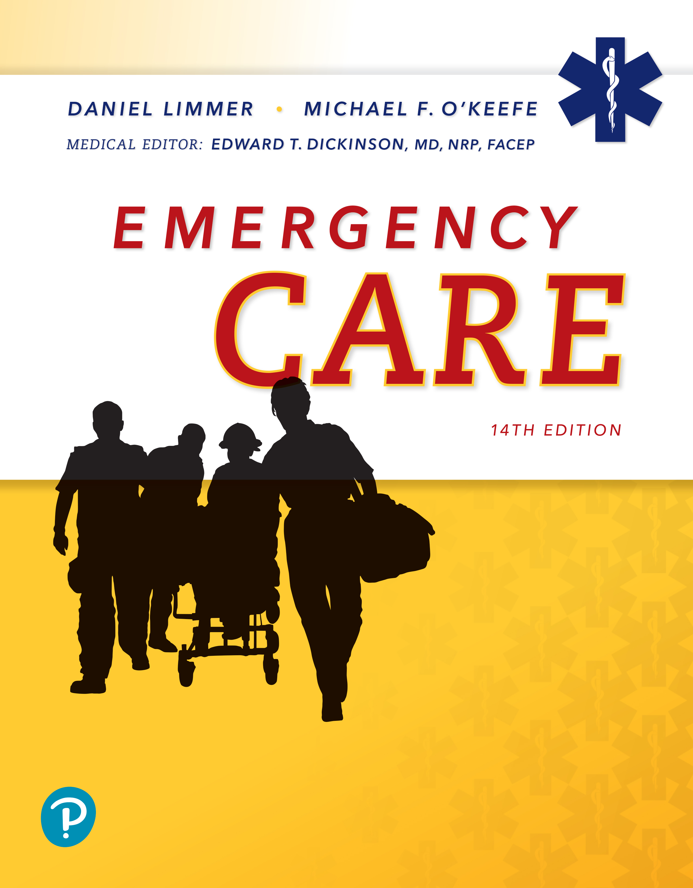
Emergency Care
Fourteenth Edition
Chapter 40
Highway Safety and Vehicle Extrication
Slides in this presentation contain hyperlinks. JAWS users should be able to get a list of links by using INSERT+F7
Copyright © 2021, 2016, 2012 Pearson Education, Inc. All Rights Reserved
Notes:
If this PowerPoint presentation contains mathematical equations, you may need to check that your computer has the following installed:
1) MathType Plugin
2) Math Player (free versions available)
3) NVDA Reader (free versions available)

Slide 2
Topics
Highway Emergency Operations
Vehicle Extrication
Notes:
Planning Your Time: Plan 80 minutes for this chapter.
Highway Emergency Operations (30 minutes)
Vehicle Extrication (50 minutes)
Note: The total teaching time recommended is only a guideline.
Core Concepts
How to position emergency apparatus to create a safe work zone at a highway emergency
How to recognize and manage hazards at the highway rescue scene
How to stabilize a vehicle
How to gain access to the patient in a crashed vehicle
How to disentangle a patient from a crashed vehicle

Slide 3
Highway Emergency Operations
Back to Topics
Notes:
Teaching Time: 30 minutes
Teaching Tips: Use multimedia graphics to illustrate highway scenes. Show providers potential hazards. Use a tabletop mock up to demonstrate the highway MVC. Use models/toys to present highway scene vehicle placement. Use a vehicle to practice exiting and positioning. Discuss best practices. Demonstrate personal protective equipment and warning devices. Discuss procedures for using them properly. Use multimedia graphics to illustrate nighttime highway scenes.

Slide 4
Highway Emergency Operations (1 of 3)
Oncoming traffic at highway incidents is one of the greatest hazards emergency responders face today.
Responding agencies and personnel need to be cognizant of their responsibilities in these types of hazardous environments.
Notes:
Covers Objective: 40.1
Discussion Topic: Describe the potential scene safety hazards of a highway scene. What threats are present?

Slide 5
Highway Emergency Operations (2 of 3)
E M S response should be limited to only the manpower and vehicles needed to accomplish the mission.
The first-arriving unit should institute “blocking” to protect the work area.
  Preferably fire apparatus
If it is necessary to block lanes of traffic, clear them quickly as possible so that flow of traffic can return to normal.
Notes:
Covers Objective: 40.1
Discussion Topic: Describe the guidelines for keeping patients and responders safe at a highway scene.

Slide 6
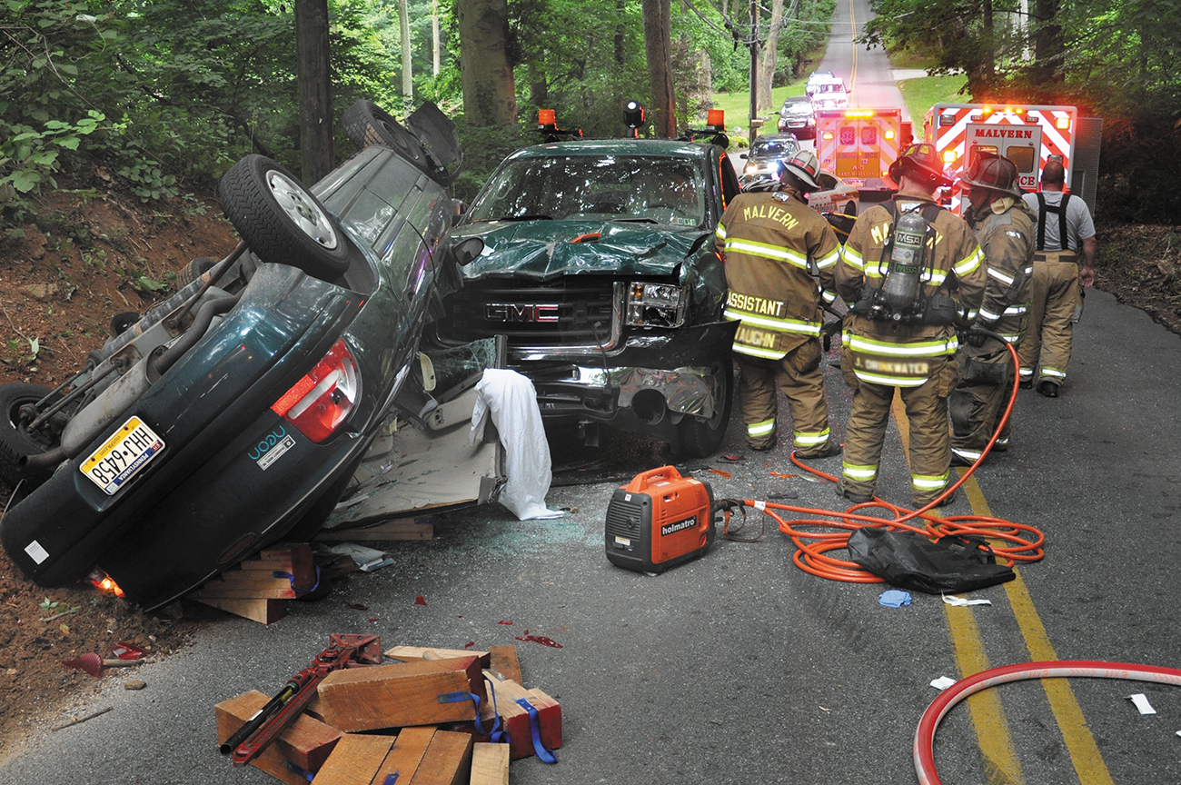
Highway Emergency Operations (3 of 3)
A vehicle collision where extrication of the patient is required is the most common type of rescue across the United States. © Edward T. Dickinson, M D
Notes:
Covers Objective: 40.1
Point to Emphasize: The first-arriving unit at a highway scene should institute "blocking" to protect the work area. Because of its size and weight, fire apparatus is preferred for this purpose.
Discussion Topics: Describe the safety responsibilities of the first units on scene at a highway response. Describe the process of positioning a "blocking" vehicle. What types of units are best suited for this role?
Knowledge Application: Use multimedia graphics to demonstrate a highway scene. Ask students to discuss initial safety procedures.
Critical Thinking: You are confronted on scene by an angry law enforcement officer, who tells you that your blocking vehicle has created a major traffic issue. He demands that you open the lane to traffic. You are concerned that doing this will create a safety issue for responders. What do you do?

Slide 7
Initial Response (1 of 2)
Limited access highways
  Only primary or first-due units should proceed directly to scene.
On-scene units
  Park single file in same direction to minimize on-scene congestion.
Notes:
Covers Objective: 40.1
Points to Emphasize: Highway response is a significant safety hazard for EMTs. EMS response at a highway scene should be limited to only the manpower and vehicles needed to accomplish the mission. Units sent for backup should stage off the highway until they are requested to the scene.
Discussion Topic: Describe the potential scene safety hazards of a highway scene. What threats are present?
Class Activity: Create a mock highway response. Have students use cars to replicate emergency vehicles and demonstrate proper positioning and exit procedures.

Slide 8
Initial Response (2 of 2)
First-arriving units should:
  Establish Command and confirm exact location of incident with dispatch center.
  Use apparatus to institute “upstream blocking” to protect work area.
  Rescue trucks arriving to perform extrication should be positioned downstream of initial blocking vehicle.
Notes:
Covers Objective: 40.1
Discussion Topic: Describe the safety responsibilities of the first units on scene at a highway response.
Knowledge Application: Use multimedia graphics to demonstrate a highway scene. Ask students to discuss initial safety procedures.

Slide 9
Position Blocking Apparatus (1 of 2)
Create one and a half to two lanes of blockage.
Position apparatus at angle with front wheels rotated away from incident.
Notes:
Covers Objective: 40.1
Point to Emphasize: The first-arriving unit at a highway scene should institute "blocking" to protect the work area. Because of its size and weight, fire apparatus is preferred for this purpose.
Discussion Topics: Describe the process of positioning a "blocking" vehicle. What types of units are best suited for this role?
Knowledge Application: Have groups of students use a tabletop and models/toys to demonstrate proper highway procedures. Focus on vehicle placement.
Critical Thinking Discussion: You are confronted on scene by an angry law enforcement officer, who tells you that your blocking vehicle has created a major traffic issue. He demands that you open the lane to traffic. You are concerned that doing this will create a safety issue for responders. What do you do?

Slide 10
Position Blocking Apparatus (2 of 2)
Positioning the other apparatus
  Leave space immediately next to crash for vehicle extrication units.
  Position ambulances, command vehicles, and other units downstream from crash.
    Allows safer patient loading and rapid departure from scene
Notes:
Covers Objective: 40.1

Slide 11
Exiting the Vehicle Safety
Responders should always exit into the safe zone, if possible, after checking to be sure traffic has stopped.
  Communicate.
  Look out for oncoming traffic.
  Monitor when it is safe to exit.
Notes:
Covers Objective: 40.1
Discussion Topic: Describe the process for safely exiting a vehicle during a highway operation.

Slide 12
Being Seen and Warning Oncoming Traffic
All responders should be in full protective clothing or, at a minimum, A N S I-approved safety vests and helmets.
Place flares or traffic cones to slow traffic and channel it away from incident lane.
Notes:
Covers Objective: 40.1
Points to Emphasize: For further support, EMTs should use protective clothing and warning devices at highway scenes.
Discussion Topic: Describe the required personal protective equipment for roadway operations. Describe the warning devices (and their deployment) used to warn oncoming drivers of an emergency scene.
Knowledge Applications: Using actual warning devices, demonstrate deployment and best practice safety procedures.

Slide 13
Night Operations
Shut off vehicle’s headlights and white response lights.
Best combination of lights to provide maximum visibility
  Red/amber warning lights-on
  Headlights-off
  Fog lights-off
  Traffic directional boards operating
Notes:
Covers Objective: 40.1
Points to Emphasize: For further support, EMTs should use protective clothing and warning devices at highway scenes.
Discussion Topics: Describe the specific safety practices associated with nighttime highway operations. How might these operations be different from the ones used in daytime situations?
Knowledge Applications: Have groups of students use a tabletop and models/toys to demonstrate proper highway procedures. Focus on vehicle placement. Using actual warning devices, demonstrate deployment and best practice safety procedures.

Slide 14
Think About It 1
Is it safe to enter the highway scene?
Which units are necessary?
Notes:
Covers Objective: 40.1
Talking Points: EMTs must determine whether hazards are sufficiently accounted for so as to allow emergency response. EMTs should limit responders on a highway scene but also must recognize the need for specialized services such as rescue.

Slide 15
Vehicle Extrication
Back to Topics
Notes:
Teaching Time: 50 minutes
Teaching Tips: Invite an extrication technician to class. Have him discuss the process and tools of extrication. Consider arranging an extrication demonstration. Contact a local fire department and arrange a dual training. Always ensure a safe environment and appropriate personal protective equipment. Have on hand and demonstrate examples of safety and appropriate personal protective equipment for extrication. Use multimedia graphics to illustrate vehicle positions. Recognize that the responsibility for vehicle stabilization may vary from department to department. Safety should be the paramount consideration for any stabilization or extrication operation. Responders should only undertake this operation if properly trained and equipped.

Slide 16
Vehicle Extrication (1 of 2)
Phases
  Preparing for rescue
  Sizing up the situation
  Recognizing and managing hazards
  Stabilizing vehicle prior to entering
  Gaining access to patient
Notes:
Covers Objective: 40.2
Point to Emphasize: Vehicle extrication often requires specialized training and resources. EMTs should know their local resources and the procedure for activating those resources.
Discussion Topic: Discuss the critical elements of a scene size-up as they apply to vehicle extrication.
Class Activity: Use multimedia graphics to present a motor-vehicle collision. Ask the class to perform a scene size-up; discuss priorities of extrication.

Slide 17
Vehicle Extrication (2 of 2)
  Providing primary patient assessment and rapid trauma assessment
  Disentangling patient
  Immobilizing and extricating patient from the vehicle
  Providing assessment, care, and transport to most appropriate hospital
  Terminating the rescue
Notes:
Covers Objective: 40.2
Discussion Topic: Describe the ten phases of the extrication process. Discuss the role of the EMT in each phase.
Knowledge Application: Have students work in groups. Assign each group a phase of extrication. Have them research and present the key objectives of that phase.

Slide 18
Preparing for Rescue
Combination of training, practice, and the right protective gear and tools
Availability of training will depend on the kinds of rescues most likely to be required in your area.
Notes:
Covers Objective: 40.2

Slide 19
Sizing up the Situation
Conduct a good size-up to evaluate hazards and address need for additional resources.
  How many patients are involved?
    Priority
    M O I
  Are additional ambulances needed?
  What is extent of patient’s entrapment?
Notes:
Covers Objective: 40.2

Slide 20
Think About It 2
What does scene size-up tell me about the need for extrication?
Notes:
Covers Objective: 40.2
Talking Points: EMTs must decide what specialized resources they need and what priority they should establish.

Slide 21
Protective Gear for E M S Responders (1 of 5)
Protective gear for E M S responders
  At a crash any personnel working in the “inner circle” should wear full protective turnout gear to avoid being injured.
  If your service does not provide protective gear, then get your own.
  Use your protective gear!
Notes:
Covers Objective: 40.2
Point to Emphasize: Proper personal protective equipment is essential at a vehicle extrication scene. EMTs also should consider patient protection.

Slide 22
Protective Gear for E M S Responders (2 of 5)
Protective gear for E M S responders
  Working in traffic
    Wear helmet.
    Wear safety vests to enhance visibility.
      Wear A N S I safety vests when working in highway operations per federal highway standards.
Notes:
Covers Objective: 40.2

Slide 23
Protective Gear for E M S Responders (3 of 5)
  During extrication operations
    Increased risk of exposure to flame, glass, fluids, and sharp objects
    Best practice to wear E M S or firefighter turnout clothing including helmet and eye protection
  Matching the level others are wearing
    Look at other workers in the industry.
Notes:
Covers Objective: 40.2
Talking Points: A typical construction site is a hard hat job. In other words, workers there are required to wear a hard hat and safety glasses. Therefore, the rescuer should always wear that level of PPE when responding to a scene at a construction site. The highway level of PPE is a hard hat and safety vest, and at extrications, one should wear full turnouts.

Slide 24
Protective Gear for E M S Responders (4 of 5)
  Helmets
  Eye protection
  Hand protection
  Body protection
Notes:
Covers Objective: 40.2
Discussion Topic: Describe the personal protective gear necessary during vehicle extrication.
Class Activity: Select and don appropriate personal protective equipment for vehicle extrication.

Slide 25
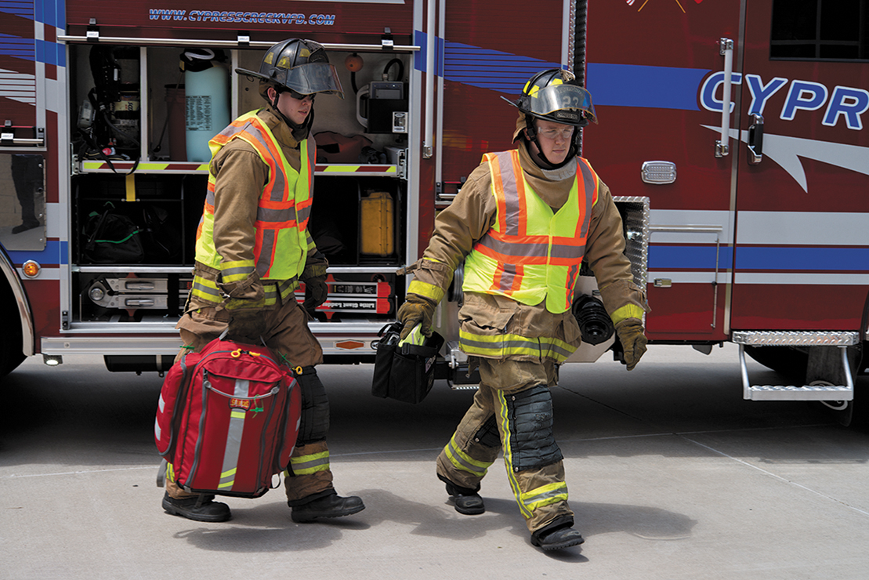
Protective Gear for E M S Responders (5 of 5)
Complex access involves the use of tools and equipment to reach and extricate the patient. © Edward T. Dickinson, M D
Notes:
Covers Objective: 40.2
Discussion Topic: Describe the personal protective gear necessary during vehicle extrication.
Class Activity: Select and don appropriate personal protective equipment for vehicle extrication.

Slide 26
Safeguarding Your Patient (1 of 2)
To protect your patient, you should have:
  Aluminized rescue blanket
  Lightweight vinyl-coated paper tarpaulin
  Wool blanket
  Short and long spine boards
Notes:
Covers Objective: 40.2

Slide 27
Safeguarding Your Patient (2 of 2)
  Hard hats, safety goggles, industrial hearing protectors, disposable dust masks, and thermal masks
  Emotional support for the patient
Notes:
Covers Objective: 40.2

Slide 28
Managing Traffic (1 of 2)
Use ambulance and its warning lights as first form of traffic control.
Position other warning devices as soon as possible.
Using flares for traffic control
  Look for and avoid spilled fuel, dry vegetation, other combustibles, especially at a road edge.
  Do not throw out of moving vehicles.
  Position a few flares at the edge of the danger zone as soon as the ambulance is parked.
Notes:
Covers Objective: 40.2

Slide 29
Managing Traffic (2 of 2)
Using flares for traffic control
  Take a handful of flares and walk (carefully) toward oncoming traffic.
  Position the flares every 10 feet, if possible, to channel vehicles into an unblocked lane.
  If the collision has occurred on a two-land road, position flares in both directions.
  Be careful when lighting the flare.
  Never use a flare as a traffic wand.
Notes:
Covers Objective: 40.2

Slide 30
Supplemental Restraint Systems: Airbags
Airbags designed to inflate on impact, dissipate kinetic energy, and minimize trauma to body
Creates “smoke” in vehicle
  Cornstarch and talcum powder (and sometimes sodium hydroxide)
Watch for an airbag that remains undeployed after a crash.
Notes:
Covers Objective: 40.2
Point to Emphasize: Airbags and energy-absorbing bumpers can pose a safety risk to responders and should be approached carefully.

Slide 31
Energy-Absorbing Bumpers
If the bumpers were involved in the collision, you may notice that the bumper’s shock absorber system is compressed, or “loaded.”
Never stand in front of a loaded bumper.
  Diagonal or perpendicular instead
In close proximity to fires, emergency responder should approach vehicle at a 45-degree angle (not head-on) if there is going to be an attempt at either fire suppression or patient care.
Notes:
Covers Objective: 38.5

Slide 32
Spectators
May interfere with rescue and emergency care efforts in addition to traffic
If policies permit, ask responsible-looking bystanders to keep spectators away.
  Give barricade tape.
  Do not put in unsafe positions.
  You may be held liable in adverse event.
Notes:
Covers Objective: 38.5

Slide 33
Electrical Hazards (1 of 5)
High-voltage lines common
Assume entire area around exposed wire dangerous.
  Conductors may have touched and energized.
Ordinary protective clothing gives no protection against electrocution.
Notes:
Covers Objective: 40.2

Slide 34
Electrical Hazards (2 of 5)
Broken utility pole with wires down
  Very dangerous
  Set up a large safety zone and discourage occupants of collision from leaving the wreckage.
  Determine the number of the nearest pole you can safely approach, and ask your dispatcher to advise the power company of the pole number and its location.
Notes:
Covers Objective: 40.2

Slide 35
Electrical Hazards (3 of 5)
  Do not attempt to move downed wires.
  Stand in a safe place until the power company disconnects the power or cuts the wire.
Broken utility pole with wires intact
  Park the ambulance outside the danger zone.
  Notify your dispatcher of the situation.
Notes:
Covers Objective: 40.2

Slide 36
Electrical Hazards (4 of 5)
Broken utility pole with wires intact
  Stay outside the danger zone until power company representatives can de-energize the conductors and stabilize the pole.
  Keep spectators and other emergency service personnel out of the danger zone.
Notes:
Covers Objective: 40.2

Slide 37
Electrical Hazards (5 of 5)
Damaged pad-mounted transformer
  Request an immediate power company response.
  Do not touch either the transformer case or a vehicle touching it.
    Warn other emergency personnel.
  Stand in a safe place until the power company de-energizes it.
  Keep spectators out of the danger zone.
Notes:
Covers Objective: 40.2

Slide 38
Vehicle Fires (1 of 4)
Small fires
  15- or 20-pound class A:B:C dry chemical fire extinguisher extinguishes almost anything burning.
Fire in the engine compartment
  Do not attempt extinguishment unless hood fully open or open to the safety latch.
Notes:
Covers Objective: 40.2
Point to Emphasize: Before you try to put out a fire, always put on a full set of protective gear.

Slide 39
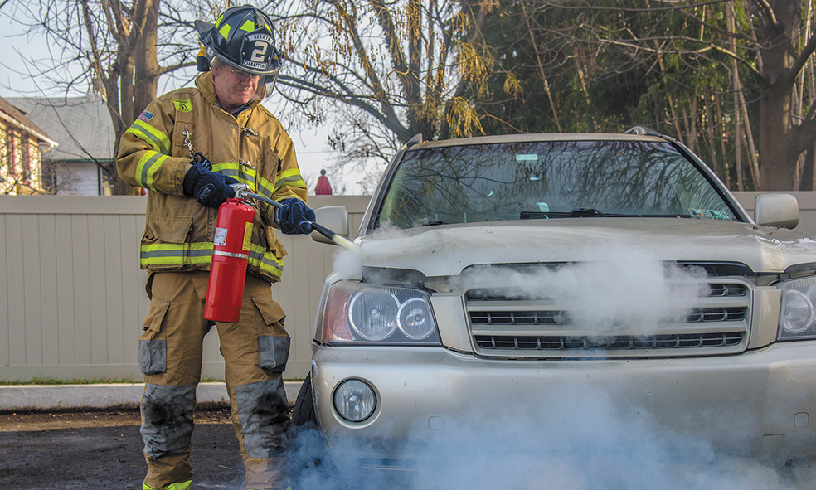
Vehicle Fires (2 of 4)
Extinguishing a fire in the engine compartment when the hood is partially open.
Notes:
Covers Objective: 40.2
Point to Emphasize: Before you try to put out a fire, always put on a full set of protective gear.

Slide 40
Vehicle Fires (3 of 4)
Fire in the passenger compartment or trunk
  Apply extinguisher sparingly until occupants can be freed.
  If in trunk, apply same principles as engine compartment fire and leave extinguishment to fire department.
Fire under the vehicle
  Sweep the flames from under the passenger compartment.
Notes:
Covers Objective: 40.2
Critical Thinking Discussion: You and your partner witness a motor-vehicle collision. As you approach, you note that the vehicle is on fire. The patient is awake and yells that the door is jammed. Your partner notes that you probably could just break the window and extricate the patient. You do not have PPE. Discuss your immediate actions.

Slide 41
Vehicle Fires (4 of 4)
Truck fires
  A:B:C extinguisher
  Burning truck tires are especially dangerous.
    Never stand directly in front of a truck wheel when there is a fire.
    Flames can spread to vehicle’s body and cargo, or the tires can explode.
Notes:
Covers Objective: 40.2
Class Activity: Ask the local fire department to conduct a fire extinguisher training session for the class.

Slide 42
Disabling a Vehicle’s Electrical System
Remember that many cars have electrically powered door locks, window operators, and seat adjustment mechanisms.
Disconnect the negative cable from the battery.
Notes:
Covers Objective: 40.2

Slide 43
Stabilizing a Vehicle (1 of 4)
Vehicle on its wheels
  Turn off engine.
  Step-chock three sides.
Notes:
Covers Objective: 40.2
Discussion Topic: Describe the important safety considerations when dealing with the following situations: broken utility pole with wires down, broken utility pole with wires intact, vehicle fires, unstable vehicles.
Knowledge Application: Use a programmed patient and a vehicle to simulate motor-vehicle collision scenarios. Discuss stabilization and simple extrication.

Slide 44
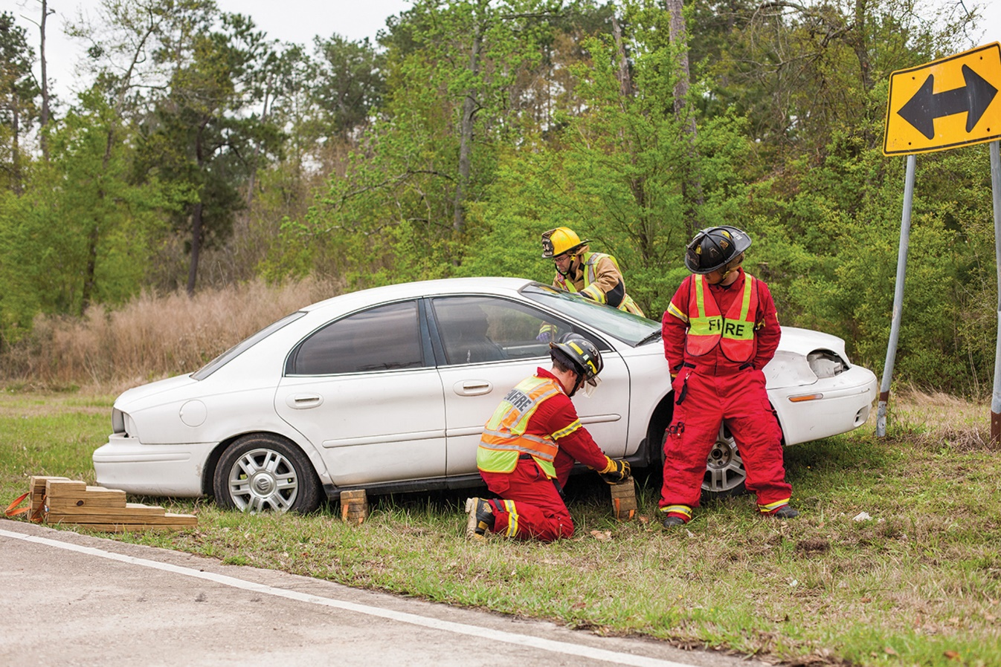
Stabilizing a Vehicle (2 of 4)
Stabilizing a car on its wheels with cribbing while patient contact is initiated.
Notes:
Covers Objective: 40.2

Slide 45
Stabilizing a Vehicle (3 of 4)
Vehicle on its side
  Stabilize with ropes, cribbing, or stabilizer bars.
Vehicle on its roof
  Utilize 4 × 4 wood blocks to build crib box.
Notes:
Covers Objective: 40.2
Discussion Topic: Describe the important safety considerations when dealing with the following situations: broken utility pole with wires down, broken utility pole with wires intact, vehicle fires, unstable vehicles.
Knowledge Application: Use a programmed patient and a vehicle to simulate motor-vehicle collision scenarios. Discuss stabilization and simple extrication.

Slide 46
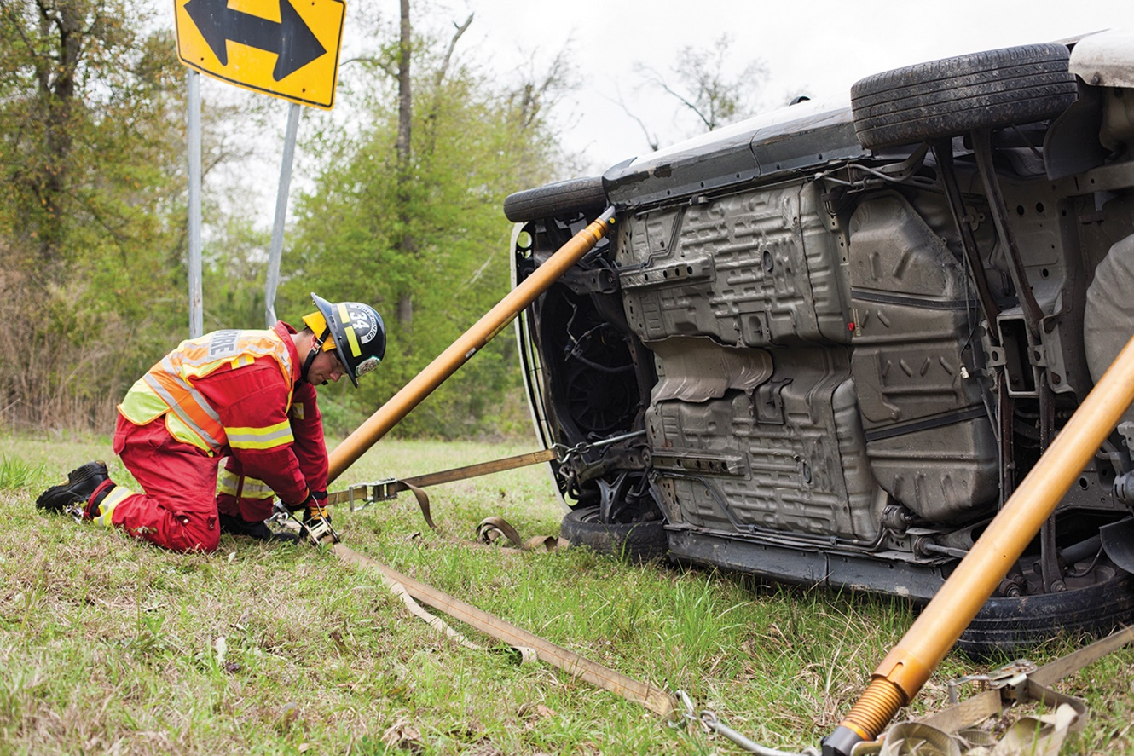
Stabilizing a Vehicle (4 of 4)
A vehicle on its side stabilized with struts. For maximum stability, it may be best to place cribbing on one side, struts on the other.
Notes:
Covers Objective: 40.2
Knowledge Application: Have students work in groups. Assign each group a photo of an unstable vehicle. Have each group research and present the best strategy to stabilize the vehicle.

Slide 47
Gaining Access
Simple access
  Check if door or window can be opened.
  “Try before you pry.”
Complex access
  Utilize tools and equipment.
  Break glass in side or rear window as far from passengers as possible.
Notes:
Covers Objective: 40.2
Point to Emphasize: Gaining access to patients should begin simply and should become more complicated only when simple measures fail.

Slide 48
Disentanglement: A Three-Part Action Plan (1 of 2)
Steps one and two: gain access by disposing of doors and the roof
  Makes vehicle interior accessible
  Creates large exit
  Provides fresh air and helps cool heated patient
  Quick access to critical patient can improve survivability and perhaps decrease morbidity.
Notes:
Covers Objective: 40.2

Slide 49
Disentanglement: A Three-Part Action Plan (2 of 2)
Step three: disentangle occupants by displacing the front end
  Easily accomplished with heavy-duty jacks and hacksaws
  Do not cut steering column or airbag wiring; may cause unexpected firing.
Notes:
Covers Objective: 40.2
Discussion Topics: Describe the common elements of simple and complex access. Describe the three-part action plan of disentanglement.
Class Activity: Attend an extrication demonstration. Use appropriate PPE and train with a local fire department or extrication squad.
Knowledge Application: Have students work in small groups. Assign each group a particular vehicle extrication hazard (wires down, for example). Ask each group to plan an appropriate approach and extrication strategy.

Slide 50
Chapter Review

Slide 51
Chapter Review (1 of 3)
Remember, highway operations are high risk. Take these precautions:
  Wear high-visibility garments.
  Position the ambulance for blocking until fire apparatus arrives. Then position ambulances “downstream” in the safe zone.
  Reduce lighting that may blind passing drivers.
  Avoid crossing traffic lanes with patients.

Slide 52
Chapter Review (2 of 3)
Scene size-up is key. How many patients are there? What is the triage status? Are additional resources needed?
Protect yourself. Look out for:
  Traffic
  Undeployed airbags (Disconnect the battery to deactivate the airbag system.)
  Loaded bumpers
  Sharp metal

Slide 53
Chapter Review (3 of 3)
Match the level of P P E being worn by other public safety responders.
Ensure scene safety:
  If wires are down, keep spectators back! If wires are over an occupied car, don’t allow the occupants to exit until the power company deactivates the wires.
  Make sure the vehicle is stable. Be sure it won’t roll away or tip over.
First try simple means to gain access.
Protect your patient during the extrication process.

Slide 54
Remember (1 of 2)
Highway response is a significant safety hazard for E M Ts. Specific safety planning and procedures must be utilized to keep responders safe.
Responding units should evaluate the need for further units, institute “blocking” to protect the work area, and always exit apparatus into the safe zone.
Use protective equipment and warning devices.
Vehicle extrication often requires specialized training and resources. Know local resources and procedure for activating those resources.

Slide 55
Remember (2 of 2)
Determine extrication resources needed and patient extrication priority through thorough scene size-up.
Extrication can pose a variety of threats. Evaluate the scene carefully and employ safety procedures.
Gaining access to patients frequently requires mechanical and technological assistance. Always start simply and escalate only when simple measures fail.

Slide 56
Questions to Consider
What is the best access for my unit?
Where should I park the apparatus?
Does the vehicle need to be stabilized?
Notes:
Talking Points: The best access may not be with the normal flow of traffic; always consult command. Apparatus should be parked in a way to block and secure the scene. Stabilizing a vehicle should be done if rescuers will be in the vehicle.

Slide 57

Copyright
This work is protected by United States copyright laws and is provided solely for the use of instructors in teaching their courses and assessing student learning. Dissemination or sale of any part of this work (including on the World Wide Web) will destroy the integrity of the work and is not permitted. The work and materials from it should never be made available to students except by instructors using the accompanying text in their classes. All recipients of this work are expected to abide by these restrictions and to honor the intended pedagogical purposes and the needs of other instructors who rely on these materials.

