Slide 1
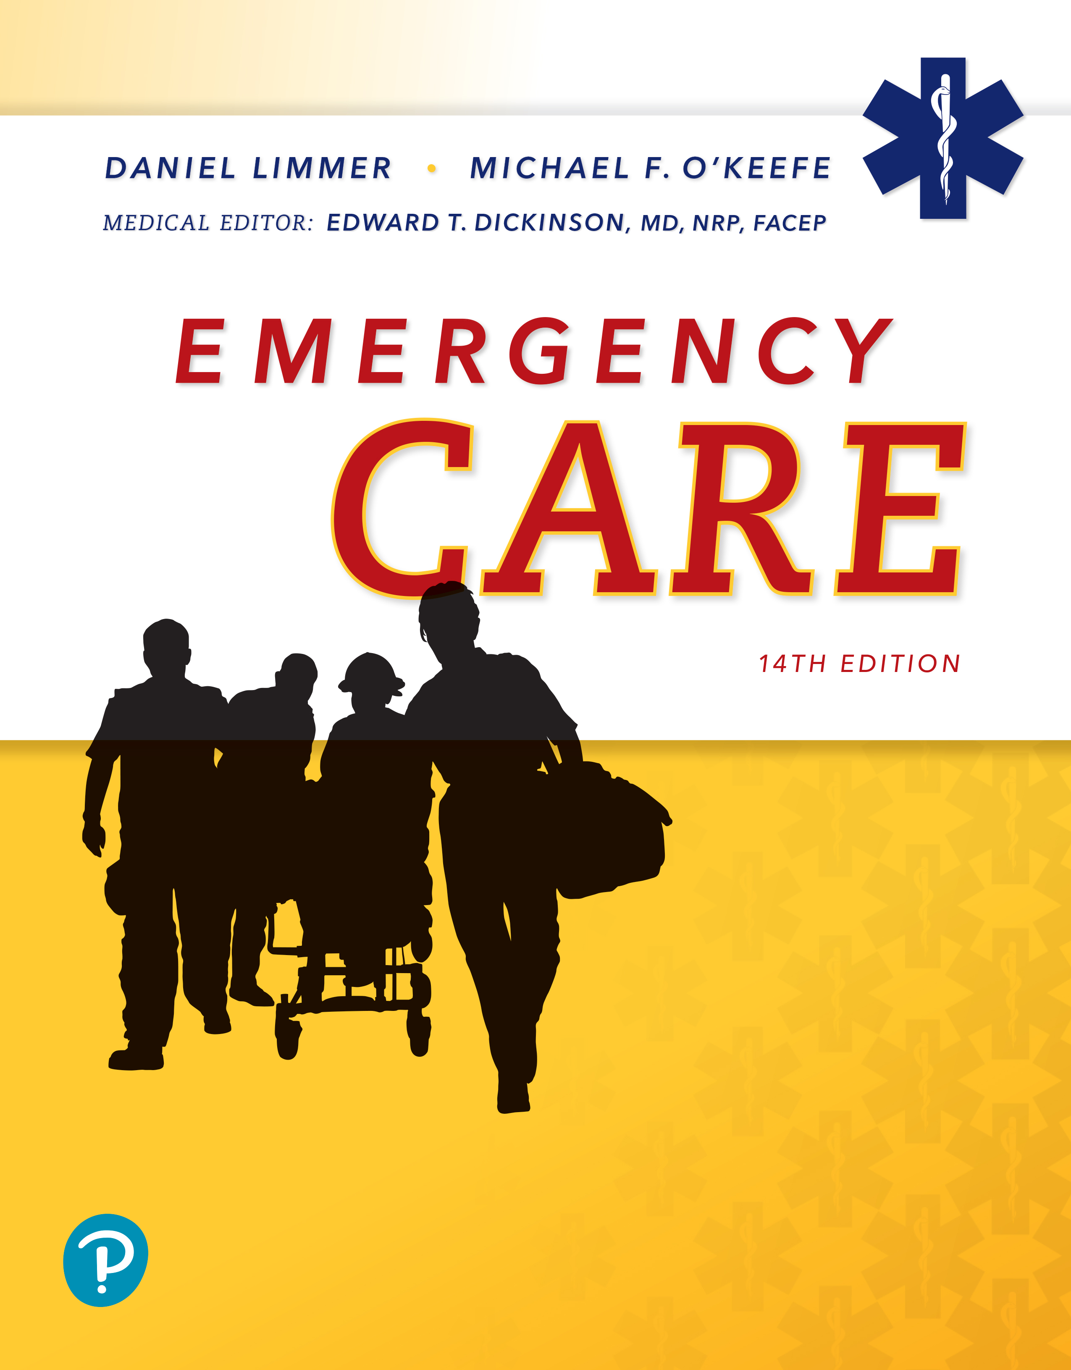
Emergency Care
Fourteenth Edition
Chapter 41
E M S Response to Terrorism
Slides in this presentation contain hyperlinks. JAWS users should be able to get a list of links by using INSERT+F7
Copyright © 2021, 2016, 2012 Pearson Education, Inc. All Rights Reserved
Notes:
If this PowerPoint presentation contains mathematical equations, you may need to check that your computer has the following installed:
1) MathType Plugin
2) Math Player (free versions available)
3) NVDA Reader (free versions available)

Slide 2
Topics (1 of 2)
Defining Terrorism
Terrorism and E M S
Time/Distance/Shielding
Responses to Terrorist Incidents
Dissemination and Weaponization
Notes:
Planning Your Time: Plan 215 minutes for this chapter.
Defining Terrorism (15 Minutes)
Terrorism and EMS (20 minutes)
Time/Distance/Shielding (10 minutes)
Responses to Terrorist Incidents (35 minutes)
Dissemination and Weaponization (15 minutes)
Characteristics of CBRNE Agents (55 minutes)
Strategy and Tactics (35 minutes)
Self-Protection at a Terrorist Incident (30 minutes)
Note: The total teaching time recommended is only a guideline.
Core Concepts
Types of terrorism and examples of terrorist tactics and doctrine
How to identify the type of threat posed by a terrorist event
Use of time/distance/shielding for protection at a terrorist event
How to respond to and deal with threats from a terrorist event
Applying strategy, tactics, and countermeasures at a terrorist event
Self-protection and safety awareness at a terrorist event

Slide 3
Topics (2 of 2)
Characteristics of C B R N E Agents
Strategy and Tactics
Self-Protection at a Terrorist Incident

Slide 4
Defining Terrorism
Back to Topics
Notes:
Teaching Time: 15 minutes
Teaching Tips: Invite a law enforcement officer to class. Ask the officer to discuss the different types of terrorists. The Internet has powerful resources relating to various types of terrorists. Be careful with the validity of sources, but consider using web resources. Use specific examples to link broad concepts to real life. Many high-profile cases are available for discussion.

Slide 5
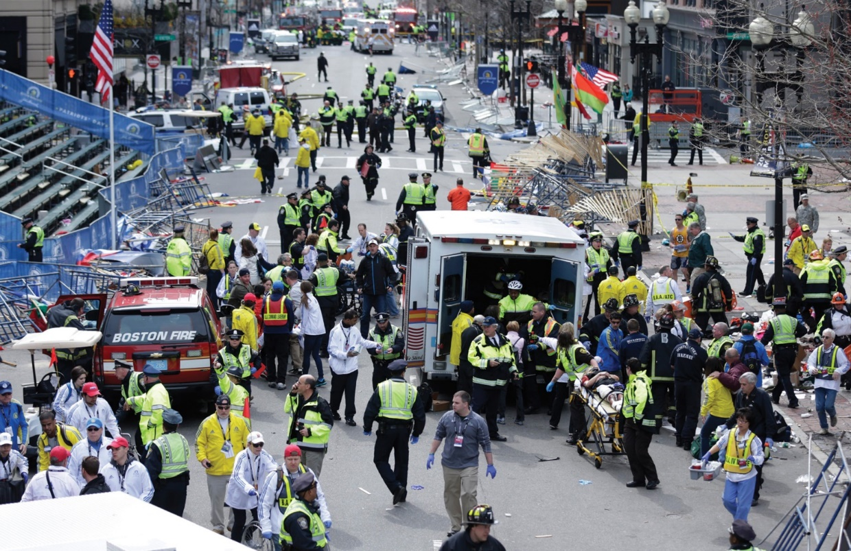
Defining Terrorism (1 of 2)
The bombing of the Boston Marathon in 2013 was perpetrated by two young men who may have become radicalized partly via the Internet.© A P Images/Charles Krupa
Notes:
Covers Objective: 41.1

Slide 6
Defining Terrorism (2 of 2)
“The unlawful use of force or violence against persons or property to intimidate or coerce a government, the civilian population or any segments thereof, in furtherance of political or social objectives”-The U.S. Department of Justice, Federal Bureau of Investigation
Notes:
Covers Objective: 41.1

Slide 7
Domestic Terrorism
Groups or individuals whose terrorist activities are directed their own government or population
  Environmental terrorists
  Antigovernment militias
  Racial-hate groups
  Groups with extreme political, religious, or other philosophies or beliefs
Notes:
Covers Objective: 41.1
Knowledge Application: Have each student research an example of domestic terrorism. Discuss the threats that come from within.

Slide 8
International Terrorism
Groups or individuals whose terrorist activities are foreign based and/or directed by countries or groups outside the targeted country or whose activities cross national boundaries.
Growing trend toward loosely organized, international networks of terrorists
Notes:
Covers Objective: 41.1
Discussion Topic: Compare and contrast domestic terrorism and international terrorism. How are they different?
Knowledge Application: Have each student research an example of international terrorism. Discuss the international threats.
Critical Thinking Discussion: How might a domestic terrorist event be linked to international groups? Discuss threats that involve both connections.

Slide 9
Types of Terrorism Incidents
Incidents of terrorism may involve C B R N E agents.
  Chemical
  Biologic
  Radiologic
  Nuclear
  Explosive
Also called weapons of mass destruction (W M D)
Notes:
Covers Objective: 41.1
Point to Emphasize: CBRNE is an acronym used to classify the different types of terrorist incidents. It stands for chemical, biologic, radiologic/nuclear, and explosive.
Discussion Topics: Describe the various types of terrorist incidents that make up CBRNE. Define weapons of mass destruction. How do they relate to CBRNE?
Knowledge Application: Have students work in small groups. Assign each group a specific element of CBRNE. Ask groups to describe and discuss the potential hazards of their category.
Class Activity: Ask each student to research a terrorist event. Have them discuss whether the terrorism was domestic or international and which element of CBRNE was utilized.

Slide 10
Terrorism and E M S
Back to Topics
Notes:
Teaching Time: 20 minutes
Teaching Tips: Emphasize that responders are targets. This is a key point that will help protect EMTs if they ever are exposed to this type of event. Use real-world examples and multimedia graphics to make the threats more than just theoretical. Use scenarios and local landmarks to discuss threats in your area. Discuss actual events and describe the type of harm that was caused.

Slide 11
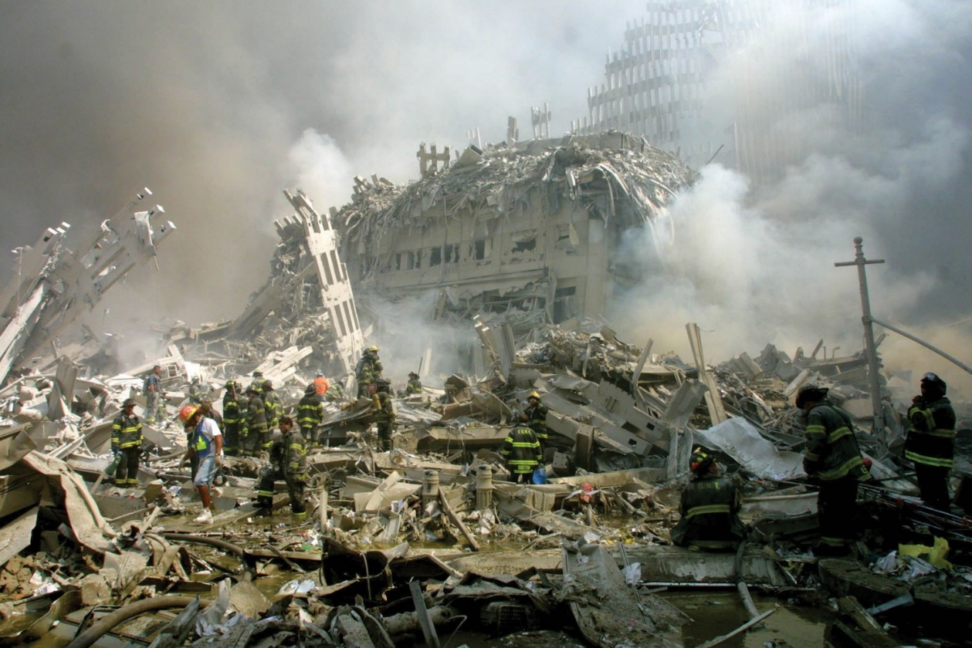
Terrorism and E M S
The Twin Towers of the World Trade Center in New York City were destroyed and thousands were killed on September 11, 2001, when terrorists flew hijacked jetliners into the famous skyscrapers. © A P Images/Shawn Baldwin
Notes:
Covers Objective: 41.1

Slide 12
Emergency Medical Responders as Targets
Emergency Medical Responders are often principal targets of terrorist attacks.
Safety of E M S providers is most important consideration when responding to potential terrorist incident.
Notes:
Covers Objective: 41.1
Discussion Topic: Discuss the reasons that a terrorist might target first responders. How might this targeting change your response?
Knowledge Application: Have students work in groups. Assign each group a terrorist incident in which responders were targeted. Have the group research the incident and discuss response strategies.

Slide 13
Identify the Threat Posed by Event (1 of 2)
Terrorists may deliberately target responders by using multiple or secondary devices
Incident that is a potential act of terrorism is also a crime scene.
Notes:
Covers Objective: 41.1

Slide 14
Identify the Threat Posed by Event (2 of 2)
Recognizing O T T O signs may help protect against secondary attack.
  Occupancy or location
  Type of event
  Timing of event
  On-scene warning signs
Notes:
Covers Objective: 41.1
Point to Emphasize: The occupancy (location), type, and timing of an event can help responders rapidly identify a potential terrorist incident.

Slide 15
Occupancy or Location
Symbolic and historic targets
Public buildings or assembly areas
Controversial businesses
Infrastructure systems
Notes:
Covers Objective: 41.1
Class Activity: Ask students to consider their own area. What local buildings and areas might present a target for terrorism?
Knowledge Application: Use multimedia graphics to present local buildings. Ask the students to determine terrorist threat levels. Discuss why these buildings might be targeted.

Slide 16
Type of Event
Explosions and/or incendiaries
Incidents involving firearms
Nontrauma mass-casualty incidents
Notes:
Covers Objective: 41.1
Critical Thinking Discussion: Racial profiling is a serious issue that relates to terrorism. Consider bombings on American soil. What role have Americans played in domestic terrorism?

Slide 17
Timing of Event
National holidays
Anniversary dates of previous attacks
  April 19
Incidents occurring in major public areas at busy points of business day
Notes:
Covers Objective: 41.1
Class Activity: Ask students to research and list specific dates that they feel could pose a terrorist threat. Have them describe why they feel that their dates are a threat.

Slide 18
On-Scene Warning Signs
Unexplained patterns of illness or deaths
Unexplained signs and symptoms of skin, eye, or airway irritation
Containers that appear out of place
Notes:
Covers Objective: 41.1
Discussion Topic: Describe the OTTO signs as they apply to identifying a terrorist incident.

Slide 19
Recognize the Harms Posed by the Threat (1 of 2)
T R A C E M-P harms
  Thermal harm
    Caused by either extreme heat or extreme cold
  Radiologic harm
    From alpha particles, beta particles, or gamma rays, generally produced by nuclear events
  Asphyxiation
    Caused by lack of oxygen in atmosphere
Notes:
Covers Objective: 41.1
Point to Emphasize: The acronym TRACEM-P represents common harms resulting from terrorist incidents. It stands for thermal, radiologic, asphyxiation, chemical, etiologic, mechanical, and psychological.
Discussion Topic: Describe the various harms that make up TRACEM-P.

Slide 20
Recognize the Harms Posed by the Threat (2 of 2)
  Chemical harm
    Caused by toxic or corrosive materials
  Etiologic harm
    Caused by disease
  Mechanical harm
    Caused by physical trauma (gunshot, bomb fragments)
  Psychological harm
    Results from any violent event
Notes:
Covers Objective: 41.1
Point to Emphasize: The acronym TRACEM-P represents common harms resulting from terrorist incidents. It stands for thermal, radiologic, asphyxiation, chemical, etiologic, mechanical, and psychological.

Slide 21
Think About It
How can I tell if I am responding to a terrorist incident?
Notes:
Covers Objective: 41.1
Talking Points: Responders should use scene size-up and situational awareness to recognize such an event.

Slide 22
Time/Distance/Shielding
Back to Topics
Notes:
Teaching Time: 10 minutes
Teaching Tips: Refer to lessons on scene safety. These core principles apply to all types of dangerous incidents, not just terrorism. Use multimedia graphics to illustrate and define distance and shielding. Use specific examples of threats posed to responders through length of exposure. Consider radiologic and biologic events.

Slide 23
Time/Distance/Shielding (1 of 2)
Time
  Minimize time in dangerous area or exposed to hazardous material, biologic agent, or radiation.
  Execute rapid entries to perform reconnaissance or rescue.
Distance
  Maximize distance from hazard area or projected hazard area.
  Follow recommended guidelines regarding hazardous materials in Emergency Response Guidebook.
Notes:
Covers Objective: 41.1
Point to Emphasize: Resources such as the Emergency Response Guidebook and the Vehicle Bomb Explosion Hazard and Evacuation Distance Tables can assist EMTs in defining the safe distance associated with particular types of terrorist threats.
Discussion Topic: might know the appDiscuss why responders should limit scene time/exposure at a radiologic incident. Describe how a responder ropriate evacuation distance for a specific terrorist threat. What resources are available?
Knowledge Application: Have students work in small groups. Assign each group a resource and a threat. Ask the group to research and discuss the safe evacuation distance for responders.
Critical Thinking Discussion: You respond to an incident that you recognize as terrorism. You know that evacuation is necessary, but you do not have specific guidebooks with you. What other resources for evacuation planning might you have?

Slide 24
Time/Distance/Shielding (2 of 2)
Shielding
  Use appropriate shielding for specific hazards.
  Can be vehicles, buildings, fire-protection clothing, H A Z M A T suits, positive pressure self-contained breathing apparatus, P P E
  Vaccinations against specific diseases
Notes:
Covers Objective: 41.1
Point to Emphasize: The term shielding refers both to physical protective structures and to preparations such as vaccinations.
Discussion Topic: Describe how shielding might apply to vaccinations.
Class Activity: Conduct a tabletop incident. Ask class members to discuss the elements of time, distance, and shielding with regard to incident response.
Knowledge Applications: Have students work in small groups. Assign each group a potential harm resulting from a terrorist incident. Ask the groups to discuss how time/distance/shielding might apply to responder safety. Discuss vaccinations required for the EMT class. Ask students to discuss how these might be considered shielding in a terrorist incident.

Slide 25
Responses to Terrorist Incidents
Back to Topics
Notes:
Teaching Time: 35 minutes
Teaching Tips: Invite a member of the local hazardous materials response team to class to discuss specific threats. Use specific examples to illustrate threats. Use the resources discussed earlier to research response tactics. Biologic attacks can be compared to lessons on disease transmission. Compare and contrast these weapons with organic illnesses. Reach out to local subject matter experts on radiation (hazardous materials response team members, local physics teachers, etc.) for assistance with this section.

Slide 26
Responses to a Chemical Incident
Includes many classes of hazardous materials
  Can be inhaled, ingested, absorbed, injected
  Can include industrial chemical or warfare-type agents
Notes:
Covers Objective: 41.2
Discussion Topic: Describe how a hazardous chemical agent might enter the body.

Slide 27
Types of Harm from Chemical Incidents (1 of 2)
Thermal harm
  Reactions create heat
Asphyxiation
  Reactions deplete oxygen
Chemical harm
  Systemic effects
Notes:
Covers Objective: 41.2
Discussion Topic: Describe the types of harm caused by chemical incidents.

Slide 28
Types of Harm from Chemical Incidents (2 of 2)
Mechanical harm
  Corrosive chemicals weaken structures
Psychological harm
  Secondary and either at the scene or some time after the event
Notes:
Covers Objective: 41.2

Slide 29
Self-Protection Measures at a Chemical Incident
Respiratory protection
Protective clothing
Be aware of possible contamination from patients.
Notes:
Covers Objective: 41.2
Point to Emphasize: Because of the wide variety of hazards posed by chemical agents, responders should take care to use the principles of time, distance, and shielding to minimize exposure risks under all circumstances.
Discussion Topic: Describe the common self-protective measures used at a chemical incident.
Knowledge Application: Have the class research a chemical incident. Have them present the harm that was caused and the protective measures used to mitigate it.

Slide 30
Responses to a Biologic Incident (1 of 2)
Presents as focused emergency or public health emergency
  Focused emergency
    Potential or actual point of origin located
    Attempts made to prevent or minimize damage and spread
  Public health emergency
    Sudden demand upon public health infrastructure with no apparent explanation
Notes:
Covers Objective: 41.2
Point to Emphasize: Biologic incidents will present as either a focused emergency or a public health emergency.

Slide 31
Responses to a Biologic Incident (2 of 2)
Causative agents
  Bacteria
  Viruses
  Toxins
Notes:
Covers Objective: 41.2

Slide 32
Critical Information about Biologic Incidents (1 of 4)
What is an exposure?
  Dose or the concentration of the agent multiplied by time
    Doses—milligrams per kilogram of body weight
    Concentration—parts per million
Notes:
Covers Objective: 41.2
Discussion Topics: Define exposure. How is it different from contamination?

Slide 33
Critical Information about Biologic Incidents (2 of 4)
Four major routes of entry
  Absorption
    Skin contact
  Ingestion
    By mouth
  Injection
    From needles or projectiles
  Inhalation
    By breathing
Notes:
Covers Objective: 41.2
Discussion Topics: Describe a biologic agent's four major routes of entry into the body.
Knowledge Application: Have students work in small groups. Assign each group a specific route of entry for a biologic agent. Have groups research and provide examples. Use specific incidents when applicable.

Slide 34
Critical Information about Biologic Incidents (3 of 4)
What is contamination?
  Material is present where it does not belong
  Material that is harmful to persons, animals, or the environment
  Things that can be contaminated
    Hard and soft surfaces
    Skin and hair
    Clothing
Notes:
Covers Objective: 41.2

Slide 35
Critical Information about Biologic Incidents (4 of 4)
Exposure versus contamination
  Exposure occurs when a substance is taken into the body through one of the routes of exposure.
  Permeation
    Movement of a substance through a surface or, on a molecular level, through intact materials.
  Remove clothing but preserve dignity.
Notes:
Covers Objective: 41.2

Slide 36
Types of Harm from Biologic Incidents
Chemical harm
  Scene of clandestine laboratory
Etiologic harm
  Agents classified as poisons
Mechanical harm
  Explosives used to disperse agents
Psychological harm
  Even the thought can cause distress
Notes:
Covers Objective: 41.2
Discussion Topic: Describe the types of harm caused by a biologic agent.
Class Activity: Provide specific examples of terrorist attacks. Ask the class to classify the type of attack; discuss specific harms and protective measures used.

Slide 37
Self-Protection Measures at a Biologic Incident
P P E and respiratory protection
Get as much information as possible.
Prioritize protective measures.
  Self-protection
  Buddy system
  Availability of rapid intervention teams
  Civilian protection
Notes:
Covers Objective: 41.2
Discussion Topic: Describe the personal protective measures that can be taken to prevent harm at a biologic incident.

Slide 38
Responses to a Radiologic/Nuclear Incident
Small nuclear devices (“suitcase bombs”) stockpiled in foreign nations
Radiologic dispersion device (“dirty bomb”) more practical and difficult to detect because radiation symptoms are delayed for hours or days
  Sickness treatable if detected early
Notes:
Covers Objective: 41.2
Point to Emphasize: Identifying a nuclear incident may be difficult because radiation cannot be detected by the senses and because symptoms of radiologic exposure generally are delayed for hours or days.

Slide 39
Types of Harm from Radiologic/Nuclear Incidents (1 of 2)
Thermal harm
  Nuclear explosion
Radiologic harm
  Radiologic materials
  Ongoing hazard
Chemical harm
  Radiological substances also chemical hazards
Notes:
Covers Objective: 41.2
Discussion Topic: Describe the types of harm that are caused by a radiologic/nuclear incident.

Slide 40
Types of Harm from Radiologic/Nuclear Incidents (2 of 2)
Mechanical harm
  Explosion
Psychological harm
  Immediate or delayed reaction
Notes:
Covers Objective: 41.2

Slide 41
Self-Protection Measures at a Radiologic/Nuclear Incident
Time, distance, shielding
Radiologic detecting equipment helps determine effectiveness of measures.
Assume dissemination of radiologic, biologic, or chemical materials.
Follow decontamination procedures.
Notes:
Covers Objective: 41.2
Discussion Topic: Describe the self-protection measures that can be utilized at a radiologic/nuclear incident.
Knowledge Application: Have students work in small groups. Assign each group a specific type of terrorist threat. Have the group research and discuss specific harms and protective measures for responders.

Slide 42
Responses to an Explosive Incident
Wide variety of devices from small pipe bombs to large vehicle bombs
May involve attacks on a fixed target or group of people
May be designed to disperse biologic, chemical, or radiologic materials
Notes:
Covers Objective: 41.2
Talking Points: Bombs and explosives have been and probably will continue to be the most frequently used weapons by terrorists. Explosives can be separated into two categories: high-order produces defining supersonic overpressurization shock wave; low-order creates subsonic explosion and lacks overpressurization wave.

Slide 43
Types of Harm from Explosive Incidents (1 of 2)
Thermal harm
  Heat of detonation
Asphyxiation
  Possibility of extremely dusty conditions
Chemical harm
  Result of explosive reaction from chemicals present at detonation site
Notes:
Covers Objective: 41.2

Slide 44
Types of Harm from Explosive Incidents (2 of 2)
Mechanical harm
  Typically seen at bombing incidents
Psychological harm
  Stunned response can last seconds or minutes
  Delayed response in the form of posttraumatic stress
Notes:
Covers Objective: 41.2

Slide 45
Self-Protection Measures at an Explosive Incident
Responder needs both preblast and postblast protection.
  Preblast
    Operations occurring after written or verbal warning received but before explosion takes place
  Postblast
    Operations occurring after at least one detonation
Notes:
Covers Objective: 41.2
Discussion Topic: Describe the specific self-protection measures associated with the following types of incidents: chemical, biologic, radiologic/nuclear, and explosive.
Critical Thinking Discussion: Identification of a terrorist incident may not always be initially possible. What protective measures should you take if you already are inside a scene when you realize that it may be a terrorist incident?

Slide 46
Dissemination and Weaponization
Back to Topics
Notes:
Teaching Time: 15 minutes
Teaching Tips: Relate this lesson to previous lessons on the respiratory system. Discuss dissemination in the context of the cardiopulmonary system. Ingestion and absorption relate to anatomy and physiology lectures. Discuss these routes in the context of the GI system and the anatomy of the skin.

Slide 47
Respiratory Route
Most effective, most common means
Vast and delicate surface area
Various levels, sizes of passageways into lungs
Notes:
Covers Objective: 41.3
Discussion Topics: Discuss the major methods used to disseminate an agent. Explain why the respiratory route is an effective means of dissemination.

Slide 48
Other Routes
Ingestion route
Dermal route
Human-to-human contact
Notes:
Covers Objective: 41.3
Discussion Topics: Describe the dermal route of exposure.
Class Activity: Discuss how dissemination relates to issues such as the spread of everyday infections. How is the movement of a biologic agent similar to the spread of the flu?
Knowledge Application: Have students work in small groups. Assign each group a specific biologic agent and ask the group to research and discuss how the agent is disseminated. Discuss specific examples when possible.

Slide 49
Weaponization
Most effective when targeted through inhalation route
Particles 3 to 5 microns in diameter
Airborne dissemination can be created by applying energy to material.
Heat, explosives, and sprayers can aerosolize materials.
Notes:
Covers Objective: 41.3
Point to Emphasize: Weaponization is the application of technology to improve dissemination performance to achieve maximum distribution.
Discussion Topic: Describe how weaponization relates to the dissemination process of an agent.
Critical Thinking Discussion: What might be on-scene clues that an agent has been disseminated? What types of devices might be used in a dissemination process?

Slide 50
Characteristics of C B R N E Agents
Back to Topics
Notes:
Teaching Time: 55 minutes
Teaching Tips: Use specific examples when discussing characteristics. Compare these examples to everyday substances. For example, discuss the volatility evaporation of alcohol when discussing chemical weapons. Invite a law enforcement officer to discuss capsicum (pepper) spray. This is a commonly used riot control agent. There are graphic multimedia examples of SLUDGEM. Use video graphics to describe assessment findings.

Slide 51
Chemical Agents (1 of 6)
Chemical agent considerations
  Physical considerations
    Can be gaseous, liquid, or solid
    Vapor pressures and densities can vary across the spectrum.
  Volatility considerations
    Low boiling point and high vapor pressure will evaporate more readily.
    Allows agent to have greater airborne release potential
Notes:
Covers Objective: 41.3

Slide 52
Chemical Agents (2 of 6)
Chemical agent considerations
  Chemical considerations
    Sufficiently stable to survive dissemination and transport to site of action
  Toxicologic considerations
    Not all individuals of a species react in the same way.
    Route of entry can also influence.
Notes:
Covers Objective: 41.3

Slide 53
Chemical Agents (3 of 6)
S L U D G E M—nerve agent poisoning
  Salivation
  Lacrimation
  Urination
  Defecation
  G I upset
  Emesis
  Miosis
Notes:
Covers Objective: 41.3
Point to Emphasize: SLUDGEM is a mnemonic that is used to remember the signs and symptoms of nerve agent poisoning. The letters stand for salivation, lacrimation, urination, defecation, GI upset, emesis, and miosis.
Knowledge Discussion Topic: Define the mnemonic SLUDGEM. Describe the associated signs and symptoms.

Slide 54
Chemical Agents (4 of 6)
Classifications of chemical agents
  Choking agents
    Predominately respiratory
  Vesicating (blister) agents
    Cause chemical changes in cells of exposed tissue
  Cyanides
    Prevent use of oxygen within cells
Notes:
Covers Objective: 41.3
Point to Emphasize: Choking agents, vesicating agents, cyanides, nerve agents, and riot control agents are common classifications of chemical weapons.
Discussion Topic: Describe the different classifications of chemical weapons. Describe their effects on the body.

Slide 55
Chemical Agents (5 of 6)
Classifications of chemical agents
  Nerve agents
    Inhibit enzyme critical to proper nerve transmission, causing out of control parasympathetic nervous system
    S L U D G E M signs and symptoms
Notes:
Covers Objective: 41.3
Knowledge Application: Have students work in small groups. Assign each group a chemical weapon type. Have the group research and present the weapon's potential harm and responder protective measures.

Slide 56
Chemical Agents (6 of 6)
Classifications of chemical agents
  Riot control agents
    Irritating materials and lacrimators (tear-flow increasers)
Notes:
Covers Objective: 41.3

Slide 57
Biologic Agents
Microorganisms or toxins that can cause disease processes
  Bacteria
    Small, free-living microorganism
  Viruses
    Organisms that requires a host cell inside which to live and reproduce
  Toxins
    Poisonous chemical produced by or derived from a living organism
Notes:
Covers Objective: 41.4
Points to Emphasize: The primary concern for all biological agents is personal protection if the agent is transmitted from human to human. Infectivity, virulence, toxicity, incubation period, transmissibility, lethality, and stability are factors that influence the potential for a substance to be used as a biological weapon.
Discussion Topic: Describe the features that make a substance a potential biologic weapon. Why do different biologic weapons have different epidemiologic impacts?
Knowledge Application: Have students work in small groups. Assign each group a specific biologic threat (such as anthrax). Have the group research and present specific harms and responder protective measures.
Critical Thinking Discussion: Weaponization of biologic agents often includes combining diseases. What new threat might a combined agent pose?

Slide 58
Biologic Agent Considerations
Features of biologic agents that influence their use as weapons
  Infectivity
  Virulence
  Toxicity
  Incubation period
  Transmissibility
  Lethality
  Stability
Notes:
Covers Objective: 41.4
Knowledge Application: Use a programmed patient to create CBRNE scenarios. Have teams of students practice recognition and treatment strategies.

Slide 59
Bacteria
Like human body cells, they have an internal cytoplasm surrounded by a rigid cell wall; unlike human body cells, they lack an organized nucleus and other intracellular structures.
Anthrax
Cholera
Plague
Q fever
Tularemia
Notes:
Covers Objective: 41.4
Talking Points: Discuss bacteria that have been used in the past for purposes of weaponization. These could include: anthrax, cholera, the plague, Q fever, and tularemia. Then move on to discuss toxins that have been used for purposes of weaponization. These could include: botulinum, ricin, Staphyloccoccal Enterotoxin B (SEB), and trichothecene mycotoxins (T2). Finally discuss viruses that have been used for purposed of weaponization. These could include: smallpox, encephalitis, and the viral hemorrhagic fevers (VHFs).

Slide 60
Toxins
Chemical compounds produced by living organisms
Not volatile and do not replicate
Botulinum
Ricin
Staphylococcal Enterotoxin B (S E B)
Trichothecene Mycotoxins (T 2)
Notes:
Covers Objective: 41.4
Talking Points: Discuss bacteria that have been used in the past for purposes of weaponization. These could include: anthrax, cholera, the plague, Q fever, and tularemia. Then move on to discuss toxins that have been used for purposes of weaponization. These could include: botulinum, ricin, Staphyloccoccal Enterotoxin B (SEB), and trichothecene mycotoxins (T2). Finally discuss viruses that have been used for purposed of weaponization. These could include: smallpox, encephalitis, and the viral hemorrhagic fevers (VHFs).

Slide 61
Viruses
Simplest microorganisms
Obligatory intracellular parasites
  Replicate only inside host cells
Not easy to manufacture viruses in large quantities
Smallpox
Encephalitis
The Viral Hemorrhagic Fevers (V H F s)
Notes:
Covers Objective: 41.4
Talking Points: Discuss bacteria that have been used in the past for purposes of weaponization. These could include: anthrax, cholera, the plague, Q fever, and tularemia. Then move on to discuss toxins that have been used for purposes of weaponization. These could include: botulinum, ricin, Staphyloccoccal Enterotoxin B (SEB), and trichothecene mycotoxins (T2). Finally discuss viruses that have been used for purposed of weaponization. These could include: smallpox, encephalitis, and the viral hemorrhagic fevers (VHFs).
Class Activity: Have each student complete a research paper on a CBRNE topic of choice. Include potential harms and protective measures.

Slide 62
Radioactive/Nuclear Devices (1 of 2)
Potential scenarios
  Military nuclear devices
  Improvised nuclear devices
  Radiological dispersal device (R D D) or “dirty bomb”
  Sabotage
Notes:
Covers Objective: 41.5
Point to Emphasize: There are four potential scenarios for a nuclear weapon attack: a military nuclear weapon, an improvised nuclear weapon, a "dirty bomb," and the sabotage of a nuclear facility.
Discussion Topic: Describe the potential scenarios for a nuclear event.

Slide 63
Radioactive/Nuclear Devices (2 of 2)
Effects of radiation
  Bone marrow
  Gastrointestinal system
  Central nervous system
Notes:
Covers Objective: 41.5
Discussion Topic: Describe the effects of radiation.

Slide 64
Incendiary Devices
Use more plausible than the use of nuclear devices
Not hard to obtain or initiate items
Specialized teams generally available to deal with incendiary devices
Notes:
Covers Objective: 41.6
Discussion Topic: Describe the agency in your area responsible for dealing with incendiary devices.

Slide 65
Blast Injury Patterns (1 of 2)
Lung injury
  Bradycardia, apnea, and hypotension from blast wave
Ear injury
  Rupture of tympanic membrane
Notes:
Covers Objective: 41.6
Discussion Topic: Describe the characteristics of common blast injury patterns in the lungs, the ears, the abdomen, and the brain.

Slide 66
Blast Injury Patterns (2 of 2)
Abdominal injury
  Rupture of gas-containing section of intestine
Brain injury
  Concussion or mild traumatic brain injury (M T B I) from blast wave
Notes:
Covers Objective: 41.6
Knowledge Application: Have students work in small groups. Assign each group a particular blast injury pattern. Have that group research and present the mechanism of injury, pathophysiology, and common presentations.

Slide 67
Treatment for Blast Injuries
No different from the treatment for patients of any other thermal or blast injury
Follow local protocol.
Notes:
Covers Objective: 41.6
Discussion Topic: Describe the typical treatment for the most common blast injury patterns.

Slide 68
Strategy and Tactics
Back to Topics
Notes:
Teaching Time: 35 minutes
Teaching Tips: Oftentimes tactics and priorities cross the service boundaries of EMS, fire, and law enforcement. Consider using these agencies to participate in this lesson. Safety is still the highest priority. Now implement the principle of force protection. Use real-life examples and multimedia graphics to demonstrate the difficulties of isolation and perimeter control. Review your state's statutes and guidelines regarding terrorist incident notification.

Slide 69
Strategy and Tactics
The D O T Emergency Response Guidebook provides information for the common terrorist weapons.
Strategies
  Broad general plans designed to achieve desired outcomes
Tactics
  Specific operational actions responders take to accomplish assigned tasks
Notes:
Covers Objective: 41.7
Class Activity: Conduct a tabletop exercise. Involve law enforcement and fire officials as you discuss general strategy and tactics.

Slide 70
Isolation (1 of 2)
Initial considerations
  Controlling scene, isolating hazards, and attempting to conduct controlled evacuation is resource-intensive and requires law enforcement personnel.
Establishing perimeter control
  Law enforcement must establish and control perimeter throughout incident.
Notes:
Covers Objective: 41.7
Points to Emphasize: Important priorities for responders at a terrorist incident are life safety, incident stabilization, and protection of property. Responders should consider isolation and perimeter control of a terrorist incident. Establishing control zones early will enhance public protection and will facilitate medical treatment.
Discussion Topics: Describe the immediate and general priorities of responders to a terrorist incident. Describe the process of isolation at a terrorist incident. How might this process be executed?
Knowledge Application: Use multimedia graphics or a city map. Describe a terrorist incident; then have groups of students discuss tactical issues such as isolation and perimeter control. Describe real local challenges.

Slide 71
Isolation (2 of 2)
Perimeter control factors
  Amount and type of resources on hand
  Capability of available resources
  Ability of resources to self-protect
  Size, configuration of incident
  Stability of scene
Notes:
Covers Objective: 41.7
Discussion Topics: Describe why perimeter control at a terrorist incident is important. Discuss how to initiate this tactic.

Slide 72
Notification
Generally required by established directives, procedures, and statutes
Request for additional specialized agencies carried out by communications center based upon early reports of E M Ts on scene
Notes:
Covers Objective: 41.7
Point to Emphasize: In a terrorist event, it is critical that appropriate response and support agencies (at local/state/federal levels) be notified. Established directives, procedures, or statutes usually require such notification.
Discussion Topic: Discuss the required notifications in the event of a terrorist incident. Which agencies must be notified?
Class Activity: Use a local emergency management plan to discuss the process of involving additional agencies in a terrorist incident. Describe how notifications would be made.
Critical Thinking Discussion: What role might you, as an EMT, play in notifications? Consider your service's disaster plan and describe the role that you might play.

Slide 73
Identification
Observe indicators of particular agent or presence of chemical containers or lab materials
Consult current edition of Emergency Response Guidebook
Notes:
Covers Objective: 41.7
Discussion Topic: Describe the identification features that would assist you with identifying a specific harmful agent. Describe resources you might use to aid in the identification of a harmful agent.
Class Activity: Use multimedia graphics to provide clues and have the class utilize resources to identify a hazardous agent.

Slide 74
Protection (1 of 2)
People, vehicles, equipment/supplies
Make an initial scene size-up to determine security threats.
Request protection (read: security) via radio as soon as practical.
Establish vehicle staging and triage/treatment areas in protected locations.
Notes:
Covers Objective: 41.7
Point to Emphasize: Force protection refers to steps taken to ensure the safety of responders and their equipment. This concept is essential in a terrorist incident.
Knowledge Applications: Critique an actual event. Discuss tactics used at a major incident. Discuss force protection at a terrorist incident. Describe an incident and have groups of students list force protection strategies.

Slide 75
Protection (2 of 2)
Advise E M S Command about protection/security concerns.
Immediately report suspicious people or activities.
Notes:
Covers Objective: 41.7

Slide 76
Decontamination
Gross decontamination by E M S personnel
  Removing surface contamination via mechanical means and initial rinsing
  Amount of surface contamination significantly reduced
Notes:
Covers Objective: 41.7
Discussion Topic: Describe gross decontamination.

Slide 77
Self-Protection at a Terrorist Incident
Back to Topics
Notes:
Teaching Time: 30 minutes
Teaching Tips: This section is primarily a review of topics previously covered. As safety is such an important issue, use this opportunity to drive home key points. Use scenarios to evaluate safety comprehension. Add terror-related elements to scenarios in an ongoing fashion, not just under the heading of this chapter.

Slide 78
Protect Yourself First (1 of 2)
Scene size-up and situational awareness
  Patients displaying signs of hazardous substance exposure?
  Unconscious patients?
  Patients exhibiting S L U D G E M signs?
  Blistering, reddening of skin, discoloration, or skin irritation?
  Patients having difficulty breathing?
Notes:
Covers Objective: 41.7
Point to Emphasize: Scene size-up and situational awareness will help identify potential hazards associated with a terrorist event.

Slide 79
Protect Yourself First (2 of 2)
Consider if there is evidence of the following:
  Medical mass casualties or fatalities with minimal or no trauma
  Responder casualties
  Dead animals and vegetation
  Unusual odors, color of smoke, vapor clouds
Notes:
Covers Objective: 41.7

Slide 80
How to Protect Yourself (1 of 4)
Recognize a Possible Terrorist Event
  Occupancy or location
  Type of event
  Timing
  On-scene clues
Notes:
Covers Objective: 41.7
Discussion Topic: What key tactics of personal protection are necessary at a terrorist incident?

Slide 81
How to Protect Yourself (2 of 4)
Don’t rush in!
  Wait until appropriate authority says scene is safe.
  Follow Incident Command protocols.
  Wear appropriate P P E.
  Beware of possible multiple explosive devices or booby traps.
  Search all patients for explosives or weapons.
Notes:
Covers Objective: 41.7
Point to Emphasize: Providers should never rush in. They should respond only when it is safe to do so—when proper protective measures have been taken.

Slide 82
How to Protect Yourself (3 of 4)
Understand the T R A C E M-P harms
Time, distance, shielding
At a chemical incident
  Chemical harm primary
At a biologic incident
  Etiologic harm primary
Notes:
Covers Objective: 41.7
Points to Emphasize: Safety is the first priority when responding to a terrorist incident. Specific protective measures apply to the different types of terrorist incidents. Providers should understand the particular threats of CBRNE incidents.
Discussion Topic: Describe the key personal protection measures with regard to the following types of incidents: chemical, biologic, radiologic, explosive.
Knowledge Application: Use a programmed patient to create CBRNE scenarios. Discuss individual safety.
Critical Thinking Discussion: There have been many examples of responders being injured while trying to save the lives of others. Discuss the motivation and thought process behind such events. Why might such acts actually be counterproductive to the rescue effort?

Slide 83
How to Protect Yourself (4 of 4)
At a radiologic/nuclear incident
  Radiologic harm primary
At an explosive incident
  Thermal and mechanical harms primary
Notes:
Covers Objective: 41.7
Knowledge Application: Discuss a backward scene size-up. Ask the class what information might be important to them if they were the second unit responding to a major incident. Discuss how a proper (or improper) scene size-up might impact them.

Slide 84
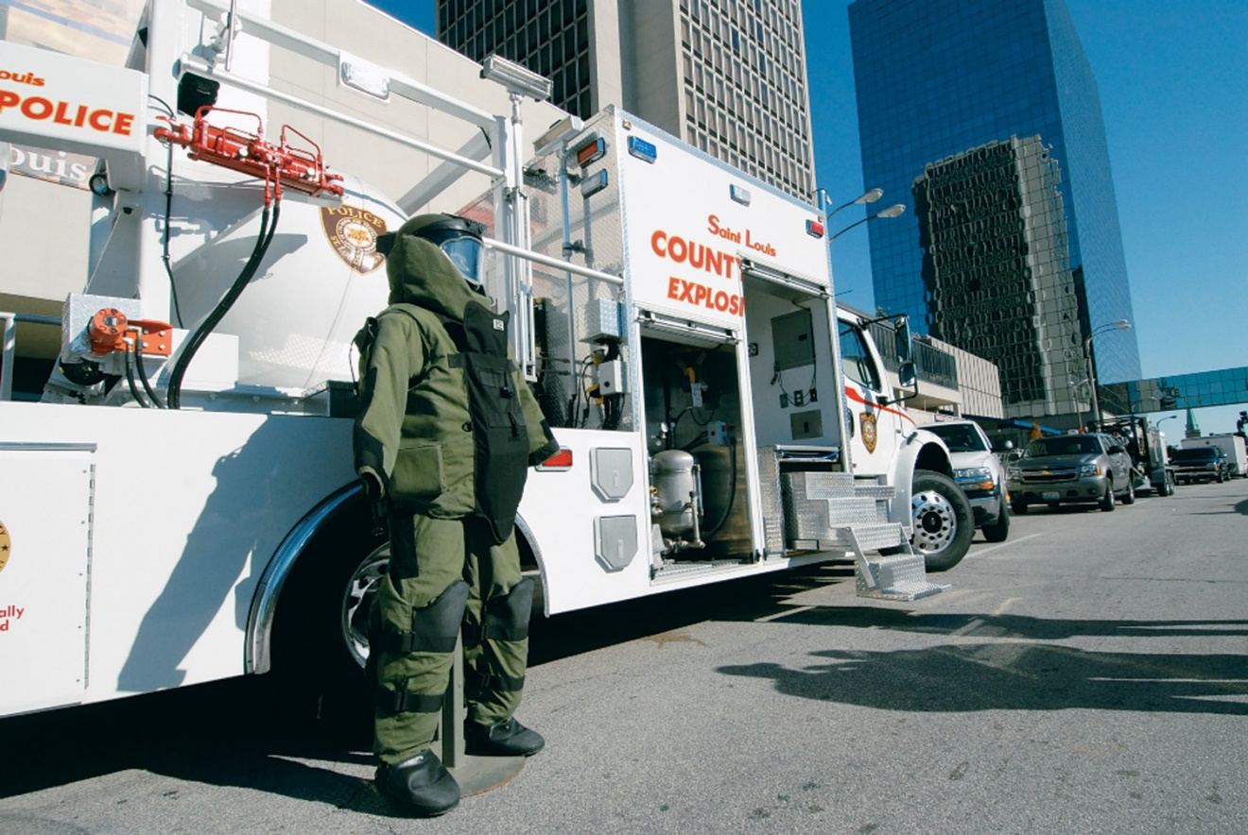
Protect Yourself
A specialized truck contains equipment for handling explosives.
Notes:
Covers Objective: 41.7
Knowledge Application: Present tabletop scenarios. Ask groups of students to formulate protective strategies for responding to the described incident.

Slide 85
Resources
Strategic National Stockpile is a stockpile of pharmaceuticals and medical supplies to be used when local resources are used up
Notes:
Covers Objective: 41.7
Discussion Topic: Discuss the types of supplies and resources that are available through the SNS.

Slide 86
Future Trends
Active shooter/mass shooting incidents
Cyberterrorism
Use of drugs of abuse as chemical weapons
Notes:
Covers Objective: 41.7
Knowledge Application: Have students research recent domestic and international terrorist incidents. What potential future trends can they identify?
Critical Thinking Discussion: Based on your knowledge of CBRNE, are there any potential agents that could be used in a terrorist attack that were not discussed in this chapter?

Slide 87
Chapter Review

Slide 88
Chapter Review (1 of 2)
There have been terrorist attacks throughout history. However, since the events of September 11, 2001, the modern world has been a different place because of the threat of terrorism.
There are many different types of agents and weapons that can be used by terrorists. C B R N E is used to remember the different types. T R A C E M-P is used to remember the types of hazards posed by these agents.

Slide 89
Chapter Review (2 of 2)
You must be sure to protect yourself from terrorist attacks as well as secondary attacks that are designed to injure or kill rescuers and further the physical and psychological impact of the attack.

Slide 90
Remember (1 of 2)
Responders often are targets of terrorists. Safety must be the highest priority. Use scene clues to identify potential terrorist incidents.
Adapt protective measures to the specific threat. Know the protective principles of C B R N E events.
Important priorities for responders at a terrorist incident are life safety, incident stabilization, and protection of property.

Slide 91
Remember (2 of 2)
Isolation, perimeter control, and appropriate notifications are important priorities in managing a terrorist incident.
Force protection is an extension of general safety procedures. It refers to the safety and security of both providers and resources.

Slide 92
Questions to Consider
How can I best protect myself from danger and hazards during a terrorist incident?
What is my role in the incident response plan for a terrorist incident?
Notes:
Talking Points: Personal protection is paramount at any incident, but when dealing with terrorist incidents, the potential for lethal exposure is much greater. You should be familiar with your local incident response plans and what your role as an EMT is.

Slide 93
Critical Thinking (1 of 2)
You arrive at an office where multiple patients are complaining of the same symptoms. They state their office received several threats due to its role in a controversial foreign relations incident. You and your partner recognize the similar symptoms and decide these may be linked.

Slide 94
Critical Thinking (2 of 2)
What is your best course of action next? Should you remove yourself from the scene at this point or remain with your patients?
Notes:
Talking Points: Recognizing the common symptoms and making the link is important for the EMT. If there is a potential you have been exposed as your patients have, you should remain isolated from the unexposed public until you are able to speak with HAZMAT professionals.

Slide 95

Copyright
This work is protected by United States copyright laws and is provided solely for the use of instructors in teaching their courses and assessing student learning. Dissemination or sale of any part of this work (including on the World Wide Web) will destroy the integrity of the work and is not permitted. The work and materials from it should never be made available to students except by instructors using the accompanying text in their classes. All recipients of this work are expected to abide by these restrictions and to honor the intended pedagogical purposes and the needs of other instructors who rely on these materials.

