Slide 1
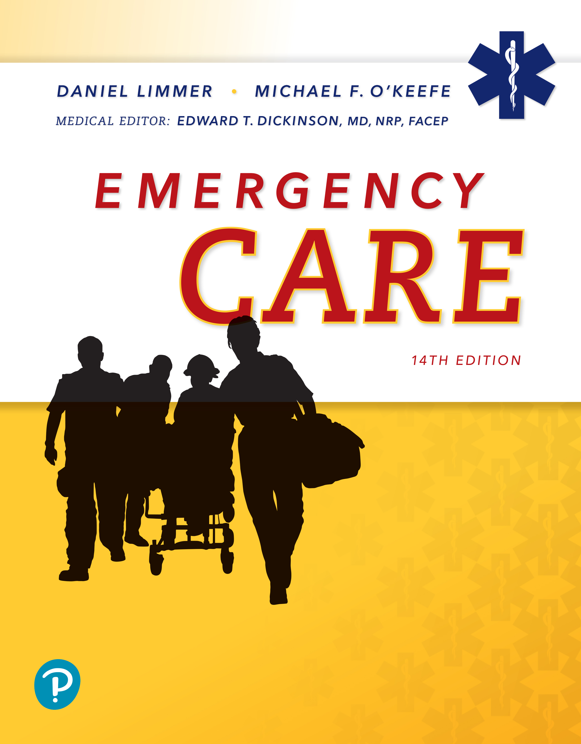
Emergency Care
Fourteenth Edition
Chapter 4
Medical, Legal, and Ethical Issues
Slides in this presentation contain hyperlinks. JAWS users should be able to get a list of links by using INSERT+F7
Copyright © 2021, 2016, 2012 Pearson Education, Inc. All Rights Reserved
Notes:
If this PowerPoint presentation contains mathematical equations, you may need to check that your computer has the following installed:
1) MathType Plugin
2) Math Player (free versions available)
3) NVDA Reader (free versions available)

Slide 2
Topics
Scope of Practice
Patient Consent and Refusal
Other Legal Issues
Notes:
Planning Your Time: Plan 75 minutes for this chapter.
Scope of Practice (10 minutes)
Patient Consent and Refusal (25 minutes)
Other Legal Issues (40 minutes)
Note: The total teaching time recommended is only a guideline.
Core Concepts:
Scope of practice defines the extent and limits of the EMT’s job
Patients must give consent for care, and they can refuse care
The EMT must be aware of legal issues such as negligence, duty to act, and crime scenes

Slide 3
Scope of Practice
Back to Topics
Notes:
Teaching Time: 10 minutes
Teaching Tip: Discuss how the scope of practice for an EMT is defined in your state. Describe the actual scope of practice. Use examples to illustrate standard of care and deviation from the standard of care.

Slide 4
Scope of Practice
Regulations and ethical considerations that defines the scope, or extent and limits of an E M T’s job
May include skills and medical interventions
Defined by state legislation and regional rules and guidelines
Notes:
Covers Objective: 4.1
Discussion Topics: Define scope of practice. How is the scope of practice for an EMT different from what it is for a paramedic?
Knowledge Application: Have students research the scope of practice for EMTs in your area. How might that scope differ from what is used in another state?

Slide 5
Standard of Care
Care that would be expected from an E M T with similar training when caring for a patient in a similar situation
Scope of practice
  What you can do
Standard of care
  How you should do it
Notes:
Covers Objective: 4.1
Discussion Topics: How is the standard of care created in your state? How might the actions you take be judged against a particular standard of care?
Knowledge Application: Present examples of patient care. Have the class become the expert witness for the prosecution. Ask students to judge whether the care that you describe meets their standard of care.

Slide 6
Patient Consent and Refusal
Back to Topics
Notes:
Teaching Time: 25 minutes
Teaching Tip: Use role-playing and simulated patients to present reality-based scenarios pertaining to consent and refusal of care.

Slide 7
Consent (1 of 4)
Permission from patient to assess, treat, and transport
Expressed consent
  Must be informed
Implied consent
  Assumed consent
Notes:
Covers Objective: 4.2
Discussion Topics: How is expressed consent different from implied consent? Discuss specific examples of each.

Slide 8
Consent (2 of 4)
Children and mentally incompetent adults
  Minors not legally permitted to provide consent or refusal for treatment
  Obtain from parent or legal guardian
  Possible exceptions (check local law)
    In loco parentis
    Emancipated minors
Notes:
Covers Objective: 4.2

Slide 9
Consent (3 of 4)
Children and mentally incompetent adults
  Possible exceptions (check local law)
    Life-threatening illness or injury
    Minors who have children
    Minors serving in armed forces
Notes:
Covers Objective: 4.2

Slide 10
Consent (4 of 4)
Involuntary transportation
  Patient considered threat to themselves or others
  Court order
  Usually requires decision by mental health professional or police officer
  If patient restrained, ensure the patient’s health and well-being during this time
Notes:
Covers Objective: 4.2
Critical Thinking Discussion: Discuss situations in which involuntary transport would be allowed in your state. When are patients not allowed to refuse transport?

Slide 11
When a Patient Refuses Care (1 of 6)
Patient may refuse care or transport under the following circumstances:
  Patient must be legally able to consent.
  Patient must be awake and oriented.
  Patient must be fully informed.
  Patient will be asked to sign a “release” form.
Despite all precautions, E M T may still be held liable.
Notes:
Covers Objective: 4.2
Knowledge Application: Have students work in small groups. Use programmed patients and create decision making scenarios around consent and patient refusal.
Discussion Topic: Describe the conditions necessary to allow a patient to refuse care. What documentation would also be necessary?

Slide 12
When a Patient Refuses Care (2 of 6)
Take all possible actions to persuade the patient to accept care and transport.
  Spend time speaking with the patient.
  Listen carefully to try to determine why the patient is refusing care.
  Inform the patient of the consequences of not going to the hospital. This is an essential component of every refusal-of-care situation.
Notes:
Covers Objective: 4.2
Knowledge Application: Work in small groups with a programmed patient. Present each group with a patient refusal scenario and discuss strategies and outcomes.

Slide 13
When a Patient Refuses Care (3 of 6)
Take all possible actions to persuade the patient to accept care and transport.
  Consult medical direction.
  Ask the patient if it is all right if you call a family member—or advise the patient that you would like to call a family member.
Notes:
Covers Objective: 4.2

Slide 14
When a Patient Refuses Care (4 of 6)
Take all possible actions to persuade the patient to accept care and transport.
  Call law enforcement personnel if necessary.
  Ask the patient to sign the refusal of care form used by your agency.
Notes:
Covers Objective: 4.2
Critical Thinking Discussion: Discuss how you might handle a patient who is refusing care but clearly has a life threatening illness or injury. What resources would you use, what steps would you take in determining a patient is incompetent?

Slide 15
Think About It 1
What are the risks of beginning treatment and/or transport without getting consent from the patient?
What if the patient refuses to sign the refusal of care form?
Notes:
Covers Objective: 4.2
Talking Points: The patient can bring a lawsuit against the EMT for assault and/or battery if the EMT begins treatment or transport without getting consent from the patient, especially if the patient does not want care. If the patient refuses to sign, the EMT should obtain witnesses to the refusal and fully document all attempts to convince the patient to accept care and transport.

Slide 16
When a Patient Refuses Care (5 of 6)
Subjecting the patient to unwanted care and transport has actually been viewed in court as assault or battery.
Have witnesses to refusal.
Inform patient that if they change their mind, they can call back.
Notes:
Covers Objective: 4.2
Knowledge Application: Have students work document patient refusal scenarios. Have other students conduct a peer review for quality assurance purposes. Discuss the results.

Slide 17
When a Patient Refuses Care (6 of 6)
If possible, have friend or relative remain with patient.
Document attempts thoroughly.
Notes:
Covers Objective: 4.2

Slide 18
Do Not Resuscitate Orders and Physician Orders for Life-Sustaining Treatment
Legal document expressing patient’s wishes if patient is unable to speak for self
Do not resuscitate order (D N R)
  May be part of an advance directive
  May be part of a Physician Order for Life-Sustaining Treatment (P O L S T)
Should also be familiar with living wills and health care proxies
Notes:
Covers Objective: 4.2
Knowledge Application: Have students research local EMS law for regulations regarding patient refusal and do not resuscitate (DNR) orders. What rules apply specifically to your EMS system?
Critical Thinking Discussion: You respond to a nursing home for a patient in cardiac arrest. Staff at the facility present you with a valid DNR order, but family members ask you to “please do everything you can.” They are very upset and agitated. What should you do?

Slide 19
Other Legal Issues
Back to Topics
Notes:
Teaching Time: 40 minutes

Slide 20
Negligence (1 of 3)
Something that should have been done was not done or was done incorrectly
Must prove:
  E M T had duty to act
  Breach of duty
    E M T failed to provide standard of care expected or failed to act
Notes:
Covers Objective: 4.3
Discussion Topic: Discuss the requirements for proving negligence. Use specific examples of each.

Slide 21
Negligence (2 of 3)
Must prove:
  Proximate causation
    Patient suffered harm because of E M T action or inaction
Negligent E M Ts may be required to pay damages.
Notes:
Covers Objective: 4.3
Critical Thinking Discussion: How does our previous discussion about standard of care relate to negligence?

Slide 22
Negligence (3 of 3)
Lawsuits against E M Ts are usually classified as torts
Res ipsa loquitur (the thing speaks for itself)
  Legal concept important in negligence cases
Notes:
Covers Objective: 4.3
Class Activity: Have a mock trial. Consider using local attorneys to add realism. Create a mock lawsuit and have a student defend himself against charges of negligence.

Slide 23
Duty to Act (1 of 2)
Obligation to provide care to a patient
Duty to act is not always clear.
  Off duty
  On duty but out of jurisdiction
Follow local laws and protocols.
Follow own conscience.
Notes:
Covers Objective: 4.3
Critical Thinking Discussion: Legal and ethical obligations are different. Describe an EMS situation where although you are not legally obligated to act, ethics might compel you to do so.
Knowledge Application: Choose three types of EMS responders: the off-duty EMT, the volunteer EMT, and the on-duty paid EMT. Discuss how the duty to act is defined for each group.

Slide 24
Duty to Act (2 of 2)
Abandonment
  Once care is initiated, it may not be discontinued until transferred to medical personnel of equal or greater training.
  Failure to do so may constitute abandonment.
Notes:
Covers Objective: 4.3

Slide 25
Good Samaritan Laws
Grant immunity from liability if rescuer acts in good faith within level of training
May not cover E M T s in some situations
Do not protect persons from gross negligence or violations of law
Notes:
Covers Objective: 4.3
Discussion Topic: Discuss the Good Samaritan laws. What protections do they afford EMS workers?

Slide 26
Think About It 2
You arrive on the scene of a patient in cardiac arrest. The family says she has a D N R, but don’t know where it is. How should you handle this?
You are off duty and arrive on the scene of a vehicle crash. Police and E M S have not yet arrived. Are you legally obligated to stop and render aid?
Notes:
Covers Objective: 4.3
Talking Points: If you are not in physical possession of a DNR, you should provide care to the patient or have a health care proxy sign a release form that they are refusing care. If the family can produce the DNR at any point during your care, you should then follow the stipulations of the DNR. If you are off duty and arrive at an accident, you are not legally obligated to stop and render aid in most states (may differ in different states), but you may feel morally or ethically compelled to do so. You would then be covered under Good Samaritan laws.

Slide 27
Confidentiality (1 of 2)
Information on patient’s history, condition, treatment considered confidential
Notes:
Covers Objective: 4.3
Knowledge Application: Present local confidentiality policies (for example, from a local clinical site). Discuss how these policies might apply to local EMS services.

Slide 28
Confidentiality (2 of 2)
Privacy Rule of the Health Insurance Portability and Accountability Act (H I P A A)
  Information shared with other health care personnel as part of patient’s continuing care
  Otherwise must be obtained through subpoena
Notes:
Covers Objective: 4.3
Discussion Topic: Describe the confidentiality laws associated with HIPAA. How might they apply to an EMS service?

Slide 29
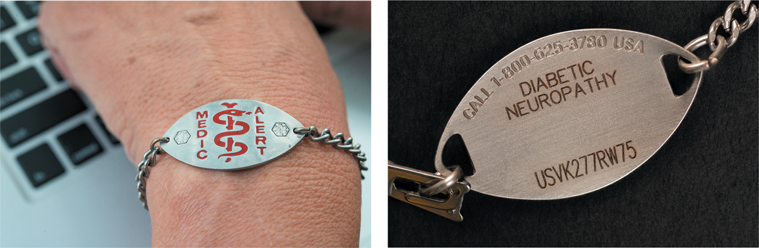
Medical Identification Devices
Example of a medical identification device (front and back).
Notes:
Covers Objective: 4.3
Teaching Tip: Obtain common examples of medical identification devices. Demonstrate what they look like and how to identify them in a clinical setting.

Slide 30
Special Situations (1 of 3)
Medical identification devices
  For particular medical conditions
  Necklace, bracelet, or card
  Conditions include:
    Heart conditions
    Allergies
    Diabetes
    Epilepsy
Notes:
Covers Objective: 4.3
Teaching Tip: Obtain common examples of medical identification devices. Demonstrate what they look like and how to identify them in a clinical setting.

Slide 31
Special Situations (2 of 3)
Organ donors
  Completed legal document allowing donation of organs and tissues in event of death
  May be identified by family members, donor card, driver’s license
  Receiving hospital and/or medical direction should be advised per protocol
Notes:
Covers Objective: 4.3
Discussion Topic: Describe how a potential organ donor would be identified in your state.
Class Activity: Invite a representative from the local organ transplant bank or trauma center to discuss the importance of organ donation.

Slide 32
Special Situations (3 of 3)
Safe haven laws
  Allow person to drop off an infant or child at any fire, police, or E M S station
  States have different guidelines for ages of children included
  Protect children who may otherwise be abandoned or harmed by parents unwilling or unable to care for them
Notes:
Covers Objective: 4.3
Discussion Topic: Describe local laws pertaining to safe haven.

Slide 33
Crime Scenes (1 of 3)
Location where crime was committed or anywhere evidence may be found
Once police have made scene safe, E M T’s priority is patient care.
Know what evidence is.
Take steps to preserve evidence.
Notes:
Covers Objective: 4.3
Discussion Topic: Describe the best practice strategies used to conduct EMS operations in a potential crime scene.

Slide 34
Crime Scenes (2 of 3)
Examples of evidence
  Condition of the scene
  The patient
  Fingerprints and footprints
  Microscopic evidence
Notes:
Covers Objective: 4.3
Critical Thinking Discussion: What if patient care meant disrupting a crime scene? Describe how you might address a situation such as this.

Slide 35
Crime Scenes (3 of 3)
Preservation of evidence
  Remember what you touch
  Minimize your impact on the scene
  Work with the police
Notes:
Covers Objective: 4.3
Knowledge Application: Use programmed patients to present simulations of crime scenes and the mandated reporting of crimes. Practice crime scene strategies.

Slide 36
Special Reporting Requirements (1 of 2)
Child, elderly, or domestic abuse
Human trafficking
Violence (gunshot wounds or stabbings)
Sexual assault
Situations where restraint may be necessary
Notes:
Covers Objective: 4.3
Discussion Topic: Discuss the situations in your state in which EMS workers are mandated to report specific crimes.

Slide 37
Special Reporting Requirements (2 of 2)
Intoxicated person with injuries
Mentally incompetent people with injuries
Check local laws and protocols.
Notes:
Covers Objective: 4.3
Discussion Topic: Discuss the situations in your state in which EMS workers are mandated to report specific crimes.

Slide 38
Other Ethical Responsibilities (1 of 2)
Morality: Personal opinions about right and wrong
Ethics: Standard of behavior for a profession
Ethical expectations for E M T:
  Be honest in reporting
  Refrain from actions that cause harm to a patient
  Work to help the patient
Notes:
Covers Objective: 4.3

Slide 39
Other Ethical Responsibilities (2 of 2)
Ethical expectations for E M T:
  Respect the right of adult patients to make their own decisions
  Treat all patients fairly and justly
  Assist others to learn your profession
  Report misconduct
  Make sure research is approved
Notes:
Covers Objective: 4.3

Slide 40
Chapter Review

Slide 41
Chapter Review (1 of 7)
Medical, legal, and ethical issues are a part of every E M S call.

Slide 42
Chapter Review (2 of 7)
Consent may be expressed or implied. If patients who are awake and oriented and have the capacity to fully understand their situation refuse care or transport, you should make every effort to persuade them, but you cannot force them to accept care or go to the hospital.

Slide 43
Chapter Review (3 of 7)
Negligence is failing to act properly when you have a duty to act. As an E M T, you have a duty to act whenever you are dispatched on a call. You may have a legal or moral duty to act even when off duty or outside your jurisdiction.

Slide 44
Chapter Review (4 of 7)
Abandonment is leaving a patient after you have initiated care and before you have transferred the patient to a person with equal or higher training.

Slide 45
Chapter Review (5 of 7)
Confidentiality is the obligation not to reveal personal information you obtain about a patient except to other health care professionals involved in the patient’s care, under court order, or when the patient signs a release.

Slide 46
Chapter Review (6 of 7)
As an E M T, you may be sued or held legally liable on any of these issues. However, E M Ts are rarely held liable when they have acted within their scope of practice and according to the standard of care, and have carefully documented the details of the call.

Slide 47
Chapter Review (7 of 7)
At a crime scene, care of the patient takes precedence over preservation of evidence; however, you should make every effort not to disturb the scene unnecessarily and to report your actions and observations to the police.

Slide 48
Remember (1 of 2)
E M Ts must use good judgment and decision-making skills when dealing with patient consent and refusal.
Avoiding negligence implies using good judgment; critical thinking is an essential component for avoiding liability.

Slide 49
Remember (2 of 2)
E M Ts hold responsibility for patients’ protected health information; exercising care when dealing with this information is a legal and ethical obligation.

Slide 50
Questions to Consider
Define scope of practice, negligence, duty to act, abandonment, and confidentiality.
What steps must you take when a patient refuses care or transportation?
What types of evidence may be found at a crime scene? How should you act to preserve evidence?
Notes:
Talking Points: Scope of practice is a set of regulations and ethical considerations that define the scope, or extent and limits, of the EMT’s job. Negligence is a finding that there was failure to act properly in a situation in which there was a duty to act, that needed care as would reasonably be expected of the EMT was not provided, and that harm was caused to the patient as a result. Duty to act is an obligation to provide care to a patient. Abandonment is leaving a patient after care has been initiated and before the patient has been transferred to someone with equal or greater medical training. Confidentiality is the obligation not to reveal information obtained about a patient except to other health care professionals involved in the patient’s care or under subpoena or in a court of law or when the patient has signed a release of confidentiality.
When a patient refuses care, the EMT should do everything possible to convince the patient to accept care and document these steps. Inform the patient of the consequences of not going to the hospital. Consult medical direction. Have someone stay with the patient. Have the patient sign a release form.
Evidence at a crime scene includes the condition of the scene, the patient, fingerprints and footprints, and microscopic evidence. Always remember what you touch, minimize your impact on the scene, and work with the police.

Slide 51
Critical Thinking
You respond to a motor vehicle crash and find a seriously injured patient. He has no pulse and you are about to begin C P R when someone says, “Don’t do that! He’s got cancer and a D N R!” No one has the D N R at the scene. Do you start C P R and transport the patient?
Notes:
Talking Points: You should provide care as you would for any other patient until someone can physically produce a DNR or until you confirm with medical direction that you should stop providing care.

Slide 52

Copyright
This work is protected by United States copyright laws and is provided solely for the use of instructors in teaching their courses and assessing student learning. Dissemination or sale of any part of this work (including on the World Wide Web) will destroy the integrity of the work and is not permitted. The work and materials from it should never be made available to students except by instructors using the accompanying text in their classes. All recipients of this work are expected to abide by these restrictions and to honor the intended pedagogical purposes and the needs of other instructors who rely on these materials.

