Slide 1
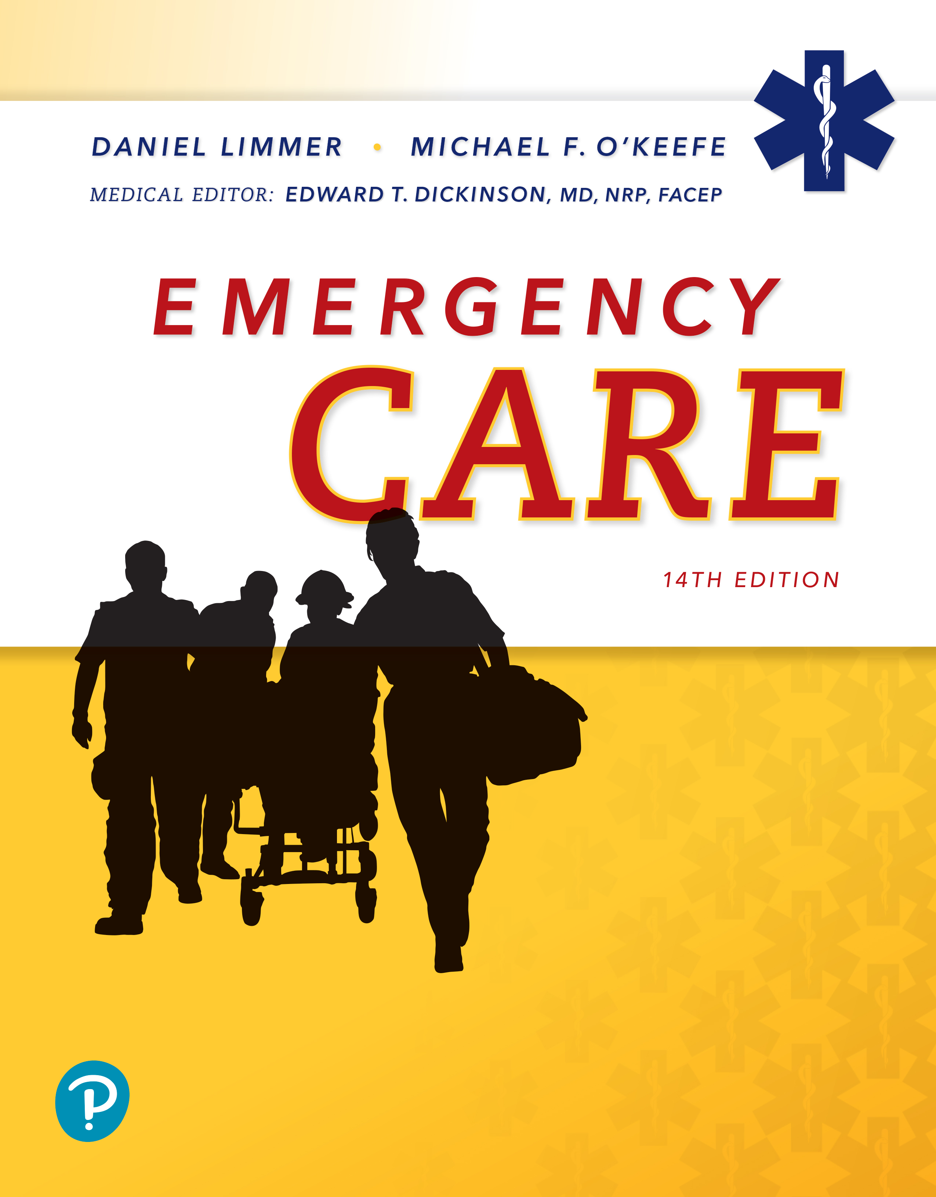
Emergency Care
Fourteenth Edition
Chapter 30
Soft-Tissue Trauma
Slides in this presentation contain hyperlinks. JAWS users should be able to get a list of links by using INSERT+F7
Copyright © 2021, 2016, 2012 Pearson Education, Inc. All Rights Reserved
Notes:
If this PowerPoint presentation contains mathematical equations, you may need to check that your computer has the following installed:
1) MathType Plugin
2) Math Player (free versions available)
3) NVDA Reader (free versions available)

Slide 2
Topics
Soft Tissues
Closed Wounds
Open Wounds
Treating Specific Types of Open Wounds
Burns
Electrical Injuries
Dressing and Bandaging
Notes:
Planning Your Time: Plan 180 minutes for this chapter.
Soft Tissues (15 minutes)
Closed Wounds (20 minutes)
Open Wounds (30 minutes)
Treating Specific Types of Open Wounds (35 minutes)
Burns (50 minutes)
Electrical Injuries (10 minutes)
Dressing and Bandaging (20 minutes)
Note: The total teaching time recommended is only a guideline.
Core Concepts
Anatomy and physiology of skin
Types of closed wounds
Emergency care for closed wounds
Types of open wounds
Emergency care for open wounds
Emergency care for burns
Emergency care for electrical injuries
Types of dressings and bandages
Techniques for dressing and bandaging wounds

Slide 3
Soft Tissues
Back to Topics
Notes:
Teaching Time: 15 minutes
Teaching Tips: Don’t forget the affective domain. It is easy to emphasize skills and assessment, but soft tissue injuries have a definitive emotional component. Use multimedia graphics to demonstrate anatomy. Spend time now on the function of the skin to improve comprehension of later lessons.

Slide 4
Soft Tissues (1 of 4)
Skin
Fatty tissues
Muscles
Blood vessels
Connective tissues
Membranes
Glands
Nerves
Notes:
Covers Objective: 30.1
Discussion Topic: Discuss the role of the blood. What specific functions does it serve?

Slide 5
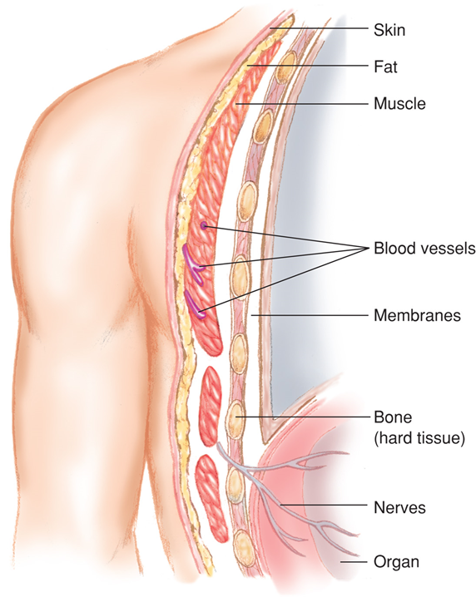
Soft Tissues (2 of 4)
Notes:
Covers Objective: 30.1

Slide 6
Soft Tissues (3 of 4)
Major functions of the skin
  Protection
  Water balance
  Temperature regulation
  Excretion
  Shock (impact) absorption
Notes:
Covers Objective: 30.1
Discussion Topics: List and describe the layers and functions of the skin.
Knowledge Application: Have students work in small groups to discuss the functions of the skin. Assign a function of the skin to each group; then have each group present the impact of losing skin on its particular function.
Critical Thinking Discussion: Many people die from infection after a large surface-area burn. How does this fact relate to our discussion about functions of the skin?

Slide 7
Soft Tissues (4 of 4)
Skin layers
  Epidermis
  Dermis
  Subcutaneous layers
Wounds often classified as closed or open.
Notes:
Covers Objective: 30.1
Knowledge Application: Have students label the layers of the skin on a blank illustration.

Slide 8
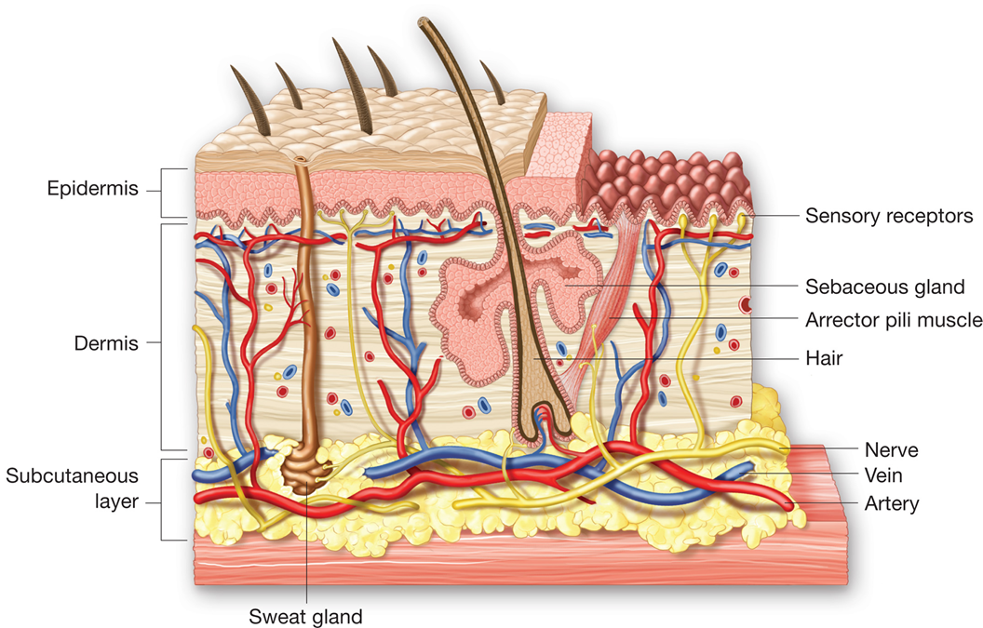
The Skin
For long description, see slide 97: Appendix 1
Notes:
Covers Objective: 30.1

Slide 9
Closed Wounds
Back to Topics
Notes:
Teaching Time: 20 minutes
Teaching Tips: Use multimedia graphics to illustrate closed injuries. Review anatomy to identify body areas that potentially threaten underlying vital organs. Relate to the lessons on internal bleeding. Closed injuries and internal bleeding are closely related.

Slide 10
Closed Wounds (1 of 4)
Internal injuries with no pathway from the outside to the injured site
Although skin unbroken, may be extensively crushed tissues beneath
Range from minor to life-threatening
Notes:
Covers Objective: 30.1

Slide 11
Closed Wounds (2 of 4)
Contusions
  Bruise
Hematomas
  Similar to contusion
  More tissue damage
  Involves larger blood vessels
Notes:
Covers Objective: 30.1
Points to Emphasize: In a closed wound, the skin has not been broken. Blunt trauma causes closed wounds. There are three types of closed wounds: contusions, hematomas, and crush injuries.
Discussion Topics: Describe the three types of closed wounds.

Slide 12
Closed Wounds (3 of 4)
Closed crush injuries
  Force transmitted from exterior to internal structures
  Crush or rupture internal organs
    Solid organs bleed severely and cause shock
    Hollow organs leak into body cavities
Notes:
Covers Objective: 30.1
Discussion Topics: Discuss the forces that create closed injuries. How could these forces transfer damage to underlying structures?

Slide 13
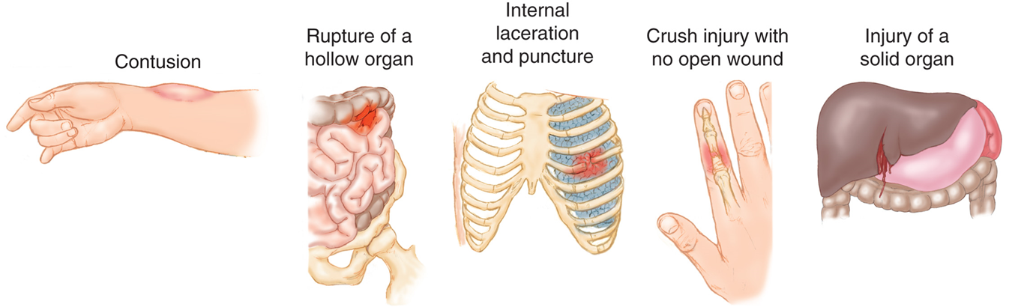
Closed Wounds (4 of 4)
Notes:
Covers Objective: 30.1
Class Activity: Describe closed injuries to different areas of the body. Discuss with the class what structures and organs are at risk.

Slide 14
Patient Assessment (1 of 3)
Bruising may be indication of internal injury or internal bleeding.
Consider mechanism of injury.
Crush injuries are difficult to identify.
Notes:
Covers Objective: 30.1
Knowledge Application: Use multimedia graphics to demonstrate different types of closed injuries. Distribute pictures to groups of students and ask groups to formulate an assessment and treatment strategy.
Critical Thinking Discussion: Ecchymosis is a sign that blood vessels have broken under the skin. What is the significance of ecchymosis around the eyes and at the base of the skull in the context of a head injury?

Slide 15
Patient Care (1 of 8)
Take appropriate Standard Precautions
Manage airway, breathing, and circulation
Manage as if there were internal bleeding and shock if there is any possibility of internal injuries
Notes:
Covers Objective: 30.1

Slide 16
Patient Care (2 of 8)
Splint extremities that are painful, swollen, or deformed
Stay alert for vomiting
Continuously monitor for changes and transport promptly
Apply cold pack to isolated injuries to manage pain and swelling
Notes:
Covers Objective: 30.1
Knowledge Application: Use programmed patients to simulate closed injuries. Have teams of students practice assessment and treatment.

Slide 17
Open Wounds
Back to Topics
Notes:
Teaching Time: 30 minutes
Teaching Tips: Use multimedia graphics to demonstrate the various types of open injuries. Discuss the specific and varied threats that each type of open wound can pose. Use specific examples.

Slide 18
Types of Open Wounds (1 of 2)
Abrasions
Lacerations
Penetrating trauma and punctures
Avulsions
Amputations
Notes:
Covers Objective: 30.1
Discussion Topics: Discuss why a small puncture wound may disguise a major injury. Use a gunshot wound as an example.

Slide 19
Types of Open Wounds (2 of 2)
Open crush injuries
Bite wounds
Blast injuries
High-pressure-injection injuries
Notes:
Covers Objective: 30.1
Discussion Topics: Describe the major types of open wounds. Discuss the specific dangers of each.
Knowledge Application: Have students work in small groups. Give each group a picture of an open wound. Have the group classify the type of wound and then discuss the potential dangers.
Class Activity: Describe a type of open wound. Ask the students to discuss what specific threats might be posed by that particular type of injury.

Slide 20
Think About It
Does an open wound necessitate using more than just gloves as Standard Precautions?
Can an open injury affect the patient’s airway or breathing?
Notes:
Covers Objective: 30.1
Talking Points: Open wounds may require more than just gloves as Standard Precautions, especially if they are spurting blood or if there is potential to get blood or other body fluids on clothing or in the face.
An open injury to the face, neck, chest, or spine could affect the airway and breathing depending on the location of the injury and the structures that are damaged.

Slide 21
Emergency Care for Open Wounds
Strict attention to Standard Precautions
  In addition to wearing gloves, a gown and protective eyewear may be required.
Notes:
Covers Objective: 30.2

Slide 22
Patient Assessment (2 of 3)
Primary assessment
  Airway
  Breathing
  Circulation
  Severe bleeding
Care for individual wounds
Notes:
Covers Objective: 30.2

Slide 23
Patient Care (3 of 8)
Expose wound.
Clean wound surface.
Control bleeding.
For all serious wounds, provide care for shock, including administration of high-concentration oxygen.
Prevent further contamination.
Notes:
Covers Objective: 30.2
Point to Emphasize: Controlling hemorrhage, recognizing and treating shock, preventing infection, and bandaging are important elements in emergency care of open wounds.
Knowledge Application: Place a puncture wound on a manikin or full-body diagram. Have the class discuss what organs and structures lie in the potential pathway. Discuss life threats and treatment strategies.

Slide 24
Patient Care (4 of 8)
Bandage dressings in place after bleeding is controlled.
Keep patient lying still.
Reassure patient.
Notes:
Covers Objective: 30.2
Knowledge Application: Have students work in small groups. Use programmed patients and moulage to simulate different types of open wounds. Practice assessment and treatment procedures.
Critical Thinking: Consider a patient with a large soft-tissue injury to the face. After you dress and bandage it properly, what emotional concerns might you address? How might an injury such as this affect the emotional well-being of the patient?

Slide 25
Treating Specific Types of Open Wounds
Back to Topics
Notes:
Teaching Time: 35 minutes
Teaching Tips: Use multimedia graphics to illustrate specific types of injuries. Use moulage to simulate injuries. This will add realism to scenario work. Instill a fear of puncture wounds. Describe a variety of offending objects (knives, bullets, arrows, and so on) and discuss the potential for underlying damage despite minimal external wounding. Research local protocol on treatment of avulsed and amputated parts. Genital injuries are sometimes taken lightly by students (snickers and laughs). Be sure to emphasize the correlation to sexual assault to keep the lesson grounded.

Slide 26
Treating Abrasions and Lacerations
Reduce wound contamination
Hold direct pressure to control bleeding
Always check pulse, motor, and sensory function distal to injury to assure function
Notes:
Covers Objective: 30.2
Discussion Topic: Describe the treatment of a patient with an abrasion or laceration.

Slide 27
Treating Penetrating Trauma (1 of 2)
Use caution because objects may be embedded deeper than they appear.
Check for exit wounds.
  May require immediate care
Bullets can fracture bones as they enter.
Stab wounds are considered serious, especially if in a vital area of body.
Notes:
Covers Objective: 30.2
Point to Emphasize: Puncture wounds are particularly dangerous as they present with only small external wounds but may damage structures deep into the body.
Discussion Topic: Discuss why a small puncture wound may disguise a major injury. Use a gunshot wound as an example.

Slide 28
Treating Penetrating Trauma (2 of 2)
Reassure patient.
Search for exit wound.
Assess need for basic life support.
Follow local protocols regarding spinal motion restriction.
Transport patient.
Notes:
Covers Objective: 30.2
Discussion Topic: Describe the treatment of a patient with a puncture wound.

Slide 29
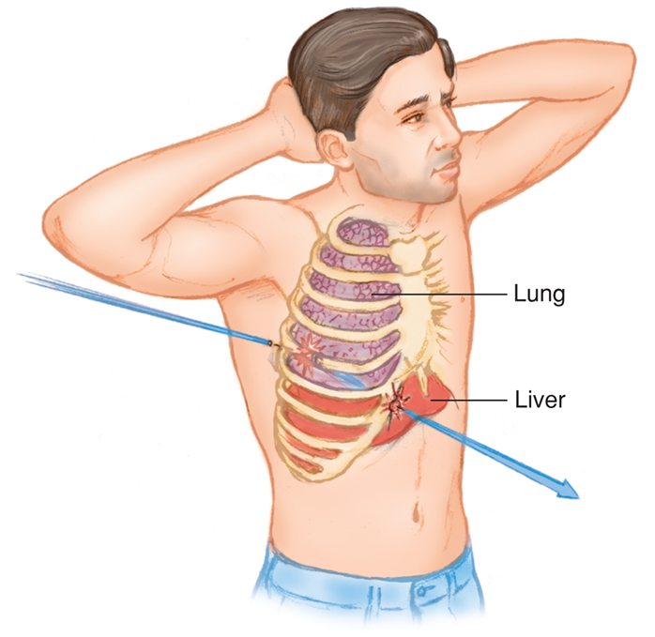
Treatment: Penetrating Trauma (1 of 2)
Bullets travel in an unpredictable path once they are inside the patient’s body, and can therefore cause damage to multiple organs and bones.
Notes:
Covers Objective: 30.2

Slide 30
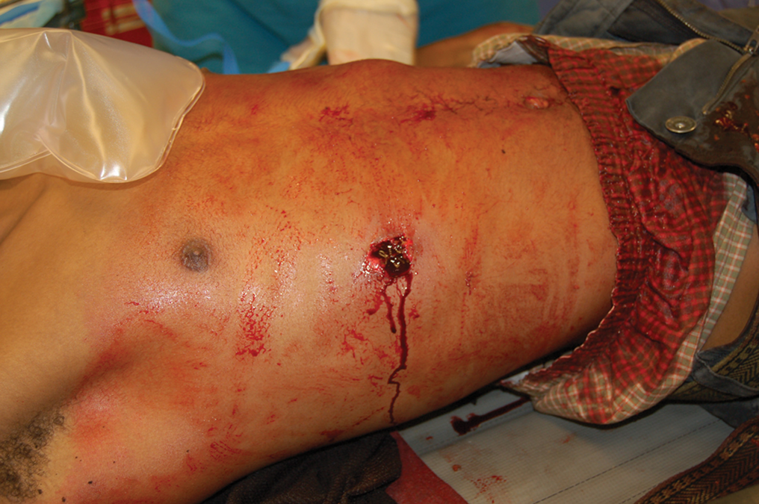
Treatment: Penetrating Trauma (2 of 2)
A gunshot wound to the right flank. © Edward T. Dickinson, M D
Notes:
Covers Objective: 30.2

Slide 31
Treating Impaled Objects (1 of 2)
Do not remove object; may cause severe bleeding.
Expose wound area.
Control profuse bleeding by direct pressure.
Get a description of the object.
Apply several layers of bulky dressing so dressing surrounds the object on all sides.
Notes:
Covers Objective: 30.2
Point to Emphasize: Do not remove or apply direct pressure to impaled objects.
Discussion Topic: Describe the treatment of a patient with an impaled object.

Slide 32
Treating Impaled Objects (2 of 2)
Place bulky dressing on opposite sides of the object.
Secure dressings in place.
Care for shock.
Keep patient at rest.
Transport the patient carefully and as soon as possible.
Reassure patient throughout all aspects of care.
Notes:
Covers Objective: 30.2

Slide 33
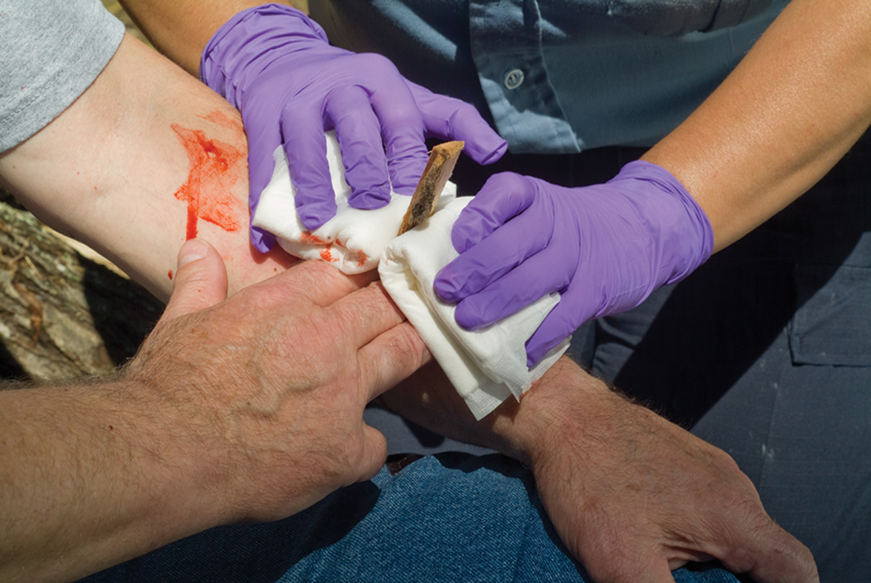
Treatment: Impaled Objects (1 of 2)
Stabilize an impaled object with bulky dressings.
Notes:
Covers Objective: 30.2
Knowledge Application: Have the students work in small groups. Simulate impaled objects and practice stabilization and treatment.

Slide 34
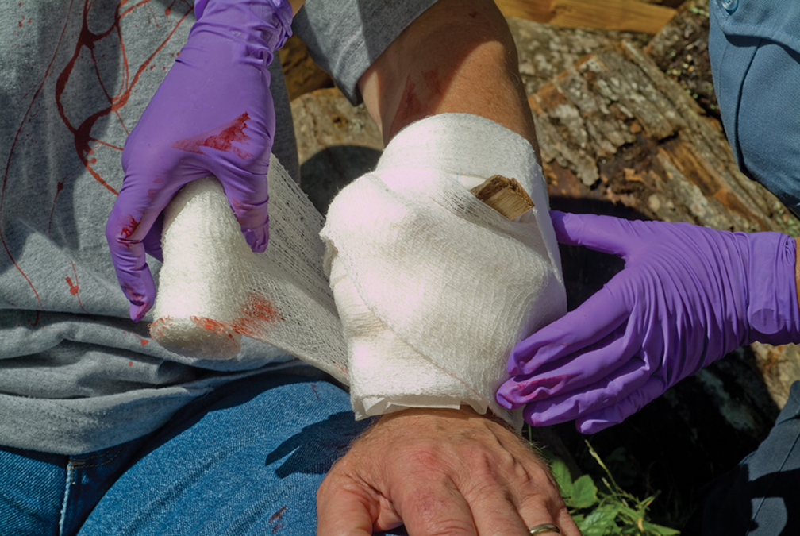
Treatment: Impaled Objects (2 of 2)
Bandage the impaled object and surrounding dressings in place.
Notes:
Covers Objective: 30.2
Knowledge Application: Have the students work in small groups. Simulate impaled objects and practice stabilization and treatment.

Slide 35
Object Impaled in the Cheek (1 of 3)
Object may enter oral cavity, causing airway obstruction.
If cheek wall is perforated, profuse bleeding into mouth and throat can cause nausea and vomiting.
External wound care will not stop the flow of blood into the mouth.
Notes:
Covers Objective: 30.2

Slide 36
Object Impaled in the Cheek (2 of 3)
Examine wound site, both inside and outside mouth
If you find the perforation and can see both ends, remove object.
  If this cannot be easily done, leave object in place.
Notes:
Covers Objective: 30.2

Slide 37
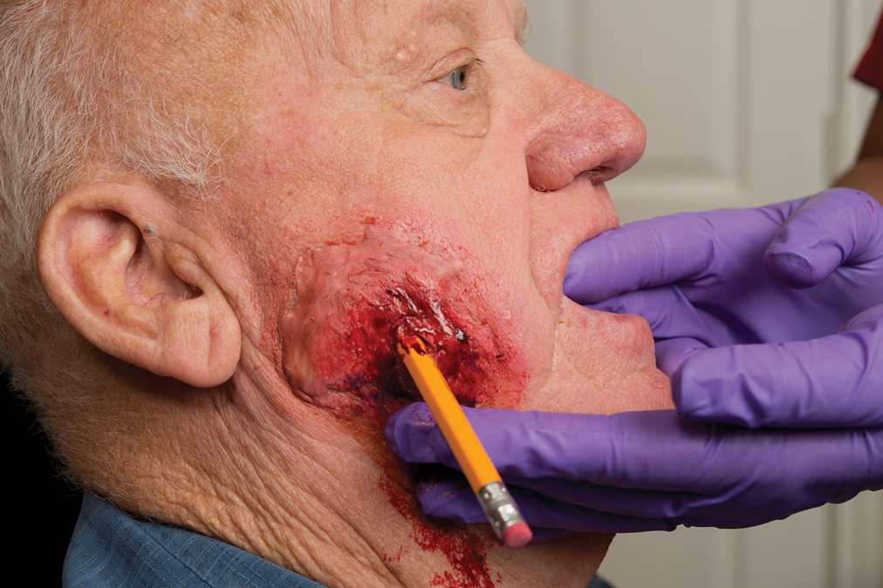
Treatment: Impaled Object in Cheek
The process of removing an impaled object from the cheek.
Notes:
Covers Objective: 30.2

Slide 38
Object Impaled in the Cheek (3 of 3)
Position patient to allow for drainage.
Monitor patient’s airway.
Dress outside of wound.
Consider the need for oxygen and care for shock.
Notes:
Covers Objective: 30.2
Knowledge Application: Have students work in small groups. Use a programmed patient and moulage and simulate various types of injuries. Practice specific treatment strategies.

Slide 39
Puncture Wound or Object Impaled in the Eye (1 of 2)
Stabilize the object.
Apply rigid protection.
Have another rescuer stabilize dressings and cut while you secure them in place with self-adherent roller bandage or with wrapping of gauze.
Notes:
Covers Objective: 30.2
Knowledge Application: Have students work in small groups. Assign each group a specific type of injury. Have the group research and present the most appropriate treatment strategies.

Slide 40
Treatment: Puncture Wound or Object Impaled in Eye (1 of 2)
Managing an object impaled in the eye.
Notes:
Covers Objective: 30.2

Slide 41
Treatment: Puncture Wound or Object Impaled in Eye (2 of 2)
The object is contained and immobilized.
Notes:
Covers Objective: 30.2

Slide 42
Puncture Wound or Object Impaled in the Eye (2 of 2)
Dress and bandage uninjured eye.
Consider need for oxygen and care for shock.
Reassure patient and provide emotional support.
Notes:
Covers Objective: 30.2

Slide 43
Treating Avulsions
Clean wound surface.
Fold skin back into normal position.
Control bleeding and dress with bulky dressings.
If avulsed parts are completely torn away, save in sterile dressing and keep moist with sterile saline.
Notes:
Covers Objective: 30.2
Point to Emphasize: Emergency care for avulsions requires the application of large, bulky pressure dressings. Preserve any avulsed parts and transport them to the medical facility along with the patient.
Discussion Topic: Describe the treatment of a patient with an avulsion.

Slide 44
Treating Amputations (1 of 3)
Take steps to control hemorrhage immediately.
Apply direct pressure to control bleeding; use tourniquet only if all other methods fail.
Notes:
Covers Objective: 30.2

Slide 45
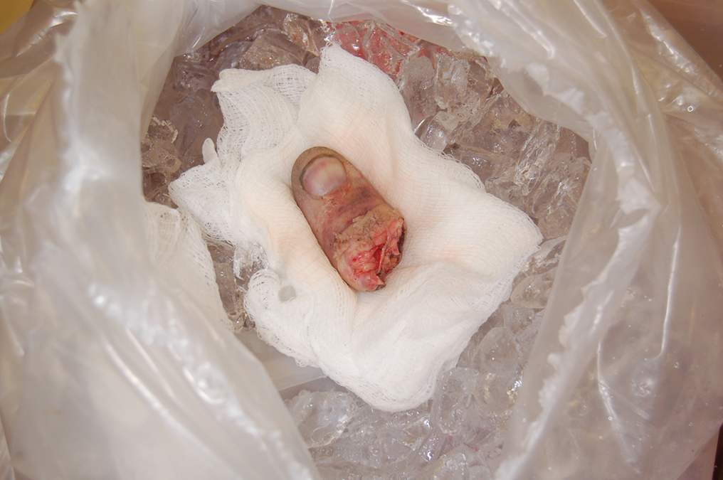
Treating Amputations (2 of 3)
Care for an amputated part. The amputated digit sits on sterile gauze, awaiting reimplantation at the trauma center. © Edward T. Dickinson, M D
Notes:
Covers Objective: 30.2
Class Activity: Use simulated amputated parts. Practice care of amputations and avulsions.

Slide 46
Treating Amputations (3 of 3)
Wrap amputation site in sterile dressing, and secure dressing with self-adhesive gauze bandage.
Then wrap or bag amputated part in plastic bag; keep it cool by cold pack.
Do not immerse amputated part directly in water or saline.
Notes:
Covers Objective: 30.2
Point to Emphasize: Take care to treat amputated parts carefully as there may be a possibility of reattachment.
Critical Thinking: How does the care of an amputated part impact the emotional side of patient care? What emotional benefit might the patient gain?

Slide 47
Treating Genital Injuries
Control bleeding.
Preserve avulsed parts.
Consider whether injury suggests another, possibly more serious, injury.
Display calm, professional manner.
Dress and bandage wound.
Consider possibility of sexual assault.
Notes:
Covers Objective: 30.2
Discussion Topic: Describe the treatment of a patient with a genital injury.

Slide 48
Burns
Back to Topics
Notes:
Teaching Time: 50 minutes
Teaching Tips: Emphasize (and reemphasize) safety and appropriate scene size-up with burn patients. Contact a burn center or national burn care organization for specialized teaching resources. Use multimedia graphics to illustrate different types of burns. Teach students to identify critical burns rapidly. Address specific criteria to make the decision. Follow local protocols.

Slide 49
Burns
May involve more than just skin-level structures
If respiratory structures are affected, swelling may occur, causing life-threatening obstruction.
Do not let burn distract from spinal damage or fractures.
Notes:
Covers Objective: 30.3
Point to Emphasize: Burns involve immediate destruction of tissue but also can have a long-term effect, both physically and emotionally.

Slide 50
Patient Assessment (3 of 3)
Classifying burns
  Agent and source
  Depth
  Severity
Notes:
Covers Objective: 30.3
Point to Emphasize: Burns can be classified and evaluated in three ways: by agent and source, by depth, and by severity.
Discussion Topic: Describe the classification of a burn.

Slide 51
Classifying Burns by Agent and Source
Agent could be chemicals or electricity
Report the agent and, when practical, the source of the agent.
  Never assume the agent or source of the burn.
  Always gather information from your observations of the scene, bystanders’ reports, and the patient interview.
Notes:
Covers Objective: 30.3

Slide 52
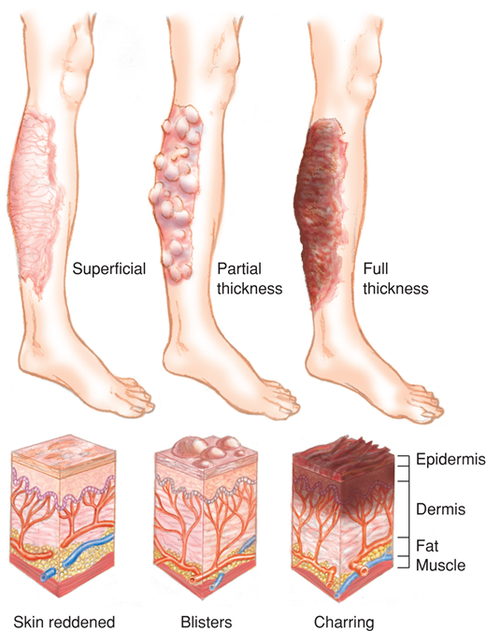
Assessment: Burns
For long description, see slide 98: Appendix 2
Burns are classified by depth.
Notes:
Covers Objective: 30.3

Slide 53
Classifying Burns by Depth (1 of 2)
Superficial burn (1st degree)
  Involves only epidermis
  Reddening with minor swelling
Partial thickness burn (2nd degree)
  Epidermis burned through, dermis damaged
  Deep, intense pain
  Noticeable reddening
  Blisters and mottling
Notes:
Covers Objective: 30.3
Point to Emphasize: The three classifications of burn depth are superficial, partial thickness, and full thickness.
Knowledge Application: Display pictures of burns. Have students classify the depth of the burn based on presentation. Discuss.

Slide 54
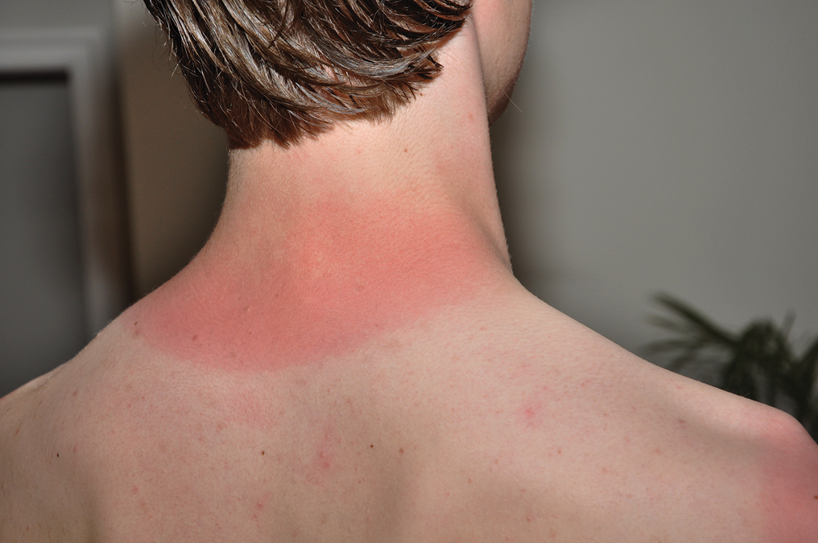
Superficial Burn
A superficial burn. © Edward T. Dickinson, M D
Notes:
Covers Objective: 30.3

Slide 55
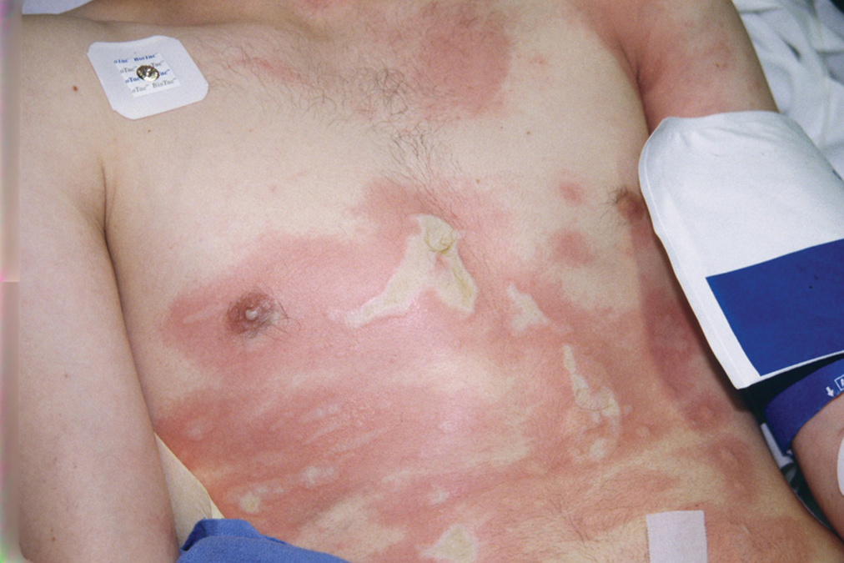
Partial Thickness Burn (1 of 2)
Partial thickness burns. © Edward T. Dickinson, M D
Notes:
Covers Objective: 30.3

Slide 56
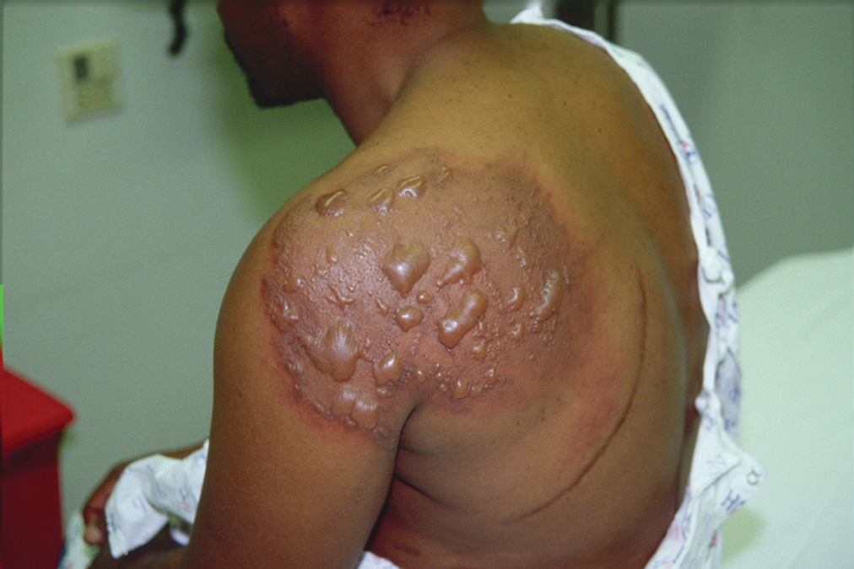
Partial Thickness Burn (2 of 2)
Partial thickness burn. © Edward T. Dickinson, M D
Notes:
Covers Objective: 30.3

Slide 57
Classifying Burns by Depth (2 of 2)
Full thickness burn (3rd degree)
  All layers of skin burned
  Blackened areas or dry and white patches
Notes:
Covers Objective: 30.3

Slide 58
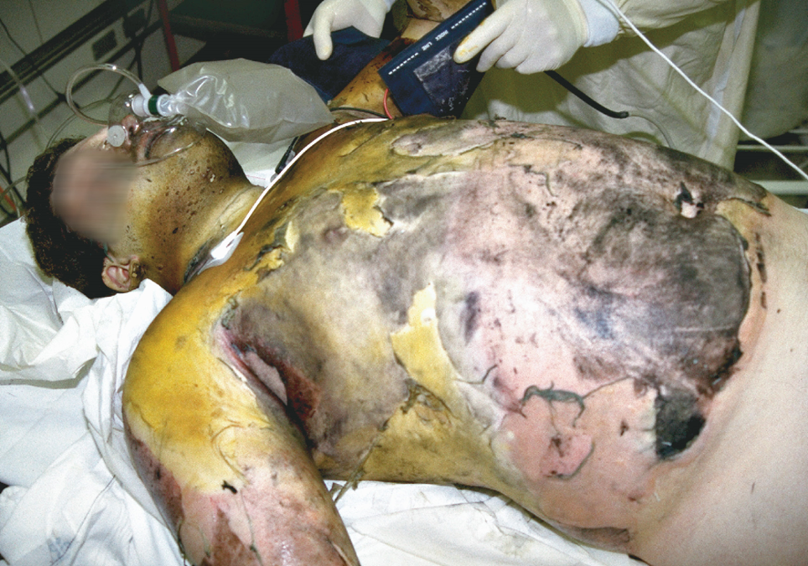
Full Thickness Burn
A full thickness burn. © Edward T. Dickinson, M D
Notes:
Covers Objective: 30.3

Slide 59
Determining the Severity of Burns (1 of 3)
Consider the following factors:
  Agent or source of the burn
  Body regions burned
  Depth of the burn
  Extent of the burn
  Age of the patient
  Other illnesses and injuries
Notes:
Covers Objective: 30.3
Discussion Topics: Discuss how the location of a burn might impact its severity. How might a hand burn be more serious than a burn of the same size on the abdomen?
Knowledge Application: Determine body surface area. Describe an area burned. Have students use various methods to determine body surface area.

Slide 60
Determining the Severity of Burns (2 of 3)
Rule of Nines
  Helps estimate extent of burn area
  Adult body is divided into 11 main areas
  Each represents 9 percent of body surface
Notes:
Covers Objective: 30.3
Point to Emphasize: The amount of skin surface involved in a burn can be calculated quickly by using the rule of nines.
Discussion Topics: Explain how to determine the surface area of a burn. Consider an adult patient and a child.

Slide 61
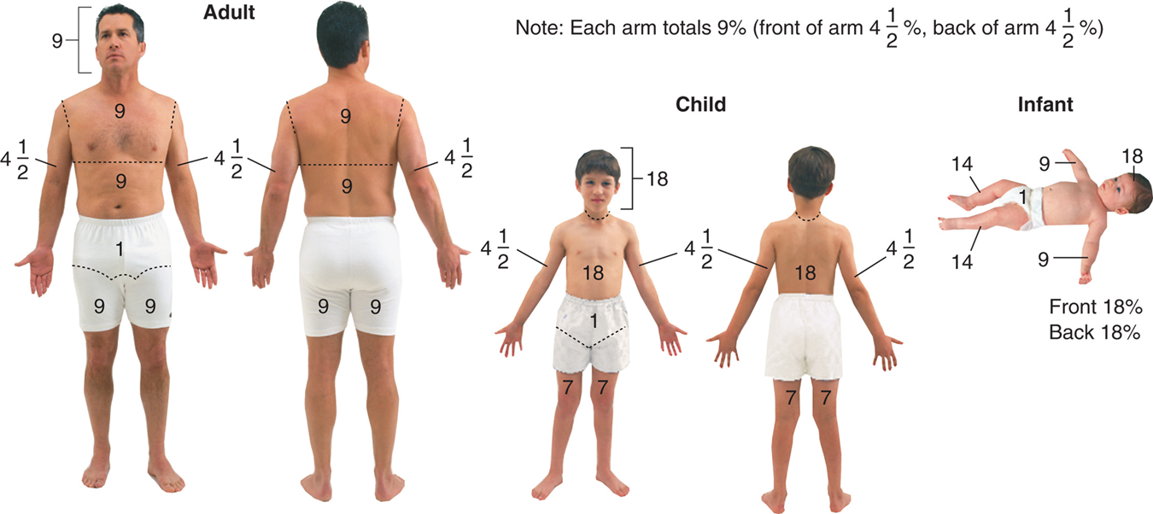
Burns: Severity
For long description, see slide 99: Appendix 3
Rule of nines.
Notes:
Covers Objective: 30.3

Slide 62
Determining the Severity of Burns (3 of 3)
Rule of palm
  Helps estimate extent of burn area
  Palm and fingers equal about 1 percent of body surface area
  Easier to apply to smaller or localized burns
Notes:
Covers Objective: 30.3
Critical Thinking Discussion: Review the Think Like an EMT feature with students and encourage discussion.

Slide 63
Classifying Burns by Severity
Must be classified to determine:
  Order and type of care
  Priority for transport
  Maximum information to provide to the emergency department.
Notes:
Covers Objective: 30.3
Knowledge Application: Use a programmed patient to simulate different types of burn scenarios. Have teams of students practice assessment and identification of a critical burn.

Slide 64
Pediatric Note
Infants and children have a much greater relationship of body surface area to total body size, resulting in greater fluid and heat loss from burned skin.
Notes:
Covers Objective: 30.3

Slide 65
Treating Specific Types of Burns (1 of 4)
Patient care for thermal burns
  Stop burning process and cool burned area.
  Ensure open airway and assess breathing.
  Look for signs of airway injury.
  Complete primary assessment.
  Treat for shock.
Notes:
Covers Objective: 30.3
Point to Emphasize: There are special approaches to the care of thermal burns, general chemical burns, and chemical burns to the eyes. EMTs should know the procedures for treating each type.

Slide 66
Treating Specific Types of Burns (2 of 4)
  Evaluate burns by depth, extent, and severity.
  Do not clear debris.
  Remove clothing and jewelry.
  Wrap with dry sterile dressing.
  For burns to hand or feet, remove patient’s rings or jewelry and separate fingers or toes with sterile gauze pads.
Notes:
Covers Objective: 30.3

Slide 67
Treating Specific Types of Burns (3 of 4)
Patient care for chemical burns
  Wash away chemical with copious amounts of flowing water.
  If dry chemical, remove contaminated clothing, then flush with water.
Notes:
Covers Objective: 30.3
Discussion Topic: Compare and contrast treatment modalities for the various types of burns. How are the modalities similar? How are they different?
Class Activities: Tour a burn unit. See firsthand the impact of burns. Interview staff from a burn center. Discuss perils and pitfalls of burn care.
Knowledge Application: Use student volunteers and practice flushing an eye. Discuss necessary equipment and strategies.

Slide 68
Treating Specific Types of Burns (4 of 4)
Patient care for chemical burns
  Apply sterile dressings.
  Treat for shock.
  Transport.
Notes:
Covers Objective: 30.3
Critical Thinking: How might a burn impact a patient emotionally? How might this be a long-term concern?

Slide 69
Radiation Burns (1 of 2)
Exposure to high levels of radiation can harm the human body both immediately and in a delayed fashion.
Great number of sources of radiation
  Difficult to detect without specific monitoring equipment
Notes:
Covers Objective: 30.3

Slide 70
Radiation Burns (2 of 2)
Extremely harmful
  Do not approach a radiological injury without protective equipment and specialized training.
  See patient with a radiological burn only after they have been decontaminated.
Most will present like thermal injuries.
Notes:
Covers Objective: 30.3

Slide 71
Electrical Injuries
Back to Topics
Notes:
Teaching Time: 10 minutes
Teaching Tips: Emphasize safety. Electrical injury scenes are extremely hazardous to emergency responders. Use multimedia graphics to illustrate electrical injuries. Invite a power company representative to discuss electrical safety and associated injuries. Note the importance of cardiac evaluation. This type of injury is not readily apparent on the outside but can be life threatening.

Slide 72
Electrical Injuries
Severe damage through body along path of electrical current
Entry and exit burns are possible.
Respiratory/cardiac arrest are possible.
Bones may fracture from violent muscle contractions.
Notes:
Covers Objective: 30.3
Points to Emphasize: The scenes of injuries due to electricity are often very hazardous. Assume that the source of electricity is still active unless a qualified person tells you that the power has been turned off. Electrical current can damage tissue in a variety of ways. Burns, nerve damage, and chemical changes are examples of the destruction that electricity can cause. Specific assessment findings can indicate the presence of electrical injuries.
Discussion Topics: Discuss how you might determine that the scene is safe when approaching an electricity-related emergency. Describe how electricity can damage the body. Use specific examples. Describe the assessment findings that might indicate an electrical emergency.
Knowledge Application: Have students work in small groups. Use programmed patients and simulate electrical emergencies. Focus on safety evaluation and approach strategies.

Slide 73
Patient Care (5 of 8)
Provide airway and breathing care.
Provide basic cardiac life support; be ready to defibrillate.
Care for shock and administer high-concentration oxygen.
Notes:
Covers Objective: 30.3
Point to Emphasize: Proper care for electrical injuries must include treatment of cardiac dysrhythmias. In addition, spinal motion restriction should be considered.
Discussion Topic: Describe the treatment of a patient injured by electricity. What are the most important elements of treatment?
Critical Thinking: You have identified a patient who has been electrocuted. You are not sure if the power has been turned off, so you have decided to hold back. What forces may be present to make you want to push forward? How can you overcome these issues?

Slide 74
Patient Care (6 of 8)
Care for spinal and head injuries as well as extremity fractures.
Evaluate burn sites.
Cool burning areas and smoldering clothing the same you would for a flame burn.
Apply sterile dressings.
Transport as soon as possible.
Notes:
Covers Objective: 30.3
Knowledge Application: Present pictures of electrical injuries. Discuss treatment priorities.

Slide 75
Dressing and Bandaging
Back to Topics
Notes:
Teaching Time: 20 minutes
Teaching Tips: Have on hand various types of dressings and bandages with which students can practice. Create a culture of infection control. Always require appropriate PPE when practicing potentially infectious skills. Moulage a programmed patient to simulate injuries and bleeding. Foster creativity. Do not always place the wound in the same convenient location. Make students bandage difficult areas. Integrate hemostatic agents with dressings and bandages.

Slide 76
Dressing and Bandaging (1 of 4)
Dressing
  Any material applied to wound to control bleeding and prevent contamination
Bandage
  Any material used to hold dressing in place
Notes:
Covers Objective: 30.3
Point to Emphasize: A dressing is any material that is applied to a wound in an effort to control bleeding and prevent further contamination. A bandage is any material that is used to hold a dressing in place.
Discussion Topics: Discuss what PPE might be necessary when dressing and bandaging a bleeding wound. Discuss the rules for the general dressing of wounds.

Slide 77
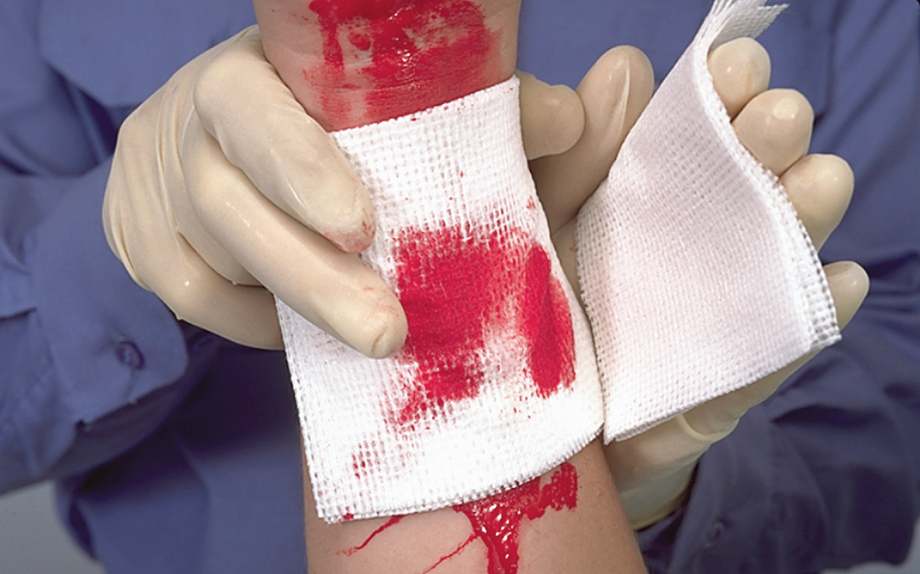
Dressing and Bandaging (2 of 4)
Dressings cover wounds.
Notes:
Covers Objective: 30.3

Slide 78
Dressing and Bandaging (3 of 4)
Universal dressing
  Available for profuse bleeding, large wound
Pressure dressing
  Used to control bleeding
Occlusive dressing
  Used to form an airtight seal
  Wounds to the abdomen, large neck veins, open wounds to chest
Notes:
Covers Objective: 30.3
Points to Emphasize: Bandaging frequently exposes providers to bloodborne pathogens. EMTs always should don the correct level of personal protection prior to beginning these procedures. Bandaging is secondary to hemorrhage control. When necessary, stop bleeding before applying a bandage.
Class Activities: (Skill Demonstration) Given a scenario involving a patient with an open soft-tissue injury, apply an appropriate dressing and bandage for the situation.

Slide 79
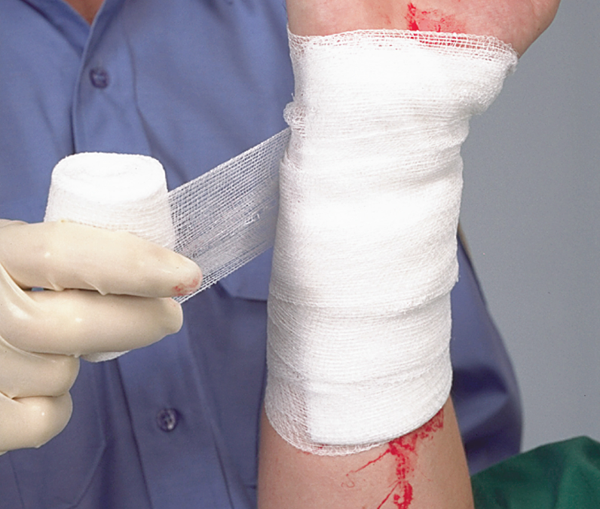
Dressing and Bandaging (4 of 4)
Bandages hold dressings in place.
Notes:
Covers Objective: 30.3

Slide 80
Patient Care (7 of 8)
Dressing open wounds
  Take Standard Precautions.
  Expose wound.
  Use sterile or very clean materials.
  Cover entire wound.
  Control bleeding by direct pressure and/or hemostatic agents or dressings to stop or slow bleeding.
  Do not remove dressings.
Notes:
Covers Objective: 30.3
Knowledge Applications: Select and don appropriate PPE for treating open soft-tissue injuries. Have students work in small groups. Practice the sequence of bleeding control and bandaging. Discuss how the steps flow together.
Critical Thinking Discussion: If you did not have EMS equipment, what common items could you use to dress and bandage a wound?

Slide 81
Patient Care (8 of 8)
Bandaging open wounds
  Do not bandage too tightly or too loosely.
  Do not leave loose ends.
  Do not cover tips of fingers or toes.
    Must observe distal skin color changes
  Cover all edges of dressings.
Notes:
Covers Objective: 30.3
Point to Emphasize: Completely cover the wound with a dressing. Apply the bandage over the dressing and completely cover the dressing.
Discussion Topic: Discuss the rules for the general bandaging of wounds.
Class Activity: Brainstorm creative bandaging techniques. List an unusual wound site and ask students to formulate creative bandaging solutions.
Knowledge Application: Using a manikin or programmed patient, practice applying dressings and bandaging wounds.

Slide 82
Bandaging Open Wounds (1 of 2)
To apply a self-adhering roller bandage, secure it with several overlapping wraps.
Notes:
Covers Objective: 30.3

Slide 83
Bandaging Open Wounds (2 of 2)
To apply a self-adhering roller bandage, keep it snug.
Notes:
Covers Objective: 30.3

Slide 84
Chapter Review

Slide 85
Chapter Review (1 of 5)
Soft-tissue injuries may be closed (internal, with no pathway to the outside) or open (an injury in which the skin is interrupted, exposing the tissues below).
Closed injuries include contusions (bruises), hematomas, crush injuries, and blast injuries. Open wounds include abrasions, lacerations, punctures, avulsions, amputations, crush injuries, and blast injuries.
For open wounds, expose the wound, control bleeding, and prevent further contamination.

Slide 86
Chapter Review (2 of 5)
For both open and closed injuries, take appropriate Standard Precautions; note the mechanism of injury; protect the patient’s airway and breathing; consider the need for oxygen by nonrebreather mask; treat for shock; and transport.

Slide 87
Chapter Review (3 of 5)
Burn severity is determined by considering the source of the burn, body regions burned, depth of the burn (superficial, partial thickness, or full thickness), extent of the burn (by rule of nines or rule of palm), age of the patient (children under 5 and adults over 55 react most severely), and other patient illnesses or injuries.

Slide 88
Chapter Review (4 of 5)
Care for burns includes stopping the burning process (using water for a thermal burn, brushing away dry chemicals), covering a thermal burn with a dry sterile dressing, flushing a chemical burn with sterile water, protecting the airway, administering oxygen as appropriate, treating for shock, and transporting the patient to a medical facility.

Slide 89
Chapter Review (5 of 5)
For treatment of electrical injuries, be sure that you and the patient are in a safe zone away from possible contact with electrical sources. Protect airway, breathing, and circulation. Be prepared to care for respiratory or cardiac arrest. Treat for shock, care for burns, and transport the patient.

Slide 90
Remember (1 of 2)
The soft tissue of the body is made up of skin, fatty tissues, muscles, blood vessels, connective tissues, membranes, glands, and nerves.
The skin provides protection, water balance, temperature regulation, excretion, and shock absorption.
Open or closed in reference to a soft-tissue injury is dictated by whether or not the skin is still intact.
Closed injuries must be evaluated with consideration to underlying anatomy and mechanism of injury.

Slide 91
Remember (2 of 2)
Open injuries typically are easier to visualize, but they often can mask underlying injuries.
Burns involve immediate destruction of tissue but also can have a long-term effect, both physically and emotionally.
Safety must be a key concern when treating a patient with a burn or an electrical injury.
The goal of dressing and bandaging wounds is to control bleeding and to prevent infection.

Slide 92
Questions to Consider (1 of 2)
Does the patient have a patent airway and is breathing adequate?
If the wound is penetrating, is there an exit wound?
What is the best way to immobilize an impaled object?
Notes:
Talking Points: Have students explain or demonstrate the answers to these questions.

Slide 93
Questions to Consider (2 of 2)
Is there respiratory involvement with the burn?
Have we irrigated the chemical burn sufficiently?
Does the electrical burn have an exit wound?
Is the bandage securely fastened to hold the dressing?
Notes:
Talking Points: Have students explain or demonstrate the answers to these questions.

Slide 94
Critical Thinking (1 of 2)
A 21-year-old male lacerated his anterior elbow when he fell through a window. There is a lot of blood around the patient. Bystanders have applied numerous towels and washcloths over the wound (at least 3 inches thick).

Slide 95
Critical Thinking (2 of 2)
There are so many dressings on the wound that you can’t tell if it is still bleeding. The patient is alert, but pale and anxious. The radial pulse on his uninjured arm is weak and rapid. How much assessment of the wound should you do and how do you do it without making things worse?
Notes:
Talking Points: Ask a student to role-play the patient. Wrap the student's arm as described in the scenario, and have other students explain how much assessment they would do and demonstrate how best to do it.

Slide 96

Copyright
This work is protected by United States copyright laws and is provided solely for the use of instructors in teaching their courses and assessing student learning. Dissemination or sale of any part of this work (including on the World Wide Web) will destroy the integrity of the work and is not permitted. The work and materials from it should never be made available to students except by instructors using the accompanying text in their classes. All recipients of this work are expected to abide by these restrictions and to honor the intended pedagogical purposes and the needs of other instructors who rely on these materials.

Slide 97
Appendix 1
From the top to the inner layers, the skin surface comprises the epidermis, dermis, and subcutaneous layers. Underlying tissues and organs comprise sensory receptors, sebaceous glands, arrector pili muscles, hair, sweat glands, nerves, veins, and arteries.
Return to presentation

Slide 98
Appendix 2
Superficial burns are associated with skin reddening and involve only the outermost layer of skin, known as the epidermis. Partial thickness burns are associated with blisters and involve both the epidermal and dermal layers of the skin. In full thickness burns, all layers of the skin are damaged including the underlying tissues. Full thickness burns are associated with black or brown charring.
Return to presentation

Slide 99
Appendix 3 (1 of 2)
The rules are as follows for an adult.
The anterior or posterior surface of the head represents 9 percent.
The anterior or posterior surface of the upper torso or upper back represents 9 percent.
The anterior or posterior surface of the abdomen and upper trunk or lower back and buttocks represents 9 percent.
The anterior or posterior surface of each leg represents 9 percent.
The anterior or posterior surface of each arm represents 4 and one half percent.
The genitalia represents 1 percent.
The rules are as follows for a child.
The anterior or posterior surface of the head represents 18 percent.
The anterior or posterior surface of the torso and upper trunk or back and buttocks represents 18 percent.
The anterior or posterior surface of each leg represents 7 percent.
The anterior or posterior surface of each arm represents 4 and one half percent.
The genitalia represents 1 percent.

Slide 100
Appendix 3 (2 of 2)
The rules are as follows for an infant.
The anterior or posterior surface of the head represents 18 percent.
The anterior or posterior surface of the torso and upper trunk or back and buttocks represents 18 percent.
The anterior or posterior surface of each leg represents 14 percent.
The anterior or posterior surface of each arm represents 9 percent.
The genitalia represents 1 percent.
Return to presentation

