Slide 1

Emergency Care
Fourteenth Edition
Chapter 11
Scene Size-Up
Slides in this presentation contain hyperlinks. JAWS users should be able to get a list of links by using INSERT+F7
Copyright © 2021, 2016, 2012 Pearson Education, Inc. All Rights Reserved
Notes:
If this PowerPoint presentation contains mathematical equations, you may need to check that your computer has the following installed:
1) MathType Plugin
2) Math Player (free versions available)
3) NVDA Reader (free versions available)

Slide 2
Topic
Scene Size-Up
Notes:
Planning Your Time: Plan 40 minutes for this chapter.
Scene Size-Up (40 minutes)
Note: The total teaching time recommended is only a guideline.
Core concepts:
Identifying hazards at a scene
Determining if a scene is safe to enter
Mechanisms of injury and how they relate to patient condition
Determining what additional assistance may be needed at a scene

Slide 3
Scene Size-Up
Back to Topic
Notes:
Teaching Time: 40 minutes
Teaching Tips: This lesson lends itself well to multimedia presentations. Use photographs and video clips of scenes to enhance your points. Make scene threats real. Discuss actual injuries to EMTs. Use news reports and journal articles to enhance realism. Use scenarios to create realistic decision making situations. Use programmed patients to add an element of urgency. Go outside and practice. Use local settings to identify potential scene hazards. Take safety evaluation out of the context of the classroom.

Slide 4
Scene Size-Up
Elements
  Checking scene safety
  Taking Standard Precautions
  Noting the mechanism of injury or nature of patient’s illness
  Determining the number of patients
  Deciding what additional resources may be necessary
Notes:
Covers Objective: 11.1
Points to Emphasize: Scene size-up begins at dispatch and continues until the conclusion of the call. Scene safety is the first priority of scene size-up. A safety assessment will determine how best to approach the scene.

Slide 5
Scene Safety (1 of 5)
The only predictable thing about emergencies is they are often unpredictable and can pose many dangers.
Notes:
Covers Objective: 11.1

Slide 6
Scene Safety (2 of 5)
As you near the collision scene
  Look and listen for other emergency units approaching.
  Look for signs of a collision-related power outage.
  Observe traffic flow.
  Look for smoke in the direction of the collision scene.
Notes:
Covers Objective: 11.1

Slide 7
Scene Safety (3 of 5)
When within sight of scene
  Look for clues indicating escaped hazardous materials.
  Look for collision victims on or near the road.
  Look for smoke not seen at a distance.
  Look for broken utility poles and downed wires.
Notes:
Covers Objective: 11.1

Slide 8
Scene Safety (4 of 5)
When within sight of scene
  Be alert for persons walking along side of road toward collision scene.
  Watch for signals of police officers and other emergency service personnel.
Notes:
Covers Objective: 11.1

Slide 9
Scene Safety (5 of 5)
As you reach the scene
  Follow instructions of person in charge.
  Don appropriate protective apparel including head protection, a bunker coat, and an A N S I-approved reflective vest over your coat.
  Sniff for odors that may indicate a hazardous materials release.
Notes:
Covers Objective: 11.1
Discussion Topic: Describe the steps of a safety evaluation as you approach the scene of a motor vehicle crash. Describe how this assessment might progress as you move from near the collision scene into the collision scene itself.

Slide 10
Establishing the Danger Zone (1 of 2)
Around the wreckage of every vehicle collision
Specific guidelines for establishing zone
  When there are no apparent hazards
    At least fifty feet in all directions
  When fuel has been spilled
    One hundred feet in all directions from wreckage and fuel
Notes:
Covers Objective: 11.1
Point to Emphasize: Consider establishing a danger zone to account for safety-related concerns.
Discussion Topic: Describe a situation in which you might establish a danger zone. Discuss why you might need to use such a zone for this particular scene.

Slide 11
Establishing the Danger Zone (2 of 2)
Specific guidelines
  When a vehicle is on fire
    At least one hundred feet in all directions
  When wires are down
    One full span of wires away from the poles to which broken wires are attached
  When a hazardous material is involved
    Check the Emergency Response Guidebook (E R G)
Notes:
Covers Objective: 11.1
Point to Emphasize: Consider establishing a danger zone to account for safety-related concerns.
Discussion Topic: Describe a situation in which you might establish a danger zone. Discuss why you might need to use such a zone for this particular scene.

Slide 12
Crime Scenes and Acts of Violence
Evaluate for threat of violence
  Fighting or loud voices
  Weapons visible or in use
  Signs of alcohol or other drug use
  Unusual silence
  Knowledge of prior violence
Notes:
Covers Objective: 11.1
Point to Emphasize: Because crime scenes and potential violence pose particular hazards, the EMT must learn to recognize the threats that these scenes present.
Discussion Topic: Describe the signals of danger from violence that you may observe as you approach a scene. Give specific examples.
Knowledge Application: Use photographs of scenes. (You could even assemble pictures of local scenes.) Have students examine the pictures and provide a scene size-up.
Critical Thinking Discussion: As you respond to a very rural area, you note the signs of violence and are concerned for your safety. The victim's family is waving you in and yelling for you to hurry. Dispatch notes that the ETA for law enforcement is approximately 20 minutes. What do you do?

Slide 13
Think About It
Although any call can present a potential safety hazard, what types of calls might pose the highest threats of potential violence?
Notes:
Covers Objective: 11.1
Talking Points: The highest threats of potential violence would be scenes that have patients fighting or loud voices, weapons visible or in use, signs of alcohol or other drug use, unusual silence, or knowledge of prior violence at this specific scene.

Slide 14
Standard Precautions
Body substance isolation (B S I)
Always have personal protective equipment (P P E) available.
Notes:
Covers Objective: 11.1

Slide 15
Nature of the Call
Determining why E M S has been called
  Mechanism of injury
  Nature of illness
Notes:
Covers Objective: 11.1
Knowledge Application: Take students outside on a walking tour in the area of your classroom. Identify and discuss potential scene safety hazards.

Slide 16
Mechanism of Injury (1 of 10)
Force(s) that may have caused injury
Understanding forces can predict injury patterns.
Can be very useful in predicting injuries associated with certain types of motor vehicle crashes
Notes:
Covers Objective: 11.1
Point to Emphasize: An assessment of mechanism of injury will help EMTs identify injuries "common" to particular situations and can help focus assessment on key subtle life threats.
Knowledge Application: Have students work in small groups. Give each group a picture of a motor vehicle crash or another mechanism of injury. Have the group discuss likely injuries based on scene clues. Discuss.

Slide 17
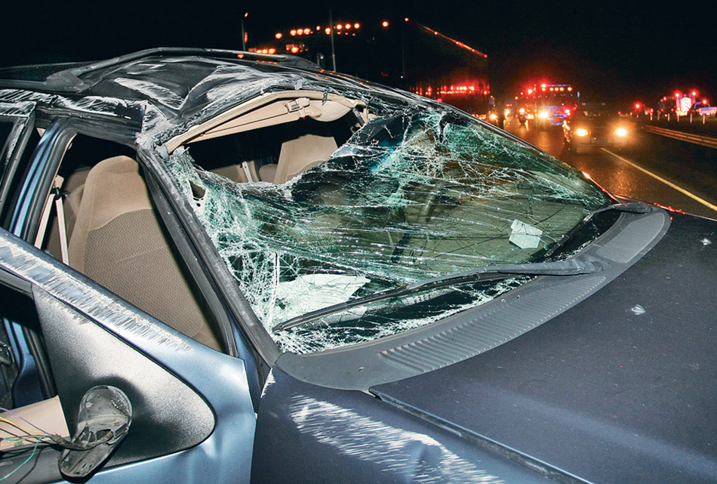
Mechanism of Injury (2 of 10)
Clues such as exterior damage may lead you to suspect certain types of injuries. © Daniel Limmer
Notes:
Covers Objective: 11.1

Slide 18
Mechanism of Injury (3 of 10)
Motor-vehicle collisions
  Head-on collisions
    Up-and-over injury pattern
    Down-and-under injury pattern
Notes:
Covers Objective: 11.1

Slide 19
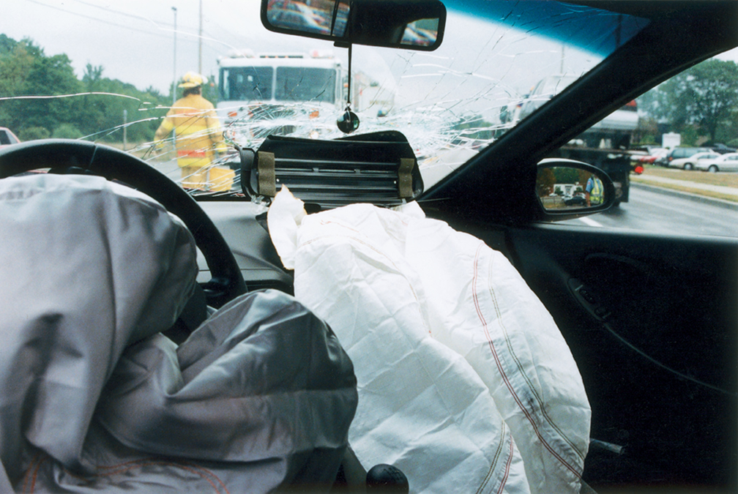
Mechanism of Injury: Head-on Collision (1 of 2)
Clues such as a deployed air bag may lead you to suspect certain types of injuries. © Daniel Limmer
Notes:
Covers Objective: 11.1

Slide 20
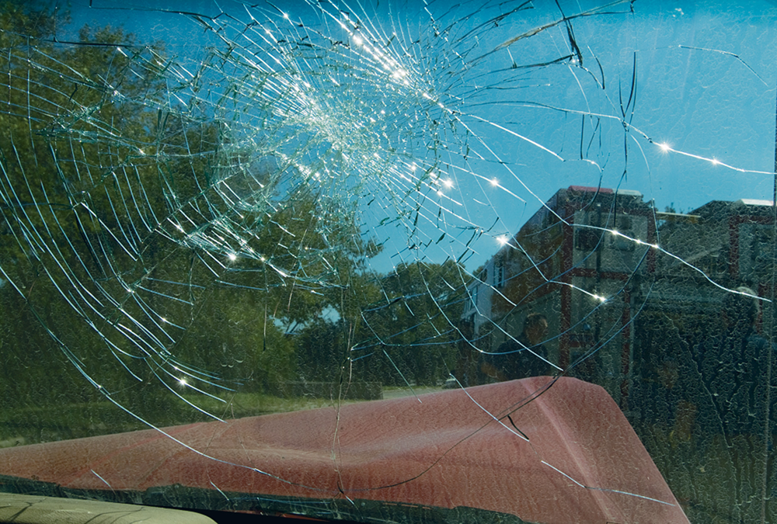
Mechanism of Injury: Head-on Collision (2 of 2)
Clues such as a damaged windshield may lead you to suspect certain types of injuries.
Notes:
Covers Objective: 11.1

Slide 21
Mechanism of Injury (4 of 10)
Motor vehicle collisions
  Rear-end collisions
  Side-impact collisions (broadside or “T-bone”)
  Rollover collisions
Notes:
Covers Objective: 11.1

Slide 22
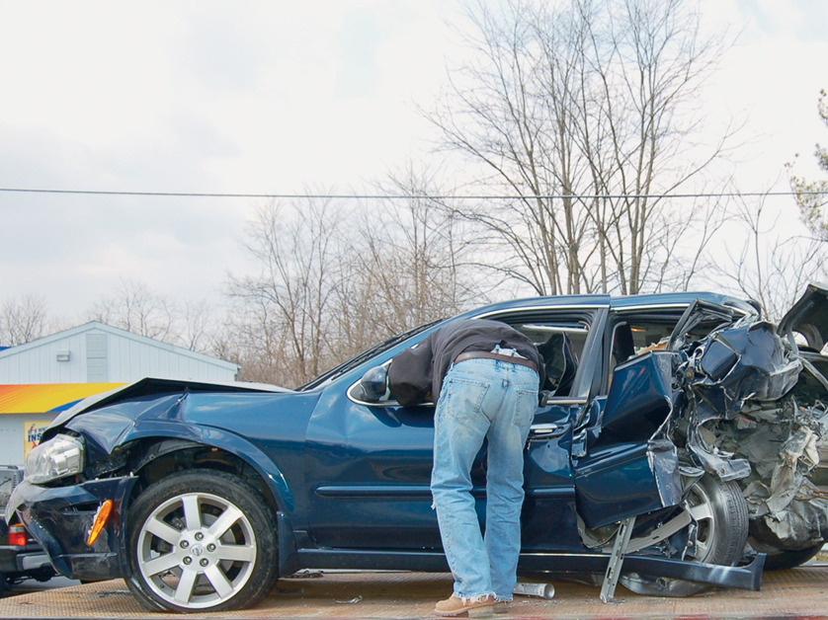
Mechanism of Injury: Rear-end Collision
Rear impact.
© Edward T. Dickinson, M D
Notes:
Covers Objective: 11.1

Slide 23
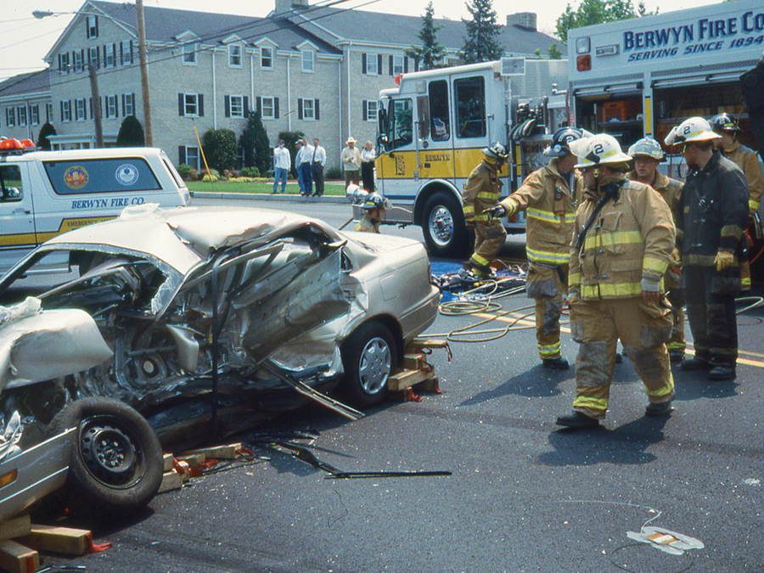
Mechanism of Injury: Side-Impact
Side impact.
© Edward T. Dickinson, M D
Notes:
Covers Objective: 11.1

Slide 24
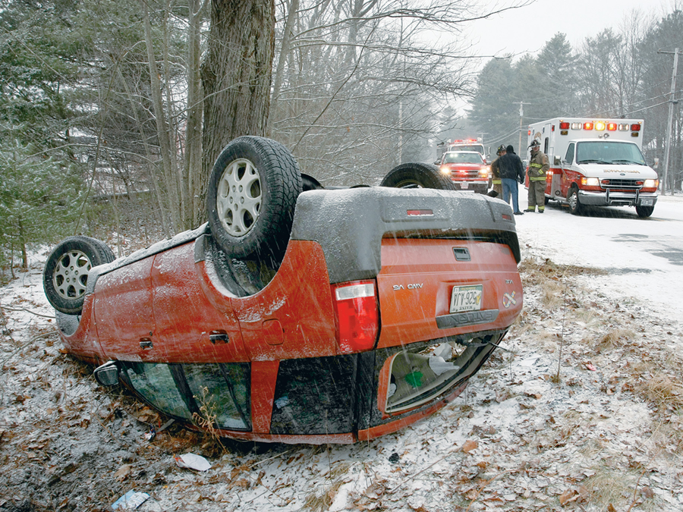
Mechanism of Injury: Rollover Collision
Rollover collision.
© Daniel Limmer
Notes:
Covers Objective: 11.1
Class Activity: Take a field trip to a junkyard. Examine cars that have been involved in collisions. Discuss how certain impacts would likely lead to specific injuries.

Slide 25
Mechanism of Injury (5 of 10)
Motor vehicle collisions
  Rotational impact collisions
    Cars are struck then spin.
    Initial impact often causes subsequent impacts.
Notes:
Covers Objective: 11.1

Slide 26
Mechanism of Injury (6 of 10)
Falls
  Adult
    More than twenty feet
  Child under fifteen years
    More than ten feet (two to three times child’s height)
Notes:
Covers Objective: 11.1

Slide 27
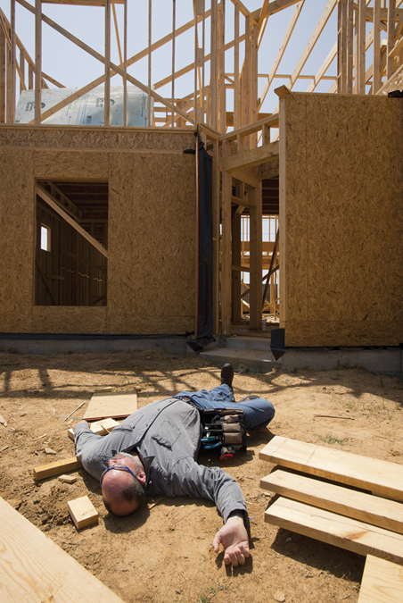
Mechanism of Injury: Severe Fall
The characteristics of a fall may provide valuable clues to a patient’s injuries.
Notes:
Covers Objective: 11.1

Slide 28
Mechanism of Injury (7 of 10)
Falls
  Important factors
    Height from which patient fell
    Surface patient fell onto
    Part of patient that hit the surface
    Anything that interrupted fall
Notes:
Covers Objective: 11.1

Slide 29
Mechanism of Injury (8 of 10)
Penetrating trauma
  Injury caused by object that passes through the skin or other body tissues
  Classified by the velocity of the item that caused the injury
Notes:
Covers Objective: 11.1

Slide 30
Mechanism of Injury (9 of 10)
Penetrating trauma
  Low-velocity (knife) injuries
    Damage limited to area penetrated
    May be multiple wounds
  Medium-velocity (handgun) and high-velocity (rifle) injuries may be anywhere in the body
    Damage directly from the projectile
    Pressure-related damage, or cavitation
Notes:
Covers Objective: 11.1

Slide 31
Mechanism of Injury (10 of 10)
Blunt-force trauma
  Injury caused by a blow that strikes body but does not penetrate skin or other body tissues
  Signs are often subtle and easily overlooked.
  Maintain index of suspicion based on mechanism of injury
Notes:
Covers Objective: 11.1
Discussion Topic: Discuss the expected injuries that might result from the following mechanisms: rear-end collisions, falls, blunt trauma.
Class Activity: Walk around the surroundings of your classroom. Point out various mechanisms of injury and discuss.

Slide 32
Nature of the Illness (1 of 3)
Reason patient called E M S
To begin identifying the nature of a patient’s illness during the scene size-up, you must scan the entire scene.
Notes:
Covers Objective: 11.1
Knowledge Application: Provide lists of scene clues. Have students consider the lists and determine the nature of illness. (Note: This is an excellent homework assignment.)

Slide 33
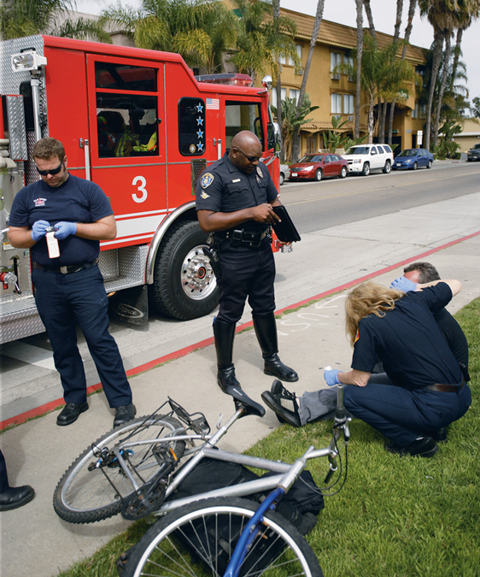
Nature of the Illness (2 of 3)
Actively look for any additional patients, such as pedestrians or cyclists.
© Kevin Link/C M S P
Notes:
Covers Objective: 11.1
Knowledge Application: Provide lists of scene clues. Have students consider the lists and determine the nature of illness. (Note: This is an excellent homework assignment.)

Slide 34
Nature of the Illness (3 of 3)
Information may be obtained from many sources.
  The patient
  Family members or bystanders
  The scene
Notes:
Covers Objective: 11.1
Point to Emphasize: EMTs should use scene clues in addition to patient information to make accurate decisions in the field.
Discussion Question: Discuss three scene clues that might help you identify the nature of the illness without talking to the patient.

Slide 35
Number of Patients and Adequacy of Resources
Questions to ask
  How many patients present?
  Sufficient resources on hand to care for all patients?
Try to anticipate the maximum numbers of patients and radio for help accordingly.
  Follow local protocols.
Notes:
Covers Objective: 11.1

Slide 36
Chapter Review

Slide 37
Chapter Review (1 of 2)
Scene size-up is the first part of the patient assessment process.
It is important during scene size-up to determine what, if any, threats there may be to your own safety and to the safety of others at the scene, then to take appropriate Standard Precautions.

Slide 38
Chapter Review (2 of 2)
Next it is important to determine the nature of the call by identifying the mechanism of injury or the nature of the patient’s illness.
Finally, you must take into account the number of patients and other factors at the scene to determine if you will need additional help.

Slide 39
Remember (1 of 2)
Determine what, if any, threats there may be to your own safety and to the safety of others at the scene.
Take appropriate Standard Precautions.

Slide 40
Remember (2 of 2)
Determine the nature of the call by identifying the mechanism of injury or nature of a patient’s illness.
Determine the number of patients and any additional resources necessary.

Slide 41
Questions to Consider (1 of 2)
For each of these dangers, what actions must be taken to remain safe at a collision scene?
  Leaking gasoline
  Toxic or hazardous material spill
  Vehicle on fire
  Downed power lines
Notes:
Talking Points: Remind students that EMT safety comes first, and that they should not go into a scene if they are not cleared to do so by appropriate authority.

Slide 42
Questions to Consider (2 of 2)
What are common mechanism-of-injury patterns for the following situations?
  Head-on collision
  Rear-end collision
  Fall from a height
Notes:
Talking Points: Lead students through the possible MOIs for each of these situations. Remind them of possible unseen injuries.

Slide 43
Critical Thinking
You are called to the scene of a shooting at a fast food restaurant. En route, you plan your scene size-up strategy. What actions do you anticipate taking on arrival?
Notes:
Talking Points: Start with the generic steps for such a situation, and then brainstorm other possibilities you would need to prepare for.

Slide 44

Copyright
This work is protected by United States copyright laws and is provided solely for the use of instructors in teaching their courses and assessing student learning. Dissemination or sale of any part of this work (including on the World Wide Web) will destroy the integrity of the work and is not permitted. The work and materials from it should never be made available to students except by instructors using the accompanying text in their classes. All recipients of this work are expected to abide by these restrictions and to honor the intended pedagogical purposes and the needs of other instructors who rely on these materials.

