Slide 1

Emergency Care
Fourteenth Edition
Chapter 25
Poisoning and Overdose Emergencies
Slides in this presentation contain hyperlinks. JAWS users should be able to get a list of links by using INSERT+F7
Copyright © 2021, 2016, 2012 Pearson Education, Inc. All Rights Reserved
Notes:
If this PowerPoint presentation contains mathematical equations, you may need to check that your computer has the following installed:
1) MathType Plugin
2) Math Player (free versions available)
3) NVDA Reader (free versions available)

Slide 2
Topics
Poisoning
Alcohol and Substance Abuse
Notes:
Planning Your Time: Plan 90 minutes for this chapter.
Poisoning (60 minutes)
Alcohol and Substance Abuse (30 minutes)
Note: The total teaching time recommended is only a guideline.
Core Concepts:
How to know if a patient has been poisoned
Assessment and care for ingested poisons
Assessment and care for inhaled poisons
Assessment and care for absorbed poisons
Types of injected poisons
Assessment and care for alcohol abuse
Assessment and care for substance abuse

Slide 3
Poisoning
Back to Topics
Notes:
Teaching Time: 60 minutes
Teaching Tip: Toxicology is a huge topic. Take care to manage time properly. Invite your medical director or a local pharmacist to class to discuss their knowledge of toxicology. Have examples on hand of common antidotes and poisoning treatments. Teach scene safety. Poisonings present a variety of possible threats to the EMT. Imprint good safety habits early.

Slide 4
Poisoning (1 of 4)
A poison is any substance that can harm the body.
The harm it can cause can result in a medical emergency.
Notes:
Covers Objective: 25.1
Point to Emphasize: Safety must be the first priority when treating a poisoned patient.

Slide 5
Poisoning (2 of 4)
Common poisonings
  Medications
  Petroleum products
  Cosmetics
  Pesticides
  Plants
  Food
Notes:
Covers Objective: 25.1

Slide 6
Poisoning (3 of 4)
Effects of a poison
  Harm to body based on nature of poison, its concentration, route of entry, patient’s age, weight, and health
  Damage to skin and tissues from contact
  Suffocation
  Localized or systemic damage to body systems
Notes:
Covers Objective: 25.1

Slide 7
Poisoning (4 of 4)
Classified by route
  Ingested (swallowed)
  Inhaled (breathed in)
  Absorbed (through unbroken skin)
  Injected (inserted through skin)
Notes:
Covers Objective: 25.1
Point to Emphasize: Poisons can be classified into four types: ingested, inhaled, absorbed, or injected.

Slide 8
Pediatric Note
E M T’s own home and squad building should be “childproofed” against poisoning.
Share poisoning-prevention information with members of the public during school visits and community outreach programs.
Notes:
Covers Objective: 25.1

Slide 9
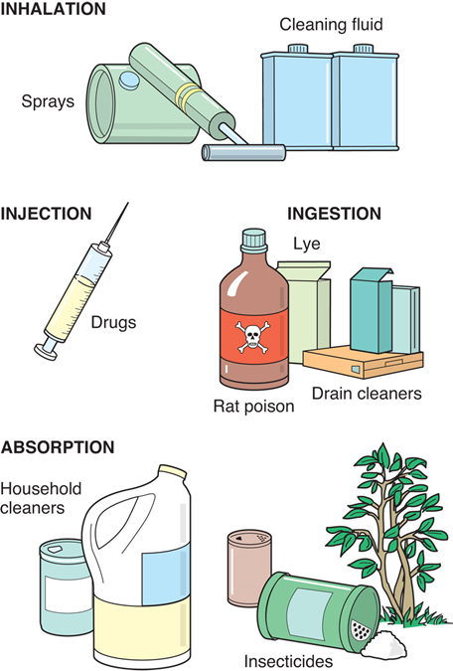
Classification of Poisons (By Routes of Entry)
For long description, see slide 84: Appendix 1
Poisons enter the body by way of ingestion, inhalation, absorption, and injection.
Notes:
Covers Objective: 25.1
Point to Emphasize: Poisons can be classified into four types: ingested, inhaled, absorbed, or injected.

Slide 10
Ingested Poisons (1 of 5)
Child
  May accidentally eat or drink a toxic substance
Adult
  Often an accidental or deliberate medication overdose
Notes:
Covers Objective: 25.2
Discussion Topic: Discuss how the EMT’s approach would be different when dealing with an adult patient versus an infant or child. How would the EMT’s actions be similar and different in both of these scenarios?

Slide 11
Patient Assessment (1 of 13)
What substance was involved?
  Get the exact spelling.
  Transport with patient to hospital.
When did exposure occur?
  Quick-acting poison requires faster treatment.
  E D personnel need to know for appropriate testing and treatment.
Notes:
Covers Objective: 25.2
Point to Emphasize: Assessment of a poisoned patient must include determining the nature and amount of the substance, the time and length of exposure, and possible interventions prior to the arrival of EMS.
Discussion Topic: Discuss the specific questions that you might ask a poisoning patient while obtaining a patient history. Why are these questions important?

Slide 12
Patient Assessment (2 of 13)
How much was ingested?
  Estimate missing pills by looking at prescription label.
Over how long a period did the ingestion occur?
  Treatments may vary.
    Was medication taken for very first time?
    Was medication being taken chronically?
Notes:
Covers Objective: 25.2

Slide 13
Patient Assessment (3 of 13)
What interventions have been taken?
  Home remedies
  Treatments indicated on label
What is patient’s estimated weight?
  Treatment is related to weight.
  Children experience greater effects because of smaller size.
Notes:
Covers Objective: 25.2

Slide 14
Patient Assessment (4 of 13)
What effects has patient experienced?
  Nausea, vomiting, altered mental status, abdominal pain, diarrhea, chemical burns around mouth, and unusual breath odors
Notes:
Covers Objective: 25.2

Slide 15
Food Poisoning
Can be caused by improperly handled or prepared food
Symptoms
  Nausea, vomiting, abdominal cramps, diarrhea, and fever
Prevent by washing hands and surfaces that touch raw meat
Notes:
Covers Objective: 25.2

Slide 16
Activated Charcoal (1 of 4)
Works through adsorption, allowing substances to attach to its surface
Not an antidote
  Prevents or reduces amount of poison absorbed by body
Notes:
Covers Objective: 25.2

Slide 17
Activated Charcoal (2 of 4)
Many poisons but not all are adsorbed by activated charcoal.
Medical direction will determine whether the use of this substance is appropriate.
Notes:
Covers Objective: 25.2

Slide 18
Activated Charcoal (3 of 4)
Contraindications of activated charcoal
  Patient cannot swallow
  Patient has altered mental status
  Patient ingested acids or alkalis
  Patient swallowed gasoline
Notes:
Covers Objective: 25.2

Slide 19
Activated Charcoal (4 of 4)
Activated charcoal versus syrup of ipecac
  Traditionally syrup of ipecac was preferred treatment for poisoning.
    Induces vomiting in most people with one dose
    However, has potential to make patient aspirate and only removes less than one-third of stomach contents
Notes:
Covers Objective: 25.2

Slide 20
Dilution
Adult patient should drink one to two glasses of water or milk.
Children should drink one-half to one full glass of water or milk.
Water may slow absorption, but milk may soothe stomach upset.
Frequently advised for patients who, as determined by medical direction, do not need transport
Notes:
Covers Objective: 25.2

Slide 21
Patient Care (1 of 6)
Detect and treat life-threatening problems
Perform a secondary assessment
Assess baseline vital signs
Consult medical direction or poison control
Transport with substance information
Perform reassessment en route
Notes:
Covers Objective: 25.2
Discussion Topic: Give an example and discuss the assessment and treatment of an ingested poison.

Slide 22
Antidotes
Thought of as substance that will neutralize the poison or its effects
  Very few genuine antidotes exist.
Naloxone directly reverses narcotics’ depressant effects on level of consciousness and respiratory drive.
Notes:
Covers Objective: 25.2
Discussion Topic: Describe the administration of intranasal naloxone.
Class Activity: Use a manikin, training medication, and standardized skill sheet to demonstrate the proper technique for the administration of an intranasal medication.
Critical Thinking Discussion: What are the negative side effects of naloxone? Why should you administer it with care?

Slide 23
Acetaminophen Poisoning (1 of 2)
Common cause of overdose
Toxic effects do not appear right away
  4-12 hours: loss of appetite, nausea, vomiting
  1-2 days: right upper quadrant pain and jaundice
Antidote should be given within the first 12 hours
Notes:
Covers Objective: 25.2
Inside/Outside: Acetaminophen Poisoning: Draw a relationship between what patients exhibit and what is occurring inside the body.

Slide 24
Acetaminophen Poisoning (2 of 2)
Prehospital assessment and management
  Suspect acetaminophen poisoning with any overdose
  Search medicine cabinets and garbage cans for empty pill bottles
  Deal with apparent threats to life first
  Treatment can be instituted at the hospital
Notes:
Covers Objective: 25.2

Slide 25
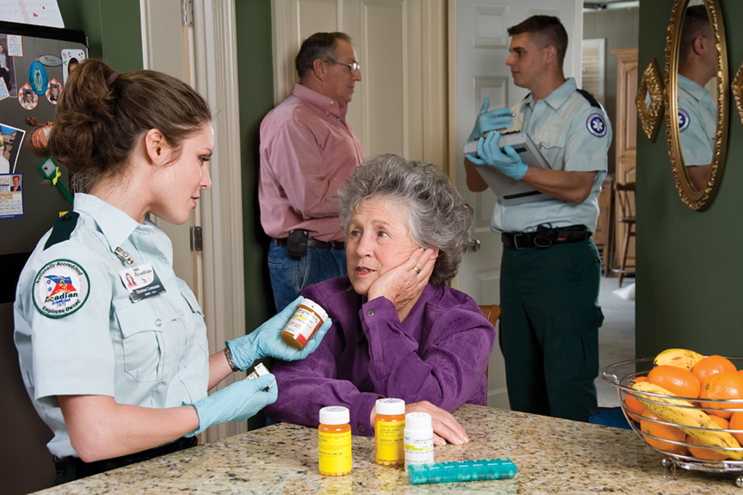
Ingested Poisons (2 of 5)
First Take Standard Precautions. 1. Quickly gather information.
Notes:
Covers Objective: 25.2
Talking Points: Take standard precautions. Quickly gather information on the substance, timeline, amount, symptoms, and interventions.

Slide 26
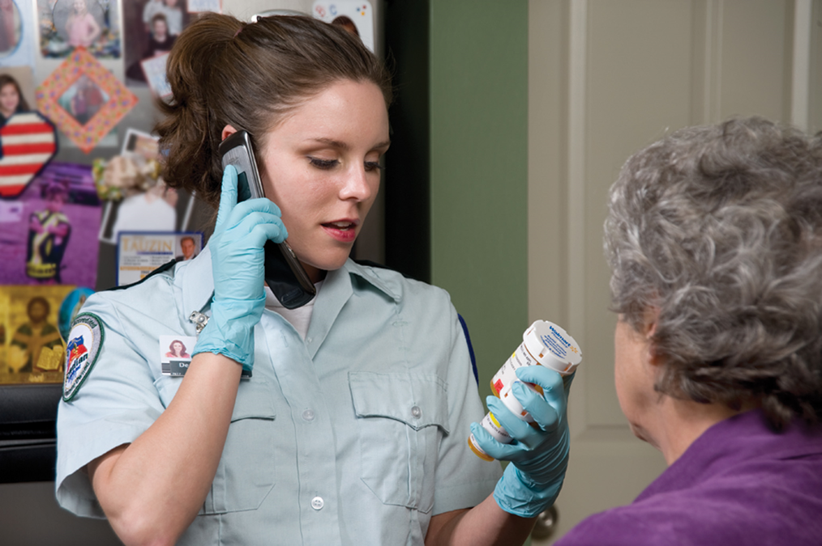
Ingested Poisons (3 of 5)
2. Call medical direction on the scene or en route to the hospital.
Notes:
Covers Objective: 25.2
Talking Points: Contact medical direction on scene or while en route to hospital. The patient's condition and local protocol will dictate your actions.

Slide 27
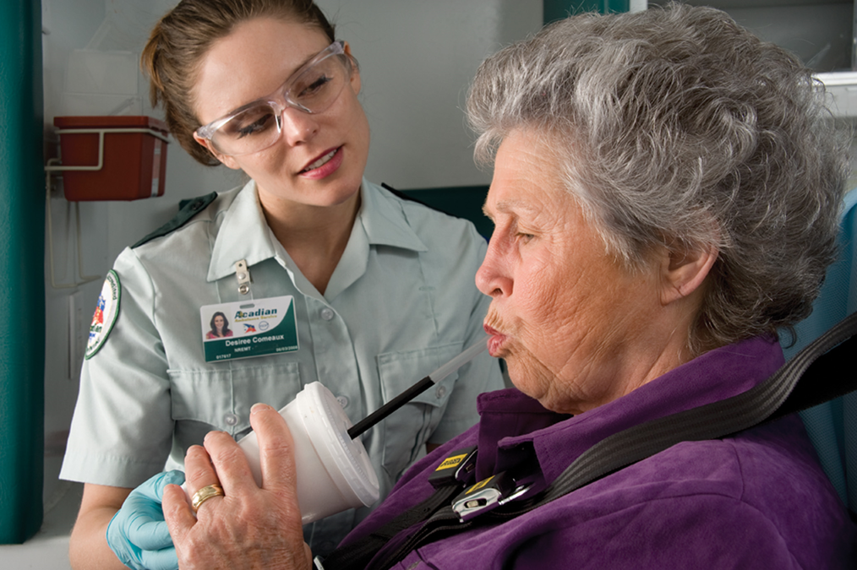
Ingested Poisons (4 of 5)
3. If directed, administer activated charcoal. You may wish to administer the medication in an opaque cup that has a lid with a hole for a straw.
Notes:
Covers Objective: 25.2
Talking Points: If directed, administer activated charcoal. If available, it may be better tolerated if given in a container with a covered lid and a straw. Remember that activated charcoal is contraindicated with some substances. Medical direction may order that you dilute the substance with water or milk if charcoal is not indicated.
Class Activity: Taste activated charcoal. Discuss how the taste might relate to the EMT's ability to administer this substance in the field.

Slide 28
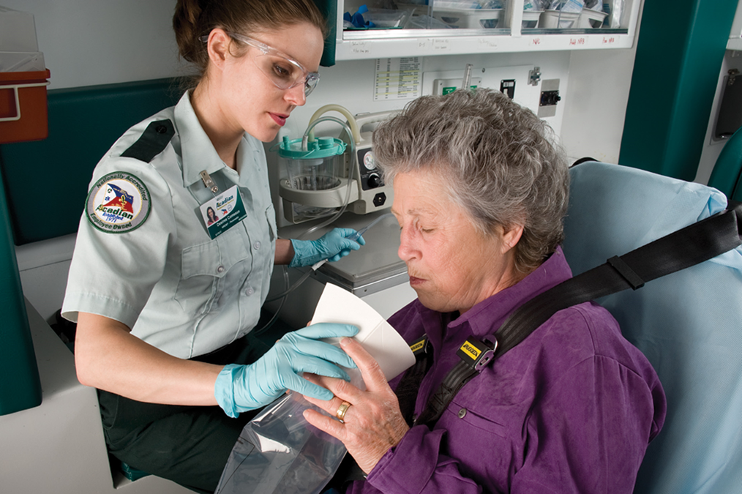
Ingested Poisons (5 of 5)
4. Position the patient for vomiting and save all vomitus. Have suction equipment ready.
Notes:
Covers Objective: 25.2
Talking Points: Be prepared for vomiting and keep suction nearby. Save vomitus for possible analysis at hospital.
Discussion Topic: Describe the administration of activated charcoal.

Slide 29
Think About It
Think about your own home. Is it safe for a small child?
Are there potential poisons within three feet of the floor, or behind unlocked doors?
Are there household cleaners that look like juices and drinks familiar to children?
Can flavored children’s medications be mistaken for candy?
What sense does a small child typically use to identify things?
Notes:
Covers Objective: 25.2
Talking Points: Many EMS agencies have community education programs that teach ways to childproof a home.

Slide 30
Inhaled Poisons (1 of 2)
Common types
  Carbon monoxide
  Chlorine gas
  Ammonia
  Agricultural chemicals and pesticides
  Carbon dioxide
Notes:
Covers Objective: 25.3
Class Activity: Review the potentially poisonous substances near your classroom. Check the janitor’s closet and review material safety data sheets.

Slide 31
Inhaled Poisons (2 of 2)
Scene safety
  Approach scene with caution.
  Protective clothing and self-contained breathing apparatus may be required.
  If not trained or equipped, call for additional resources.
Notes:
Covers Objective: 25.3
Knowledge Application: Use programmed patients to simulate poisoning assessment scenarios. Use mock poisons and design specific safety hazards to test student scene assessment.

Slide 32
Patient Assessment (5 of 13)
What substance was involved (exact name)?
When did exposure occur?
Over how long did exposure occur?
What interventions has anyone taken?
  Did someone remove patient?
  Did someone ventilate the area?
What effects is patient experiencing?
Notes:
Covers Objective: 25.3
Discussion Topic: Give an example and discuss the assessment and treatment of an inhaled poison.

Slide 33
Carbon Monoxide (1 of 3)
Colorless, odorless, tasteless gas
Can be caused by improper venting of wood-burning stoves, furnaces, generators
Common cause of death during natural disasters and power outages
Notes:
Covers Objective: 25.3

Slide 34
Carbon Monoxide (2 of 3)
Signs and symptoms of poisoning
  Headache, especially “a band around head”
  Dizziness
  Breathing difficulty
  Nausea
  Cyanosis
  Altered mental status
    In severe cases, unconsciousness
Notes:
Covers Objective: 25.3
Point to Emphasize: You should suspect carbon monoxide poisoning whenever you are treating a patient with vague, flulike symptoms who has been in an enclosed area. This is especially true when a group of people in the same area have similar symptoms.

Slide 35
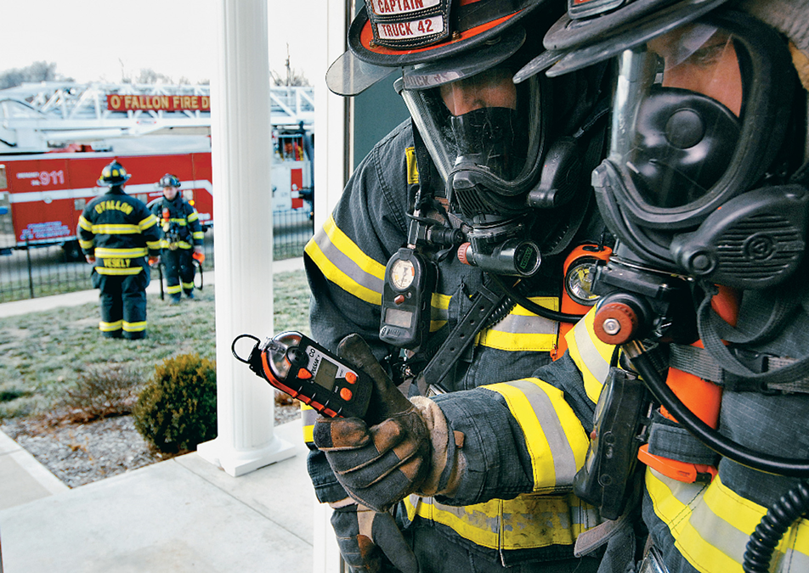
C O Monitor
Special monitors are needed to detect the presence of carbon monoxide in the environment.
Notes:
Covers Objective: 25.3

Slide 36
Carbon Monoxide (3 of 3)
Treatment
  Patient may begin to feel better shortly after being removed from dangerous environment.
    Administer 100 percent oxygen.
    Transport to hospital.
  Takes time to “wash out” C O from bloodstream
Notes:
Covers Objective: 25.3

Slide 37
Patient Care (2 of 6)
Move patient from unsafe environment using trained and equipped personnel.
Detect and treat immediately life-threatening problems in primary assessment.
Perform secondary assessment, obtain vital signs.
Administer high-concentration oxygen
Transport with all containers, bottles, and labels
Perform reassessment en route
Notes:
Covers Objective: 25.3
Knowledge Application: Have students work in small groups. Use programmed patients to create a variety of poisoning scenarios. Have groups practice assessment and treatment strategies.

Slide 38
Smoke Inhalation (1 of 3)
Smoke inhalation is associated with thermal burns as well as effects of irritants and chemical poisons within the smoke.
Substances can burn the skin, irritate the eyes, injure the airway, and progress to respiratory or cardiac arrest.
Notes:
Covers Objective: 25.3

Slide 39
Smoke Inhalation (2 of 3)
Signs and symptoms
  Difficulty breathing
  Coughing
  “Smoky” or chemical smell on breath
  Black (carbon) residue in mouth, nose, or sputum
  Singed nasal hair
Notes:
Covers Objective: 25.3

Slide 40
Smoke Inhalation (3 of 3)
Treatment
  Move patient to safe area.
  Assess patient.
  Maintain airway.
  Provide high-concentration oxygen.
  Transport.
Notes:
Covers Objective: 25.3

Slide 41
“Detergent Suicides” (1 of 2)
Method of suicide started in Japan and is becoming more common in the United States.
Mix of two easily obtained chemicals to release toxic hydrogen sulfide gas
Commonly released inside enclosed space such as a car
Notes:
Covers Objective: 25.3
Talking Points: A source of acid, such as a strong household cleaner, and a source of sulfur, often a pesticide, when mixed together will quickly release significant amounts of toxic hydrogen sulfide gas. Often the victim will leave notes warning others of the hazardous gas.
Discussion Topic: Describe the effects, assessment, and care of a carbon monoxide poisoning patient, a smoke inhalation patient, and a detergent suicide patient.

Slide 42
“Detergent Suicides” (2 of 2)
Scene safety
  Exposure to fumes may injure E M S personnel.
  Warning note may be left on vehicle, but this is not assured.
  May need to treat first as a H A Z M A T scene
Notes:
Covers Objective: 25.3
Talking Points: Warning signs to look for include a small enclosed space, such as a car, with tape sealing the windows and doors. Any kind of sign or note warning people not to approach should be taken very seriously. Call the appropriate agency to open the space and remove the body. Do not become another casualty!
Critical Thinking Discussion: What in particular makes inhaled poisons so dangerous to responders?

Slide 43
Absorbed Poisons
Can be absorbed through skin
May or may not cause damage to skin
Patient may require decontamination prior to treatment
Notes:
Covers Objective: 25.4

Slide 44
Patient Assessment (6 of 13)
Detect and treat immediate life-threatening problems in primary assessment.
Perform secondary assessment, obtain vital signs.
Remove powder by:
  Brushing off powder
  Irrigating with clean water for at least 20 minutes and during transport
Transport with all containers, bottles, S D Ss, and labels from substance.
Perform reassessment en route.
Notes:
Covers Objective: 25.4
Discussion Topic: Give an example and discuss the assessment and treatment of an absorbed poison.
Knowledge Application: Have students work in small groups. Have groups practice the assessment of different types of poisonings. What questions might be important for each type?

Slide 45
Injected Poisons
Most common are:
  Illicit drugs injected with a needle
  Venom of snakes and insects
Notes:
Critical Thinking Discussion: Which route of poisoning might be the most dangerous to the rescuer, and why?

Slide 46
Poison Control Centers
Excellent resource
Information on poisons, signs and symptoms, and treatments
Follow local protocol for contact procedures.
Notes:
Point to Emphasize: Poison control centers offer the EMT a vast network of poison-related resources that may aid in patient care. An EMT should access these centers early in a poison-related emergency.
Discussion Topic: Discuss the role of a poison control center in a poisoning emergency.
Knowledge Application: Contact a local poison control center and arrange a mock call. Assign a scenario and have the team actually contact poison control. Use a speakerphone so the group can hear the interaction. Discuss.

Slide 47
Alcohol and Substance Abuse
Back to Topics
Notes:
Teaching Time: 30 minutes
Teaching Tip: Alcohol and substance abuse are both safety threats to the EMT. Assure good safety habits when dealing with these types of patients. Refer to mental status lessons. Discuss how alcohol might disrupt the assessment of a patient with altered mental status. Reach out to local law enforcement for educational resources on substance abuse. Relate substance abuse to the discussion of poisonings. Teach students to consider a potential overdose in the same manner that they would a poisoning.

Slide 48
Alcohol and Substance Abuse
Many patients have conditions that are caused either directly or indirectly by alcohol or substance abuse
Abuse of alcohol and other drugs crosses all geographic and economic boundaries.
Notes:
Covers Objective: 25.5

Slide 49
Alcohol Abuse (1 of 2)
Potent drug affects central nervous system.
Emergencies may result from recent consumption or years of abuse.
Treat patients with same respect and dignity as any others.
Abuse can lead to or worsen other medical conditions.
Notes:
Covers Objectives: 25.5 and 25.6

Slide 50
Alcohol Abuse (2 of 2)
Alcohol often consumed with other drugs, which can result in a serious medical emergency.
Impaired patients can be irrational or aggressive.
Contact law enforcement if safety concern.
Notes:
Covers Objectives: 25.5 and 25.6
Critical Thinking Discussion: How might alcohol impact a patient's ability to give informed consent or to refuse care? How might you deal with a patient who is refusing care but who obviously is intoxicated?

Slide 51
Patient Assessment (7 of 13)
Many medical conditions mimic alcohol intoxication.
Intoxicated patients may also have medical problems.
All patients receive full assessment regardless of suspicion of intoxication.
Notes:
Covers Objectives: 25.5 and 25.6
Point to Emphasize: Alcohol abuse may be a primary problem or a problem that compounds other illnesses or injuries.
Discussion Topic: Describe the assessment and care of a patient who has abused alcohol.

Slide 52
Patient Assessment (8 of 13)
Signs and symptoms of alcohol abuse:
  Alcohol odor on breath or clothing
  Swaying or unsteady on feet
  Slurred, rambling speech
  Flushed, complaining of being warm
  Nausea/vomiting
  Poor coordination
  Slowed reaction time
Notes:
Covers Objectives: 25.5 and 25.6

Slide 53
Patient Assessment (9 of 13)
  Blurred vision
  Confusion
  Hallucinations, visual or auditory
  Lack of memory (blackout)
  Altered mental status
Notes:
Covers Objectives: 25.5 and 25.6

Slide 54
Patient Assessment (10 of 13)
Alcohol withdrawal
  Abrupt cessation of drinking may cause some alcoholics to suffer from delirium tremens (D Ts).
  Can be serious, resulting in tremors, hallucinations, and seizures
Notes:
Covers Objectives: 25.5 and 25.6
Point to Emphasize: Alcohol withdrawal can cause a serious physiological reaction. In some cases, this reaction can be fatal.

Slide 55
Patient Assessment (11 of 13)
  Signs and symptoms of alcohol withdrawal:
    Confusion and restlessness
    Unusual behavior
    Hallucinations
    Gross tremor of hands
    Profuse sweating
    Seizures
    Hypertension
    Tachycardia
Notes:
Covers Objectives: 25.5 and 25.6
Discussion Topic: Describe the effects of alcohol abuse. Include the signs and symptoms of withdrawal.

Slide 56
Patient Care (3 of 6)
Vomiting common
  Standard precautions are essential.
Stay alert for airway and respiratory problems.
Assess for trauma.
Be alert for changes in mental status.
Notes:
Covers Objectives: 25.5 and 25.6

Slide 57
Patient Care (4 of 6)
Monitor vital signs.
Treat for shock.
Protect the patient from self-injury.
Stay alert for seizures.
Transport the patient to a medical facility.
Notes:
Covers Objectives: 25.5 and 25.6

Slide 58
Substance Abuse (1 of 8)
Any chemical substance taken for other-than-therapeutic (medical) reasons
Includes opioids, uppers, downers, hallucinogens, and volatile chemicals
Notes:
Covers Objective: 25.5

Slide 59
Substance Abuse (2 of 8)
Opioids
  Used to relieve pain or cause a state of relaxation
  Opiates
    Codeine, oxycontin, Percocet
  Heroin
Notes:
Covers Objective: 25.7
Discussion Topic: Discuss the classifications of commonly abused substances. Include examples and common signs and symptoms of abuse.

Slide 60
Substance Abuse (3 of 8)
  Signs and symptoms of opioids
    Reduced rate of pulse and rate and depth of breathing
    Lowered skin temperature
    Pinpoint pupils
    Relaxed muscles
    Profuse sweating
    Sleepy
    Coma
Notes:
Covers Objective: 25.7

Slide 61
Substance Abuse (4 of 8)
Uppers
  Stimulants that affect the nervous system
  Cocaine
  Methamphetamine
  May be snorted, smoked, or injected
Notes:
Covers Objective: 25.7

Slide 62
Substance Abuse (5 of 8)
Signs and symptoms of uppers
  Excitement, restlessness
  Increased pulse and breathing rates
  Rapid speech
  Dry mouth
  Dilated pupils
  Sweating
  No sleep for a long time, possibly days
Notes:
Covers Objective: 25.7

Slide 63
Substance Abuse (6 of 8)
Downers
  Central nervous system depressants
  Benzodiazepines
  Rohypnol (roofies)
  G H B (gamma hydroxybutyrate)
  Signs and symptoms
    Sluggishness, poor coordination
    Decreased pulse and respirations
Notes:
Covers Objective: 25.7

Slide 64
Substance Abuse (7 of 8)
Hallucinogens
  Create intense state of excitement and distorted perception
  L S D, P C P, X T C
  Signs and symptoms
    Rapid pulse
    Dilated pupils
    Flushed face
    Seeing or hearing things
Notes:
Covers Objective: 25.7

Slide 65
Substance Abuse (8 of 8)
Volatile chemicals
  Produce vapors that are inhaled
  Initial “rush” then acts as central nervous system depressant.
  Signs and symptoms
    Dazed/loss of contact with reality
    May develop a coma
    Swollen membranes in nose or mouth
    “Funny numb feeling” or “tingling” inside head
    Changes in heart rhythm
Notes:
Covers Objective: 25.7
Knowledge Application: Have students work in small groups. Assign each group a specific category of commonly abused substance. Ask the group to research and report on examples, effects, and important assessment elements.

Slide 66
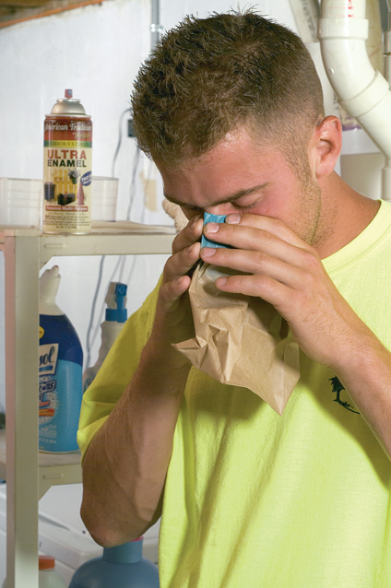
Volatile Chemicals
Volatile chemicals produce vapors that can be inhaled. Methods of inhaling substances include “huffing” (breathing fumes directly or from a substance-impregnated fabric) and “bagging” (breathing fumes from a substance sprayed into a bag).
Notes:
Covers Objective: 25.7

Slide 67
Patient Assessment (12 of 13)
May be difficult
  Signs and symptoms vary from patient to patient.
  Patient may have taken more than one type of drug.
  Signs and symptoms are similar to other medical emergencies.
Begin by asking if the patient has taken any medications, then ask about drugs.
Notes:
Covers Objective: 25.7
Point to Emphasize: EMTs should use a thorough patient assessment and clues gained from the scene, bystanders, and the patient himself to help determine the nature of unknown substance abuse.
Class Activity: If the class is completing a clinical rotation, ask students to identify how many calls are complicated by substance abuse. Discuss.

Slide 68
Patient Assessment (13 of 13)
Signs and symptoms of drug withdrawal:
  Shaking
  Anxiety
  Nausea
  Confusion and irritability
  Hallucinations, visual or auditory
  Profuse sweating
  Increased pulse and breathing rates
Notes:
Covers Objective: 25.7
Knowledge Application: Have students work in small groups. Using a programmed patient, have students practice the assessment of a substance-abuse patient. Use realism to demonstrate specific challenges. Discuss how scene clues can help an EMT identify unknown substances.

Slide 69
Patient Care (5 of 6)
Perform a primary assessment.
Be alert for airway problems and respiratory distress.
Provide oxygen and assist ventilations as needed.
Administer naloxone intranasally.
Treat for shock.
Talk to patient to keep them calm and cooperative.
Perform physical exam.
Notes:
Covers Objective: 25.7
Discussion Topic: Describe the potential safety hazards associated with treating a substance-abuse patient.

Slide 70
Patient Care (6 of 6)
Look for evidence of injection sites (“track marks”).
Protect the patient from self-injury.
Transport as soon as possible.
Consult medical direction according to local protocols.
Perform reassessment with monitoring vital signs.
Continue to reassure patient throughout all phases of care.
Notes:
Covers Objective: 25.7
Discussion Topic: Compare the assessment and treatment of an overdose to that of an accidental ingested poisoning. How are they similar? How are they different?

Slide 71
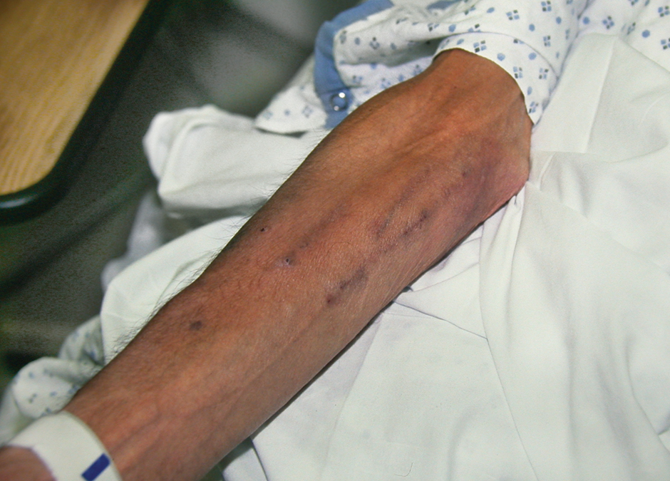
Treatment: Substance Abuse
Needle tracks on a patient’s arm indicate a history of injected drug use.
© Edward T. Dickinson, M D
Notes:
Covers Objective: 25.7

Slide 72
Chapter Review

Slide 73
Chapter Review (1 of 4)
In a poisoned patient, perform a primary assessment and immediately treat life-threatening problems. Ensure an open airway. Administer high-concentration oxygen if the poison was inhaled or injected.

Slide 74
Chapter Review (2 of 4)
Next perform a secondary assessment, including baseline vital signs. Find out if the poison was ingested, inhaled, absorbed, or injected; what substance was involved; how much poison was taken in; when and over how long a period exposure took place; what interventions others have already done; and what effects the patient experienced.

Slide 75
Chapter Review (3 of 4)
Consult medical direction. As directed, administer activated charcoal or water or milk for ingested poisons.
Remove the patient who has inhaled a poison from the environment and administer high-concentration oxygen. Remove poisons from the skin by brushing them off or diluting them.

Slide 76
Chapter Review (4 of 4)
Transport the patient with all containers, bottles, and labels from the substance.
Reassess patient en route.
Carefully document all information about poisoning, interventions, and patient’s responses.

Slide 77
Remember (1 of 3)
Safety is always the first concern when dealing with a poisoning or substance-abuse patient.
Poisonings are generally classified by route of exposure. Effects vary greatly, depending upon type of poison and method of entrance into body.

Slide 78
Remember (2 of 3)
E M Ts must use thorough assessment, including scene clues, to help identify the nature and severity of poisoning.
Poison control centers offer a wealth of resources to assist in assessment and treatment of poisoning patients.

Slide 79
Remember (3 of 3)
Alcohol is a common underlying issue with patients. In some patients, it may be the most significant problem.
The effects of substance abuse can vary greatly, based on the type of substance. Determining the type of drug ingested can shed light on effects to come.

Slide 80
Questions to Consider
What are potential risks to the responder on a poisoning or overdose call?
What are the routes of entry into the body?
What are some things E M S can do to prevent poisonings, especially in children?
Notes:
Talking Points: The poison or toxic substance may still be present and be a risk for you and your crew. In addition, patients may potentially be combative due to the effects of the substances they have taken or come in contact with, which may alter their mental status.
Inhalation, ingestion, absorption, injection
Public education programs that emphasize the importance of securing hazardous and toxic substances from children. This may include distribution of information, child safety locks, or Mr. Yuk stickers.

Slide 81
Critical Thinking (1 of 2)
A farmer calls 911 because one of his farm hands has tried to clean up spilled pesticide powder with his hands. On arrival, you find that the patient insists he has brushed all the powder off, feels fine, and doesn’t need to go to the hospital.

Slide 82
Critical Thinking (2 of 2)
As he talks, he continues to make brushing motions at his jeans on which you can see the marks of a powdery residue. How do you manage the situation?
Notes:
Talking Points: Find out which pesticide is involved, when it occurred, and what interventions have already occurred. Check the pesticide label. Attempt to help the patient understand the seriousness of the situation, and that effects may be delayed.

Slide 83

Copyright
This work is protected by United States copyright laws and is provided solely for the use of instructors in teaching their courses and assessing student learning. Dissemination or sale of any part of this work (including on the World Wide Web) will destroy the integrity of the work and is not permitted. The work and materials from it should never be made available to students except by instructors using the accompanying text in their classes. All recipients of this work are expected to abide by these restrictions and to honor the intended pedagogical purposes and the needs of other instructors who rely on these materials.

Slide 84
Appendix 1
Under the word inhalation is a labeled image of a spray can and a labeled image of cans of cleaning fluid. Under the word, injection is a labeled image of a hypodermic needle. Under the word ingestion is a labeled image of rat poison, a labeled image of lye, and a labeled image of drain cleaners. Under the word absorption is a labeled image of household cleaners and a labeled image of insecticides.
Return to presentation

